Slide 1

EntroPass

Slide 2
Introduction
Project Goals
Idea of EntroPass
Research Results
EntroPass Functionality
Conclusion & Further R&D

Slide 3
Project Goals
Documentation
  To-Do lists
  Development guidelines
  Fully commented code

Slide 4
Project Goals
Functionality
  Guess passwords
  Create wordlists
  Password comparison

Slide 5
Idea of EntroPass
Pentesting
Security awareness
Security research

Slide 6
Research Results
Password formats
Used characters
Password lengths
Information categories

Slide 7
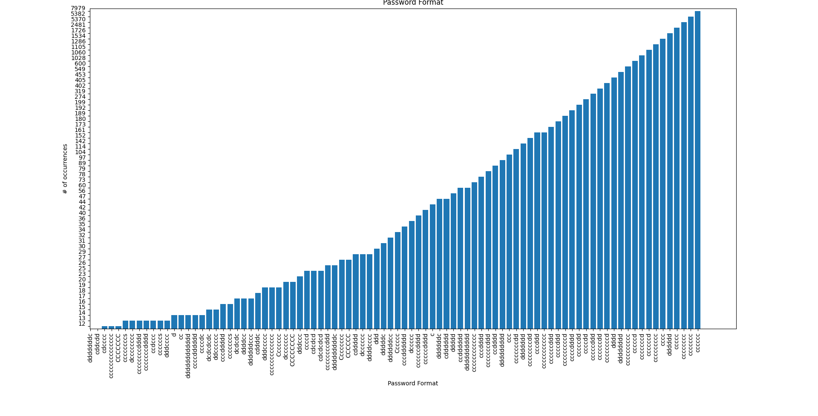
Research Results
Password Format
- Top 7 all single character type
- Lowercase char and digits most used
- Only two character types per password

Slide 8
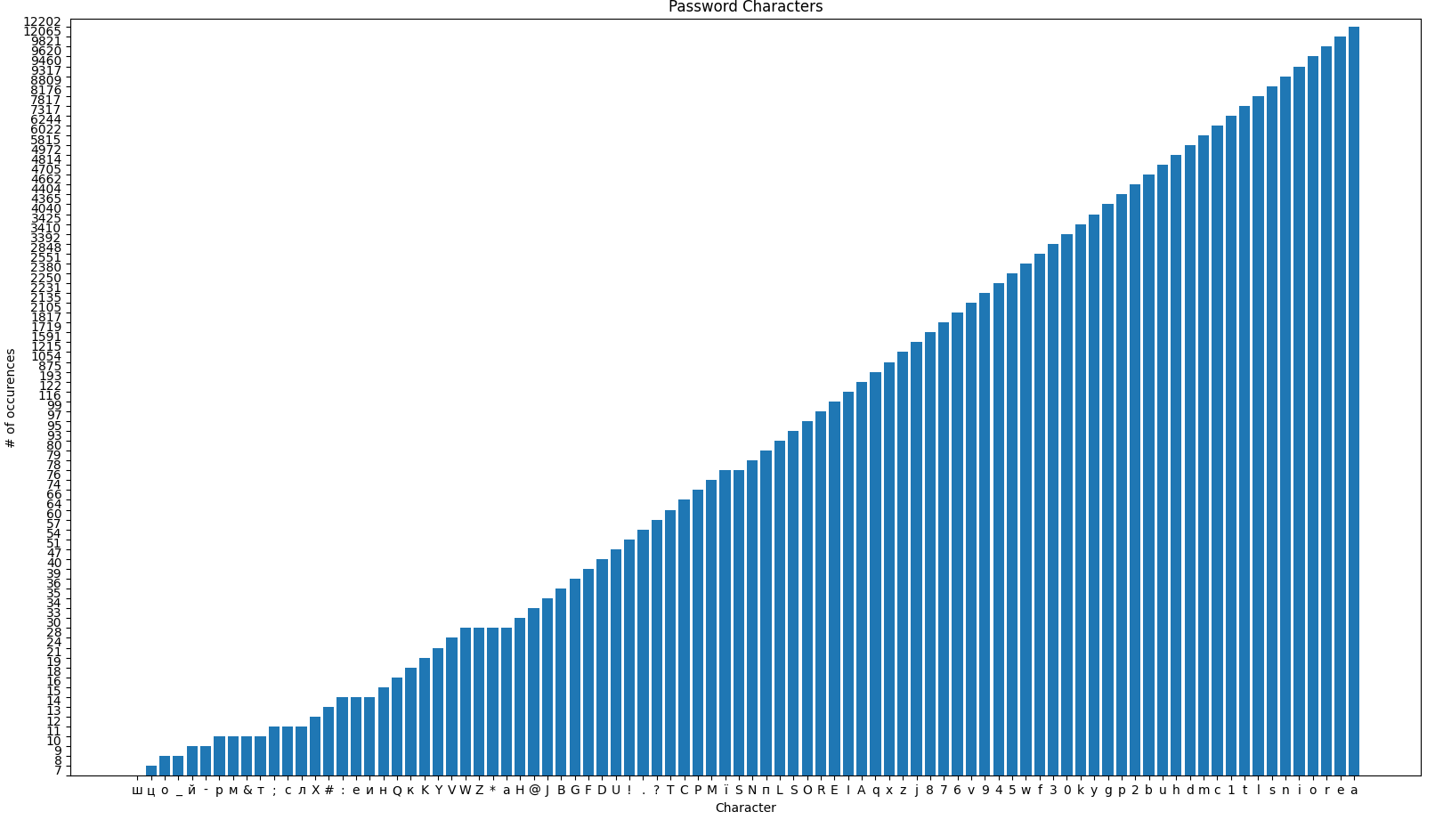
Research Results
Character Usage
- Lowercase alphabetical holds top 16
- Most used digit has ~4400 occurrences
- Most used char has ~12200 occurrences

Slide 9
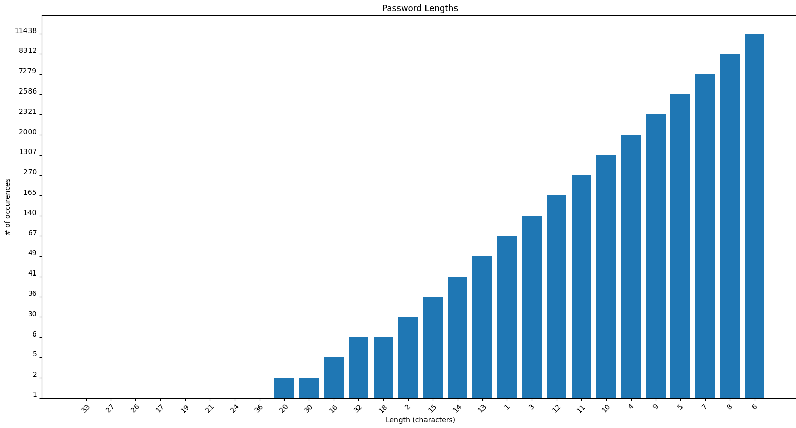
EntroPass Functionality
Top 7 all 10 or less characters
Over 10 chars has a max of ~270 occurences
6 chars has ~11400

Slide 10
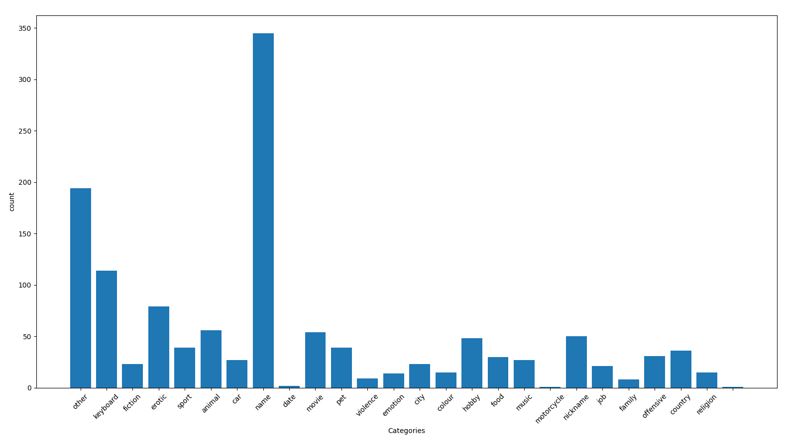
Research Results
Information Categories
Names most used by far
Keyboard strokes and erotic related follow names
Other categories closely related to personal interests

Slide 11
Conclusion & Further R&D
Goals fulfilled
Strong base and proof of concept
Requires field tests
More information gathering on categories

Slide 12
Questions?

