Slide 1
Architecture of Information Systems (192320111)
Advice to BriteLite
17 June 2015
Group 3
João Moreira
Jochem Verburg
Muhammad Arif Wicaksana
Quan Wang

Slide 2
Overview
Three focus areas:
Strategic
Organizational
IT
Details in report

Slide 3
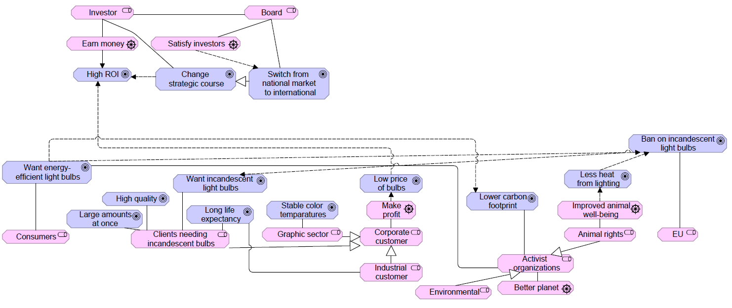





Strategic changes

Slide 4
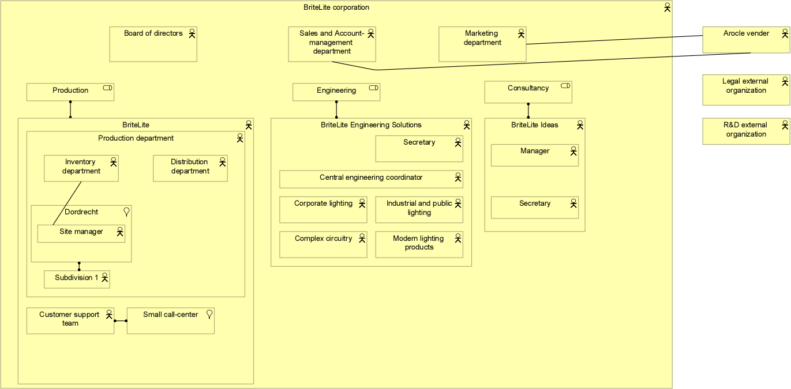



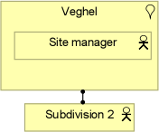

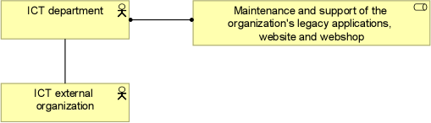
Organizational changes

Slide 5
IT Changes
Problems on baseline architecture:
Gateway integrations (“spaghetti architecture”)
High complexity and timing for business processes changes
OTOMATIC x ZAP: Determine production schedule
Arocle x E-Support: Engineering assignments
L-Info x Webshop: Sale and order tracking
Existing legacy applications and technology may be a bottleneck (e.g. L-Info)
IT is not the main business of BriteLine
IT-related work is expensive and complex:
Hardware deterioration (e.g. servers)
Software licenses
Specialized staff
Notes:
Since IT is not the main business of BriteLine and outsourcing IT-related work is cheaper and a trend – through SaaS solutions and cloud computing (IaaS) – the idea is to “outsource as possible”. This will lead to the cut of the costs with license and IT-related maintenances (e.g. server’s deterioration). The following applications are assumed to have APIs where their functions are offered through SaaS solutions: ZAP ERP, Arocle CRM, E-Support, OrderPRO, OTOMATIC applications. This assumption is due to the fact that nowadays almost all enterprise applications are provided through this type of solution in the cloud, as Amazon Web Services (AWS). Following this line of though, we recommend the adoption of an Enterprise Service Bus (ESB) to enable the gradual elimination of unnecessary in-house software and hardware.

Slide 6
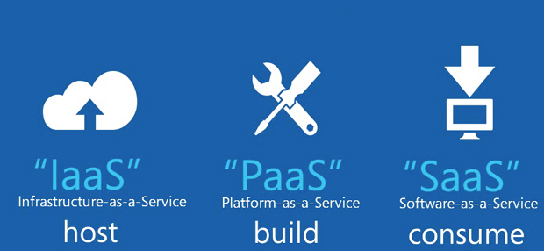
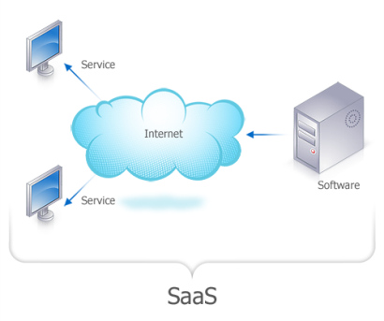
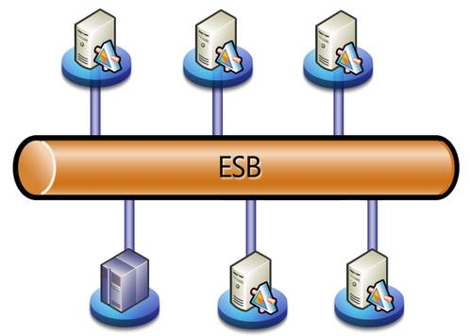
IT Changes
Trends on Enterprise Architecture
Idea: “outsource IT as possible”
Solution
Adoption of an Enterprise Service Bus (ESB)
Flexibility and extensibility for business processes
“Plug-and-play” enterprise functionalities: configure instead of coding
Docking stations: host applications and services to be assembled and orchestrated
User-friendly: web UI with drag and drop for service compositions
e.g. E-Support system
Notes:
ESB: A massage backbone based on a number of standards (e.g. SOAP, REST, CORBA, RMI) to enable the implementation, deployment and management of SOA solutions

Slide 7
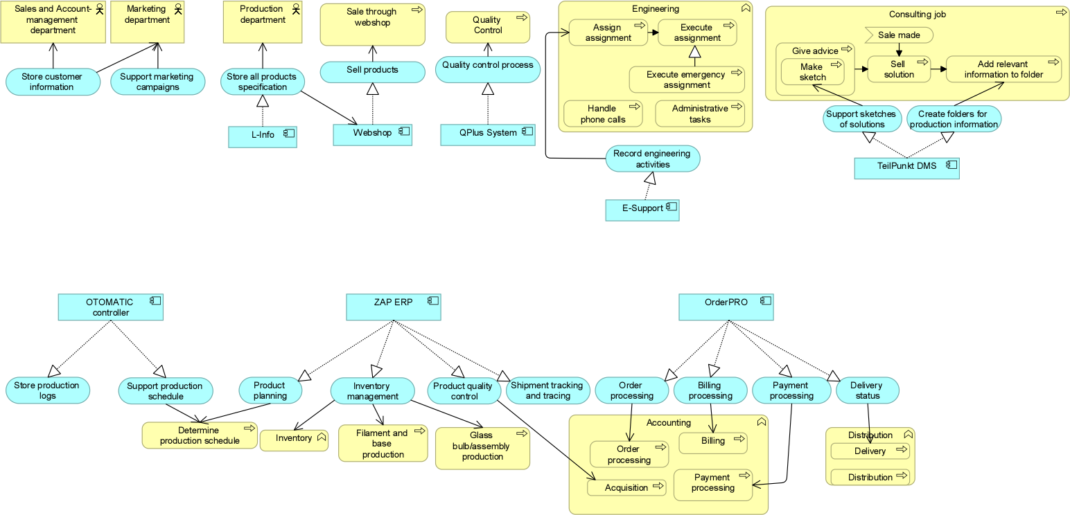
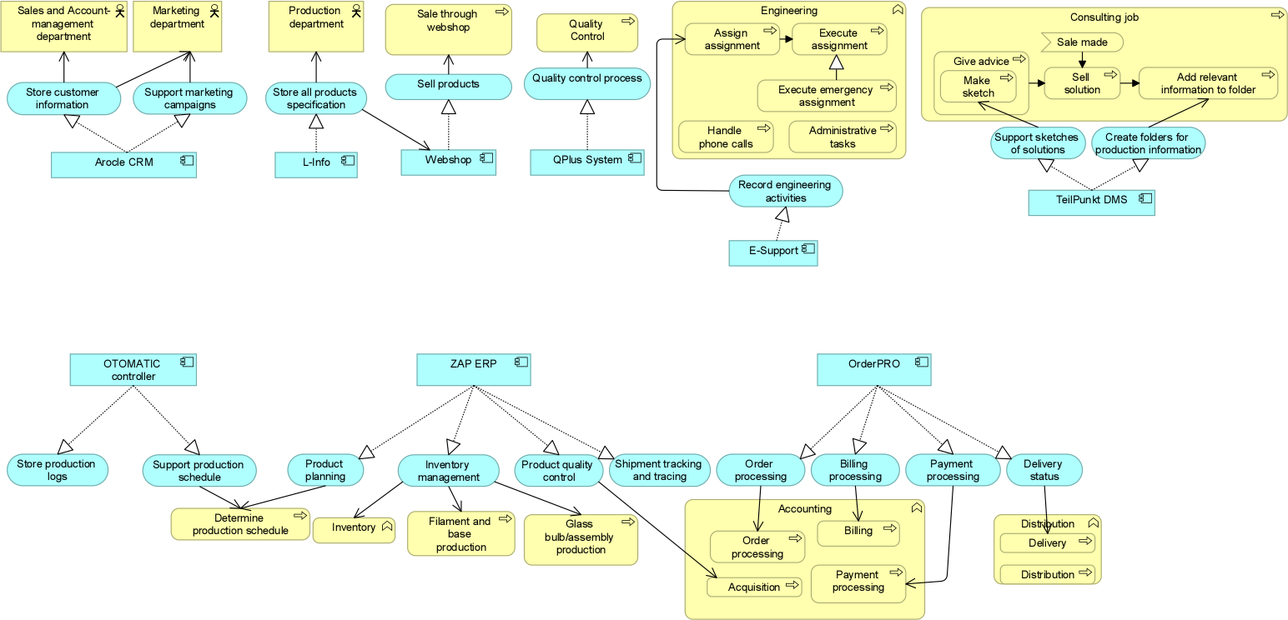
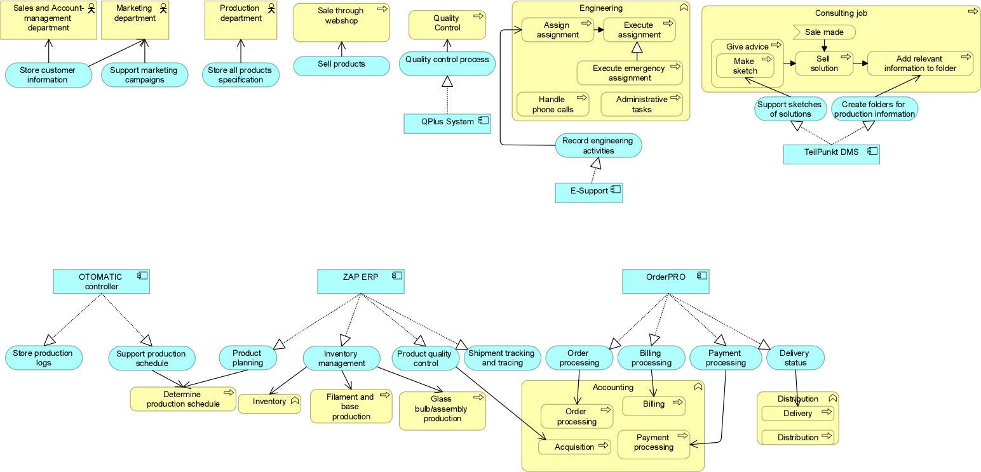
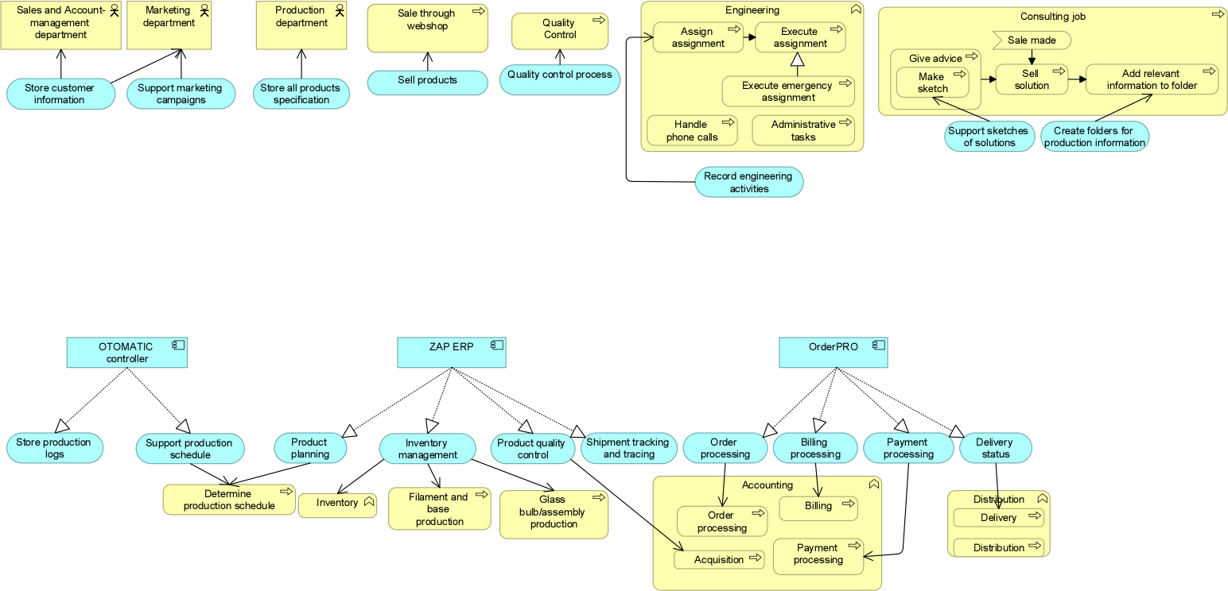
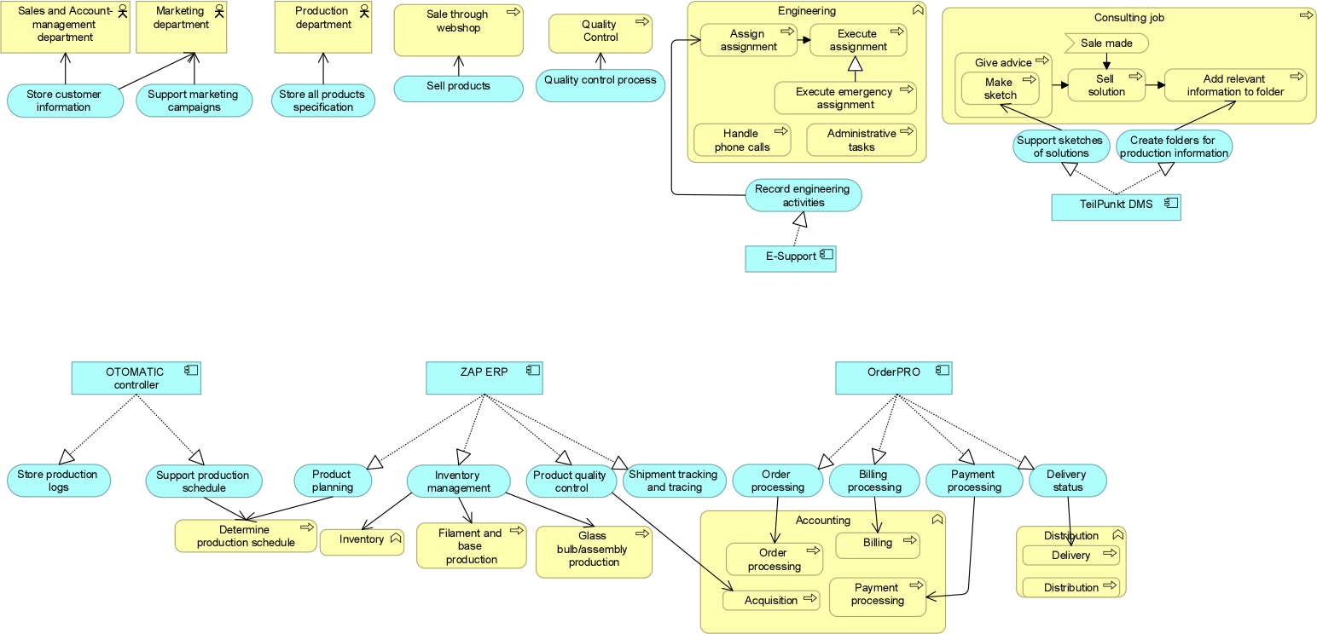
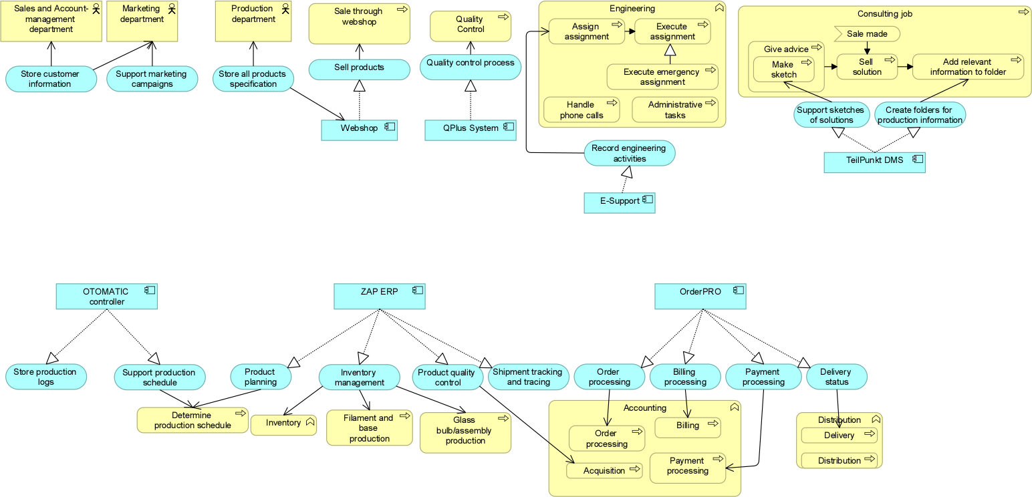
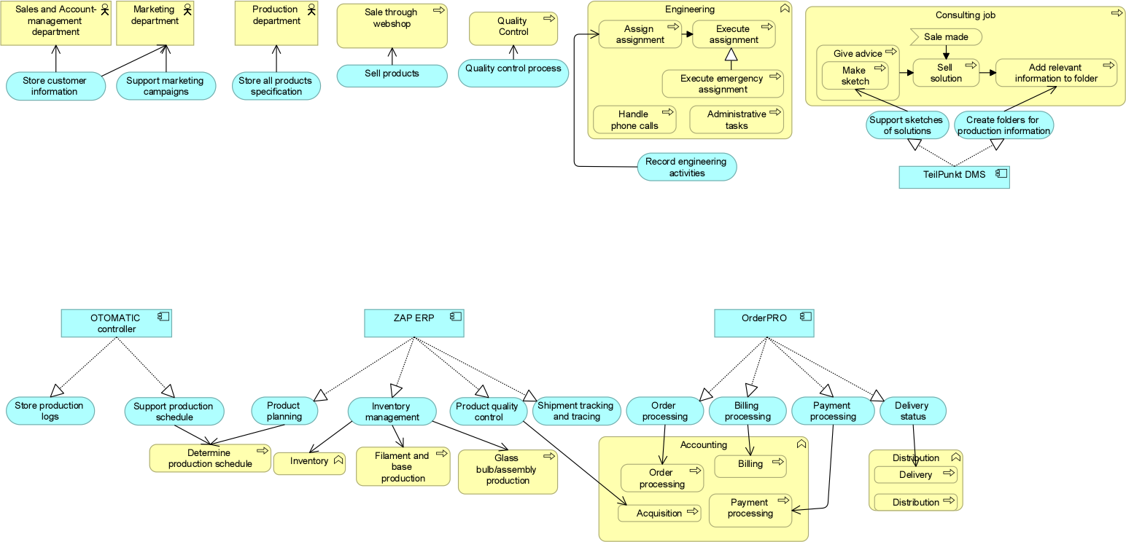
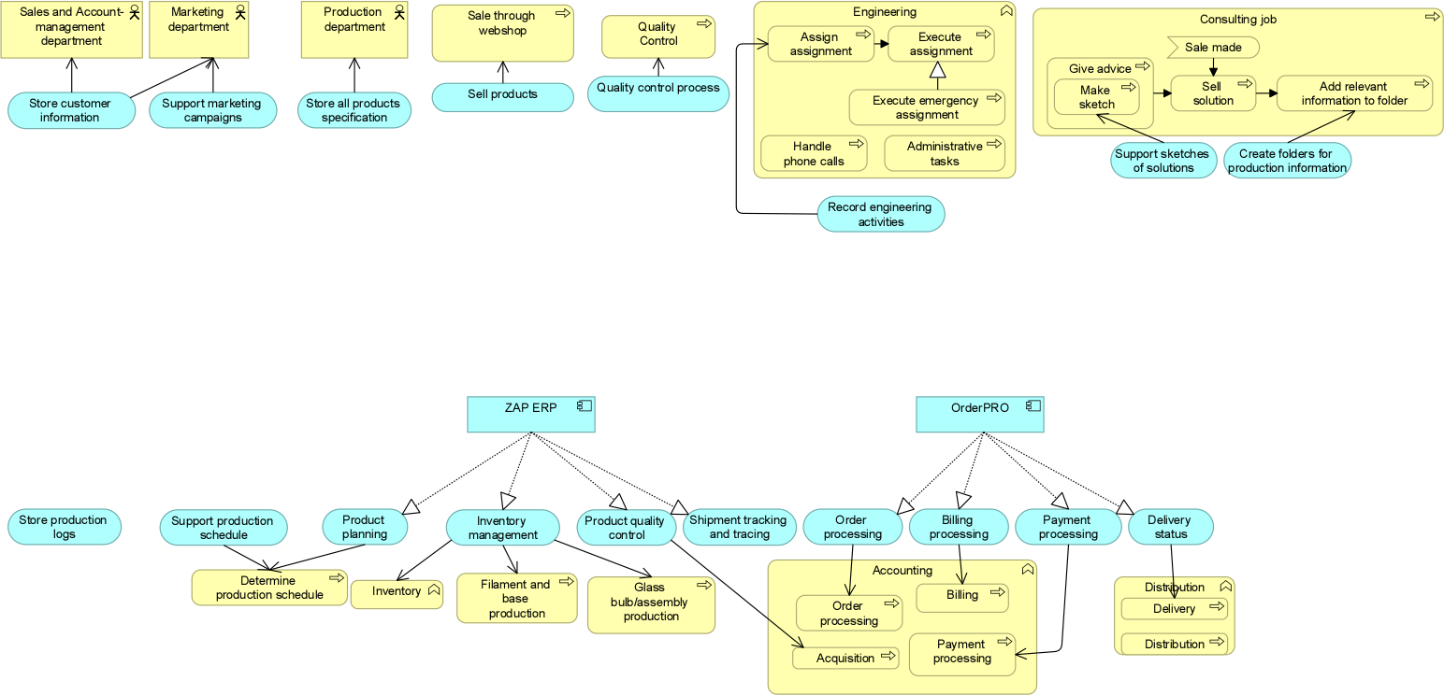
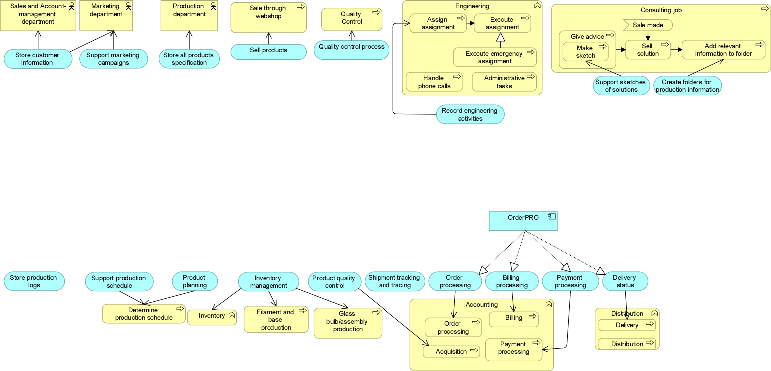
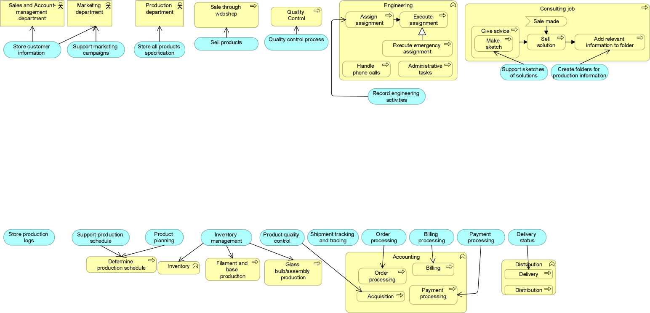
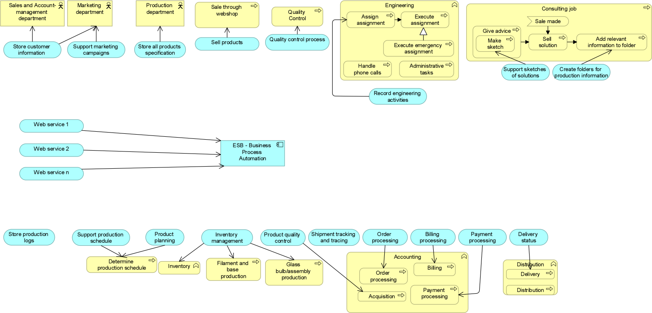
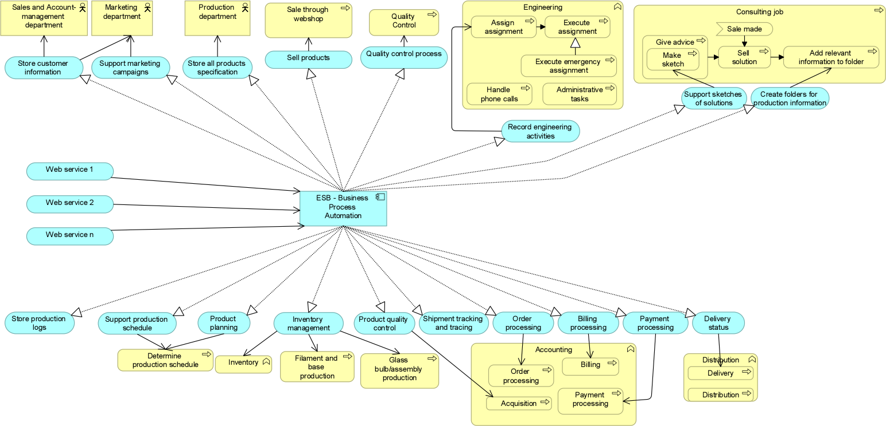
IT Changes – Application usage view

Slide 8

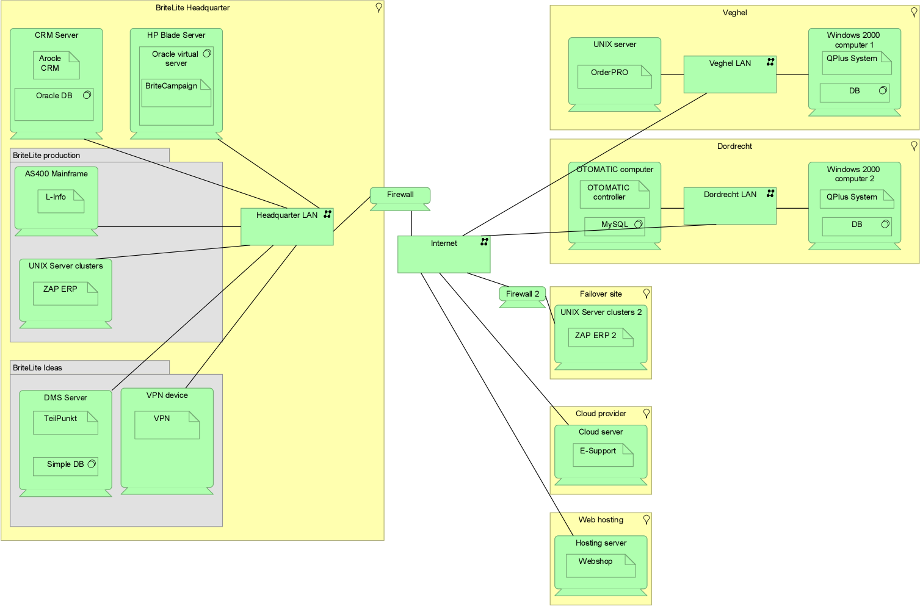
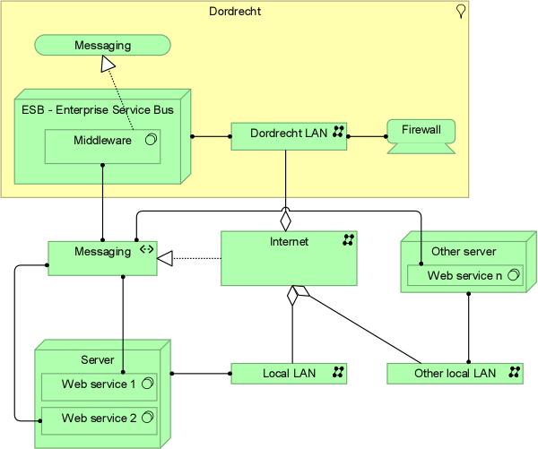
IT Changes – Infrastructure view

Slide 9
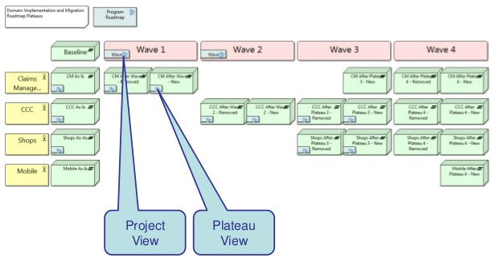
Conclusion
Real case: detailed migration plan with a set of plateaus and different possibilities:
Other trends that may be considered:
“Sensing enterprise”: use of Internet-of-Things and sensors to detect lamps failures
Sentiment analysis of the consumers opinion about the lamps and the company brand

