Slide 1
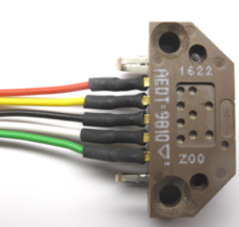
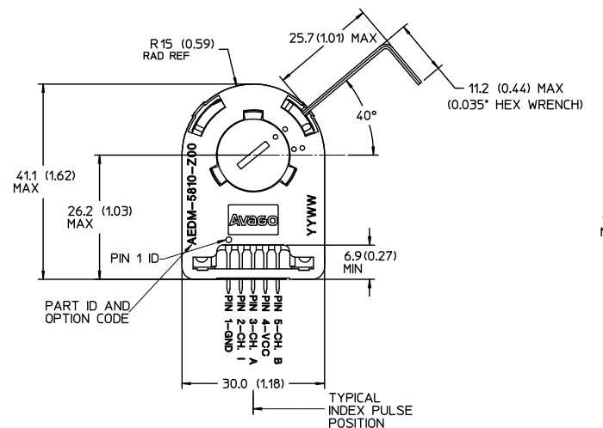
Wiring Encoder
B
5V
A
I
GND

Slide 2
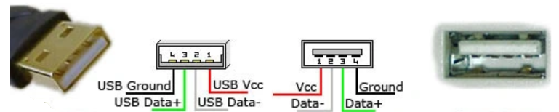
Wiring IMU
USB socket DB9 Cable
USB 1 = USB Vcc Pin 3 red
USB 2 = D- Pin 1 black
USB 3 = D+ Pin 2 brown
USB 4 = GND Pin 8 lilac
UART Host IMU
GND Pin 8 lilac GND
RX Pin 5 yellow TX
TX Pin 4 orange RX
Vcc Pin 3 red VCC

Slide 3
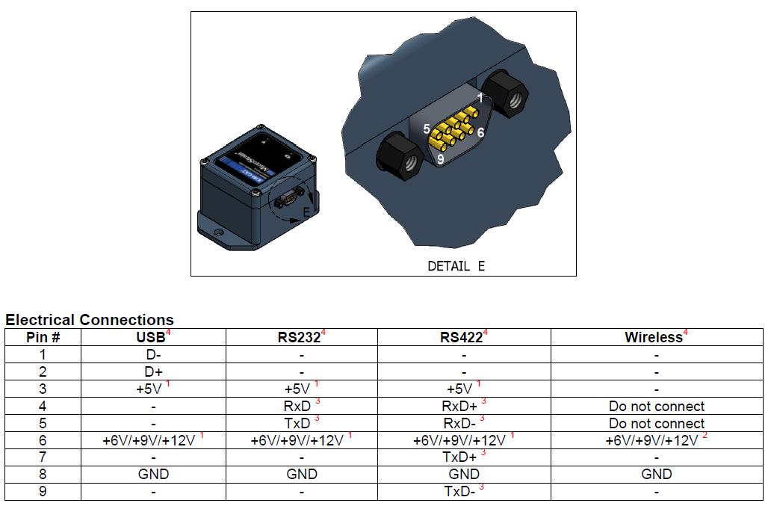
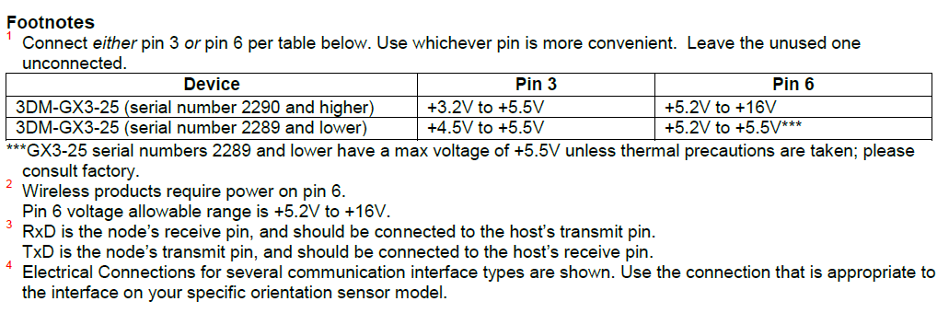
Documentation
https://www.microstrain.com/inertial/3dm-gx3-25?qt-product_quicktab=2#qt-product_quicktab
3.2-5.2V
D-
TX
RX
D+
GND
USB socket DB9 Cable
USB 1 = USB Vcc Pin 3 red
USB 2 = D- Pin 1 black
USB 3 = D+ Pin 2 brown
USB 4 = GND Pin 8 lilac
UART Host IMU
GND Pin 8 lilac GND
RX Pin 5 yellow TX
TX Pin 4 orange RX
Vcc Pin 3 red VCC

Slide 4
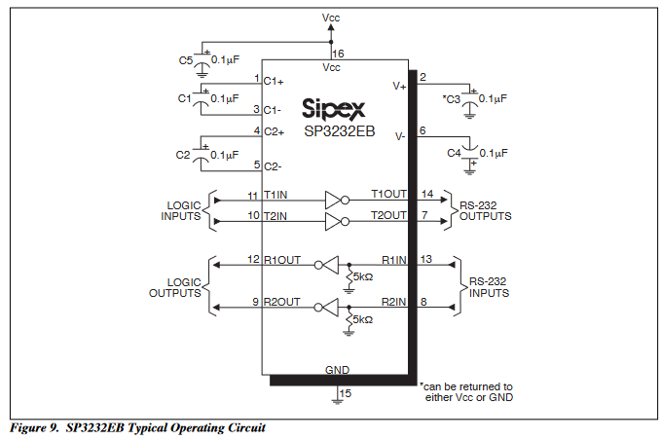
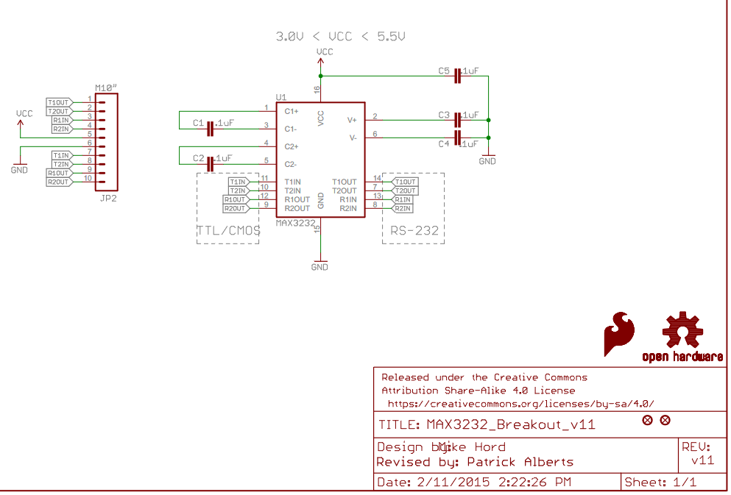
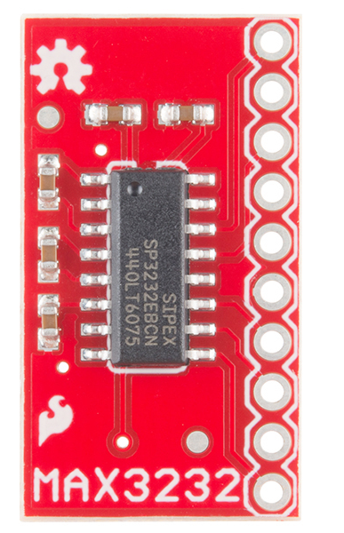
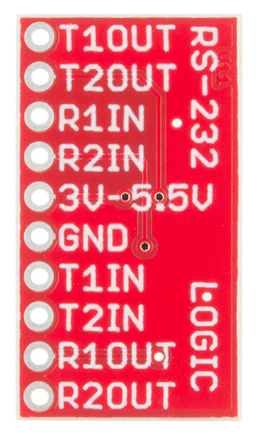
https://www.sparkfun.com/products/11189

Slide 5
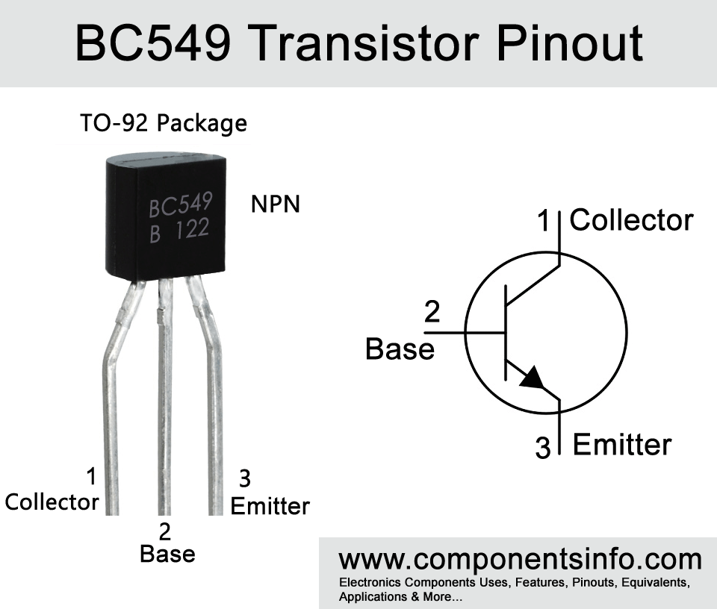
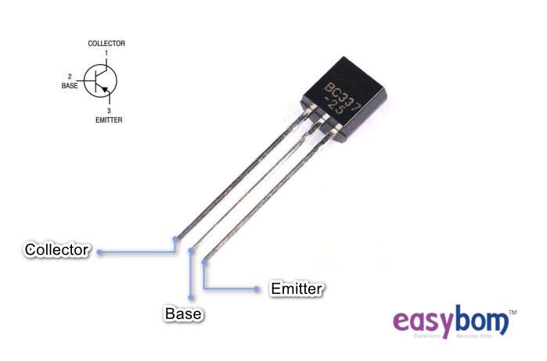
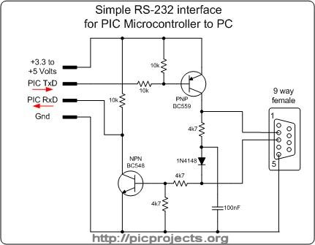
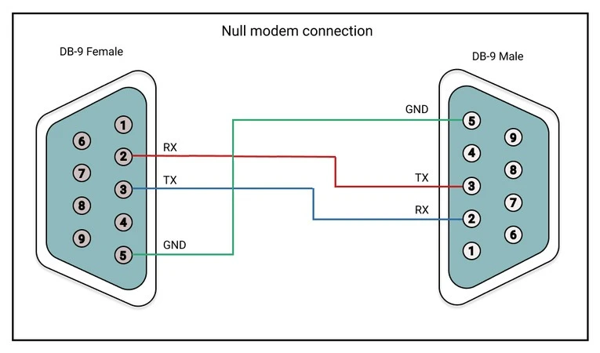
http://picprojects.org.uk/projects/simpleSIO/ssio.htm

Slide 6
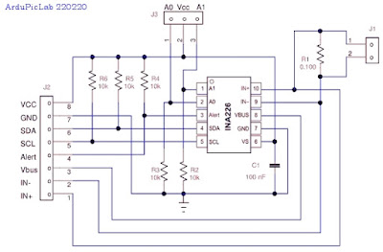
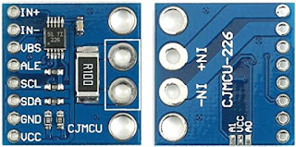

Slide 7
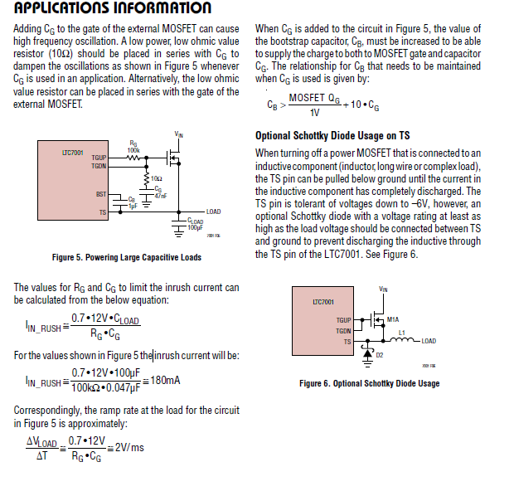
C_{load} = 6*2.2uF
C_{G} = 47nF
R_{G} = 22k
-> I_{IN_RUSH} = 0.1 A
C_{B} = 2.2uF

Slide 8
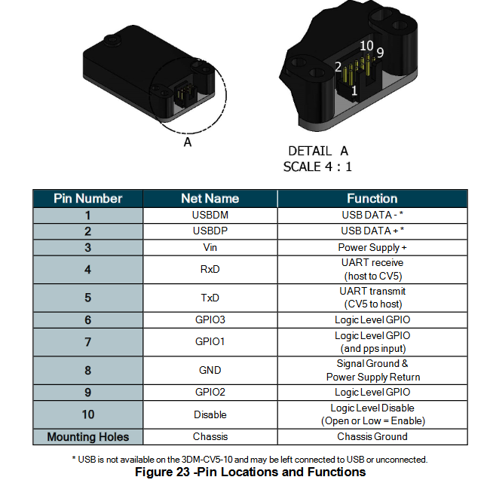
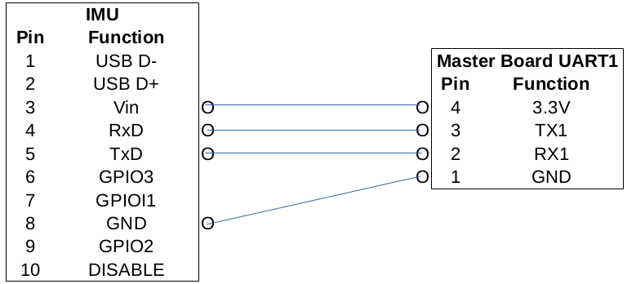
GND
Disable
RX
8
4
4
TX
5
3
3.2-5.2V
GND

Slide 9
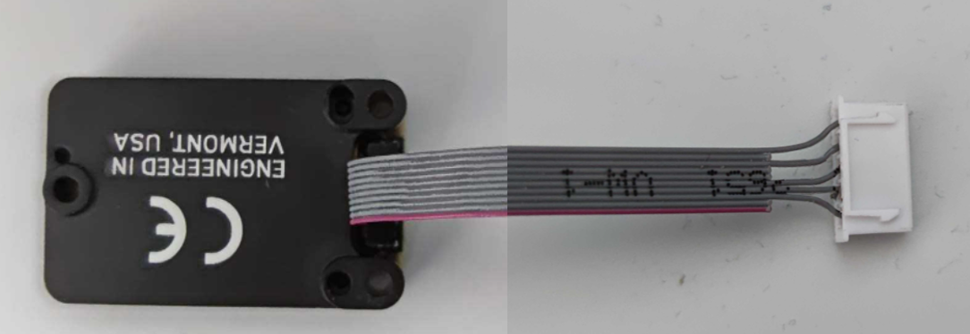
IMU PIN Function Teensy
10 5 Disable 32
8 4 GND GND
5 3 TxD RX7
4 2 RxD TX7
3 1 Vin 3.3V

Slide 10
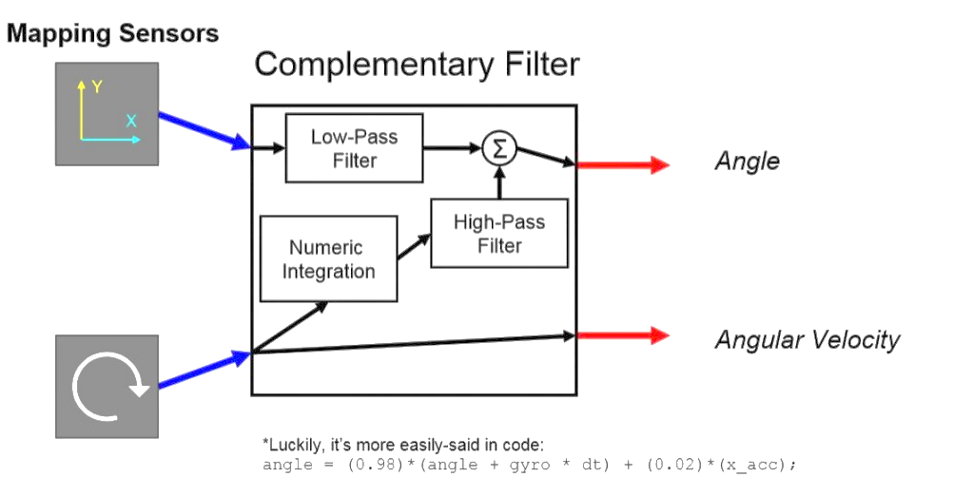
Acceleration
Angle
Angular Rate
Gyro

Slide 11
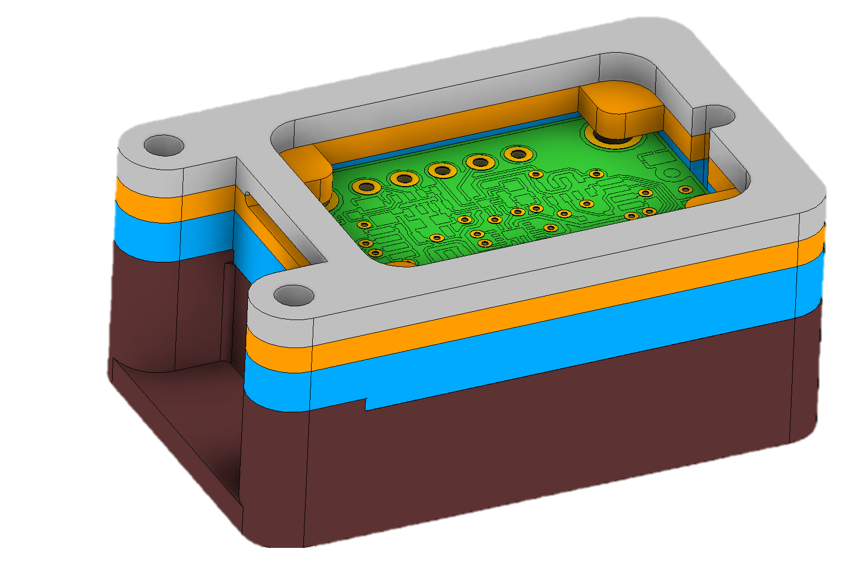

Slide 12
IMU Manager
Microstrain
LIS3DM

