Slide 1
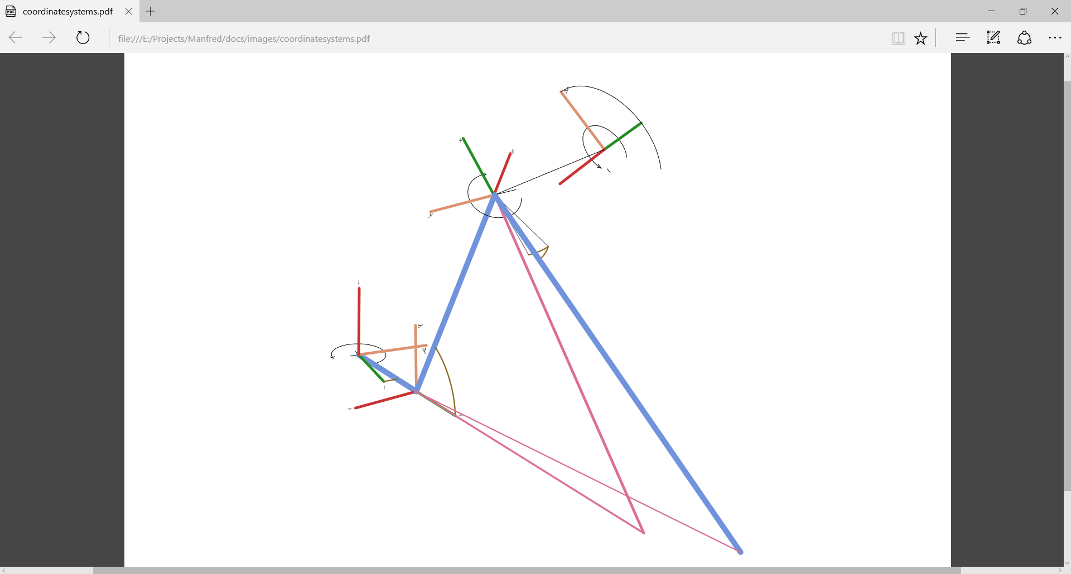
θ₂
X-axis
Y-axis
Z-axis
θ₃
θ₀
θ₁

Slide 2
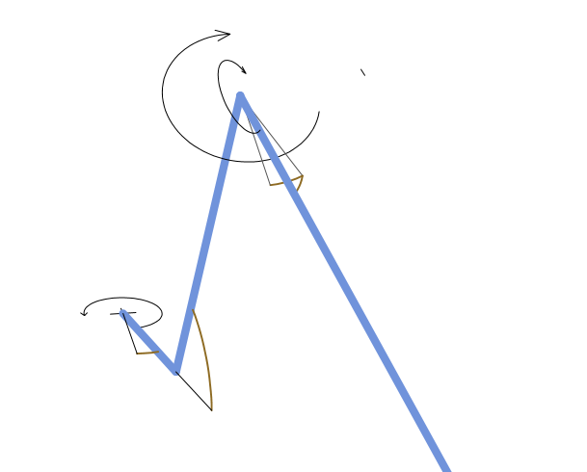
knee
foot
turning knee
hip
thigh
toe

Slide 3
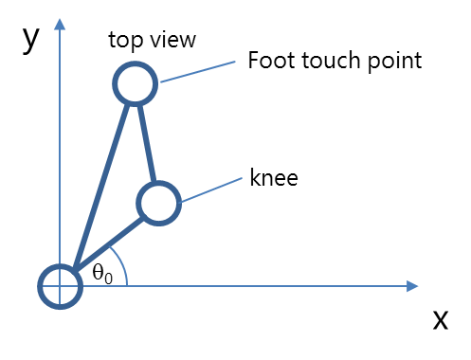

Slide 4
body coordinate
system
1st leg
y
y
2nd leg
y
3rd leg (front leg)
Hip coordinate
system
y
z
y
x
x
x
z
x
x
belly coordinate
system
y
x
5th leg
4th leg

Slide 5
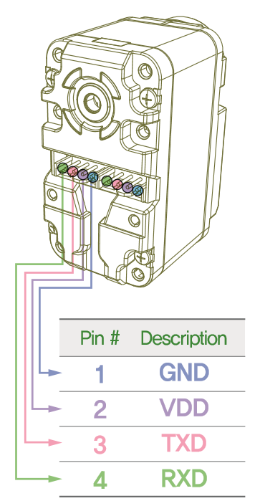
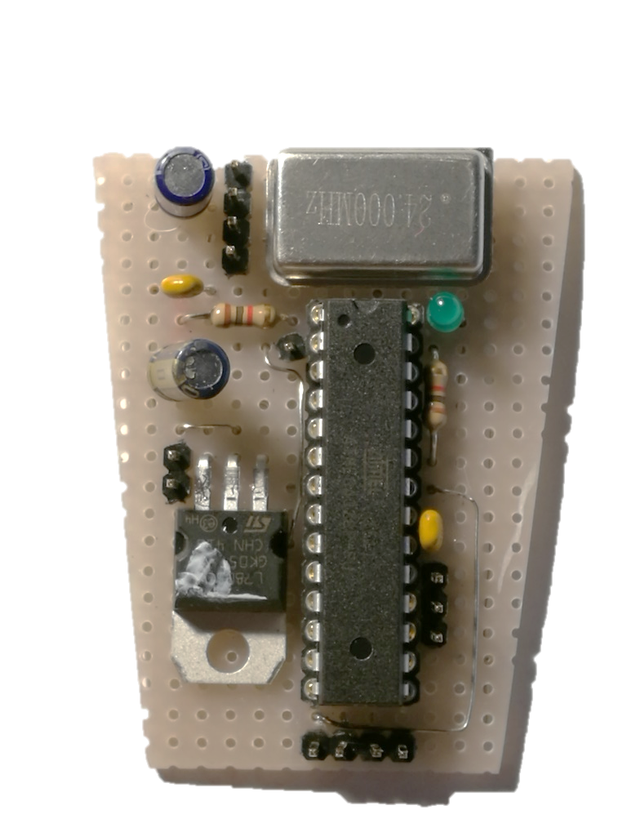
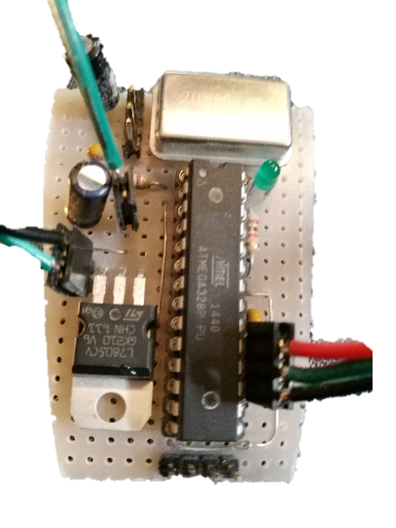
Herkulex
Servo Out
GND o
VDD o
TXD o
RXD o
RST o
GND o
5V o
AVR-ISP
o SCL o MISO
o MOSI
GND o 5V o
SDA o Scl o
VL6180X

Slide 6
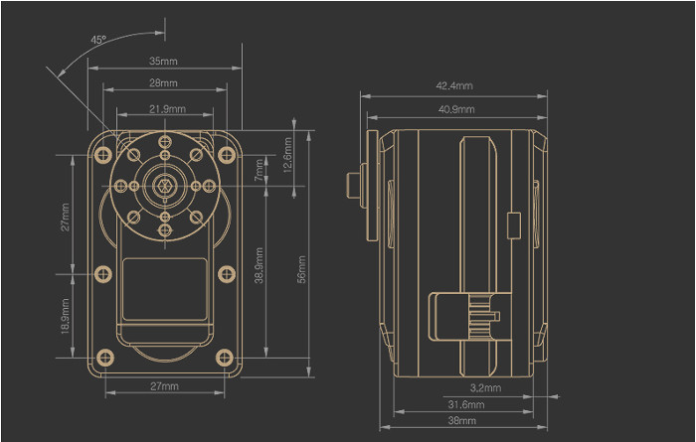

Slide 7
Odroid
Linux/ROS
Teensy 3.5,
Arm M4, 120 Mhz
Legs
ROS node rplidarNode
Leg 1..5
ROS node pentapod_server
Leg
Leg
Cortex
Servo Control, IMU Data Grabber, Distance Sensor Grabber
UART₂
Servo Thigh
Servo
Hip
RPLidar Driver
Lidar
Leg
UART _{/dev/ttyS1}
Leg
UART₃
Servo Knee
Servo Foot
UART₄
Webserver REST Mongoose
ROS node hector_mapping
UART₅
Servo Sensor
Adapter
Distance
Sensor
VL6180
Hector SLAM
UART₆
I2C₀
ROS node pentapod_engine
Engine
I2C _{/dev/i2c-1}
I2C₁
IMU
BNO055
Software
Module
Hardware, Sensor, Motor
Protocol,
Adapter

Slide 8
Odroid
Linux/ROS
node „Server“
node „SLAM“
Webserver
SLAM
map
Lidar
Planning
target
move
Odometry
node „Engine“
map
Engine
state
state
move
move

