Slide 1
An Introduction to Probabilistic Topic Modeling, LDA and Topic Grouper
Daniel Pfeifer, June 16 2016

Slide 2
Topic Modeling (TM)
Information Retrieval problem:
Working with a document collection D
Word order in a document d is ignored
Similar to document clustering (DC)
DC: Group documents according to a distance measure – e.g. Salton 1975 / Vector Space Model
However for Topic Modeling:
Find latent topics in D.
A document d may belong to more than one topic t.
Topics are described via words from D.

Slide 3
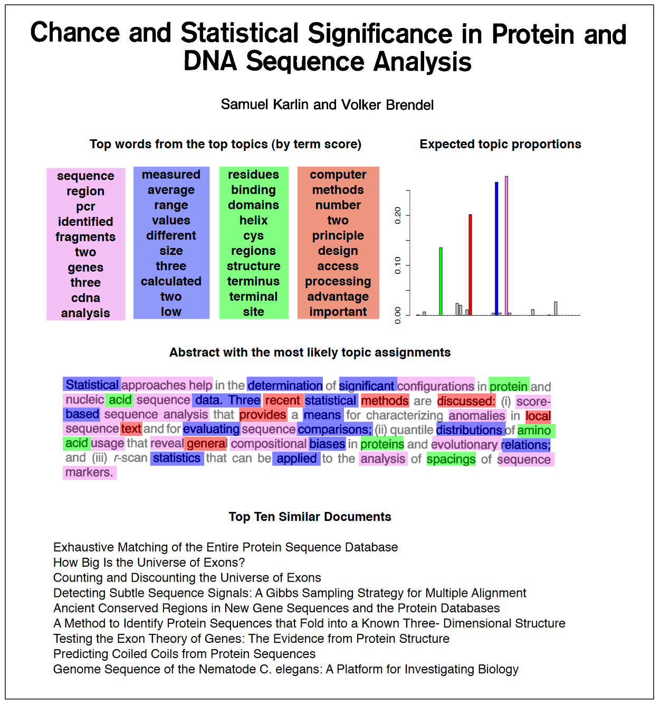
Example (from Blei / Review Paper)

Slide 4
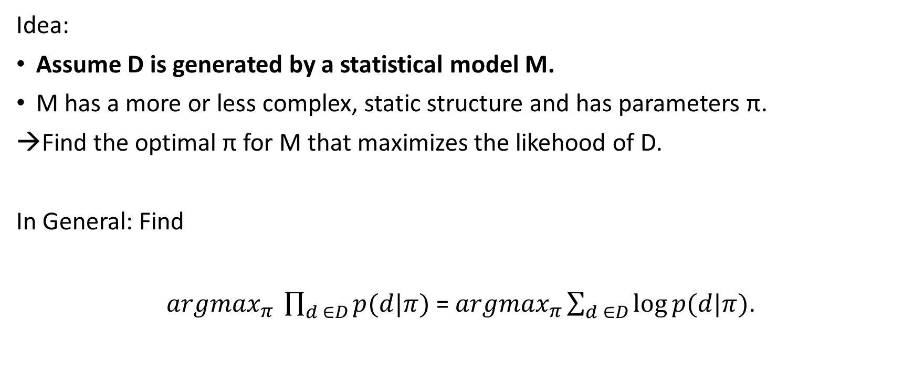
Probabilistic TM (PTM) (1)
Idea:
Assume D is generated by a statistical model M.
M has a more or less complex, static structure and has parameters π.
Find the optimal π for M that maximizes the likehood of D.
In General: Find
${argmax}_{π} \prod_{d ∈D}{p(d|π)}$ = ${argmax}_{π}\sum_{d ∈D}{\log{p(d|π)}}$.
Model M
Parameters
Document collection
Apply logarithm for better computability

Slide 5
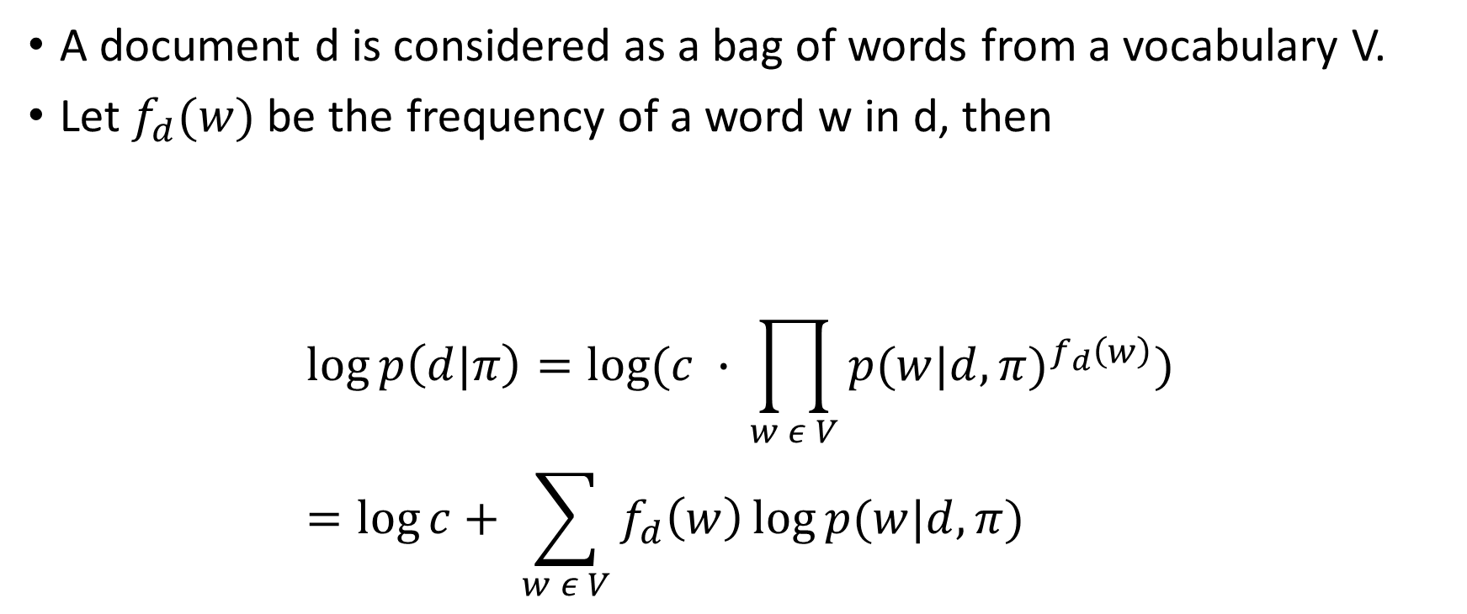
PTM (2)
A document d is considered as a bag of words from a vocabulary V.
Let $f_{d}(w)$ be the frequency of a word w in d, then
$$\log{p\left(d|π\right)}=\log{(c ∙} \prod_{w ε V}{{p(w|d,π)}^{f_{d}\left(w\right)}})=\log{c}+ \sum_{w ε V}{f_{d}\left(w\right)\log{p(w|d,π)}}$$
A „constant“ (multinomial) that factors out that word order is ignored

Slide 6
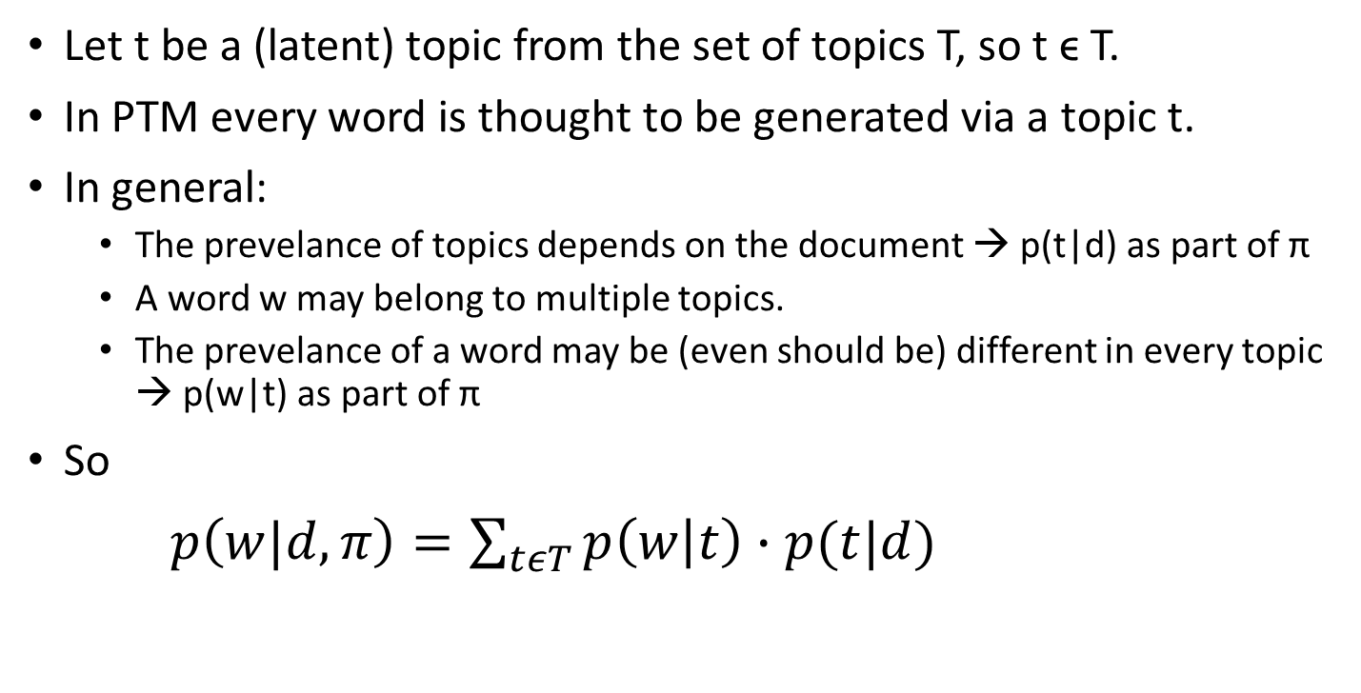
PTM (3)
Let t be a (latent) topic from the set of topics T, so t ϵ T.
In PTM every word is thought to be generated via a topic t.
In general:
The prevelance of topics depends on the document → p(t|d) as part of π
A word w may belong to multiple topics.
The prevelance of a word may be (even should be) different in every topic → p(w|t) as part of π
So
$p\left(w|d,π\right)=\sum_{tεT}{p\left(w | t\right)∙p(t|d)}$

Slide 7
Latent Dirichlet Allocation (LDA) (1)
LDA tries to estimate p(w|t) and p(t|d) via D.
Problem:
Infinite (uncountable) possibilities when trying out distributions for p(w|t) and p(t|d).
Help:
The Dirichlet Distribution is a „distribution of distributions“ with „reasonably nice“ mathematical qualities regarding integration.
Drawing from a Dirichlet returns a distribution in itself (not a real value).
LDA draws infinitely many samples from a Dirichlet to compute p(w|t) and p(t|d) based on the data.

Slide 8
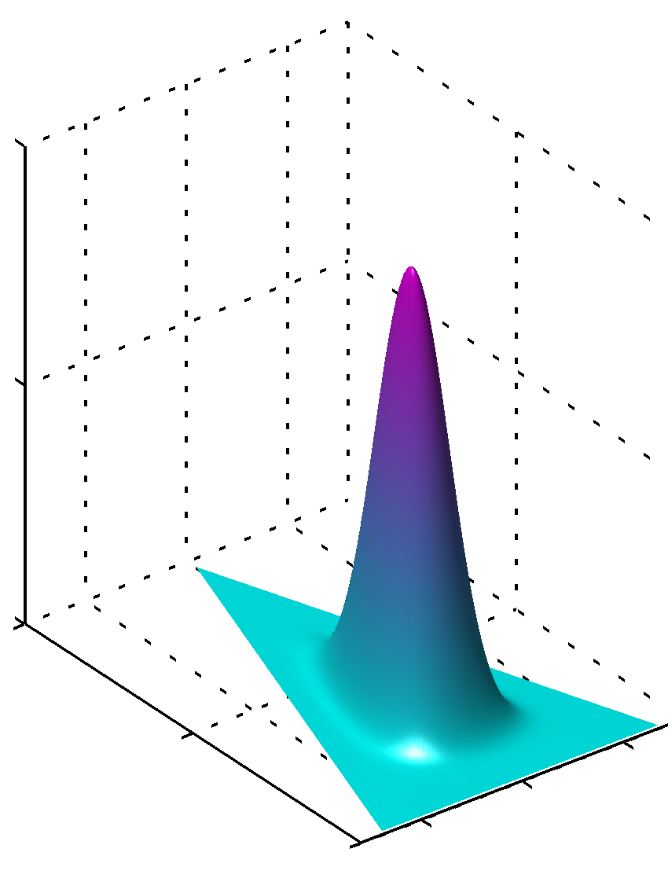
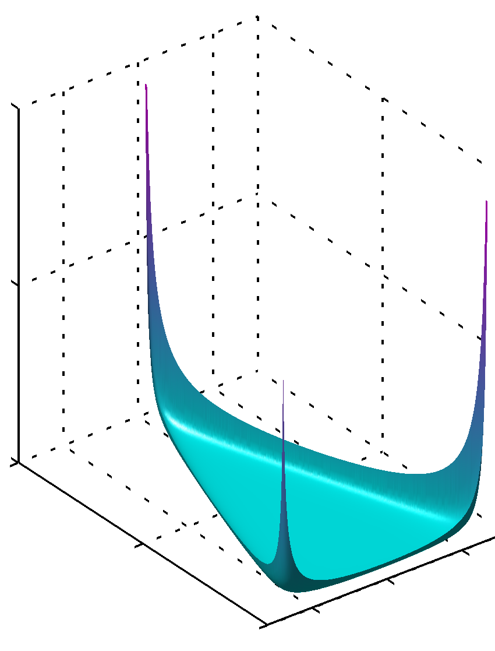
Dirichlet Distribution for n = 3
A Dirichlet can itself be parametrized with a real-valued, n-sized vector α.

Slide 9
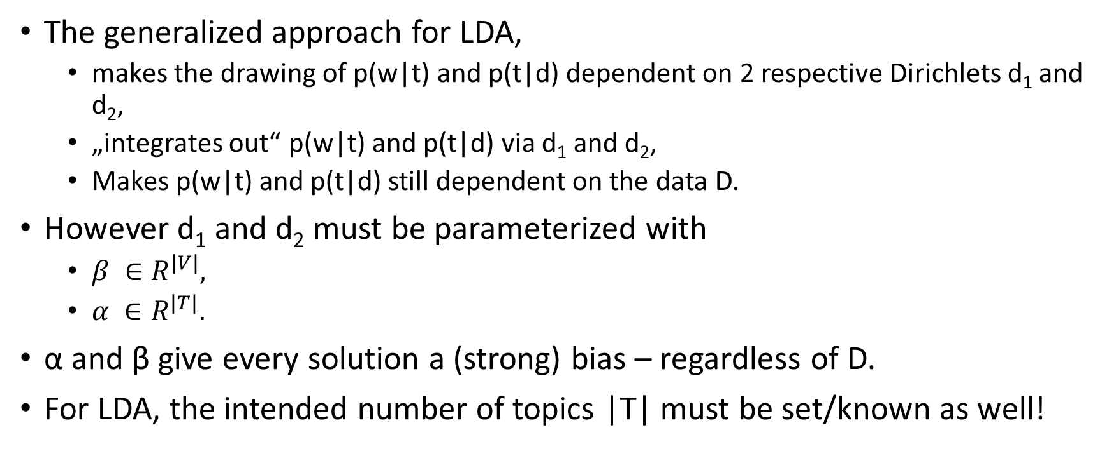
LDA (2)
The generalized approach for LDA,
makes the drawing of p(w|t) and p(t|d) dependent on 2 respective Dirichlets d₁ and d₂,
„integrates out“ p(w|t) and p(t|d) via d₁ and d₂,
Makes p(w|t) and p(t|d) still dependent on the data D.
However d₁ and d₂ must be parameterized with
$β ∈R^{\left|V\right|},$
$α ∈R^{\left|T\right|}.$
α and β give every solution a (strong) bias – regardless of D.
For LDA, the intended number of topics |T| must be set/known as well!

Slide 10
LDA (3)
Using α and β one can define an integral for the expectation of p(w|t) and p(w|d). → „integrating out“
However the integral cannot be solved analytically.
Numerical approaches are used instead:
The most popular is the „Gibbs sampler“ (others exist).
Gibbs sampling is a method of sampling a multi-dimensional distribution:
It works by sampling a long every dimension, one at a time,
„Jumping dots along the axis“
Over time (iterations) the samples reflect (more or less) the true distribution.
See this video:
https://www.youtube.com/watch?v=ZaKwpVgmKTY

Slide 11
LDA (4)
LDA is the predominant approach for PTM.
A body of scientific work exists
to overcome its general short comings,
to go from topics as word collections to phrases etc.
Worst problem:
Nobody knows the right |T|, α and β in advance.
If set wrong → (really) bad results.
Solutions are „dangerous“, theoretically complex or computationally intensive.
Simple heuristics for α and β.
Extended versions of LDA to „integrate out“ α and β or |T|.
Parameter search at least over |T|.

Slide 12
LDA – Example of a parameter search

Slide 13
Curiously…
… optimized LDA parameters often return
good prediction (cause that's for what they got optimized for),
but really bad (unplausible) topics for humans.
This is also highlighted in publications:
„Reading Tea Leaves: How Humans Interpret Topic Models“ (Chang et al)

Slide 14
PTM – A Great Approach for Recommender Systems!
w = item of interest (e.g. consumer product)
d = user (profile) (e.g. what he / she bought)
D = all user profiles
T = interest groups
p(t|d) = what is user d generally interested in (it can be more than one topic)
A an item of interest w with large expression p(w|t)∙p(t|d)
is what to recommend to the user (but only in case user hasn‘t got w yet).

Slide 15
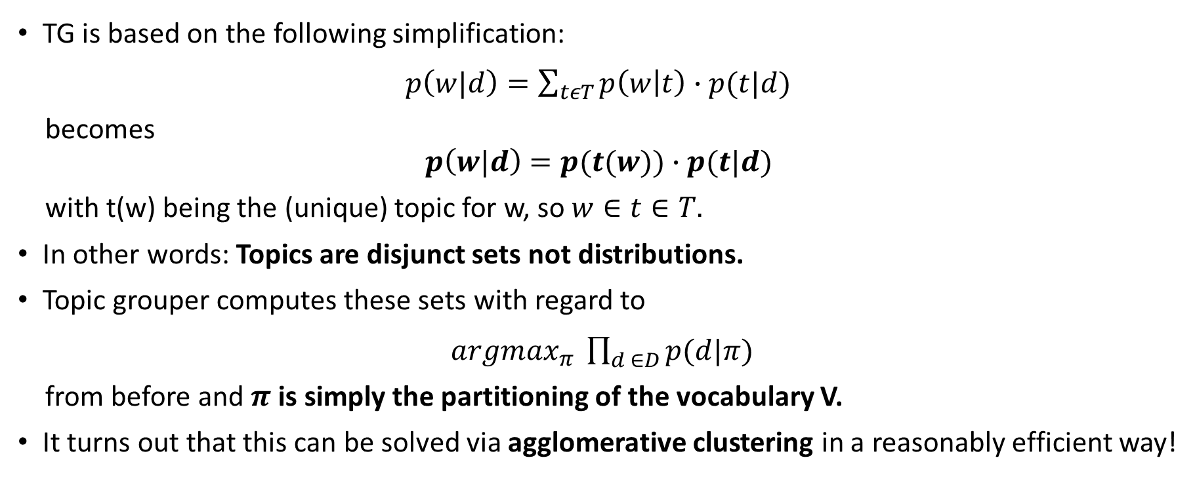
Topic Grouper (TG) – an Alternative Approach
TG is based on the following simplification:
$p\left(w|d\right)=\sum_{tεT}{p\left(w | t\right)∙p(t|d)}$
becomes
$$p\left(w|d\right)=p(t(w))∙p(t|d)$$
with t(w) being the (unique) topic for w, so $w∈t∈T.$
In other words: Topics are disjunct sets not distributions.
Topic grouper computes these sets with regard to
${argmax}_{π} \prod_{d ∈D}{p(d|π)}$
from before and $π$ is simply the partitioning of the vocabulary V.
It turns out that this can be solved via agglomerative clustering in a reasonably efficient way!

Slide 16
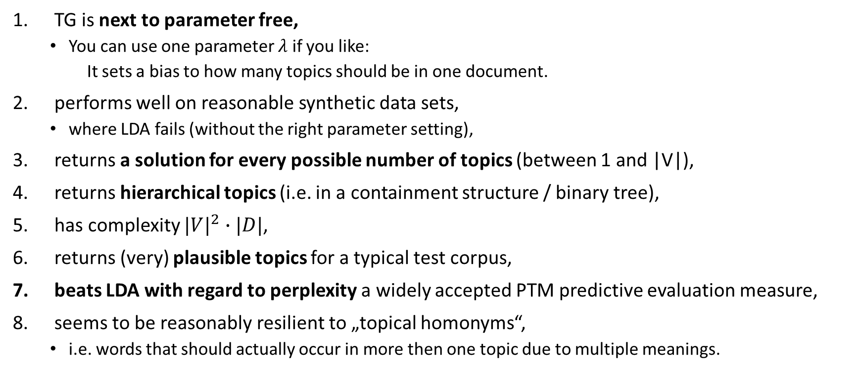
Qualities of Topic Grouper
TG is next to parameter free,
You can use one parameter $λ$ if you like:
It sets a bias to how many topics should be in one document.
performs well on reasonable synthetic data sets,
where LDA fails (without the right parameter setting),
returns a solution for every possible number of topics (between 1 and |V|),
returns hierarchical topics (i.e. in a containment structure / binary tree),
has complexity ${|V|}^{2}∙|D|$,
returns (very) plausible topics for a typical test corpus,
beats LDA with regard to perplexity a widely accepted PTM predictive evaluation measure,
seems to be reasonably resilient to „topical homonyms“,
i.e. words that should actually occur in more then one topic due to multiple meanings.

Slide 17
Perplexity: LDA vs. Topic Grouper (Intra-Document Holdout)
Perplexity values for LDA and Topic Grouper on AP corpus extract with optimized hyperparameters for LDA:
Stop words gone, stemming done,
only kept word with frequency ≥ 10 in resulting corpus,
|V| = 5575, |C| = 2946,
10% holdout.

Slide 18
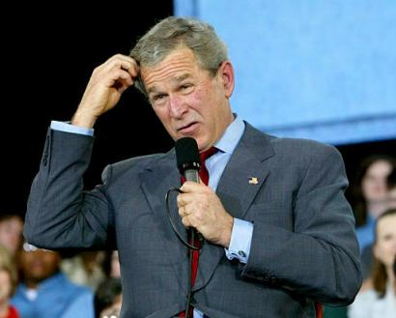
Perplexity: LDA vs. Topic Grouper (Full Document Holdout)
Same as before but
complete documents are held out.
This poses problems w.r.t. to LDA because p(t|d) is not available for held out documents (when using LDA).
To solve this p(t|d) is estimated via p(w|t) and f_{d}(w) (which are available).
I tried to be fair…
Have I done something wrong?

Slide 19
This (probably) means that…
… unless there is a flaw in my analysis …
… LDA tends to overfit the data big time (given the circumstances).
And this (probably) means that
LDA is not so good at finding abstractions that go beyond the analyzed documents,
but Topic Grouper is.
And anyways – if you want to predict
like for recommender systems,
you are better of with Topic Grouper

Slide 20
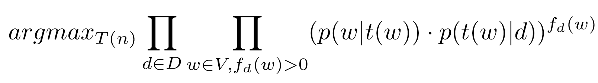
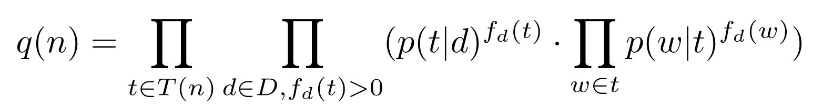
The „Math“ (1)
Optimize partitioning T(n) of V with |T(n)| = n:
Reorganize such that one can optimize on topics (instead of documents):

Slide 21
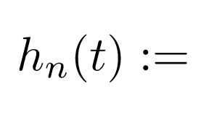
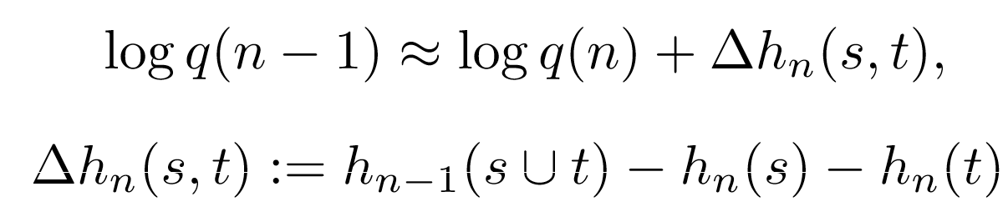
The „Math“ (2)
Apply the logarithm:
Estimate probabilities via maximum likelihood using D:
Think of it as stepwise optimization process joining 2 topics s and t at each step:

Slide 22



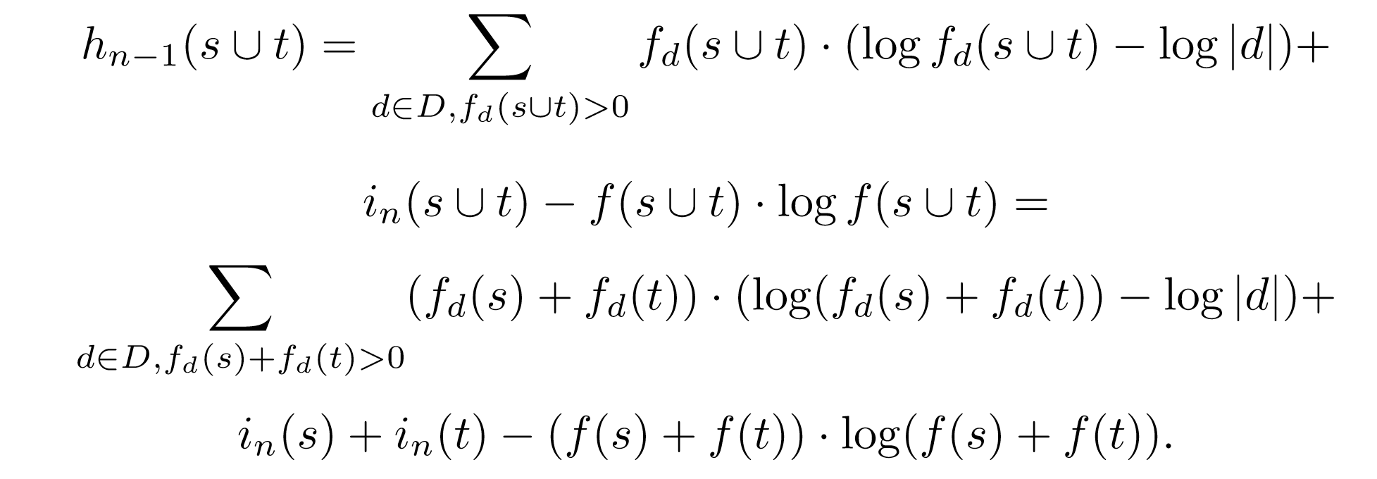
The „Math“ (3)
See what computations you can avoid from one step to the next:
➔
This formula has no sum over words anymore!
→ Efficiency

Slide 23

Algorithm and Complexity
Topic Grouper can be thought of
an agglomerative clustering, starting with as many topics as words in V,
always joins word sets s, t where it „hurts the least“ according to ,
ends at 1 topic (including all words).
Using dynamic programming, the complexity is in O(|V|²∙ |D|).
Example:
AP Corpus Extract („News wire“) with |D| = 16.000 documents and |V| = 13383 words took about
4,39 hours on my machine (Java / no high job priority),
process required 850 GB of RAM.

Slide 24
So what do the topics look like?
Short Demo on AP Corpus Extract:
2946 „dated“ news reports,
5575 words after stop word removal, stemming, filtering by word frequency ≥ 10.
Flat View (just like for LDA)
100 topics – snapshot of the „last 100 clusters“ on the way to 1
Exploration of the hierarchy (more useful):
Reflection of the cluster join process,
displayed as a Mindmap using „Freemind“.

Slide 25
This is work in progress…
… but if you are more interested, you find everything (including these slides) on
https://github.com/pfeiferd/TopicGrouperJ

