Slide 1
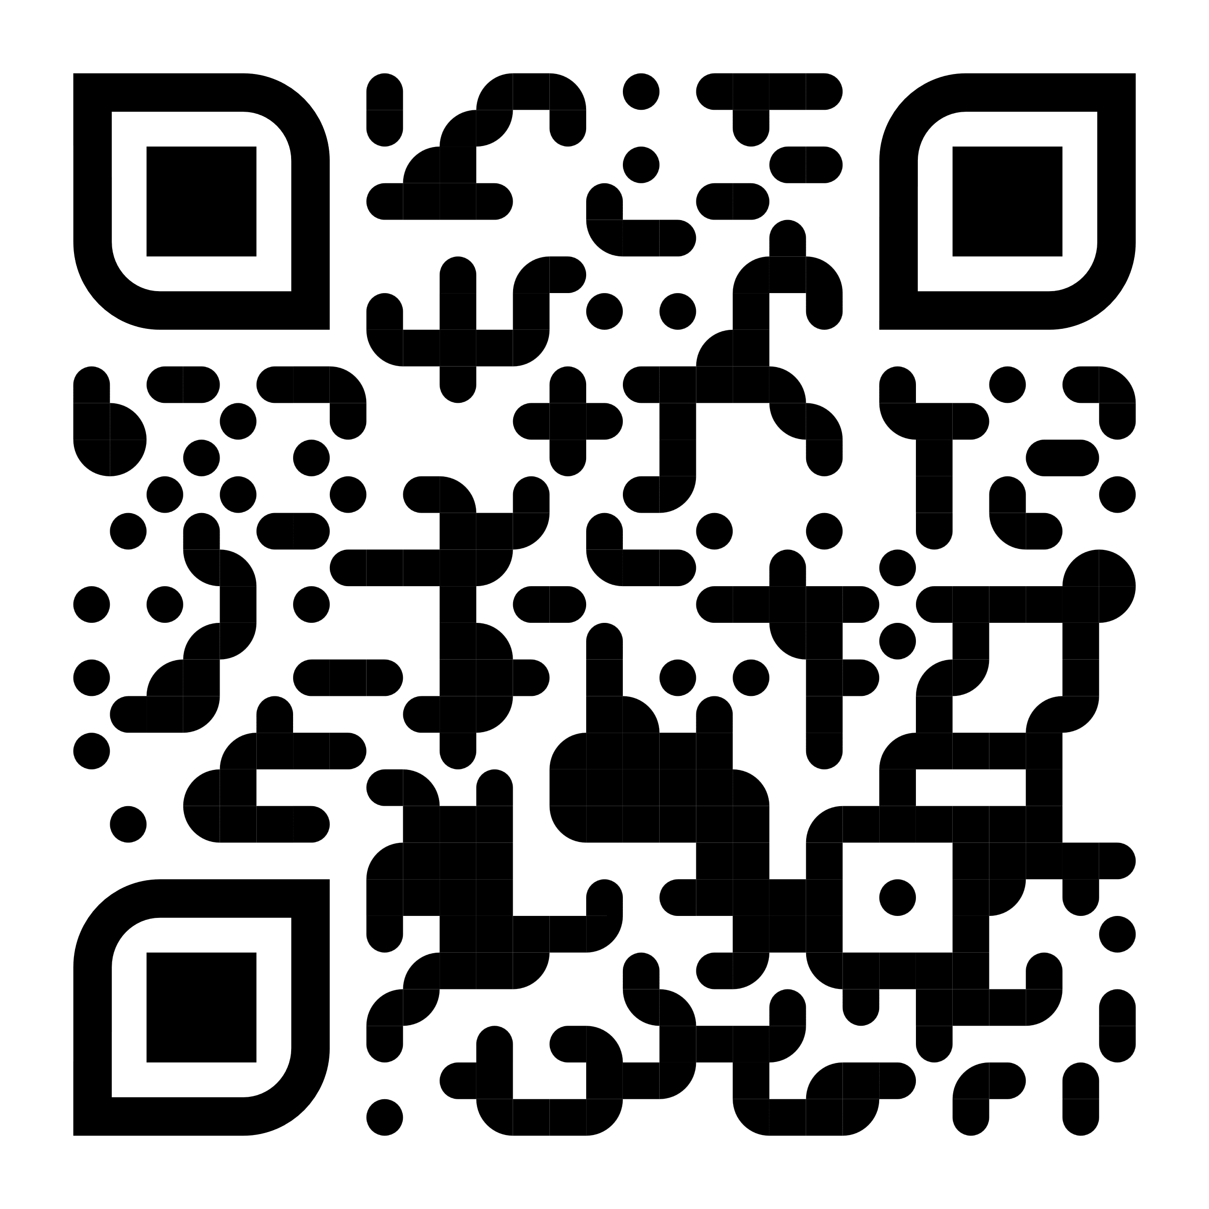
G
Extended PRIME GO | 4 | 4+
R
Electronic Green Room
http://electronic-green-room.de/skin

