Slide 1
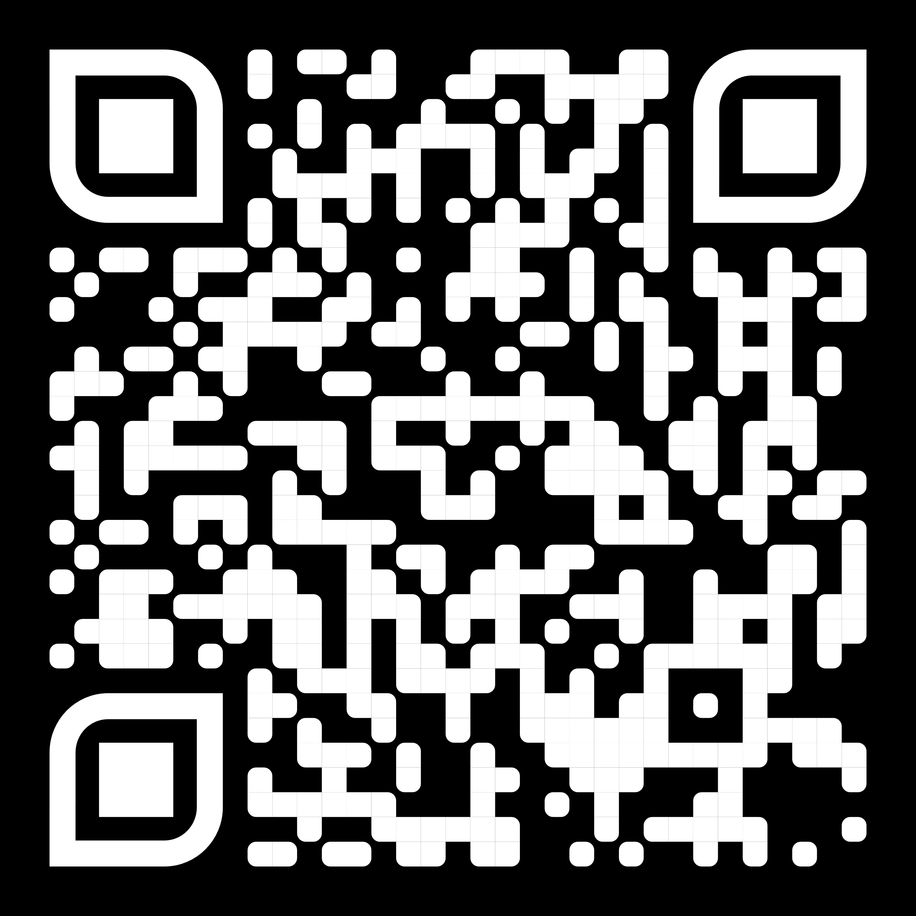
G
Extended PRIME GO | 4 | 4+
R
Electronic Green Room

