Slide 1
Viral hits among assembled contigs
Group | Contigs | % of 6,004 | Called viral by geNomad
RNA virus families (candidates) | 432 | 7.2 | 142
DNA virus families | 522 | 8.7 | 122
DNA virus families (no realm assigned) | 826 | 13.8 | 180
Bacteriophages | 142 | 2.4 | 26
Retroviruses / retroelements | 31 | 0.5 | 5
Viral hit without family | 136 | 2.3 | 65
Weak (blastn < 30% cover, no protein) | 1,018 | 17.0 | 102
No viral hit | 2,897 | 48.3 | 502
Best hit per contig vs. custom viral DB. DNA-virus and phage hits in an RNA-seq library are host or bacterial genes with viral homologues. | Best hit per contig vs. custom viral DB. DNA-virus and phage hits in an RNA-seq library are host or bacterial genes with viral homologues. | Best hit per contig vs. custom viral DB. DNA-virus and phage hits in an RNA-seq library are host or bacterial genes with viral homologues. | Best hit per contig vs. custom viral DB. DNA-virus and phage hits in an RNA-seq library are host or bacterial genes with viral homologues.

Slide 2
RNA viruses confirmed by geNomad
Virus | Family | Samples | Contigs | geNomad-supported | Max length (bp) | Max nt id. (%) | Max aa id. (%)
Verdadero virus | Partitiviridae | 19/22 | 38 | 38 | 1,901 | 99.9 | 100.0
Chaq-like virus | Partitiviridae | 19/22 | 19 | 19 | 2,003 | 99.7 | 100.0
Aedes anphevirus | Xinmoviridae | 14/22 | 21 | 18 | 15,488 | 99.9 | 100.0
Bafoussam mosquito rhabdovirus-like | Rhabdoviridae | 6/22 | 8 | 8 | 4,012 | 71.8 | 80.1
Formosus virus-like | Rhabdoviridae | 6/22 | 8 | 5 | 4,110 | 74.2 | 90.6
Aedes aegypti totivirus | Inseviridae | 5/22 | 11 | 11 | 4,797 | 98.6 | 99.3
Mos8Chu0 chuvirus-like | Chuviridae | 5/22 | 6 | 4 | 1,694 | 77.0 | 83.5
Liao ning virus-like | Sedoreoviridae | 4/22 | 4 | 4 | 1,516 | 81.2 | 84.5
Lispiviridae sp. | Lispiviridae | 4/22 | 4 | 4 | 1,612 | - | 47.3
Aedes flavivirus-like | Flaviviridae | 3/22 | 3 | 1 | 2,039 | - | 38.5
Cell fusing agent virus | Flaviviridae | 2/22 | 4 | 4 | 10,680 | 99.0 | 99.4
Atrato virus-like | Orthototiviridae | 2/22 | 2 | 2 | 1,365 | - | 29.7
Culex mosquito virus 1-like | Nodaviridae | 2/22 | 2 | 2 | 2,161 | 97.5 | 45.6
Culex-associated Tombus-like virus relative | Tombusviridae | 2/22 | 2 | 2 | 2,456 | 67.8 | 57.1
Phasivirus phasiense | Phenuiviridae | 1/22 | 4 | 4 | 2,335 | 97.9 | 100.0
San Gabriel mononegavirus | Rhabdoviridae | 1/22 | 3 | 3 | 2,713 | 97.1 | 99.4
Aedes anphevirus-like | Xinmoviridae | 1/22 | 1 | 1 | 1,083 | 66.8 | 68.3
Rhabdoviridae sp. | Rhabdoviridae | 1/22 | 1 | 1 | 1,418 | 73.5 | 35.2

Slide 3
RNA virus hits to verify
Virus | Family | Samples | Contigs | geNomad-supported | Max length (bp) | Max nt id. (%) | Max aa id. (%) | Note
Hattula partiti-like virus relative | Partitiviridae | 21/22 | 130 | 2 | 7,546 | 99.2 | 97.1 | Ubiquitous, short nt hit: possible EVE
Iflavirus sp. | Iflaviridae | 19/22 | 113 | 0 | 2,462 | 99.7 | - | Ubiquitous, no geNomad support: rRNA pattern (cf. Hanko)
Kamiti River virus-like | Flaviviridae | 6/22 | 6 | 2 | 2,766 | 71.7 | 50.7 | Short nt hit; possible flavivirus EVE
Bole tick virus 4-like | Pestiviridae | 5/22 | 6 | 0 | 1,336 | 80.3 | -
Oropouche virus | Peribunyaviridae | 3/22 | 6 | 0 | 1,429 | 98.8 | - | Short nt hit; protein closest to Culex mosquito virus 1
Murri virus-like | Orthototiviridae | 3/22 | 3 | 0 | 1,907 | - | 35.4
Hameenlinna phasivirus | Phenuiviridae | 1/22 | 1 | 0 | 1,037 | 91.1 | 68.8 | No protein hit in any database
Hulunbuir Totiv tick virus 2-like | Orthototiviridae | 1/22 | 1 | 0 | 1,193 | - | 31.8
Leksozero Aedes Stangrhavirus-like | Rhabdoviridae | 1/22 | 1 | 0 | 1,217 | - | 34.2
Mato partitivirus-like | Partitiviridae | 1/22 | 1 | 0 | 1,059 | 76.0 | 49.8
Onega tick phlebovirus-like | Phenuiviridae | 1/22 | 1 | 0 | 1,025 | 78.6 | -
Plateau tick ixovirus-like | Phenuiviridae | 1/22 | 1 | 0 | 1,004 | 82.3 | -

Slide 4
Hits attributed to host (EVE / rRNA)
Virus | Family | Samples | Contigs | geNomad-supported | Max length (bp) | Max nt id. (%) | Max aa id. (%) | Note
Hanko iflavirus 1 | Iflaviridae | 11/22 | 16 | 5 | 1,392 | 96.7 | - | Host-derived: genome screen / rRNA
Tick-borne encephalitis virus-like | Flaviviridae | 2/22 | 3 | 1 | 1,065 | 76.4 | 35.2 | EVE in AaegL5 (genome screen)
Panayarvi Aedes partiti-like virus 2 relative | Partitiviridae | 2/22 | 2 | 1 | 1,081 | 78.3 | 76.7 | EVE in AaegL5 (genome screen)

Slide 5
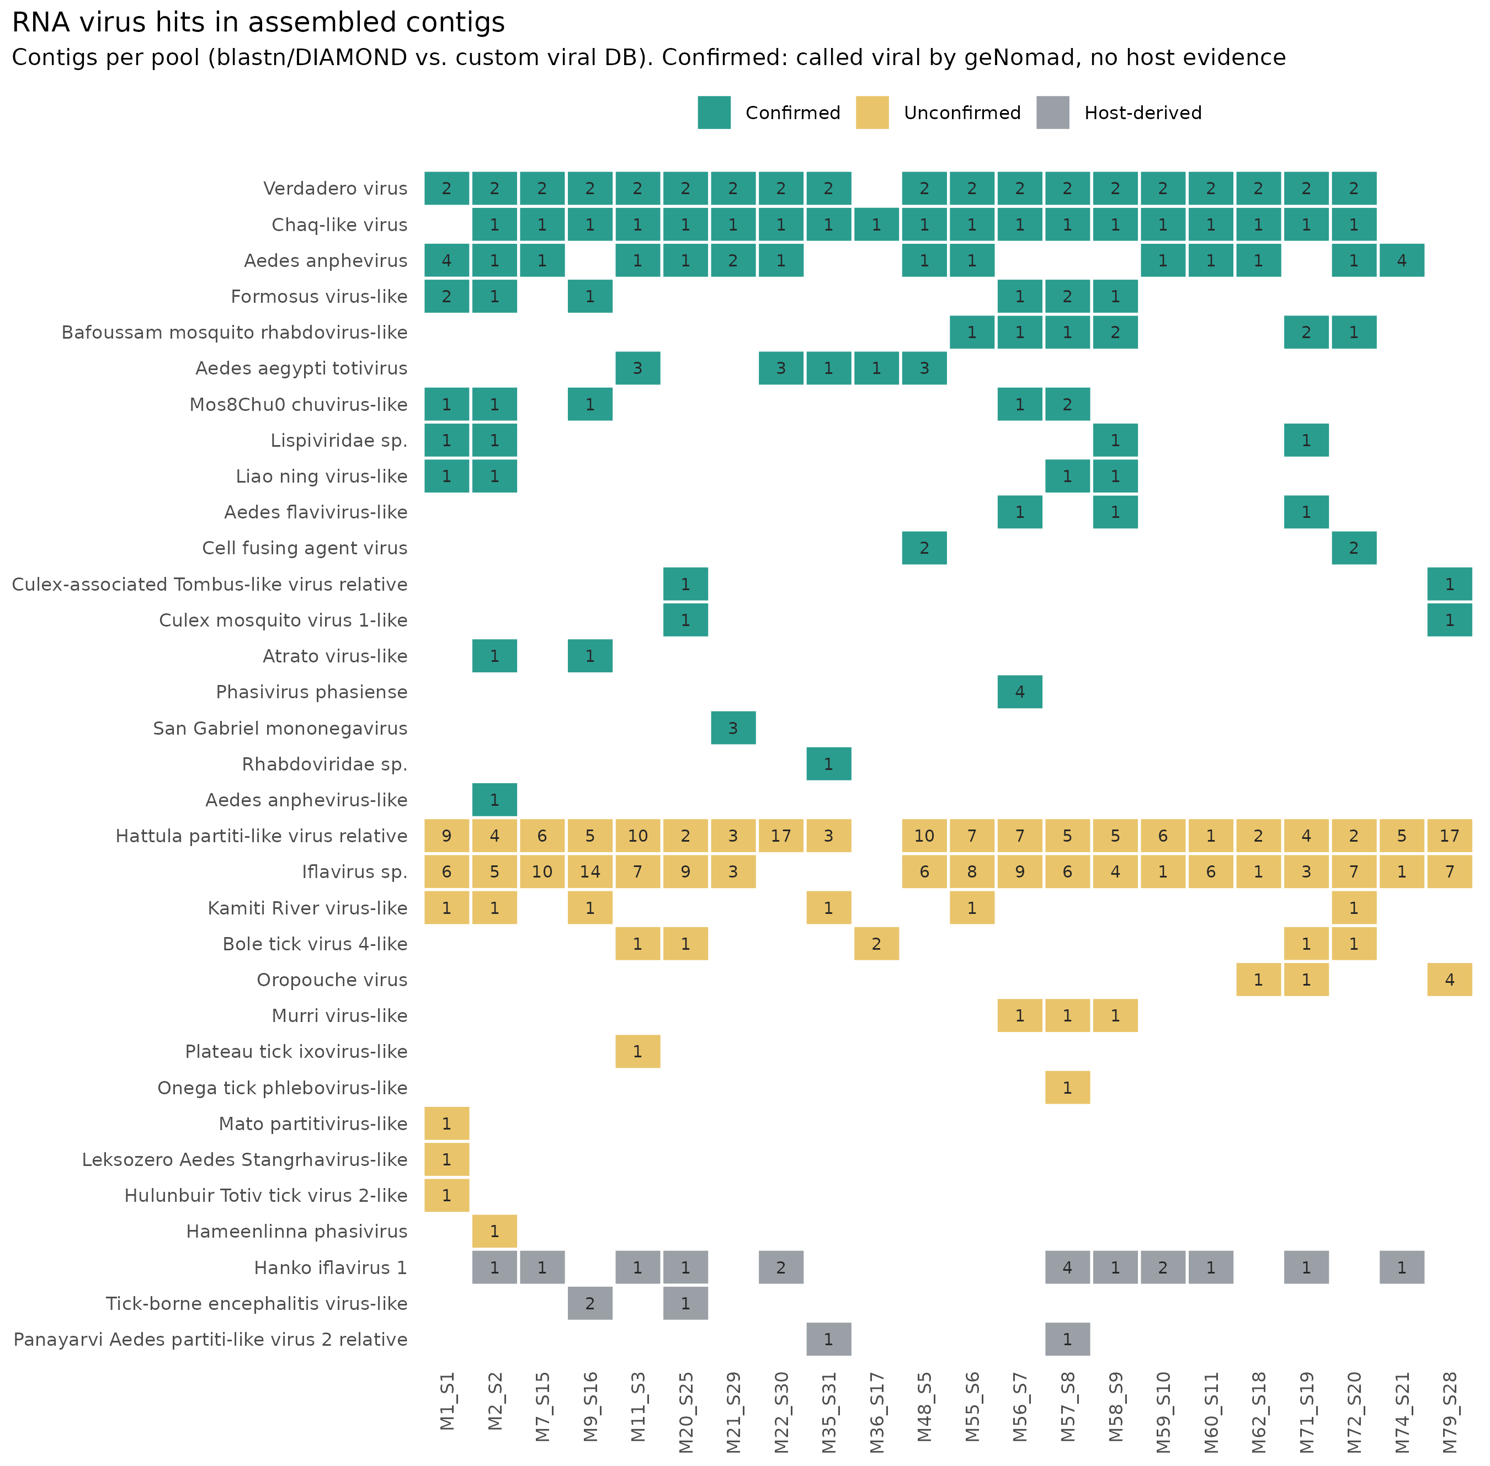
RNA virus hits per pool

