Slide 1
The Contact Process
Alice, Ida, Joakim, Xinxi

Slide 2
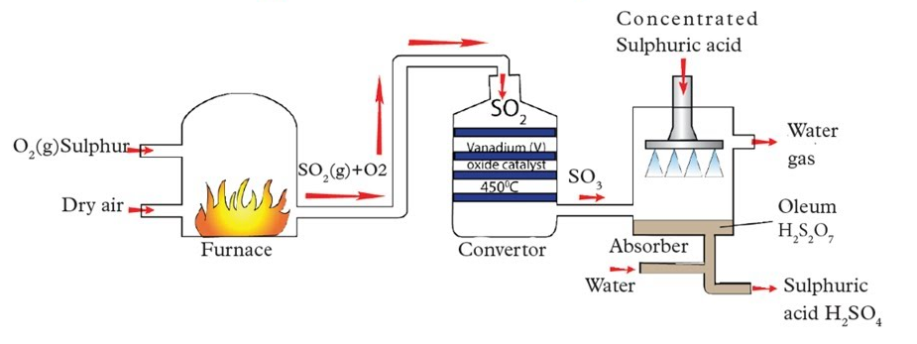

What is it, and where is it used?
A chemical process which is used in industrial applications
to synthesise Sulfuric Acid ($H_{2}SO_{4}$).
It consists of three 3 main steps:
Sulfur Dioxide synthesis
Conversion of Sulfur Dioxide
Conversion of Sulfur Trioxide
to Sulfur Trioxide
to Sulfuric Acid
Notes:
A:
Catalysts- Vanadium oxide (V₂$O_{5}$), Vanadium pentoxide
sulfur (S)+ oxygen ($O_{2}$) → sulfur dioxide S$O_{2}$
2S$O_{2}$(g)+$O_{2}$(g)⇌2S$O_{3}$(g) ΔH=−196kJ/mol

Slide 3
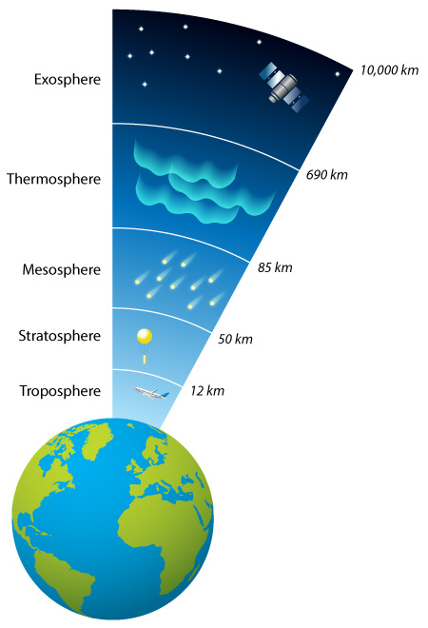
Where does it take place?
Is not found in nature
Volcanic activity
Stratosphere
Notes:
A
Britannica(Sulfuric acid | Structure, Formula, Uses, & Facts | Britannica) – Pure anhydrous sulfuric acid does not exist in nature. Volcanic activity can result in the production of sulfuric acid, depending on the emissions from specific volcanoes, and sulfuric acid aerosols from an eruption can stay in the stratosphere for many years.

Slide 4
Why is it important to us
The Contact process creates large amounts of sulfuric acid
Sulfuric acid is commonly used for:
Production of phosphate fertilizers
Manufacture explosives
Make dyes
Create automobile batteries
Oil refining
Notes:
J:
The contact process allows large quantities of sulfuric acid to be produced
Britannica(Sulfuric acid | Structure, Formula, Uses, & Facts | Britannica) - The acid is used in the manufacture of fertilizers, pigments, dyes, drugs, explosives, detergents, and inorganic salts and acids, as well as in petroleum refining and metallurgical processes. In one of its most familiar applications, sulfuric acid serves as the electrolyte in lead–acid storage batteries.

Slide 5

Step 1
Preparation of Sulfur Dioxide
Solid sulfur is melted into a liquid. This liquid is then combusted with oxygen
Reaction:
$$S+O_{2}→SO_{2}$$
Notes:
J

Slide 6
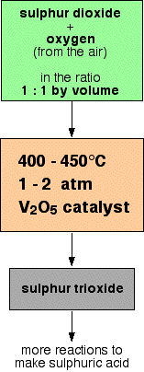

Step 2
The second step in the contact process is the conversion of SO₂ to Sulfur Trioxide (SO₃)
Reaction:
$$2SO_{2\left(g\right)}+O_{2\left(g\right)}⇌2SO_{3\left(g\right)} ΔH=−196KJ/mol$$
exothermic reaction
Notes:
X:
In the second step in the contact process, sulfur dioxide is converted to sulfur trioxide. Here is the reaction. This is an exothermic reaction, and 196 kilojoules energy is released per mol.
According to Le Chatelier's Principle, increasing the concentration of oxygen in the mixture causes the equilibrium position to shift towards the right. Since the oxygen comes from the air, this is a very cheap way of increasing the conversion of sulfur dioxide into sulfur trioxide.
The ratio in moles for sulfur dioxide and oxygen in the reaction is 2:1. But according to Avogadro’s law, equal volumes of gases at the same temperature and pressure contain equal numbers of molecules. This means that we have an excess of oxygen gas. In equilibrium, an excess of reactants (oxygen) leads to the shift of equilibrium towards the right, favoring the products, which increases the conversion of sulfur dioxide into sulfur trioxide.

Slide 7
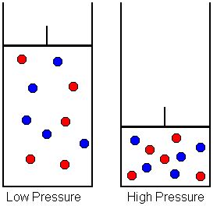

The Role of Pressure
In the second step, pressure plays a big part.
Higher pressure $⟹$ More $SO_{3}$
Why?
Pressure causes the equilibrium to tip towards the product side of the equation, i. e. K to increase.
NOTE: Although more pressure gives a higher yield, quite low pressures are used in industrial processes due to economical and safety reasons.
1 atm gives ~95% conversion rate
Notes:
J: In the second step, pressure plays an important role. The application of excess pressure favors the production of more sulphur trioxide. This happends because the pressure causes the equilibrium to tip towards the product side. However, in the production of sulfur trioxide a lower pressure is preferred because of economical and safety reasons.

Slide 8
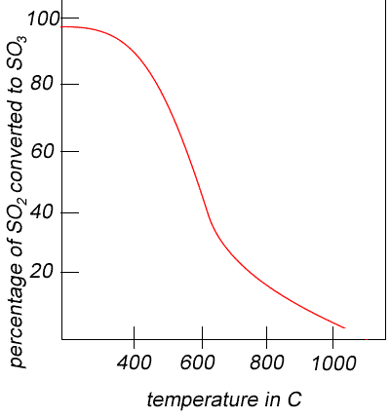

The Role of Temperature
The conversion of $SO_{2}$ to $SO_{3}$ is exothermic
High temperature:
Reactants ($SO₂$and $O₂$) are favored
Rate increases
Lower temperature:
Product ($SO_{2}$) is favored
BUT! Reaction rate decreases
A compromised temperature around 400-600˚C allows the reaction to favor the formation of product while having a reasonable rate.
Notes:
X:
The conversion of sulfur dioxide to sulfur trioxide is exothermic, so heat is released.
A high temperature increases the rate of reaction, but it also shifts the equilibrium reaction towards the left and favors the formation of reactants to absorb the added heat. (SO₂ and O₂)
A relative lower temperature favors the formation of sulfur trioxide which is the product, but at the same time, the rate of reaction decreases
A compromised temperature around 400-600˚C allows the reaction to favor the formation of product but at the same time, the reaction has a reasonable rate.

Slide 9

Step 3
Conversion of sulfur trioxide to disulfuric acid
$SO_{3}+H_{2}SO_{4}→H_{2}S_{2}O_{7}$
Conversion of disulfuric acid to sulfuric acid
$H_{2}S_{2} O_{7(l)}$+${H_{2}O}_{(l)}$→${\text{2}{H_{2}SO}_{4}}_{(l)}$
Notes:
J: H2S2O7 – disulfuric acid or fuming sulfuric acid

Slide 10
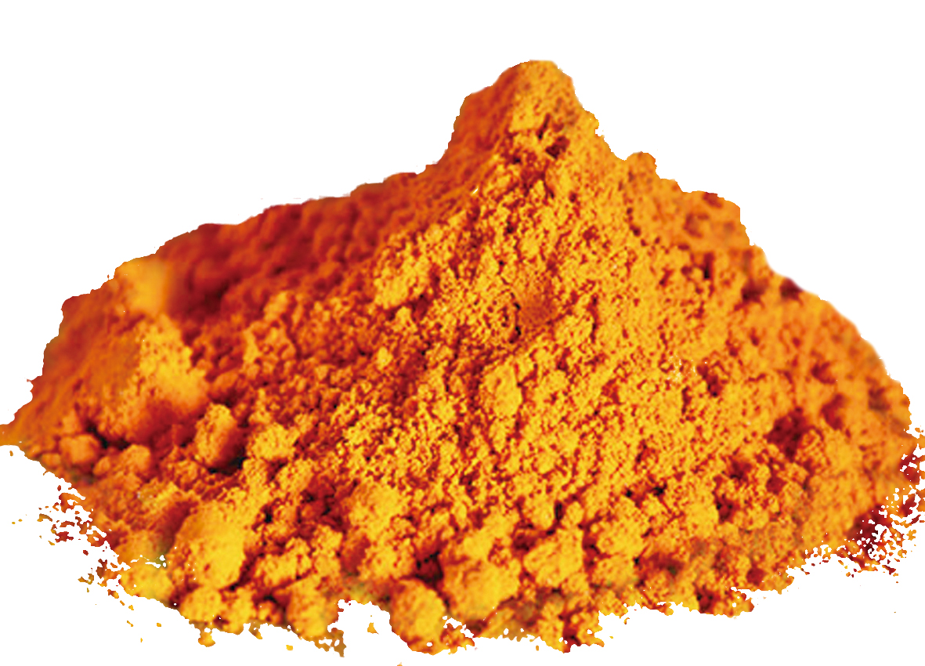
Catalyst
Vanadium pentoxide
Forces the reaction to reach equilibrium quicker
Notes:
A:
The catalyst used in this reaction is vanadium pentoxide. Vanadium pentoxide aids in increasing the rate of the reaction and forces the reaction to reach equilibrium faster.
The catalyst provides an alternative pathway with lower activation energy, allowing the reaction to reach equilibrium more quickly. However, the catalyst does not affect the position of equilibrium itself or change the concentration of reactants and products.

Slide 11

Equilibrium
$$2SO_{2}+O_{2}⇌2SO_{3}$$
This reaction is an equilibrium
How is the equilibrium affected by outside factors?
In summary, the equilibrium is affected by:
Temperature
Pressure
Catalyst
Notes:
X

Slide 12
Source:
Sulfuric acid | Structure, Formula, Uses, & Facts | Britannica
https://byjus.com/jee/contact-process/
https://www.youtube.com/watch?v=xjLUJ-7m5v8

