Slide 1
IPR 2 Decision Brief
Purpose: Confirm the Adelman mathematics, course-requirement coverage, and evidence plan for the final presentation
Agenda | Decisions requested
Progress and requirement crosswalk
Review Exact, fluid, and affine models | Confirm Proof and model depth (slide 8)
Bound proof and column generation
Experiment Design | Confirm computation scope (slide 10)
Final scop and risks
1
2

Slide 2
Final-presentation crosswalk and status
Section (Prof Requirement) | Deliverable | Status | Next action
1. Intro (I14) | Pricing motivation and approved RQs | Draft | Verify history and prevalence
2. RM (I01–I03) | Discounted LP, exact MDP, fluid LP | Draft | Audit signs and example
3. Method (I04–I06, I09) | Affine ALP, duality, decision rule | Draft | Complete formal audit
4. Proof (I07, I10) | Bound hierarchy and theorem | Draft | File independent proof audit
5. Scale (I11) | Pricing and column generation | Draft | Verify complexity and separation
6. Design (I08, I12) | Benchmarks, metrics, policies | Draft | Approve factors and baselines
6. Results (I08, I12) | Code, tables, chart, sensitivity | Not started | Pass preflight and tests
7. Critique (I13) | Assumptions and alternatives | Draft | Link claims to evidence
8. Literature (I14) | Pricing lineage and FTC context | Not started | Verify works and primary source
8. Extension (I14) | Synthetic pricing application | Blocked | Pending successful replication
9. Conclusion | Three supported takeaways | Draft | Update after results
Key:
Red Blocked
Yellow Draft
Amber Not started
Green Complete

Slide 3
Roadmap from IPR 1 to the final presentation
IPR 1: scope
IPR 2: theory
IPR 3: evidence
Final: synthesis
• Six approved questions
• Exact and discounted LPs
• Independent oracle
• Motivation
• LP themes
• Fluid and affine models
• Certified bounds
• Adelman result
• Verification plan
• Bound proof
• Static/dynamic policies
• Measured comparisons
• Application guardrails
• Pricing formulation
• Scaling and truncation
• Critique
• Experiment approval
• Reviewed results
• Gated application
• Limits
Current gate: Theory drafted. Experiment design/code in progress.
Approved Research Questions
What is gained—and lost—by replacing the exact MDP value function with Adelman’s approximate value function?
Why does Adelman’s approximate LP produce a bound that dominates the deterministic/fluid formulation?
How do LP duality, reduced costs, and column generation make the resulting large-scale problem computationally tractable?
How does the method scale with increasing state/action-space complexity, and can portions of the problem be truncated without materially changing the solution?
How large are the performance gaps among the fluid formulation, approximate LP, dynamic bid-price policy, and exact MDP—and under what conditions do dynamic prices provide the greatest benefit?
Can Adelman’s framework be meaningfully applied to a surveillance-pricing problem using real or realistically calibrated data?

Slide 4
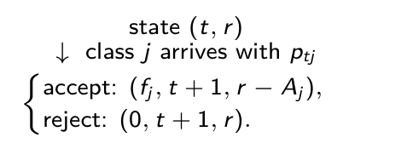

Finite-horizon network revenue management
Model element | Definition
State | Period t ∈ {1,…,T}; remaining capacity r = (r_1,…,r_m), with each r_i ∈ {0,1,…,c_i}.
Arrival | Class j arrives with probability p_tj. No arrival has probability 1 − Σ_j p_tj. At most one request arrives per period.
Action | u_j ∈ {0,1} indicates whether class j would be accepted; a_ij u_j ≤ r_i for each resource and class.
Reward and next state | Accepting class j earns f_j and moves to r − A_j; otherwise capacity remains r.
One-period MDP sketch
Adelman’s acceptance rule
Revenue today must cover the next-period value of capacity used.
Variables: t = 1, . . . , T period; i = 1, . . . , m resource; j = 1, . . . , n class; ci initial and ri remaining capacity; aij units used; Aj = (aij )i ; ptj arrival probability; uj accept indicator; fj fare; vt (r) optimal future reward.
Source: Adelman (2007), pp. 648–649, §2.1 and eqs. (1)–(2).

Slide 5
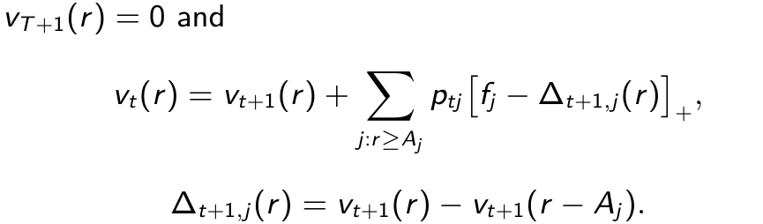
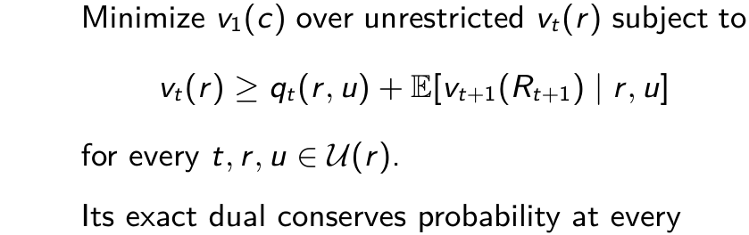

Exact MDP and its linear program
Bellman recursion
Bellman LP (D0)
For a feasible arrival, accept if
time-state pair. Complementary slackness
identifies optimal actions on occupied states.
Variables: t period; T horizon; r remaining capacity; c initial capacity; Aj class-j resource use; ptj arrival probability; fj fare; vt (r) optimal value; ∆opportunity cost; [x]+ = max(0, x); u
feasible action in U(r); qt expected reward; Rt+1 next state; E expectation.
Source: Adelman (2007), p. 649, eqs. (1)–(3); occupancy dual independently derived in backup slide A2.

Slide 6
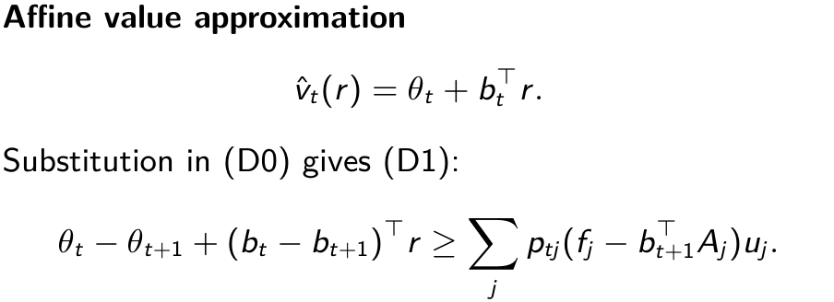
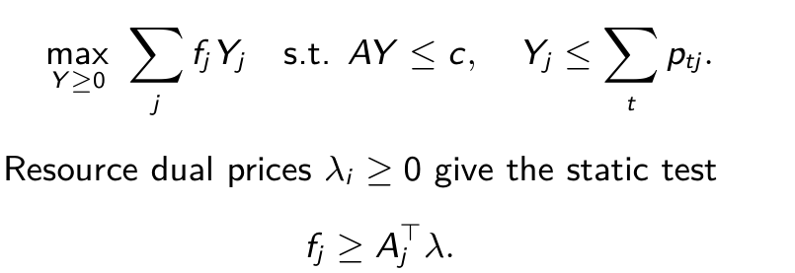
Fluid LP and affine approximate LP
Fluid LP: expected acceptances Yj
This solve aggregates demand over time.
Within one affine solve, bid prices vary by period. Re-solving can update the trajectory after capacity changes.
Variables: Yj expected acceptances; A = (aij ) resource-use matrix; c initial capacity; fj fare; ptj arrival probability; λi fluid resource dual; ˆvt affine value; θt intercept; bt resource-price vector; r
remaining capacity; uj accept indicator; t period.
Source: Adelman (2007), p. 650, eqs. (4)–(6), and p. 652, eqs. (14)–(17).

Slide 7

Two upper-bound arguments
1
1. Affine LP versus exact MDP. Every feasible D1 function satisfies the Bellman inequalities.
Backward induction bounds the exact value above. Restricting the value family cannot lower the minimum.
2. Fluid LP versus affine LP. Map feasible P1 weights X to expected class acceptances Y.
P1's moment equations give each class acceptance ≤ expected arrivals and AY ≤ c. The objectives agree.
Structural result: if every c_i > 0 and every p_tj > 0, a nonincreasing optimal price trajectory exists.
An arbitrary optimal solver output need not be monotone.
Variables: zLP fluid upper bound; zP1 affine-LP upper bound; v1(c) exact initial MDP value; Xt,r,u P1 state-action weight; Yj expected class-j acceptance; ptj arrival probability; uj accept
indicator; A resource-use matrix; bt,i resource-i slope; ci initial capacity.
Source: Adelman (2007), pp. 652–655, Theorems 1–2 and eqs. (22)–(29).

Slide 8
Published example and planned verification
Example 1: one resource, one seat, one class, f = a = 1, T = 2, and p1 = p2 = 0.5.
Formulation | Value | Evidence status
Exact MDP | 0.75 | Hand calculation; published example
Affine LP (P1) | 0.75 | Published example; reproduction planned
Fluid LP | 1.00 | Hand calculation; published example
Verification gate: independently compare exact DP, exact LP primal/dual, fluid LP, and full affine LP on this
case and a two-resource network. Test zero demand, zero capacity, terminal decisions, and infeasible arrivals.
Variables: T horizon; f fare; a resource use; pt arrival probability; vt (r) exact value at period t with remaining capacity r; P1 affine approximation; fluid LP deterministic relaxation.
Source: Adelman (2007), p. 653, Example 1. Project-generated solver results are pending.

Slide 9


Column generation and its certificate
Primary: start (P1) with feasible no-acceptance columns. Solve the restricted primary and obtain θt, bt.
Add a column when its reduced profit is positive, then re-solve. Adelman formulates the period problem as an
integer program.
Stopping certificate (Proposition 3):
ZΛ alone does not certify an upper bound on the exact MDP.
Variables: t, T period/horizon; (r, u) state/action; ptj , fj , Aj arrival probability, fare, resource use; bt , θt slopes/intercept; ρt , ρ∗
reduced profit/period maximum; ZΛ, zP1 restricted/full
primary objectives.
t
Source: Adelman (2007), pp. 650–651, Proposition 3; pp. 655–657, §4.4 and eqs. (33)–(36).

Slide 10
Proposed experiment design for IPR 3
2
Goal: Replicate Adelman’s plots and tables. Add-to as possible
Factors | Resources, horizon, load, fare spread, arrival timing, and single- versus multi-resource products. Start with exactly enumerable cases.
Comparators | Exact DP where tractable; fluid and certified affine bounds; fixed static and dynamic policies; separately labeled re-solving variants; proposed first-come feasible baseline.
Outcomes | Bound gaps, exact or estimated policy reward, paired dynamic-minus-static difference, runtime, memory, iterations, and generated columns.
Inference | Common arrival paths and predeclared seeds; report 95% intervals for each policy mean and paired difference. Use absolute gaps when exact value is zero.
Source: Adelman (2007), pp. 657–660.

Slide 11
Extension: Assessment of Adelman’s paper
Model assumption | Question to test or discuss
Known exogenous arrivals | How sensitive are policies to misspecified probabilities?
Nonreplenishing capacity | Does the intended application have reusable assets?
Affine value function | How much state dependence is lost within one solve?
Algorithm and scaling | Which claims are proved, certified, or only observed on test instances?
Published policy comparison | How much gain comes from time prices, lookahead, or re-solving?
Final evidence rule: compare bounds with exact values where possible; compare policies using exact evaluation
or paired simulation. Label published results separately from project measurements.

Slide 12
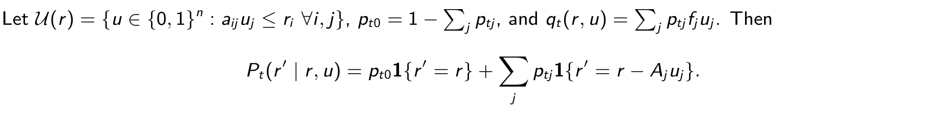

ISE 631
Adelman research
A1. Full transition and Bellman model
Initial state is c in period 1. No discount factor applies to this finite-horizon model.
Variables: t, T period and horizon; r, r′ current and next resource vectors; c initial vector; i, j, n resource, class, class count; aij , Aj class resource use; uj , U(r) accept indicator and feasible
actions; ptj , pt0 arrival/no-arrival probabilities; fj fare; qt expected reward; Pt transition; vt optimal value; 1 indicator.
Source: Adelman (2007), pp. 648–649, eq. (1); transition notation derived.

Slide 13

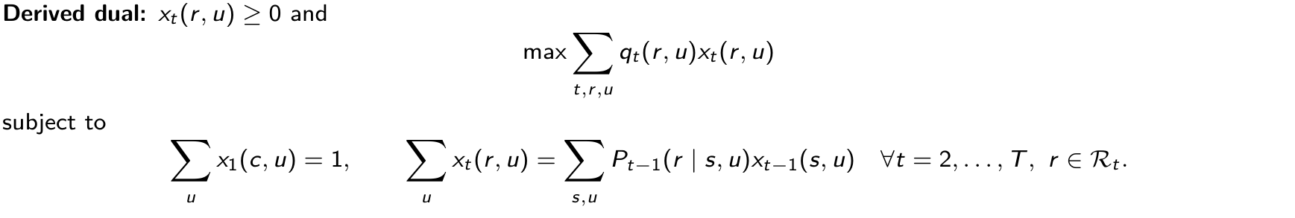
ISE 631
Adelman research
A2. Exact finite-horizon Bellman LP and occupancy dual
Strong duality gives the exact initial value. Positive xt(r, u) makes its Bellman inequality tight.
Variables: t, T period/horizon; r, s states in Rt ; u ∈U(r) feasible action; c initial state; qt expected reward; Pt transition probability; vt free value variable; xt nonnegative state-action
occupancy; vT+1 = 0 terminal value.
Source: Adelman (2007), p. 649, eq. (3); dual independently derived, not labeled P0 in the paper.

Slide 14
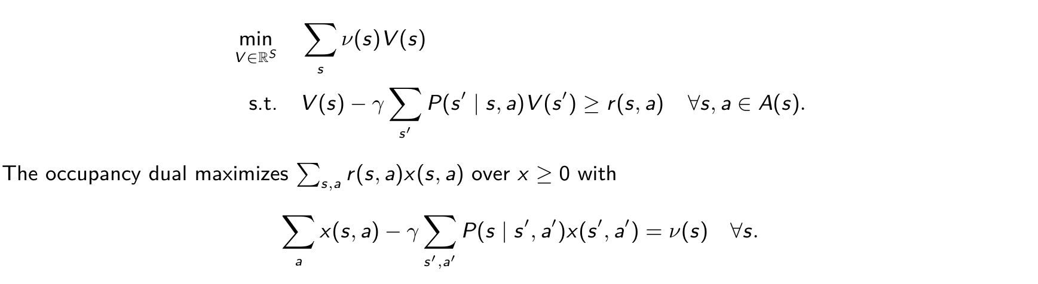
ISE 631
Adelman research
A3. Instructor’s discounted MDP LP
For finite states S, actions A(s), discount 0 ≤γ < 1, and initial weight ν ≥0:
x counts discounted visits weighted by the initial-state measure. Complementary slackness identifies optimal actions.
With positive initial weight on every state, the minimizing value vector equals the optimal value everywhere.
Variables: S state set; A(s) feasible actions; s, s′ states; a action; γ discount; ν initial state weights; V , V ∗candidate/optimal values; P transition probability; r(s, a) reward; x(s, a) discounted
occupancy.
Source: ISE 631 instructor prompt, p. 1; dual and full-support qualification derived.

Slide 15
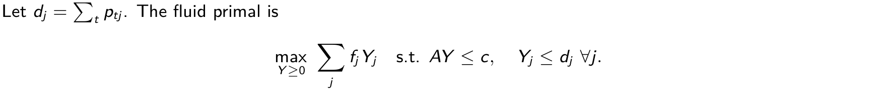
ISE 631
Adelman research
A4. Fluid primal, dual, and policy distinction
Each capacity shadow price is nonnegative. Complementary slackness characterizes primal-dual optima.
An online rule accepts when fare covers the capacity shadow cost; its policy performance needs separate evaluation.
Variables: t period; j class; dj = ∑
ptj expected demand; Yj expected acceptances; fj fare; A = (aij ) resource use; c initial capacity; λi resource dual; µj demand-cap dual.
t
Source: Adelman (2007), p. 650, eqs. (4)–(6) and displayed dual.

Slide 16

ISE 631
Adelman research
A5. Full affine Bellman LP (D1)
At period 1, use only initial capacity c; in later periods use the full remaining-capacity state set.
Terminal intercept and slopes are zero. Earlier affine coefficients are free. The program is
Theorem 2 permits a nonnegative monotone optimal selection only under its stated positive-capacity and
positive-arrival assumptions.
Variables: t = 1, . . . , T period; r ∈Rt remaining state; c initial capacity; u ∈U(r) feasible acceptance vector; θt free intercept; bt free resource slopes; ptj arrival probability; fj fare; Aj
class-j resource use.
Source: Adelman (2007), p. 652, eqs. (14), (16)–(17); Theorem 2, pp. 654–655.

Slide 17
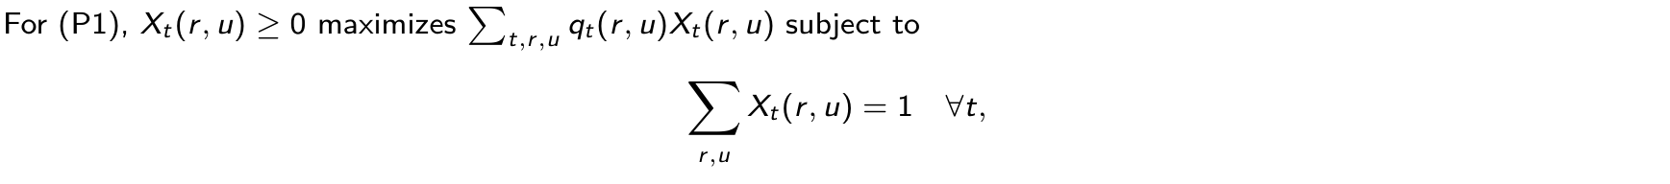
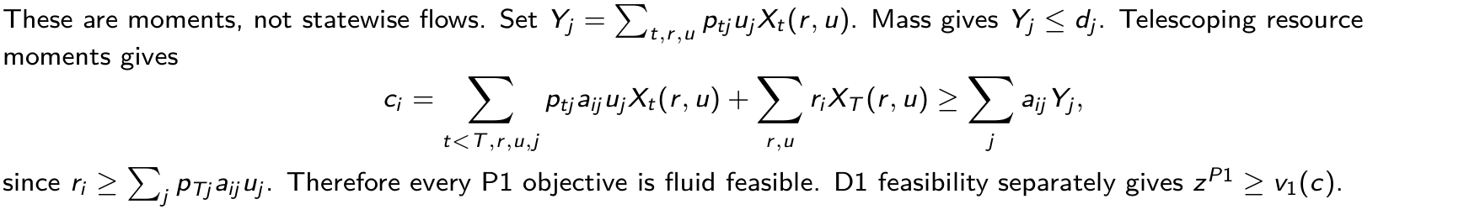
ISE 631
Adelman research
A6. Affine dual and the bound proof
Variables: t, T period/horizon; i, j resource/class; r, s remaining states; uj accept indicator; Xt (r, u) P1 weight; qt expected reward; ptj arrival probability; aij resource use; ci initial capacity;
Yj , dj expected acceptances/arrivals; zP1, v1(c) affine bound/exact value.
Source: Adelman (2007), pp. 652–653, eqs. (18)–(24), Theorem 1.

Slide 18
ISE 631
Adelman research
A7. Monotone prices: scope of Theorem 2
Under ci > 0 and ptj > 0 for every i, t, j, an optimal D1 solution exists with
The proof uses the first period with positive P1 support for a resource, complementary slackness,
and price changes that preserve feasibility and optimality.
Why “exists” matters: Example 1 admits θ₂=0, b₂=0.5, θ₁=0.75, b₁=0, with objective 0.75.
Here b₁ < b₂. Zero-demand and zero-capacity cases lie outside the theorem assumptions.
Variables: t period; i resource; j class; ci initial capacity; ptj arrival probability; bt,i affine resource price; θt affine intercept; D1/P1 are the affine primal-dual pair.
Source: Adelman (2007), pp. 653–655, eqs. (25)–(29), Theorem 2 and Corollary 1; counterexample derived.

Slide 19
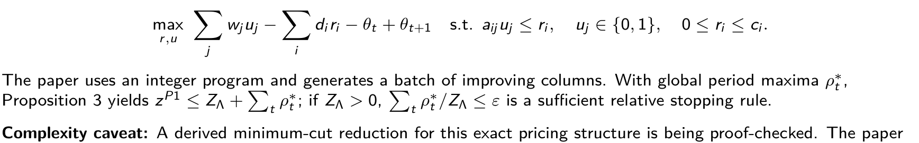
ISE 631
Adelman research
A8. Pricing, reduced costs, and stopping
For t>1, define w_j = p_tj(f_j − b_{t+1}ᵀA_j) and d_i = b_{t,i} − b_{t+1,i}. Pricing solves
itself does not claim NP-hardness or polynomial complexity.
Variables: t, T period/horizon; i, j resource/class; wj net expected class profit; di price change; ri , ci remaining/initial capacity; aij resource use; uj accept indicator; θt , bt intercept/slopes;
ρ∗
max reduced profit; ZΛ restricted-primary value; zP1 full value; ε tolerance.
t
Source: Adelman (2007), pp. 650–651, Proposition 3, and pp. 655–657, eqs. (33)–(36), Figure 2.

Slide 20
ISE 631
Adelman research
A9. Proposed experiment matrix
Block | Variation | Evidence to record
Verification | Example 1; two-resource case; edge cases | DP, exact LP and dual, fluid, full affine LP; values and residuals
Bound strength | Size, load, timing, fare | Exact V* when feasible; fluid and certified affine bounds
Policy value | Fixed and re-solved policies | Tiny-case exact value; policy and paired-difference 95% intervals
Computation | Enumeration versus columns | Runtime, memory, iterations, generated columns, pricing gaps
Truncation | Columns, states, horizon | Time saved, omitted constraints, surviving certificates
Factor levels, pilot size, final replication precision, seeds, and published replication target require approval before Phase 4
runs.

Slide 21
ISE 631
Adelman research
A10. Instructor requirements I01–I07
ID | Final part | Register | Evidence needed next
I01 | 2–4 | Planned | Discounted Bellman LP, occupancy dual, complementary slackness audit
I02 | 2 | Planned | Exact network MDP and state-growth analysis
I03 | 2–3 | Planned | Fluid primal/dual and static-policy validation
I04 | 3–5 | Planned | Source-matched affine ALP and algorithm audit
I05 | 3 | Planned | Paper method and solution approach, source-linked
I06 | 3–5 | Planned | Correct LP course-concept mapping
I07 | 4 | Planned | Principal theorem and independently reviewed proof
Draft formulas in this brief are presentation material. The register remains planned until evidence paths and a separate
reviewer are recorded.
Source: requirements.csv, I01–I07; instructor prompt, pp. 1–2.

Slide 22
ISE 631
Adelman research
A11. Instructor requirements I08–I14
ID | Final part | Register | Evidence needed next
I08 | 6 | Planned | Reproducible fluid, static, and dynamic policy tests
I09 | 3–4 | Planned | Approximation benefit with verified example
I10 | 4 | Planned | Full bound-dominance derivation and audit
I11 | 5 | Planned | Pricing formulation and qualified complexity account
I12 | 6 | Planned | Policy, exact MDP, and fluid gap results
I13 | 7 | Planned | Evidence-based critique and alternatives
I14 | 1, 5, 8 | Planned | Approved independent RQs linked to final analysis
I14 has approved questions on file, but its requirement register is not reviewed. I08 and I12 have no project numerical
results yet.
Source: requirements.csv, I08–I14; instructor prompt, p. 2.

