Slide 1
ISE 631
Adelman research
IPR 2 Decision Brief
Purpose: Confirm the Adelman mathematics, course-requirement coverage, and evidence plan for the final
presentation.
Decisions requested
Agenda today
Successful end state
• Slide 8: Proof and LP
• Progress and requirement
• Theory coverage agreed
depth?
crosswalk
• Numerical gates defined
• Slide 10: IPR 3 computation
• Exact, fluid, and affine models
• IPR 3 comparisons approved
scope?
• Bound proof and column
• Slide 11: Published
• Final narrative ordered
generation
replication target?
• Extension limits recorded
• Verification and experiment
• Slide 13: Conceptual
design
application scope?
• Final-brief scope and risks
Source: Structure follows the IPR 1 decision brief, p. 1. Status and requests are project-specific.
Adelman Project IPR 2
Herbert Jockheck
1/25

Slide 2
ISE 631
Adelman research
Final-presentation crosswalk and current status
Section | Deliverable | Status | Next action
1. Intro (I14) | Pricing motivation and approved RQs | Draft | Verify history and prevalence
2. RM (I01–I03) | Discounted LP, exact MDP, fluid LP | Draft | Audit signs and example
3. Method (I04–I06, I09) | Affine ALP, duality, decision rule | Draft | Complete formal audit
4. Proof (I07, I10) | Bound hierarchy and theorem | Draft | File independent proof audit
5. Scale (I11) | Pricing and column generation | Draft | Verify complexity and separation
6. Design (I08, I12) | Benchmarks, metrics, policies | Draft | Approve factors and baselines
6. Results (I08, I12) | Code, tables, chart, sensitivity | Not started | Pass preflight and tests
7. Critique (I13) | Assumptions and alternatives | Draft | Link claims to evidence
8. Literature (I14) | Pricing lineage and FTC context | Not started | Verify works and primary source
8. Extension (I14) | Synthetic pricing application | Blocked | Await course and human gate
9. Conclusion | Three supported takeaways | Draft | Update after results
Key:
Red Blocked
Yellow Draft
Amber Not started
Green Complete
Source: User’s final outline and project phase plan. Status describes presentation progress; formal requirements I01–I14 remain unverified in the project register.
Adelman Project IPR 2
Herbert Jockheck
2/25

Slide 3
ISE 631
Adelman research
Roadmap from IPR 1 to the final presentation
IPR 1: scope
IPR 2: theory
IPR 3: evidence
Final: synthesis
• Six approved questions
• Exact and discounted LPs
• Independent oracle
• Motivation
• LP themes
• Fluid and affine models
• Certified bounds
• Adelman result
• Verification plan
• Bound proof
• Static/dynamic policies
• Measured comparisons
• Application guardrails
• Pricing formulation
• Scaling and truncation
• Critique
• Experiment approval
• Reviewed results
• Gated application
• Limits
Current gate: Theory drafted. Formal audit, Windows solver preflight, code, and numerical results pending.
Final brief rule: every numerical chart must trace to a reviewed result. The optional application cannot displace
instructor-required theory or computation.
Source: Roadmap structure follows IPR 1 brief, p. 6; milestones follow the project phase plan.
Adelman Project IPR 2
Herbert Jockheck
3/25

Slide 4
ISE 631
Adelman research
Research scope and current progress
Question groups
Theory (RQ1–3)
What does the affine value approximation retain? Why is its bound stronger? How do
dual prices and column generation work?
Computation (RQ4–5)
How do size and truncation affect cost and quality? When do dynamic prices improve
expected reward?
Application (RQ6)
Does the resource-allocation model transfer to surveillance missions?
Formulations and proofs
Source analysis drafted; formal audit artifact pending.
Implementations and tests
Exact DP, LPs, policies, and assertions pending.
Experiments and replication
Design proposed; no project run or published-table reproduction.
Source: Six approved research questions and the project phase plan.
Adelman Project IPR 2
Herbert Jockheck
4/25

Slide 5
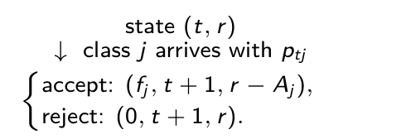

ISE 631
Adelman research
Finite-horizon network revenue management
Model element | Definition
State | Period t ∈ {1,…,T}; remaining capacity r = (r_1,…,r_m), with each r_i ∈ {0,1,…,c_i}.
Arrival | Class j arrives with probability p_tj. No arrival has probability 1 − Σ_j p_tj. At most one request arrives per period.
Action | u_j ∈ {0,1} indicates whether class j would be accepted; a_ij u_j ≤ r_i for each resource and class.
Reward and next state | Accepting class j earns f_j and moves to r − A_j; otherwise capacity remains r.
One-period MDP sketch
Adelman’s acceptance rule
Revenue today must cover the next-period value of capacity used.
Variables: t = 1, . . . , T period; i = 1, . . . , m resource; j = 1, . . . , n class; ci initial and ri remaining capacity; aij units used; Aj = (aij )i ; ptj arrival probability; uj accept indicator; fj
fare; vt (r) optimal future reward.
Source: Adelman (2007), pp. 648–649, §2.1 and eqs. (1)–(2).
Adelman Project IPR 2
Herbert Jockheck
5/25

Slide 6
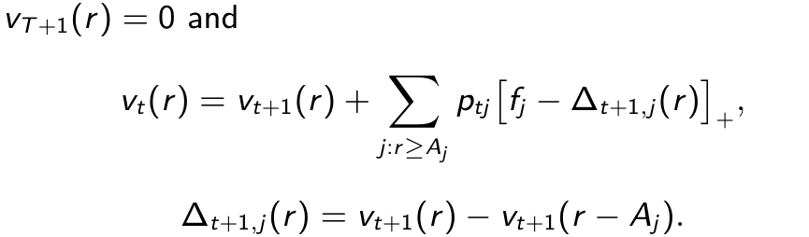
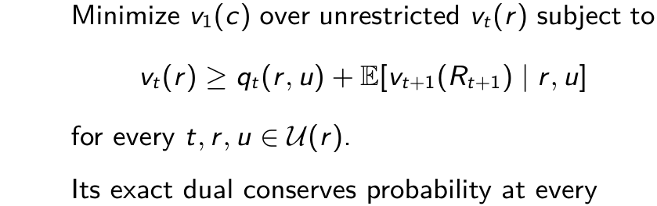

ISE 631
Adelman research
Exact MDP and its linear program
Bellman recursion
Bellman LP (D0)
For a feasible arrival, accept if
time-state pair. Complementary slackness
identifies optimal actions on occupied states.
Variables: t period; T horizon; r remaining capacity; c initial capacity; Aj class-j resource use; ptj arrival probability; fj fare; vt (r) optimal value; ∆opportunity cost; [x]+ = max(0, x); u
feasible action in U(r); qt expected reward; Rt+1 next state; E expectation.
Source: Adelman (2007), p. 649, eqs. (1)–(3); occupancy dual independently derived in backup slide A2.
Adelman Project IPR 2
Herbert Jockheck
6/25

Slide 7
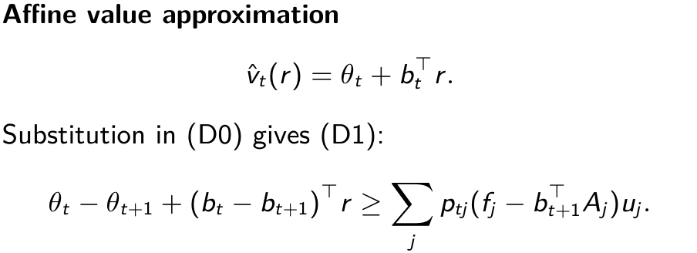
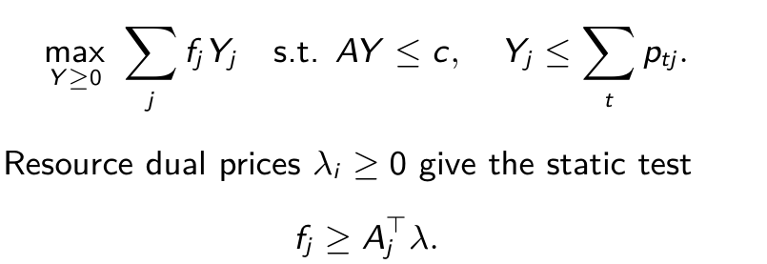
ISE 631
Adelman research
Fluid LP and affine approximate LP
Fluid LP: expected acceptances Yj
This solve aggregates demand over time.
Within one affine solve, bid prices vary by period. Re-solving can update the trajectory after capacity changes.
Variables: Yj expected acceptances; A = (aij ) resource-use matrix; c initial capacity; fj fare; ptj arrival probability; λi fluid resource dual; ˆvt affine value; θt intercept; bt resource-price vector; r
remaining capacity; uj accept indicator; t period.
Source: Adelman (2007), p. 650, eqs. (4)–(6), and p. 652, eqs. (14)–(17).
Adelman Project IPR 2
Herbert Jockheck
7/25

Slide 8

ISE 631
Adelman research
Two upper-bound arguments
1. Affine LP versus exact MDP. Every feasible D1 function satisfies the Bellman inequalities.
Backward induction bounds the exact value above. Restricting the value family cannot lower the minimum.
2. Fluid LP versus affine LP. Map feasible P1 weights X to expected class acceptances Y.
P1's moment equations give each class acceptance ≤ expected arrivals and AY ≤ c. The objectives agree.
Structural result: if every c_i > 0 and every p_tj > 0, a nonincreasing optimal price trajectory exists.
An arbitrary optimal solver output need not be monotone.
⋆Decision: Is this theorem and proof depth sufficient for the final brief?
Variables: zLP fluid upper bound; zP1 affine-LP upper bound; v1(c) exact initial MDP value; Xt,r,u P1 state-action weight; Yj expected class-j acceptance; ptj arrival probability; uj accept
indicator; A resource-use matrix; bt,i resource-i slope; ci initial capacity.
Source: Adelman (2007), pp. 652–655, Theorems 1–2 and eqs. (22)–(29).
Adelman Project IPR 2
Herbert Jockheck
8/25

Slide 9
ISE 631
Adelman research
Published example and planned verification
Example 1: one resource, one seat, one class, f = a = 1, T = 2, and p1 = p2 = 0.5.
Formulation | Value | Evidence status
Exact MDP | 0.75 | Hand calculation; published example
Affine LP (P1) | 0.75 | Published example; reproduction planned
Fluid LP | 1.00 | Hand calculation; published example
Verification gate: independently compare exact DP, exact LP primal/dual, fluid LP, and full affine LP on this
case and a two-resource network. Test zero demand, zero capacity, terminal decisions, and infeasible arrivals.
Variables: T horizon; f fare; a resource use; pt arrival probability; vt (r) exact value at period t with remaining capacity r; P1 affine approximation; fluid LP deterministic relaxation.
Source: Adelman (2007), p. 653, Example 1. Project-generated solver results are pending.
Adelman Project IPR 2
Herbert Jockheck
9/25

Slide 10


ISE 631
Adelman research
Column generation and its certificate
Primary: start (P1) with feasible no-acceptance columns. Solve the restricted primary and obtain θt, bt.
Add a column when its reduced profit is positive, then re-solve. Adelman formulates the period problem as an
integer program.
Stopping certificate (Proposition 3):
ZΛ alone does not certify an upper bound on the exact MDP.
⋆Decision: How much of the pricing and column-generation algorithm must IPR 3 implement?
Variables: t, T period/horizon; (r, u) state/action; ptj , fj , Aj arrival probability, fare, resource use; bt , θt slopes/intercept; ρt , ρ∗
reduced profit/period maximum; ZΛ, zP1 restricted/full
primary objectives.
t
Source: Adelman (2007), pp. 650–651, Proposition 3; pp. 655–657, §4.4 and eqs. (33)–(36).
Adelman Project IPR 2
Herbert Jockheck
10/25

Slide 11
ISE 631
Adelman research
Proposed experiment design for IPR 3
Factors | Resources, horizon, load, fare spread, arrival timing, and single- versus multi-resource products. Start with exactly enumerable cases.
Comparators | Exact DP where tractable; fluid and certified affine bounds; fixed static and dynamic policies; separately labeled re-solving variants; proposed first-come feasible baseline.
Outcomes | Bound gaps, exact or estimated policy reward, paired dynamic-minus-static difference, runtime, memory, iterations, and generated columns.
Inference | Common arrival paths and predeclared seeds; report 95% intervals for each policy mean and paired difference. Use absolute gaps when exact value is zero.
Truncation study: record which state, column, or horizon restriction is used and whether a valid pricing
certificate survives.
⋆Decision: Which published result and comparison protocol should IPR 3 target?
Source: Proposed design; no project experiment has run. Adelman (2007), pp. 657–660, supplies comparison context.
Adelman Project IPR 2
Herbert Jockheck
11/25

Slide 12
ISE 631
Adelman research
Critical appraisal for the final presentation
Model assumption | Question to test or disclose
Known exogenous arrivals | How sensitive are policies to misspecified probabilities?
Nonreplenishing capacity | Does the intended application have reusable assets?
Affine value function | How much state dependence is lost within one solve?
Algorithm and scaling | Which claims are proved, certified, or only observed on test instances?
Published policy comparison | How much gain comes from time prices, lookahead, or re-solving?
Final evidence rule: compare bounds with exact values where possible; compare policies using exact evaluation
or paired simulation. Label published results separately from project measurements.
Source: Reviewer-style questions derived from Adelman (2007), §§2–5; empirical answers remain pending.
Adelman Project IPR 2
Herbert Jockheck
12/25

Slide 13
ISE 631
Adelman research
Adelman and individualized pricing: a research lineage
Distinct mechanisms
Adelman (2007) estimates an internal capacity opportunity cost. Personalized pricing also models how an
individual responds to an offered price.
Research thread | Candidate references supplied for verification
Customer choice and related methods | Zhang and Adelman (2009); Barz et al. (2023); Hausenblas et al. (2025)
Individualized pricing | Jahandideh et al. (2020); Lei et al. (2023/2025)
Parallel personalization line | Acquisti and Varian (2005); Aydin and Ziya (2009); Ban and Keskin (2021)
Policy context | FTC inquiry (January 2025): consumer data in individualized pricing
Evidence boundary: these are reading leads, not yet source-checked for this project. A citation trail does not
establish that Adelman created surveillance-pricing systems.
⋆Decision: Is a conceptual, source-checked connection sufficient for the final brief?
Source: Adelman (2007), pp. 647–648; subsequent works and FTC item supplied by the researcher, pending source verification.
Adelman Project IPR 2
Herbert Jockheck
13/25

Slide 14
ISE 631
Adelman research
IPR 3 gates and decisions requested
Next evidence gate | Source-linked proof notes; exact DP and LP agreement; fluid/static tests; full small affine LP; pricing versus exhaustive search; paired policy comparisons.
★ Proof (8) | Is the theorem and LP treatment sufficient for the final brief?
★ Algorithm (10) | How much pricing and column generation must IPR 3 implement?
★ Evidence (11) | Which published result and comparison protocol should IPR 3 target?
★ Application (13) | Is a conceptual, source-checked connection sufficient?
Source: ISE 631 course prompt, p. 2; project phase plan.
Adelman Project IPR 2
Herbert Jockheck
14/25

Slide 15
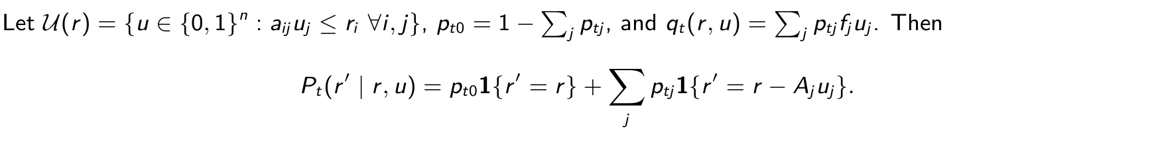

ISE 631
Adelman research
A1. Full transition and Bellman model
Initial state is c in period 1. No discount factor applies to this finite-horizon model.
Variables: t, T period and horizon; r, r′ current and next resource vectors; c initial vector; i, j, n resource, class, class count; aij , Aj class resource use; uj , U(r) accept indicator and feasible
actions; ptj , pt0 arrival/no-arrival probabilities; fj fare; qt expected reward; Pt transition; vt optimal value; 1 indicator.
Source: Adelman (2007), pp. 648–649, eq. (1); transition notation derived.
Adelman Project IPR 2
Herbert Jockheck
15/25

Slide 16

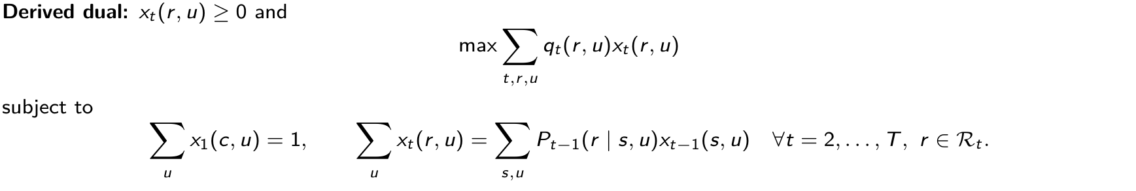
ISE 631
Adelman research
A2. Exact finite-horizon Bellman LP and occupancy dual
Strong duality gives the exact initial value. Positive xt(r, u) makes its Bellman inequality tight.
Variables: t, T period/horizon; r, s states in Rt ; u ∈U(r) feasible action; c initial state; qt expected reward; Pt transition probability; vt free value variable; xt nonnegative state-action
occupancy; vT+1 = 0 terminal value.
Source: Adelman (2007), p. 649, eq. (3); dual independently derived, not labeled P0 in the paper.
Adelman Project IPR 2
Herbert Jockheck
16/25

Slide 17
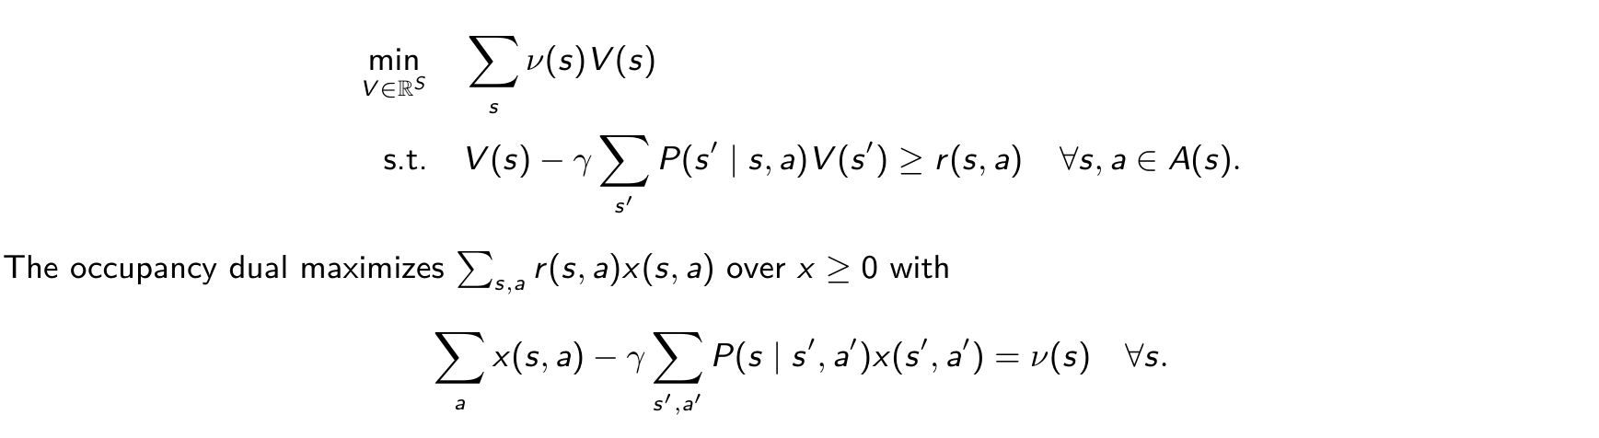
ISE 631
Adelman research
A3. Instructor’s discounted MDP LP
For finite states S, actions A(s), discount 0 ≤γ < 1, and initial weight ν ≥0:
x counts discounted visits weighted by the initial-state measure. Complementary slackness identifies optimal actions.
With positive initial weight on every state, the minimizing value vector equals the optimal value everywhere.
Variables: S state set; A(s) feasible actions; s, s′ states; a action; γ discount; ν initial state weights; V , V ∗candidate/optimal values; P transition probability; r(s, a) reward; x(s, a) discounted
occupancy.
Source: ISE 631 instructor prompt, p. 1; dual and full-support qualification derived.
Adelman Project IPR 2
Herbert Jockheck
17/25

Slide 18
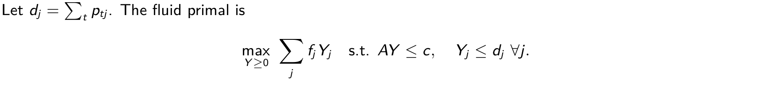
ISE 631
Adelman research
A4. Fluid primal, dual, and policy distinction
Each capacity shadow price is nonnegative. Complementary slackness characterizes primal-dual optima.
An online rule accepts when fare covers the capacity shadow cost; its policy performance needs separate evaluation.
Variables: t period; j class; dj = ∑
ptj expected demand; Yj expected acceptances; fj fare; A = (aij ) resource use; c initial capacity; λi resource dual; µj demand-cap dual.
t
Source: Adelman (2007), p. 650, eqs. (4)–(6) and displayed dual.
Adelman Project IPR 2
Herbert Jockheck
18/25

Slide 19

ISE 631
Adelman research
A5. Full affine Bellman LP (D1)
At period 1, use only initial capacity c; in later periods use the full remaining-capacity state set.
Terminal intercept and slopes are zero. Earlier affine coefficients are free. The program is
Theorem 2 permits a nonnegative monotone optimal selection only under its stated positive-capacity and
positive-arrival assumptions.
Variables: t = 1, . . . , T period; r ∈Rt remaining state; c initial capacity; u ∈U(r) feasible acceptance vector; θt free intercept; bt free resource slopes; ptj arrival probability; fj fare; Aj
class-j resource use.
Source: Adelman (2007), p. 652, eqs. (14), (16)–(17); Theorem 2, pp. 654–655.
Adelman Project IPR 2
Herbert Jockheck
19/25

Slide 20
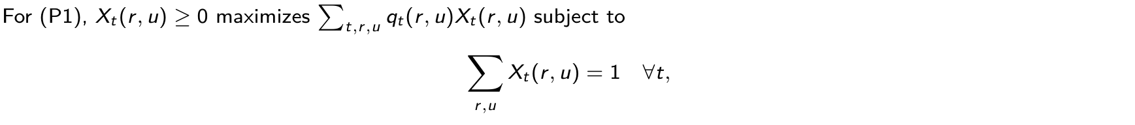
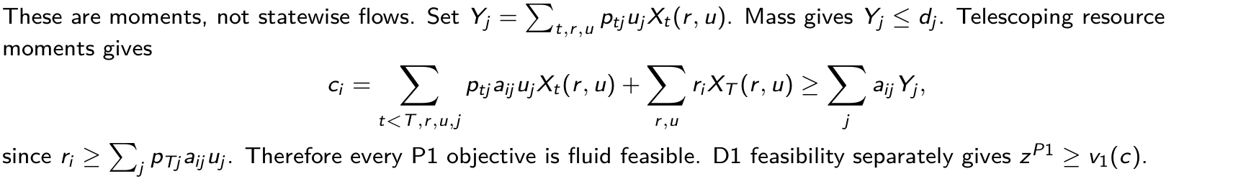
ISE 631
Adelman research
A6. Affine dual and the bound proof
Variables: t, T period/horizon; i, j resource/class; r, s remaining states; uj accept indicator; Xt (r, u) P1 weight; qt expected reward; ptj arrival probability; aij resource use; ci initial capacity;
Yj , dj expected acceptances/arrivals; zP1, v1(c) affine bound/exact value.
Source: Adelman (2007), pp. 652–653, eqs. (18)–(24), Theorem 1.
Adelman Project IPR 2
Herbert Jockheck
20/25

Slide 21
ISE 631
Adelman research
A7. Monotone prices: scope of Theorem 2
Under ci > 0 and ptj > 0 for every i, t, j, an optimal D1 solution exists with
The proof uses the first period with positive P1 support for a resource, complementary slackness,
and price changes that preserve feasibility and optimality.
Why “exists” matters: Example 1 admits θ₂=0, b₂=0.5, θ₁=0.75, b₁=0, with objective 0.75.
Here b₁ < b₂. Zero-demand and zero-capacity cases lie outside the theorem assumptions.
Variables: t period; i resource; j class; ci initial capacity; ptj arrival probability; bt,i affine resource price; θt affine intercept; D1/P1 are the affine primal-dual pair.
Source: Adelman (2007), pp. 653–655, eqs. (25)–(29), Theorem 2 and Corollary 1; counterexample derived.
Adelman Project IPR 2
Herbert Jockheck
21/25

Slide 22
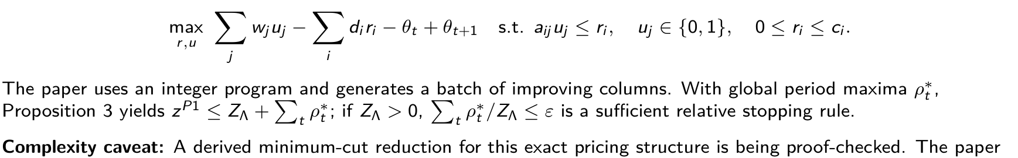
ISE 631
Adelman research
A8. Pricing, reduced costs, and stopping
For t>1, define w_j = p_tj(f_j − b_{t+1}ᵀA_j) and d_i = b_{t,i} − b_{t+1,i}. Pricing solves
itself does not claim NP-hardness or polynomial complexity.
Variables: t, T period/horizon; i, j resource/class; wj net expected class profit; di price change; ri , ci remaining/initial capacity; aij resource use; uj accept indicator; θt , bt intercept/slopes;
ρ∗
max reduced profit; ZΛ restricted-primary value; zP1 full value; ε tolerance.
t
Source: Adelman (2007), pp. 650–651, Proposition 3, and pp. 655–657, eqs. (33)–(36), Figure 2.
Adelman Project IPR 2
Herbert Jockheck
22/25

Slide 23
ISE 631
Adelman research
A9. Proposed experiment matrix
Block | Variation | Evidence to record
Verification | Example 1; two-resource case; edge cases | DP, exact LP and dual, fluid, full affine LP; values and residuals
Bound strength | Size, load, timing, fare | Exact V* when feasible; fluid and certified affine bounds
Policy value | Fixed and re-solved policies | Tiny-case exact value; policy and paired-difference 95% intervals
Computation | Enumeration versus columns | Runtime, memory, iterations, generated columns, pricing gaps
Truncation | Columns, states, horizon | Time saved, omitted constraints, surviving certificates
Factor levels, pilot size, final replication precision, seeds, and published replication target require approval before Phase 4
runs.
Source: Project experiment design proposal; no project experimental results.
Adelman Project IPR 2
Herbert Jockheck
23/25

Slide 24
ISE 631
Adelman research
A10. Instructor requirements I01–I07
ID | Final part | Register | Evidence needed next
I01 | 2–4 | Planned | Discounted Bellman LP, occupancy dual, complementary slackness audit
I02 | 2 | Planned | Exact network MDP and state-growth analysis
I03 | 2–3 | Planned | Fluid primal/dual and static-policy validation
I04 | 3–5 | Planned | Source-matched affine ALP and algorithm audit
I05 | 3 | Planned | Paper method and solution approach, source-linked
I06 | 3–5 | Planned | Correct LP course-concept mapping
I07 | 4 | Planned | Principal theorem and independently reviewed proof
Draft formulas in this brief are presentation material. The register remains planned until evidence paths and a separate
reviewer are recorded.
Source: requirements.csv, I01–I07; instructor prompt, pp. 1–2.
Adelman Project IPR 2
Herbert Jockheck
24/25

Slide 25
ISE 631
Adelman research
A11. Instructor requirements I08–I14
ID | Final part | Register | Evidence needed next
I08 | 6 | Planned | Reproducible fluid, static, and dynamic policy tests
I09 | 3–4 | Planned | Approximation benefit with verified example
I10 | 4 | Planned | Full bound-dominance derivation and audit
I11 | 5 | Planned | Pricing formulation and qualified complexity account
I12 | 6 | Planned | Policy, exact MDP, and fluid gap results
I13 | 7 | Planned | Evidence-based critique and alternatives
I14 | 1, 5, 8 | Planned | Approved independent RQs linked to final analysis
I14 has approved questions on file, but its requirement register is not reviewed. I08 and I12 have no project numerical
results yet.
Source: requirements.csv, I08–I14; instructor prompt, p. 2.
Adelman Project IPR 2
Herbert Jockheck
25/25

