Slide 1
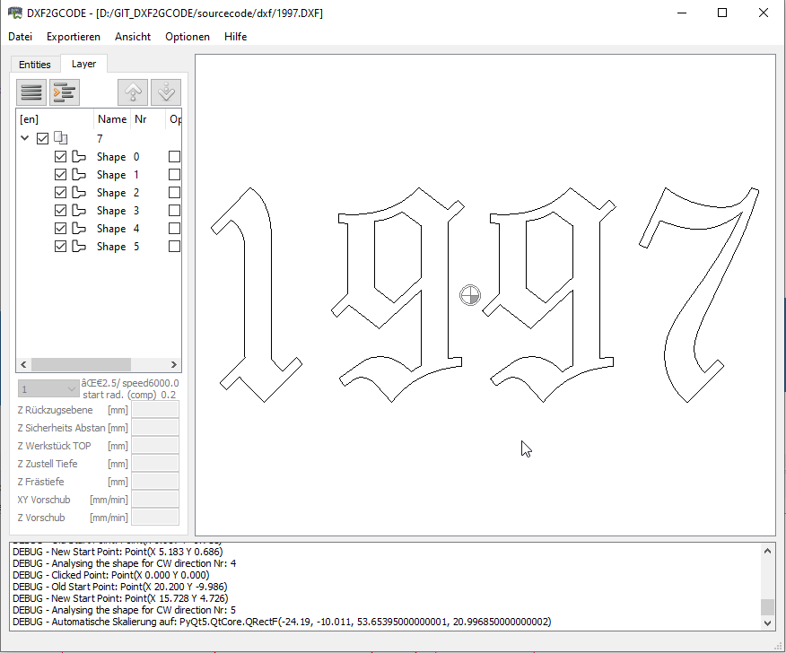
Window Menu
Tab Menu
Tab Group
Canvas Area
Textbox

Slide 2
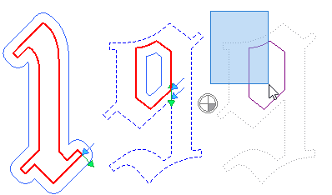
Selection area
Shape
Cutting direction
Selected Shape
Offset direction
Disabled Shape
Offsetted Shape
Selected disabled Shape

