Slide 1
fabric
presentation by Joe Cosenza

Slide 2

introduction
Developed by Twitter
Designed for SDK integration to create mobile applications
Provides tools and libraries to integrate Twitter-type features into the user’s mobile application
The mission statement of fabric is to solve the challenges developers face: stability, distribution, revenue and identity

Slide 3
features
fabric has four main features
Crashlytics Kit
Supports iOS and Android
Twitter Kit
Supports Android and iOS SDKs
MoPub Kit
Mobile app business tracking product
Digits
Twitter identity/sign-on tools

Slide 4
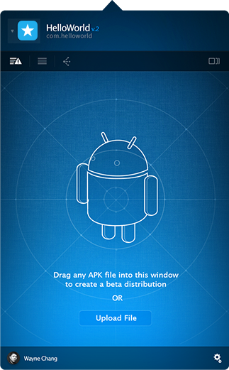
crashlytics
A system for tracking app usage
User interaction
Crashes
Provisions
Defensive reporting
Stack unwinding
Mach exceptions
Uncaught/caught exception reporting
Fully automated deobufuscation
Supports Android NDK for Android developers
Kits include
crashytics
crashlytics (beta)
Provides cross-platform support for iOS and Android
Tracks tests from multiple users and developers
crashlytics Answers
Supports integration with many IDE’s such as Xcode, Android Studio, Eclipse, and IntelliJ

Slide 5
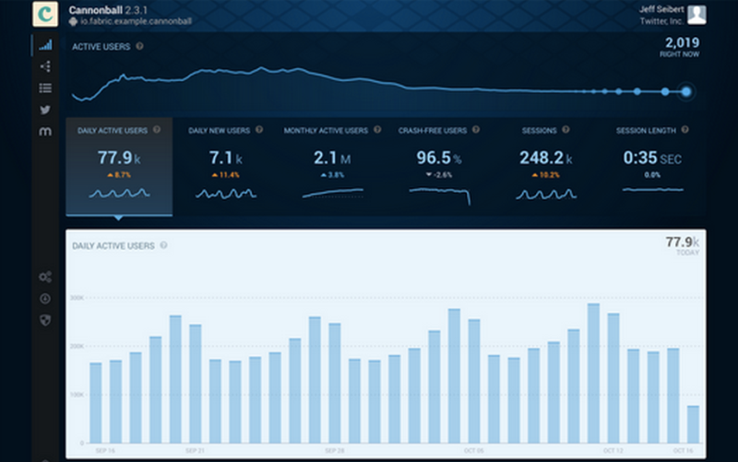
crashlytics (screenshot)

Slide 6
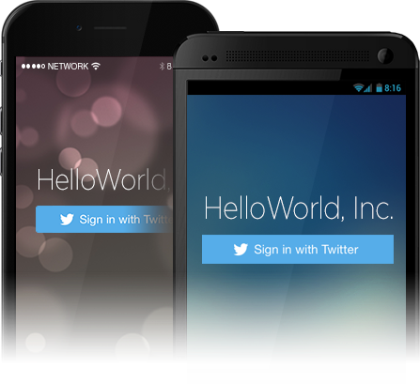
twitter kit
Allows easy integration of twitter into the developer’s application
Biggest feature: Users can use their Twitter account to sign into the application
Supports user sign in, user tweet, real-time public tweet access, keyword searching etc.
Lets developers access Twitter content/services including their APIs and SDKs

Slide 7
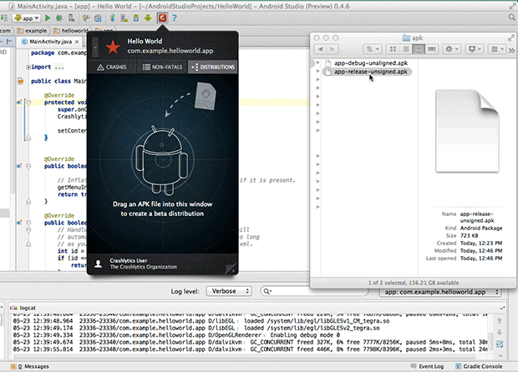

Slide 8
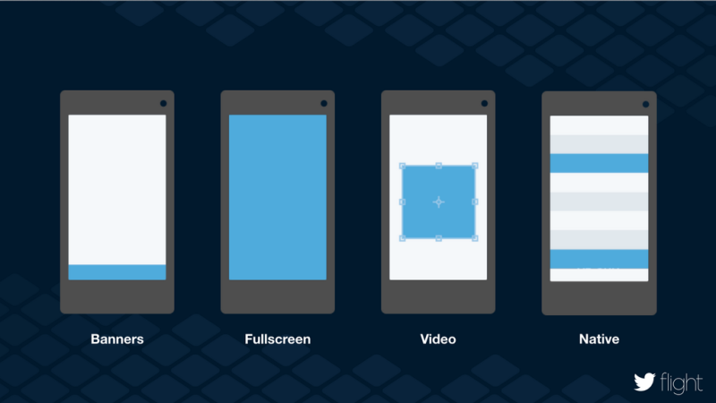
MoPub
MoPub is basically an easy to use advertisement manager to integrate advertisements into your application
Supports Google based advertisements, imported from third party companies
Main purpose is to generate advertisement income for the developer

Slide 9
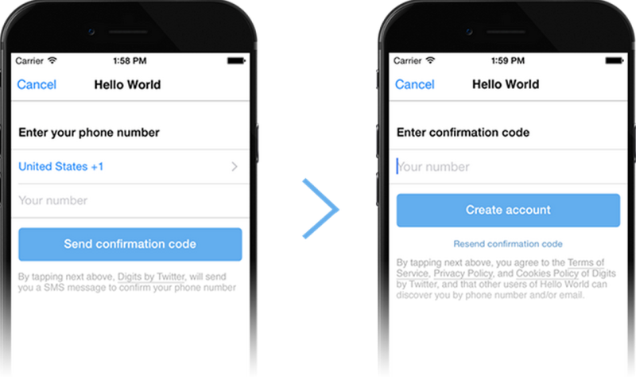
digits
Digits allows users to sign on and create accounts on the application using their phone number rather than a social account or email
Easier and more accessible to users who do not use social media or email as their main form of communication thus including a larger consumer base
“Twitter created digits because the state of the login ecosystem is so dysfunctional” –Jeff Seibert, fabric Director of Product.

Slide 10
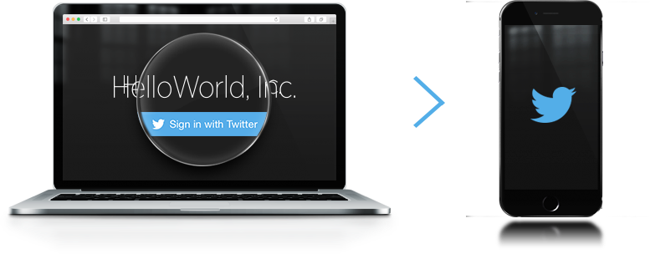
conclusion
Twitter-Out your mobile app with fabric
fabric provides developers with the “tools of Twitter” to boost downloads, popularity and revenue… This also applies to Twitter, by heavily utilizing their services
If you’re interested, fabric is free to obtain at http://get.fabric.io
More information can be found at https://blog.twitter.com/2014/introducing-fabric

