Slide 1
AIMSIGH · GOODWILL MICHIANA
From report chasing
to a clearer daily picture.
Teach a workflow once. Keep the proof. Put answers beside the dashboard.
COLLECT → VERIFY & DELIVER → UNDERSTAND
Sources: DEMO · PITCH | AIMSIGH / 01
Notes:
Introduce Aimsigh as our local prototype for Goodwill. All displayed records are synthetic. Labor and shipping inputs are invented demonstration assumptions. The live showcase has no external model or production Teams connection.
Segment: The problem · 20 seconds
DEMO PLAN · reviewed October 4, 2026
https://docs.google.com/document/d/1jhTiJcOi1yoRKHGe-WMquckIWISXWdzmWe6NV3tbdFk/edit
Aimsigh founder presentation · reference and nonbinding LOI context
https://docs.google.com/presentation/d/1z-6jdYtqZ3t0SwIbbGc7pAyQ7cWptPXiYY-Tj7PNGLM/edit

Slide 2
START WITH THE PEOPLE
The dashboard problem
starts before the dashboard.
Amanda needs reports to arrive. Debie needs dependable visibility. Manual retrieval and consolidation connect the two.
Amanda
The handoff
The commitment
Upright is the repeated, date-changing task. Her 30–45 minute estimate includes interruptions.
Reports feed Excel, Sonia’s summary and existing Power BI. Compatible delivery matters.
Amanda’s nonbinding LOI expresses interest. Access, a pilot and purchase are not approved.
Sources: AMANDA · FOLLOWUP · PITCH | AIMSIGH / 02
Notes:
We spoke with operational stakeholders and technical mentors rather than starting with charts. Amanda now has an assistant; support cannot depend on the departed e-commerce manager. Cite the interview estimate, not measured savings. The founder deck describes nonbinding interest; do not imply that the scanned LOI establishes a purchased or authorized production pilot.
Segment: The problem · 65 seconds
Amanda Baumer interview · reported workflow and effort estimate
https://drive.google.com/file/d/1WM1HJVAu_YF-Q48CQDa7SFwnPKg1FPlF/view
Amanda2.0 · staffing correction
https://docs.google.com/document/d/1yveSPTDJ4PUVi1MjMvCP6ovVtyVy-M7UGOeDdDngz7g/edit
Aimsigh founder presentation · reference and nonbinding LOI context
https://docs.google.com/presentation/d/1z-6jdYtqZ3t0SwIbbGc7pAyQ7cWptPXiYY-Tj7PNGLM/edit

Slide 3
NINE REPORTS · REUSABLE ACQUISITION CLASSES
Bring fragmented reports
into a controlled workflow.
Share acquisition mechanisms. Keep source meaning, parsing and overlap rules specific.
Upright · connected local replica
Cash Monkey · connected local replica
Jewelry · fixture / access pending
Paid-order sales · portal initiation
Unit/order sales · portal CSV export
Provided report · mappings unconfirmed
OSM / PB / EasyPost · fixture / access pending
FedEx · fixture / access pending
ShopGoodwill · fixture / access pending
Shipping expenses · export or lookup
Charges and refunds · expense control
Marketplace report · overlap review
Goodwill Books · fixture / access pending
eBay · fixture / access pending
Amazon · fixture / access pending
Monthly statement · settlement control
Marketplace report · overlap review
Payment summary · settlement control
Sources: PLAN · BRIEF | AIMSIGH / 03
Notes:
Nine reports are not nine revenue feeds. Upright and Cash Monkey are connected local replicas. Jewelry, shipping expenses, marketplace reports and settlement summaries have different meanings. The other seven are fixture examples or await approved access. We do not sum their amounts into our showcase revenue.
Segment: The problem · 35 seconds
Goodwill three-phase solution · corrected technical synthesis
https://drive.google.com/file/d/1RffkmafbqbMEs7o_lNaTvIRL3hW9paai/view
Corrected Goodwill track brief
https://drive.google.com/file/d/1o0QBoew17f7IgEEHweBoe-VLQFGDEatg/view

Slide 4
01 · COLLECT
Teach the task once.
Change the dates next time.
Reports → Paid orders → Dates → Generate → Ready → Download.
Record
Review
Replay
Actual local DOM actions and date parameters.
A bounded recipe with an explicit operator approval.
Real browser execution and a verified CSV artifact.
Sources: DEMO · AMANDA · PLAN | AIMSIGH / 04
Notes:
Open the live showcase Collect view. This is a screenshot-informed, functioning simulated portal. Restricted Upright API access is reported; the commercial reason is not confirmed. We are not bypassing a provider restriction. Model-free replay is distinct from optional probabilistic Jev decisions.
Segment: Collect · 25 seconds
DEMO PLAN · reviewed October 4, 2026
https://docs.google.com/document/d/1jhTiJcOi1yoRKHGe-WMquckIWISXWdzmWe6NV3tbdFk/edit
Amanda Baumer interview · reported workflow and effort estimate
https://drive.google.com/file/d/1WM1HJVAu_YF-Q48CQDa7SFwnPKg1FPlF/view
Goodwill three-phase solution · corrected technical synthesis
https://drive.google.com/file/d/1RffkmafbqbMEs7o_lNaTvIRL3hW9paai/view

Slide 5
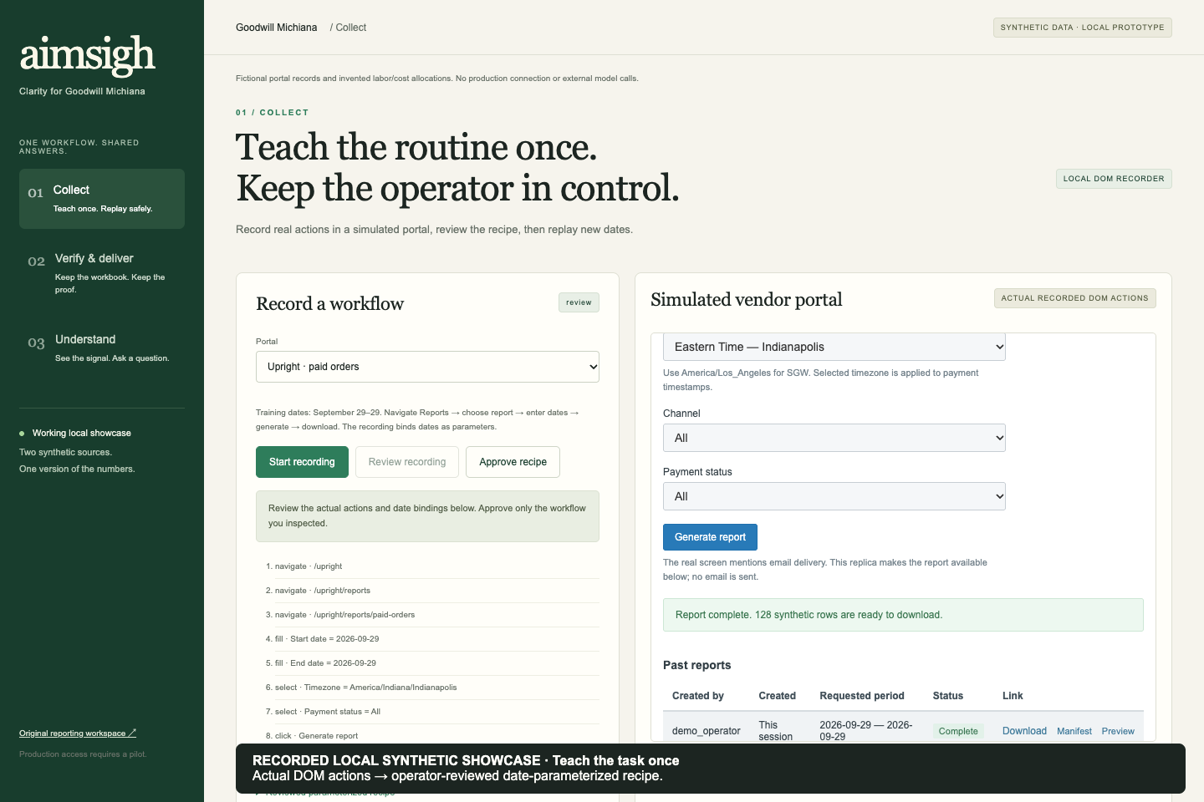
LIVE · RECORD AND REVIEW
Amanda shows
the workflow.
Record September 29. Review the captured actions. Approve the recipe before replay.
Actual local recorder and simulated portal
Sources: DEMO · CONTRACT | AIMSIGH / 05
Notes:
Perform the task in the embedded portal: navigate to the report, fill both dates, generate, wait for ready and download. Stop recording and review accessible control labels and parameter bindings. Approve the recipe. The recording is captured from user actions; it is not a video presented as a recorder. If the live state is unavailable, identify this screenshot as a previously verified capture.
Segment: Collect · 110 seconds
DEMO PLAN · reviewed October 4, 2026
https://docs.google.com/document/d/1jhTiJcOi1yoRKHGe-WMquckIWISXWdzmWe6NV3tbdFk/edit
Approved showcase-v1 interfaces and sample definitions
https://github.com/joconne8/sprinthack-nd-2026/blob/peyton/aimsigh-showcase/reports/SHOWCASE/CONTRACT.md

Slide 6
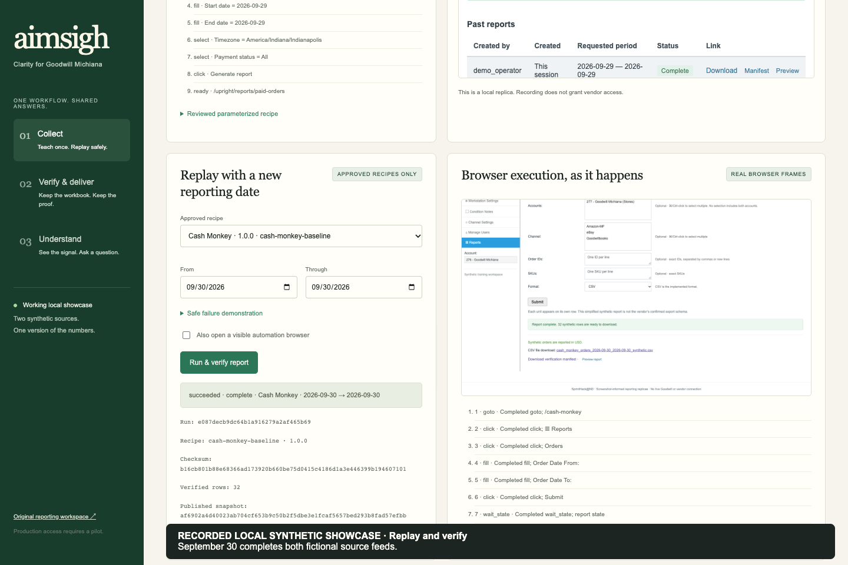
LIVE · TWO IMPLEMENTED SOURCES
New dates.
The same reviewed task.
Replay September 30 for Upright, then Cash Monkey. Watch genuine browser frames and import evidence.
Actual replay frames and verified collection result
Sources: DEMO · CONTRACT | AIMSIGH / 06
Notes:
The rehearsal is already seeded through September 29. September 30 collection completes the month. Explain collection, verification, import and publication as separate states. Source records are explicitly disjoint in this fictional sample; this is not a claim that real marketplace reports never overlap. Cash Monkey unit rows and order counts retain their separate grains.
Segment: Collect · 70 seconds
DEMO PLAN · reviewed October 4, 2026
https://docs.google.com/document/d/1jhTiJcOi1yoRKHGe-WMquckIWISXWdzmWe6NV3tbdFk/edit
Approved showcase-v1 interfaces and sample definitions
https://github.com/joconne8/sprinthack-nd-2026/blob/peyton/aimsigh-showcase/reports/SHOWCASE/CONTRACT.md

Slide 7
CONTROLLED FAILURE
A changed page
needs an explicit decision.
A mismatched control stops replay. The operator reviews and approves a new recipe. Last-good data stays available.
Bounded execution
No bad publication
Jev is conditional
Known local destinations and permitted operations.
Wrong dates, missing reports or failed checks cannot become new financial totals.
Probabilistic decision adapter is a future approved option. Main demo is model-free.
Sources: PLAN · JEV | AIMSIGH / 07
Notes:
Demonstrate changed-label mode if time permits, then show the reviewed repair path. Do not claim that automation works forever or that typed AI output is financially correct. A separate scripted Jev mockup is not a real model call. No credentials or provider approval have been assumed.
Segment: Collect · 35 seconds
Goodwill three-phase solution · corrected technical synthesis
https://drive.google.com/file/d/1RffkmafbqbMEs7o_lNaTvIRL3hW9paai/view
TypeSafe · Jev probabilistic structured decisions
https://typesafe.ai/blog/introducing-system-one-models-and-jev

Slide 8
02 · VERIFY & DELIVER
One published snapshot.
Every result keeps its lineage.
Raw file → staging → versioned sales → published rows → snapshot → workbook, charts and answers.
Raw CSV → Typed staging → Versioned sales → Published snapshot → Excel + answers
Original report
Published records
Showcase snapshot
source_files.id / checksum
import_batches.file_id
staging_rows.batch_id + row_number
sale_versions.id / record_key
metric_runs.id
metric_run_rows.run_id + version_id
Source publication identifiers
Versioned labor / shipping inputs
Scope, coverage and checksums
Sources: PLAN · CONTRACT | AIMSIGH / 08
Notes:
This diagram reflects the actual Python/SQLite implementation. source_files archive checksummed bytes; import_batches and staging_rows retain reconciliation; sale_versions and metric_run_rows pin published records. Showcase snapshots pin both source publications and versioned labor/shipping inputs. A hosted PostgreSQL system is a future deployment choice, not what is running here.
Segment: Verify & deliver · 50 seconds
Goodwill three-phase solution · corrected technical synthesis
https://drive.google.com/file/d/1RffkmafbqbMEs7o_lNaTvIRL3hW9paai/view
Approved showcase-v1 interfaces and sample definitions
https://github.com/joconne8/sprinthack-nd-2026/blob/peyton/aimsigh-showcase/reports/SHOWCASE/CONTRACT.md

Slide 9
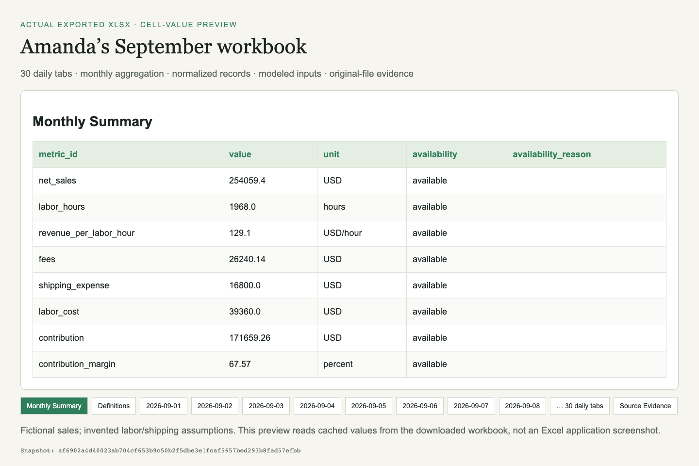
LIVE · THE FAMILIAR OUTPUT
Give Amanda
a usable workbook.
A monthly summary, 30 daily tabs, normalized records, modeled inputs and source evidence—all from the same snapshot.
Preview rendered from the actual exported XLSX values
Sources: DEMO · AMANDA · CONTRACT | AIMSIGH / 09
Notes:
Download the workbook from the application. Open it in Excel if available or use the supplied preview, which reads the real exported OOXML cells. Show the monthly summary, a daily tab and source evidence. Backend calculations and cached workbook values reconcile. This output is not the approved month-end allocation workbook or a Business Central posting file. CSV plus a dictionary offers a bridge to existing Power BI.
Segment: Verify & deliver · 90 seconds
DEMO PLAN · reviewed October 4, 2026
https://docs.google.com/document/d/1jhTiJcOi1yoRKHGe-WMquckIWISXWdzmWe6NV3tbdFk/edit
Amanda Baumer interview · reported workflow and effort estimate
https://drive.google.com/file/d/1WM1HJVAu_YF-Q48CQDa7SFwnPKg1FPlF/view
Approved showcase-v1 interfaces and sample definitions
https://github.com/joconne8/sprinthack-nd-2026/blob/peyton/aimsigh-showcase/reports/SHOWCASE/CONTRACT.md

Slide 10
DEFINITIONS BEFORE CLAIMS
Sales are measured.
The model is disclosed.
Demo net sales = item sales − refunds. Shipping collected, taxes and fees are excluded from that metric.
Labor assumptions
Cost assumptions
Contribution margin
Upright: 2 h/store/day, then 3 h from Sept 24. Cash Monkey: 0.5 h/store/day.
Source fees; invented $3.50 shipping/record and $20/h labor.
Net sales less fees, modeled shipping and labor. Excludes overhead and taxes.
Sources: PLAN · CONTRACT | AIMSIGH / 10
Notes:
Missing inputs remain unavailable. Contribution margin is a demonstration measure, not approved production net margin. Labor is allocated by source/store/day, not platform; a platform filter therefore makes labor-dependent metrics unavailable. Distinct customers retain supported source/platform scopes. The August inventory example is separately dated and is never joined to these September sales.
Segment: Verify & deliver · 40 seconds
Goodwill three-phase solution · corrected technical synthesis
https://drive.google.com/file/d/1RffkmafbqbMEs7o_lNaTvIRL3hW9paai/view
Approved showcase-v1 interfaces and sample definitions
https://github.com/joconne8/sprinthack-nd-2026/blob/peyton/aimsigh-showcase/reports/SHOWCASE/CONTRACT.md

Slide 11
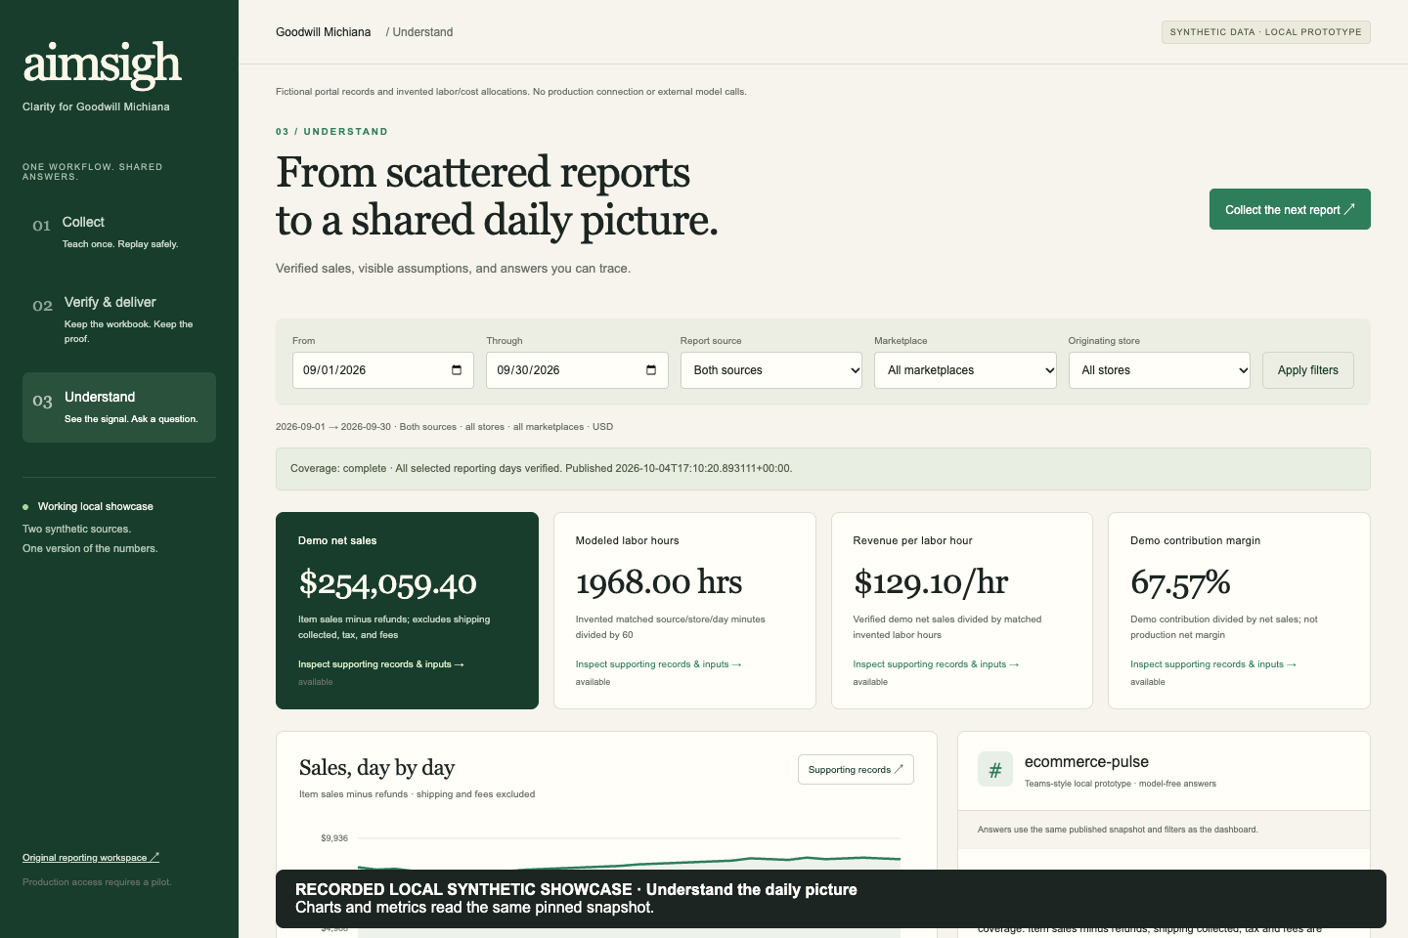
03 · UNDERSTAND
The charts follow
the verified data.
Daily trends, source and store breakdowns, productivity, coverage and freshness share the selected snapshot.
Actual API-backed September showcase dashboard
Sources: BRIEF · CONTRACT | AIMSIGH / 11
Notes:
Open Understand. Change a source or store filter and show the chart/cards/evidence updating together. Explain what the chart can and cannot establish. September sell-through, year-over-year growth and production net margin remain unavailable without their required inputs. Inventory examples use their own August view. This is our local dashboard, not a native Power BI or Superset deployment.
Segment: Understand · 90 seconds
Corrected Goodwill track brief
https://drive.google.com/file/d/1o0QBoew17f7IgEEHweBoe-VLQFGDEatg/view
Approved showcase-v1 interfaces and sample definitions
https://github.com/joconne8/sprinthack-nd-2026/blob/peyton/aimsigh-showcase/reports/SHOWCASE/CONTRACT.md

Slide 12
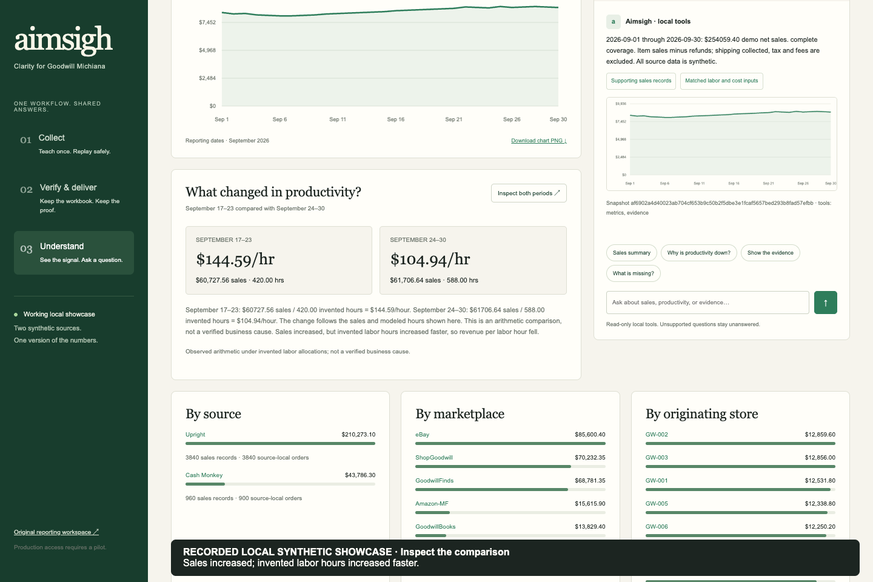
LIVE · A COMPARISON YOU CAN INSPECT
Revenue rose.
Modeled hours rose faster.
The productivity comparison uses matched sales and invented labor inputs across two seven-day periods.
Actual September 17–23 and September 24–30 comparison
Sources: CONTRACT | AIMSIGH / 12
Notes:
The intended controls are net sales $60,727.56 / 420 hours = $144.59 per hour, versus $61,706.64 / 588 hours = $104.94 per hour. Show the values returned by the final tested application. This demonstrates an arithmetic driver in fictional data. It does not prove real staffing inefficiency or a causal business explanation. Source filters apply to both periods consistently.
Segment: Understand · 60 seconds
Approved showcase-v1 interfaces and sample definitions
https://github.com/joconne8/sprinthack-nd-2026/blob/peyton/aimsigh-showcase/reports/SHOWCASE/CONTRACT.md

Slide 13
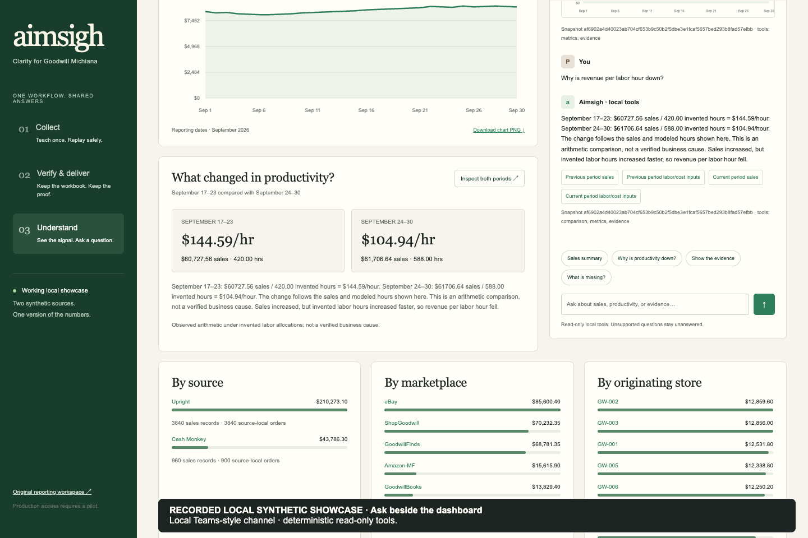
LIVE · ANSWERS WHERE THE TEAM WORKS
“Why is revenue
per labor hour down?”
A Teams-style local channel answers supported questions with deterministic tools, periods, definitions and evidence links.
Actual model-free local conversation beside its dashboard
Sources: DEMO · PLAN · CONTRACT | AIMSIGH / 13
Notes:
Ask the productivity question, follow a source citation and open labor input evidence. Then show an unsupported question returning supported alternatives rather than inventing a number or cause. The channel is a local prototype, not a Teams tenant integration. Answers use tested metrics/comparison/evidence tools and templates, with no Copilot, LLM, RAG or external model call. A real Copilot/Teams adapter requires tenant and security approval.
Segment: Understand · 90 seconds
DEMO PLAN · reviewed October 4, 2026
https://docs.google.com/document/d/1jhTiJcOi1yoRKHGe-WMquckIWISXWdzmWe6NV3tbdFk/edit
Goodwill three-phase solution · corrected technical synthesis
https://drive.google.com/file/d/1RffkmafbqbMEs7o_lNaTvIRL3hW9paai/view
Approved showcase-v1 interfaces and sample definitions
https://github.com/joconne8/sprinthack-nd-2026/blob/peyton/aimsigh-showcase/reports/SHOWCASE/CONTRACT.md

Slide 14
NEXT · A SUPERVISED GOODWILL PILOT
Fit the workflow
to Goodwill’s tools.
Validate one authorized source in parallel with current reporting. Reuse Excel and Power BI before choosing new infrastructure.
Approve the inputs
Fit Microsoft
Own the operation
Report authority, overlap, real formats, definitions and access.
Workbook consumption, Power BI, identity, tenant policy and optional Copilot/Teams.
Measure handling time and reliability. Name support, rollback and acceptance owners.
Sources: PITCH · PLAN · AMANDA | AIMSIGH / 14
Notes:
Nonbinding LOI interest is the starting point, not approval to deploy. Managed databases and Superset are alternatives with hosting/maintenance requirements, not guaranteed faster or free operation. Accounting-close automation requires separate finance mappings, validation and approval. We have not measured ROI. Pilot success needs a baseline and named process/IT owners.
Segment: Pilot · 85 seconds
Aimsigh founder presentation · reference and nonbinding LOI context
https://docs.google.com/presentation/d/1z-6jdYtqZ3t0SwIbbGc7pAyQ7cWptPXiYY-Tj7PNGLM/edit
Goodwill three-phase solution · corrected technical synthesis
https://drive.google.com/file/d/1RffkmafbqbMEs7o_lNaTvIRL3hW9paai/view
Amanda Baumer interview · reported workflow and effort estimate
https://drive.google.com/file/d/1WM1HJVAu_YF-Q48CQDa7SFwnPKg1FPlF/view

Slide 15
AIMSIGH · THE WORKING STORY
Teach the task.
Keep the proof.
Understand the number.
Local synthetic showcase · verified sample inputs · downloadable workbook · evidence-backed supported answers.
COLLECT → VERIFY & DELIVER → UNDERSTAND
Sources: DEMO · CONTRACT | AIMSIGH / 15
Notes:
Close with what the working application showed. Offer the code, workbook, HTML/PDF/PowerPoint deck and narrated recorded walkthrough. The backup video is labelled as a recording. Final human acceptance and organizer submission are separate. Repository: github.com/joconne8/sprinthack-nd-2026.
Segment: Pilot · 35 seconds
DEMO PLAN · reviewed October 4, 2026
https://docs.google.com/document/d/1jhTiJcOi1yoRKHGe-WMquckIWISXWdzmWe6NV3tbdFk/edit
Approved showcase-v1 interfaces and sample definitions
https://github.com/joconne8/sprinthack-nd-2026/blob/peyton/aimsigh-showcase/reports/SHOWCASE/CONTRACT.md

