Slide 1
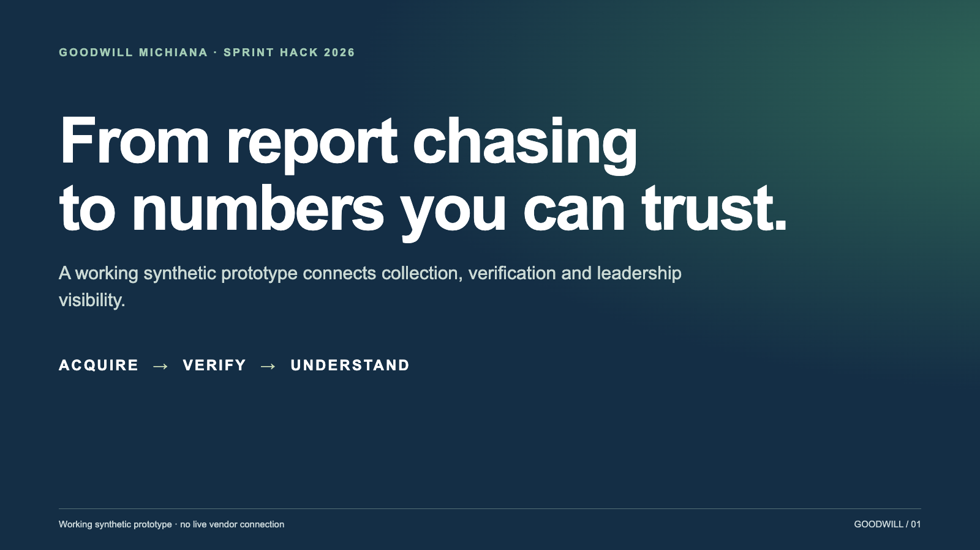
Notes:
Open with the operational problem, not a feature list. This is a simulated portal and fictional data, not a live Upright integration.
From report chasing
to numbers you can trust.
A working synthetic prototype connects collection, verification and leadership visibility.

Slide 2
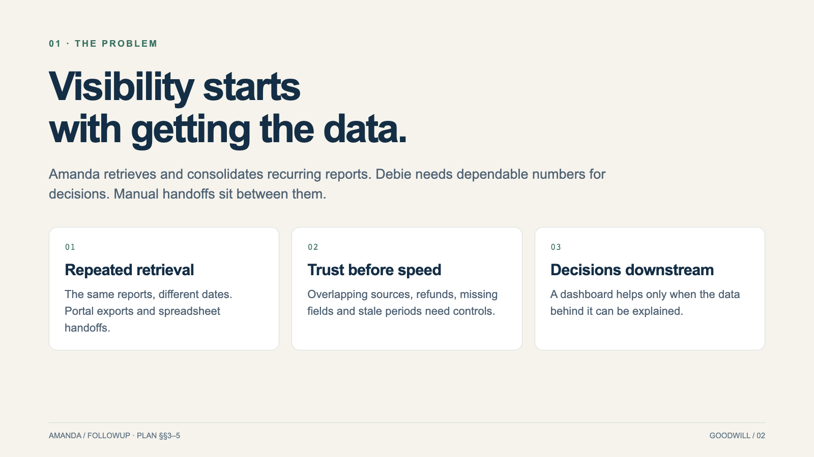
Notes:
Interview estimates describe the pain. We have not measured hours saved or promised production performance.
Visibility starts
with getting the data.
Amanda retrieves and consolidates recurring reports. Debie needs dependable numbers for decisions. Manual handoffs sit between them.

Slide 3
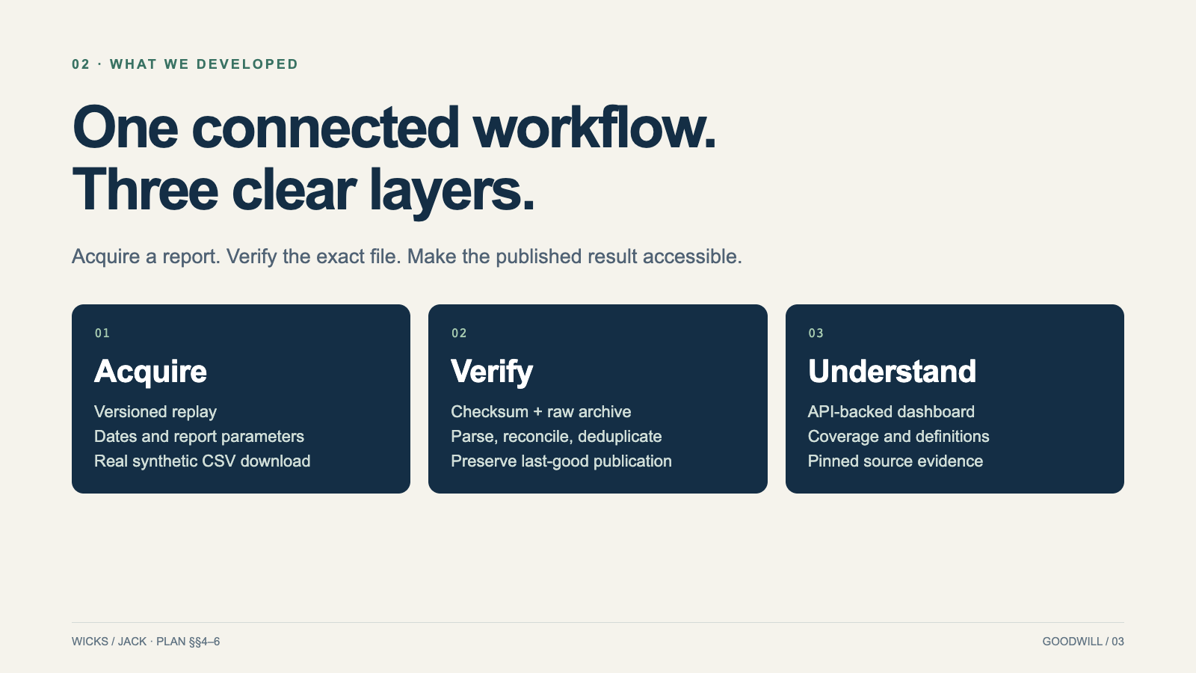
Notes:
The replica is reused from the team contribution. Our shared Python/SQLite pipeline and dashboard connect its exact output to evidence.
One connected workflow.
Three clear layers.
Acquire a report. Verify the exact file. Make the published result accessible.

Slide 4
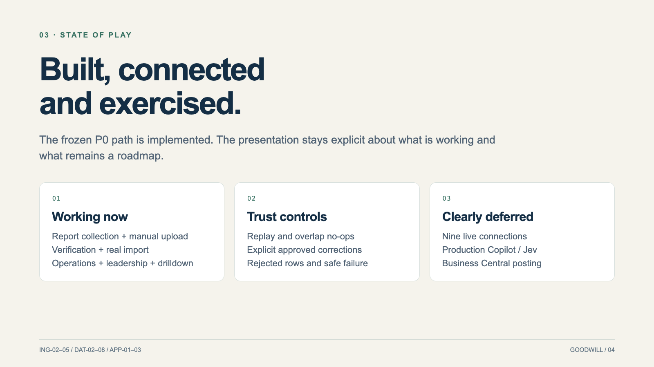
Notes:
The project is a synthetic P0 prototype. Human release acceptance and external submission are recorded separately from test results.
Built, connected
and exercised.
The frozen P0 path is implemented. The presentation stays explicit about what is working and what remains a roadmap.

Slide 5
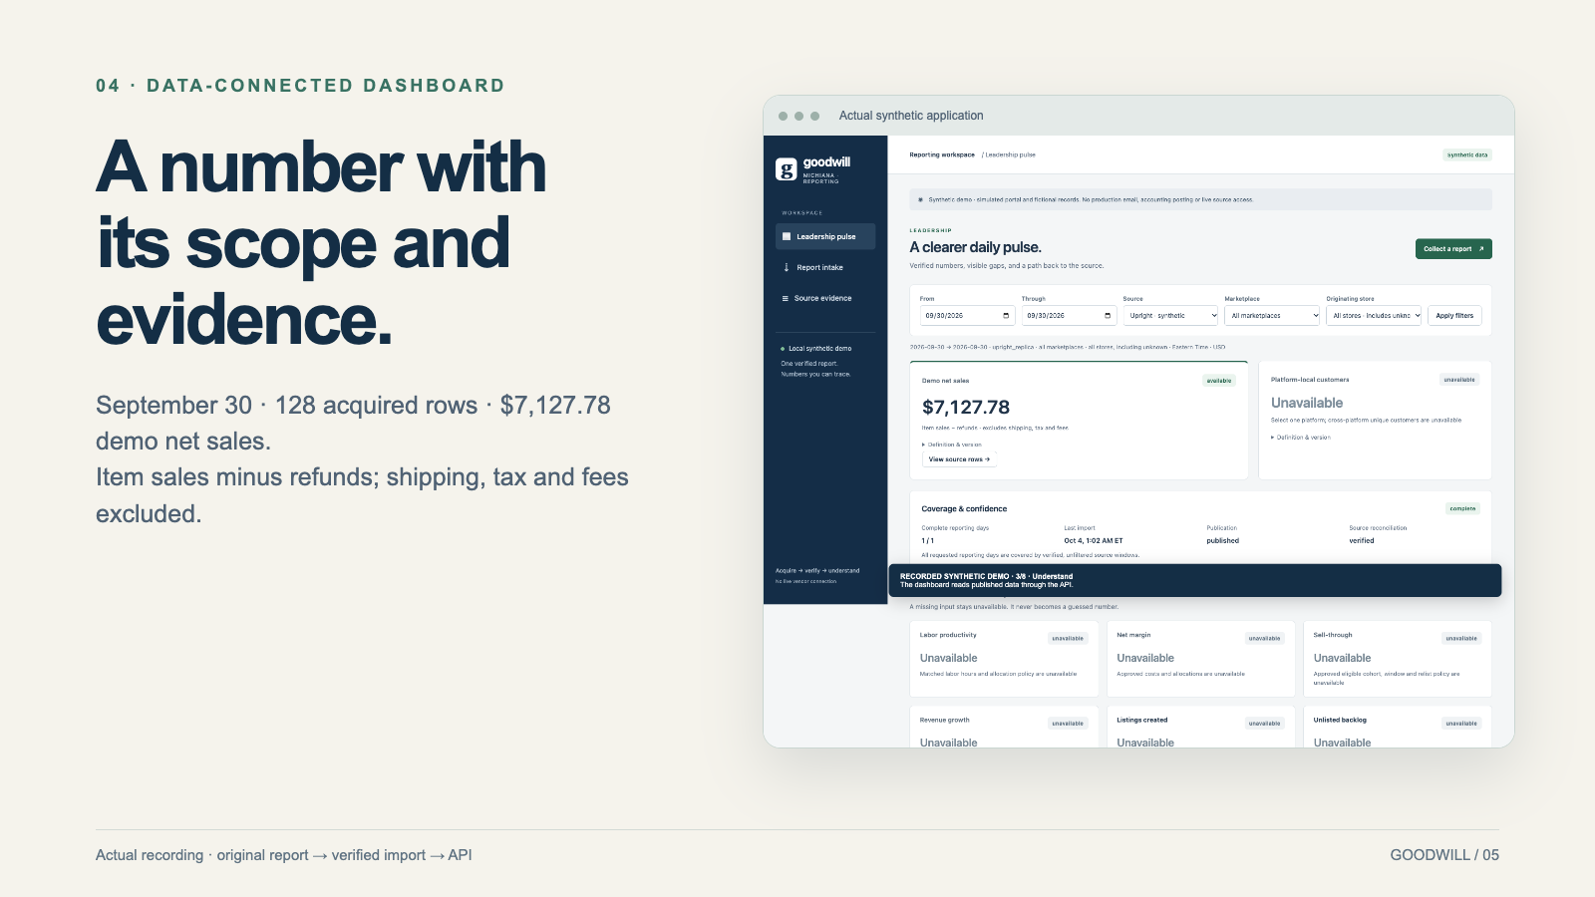
Notes:
Show the real API-backed dashboard. Strategic metrics with missing inputs remain unavailable. This example is fictional, not a business result.
A number with
its scope and evidence.
September 30 · 128 acquired rows · $7,127.78 demo net sales.
Item sales minus refunds; shipping, tax and fees excluded.

Slide 6
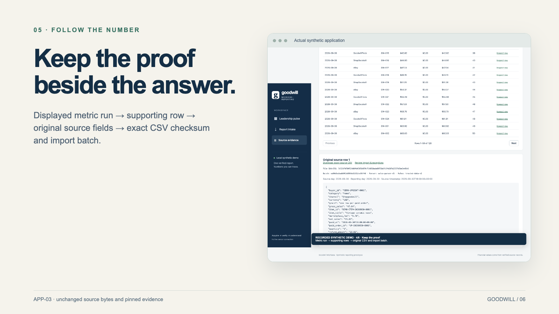
Notes:
The displayed result and evidence share the selected run and date/source scope. The UI does not recalculate revenue or substitute mock values.
Keep the proof
beside the answer.
Displayed metric run → supporting row → original source fields → exact CSV checksum and import batch.

Slide 7
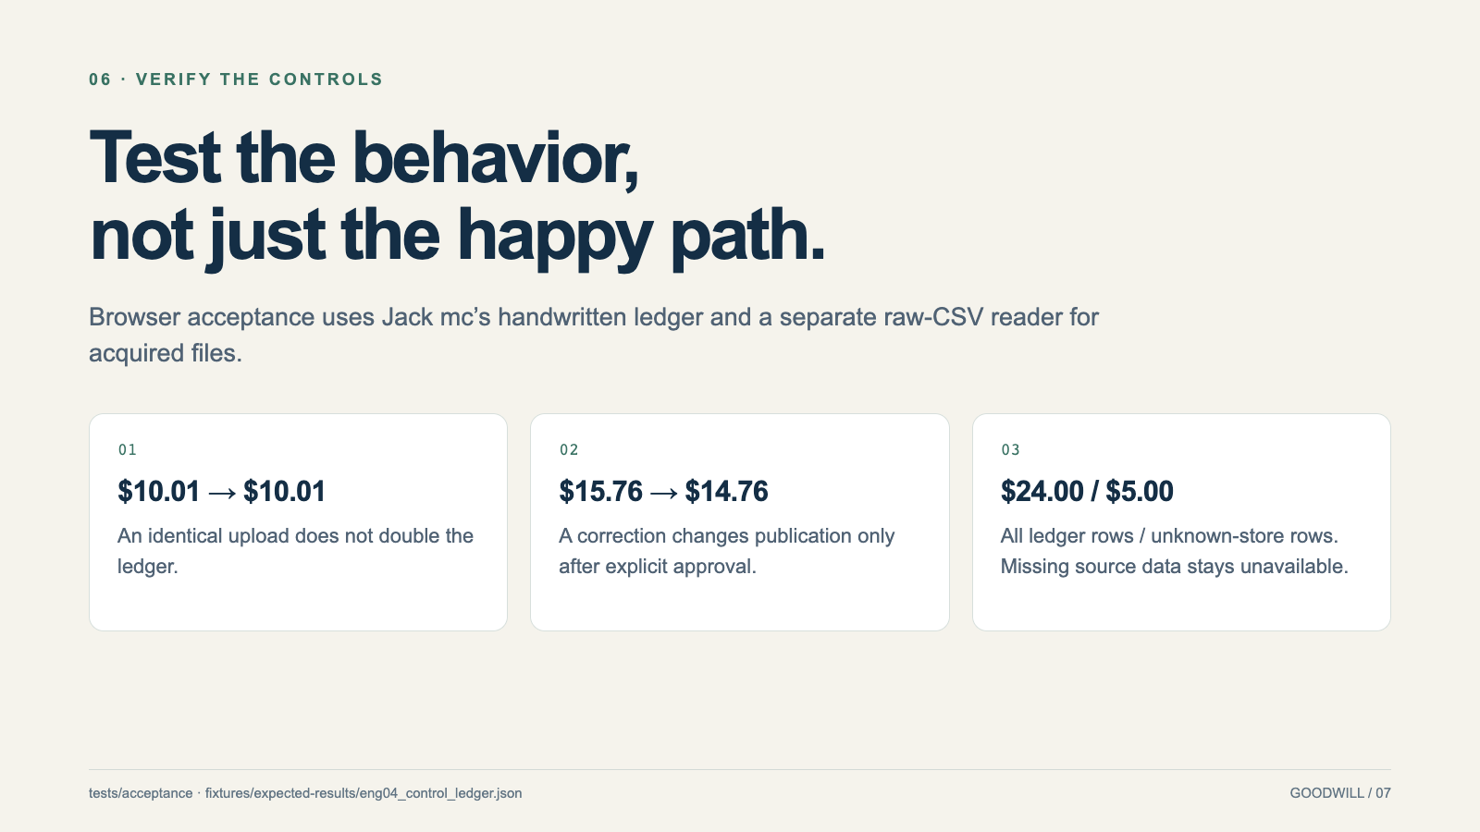
Notes:
These are independent expected amounts, not values copied from the metric API. Existing backend mutation tests and new browser assertions exercise the control rules.
Test the behavior,
not just the happy path.
Browser acceptance uses Jack mc’s handwritten ledger and a separate raw-CSV reader for acquired files.

Slide 8
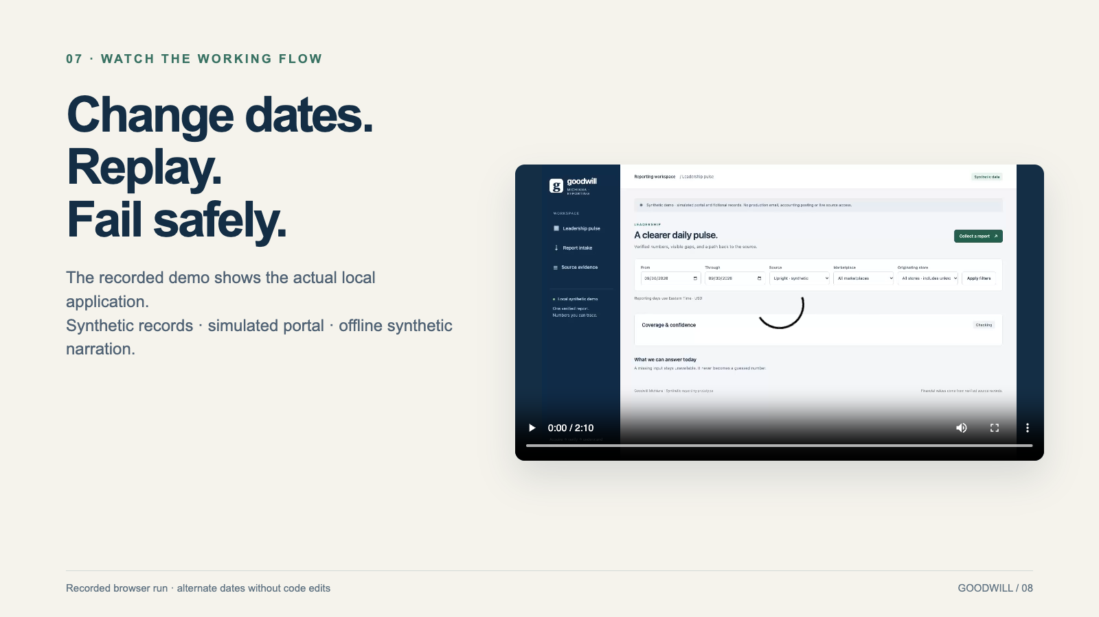
Notes:
Play the MP4. It includes September 30, October 1–2, replay no-op and expired-session recovery ownership. If time is short, show collection and source evidence live.
Change dates. Replay.
Fail safely.
The recorded demo shows the actual local application.
Synthetic records · simulated portal · offline synthetic narration.

Slide 9
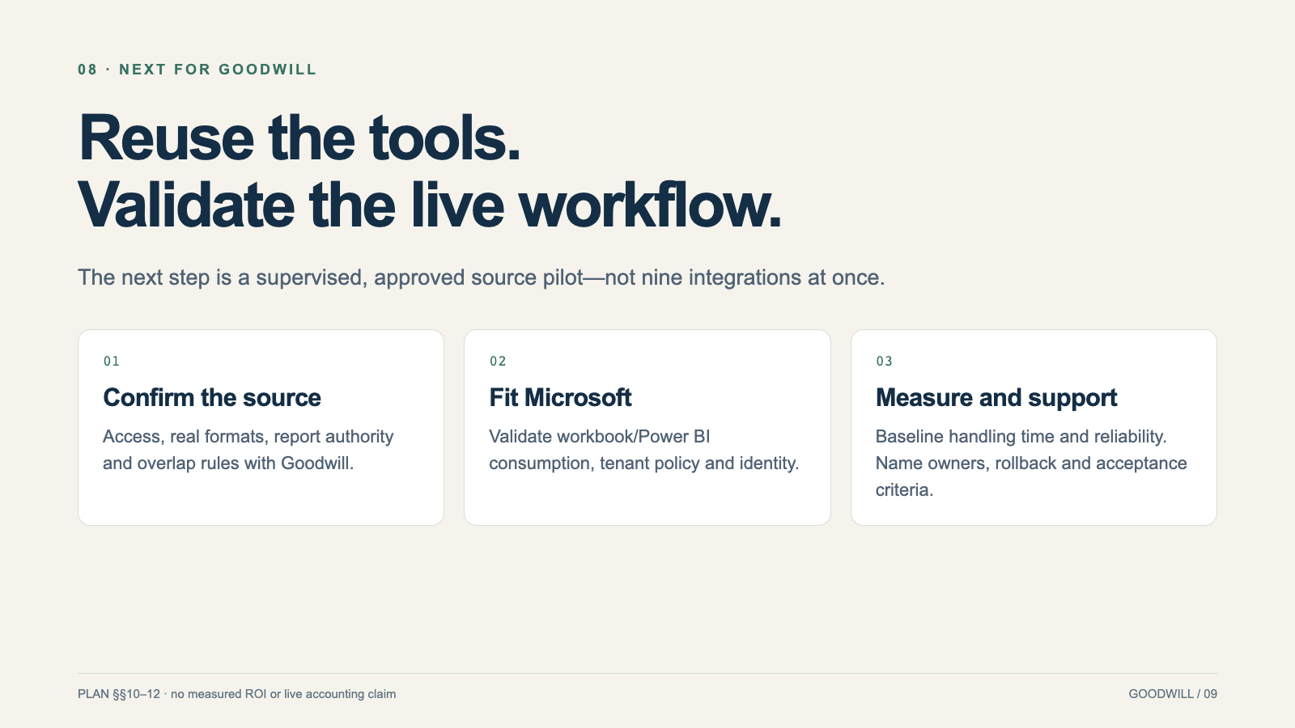
Notes:
The roadmap is conditional on partner approvals. Preserve the current pipeline controls while validating live exports and source meaning.
Reuse the tools.
Validate the live workflow.
The next step is a supervised, approved source pilot—not nine integrations at once.

Slide 10
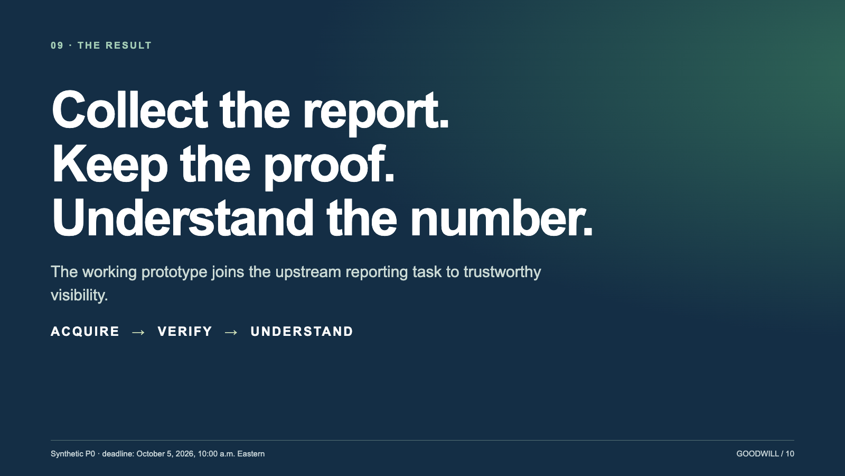
Notes:
Close with what was demonstrated. Share the repo, HTML/PDF/PowerPoint slides and MP4. Final human acceptance and the organizer upload remain explicit.
Collect the report.
Keep the proof.
Understand the number.
The working prototype joins the upstream reporting task to trustworthy visibility.

