Slide 1
Language Translation by IbmWatsons http://jodanchua.github.io/language-translation/

Slide 2
Language Translation
Converts text input in one language into a target language
Created using REST API
“REpresentational State Transfer”
The Watson Content Analytics REST application programming interfaces (APIs) enable you to create applications to search, explore, and administer collections.
Can translate text using these three business domains:
The News Domain
The Conversational Domain
The Patent Domain
Notes:
The News domain - targeted at news articles and transcripts, it translates English to and from French, Spanish, Portuguese or Arabic.
The Conversational domain - targeted at conversational colloquialisms, it translates English to and from French, Spanish, Portuguese or Arabic.
The Patent domain - targeted at technical and legal terminology, it translates Spanish, Portuguese, Chinese, or Korean to English.

Slide 3
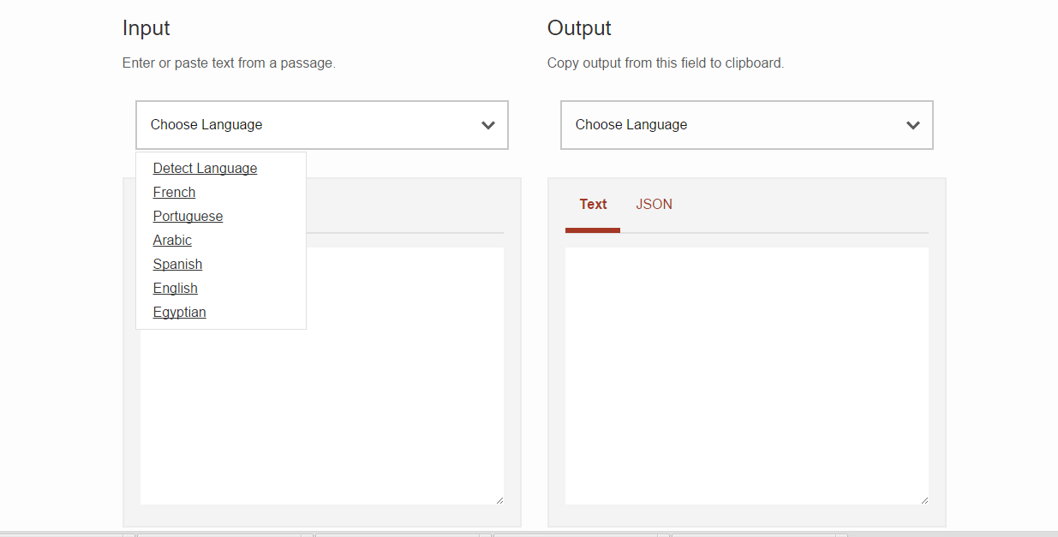
Demo

Slide 4
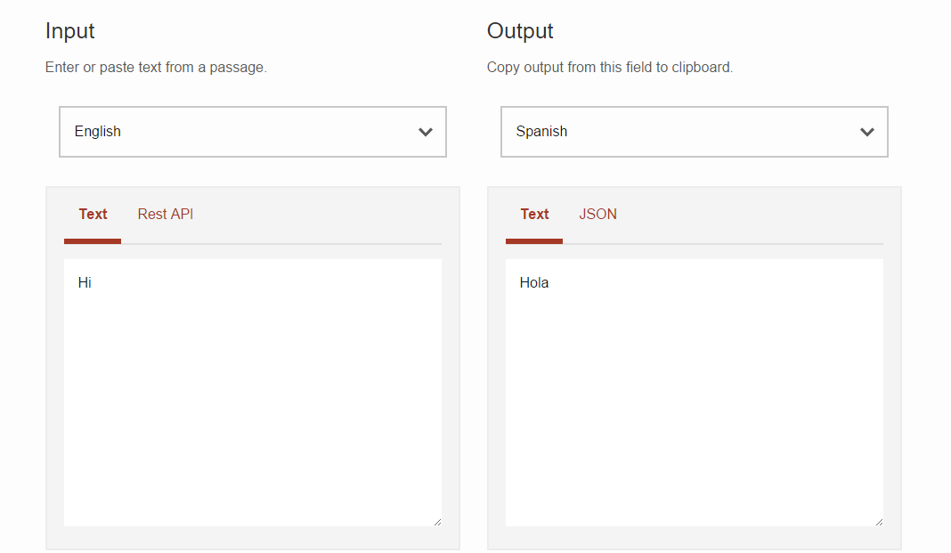
Demo

Slide 5
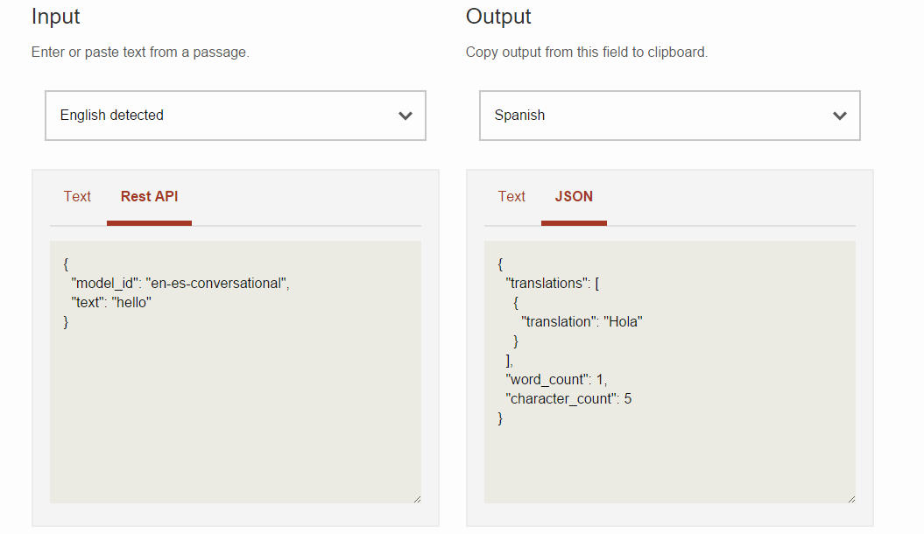
Demo

Slide 6
How does it work?
Build.gradle
Dependencoes
{
compile ‘com.ibm.Watson developer_cloud:java-wrapper:1.1.0’
}

Slide 7
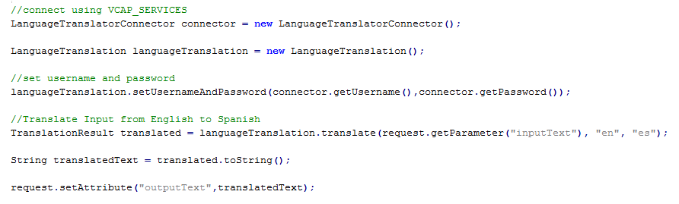
How does it work?
LanguageTranslationServlet.java

Slide 8
Example Usage of the Service
To provide domain-relevant translations
English-speaking help desk could assist a Spanish-speaking customer through a chat session that can be translated in real time
A West African news website can curate English news from across the globe and present it in French to its constituents.

Slide 9
Language Translation by IbmWatsons http://jodanchua.github.io/language-translation/

