Slide 1
ECE 558 Final Project
Historical Environmental Tracker
Josiah Sweeney
Neima Kashani

Slide 2
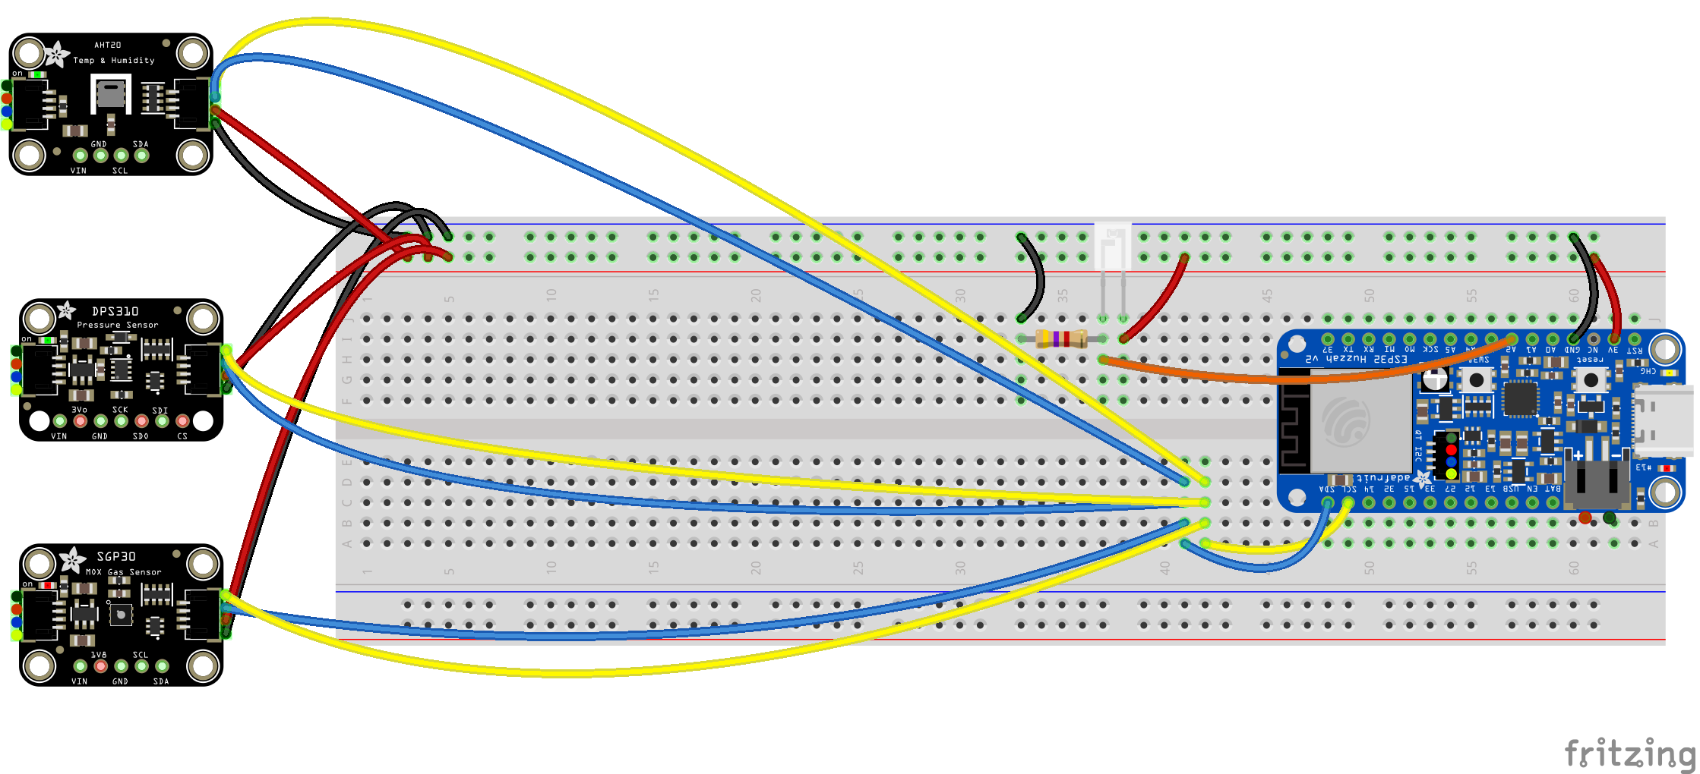
Wiring Layout

Slide 3
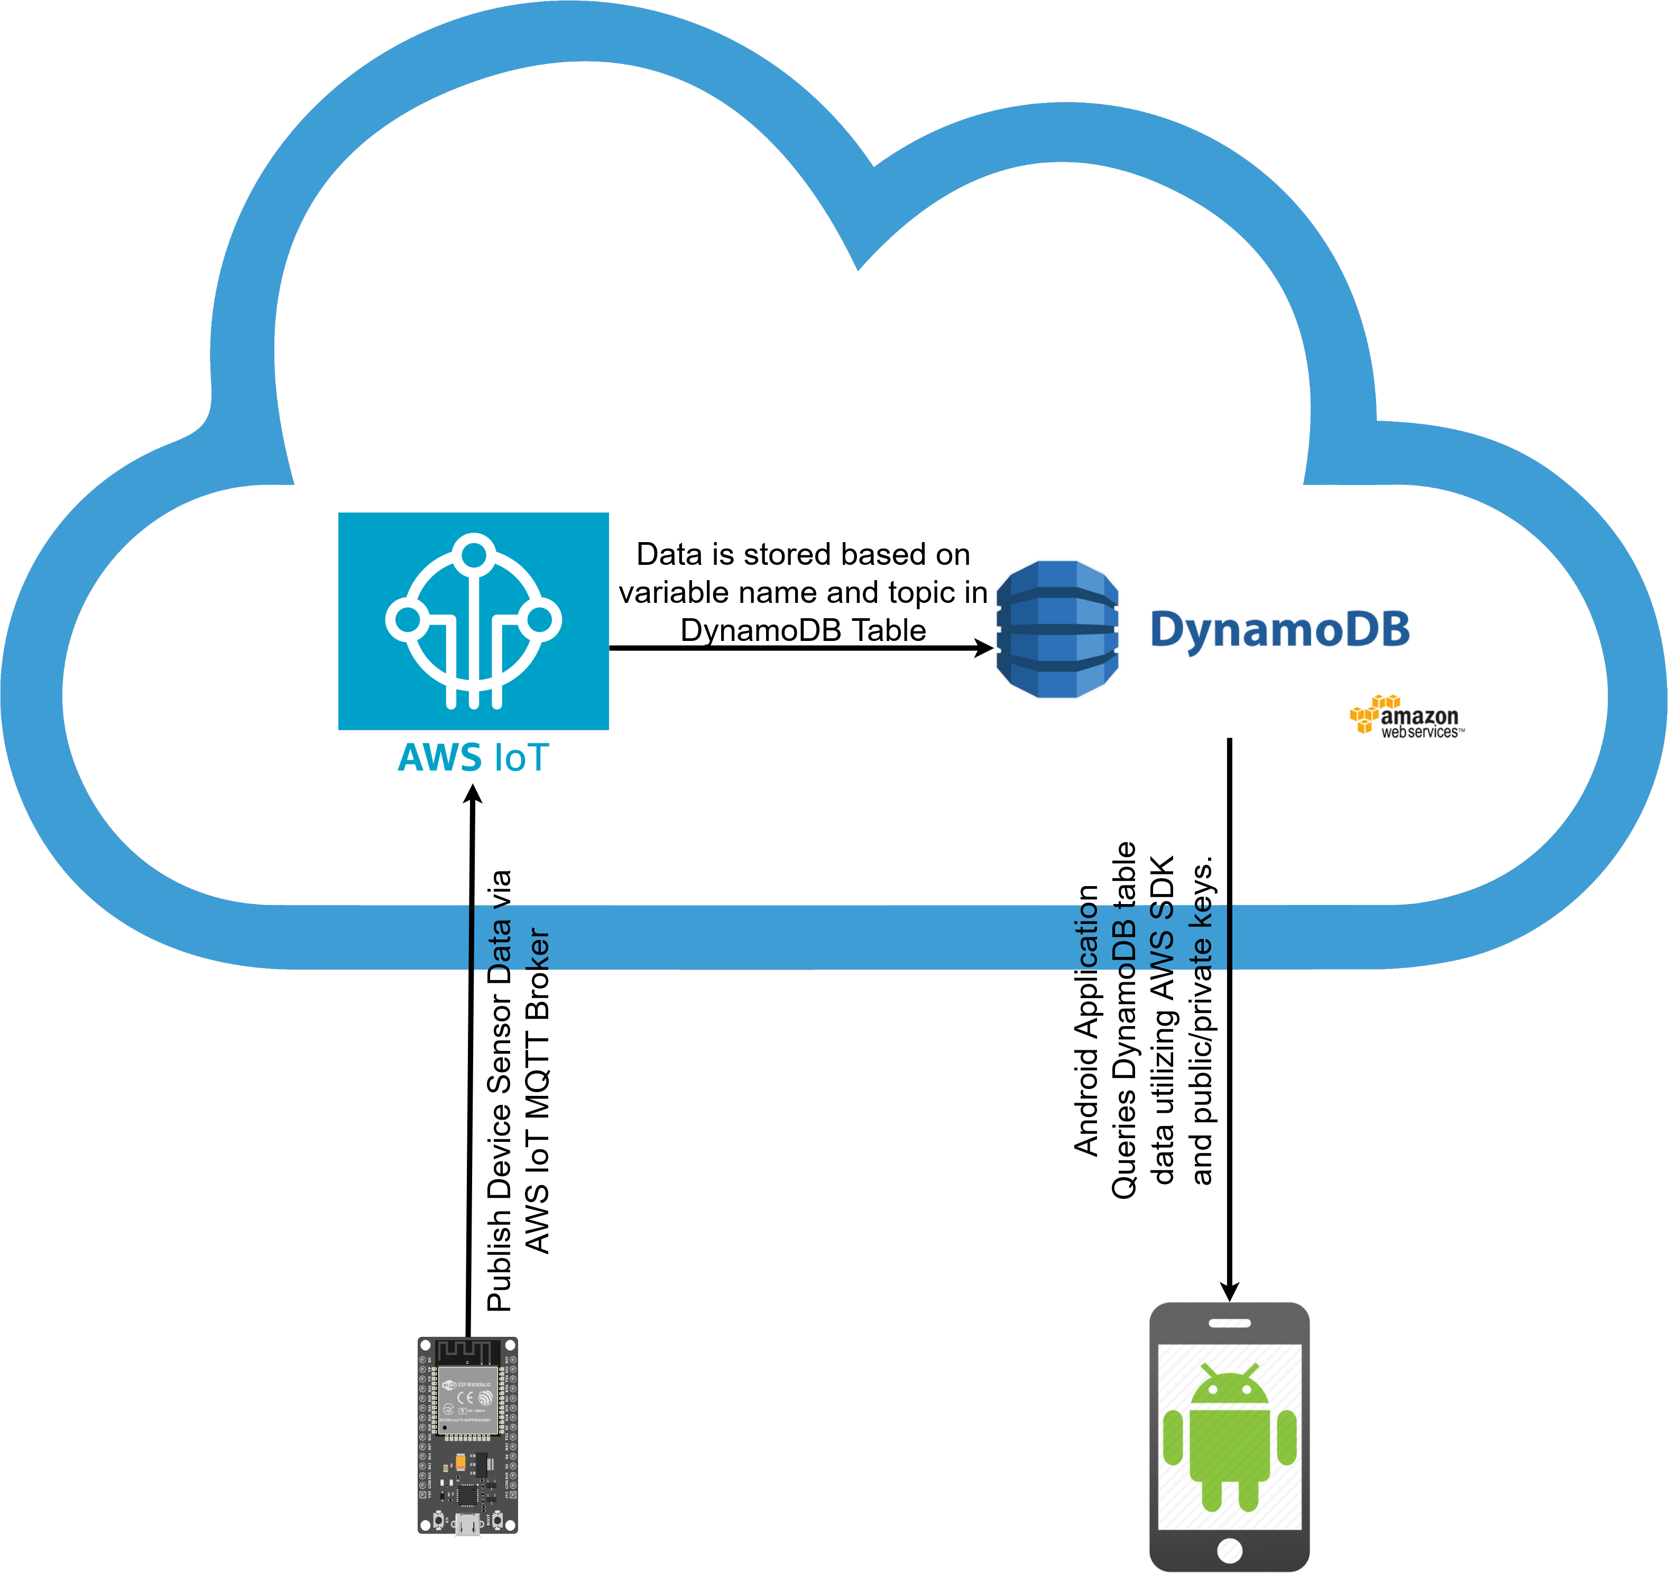
Data Flow Diagram

Slide 4
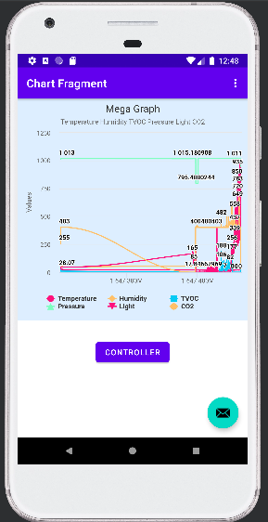
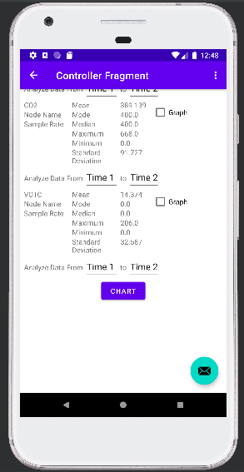
Android Application

Slide 5
Demo

