Slide 1
Bounding Volumes
jodavis42@gmail.com
Notes:
This presentation is all about bounding volumes. Bounding volumes are one of the key foundations of computational geometry and reducing cost in a collision detection pipeline.

Slide 2
Bounding Volumes
What is a bounding volume?
A shape that fully contains a (typically) more expensive underlying shape
Notes:
To start off with we have to establish what a bounding volume is. There’s only really 1 rule to a bounding volume: it’s some shape that fully contains (bounds) some underlying set of shapes. These shapes are typically more expensive than the bounding volume for reasons that will be explored further in this presentation. No other rule is really required for a shape to be a bounding volume.

Slide 3
Bounding Volumes
Bounding Volumes don’t change algorithmic complexity
They allow cheap rejection tests
If the BVs collide then we check the underlying shapes
Wait, we have to check both?
Is this actually faster?
can’t collide: skip
could collide: check
Notes:
So what is the purpose of a bounding volume? The main purpose is to speed up the collision detection pipeline, but not through algorithmic complexity change. If a bounding volume doesn’t intersect with some shape then neither can the underlying geometry that it contains. This allows bounding volume to provide cheap rejection tests for more complex shapes. If the bounding volumes do collide then the underlying shapes have to be checked.
This should lead to the obvious realization that sometimes we get away with a cheaper computation but sometimes we have to check the bounding volume and the underlying shapes, resulting in “double” the work. So is doing more work sometimes worth it or should we just check the underlying shapes.

Slide 4
Bounding Volumes
Bounding volumes reduce algorithmic constants
Given 100 shapes that are twice as expensive as spheres:
How many can collide?
How many could realistically collide?
Compare these costs. Are bounding volumes worth it?
*An average bounding volume is much cheaper than ½ cost
Notes:
To help illustrate why we use bounding volumes it’s important to first realize that they effectively reduce the algorithmic constants. Now we can perform a simple thought experiment. If we have 100 shapes that are twice as expensive to check for intersection than spheres then how much could we possibly save?
First we need to determine how many collisions could happen. To make life easy we’ll just use a pure $n^{2}$ calculation and go with 10,000 possible collisions.
Now we need to determine how many shapes could possibly collide. With a sphere in 2d it’s reasonable to assume that a sphere could intersect 8 other spheres at max. This leads to an average max of 400 intersections (800 / 2 because of a colliding with b and b colliding with a).
This gives us less than a 1% actual collision rate. Now how much does this actually save? Well the brute force method would cost: 10,000 * 2 or 20,000 to test. With bounding spheres we’d on average expect 99% to use the sphere cost and 1% use both: 9,900 * 1 + 100 * (1 + 2) = 9,900 + 300 = 12,000.
We save a lot by using a bounding volume! Realistically though, the underlying shape cost is significantly more than twice as expensive.

Slide 5
Bounding Volumes
Unfortunately, there is no best bounding volume
Considerations:
Intersection cost
Tight fitting
Initial computation cost
Update cost
Memory overhead
Notes:
Unfortunately, no “best” bounding volume exists. It’s typically a trade off of several characteristics:
Intersection cost: How expensive it is to test a bounding volume is very important as we saw earlier. This is effectively the constant term in front of all tests.
Tight fitting: How many tests will pass the bounding volume test and still fail the intersection test. This is basically how many false positives are returned.
Computation cost: How expensive is it to compute a bounding volume. This gets complicated as there are often several different methods to compute a bounding volume that produce differing levels of tight fitting. For example, we’ll see several different sphere methods that produce tighter and tighter bounding spheres. Typically we have to choose to produce a less than perfectly fitting bounding volume due to how expensive it is to compute.
Update cost: As a shape moves, and primarily as it rotates, how hard is it to update the bounding volume. Some methods will maintain the tightness of the original computation while some may favor cheap approximations.
Memory overhead: To store a bounding volume requires extra memory per shape. Memory overhead is important not only because of total memory budget, but because of performance ramifications with memory and cache. Typically the more tight fitting a bounding volume can be the more memory is required.
These metrics typically have to be weighed against each other for a specific application to choose a bounding volume.

Slide 6
Bounding Volumes
Common bounding volumes:
Aabb
Sphere
Obb
K-Dop
Convex-Hull
Notes:
The two simplest and probably most common bounding volumes are bounding sphere’s and axis aligned bounding boxes (aabb). I will go into great depth on our considerations for these two bounding volumes as they are very useful. In particular, I will go into the previous 5 considerations for these two.
The remaining bounding volumes aren’t as commonly used so I will only spend a small amount of time talking about them.
Personally, aabb’s are my favorite.

Slide 7
Aabb
Two primary representations:
Min/Max tends to be more commonly used
*both require 6 floats
struct Aabb
{
Vector3 mMin;
Vector3 mMax;
};
struct Aabb
{
Vector3 mCenter;
Vector3 mHalfExtents;
};
Notes:
An aabb is a min/max on each cardinal axis (x, y, z). Because of this only 6 floats are needed to store it. There are two primary formats for an aabb: Min + Max, and Center + Half-Extents. Both have their benefits but I’ll stick to min/max for the majority of this class as I prefer it, especially for computation and intersection tests. Luckily, for the few operations where center and half-extents are preferred, it’s very easy to convert between the two.

Slide 8
Aabb Computation
How do we compute from a point cloud?
Find min/max on each axis
How good of an Aabb is this?
Notes:
First we’ll look at the initial computation of an aabb. As an aabb is defined by a min/max on each axis, it should be clear that we can compute it finding the min/max axis values of all the points.
One question to always ask is how good of an Aabb did we construct? Is it really bad? Just ok? Or really good? In this case we’ve managed to construct the minimum aabb possible. As this was cheap and easy to implement there’s no point in discussing any other methods.

Slide 9
Aabb Update
Method 1: Full re-computation
Transform the shape and re-compute from scratch
Notes:
The simplest method to refit an aabb is to just re-compute it from scratch. This means taking each vertex and transforming it into world space and then running the initial aabb computation over it. This is a fairly slow method, as each point has to be transformed, but this is the tightest fit aabb possible.
While this is the best aabb possible, it’s typically too slow to perform per object per frame. Can we find a cheaper aabb update method?

Slide 10
Aabb Update
Method 2: From a bounding sphere
Cheap and easy, but inaccurate
From bounding sphere
Best
Notes:
If refitting the aabb every frame is all accuracy and no speed, then the opposite of that is to compute the aabb from a bounding sphere. Since the bounding sphere is guaranteed to contain the object at all rotations, then the aabb of the bounding sphere is guaranteed to always contain the object. That means only translation needs to be updated, which is just setting the aabb center/offset from the object’s center.
Now we’ve seen both ends of the spectrum. We’ve seen the best aabb that’s the most expensive to compute. We’ve also seen the cheapest aabb to compute that’s typically a really bad fit. Perhaps we can find a good middle ground?

Slide 11


Aabb Update
Method 3: Hill Climbing
$$\vec{p}′$$
$$\vec{p}$$
Notes:
Hill climbing is a method that tries to compute the best fit aabb in an efficient manner. The main idea is that when computing the initial aabb we not only computed what the min/max was on each axis, but we know what point this min/max came from. If we build adjacency information then we can perform a hill-climbing search of the neighboring points to find the new min/max on an axis. This will typically only check a sub-set of the points and still produce the best-fit aabb.
One speed performance gain that can be achieved is by realizing that when finding the min/max x we only need to transform the x coordinate into world space. This can cut expenses down quite a bit.

Slide 12


Aabb Update
Hill climbing breaks down in 2 areas
Concave shapes
Local minima
Search dir
Search dir
$$\vec{p}$$
$$\vec{p}$$
Notes:
There are two major problems with this approach though, and they both stem from the fact that hill climbing only works when we’re guaranteed to make progress at each (i.e. there’s no local minima). The first problem arises when the mesh is not convex. One way to fix this is to pre-compute the convex hull and only update the aabb from the convex hull. This does require storing a bit of extra data per mesh, but the convex hull is commonly used so it’s not too bad.
The other local minima arises when there’s a plateau. This can happen if you imagine (pictured on the right) a highly tessellated cube that rotates 180 degrees. Any point in the center will be unable to find a point further in the direction and stop at a wrong extremal point. These sort of scenarios have to be special cased for hill-climbing and hence I don’t’ recommend it.

Slide 13
Aabb Update
Method 4: Aabb of rotated Aabb
Aabb of aabb
Original
Best
Notes:
A good compromise between speed and accuracy is to compute an aabb from the rotated aabb.

Slide 14
Aabb Rotation
Attempt 1: Compute aabb of rotated aabb points (8)
Can we do better?
Notes:
The simple way to think about doing this is to take the 8 points of the aabb and rotate them then build the new world aabb from these points. This is obviously not as tight fit as the refitted aabb, but is still much tighter than the sphere method.
Rotating 8 points is still a little expensive. This method can be sped up quite a bit by examining the aabb calculation and the matrix properties.

Slide 15








Aabb Rotation - Optimized
Attempt 2: Transform the basis vectors
Build the new points from the basis vectors and compute the aabb
Can we do better?
$$+{\vec{x}}^{′}+\vec{y}′$$
$$\vec{y}$$
$$\vec{y}′$$
$$\vec{x}′$$
$$\vec{x}$$
$${−\vec{x}}^{′}+\vec{y}′$$
$${+\vec{x}}^{′}−\vec{y}′$$
$${−\vec{x}}^{′}−\vec{y}′$$
Notes:
The bottleneck of the previous method was transforming all 8 points. We can drastically speed this up by transforming the 3 basis vectors of the aabb. We can then easily compute all 8 points as $\left(±\vec{x},±\vec{y},±\vec{z}\right)$ and then compute the aabb of these points. This is about twice as fast as the previous method for little extra effort.
This is still transforming 3 vectors (plus the center) and then computing the aabb of 8 points. While this is far from expensive, can we make this even better?

Slide 16


Aabb Rotation - Optimized
Attempt 3: Directly compute the new half-extent
How?!?
$$\vec{r}′$$
$$\vec{r}$$
Notes:
The final method we’ll look at is the one you’ll do for your assignment. This method does work with min/max but it’s easiest to derive with the center and half-extent representation. The idea is to just directly compute the new aabb’s half-extent.
You might wonder how we could directly compute it, but the math isn’t too bad.

Slide 17









Aabb Rotation - Optimized
We have $\vec{r}$ and we want $\vec{r}′$
Each can be separated into basis vectors
$${\vec{y}}^{′}$$
$${\vec{r}}^{′}$$
$$\vec{y}$$
$$\vec{r}$$
$$\vec{x}$$
$${\vec{x}}^{′}$$
$$\vec{r}=\vec{x}+\vec{y}=\left[\begin{matrix}x \\ 0\end{matrix}\right]+\left[\begin{matrix}0 \\ y\end{matrix}\right]$$
$${\vec{r}}^{′}={\vec{x}}^{′}+{\vec{y}}^{′}=\left[\begin{matrix}x^{′} \\ 0\end{matrix}\right]+\left[\begin{matrix}0 \\ y^{′}\end{matrix}\right]$$
Notes:
To start let’s inspect what we have and what we want. We have the half-extent of the original aabb and we want to compute the new half-extent. It’s important to understand that $\vec{r}$ is just a sum of these basis vectors: $\vec{r}=\vec{x}+\vec{y}+\vec{z}$.
We can expand this further by writing out the full vector formula: $\vec{r}=\left[\begin{matrix}x \\ 0 \\ 0\end{matrix}\right]+\left[\begin{matrix}0 \\ y \\ 0\end{matrix}\right]+\left[\begin{matrix}0 \\ 0 \\ z\end{matrix}\right]$.
We can do the same thing with $\vec{r}′$. So we know the scalars $x, y,$and $z$ and we want to find the scalars $x^{′},y^{′}$ and $z^{′}$.

Slide 18



Aabb Rotation - Optimized
We get $y^{′}$ from the most-positive y-value point
$$\vec{p}$$
$$y^{′}$$
Notes:
Without loss of generality, let’s look at how $y^{′}$ is computed. We know if we transform all 8 points of the aabb that $y′$ will come from the point with the most positive y-value.

Slide 19




Aabb Rotation - Optimized
We can compute any point from the transformed bases
$$\vec{p}$$
$$M\vec{y}$$
$$M\vec{x}$$
$$\vec{p}=M\vec{x}+M\vec{y}$$
Notes:
As shown previously, any point can be represented from the basis vectors. In this case $\vec{p}=M\vec{x}+M\vec{y}$.

Slide 20





Aabb Rotation - Optimized
How do we know whether to add or subtract a basis?
$$\vec{p}$$
$$\vec{y}$$
$$M\vec{y}$$
$$M\vec{y}$$
$$M(−\vec{x})$$
$$\vec{x}$$
$$M\vec{x}$$
$$\vec{p}=M(−\vec{x})+M\vec{y}$$
Notes:
However, the points are created from the plus or minus of the basis vectors, how do we know whether to add or subtract a basis? If we have to test all combinations then we’re back at attempt 2 of computing all 8 points.

Slide 21




Aabb Rotation - Optimized
Compute $y^{′}$ directly, not from a point
$y^{′}$ is the largest positive value
$$\left|{\left(M\vec{y}\right)}_{y}\right|$$
$$\left|{\left(M\vec{x}\right)}_{y}\right|$$
$y^{′}=\left|{\left(M\vec{x}\right)}_{y}\right|$+$\left|{\left(M\vec{y}\right)}_{y}\right|$
Notes:
Instead of trying to compute the point with the most positive y-value and then taking its y-value, we can compute $y′$ directly.
To do this let’s further inspect $y^{′}$. We previously defined $\vec{p}=±M\vec{x}±M\vec{y}±M\vec{z}$ so we can define $y^{′}=±{\left(M\vec{x}\right)}_{y}±{\left(M\vec{y}\right)}_{y}±{\left(M\vec{z}\right)}_{y}$. To compute the most positive value, we want to only add positive terms. We can do this by re-writing the equation with absolute values: $y^{′}=\left|{\left(M\vec{x}\right)}_{y}\right|$+$\left|{\left(M\vec{y}\right)}_{y}\right|+\left|{\left(M\vec{z}\right)}_{y}\right|$.
Another way to look at this is to think of $y′$ as the sum of the projections of each rotated basis onto the y-axis. To maximize this sum we want only positive values, hence the absolute value of the rotation.
The same operation can be performed for the x and z axes.

Slide 22

Aabb Rotation - Optimized
We can now compute ${\vec{r}}^{′}={\vec{x}}^{′}+\vec{y}′$
Slightly better than attempt 2
Can we do better?
Notes:
Now we know how to compute $x^{′}, y^{′},$ and $z^{′}$ directly from the 3 transformed bases vectors. This is a slight improvement over attempt 2 as we don’t have to iterate over the points to compute the aabb. Once again though, can we make this better?

Slide 23

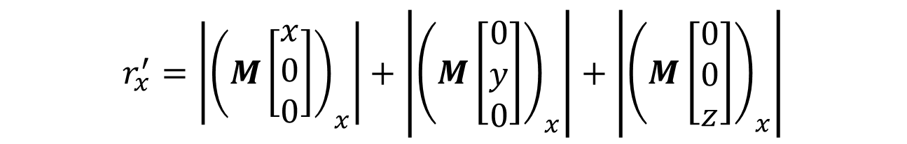
Aabb Rotation - Optimized
Let’s inspect $r_{x}^{′}$
There’s a lot of zero multiplications…
How do we optimize?
$$r_{x}^{′}=\left|{\left(M\left[\begin{matrix}x \\ 0 \\ 0\end{matrix}\right]\right)}_{x}\right|+\left|{\left(M\left[\begin{matrix}0 \\ y \\ 0\end{matrix}\right]\right)}_{x}\right|+\left|{\left(M\left[\begin{matrix}0 \\ 0 \\ z\end{matrix}\right]\right)}_{x}\right|$$
Notes:
If we look at $r_{x}^{′}$ and expand it out we’d see that we’re doing a lot of matrix * vector operations with a vector that is 2/3 zero. We should avoid these wasted zero multiplications if possible.
So how do we optimize this?

Slide 24

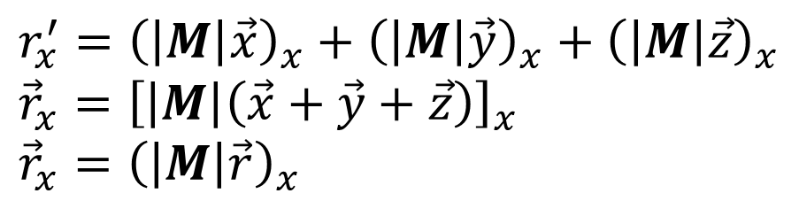
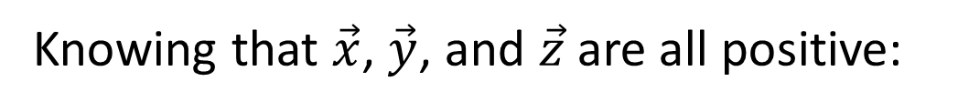
Aabb Rotation - Optimized
Given:
$$r_{x}^{′}=\left|{\left(M\vec{x}\right)}_{x}\right|+\left|{\left(M\vec{y}\right)}_{x}\right|+\left|{\left(M\vec{z}\right)}_{x}\right|$$
Knowing that $\vec{x}$, $\vec{y}$, and $\vec{z}$ are all positive:
$$r_{x}^{′}={\left(\left|M\right|\vec{x}\right)}_{x}+{\left(\left|M\right|\vec{y}\right)}_{x}+{\left(\left|M\right|\vec{z}\right)}_{x} \\ {\vec{r}}_{x}={\left[\left|M\right|\left(\vec{x}+\vec{y}+\vec{z}\right)\right]}_{x} \\ {\vec{r}}_{x}={\left(\left|M\right|\vec{r}\right)}_{x}$$
With further inspection we can see:
$$\vec{r}′=\left|M\right|\vec{r}$$
Notes:
We could expand the individual terms of these multiplications to pull out the non-zero terms, but there’s an easier way. By realizing that $\vec{x}, \vec{y},$ and $\vec{z}$ are all positive axis aligned vectors we can pull them outside of the absolute value. This allows us to factor the matrix multiplication out of the basis sum. We can then replace the basis sum with the half-extents vector.
This allows boiling this all down into the simple equation above: simply transform the half-extent by the absolute value of the rotation matrix.

Slide 25


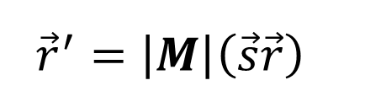
Aabb Full Transform
How do we include scale and translation?
$\vec{r}$ is a direction vector:
The aabb center is a position vector:
$${\vec{r}}^{′}=\left|M\right|\left(\vec{s}\vec{r}\right)$$
$${\vec{c}}^{′}=\vec{t}+M\left(\vec{s}\vec{c}\right)$$
Notes:
So how do we perform a full transformation including scale and rotation?
The aabb’s $\vec{r}$ vector is a direction vector so it’s unaffected by translation. We can simply scale it before applying the previous operation.
The aabb center is a position vector so it transforms with the regular rotation matrix (not the absolute value one) and translation is added afterwards.
Note here that $\vec{s}\vec{r}$ is short-hand for $\left[\begin{matrix}s_{x}∗r_{x} \\ s_{y}∗r_{y} \\ s_{z}∗r_{z}\end{matrix}\right]$.

Slide 26


Aabb Full Transform
What if $M$ is a 4x4 matrix?
$M$ will be of the form:
Use the 3x3 abs to update the half-extent
Use the 4x4 to update the center
$$\left[\begin{matrix}sr & sr & sr & tsr \\ sr & sr & sr & tsr \\ sr & sr & sr & tsr \\ 0 & 0 & 0 & 1\end{matrix}\right]$$
Notes:
What if we had a full 4x4 affine transformation though?
We could decompose into scale, rotation, and translation, but there’s a more efficient method. If we inspect a matrix we’ll see that it will always be off the form shown above. The important thing for us here is that the translation doesn’t affect the 3x3 portion of the matrix. It’s not hard to show that scale won’t affect our previous derivation so we can use the absolute value of this matrix in the same way.

Slide 27
Aabb Rotation
Problem: Aabb will grow forever with rotations
Solution: store local (original) aabb and transform to world space
Notes:
There is one major problem with this method to consider, luckily it is easy to deal with. If we compute the new aabb by transforming the current aabb with a delta then it’ll keep growing forever. This is actually easy to deal with as we almost never perform a delta transformation anyways. Instead we need to use a little more memory by storing the local space aabb and transforming that each frame into world space.

Slide 28
Sphere
Typically only one storage format
struct Sphere
{
Vector3 mPosition;
float mRadius;
};
Notes:
Bounding spheres are typically only stored in one format: center and radius.
The computation of a sphere is quite hard. In fact, the process of computing the tightest fit sphere is very complicated so typically one opts for an approximation method.

Slide 29
Sphere Update
Updates are mostly trivial
*Careful as some shapes don’t rotate around their centroid.
Notes:
Unlike aabb’s, sphere computation is hard while updating is trivial. Do note though, that sphere’s have to be careful of objects that don’t rotate about their centroid. Often times in a game an object will rotate about a point that is not it’s center (say a sword rotating about the handle). In this case you need to store an offset of the sphere’s center from the pivot point and transform that as the object rotates.

Slide 30
Sphere Computation
Method 0: From an Aabb
Optimal aabb’s are easy, compute the sphere of the aabb
Notes:
The first method I’ll talk about is to utilize the ease of optimal aabb computation. Simply compute the aabb for the object then compute the bounding sphere of that aabb. This method should almost never be used though as it’s easy to do better. Because of that I’m calling this method 0…

Slide 31
Sphere Computation
Method 1: Centroid
2 pass algorithm:
Compute centroid (aabb center)
Pick furthest away point as radius
Notes:
To improve upon the aabb method we can look at the centroid method. We can pick a good center point for our sphere by first computing the centroid (which just so happens to be the aabb center). Now instead of using the aabb’s “radius” as the sphere’s radius, we can do a second pass to find the actual furthest away point from the sphere center. This will always give as good if not better of a sphere than the aabb method.

Slide 32
Sphere Computation
Two key observations:
Our sphere radius computation is bad
We can improve the initial guess of the sphere’s center.
Notes:
There’s two important observations we can make before moving on. The first is how we compute the radius.

Slide 33




Sphere Computation
We found the furthest point and added it to the sphere
How good is this sphere?
$$\vec{c}$$
$$\vec{c}$$
$$\vec{p}$$
$$\vec{p}$$
Notes:
If we boil down our previous algorithm, we start with a sphere of radius 0 and found the furthest away point to add to the sphere. We computed this new sphere by updating the radius so the new point was contained, but is this new sphere good?

Slide 34




Sphere Computation
Which is a better sphere?
$$\vec{c}$$
or
$$\vec{c}$$
$$\vec{p}$$
$$\vec{p}$$
Notes:
If we look at this problem in isolation it should be clear that we did not compute a minimum sphere of these two points. We can easily do this by moving the center to the midpoint of the two points.

Slide 35
Sphere Computation
Problem: This sphere doesn’t contain the shape
What if we just iteratively add all points?
or
Notes:
When we do this it’s pretty obvious that this new sphere won’t contain the entire shape unlike our previous technique. We were already doing a pass to find the furthest point, so what if we just iteratively add all points that aren’t inside the sphere?

Slide 36


Sphere Computation
How do we expand a sphere by a point?
$$\vec{p}$$
$$\vec{c}$$
Notes:
To do this we need to know how to minimally expand a sphere by a point.

Slide 37








Sphere Computation
Compute the point opposite $\vec{p}$
Compute the sphere of $\vec{b}$ and $\vec{p}$
$$\vec{p}$$
$$\vec{p}$$
$$\vec{c}′$$
$$\vec{c}$$
$$\vec{b}$$
$$\vec{b}$$
Notes:
When minimally expanding a sphere it should be clear that the point on the opposite side of the sphere shouldn’t move. So if we can compute the back point $\vec{b}$ then we can easily compute the sphere of this point and $\vec{p}$.

Slide 38
Sphere Computation
Problem 2: The starting center is important
Where’s a good heuristic for the center?
Notes:
We now have the basis for iteratively computing a bounding sphere, but we need to look at the other observation. Since we started with one point and iteratively expanded, the center’s starting location is important.
This is the basis of several bounding sphere techniques: what’s a good first guess for the sphere center?

Slide 39
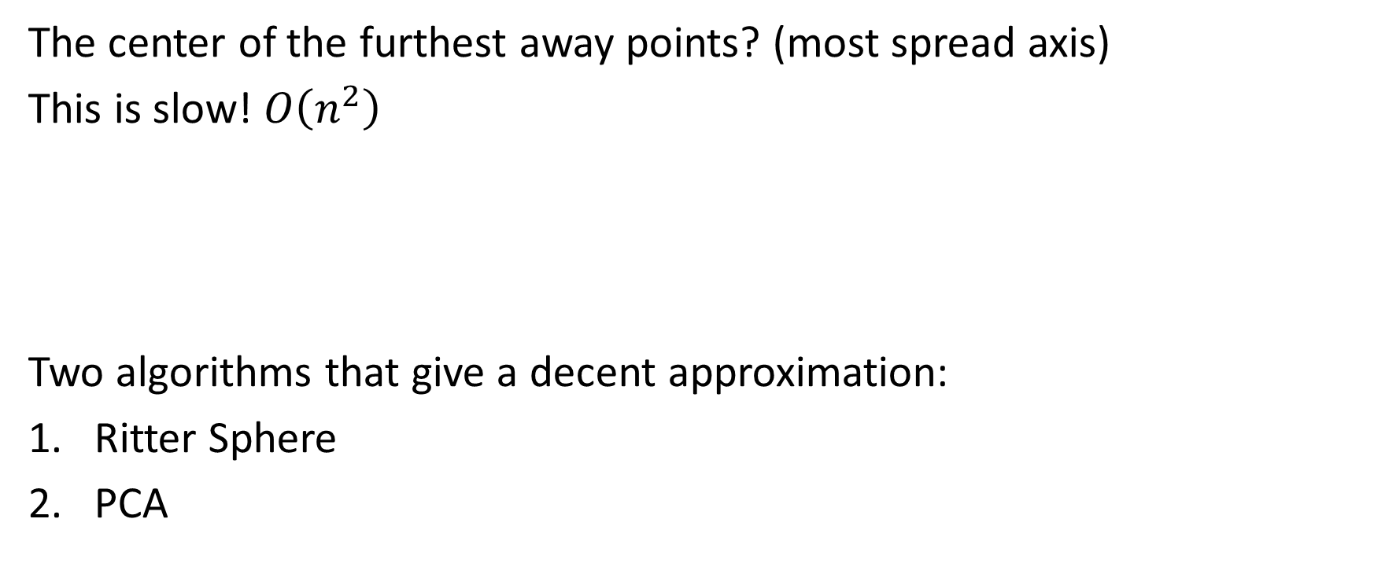
Sphere Computation
The center of the furthest away points? (most spread axis)
This is slow! $O\left(n^{2}\right)$
Two algorithms that give a decent approximation:
Ritter Sphere
PCA
Notes:
The common opinion for the sphere’s starting center is the center of the furthest away points. This would be slow as this is an $O\left(n^{2}\right)$ algorithm. Instead we’ll look at two techniques that attempt to find the axis of most spread in a more efficient way.

Slide 40
Sphere Computation - Ritter
Method 2: Ritter Sphere
Check each cardinal axes for largest spread
Largest x-spread
Largest y-spread
Notes:
Ritter sphere approximates the best axis by only checking the cardinal axes. It’s easy to find the min/max points on a cardinal axis, so we can just check all 3.

Slide 41




Sphere Computation - Ritter
Find which axis’ spread has the largest vector distance
The starting sphere is the minimum sphere of this line
$${\vec{y}}_{max}$$
$${\vec{x}}_{max}$$
$${\vec{x}}_{min}$$
$${\vec{y}}_{min}$$
Notes:
Once we have the min/max points on each axis, we compute the vector length (not axis length) of these points.
Whichever axis has the furthest away points is our approximation of the most spread.
We can now pick the starting sphere center as the midpoint of these two points with the initial radius as half the line length and then iteratively expand the sphere to contain any missing points.

Slide 42
Sphere Computation
Method 3: PCA – Principle Component Analysis
Use statistical analysis to find the axis of max spread
Notes:
Instead of checking only the cardinal axes, the axis of most spread can be computed using statistics. This is done with a technique called PCA, or Principle Component Analysis.

Slide 43


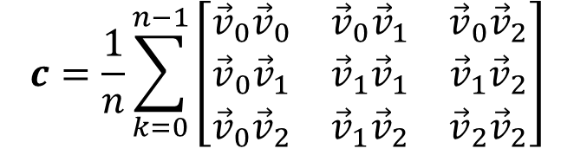

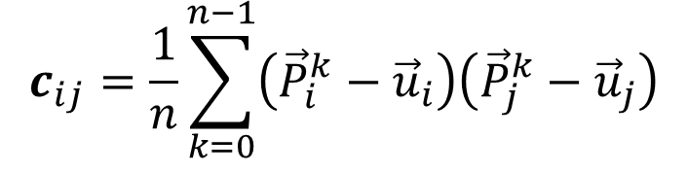
Covariance Matrix
Covariance measures how data varies together
Summation notation
Vector form
$${\vec{u}}_{i}=\frac{1}{n}\sum_{k=0}^{n−1}{{\vec{P}}_{i}^{k}}$$
$$\vec{u}=\frac{1}{n}\sum_{k=0}^{n−1}{{\vec{P}}^{k}}$$
mean
$$c_{ij}=\frac{1}{n}\sum_{k=0}^{n−1}{\left({\vec{P}}_{i}^{k}−{\vec{u}}_{i}\right)\left({\vec{P}}_{j}^{k}−{\vec{u}}_{j}\right)}$$
$$c=\frac{1}{n}\sum_{k=0}^{n−1}{\left[\begin{matrix}{\vec{v}}_{0}{\vec{v}}_{0} & {\vec{v}}_{0}{\vec{v}}_{1} & {\vec{v}}_{0}{\vec{v}}_{2} \\ {\vec{v}}_{0}{\vec{v}}_{1} & {\vec{v}}_{1}{\vec{v}}_{1} & {\vec{v}}_{1}{\vec{v}}_{2} \\ {\vec{v}}_{0}{\vec{v}}_{2} & {\vec{v}}_{1}{\vec{v}}_{2} & {\vec{v}}_{2}{\vec{v}}_{2}\end{matrix}\right]}$$
covariance
$$\text{∗}\vec{v}={\vec{P}}^{k}−\vec{u}$$
Notes:
To start with, we have to compute what’s called the covariance matrix. For two variables, we can compute the covariance value which measures how the two variables vary together. For multiple variables we end up getting a matrix.
Shown above is the equations for computing the mean of a data set which is needed to compute the covariance matrix. Typically these equations are given in summation notation (as shown on the left), on the right is the expanded vector equations.
Note that for the vector form of the covariance matrix that $\vec{v}={\vec{P}}^{k}−\vec{u}$
Also note that for the summation notation format that the superscript is the point index while the subscript is the vector index (x, y, or z value).

Slide 44
Covariance Matrix Properties
The covariance matrix is symmetric
The eigenvector with the largest eigenvalue is the axis of max spread
How do we find the eigenvectors?
Notes:
The covariance matrix has the useful property that the eigenvector that has the largest eigenvalue is the axis of max spread of the data set. The question then is how to compute the eigenvectors and eigenvalues of the matrix. There are a number of different techniques, but the one we’ll look at is the Jacobi rotation method.

Slide 45


Eigenvector and Eigenvalue
An eigenvector for a matrix is a vector that doesn’t change direction under a linear transform
$\vec{v}$ is the eigenvector
$λ$ is the eigenvalue
$$A\vec{v}=λ\vec{v}$$
Notes:
Just a quick refresher for what eigenvectors and eigenvalues are.
Basically we’re after a vector that only gets scaled when being multiplied by the matrix.

Slide 46

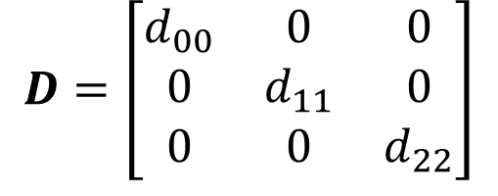
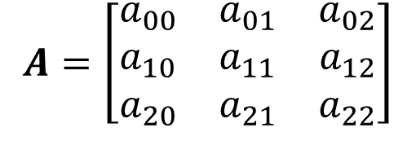
Jacobi Rotation
Hard to compute eigenvectors for general matrices:
$$A=\left[\begin{matrix}a_{00} & a_{01} & a_{02} \\ a_{10} & a_{11} & a_{12} \\ a_{20} & a_{21} & a_{22}\end{matrix}\right]$$
Easy for a diagonal matrix:
$$D=\left[\begin{matrix}d_{00} & 0 & 0 \\ 0 & d_{11} & 0 \\ 0 & 0 & d_{22}\end{matrix}\right]$$
Idea! Rotate $A$ into a diagonal matrix via some rotation matrix $J$:
$$D=J^{−1}AJ$$
Notes:
The idea of Jacobi rotation is fairly straightforward. It’s difficult to compute the eigenvectors and eigenvalues of a general matrix, however computing these is really easy for a diagonal matrix. So what we can do is build a series of rotation matrices to transform A.

Slide 47




Jacobi Rotation
Let $a_{pq}$ be the largest off-diagonal term
We want to rotate $a_{pq}$ and $a_{qp}$ to 0:
Build the rotation matrix $J$:
$$\left[\begin{matrix}∗ & & & … & & & ∗ \\ & ⋱ & & & & & \\ & & a_{pp} & … & a_{pq} & & \\ ⋮ & & ⋮ & ⋱ & ⋮ & & ⋮ \\ & & a_{qp} & … & a_{qq} & & \\ & & & & & ⋱ & \\ ∗ & & & … & & & ∗\end{matrix}\right]$$
$$\left[\begin{matrix}∗ & & & … & & & ∗ \\ & ⋱ & & & & & \\ & & {a′}_{pp} & … & 0 & & \\ ⋮ & & ⋮ & ⋱ & ⋮ & & ⋮ \\ & & 0 & … & {a′}_{qq} & & \\ & & & & & ⋱ & \\ ∗ & & & … & & & ∗\end{matrix}\right]$$
$$\left[\begin{matrix}1 & & & … & & & 0 \\ & ⋱ & & & & & \\ & & c & … & s & & \\ ⋮ & & ⋮ & ⋱ & ⋮ & & ⋮ \\ & & −s & … & c & & \\ & & & & & ⋱ & \\ 0 & & & … & & & 1\end{matrix}\right]$$
Notes:
The easiest way to think about the Jacobi rotation algorithm is that we build rotation matrices one at a time to transform $A$ such that the largest off-diagonal term (and it’s symmetric pair) becomes zero. The idea behind picking the largest term is to make the most progress at each step.
Since we’re only worrying about 2 terms each rotation matrix we can envision the rotation matrix as a very sparse matrix that is the identity except for the rotational sin and cosine terms that are at $p$ and $q$ indices.

Slide 48

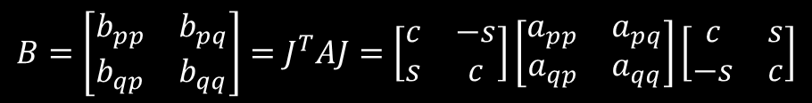
Jacobi Rotation
Inspect the rotational terms:
We can expand to get equations for to get $b_{pq}$:
$$b_{pq}=csa_{pp}−s^{2}a_{pq}+c^{2}a_{pq}−csa_{qq}$$
Solve for $b_{pq}=0$
$$B=\left[\begin{matrix}b_{pp} & b_{pq} \\ b_{qp} & b_{qq}\end{matrix}\right]=J^{T}AJ=\left[\begin{matrix}c & −s \\ s & c\end{matrix}\right]\left[\begin{matrix}a_{pp} & a_{pq} \\ a_{qp} & a_{qq}\end{matrix}\right]\left[\begin{matrix}c & s \\ −s & c\end{matrix}\right]$$
Notes:
Instead of building this large matrix each time, we can further inspect the multiplications of $J^{1}AJ$. What we’re after here is to compute the new matrix that will cause $a_{pq}$ and $a_{qp}$ which will go to 0.
With a little bit of work, we can expand this matrix multiplication to get all of the terms of B. However, we only care about the off-diagonal terms as we want to solve to make them equal to 0.
Note: I re-arranged some terms knowing that $a_{pq}=a_{qp}$

Slide 49

Jacobi Rotation
Expand and solve:
$b_{pq}=0=csa_{pp}−s^{2}a_{pq}+c^{2}a_{pq}−csa_{qq}$
To get:
$\frac{a_{qq}−a_{pp}}{a_{pq}}=\frac{c^{2}−s^{2}}{cs}$
To make life easier divide both sides by 2
$\frac{a_{qq}−a_{pp}}{2a_{pq}}=\frac{c^{2}−s^{2}}{2cs}$
Let $β=\frac{a_{qq}−a_{pp}}{2a_{pq}}$
Solve for $s$ and $c$
Notes:
With some simple re-arranging we can get all of the terms in $a$ on one side and all cosine and sine terms on the other. Now since one side is just a bunch of constants (all the $a$ terms) we can group them together: $β=\frac{a_{qq}−a_{pp}}{2a_{pq}}$. Now we have the equation $β=\frac{c^{2}−s^{2}}{2cs}$ to solve.

Slide 50

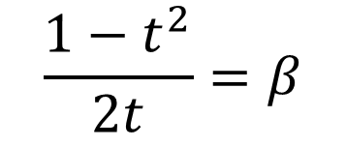
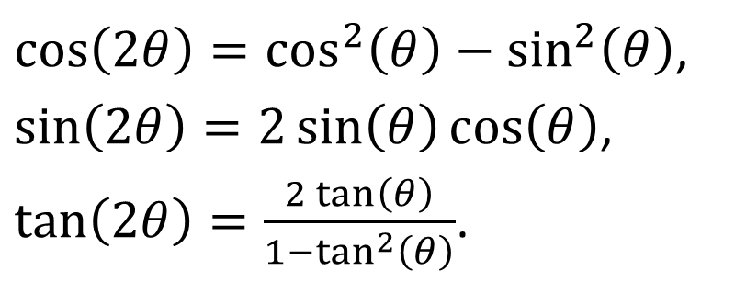

Jacobi Rotation
Use the trig identities:
Re-arrange into an equation in terms of tangent ($t=\tan\left(θ\right)$):
$\cos\left(2θ\right)=\cos^{2}\left(θ\right)−\sin^{2}\left(θ\right)$,
$\sin\left(2θ\right)=2\sin\left(θ\right)\cos\left(θ\right)$,
$\tan\left(2θ\right)=\frac{2\tan\left(θ\right)}{1−\tan^{2}\left(θ\right)}$.
$$\frac{1−t^{2}}{2t}=β$$
Or
$$t^{2}+2tβ−1=0$$
Notes:
Now we have 1 equation with 2 unknowns (cosine and sine). We can use trig identities to re-arrange and get everything in terms of tangent (so we only have 1 unknown).
We had $β=\frac{c^{2}−s^{2}}{2cs}$, plugging the double angle formulas for cosine and sine in we now can get: $β=\frac{cos\left(2θ\right)}{sin\left(2θ\right)}$ which we can then relabel as $β=\frac{1}{tan\left(2θ\right)}$.
Now we can plug in the double angle formula for tangent to get: $β=\frac{1−\tan^{2}\left(θ\right)}{2tan\left(θ\right)}$.
Now by labeling $t=tan\left(θ\right)$ we can re-arrange this equation to put everything on one side and we end up with a quadratic formula to solve in terms of $t$.

Slide 51
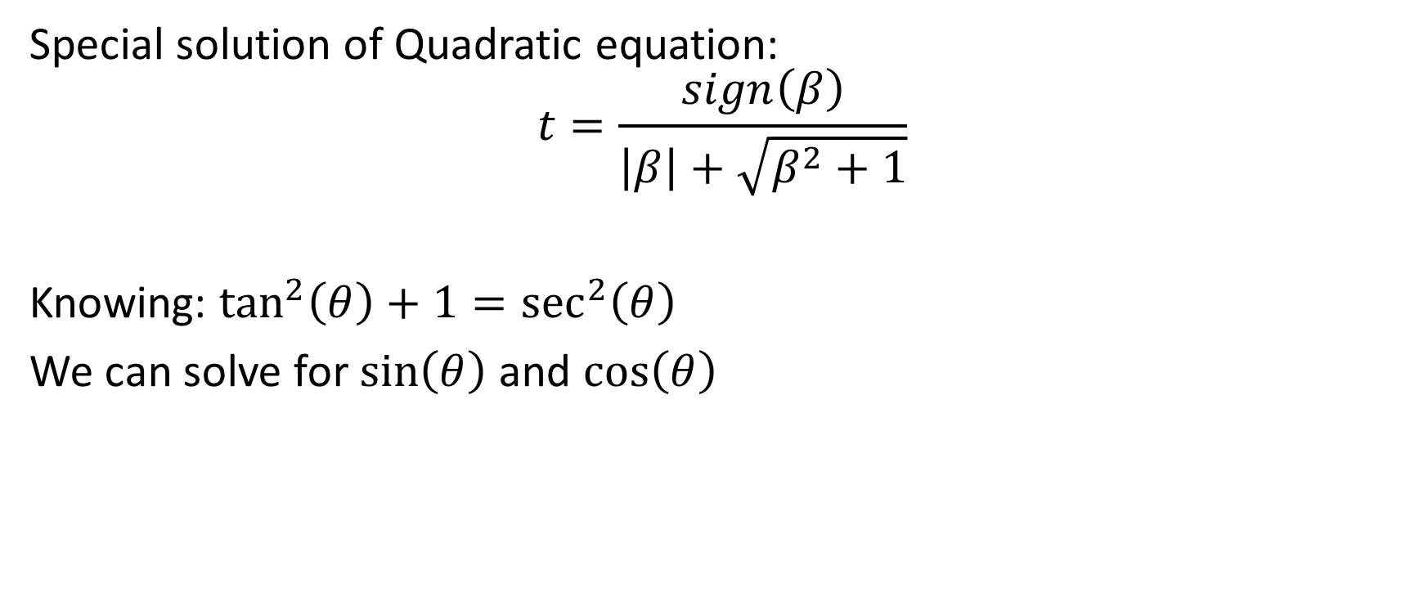
Jacobi Rotation
Special solution of Quadratic equation:
$$t=\frac{sign\left(β\right)}{\left|β\right|+\sqrt{β^{2}+1}}$$
Knowing: $\tan^{2}\left(θ\right)+1=\sec^{2}\left(θ\right)$
We can solve for $\sin\left(θ\right)$ and $\cos\left(θ\right)$
Notes:
We can solve this specific version of the quadratic formula as shown above, where $sign\left(β \right)$ returns either -1 or 1 depending on the sign of $β$.
Finally, knowing a few more trig identities we can solve for cosine and sine.

Slide 52
Jacobi Rotation
Continue this process until:
The matrix is diagonal (or close enough)
We do enough iterations
Notes:
So how long do we perform this for? Well the desired result is until our matrix becomes diagonal, or at least close enough. One good measure is to see if the sum of the squared off diagonal terms is below some epsilon value.
The other termination condition is just some max number of iterations. It could take too long to converge to a solution so in that case we just cap out at something like 50 iterations.

Slide 53

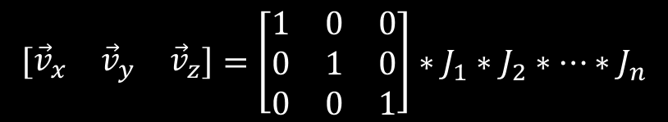

Jacobi Rotation
$$A=\left[\begin{matrix}e_{x} & 0 & 0 \\ 0 & e_{y} & 0 \\ 0 & 0 & e_{z}\end{matrix}\right]$$
At the end we’ll have:
Where $e_{i}$ is the eigenvalue of eigenvector $i$.
To get the eigenvectors:
$$\left[\begin{matrix}{\vec{v}}_{x} & {\vec{v}}_{y} & {\vec{v}}_{z}\end{matrix}\right]=\left[\begin{matrix}1 & 0 & 0 \\ 0 & 1 & 0 \\ 0 & 0 & 1\end{matrix}\right]∗J_{1}∗J_{2}∗…∗J_{n}$$
Notes:
So after all that work we’ll have the eigenvalues of our points which we can use to select the largest eigenvector, but how do we get the eigenvector? We simply transform the identity matrix by our series of rotation matrices and the columns of the resultant matrix are the eigenvectors.

Slide 54
PCA
Find the axis of max spread (Jacobi Rotation)
Find the two points furthest apart on this axis
The mid-point is the sphere’s starting center
Iteratively expand until all points are contained
Notes:
Now that we have the axis of most spread we can find the 2 points furthest away on this axis and choose their mid-point as the center of our sphere.
From here we can iteratively increase our sphere as before.

Slide 55
Sphere Computation
Method 4: Iterative refinement
Take previous results
Shrink sphere
Try again
Notes:
Another simple idea is to iterate on the results of a previous guess. When expanding a sphere to contain all points, the choice of the center and the order of the points greatly affect the result. We can take the previous sphere’s center, shrink the radius by some amount (so some points are outside), and visit the points in a different order to produce a different sphere. At some point, this new sphere is likely to be smaller than our previous one. In this case we keep that sphere and continue iterating again. If we do this for a few iterations then we’re likely to produce a close to ideal bounding sphere.

Slide 56

Sphere Computation
Method 5: Minimum bounding sphere - brute force
A sphere is uniquely defined by up-to 4 non-coplanar points
Try all combinations of 2, 3, and 4 point spheres $O\left(n^{5}\right)$
Need to know how to compute minimum sphere of these sizes
Notes:
All of the previous methods were approximation methods at a bounding sphere. Methods for computing the minimum bounding sphere do exist, but they can become quite expensive. In computing a minimum bounding sphere, the best place to start looking is the brute force method. It should be easy to see that a sphere in 3d is uniquely defined by 4 points. Sometimes, 4 points are unnecessary. It should be easy to come up with an example of 4 points where some of the points are not on the surface of the sphere. This leads us to realize that a minimum bounding sphere in 3d comes from some combination of up to 4 points.
From here it’s easy to come up with a brute force algorithm. Compute the minimum bounding sphere for all combinations of 4 points, 3 points, and 2 points. The smallest of these are the minimum bounding sphere. Unfortunately, this algorithm is $O\left(n^{5}\right)$ so not feasible for any reasonably sides point set. That being said, it lets us know what information is required. Namely, we need to know how to compute the minimum bounding sphere of 2 points, 3 points, and 4 points.

Slide 57

Sphere Computation
Method 6: Minimum bounding sphere
- Welzl’s Algorithm (expected $O\left(n\right)$)
Sphere Welzl(const std::vector<Vector3>& points, int numPoints, std::vector<Vector3>& sos, int numSos)
{
if(numPoints == 0 || numSos == 4)
{
switch(numSos)
{
case 0: return Sphere();
case 1: return Sphere(sos[0]);
case 2: return Sphere(sos[0], sos[1]);
case 3: return Sphere(sos[0], sos[1], sos[2]);
case 4: return Sphere(sos[0], sos[1], sos[2], sos[3]);
}
}
int index = numPoints - 1;
Sphere smallestSphere = Welzl(points, numPoints - 1, sos, numSos);
if(smallestSphere.ContainsPoint(points[index]))
return smallestSphere;
sos[numSos] = points[index];
return Welzl(points, numPoints - 1, sos, numSos + 1);
}
Notes:
There many are ways to compute a minimum bounding sphere from a collection of points. The simplest way to think of is a $n^{5}$ algorithm where you start with all combinations of 4 points (then 3 then 2) and keep the smallest sphere that contains all other points.
Fortunately, the problem of finding a minimum bounding sphere has been well researched and there is a better method (although still slow) known as Welzl’s method. This method is a randomized algorithm that is expected to run in linear time. The idea is that if you have a bounding sphere and a point, if that point is inside the sphere then we’re fine, however if the point is outside the sphere then the minimum sphere needs to be recomputed and that point is on the surface of the minimum bounding sphere.
Once you grasp the flow of the algorithm, the only parts left to cover are how to compute the minimum bounding sphere of all the different number of points. For 0, 1, and 2, points the result is trivial, however 3 and 4 are not so trivial. The simple idea is to find the point equidistance from each point but taking into account several edge cases. Details of this are not shown here, although I’ll give a quick outline in class.

Slide 58
Obb
struct Obb
{
Vector3 mPosition;
Matrix3 mBasis;
Vector3 mHalfExtents;
};
Not easy to compute – which axes?
Use PCA
Expensive intersection:
15 axis checks (more in SAT lecture)
Notes:
Obbs (oriented bounding boxes) are a more tight fitting bounding volume than aabbs and spheres, however the computational cost of computing them is higher. On top of that, intersection tests are significantly more expensive (full SAT test required of 15 axes). Because of this I don’t recommend using them and I won’t go into any more detail on them.

Slide 59
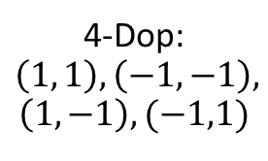

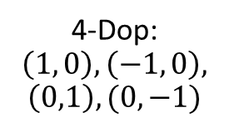
K-Dop
Basically an aabb on certain pre-defined axes
Typically some form of $\left\{−1,0,1\right\}$ on each axis
4-Dop:
$$\left(1, 0\right), \left(−1, 0\right),$$
$$\left(0,1\right), (0, −1)$$
4-Dop:
$$\left(1, 1\right), \left(−1, −1\right),$$
$$\left(1,−1\right), (−1,1)$$
8-Dop
Notes:
One tighter fit bounding volume is what’s known as a k-dop (Discrete-oriented polytope). K-Dops are very similar to Aabbs, except that we pick several other axes. For instance, a 6-Dop is equivalent to an aabb. Typically, the axes used are only of some form of $\{−1, 0, 1\}$. K-dops are fairly easy to compute, as they are just performing some dot products to find the furthest value in a given direction.
Intersections for k-dops are easy as it’s just an extension of the aabb check, that is check all “axes” and see if the projection interval overlaps.
Updates are not as easy. The same methods to update an aabb can be used on a k-dop, albeit they are more expensive and complicated to implement.

Slide 60
Convex Hull
Best convex approximation possible
Expensive to compute
Expensive to intersect
Notes:
At the extreme end of tight fit bounding volumes is the convex hull. A convex hull is the tightest fit convex shape that wraps your object. While they are tight fit, they are also fairly expensive to compute and test for intersection.
One common method of computing the convex hull is to use the quick-hull algorithm. At a high level, quick-hull sub-divides the points into two sides. On each side the point furthest in the direction of the normal is computed and then those points are split into the two new sides. This continues until all points are contained. 3d quick-hull follows the same algorithm but has a few more edge cases to deal with.
Another form of convex hull computation which is sometimes more beneficial is approximate convex hulls. The idea is to not take the tightest fit hull, but some approximation that will be good enough and require less detail.
To intersect convex hulls you either need to test all half-spaces or use some generic convex algorithm such as GJK (which will be covered later).

Slide 61
Questions?

