Slide 1
Sweep And Prune
jodavis42@gmail.com

Slide 2
What’s good changes over time
SAP used to be hot
Now it’s not

Slide 3
Non-Uniform Grids
Uniform grids have problems
Cell size
Cell boundaries
Can we make a non-uniform grid?
Notes:
For all of the benefits given by uniform grids so far they have a small set of big problems. The two main problems are what size cells to pick when we have varying sized objects and how to deal with objects that cross cell boundaries. The first of these problems are addressed by H-grids but not without cost. H-grids take a significantly larger memory footprint and queries are more costly. These are all problems because we’ve made a fixed grid in space independently of where objects are.
This leads to the question, can we make a non-uniform grid?

Slide 4
Aabbs Define a Non-Uniform Grid
Each object’s Aabb defines a “cell”
Notes:
The short answer is yes, we can define a non-uniform grid. In fact, aabbs implicitly define a non-uniform grid as shown above.

Slide 5
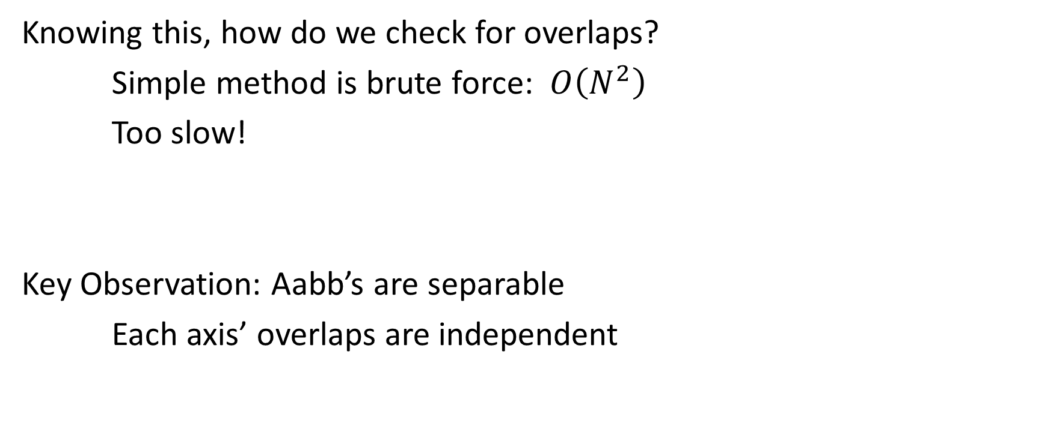
Aabbs Define a Non-Uniform Grid
Knowing this, how do we check for overlaps?
Simple method is brute force: $O\left(N^{2}\right)$
Too slow!
Key Observation: Aabb’s are separable
Each axis’ overlaps are independent
Notes:
The simple way to check for overlaps in a non-uniform grid is brute force which is $n^{2}$ complexity, but we can do much better than this!
The key observation that will provide improvements is that aabb intersection tests are separable, that is each axis’ overlap result can be computed independently and combined later.

Slide 6
Aabb Overlap Separation
Basic (and slow) idea is to separate each axis’ check
for(size_t axis = 0; axis < 3; ++axis)
{
for(size_t i = 0; i < mAabbs.size(); ++i)
{
for(size_t j = i; j < mAabb.size(); ++j)
{
// Check the overlap only on the given axis
CheckOverlap(mAabbs[i], mAabbs[j], axis);
}
}
}
for(size_t i = 0; i < mAabbs.size(); ++i)
{
for(size_t j = i; j < mAabb.size(); ++j)
{
// Check the aabbs for overlap
CheckOverlap(mAabbs[i], mAabbs[j]);
}
}
Notes:
The most basic idea here now is instead of doing a double loop over the input aabbs we now iterate over each axis independently and check for overlaps on that axis (a range check). So far this doesn’t give us anything except more work but we’ll slowly get somewhere better.

Slide 7
Simple 1-Dimensional SAP
Let’s make an approximation and only check the x-axis (for now)
This will return (big) false positives but allows us to build up to something
Notes:
As a spatial partition’s job is to find false positives we can make a very crude approximation: If the aabbs don’t overlap on the x-axis then we prune them out of our possible pairs. This means we can still return objects that overlap on the other axis’ and leave that to narrow-phase to detect (for now). While this may save us some small work we still have algorithmic complexity of $O\left(n^{2}\right)$, but now that we’re investigating one axis we can more easily solve this problem.

Slide 8
Simple 1-Dimensional SAP
How do we represent each object?
Min/Max projections on each axis (end points)
class SapBox
{
void* mClientData;
Aabb mAabb;
}
Each object has an associated box
class EndPoint
{
bool mIsMin;
float mValue;
SapBox* mBox;
}
Each box creates two end-points for an axis
Notes:
Moving forward to optimize this we need to first figure out how we want to represent each object on an axis. While there are other options I’ll just jump forward to the simple representation of an end-point.

Slide 9
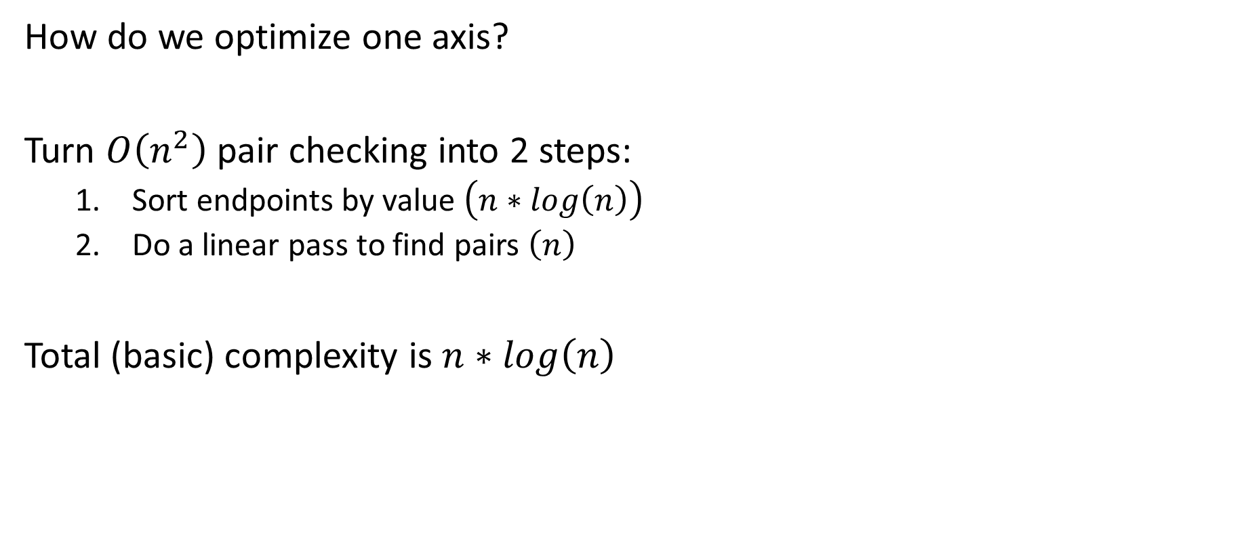
Simple 1-Dimensional SAP
How do we optimize one axis?
Turn $O\left(n^{2}\right)$ pair checking into 2 steps:
Sort endpoints by value $\left(n∗log\left(n\right)\right)$
Do a linear pass to find pairs $\left(n\right)$
Total (basic) complexity is $n∗log\left(n\right)$
class SapBox
{
void* mClientData;
Aabb mAabb;
}
class EndPoint
{
bool mIsMin;
float mValue;
SapBox* mBox;
}
Notes:
So with this collection of end-points on each axis how can we optimize finding pairs? Well I’m going to claim that we can turn finding pairs from $O\left(n^{2}\right)$ into a sort operation (technically $O\left(nlogn\right)$ but we’ll come back to this) and a linear sweep.

Slide 10
Simple 1-Dimensional SAP
Finding pairs on a sorted array is simple:
for(size_t i = 0; i < mEndpoints.size(); ++i)
{
if(mEndpoints[i].IsMin())
{
// Create pairs with everything in our map
// Add this object to the map
}
else
// Remove from the map
}
Notes:
The algorithm to find pairs on a sorted array is simple with the use of an associative container. Simply walk over all end-points, and add/remove them to a map depending on if they’re a min or a max.

Slide 11






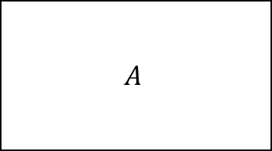
1-D Sweep Example
EndPoint Set
$$A$$
C
A
B
Registered Pairs
$$A_{min}$$
$$C_{min}$$
$$A_{max}$$
$$B_{min}$$
$$C_{max}$$
$$B_{max}$$
Encountered a min: Create pairs with everything in the set and then add to set
Notes:
Now for a quick example of performing this sweep to find pairs. To start we have A’s min. There’s nothing already in the end-point set so no pairs are created. Object A is then added to the set.

Slide 12
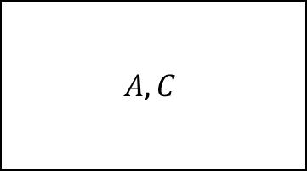
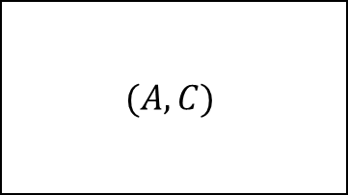
1-D Sweep Example
EndPoint Set
$$A,C$$
C
A
B
Registered Pairs
$$(A,C)$$
$$A_{min}$$
$$C_{min}$$
$$A_{max}$$
$$B_{min}$$
$$C_{max}$$
$$B_{max}$$
Encountered a min: Create pairs with everything in the set and then add to set
Notes:
No we find C’s min. Since A is already in the set we create the pair (A,C) and then add C to the set.

Slide 13
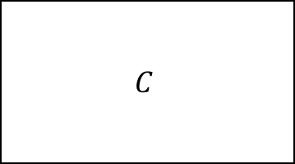
1-D Sweep Example
EndPoint Set
$$C$$
C
A
B
Registered Pairs
$$(A,C)$$
$$A_{min}$$
$$C_{min}$$
$$A_{max}$$
$$B_{min}$$
$$C_{max}$$
$$B_{max}$$
Encountered a max: Remove from endpoint set
Notes:
Now we find A’s max. As this is a max end-point we just remove the associated object from the end-point set.

Slide 14
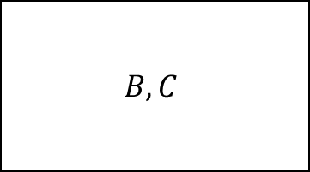
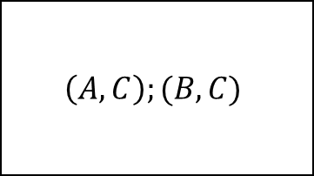
1-D Sweep Example
EndPoint Set
$$B,C$$
C
A
B
Registered Pairs
$$\left(A,C\right);(B,C)$$
$$A_{min}$$
$$C_{min}$$
$$A_{max}$$
$$B_{min}$$
$$C_{max}$$
$$B_{max}$$
Encountered a min: Create pairs with everything in the set and then add to set
Notes:
Once again, we find B’s min so we create the pair (B,C) and then add B to our set.

Slide 15
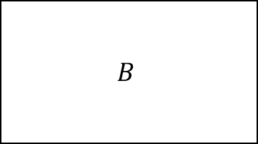
1-D Sweep Example
EndPoint Set
$$B$$
C
A
B
Registered Pairs
$$\left(A,C\right);(B,C)$$
$$A_{min}$$
$$C_{min}$$
$$A_{max}$$
$$B_{min}$$
$$C_{max}$$
$$B_{max}$$
Encountered a max: Remove from endpoint set
Notes:
C’s max removes C from the end-point set.

Slide 16
1-D Sweep Example
EndPoint Set
C
A
B
Registered Pairs
$$\left(A,C\right);(B,C)$$
$$A_{min}$$
$$C_{min}$$
$$A_{max}$$
$$B_{min}$$
$$C_{max}$$
$$B_{max}$$
Encountered a max: Remove from endpoint set
Notes:
Finally we have B’s max so we remove B from the set.

Slide 17
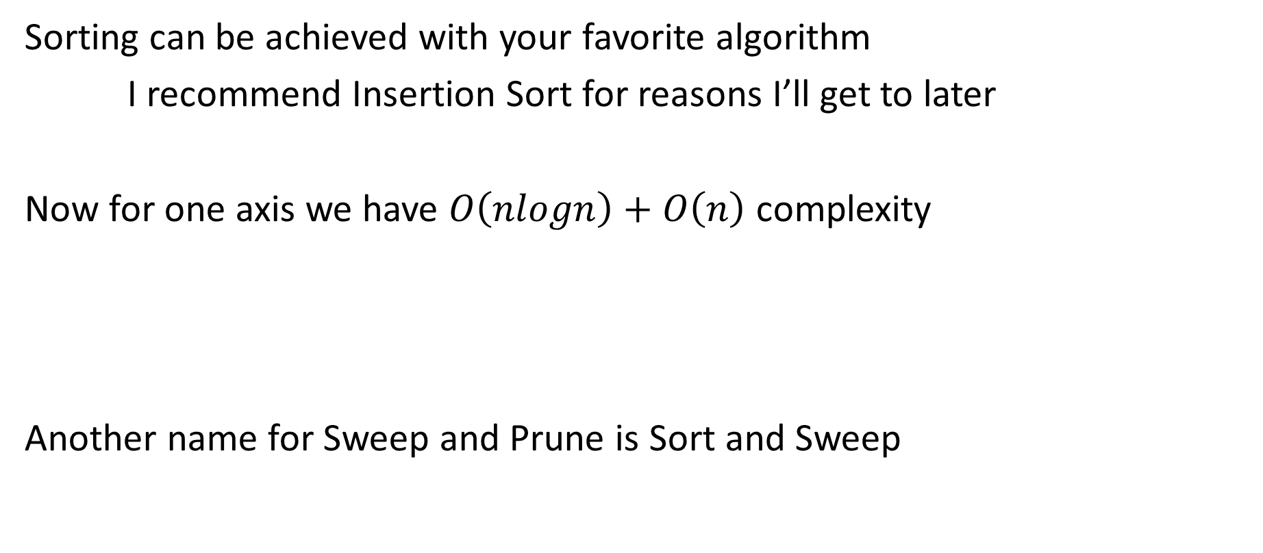
Simple 1-Dimensional SAP
Sorting can be achieved with your favorite algorithm
I recommend Insertion Sort for reasons I’ll get to later
Now for one axis we have $O\left(nlogn\right)+O\left(n\right)$ complexity
Another name for Sweep and Prune is Sort and Sweep
Notes:
Sorting on an axis is simple and can be achieved with any sorting algorithm you know of. This technically will gives us an $O\left(nlogn\right)$ sort time with something like quick-sort, but for reasons I’ll get to soon I actually recommend insertion sort even though it is $O\left(n^{2}\right)$.
Now we’ve finished off a 1-dimensional SAP algorithm, or to be more precise this version of SAP is often called Sort and Sweep instead. This should be obvious from the name: we perform a sort over an array and then a linear sweep to find pairs.

Slide 18
N-Dimensional SAP
Shapes only overlap when all axes overlap!
Sort all axes
Sweep over all axes, only inserting a pair if all overlap
Notes:
Now that we’ve established how SAP works in 1-Dimension it shouldn’t be too hard to see how we can extend it to 2 or even n-dimensions. Just as with an aabb where we combine each axis’ results and only register a collision if we have an overlap on all axes, with SAP we simply keep track of how many axes a pair is overlapping on. If there is overlap on all $n$ axes then the shapes overlap.
One alternative to SAP is to only sort and sweep on 1 (or more) axes and perform the remaining aabb check before inserting a pair.

Slide 19
Simple SAP Structure
We can now define the most basic SAP structure:
class Sap
{
Array<SapBox> mBoxes;
Array<EndPoint> mEndPoints[3];
}
We’ll build up to something better (and more complex) now.
Ask now if you are confused!!
class SapBox
{
void* mClientData;
Aabb mAabb;
}
class EndPoint
{
bool mIsMin;
float mValue;
SapBox* mBox;
}
*Please ignore any structure issues for now…
Notes:
This is the basic data structure of what’s been described so far. Our SAP class has a collection of boxes, one for each object. This box stores the client data inserted as well as the aabb inserted. Additionally we have several arrays of end-points (one for each axis). Each end-point array is sorted based upon the value in the end-point structure. To add/remove pairs we also store the box pointer in each end-point.
This structure has several problems (such as pointers into arrays), but ignore them for now. I’ll start going over the canonical form of SAP now that we understand the basics of how everything works. As a warning, while this will give quite a big performance boost it will also make things much more complicated!

Slide 20
Spatial Coherence – EndPoint Sorting
Problem 1: Why are we sorting each axis every frame?
Object’s don’t move much from frame-to-frame!
Examples:
What if only one object moves?
What if no objects move?
What if all objects barely move (endpoint order might not change)?
Notes:
The first thing to note is that we are wasting a lot of time by sorting each axis from scratch every frame. If we have 100 objects but only 1 moves why not store last frame’s sorted axes and just update the endpoints for that box? This is an extreme example but it comes up more than you might think. In particular, if we look at the principle of spatial coherence you’ll see that this happens a lot! As objects barely move from frame-to-frame there’s a good chance that even if every object moves that they’ve only moved a little and hence we’ll have an update very close to $n$.

Slide 21
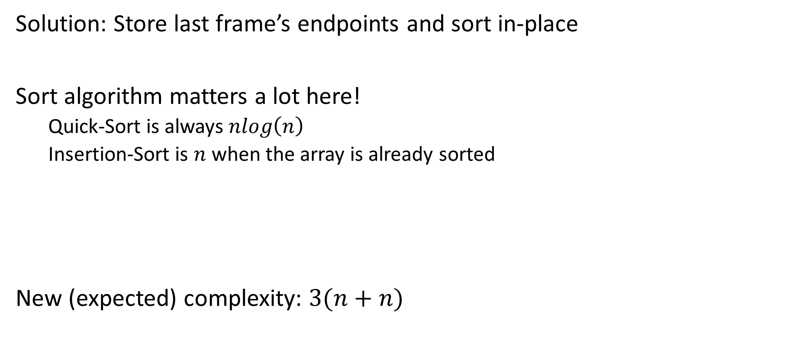
Spatial Coherence – EndPoint Sorting
Solution: Store last frame’s endpoints and sort in-place
Sort algorithm matters a lot here!
Quick-Sort is always $nlog\left(n\right)$
Insertion-Sort is $n$ when the array is already sorted
New (expected) complexity: $3(n+n)$
Notes:
This leads us to the obvious solution of keeping around last frame’s sorted endpoints. We have to be careful of our sorting algorithm though, as some of the “better” sorting algorithms like quick-sort are always (worst and best case) $nlogn$. This is where insertion sort will out-perform other sorting algorithms as it is $n$ when the array is already sorted.
Now we can expect SAP to sort in almost $n$ time for each axis plus as additional $n$ per axis of finding overlaps

Slide 22
Spatial Coherence – Pair Registration
Problem 2: Why perform a full pass on an axis to find pairs each frame?
Idea: Cache last frame’s pairs and incrementally update!
Notes:
The second major optimization we can make is also related to spatial coherency. If we don’t sort each frame then why are we finding all pairs every frame? Why not use last-frame’s cached pairs and update them incrementally whenever we move (or insert or remove) an object?

Slide 23
Spatial Coherence – Pair Registration
4 Rules for updating:
B
B
A
A
1. A max becomes greater than a min: Insert a pair
2. A min becomes less than a max: Insert a pair
* Depends on if A or B was moving
Notes:
It turns out we can build 4 simple rules (plus one minor rule) that allow us to determine whether to add or remove a pair while swapping end-points. This means while performing insertion sort we can simultaneously (un)register pairs.
The first two cases both are when a pair needs to be inserted. These cases are effectively the same thing, they only differ by which object moved into the other.

Slide 24
Spatial Coherence – Pair Registration
4 Rules for updating:
B
B
A
A
3. A max becomes less than a min: Remove a pair
4. A min becomes greater than a max: Remove a pair
* Depends on if A or B was moving
Notes:
The second two cases both cause a pair to be removed.

Slide 25
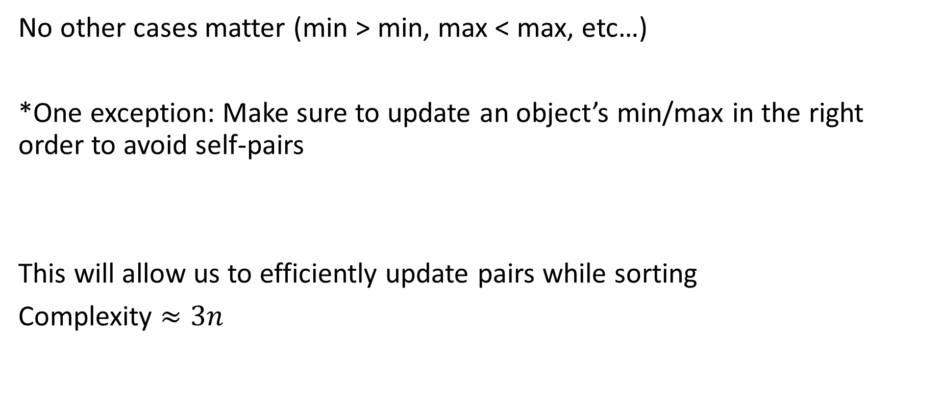
Spatial Coherence – Pair Registration
No other cases matter (min > min, max < max, etc…)
*One exception: Make sure to update an object’s min/max in the right order to avoid self-pairs
This will allow us to efficiently update pairs while sorting
Complexity $≈3n$
Notes:
You might be wondering about all of the other end-point cases, but none of them matter as none of them can create/remove a pair.
There is one small exception to this rule that only applies to “fast” moving objects. If you aren’t careful and a max of an object becomes less than its own min (because it’s moving fast to the left) then a pair will be registered with itself. This is easy to fix by just adjusting whether which end-point is moved first. If the object is moving to the right then update max then min, otherwise update min then max.
With this in place our theoretical complexity is now $3n$ because we sort in approximately $n$ complexity on each axis while simultaneously registering pairs on each axis. Before going over the actual issues that come up (such as worst-case counter examples) I need to revisit the structure of SAP and do some examples.

Slide 26
SAP Structure - Revisted
When updating how do we find the box?
Give the box pointers to each endpoint?
Storing pointers in an array is bad
Linked lists are slower
Store indices?
Close, but we’ll go a step further
class Sap
{
Array<SapBox> mBoxes;
Array<EndPoint> mEndPoints[3];
}
class SapBox
{
void* mClientData;
Aabb mAabb;
}
class EndPoint
{
bool mIsMin;
float mValue;
SapBox* mBox;
}
Notes:
There’s a few major structural problems with SAP now that we have cache last frame’s data. Namely how do we find each endpoint to update. If we have to search for it then we’re back to an $n^{2}$ complexity.
We could try to store pointers into the endpoint array but this is all sorts of bad. Not only would we have to manage and update the pointers, but any time we resize the array all pointers could go bad. One solution is to instead store the endpoints in a linked list. This will actually be slower in the long run, mostly due to memory overhead and cache coherency.
If we’re sticking with arrays then we could store indices instead of pointers. Indices are stable when an array is resized, but we have to do a lot of maintenance on them. This is very close to what we’ll end up with, but we’ll go one step further to help optimize performance, mainly cache coherency.

Slide 27
SAP Structure - Revisted
class Sap
{
Array<SapBox> mBoxes;
Array<EndPoint> mEndPoints[3];
Array<int> mIndices;
}
Give each endpoint an index (not into boxes)
Add this “weird” indices array
class SapBox
{
void* mClientData;
Aabb mAabb;
}
class EndPoint
{
bool mIsMin;
float mValue;
int mIndex;
}
Notes:
Now we’ve done some very minor changes for a much more stable (and efficient) SAP representation. In particular, we gave each endpoint an index (note: this is not the box index, I’ll get there later) and now the SAP structure has this weird array of indices. Understanding mIndices is crucial and requires pictures.

Slide 28













SAP Structure - Revisted
$$Box 0_{A}$$
Indices is an in-between mapping of boxes to endpoints
1:6 box to endpoint mapping
Endpoint index points into indices
Can check all endpoint values
Can get to box by dividing by 6
Can hijack a bit from index for min/max flag
Very cache coherent
Questions!?
mBoxes
mIndices
$$0_{x}$$
$$1_{x}$$
$$0_{y}$$
$$1_{y}$$
$$0_{z}$$
$$1_{z}$$
mAxes[0]
$$0_{i}$$
$$1_{i}$$
mAxes[1]
$$2_{i}$$
$$3_{i}$$
mAxes[2]
$$4_{i}$$
$$5_{i}$$
Notes:
This weird indices gives us a 1:6 mapping of a box to its endpoints. Each box gets 6 entries in the indices array. Each of these indices corresponds to the locations of the min/max endpoints on each axis. Each axis now stores an index back into the indices array.
We can now very efficiently jump around from axes to indices to boxes to other axes and so on. Here’s a quick list of what you can do:
Go from an endpoint to it’s box: endpoint.mIndex / 6.
Go from a box to any min/max. For instance the y-min will be at index: boxIndex * 6 + 2
Compute a max’s index for a min: mIndices[endpoint.mIndex + 1]
Go from any axis’ endpoint to any other. For instance x-min to z-max will be at index: mIndices[endpoint.mIndex + 5].
And so on…
This is especially efficient as we can jump between all of these with as minimal cache misses as possible which leads to SAP being very fast. We can actually increase the cache coherency by a small amount by combining the min/max bool with the index (since we’re never going to store 2 billion contiguous objects anyways…).

Slide 29
SAP
Insertion/Removal/Update are all very similar now
They all involve sorting endpoints into place
Notes:
Now I can finally talk about insertion, update, and removal. They’re all very similar though as they all have to sort end-points into place and register pairs. In fact, there’s a high chance (read this as you should implement SAP like this) that they’ll all share some function to sort end-points while registering pairs.

Slide 30
SAP - Insert
To insert:
Add a new box (or re-use an empty one)
Add 6 new indices (or re-use old ones)
Push 2 endpoints onto each axis and sort into place
* Don’t forget to register pairs while sorting
Notes:
To insert we have to first determine if we have any boxes that are empty (that we’re previously deleted). If so then we re-use that box and its corresponding indices. Otherwise we push back a new box and 6 new endpoints. In either case we then push back 2 new endpoints per axis and sort them into place.

Slide 31









SAP - Insert
mBoxes
$$Box 0_{A}$$
$$Box 1_{B}$$
mIndices
$$0_{x}$$
$$1_{x}$$
$$…$$
$$2$$
$$3_{x}$$
mAxes[0]
$$0_{i}$$
$$1_{i}$$
$$6_{i}$$
$$7_{i}$$
* Only x-axis is shown
Notes:
Showing a very basic insert. We don’t have any free boxes so we just push back a new one, 6 new indices, and push back 2 new endpoints. Note that only the x-axis is shown here for simplicity.

Slide 32








SAP - Insert
mBoxes
$$Box 0_{A}$$
$$Box 1_{B}$$
$$Box 2_{C}$$
mIndices
$$0_{x}$$
$$1_{x}$$
$$…$$
$$2$$
$$3_{x}$$
$$…$$
$$4_{x}$$
$$5_{x}$$
mAxes[0]
$$0_{i}$$
$$1_{i}$$
$$6_{i}$$
$$7_{i}$$
$${12}_{i}$$
$${13}_{i}$$
* Only x-axis is shown
Notes:
Now we added shape C. Once again we just push back a new box, 6 new indices, and 6 new endpoints.

Slide 33
SAP - Removal
To Remove:
Mark the box as invalid
Set the endpoints to infinity and sort out
*Make sure to remove pairs when sorting
Stop referencing the indices
Notes:
To remove we simply mark the associated box as invalid and set all of the endpoints to infinity. After this running the sort update algorithm will move the endpoints to the end of each axis and we can remove them. This will also remove all pairs.

Slide 34




SAP - Removal
mBoxes
$$Box 0_{A}$$
$$Box 2_{C}$$
mIndices
$$0_{x}$$
$$1_{x}$$
$$…$$
$$…$$
$$2_{x}$$
$$3_{x}$$
mAxes[0]
$$0_{i}$$
$$1_{i}$$
$${12}_{i}$$
$${13}_{i}$$
Notes:
Now we deleted box B. We mark the box as invalid and sort the endpoints out to remove them.

Slide 35





SAP - Insert
mBoxes
$$Box 0_{A}$$
$$Box{ 1}_{D}$$
$$Box 2_{C}$$
mIndices
$$0_{x}$$
$$1_{x}$$
$$…$$
$$4_{x}$$
$$5_{x}$$
$$…$$
$$2_{x}$$
$$3_{x}$$
mAxes[0]
$$0_{i}$$
$$1_{i}$$
$${12}_{i}$$
$${13}_{i}$$
$$6_{i}$$
$$7_{i}$$
Notes:
Now we added another shape, but since we had a spare box we re-use it and its indices.

Slide 36
SAP - Update
To Update:
Set the new end-point values and sort into place
Insert/Remove pairs via the update rules
When there’s an overlap on one axis check the remaining axes first
Only insert a pair if all axes overlap
* Due to geometric coherency, you only have to check indices
Notes:
To update just set the new end-point values and sort them into place. We can then create pairs via the 4 update rules from before. The only difference is that since we are updating one axis at a time we need to check the remaining axes to determine if there’s actually an overlap. We only insert a pair if all of the axis overlap.
As a minor optimization, we don’t actually have to check the aabb’s values on the other axes. Instead, since all of the endpoints are sorted already we can check the indices of the other axes. If there is an overlap of the float values then logically there will be an overlap of the indices. This allows us to not only avoid floating point checks (slightly more expensive) but it also allows us to avoid indexing into the other endpoints which helps to avoid cache misses.

Slide 37




SAP - Update
mBoxes
$$Box 0_{A}$$
$$Box{ 1}_{D}$$
$$Box 2_{C}$$
mIndices
$$0_{x}$$
$$1_{x}$$
$$…$$
$$3_{x}$$
$$5_{x}$$
$$…$$
$$2_{x}$$
$$4_{x}$$
mAxes[0]
$$0_{i}$$
$$1_{i}$$
$${12}_{i}$$
$$6_{i}$$
$${13}_{i}$$
$$7_{i}$$
Notes:
Now for a lot of update examples.

Slide 38






SAP - Update
mBoxes
$$Box 0_{A}$$
$$Box{ 1}_{D}$$
$$Box 2_{C}$$
mIndices
$$0_{x}$$
$$1_{x}$$
$$…$$
$$3_{x}$$
$$4_{x}$$
$$…$$
$$2_{x}$$
$$5_{x}$$
mAxes[0]
$$0_{i}$$
$$1_{i}$$
$${12}_{i}$$
$$6_{i}$$
$$7_{i}$$
$${13}_{i}$$

Slide 39







SAP - Update
mBoxes
$$Box 0_{A}$$
$$Box{ 1}_{D}$$
$$Box 2_{C}$$
mIndices
$$0_{x}$$
$$1_{x}$$
$$…$$
$$2_{x}$$
$$4_{x}$$
$$…$$
$$3_{x}$$
$$5_{x}$$
mAxes[0]
$$0_{i}$$
$$1_{i}$$
$$6_{i}$$
$${12}_{i}$$
$$7_{i}$$
$${13}_{i}$$

Slide 40





SAP - Update
mBoxes
$$Box 0_{A}$$
$$Box{ 1}_{D}$$
$$Box 2_{C}$$
mIndices
$$0_{x}$$
$$1_{x}$$
$$…$$
$$2_{x}$$
$$3_{x}$$
$$…$$
$$4_{x}$$
$$5_{x}$$
mAxes[0]
$$0_{i}$$
$$1_{i}$$
$$6_{i}$$
$$7_{i}$$
$${12}_{i}$$
$${13}_{i}$$

Slide 41







SAP - Update
mBoxes
$$Box 0_{A}$$
$$Box{ 1}_{D}$$
$$Box 2_{C}$$
mIndices
$$0_{x}$$
$$2_{x}$$
$$…$$
$$1_{x}$$
$$3_{x}$$
$$…$$
$$4_{x}$$
$$5_{x}$$
mAxes[0]
$$0_{i}$$
$$6_{i}$$
$$1_{i}$$
$$7_{i}$$
$${12}_{i}$$
$${13}_{i}$$

Slide 42
Sentinels
Adding sentinel nodes make it easier to write the inner iteration loop
Be careful to not insert pairs with the sentinel
Notes:
Adding sentinel nodes to SAP is very helpful. Sentinels clean up code to avoid out-of-bounds checks when updating nodes. The only thing to be careful about is during insertion/removal. In particular, during insertion new endpoints should be inserted before the last sentinel. During removal objects should be sorted out to some large value (like infinity * 0.5) instead to avoid creating pairs with the sentinels.

Slide 43
SAP Problems
We rely on spatial coherency so that updates are cheap
Is there a scenario where a small update can cause a lot of change?
Notes:
So far we’ve seen how SAP can find pairs very efficiently, namely it uses spatial coherency to only perform small updates. As long as an object doesn’t teleport then it in theory will perform very few swaps. Unfortunately there are some edge cases where this isn’t true…

Slide 44
SAP Problems - Clustering
Small changes can move across many endpoints
Notes:
If there’s clustering on an axis then SAP can perform very poorly. Since a small change can cause an object to move across many endpoints the update time can become very expensive. While this might not seem likely clustering tends to naturally happen on the y-axis if there is gravity and a flat ground.

Slide 45
SAP Problems - Clustering
Solutions?
Ignore an axis
Use non-axis aligned axes
Multi-SAP
Notes:
Unfortunately there’s not many “great” solutions to this problem. The easiest is to not build/test an axis if we know it’s likely to cluster. For instance, we could have a mostly flat game and choose to ignore the y-axis for SAP. This means objects overlapping on all axes except the y will incorrectly report a pair, but as long as there’s not too many to worry about this might not be an issue.
Another way is to pick some non-axis aligned axes. Other axes can be less likely to have clustering, but unfortunately projecting onto arbitrary axes can often slow down the spatial partition enough to make this option less practical.
The final method to avoid clustering problems is to have multiple SAP spatial partitions in a uniform grid. This means that objects very far away will not cause swap orders with each other because they’ll be in a different SAP. The practicality of implementing this is a lot harder, especially when dealing with an object straddling cell boundaries in the uniform grid. I’ll defer more in-detailed talks of this to the Spatial Partition Extensions lecture, just know that this is an option.

Slide 46
SAP Problems – Massive Insertions/Removals
When an object is inserted/removed it can cross the entire array
If we do this for a lot of objects it’s slow
Solutions?
Batch operations!
Notes:
The other big problem that can happen is in insertion/removal. Since we detect pairs during the incremental sorting of endpoints we have to incrementally update when inserting/removing. This means that if we have a scene where a new object is inserted and its endpoints end up at the beginning of the array we have to sort into place (both to swap endpoints and to insert pairs). While this might not be too big of a problem for one off insertion/removals, if we perform several of these operations a frame we can see very large lag spikes. While there are several ideas on how to fix this, the only useful one to talk about are batch operations.

Slide 47
Batch Insertion
Endpoints are inserted in 3 steps:
Find boxes/indices for each object and resize the endpoints
Reverse sort the new endpoints
Move the largest of the old and new endpoint to the end of the endpoints
A second pass is performed to find pairs (sweep pass)
Notes:
Batch insertion is more straightforward than removal and can simply be summarized in the 3 steps above (pictures to follow). After sorting the endpoints pairs have to be determined in a second pass. This algorithm means we do at worse 2 passes over the array no matter how many objects there are.

Slide 48



































Batch Insertion
mBoxes
$$Box 0_{A}$$
$$Box 1_{B}$$
$$Box 2_{C}$$
$$Box 3_{D}$$
$$Box 4_{E}$$
$$Box 5_{F}$$
mIndices
$$3_{x}$$
$$4_{x}$$
$$…$$
$$4_{x}$$
$$5_{x}$$
$$…$$
$$0_{x}$$
$$1_{x}$$
$$…$$
$$?_{x}$$
$$?_{x}$$
$$…$$
$$?_{x}$$
$$?_{x}$$
$$…$$
$$?_{x}$$
$$?_{x}$$
mAxes[0]
$$\begin{matrix}{12}_{i} \\ {0.2}_{f}\end{matrix}$$
$$\begin{matrix}{13}_{i} \\ {0.5}_{f}\end{matrix}$$
$$\begin{matrix}0_{i} \\ {1.1}_{f}\end{matrix}$$
$$\begin{matrix}6_{i} \\ {1.3}_{f}\end{matrix}$$
$$\begin{matrix}1_{i} \\ {3.0}_{f}\end{matrix}$$
$$\begin{matrix}7_{i} \\ {3.2}_{f}\end{matrix}$$
New Endpoints:
$$\begin{matrix}{18}_{i} \\ {2.2}_{f}\end{matrix}$$
$$\begin{matrix}{19}_{i} \\ {3.1}_{f}\end{matrix}$$
$$\begin{matrix}{24}_{i} \\ {0.1}_{f}\end{matrix}$$
$$\begin{matrix}{25}_{i} \\ {0.7}_{f}\end{matrix}$$
$$\begin{matrix}{30}_{i} \\ {1.4}_{f}\end{matrix}$$
$$\begin{matrix}{31}_{i} \\ {2.4}_{f}\end{matrix}$$
Notes:
First we find boxes for our new endpoints. At this point the indices for these new boxes don’t yet mean anything.

Slide 49
Batch Insertion
mBoxes
$$Box 0_{A}$$
$$Box 1_{B}$$
$$Box 2_{C}$$
$$Box 3_{D}$$
$$Box 4_{E}$$
$$Box 5_{F}$$
mIndices
$$3_{x}$$
$$4_{x}$$
$$…$$
$$4_{x}$$
$$5_{x}$$
$$…$$
$$0_{x}$$
$$1_{x}$$
$$…$$
$$?_{x}$$
$$?_{x}$$
$$…$$
$$?_{x}$$
$$?_{x}$$
$$…$$
$$?_{x}$$
$$?_{x}$$
Resize endpoints to fit all new endpoints
mAxes[0]
$$\begin{matrix}{12}_{i} \\ {0.2}_{f}\end{matrix}$$
$$\begin{matrix}{13}_{i} \\ {0.5}_{f}\end{matrix}$$
$$\begin{matrix}0_{i} \\ {1.1}_{f}\end{matrix}$$
$$\begin{matrix}6_{i} \\ {1.3}_{f}\end{matrix}$$
$$\begin{matrix}1_{i} \\ {3.0}_{f}\end{matrix}$$
$$\begin{matrix}7_{i} \\ {3.2}_{f}\end{matrix}$$
$$\begin{matrix}{18}_{i} \\ {2.2}_{f}\end{matrix}$$
$$\begin{matrix}{19}_{i} \\ {3.1}_{f}\end{matrix}$$
$$\begin{matrix}{24}_{i} \\ {0.1}_{f}\end{matrix}$$
$$\begin{matrix}{25}_{i} \\ {0.7}_{f}\end{matrix}$$
$$\begin{matrix}{30}_{i} \\ {1.4}_{f}\end{matrix}$$
$$\begin{matrix}{31}_{i} \\ {2.4}_{f}\end{matrix}$$
Notes:
The first step is to allocate enough space for the new endpoints

Slide 50






Batch Insertion
mBoxes
$$Box 0_{A}$$
$$Box 1_{B}$$
$$Box 2_{C}$$
$$Box 3_{D}$$
$$Box 4_{E}$$
$$Box 5_{F}$$
mIndices
$$3_{x}$$
$$4_{x}$$
$$…$$
$$4_{x}$$
$$5_{x}$$
$$…$$
$$0_{x}$$
$$1_{x}$$
$$…$$
$$?_{x}$$
$$?_{x}$$
$$…$$
$$?_{x}$$
$$?_{x}$$
$$…$$
$$?_{x}$$
$$?_{x}$$
mAxes[0]
$$\begin{matrix}{12}_{i} \\ {0.2}_{f}\end{matrix}$$
$$\begin{matrix}{13}_{i} \\ {0.5}_{f}\end{matrix}$$
$$\begin{matrix}0_{i} \\ {1.1}_{f}\end{matrix}$$
$$\begin{matrix}6_{i} \\ {1.3}_{f}\end{matrix}$$
$$\begin{matrix}1_{i} \\ {3.0}_{f}\end{matrix}$$
$$\begin{matrix}7_{i} \\ {3.2}_{f}\end{matrix}$$
Reverse sort new endpoints
$$\begin{matrix}{19}_{i} \\ {3.1}_{f}\end{matrix}$$
$$\begin{matrix}{31}_{i} \\ {2.4}_{f}\end{matrix}$$
$$\begin{matrix}{18}_{i} \\ {2.2}_{f}\end{matrix}$$
$$\begin{matrix}{30}_{i} \\ {1.4}_{f}\end{matrix}$$
$$\begin{matrix}{25}_{i} \\ {0.7}_{f}\end{matrix}$$
$$\begin{matrix}{24}_{i} \\ {0.1}_{f}\end{matrix}$$
Notes:
Then we reverse sort the new endpoints. Note that no pair management matters here and we can use our favorite sorting algorithm

Slide 51






Batch Insertion
mBoxes
$$Box 0_{A}$$
$$Box 1_{B}$$
$$Box 2_{C}$$
$$Box 3_{D}$$
$$Box 4_{E}$$
$$Box 5_{F}$$
mIndices
$$3_{x}$$
$$4_{x}$$
$$…$$
$$4_{x}$$
$$5_{x}$$
$$…$$
$$0_{x}$$
$$1_{x}$$
$$…$$
$$?_{x}$$
$$?_{x}$$
$$…$$
$$?_{x}$$
$$?_{x}$$
$$…$$
$$?_{x}$$
$$?_{x}$$
Insert
mAxes[0]
$$\begin{matrix}{12}_{i} \\ {0.2}_{f}\end{matrix}$$
$$\begin{matrix}{13}_{i} \\ {0.5}_{f}\end{matrix}$$
$$\begin{matrix}0_{i} \\ {1.1}_{f}\end{matrix}$$
$$\begin{matrix}6_{i} \\ {1.3}_{f}\end{matrix}$$
$$\begin{matrix}1_{i} \\ {3.0}_{f}\end{matrix}$$
$$\begin{matrix}7_{i} \\ {3.2}_{f}\end{matrix}$$
New
Old
$$\begin{matrix}{19}_{i} \\ {3.1}_{f}\end{matrix}$$
$$\begin{matrix}{31}_{i} \\ {2.4}_{f}\end{matrix}$$
$$\begin{matrix}{18}_{i} \\ {2.2}_{f}\end{matrix}$$
$$\begin{matrix}{30}_{i} \\ {1.4}_{f}\end{matrix}$$
$$\begin{matrix}{25}_{i} \\ {0.7}_{f}\end{matrix}$$
$$\begin{matrix}{24}_{i} \\ {0.1}_{f}\end{matrix}$$
* old > new: insert old
Notes:
Now we start at the end of the array and choose to move the largest between the end of the old array and the largest of the new array. If we choose from the old array then we decrement our index. If we choose from the new array then we increment. Either way we decrement the insertion point.
In this case the old position is larger than the new one so we move the old.

Slide 52


Batch Insertion
mBoxes
$$Box 0_{A}$$
$$Box 1_{B}$$
$$Box 2_{C}$$
$$Box 3_{D}$$
$$Box 4_{E}$$
$$Box 5_{F}$$
mIndices
$$3_{x}$$
$$4_{x}$$
$$…$$
$$4_{x}$$
$${11}_{x}$$
$$…$$
$$0_{x}$$
$$1_{x}$$
$$…$$
$$?_{x}$$
$$?_{x}$$
$$…$$
$$?_{x}$$
$$?_{x}$$
$$…$$
$$?_{x}$$
$$?_{x}$$
Insert
mAxes[0]
$$\begin{matrix}{12}_{i} \\ {0.2}_{f}\end{matrix}$$
$$\begin{matrix}{13}_{i} \\ {0.5}_{f}\end{matrix}$$
$$\begin{matrix}0_{i} \\ {1.1}_{f}\end{matrix}$$
$$\begin{matrix}6_{i} \\ {1.3}_{f}\end{matrix}$$
$$\begin{matrix}1_{i} \\ {3.0}_{f}\end{matrix}$$
$$\begin{matrix}7_{i} \\ {3.2}_{f}\end{matrix}$$
New
Old
$$\begin{matrix}{19}_{i} \\ {3.1}_{f}\end{matrix}$$
$$\begin{matrix}{31}_{i} \\ {2.4}_{f}\end{matrix}$$
$$\begin{matrix}{18}_{i} \\ {2.2}_{f}\end{matrix}$$
$$\begin{matrix}{30}_{i} \\ {1.4}_{f}\end{matrix}$$
$$\begin{matrix}{25}_{i} \\ {0.7}_{f}\end{matrix}$$
$$\begin{matrix}{24}_{i} \\ {0.1}_{f}\end{matrix}$$
* new > old: insert new
Notes:
This will continue until we exhaust the new endpoints.

Slide 53




Batch Insertion
mBoxes
$$Box 0_{A}$$
$$Box 1_{B}$$
$$Box 2_{C}$$
$$Box 3_{D}$$
$$Box 4_{E}$$
$$Box 5_{F}$$
mIndices
$$3_{x}$$
$$4_{x}$$
$$…$$
$$4_{x}$$
$${11}_{x}$$
$$…$$
$$0_{x}$$
$$1_{x}$$
$$…$$
$$?_{x}$$
$${10}_{x}$$
$$…$$
$$?_{x}$$
$$?_{x}$$
$$…$$
$$?_{x}$$
$$?_{x}$$
Insert
mAxes[0]
$$\begin{matrix}{12}_{i} \\ {0.2}_{f}\end{matrix}$$
$$\begin{matrix}{13}_{i} \\ {0.5}_{f}\end{matrix}$$
$$\begin{matrix}0_{i} \\ {1.1}_{f}\end{matrix}$$
$$\begin{matrix}6_{i} \\ {1.3}_{f}\end{matrix}$$
$$\begin{matrix}1_{i} \\ {3.0}_{f}\end{matrix}$$
$$\begin{matrix}{19}_{i} \\ {3.1}_{f}\end{matrix}$$
$$\begin{matrix}7_{i} \\ {3.2}_{f}\end{matrix}$$
New
Old
$$\begin{matrix}{19}_{i} \\ {3.1}_{f}\end{matrix}$$
$$\begin{matrix}{31}_{i} \\ {2.4}_{f}\end{matrix}$$
$$\begin{matrix}{18}_{i} \\ {2.2}_{f}\end{matrix}$$
$$\begin{matrix}{30}_{i} \\ {1.4}_{f}\end{matrix}$$
$$\begin{matrix}{25}_{i} \\ {0.7}_{f}\end{matrix}$$
$$\begin{matrix}{24}_{i} \\ {0.1}_{f}\end{matrix}$$
* old > new: insert old

Slide 54




Batch Insertion
mBoxes
$$Box 0_{A}$$
$$Box 1_{B}$$
$$Box 2_{C}$$
$$Box 3_{D}$$
$$Box 4_{E}$$
$$Box 5_{F}$$
mIndices
$$3_{x}$$
$$9_{x}$$
$$…$$
$$4_{x}$$
$${11}_{x}$$
$$…$$
$$0_{x}$$
$$1_{x}$$
$$…$$
$$?_{x}$$
$${10}_{x}$$
$$…$$
$$?_{x}$$
$$?_{x}$$
$$…$$
$$?_{x}$$
$$?_{x}$$
Insert
mAxes[0]
$$\begin{matrix}{12}_{i} \\ {0.2}_{f}\end{matrix}$$
$$\begin{matrix}{13}_{i} \\ {0.5}_{f}\end{matrix}$$
$$\begin{matrix}0_{i} \\ {1.1}_{f}\end{matrix}$$
$$\begin{matrix}6_{i} \\ {1.3}_{f}\end{matrix}$$
$$\begin{matrix}1_{i} \\ {3.0}_{f}\end{matrix}$$
$$\begin{matrix}{19}_{i} \\ {3.1}_{f}\end{matrix}$$
$$\begin{matrix}7_{i} \\ {3.2}_{f}\end{matrix}$$
New
Old
$$\begin{matrix}{19}_{i} \\ {3.1}_{f}\end{matrix}$$
$$\begin{matrix}{31}_{i} \\ {2.4}_{f}\end{matrix}$$
$$\begin{matrix}{18}_{i} \\ {2.2}_{f}\end{matrix}$$
$$\begin{matrix}{30}_{i} \\ {1.4}_{f}\end{matrix}$$
$$\begin{matrix}{25}_{i} \\ {0.7}_{f}\end{matrix}$$
$$\begin{matrix}{24}_{i} \\ {0.1}_{f}\end{matrix}$$
* new > old: insert new

Slide 55




Batch Insertion
mBoxes
$$Box 0_{A}$$
$$Box 1_{B}$$
$$Box 2_{C}$$
$$Box 3_{D}$$
$$Box 4_{E}$$
$$Box 5_{F}$$
mIndices
$$3_{x}$$
$$9_{x}$$
$$…$$
$$4_{x}$$
$${11}_{x}$$
$$…$$
$$0_{x}$$
$$1_{x}$$
$$…$$
$$?_{x}$$
$${10}_{x}$$
$$…$$
$$?_{x}$$
$$?_{x}$$
$$…$$
$$?_{x}$$
$$8_{x}$$
Insert
mAxes[0]
$$\begin{matrix}{12}_{i} \\ {0.2}_{f}\end{matrix}$$
$$\begin{matrix}{13}_{i} \\ {0.5}_{f}\end{matrix}$$
$$\begin{matrix}0_{i} \\ {1.1}_{f}\end{matrix}$$
$$\begin{matrix}6_{i} \\ {1.3}_{f}\end{matrix}$$
$$\begin{matrix}{31}_{i} \\ {2.4}_{f}\end{matrix}$$
$$\begin{matrix}1_{i} \\ {3.0}_{f}\end{matrix}$$
$$\begin{matrix}{19}_{i} \\ {3.1}_{f}\end{matrix}$$
$$\begin{matrix}7_{i} \\ {3.2}_{f}\end{matrix}$$
New
Old
$$\begin{matrix}{19}_{i} \\ {3.1}_{f}\end{matrix}$$
$$\begin{matrix}{31}_{i} \\ {2.4}_{f}\end{matrix}$$
$$\begin{matrix}{18}_{i} \\ {2.2}_{f}\end{matrix}$$
$$\begin{matrix}{30}_{i} \\ {1.4}_{f}\end{matrix}$$
$$\begin{matrix}{25}_{i} \\ {0.7}_{f}\end{matrix}$$
$$\begin{matrix}{24}_{i} \\ {0.1}_{f}\end{matrix}$$
* new > old: insert new

Slide 56




Batch Insertion
mBoxes
$$Box 0_{A}$$
$$Box 1_{B}$$
$$Box 2_{C}$$
$$Box 3_{D}$$
$$Box 4_{E}$$
$$Box 5_{F}$$
mIndices
$$3_{x}$$
$$9_{x}$$
$$…$$
$$4_{x}$$
$${11}_{x}$$
$$…$$
$$0_{x}$$
$$1_{x}$$
$$…$$
$$7_{x}$$
$${10}_{x}$$
$$…$$
$$?_{x}$$
$$?_{x}$$
$$…$$
$$?_{x}$$
$$8_{x}$$
Insert
mAxes[0]
$$\begin{matrix}{12}_{i} \\ {0.2}_{f}\end{matrix}$$
$$\begin{matrix}{13}_{i} \\ {0.5}_{f}\end{matrix}$$
$$\begin{matrix}0_{i} \\ {1.1}_{f}\end{matrix}$$
$$\begin{matrix}6_{i} \\ {1.3}_{f}\end{matrix}$$
$$\begin{matrix}{18}_{i} \\ {2.2}_{f}\end{matrix}$$
$$\begin{matrix}{31}_{i} \\ {2.4}_{f}\end{matrix}$$
$$\begin{matrix}1_{i} \\ {3.0}_{f}\end{matrix}$$
$$\begin{matrix}{19}_{i} \\ {3.1}_{f}\end{matrix}$$
$$\begin{matrix}7_{i} \\ {3.2}_{f}\end{matrix}$$
New
Old
$$\begin{matrix}{19}_{i} \\ {3.1}_{f}\end{matrix}$$
$$\begin{matrix}{31}_{i} \\ {2.4}_{f}\end{matrix}$$
$$\begin{matrix}{18}_{i} \\ {2.2}_{f}\end{matrix}$$
$$\begin{matrix}{30}_{i} \\ {1.4}_{f}\end{matrix}$$
$$\begin{matrix}{25}_{i} \\ {0.7}_{f}\end{matrix}$$
$$\begin{matrix}{24}_{i} \\ {0.1}_{f}\end{matrix}$$
* new > old: insert new

Slide 57




Batch Insertion
mBoxes
$$Box 0_{A}$$
$$Box 1_{B}$$
$$Box 2_{C}$$
$$Box 3_{D}$$
$$Box 4_{E}$$
$$Box 5_{F}$$
mIndices
$$3_{x}$$
$$9_{x}$$
$$…$$
$$4_{x}$$
$${11}_{x}$$
$$…$$
$$0_{x}$$
$$1_{x}$$
$$…$$
$$7_{x}$$
$${10}_{x}$$
$$…$$
$$?_{x}$$
$$?_{x}$$
$$…$$
$$6_{x}$$
$$8_{x}$$
Insert
mAxes[0]
$$\begin{matrix}{12}_{i} \\ {0.2}_{f}\end{matrix}$$
$$\begin{matrix}{13}_{i} \\ {0.5}_{f}\end{matrix}$$
$$\begin{matrix}0_{i} \\ {1.1}_{f}\end{matrix}$$
$$\begin{matrix}6_{i} \\ {1.3}_{f}\end{matrix}$$
$$\begin{matrix}{30}_{i} \\ {1.4}_{f}\end{matrix}$$
$$\begin{matrix}{18}_{i} \\ {2.2}_{f}\end{matrix}$$
$$\begin{matrix}{31}_{i} \\ {2.4}_{f}\end{matrix}$$
$$\begin{matrix}1_{i} \\ {3.0}_{f}\end{matrix}$$
$$\begin{matrix}{19}_{i} \\ {3.1}_{f}\end{matrix}$$
$$\begin{matrix}7_{i} \\ {3.2}_{f}\end{matrix}$$
New
Old
$$\begin{matrix}{19}_{i} \\ {3.1}_{f}\end{matrix}$$
$$\begin{matrix}{31}_{i} \\ {2.4}_{f}\end{matrix}$$
$$\begin{matrix}{18}_{i} \\ {2.2}_{f}\end{matrix}$$
$$\begin{matrix}{30}_{i} \\ {1.4}_{f}\end{matrix}$$
$$\begin{matrix}{25}_{i} \\ {0.7}_{f}\end{matrix}$$
$$\begin{matrix}{24}_{i} \\ {0.1}_{f}\end{matrix}$$
* old > new: insert old

Slide 58




Batch Insertion
mBoxes
$$Box 0_{A}$$
$$Box 1_{B}$$
$$Box 2_{C}$$
$$Box 3_{D}$$
$$Box 4_{E}$$
$$Box 5_{F}$$
mIndices
$$3_{x}$$
$$9_{x}$$
$$…$$
$$5_{x}$$
$${11}_{x}$$
$$…$$
$$0_{x}$$
$$1_{x}$$
$$…$$
$$7_{x}$$
$${10}_{x}$$
$$…$$
$$?_{x}$$
$$?_{x}$$
$$…$$
$$6_{x}$$
$$8_{x}$$
Insert
mAxes[0]
$$\begin{matrix}{12}_{i} \\ {0.2}_{f}\end{matrix}$$
$$\begin{matrix}{13}_{i} \\ {0.5}_{f}\end{matrix}$$
$$\begin{matrix}0_{i} \\ {1.1}_{f}\end{matrix}$$
$$\begin{matrix}6_{i} \\ {1.3}_{f}\end{matrix}$$
$$\begin{matrix}{30}_{i} \\ {1.4}_{f}\end{matrix}$$
$$\begin{matrix}{18}_{i} \\ {2.2}_{f}\end{matrix}$$
$$\begin{matrix}{31}_{i} \\ {2.4}_{f}\end{matrix}$$
$$\begin{matrix}1_{i} \\ {3.0}_{f}\end{matrix}$$
$$\begin{matrix}{19}_{i} \\ {3.1}_{f}\end{matrix}$$
$$\begin{matrix}7_{i} \\ {3.2}_{f}\end{matrix}$$
New
Old
$$\begin{matrix}{19}_{i} \\ {3.1}_{f}\end{matrix}$$
$$\begin{matrix}{31}_{i} \\ {2.4}_{f}\end{matrix}$$
$$\begin{matrix}{18}_{i} \\ {2.2}_{f}\end{matrix}$$
$$\begin{matrix}{30}_{i} \\ {1.4}_{f}\end{matrix}$$
$$\begin{matrix}{25}_{i} \\ {0.7}_{f}\end{matrix}$$
$$\begin{matrix}{24}_{i} \\ {0.1}_{f}\end{matrix}$$
* old > new: insert old

Slide 59




Batch Insertion
mBoxes
$$Box 0_{A}$$
$$Box 1_{B}$$
$$Box 2_{C}$$
$$Box 3_{D}$$
$$Box 4_{E}$$
$$Box 5_{F}$$
mIndices
$$4_{x}$$
$$9_{x}$$
$$…$$
$$5_{x}$$
$${11}_{x}$$
$$…$$
$$0_{x}$$
$$1_{x}$$
$$…$$
$$7_{x}$$
$${10}_{x}$$
$$…$$
$$?_{x}$$
$$?_{x}$$
$$…$$
$$6_{x}$$
$$8_{x}$$
Insert
mAxes[0]
$$\begin{matrix}{12}_{i} \\ {0.2}_{f}\end{matrix}$$
$$\begin{matrix}{13}_{i} \\ {0.5}_{f}\end{matrix}$$
$$\begin{matrix}0_{i} \\ {1.1}_{f}\end{matrix}$$
$$\begin{matrix}6_{i} \\ {1.3}_{f}\end{matrix}$$
$$\begin{matrix}{30}_{i} \\ {1.4}_{f}\end{matrix}$$
$$\begin{matrix}{18}_{i} \\ {2.2}_{f}\end{matrix}$$
$$\begin{matrix}{31}_{i} \\ {2.4}_{f}\end{matrix}$$
$$\begin{matrix}1_{i} \\ {3.0}_{f}\end{matrix}$$
$$\begin{matrix}{19}_{i} \\ {3.1}_{f}\end{matrix}$$
$$\begin{matrix}7_{i} \\ {3.2}_{f}\end{matrix}$$
New
Old
$$\begin{matrix}{19}_{i} \\ {3.1}_{f}\end{matrix}$$
$$\begin{matrix}{31}_{i} \\ {2.4}_{f}\end{matrix}$$
$$\begin{matrix}{18}_{i} \\ {2.2}_{f}\end{matrix}$$
$$\begin{matrix}{30}_{i} \\ {1.4}_{f}\end{matrix}$$
$$\begin{matrix}{25}_{i} \\ {0.7}_{f}\end{matrix}$$
$$\begin{matrix}{24}_{i} \\ {0.1}_{f}\end{matrix}$$
* new > old: insert new

Slide 60




Batch Insertion
mBoxes
$$Box 0_{A}$$
$$Box 1_{B}$$
$$Box 2_{C}$$
$$Box 3_{D}$$
$$Box 4_{E}$$
$$Box 5_{F}$$
mIndices
$$4_{x}$$
$$9_{x}$$
$$…$$
$$5_{x}$$
$${11}_{x}$$
$$…$$
$$0_{x}$$
$$1_{x}$$
$$…$$
$$7_{x}$$
$${10}_{x}$$
$$…$$
$$?_{x}$$
$$3_{x}$$
$$…$$
$$6_{x}$$
$$8_{x}$$
Insert
mAxes[0]
$$\begin{matrix}{12}_{i} \\ {0.2}_{f}\end{matrix}$$
$$\begin{matrix}{13}_{i} \\ {0.5}_{f}\end{matrix}$$
$$\begin{matrix}{25}_{i} \\ {0.7}_{f}\end{matrix}$$
$$\begin{matrix}0_{i} \\ {1.1}_{f}\end{matrix}$$
$$\begin{matrix}6_{i} \\ {1.3}_{f}\end{matrix}$$
$$\begin{matrix}{30}_{i} \\ {1.4}_{f}\end{matrix}$$
$$\begin{matrix}{18}_{i} \\ {2.2}_{f}\end{matrix}$$
$$\begin{matrix}{31}_{i} \\ {2.4}_{f}\end{matrix}$$
$$\begin{matrix}1_{i} \\ {3.0}_{f}\end{matrix}$$
$$\begin{matrix}{19}_{i} \\ {3.1}_{f}\end{matrix}$$
$$\begin{matrix}7_{i} \\ {3.2}_{f}\end{matrix}$$
New
Old
$$\begin{matrix}{19}_{i} \\ {3.1}_{f}\end{matrix}$$
$$\begin{matrix}{31}_{i} \\ {2.4}_{f}\end{matrix}$$
$$\begin{matrix}{18}_{i} \\ {2.2}_{f}\end{matrix}$$
$$\begin{matrix}{30}_{i} \\ {1.4}_{f}\end{matrix}$$
$$\begin{matrix}{25}_{i} \\ {0.7}_{f}\end{matrix}$$
$$\begin{matrix}{24}_{i} \\ {0.1}_{f}\end{matrix}$$
* old > new: insert old

Slide 61




Batch Insertion
mBoxes
$$Box 0_{A}$$
$$Box 1_{B}$$
$$Box 2_{C}$$
$$Box 3_{D}$$
$$Box 4_{E}$$
$$Box 5_{F}$$
mIndices
$$4_{x}$$
$$9_{x}$$
$$…$$
$$5_{x}$$
$${11}_{x}$$
$$…$$
$$0_{x}$$
$$2_{x}$$
$$…$$
$$7_{x}$$
$${10}_{x}$$
$$…$$
$$?_{x}$$
$$3_{x}$$
$$…$$
$$6_{x}$$
$$8_{x}$$
Insert
mAxes[0]
$$\begin{matrix}{12}_{i} \\ {0.2}_{f}\end{matrix}$$
$$\begin{matrix}{13}_{i} \\ {0.5}_{f}\end{matrix}$$
$$\begin{matrix}{25}_{i} \\ {0.7}_{f}\end{matrix}$$
$$\begin{matrix}0_{i} \\ {1.1}_{f}\end{matrix}$$
$$\begin{matrix}6_{i} \\ {1.3}_{f}\end{matrix}$$
$$\begin{matrix}{30}_{i} \\ {1.4}_{f}\end{matrix}$$
$$\begin{matrix}{18}_{i} \\ {2.2}_{f}\end{matrix}$$
$$\begin{matrix}{31}_{i} \\ {2.4}_{f}\end{matrix}$$
$$\begin{matrix}1_{i} \\ {3.0}_{f}\end{matrix}$$
$$\begin{matrix}{19}_{i} \\ {3.1}_{f}\end{matrix}$$
$$\begin{matrix}7_{i} \\ {3.2}_{f}\end{matrix}$$
New
Old
$$\begin{matrix}{19}_{i} \\ {3.1}_{f}\end{matrix}$$
$$\begin{matrix}{31}_{i} \\ {2.4}_{f}\end{matrix}$$
$$\begin{matrix}{18}_{i} \\ {2.2}_{f}\end{matrix}$$
$$\begin{matrix}{30}_{i} \\ {1.4}_{f}\end{matrix}$$
$$\begin{matrix}{25}_{i} \\ {0.7}_{f}\end{matrix}$$
$$\begin{matrix}{24}_{i} \\ {0.1}_{f}\end{matrix}$$
* old > new: insert old

Slide 62




Batch Insertion
mBoxes
$$Box 0_{A}$$
$$Box 1_{B}$$
$$Box 2_{C}$$
$$Box 3_{D}$$
$$Box 4_{E}$$
$$Box 5_{F}$$
mIndices
$$4_{x}$$
$$9_{x}$$
$$…$$
$$5_{x}$$
$${11}_{x}$$
$$…$$
$$1_{x}$$
$$2_{x}$$
$$…$$
$$7_{x}$$
$${10}_{x}$$
$$…$$
$$?_{x}$$
$$3_{x}$$
$$…$$
$$6_{x}$$
$$8_{x}$$
Insert
mAxes[0]
$$\begin{matrix}{12}_{i} \\ {0.2}_{f}\end{matrix}$$
$$\begin{matrix}{13}_{i} \\ {0.5}_{f}\end{matrix}$$
$$\begin{matrix}{25}_{i} \\ {0.7}_{f}\end{matrix}$$
$$\begin{matrix}0_{i} \\ {1.1}_{f}\end{matrix}$$
$$\begin{matrix}6_{i} \\ {1.3}_{f}\end{matrix}$$
$$\begin{matrix}{30}_{i} \\ {1.4}_{f}\end{matrix}$$
$$\begin{matrix}{18}_{i} \\ {2.2}_{f}\end{matrix}$$
$$\begin{matrix}{31}_{i} \\ {2.4}_{f}\end{matrix}$$
$$\begin{matrix}1_{i} \\ {3.0}_{f}\end{matrix}$$
$$\begin{matrix}{19}_{i} \\ {3.1}_{f}\end{matrix}$$
$$\begin{matrix}7_{i} \\ {3.2}_{f}\end{matrix}$$
New
Old
$$\begin{matrix}{19}_{i} \\ {3.1}_{f}\end{matrix}$$
$$\begin{matrix}{31}_{i} \\ {2.4}_{f}\end{matrix}$$
$$\begin{matrix}{18}_{i} \\ {2.2}_{f}\end{matrix}$$
$$\begin{matrix}{30}_{i} \\ {1.4}_{f}\end{matrix}$$
$$\begin{matrix}{25}_{i} \\ {0.7}_{f}\end{matrix}$$
$$\begin{matrix}{24}_{i} \\ {0.1}_{f}\end{matrix}$$
* old list is empty: insert new

Slide 63





Batch Insertion
mBoxes
$$Box 0_{A}$$
$$Box 1_{B}$$
$$Box 2_{C}$$
$$Box 3_{D}$$
$$Box 4_{E}$$
$$Box 5_{F}$$
mIndices
$$4_{x}$$
$$9_{x}$$
$$…$$
$$5_{x}$$
$${11}_{x}$$
$$…$$
$$1_{x}$$
$$2_{x}$$
$$…$$
$$7_{x}$$
$${10}_{x}$$
$$…$$
$$0_{x}$$
$$3_{x}$$
$$…$$
$$6_{x}$$
$$8_{x}$$
Insert
mAxes[0]
$$\begin{matrix}{24}_{i} \\ {0.1}_{f}\end{matrix}$$
$$\begin{matrix}{12}_{i} \\ {0.2}_{f}\end{matrix}$$
$$\begin{matrix}{13}_{i} \\ {0.5}_{f}\end{matrix}$$
$$\begin{matrix}{25}_{i} \\ {0.7}_{f}\end{matrix}$$
$$\begin{matrix}0_{i} \\ {1.1}_{f}\end{matrix}$$
$$\begin{matrix}6_{i} \\ {1.3}_{f}\end{matrix}$$
$$\begin{matrix}{30}_{i} \\ {1.4}_{f}\end{matrix}$$
$$\begin{matrix}{18}_{i} \\ {2.2}_{f}\end{matrix}$$
$$\begin{matrix}{31}_{i} \\ {2.4}_{f}\end{matrix}$$
$$\begin{matrix}1_{i} \\ {3.0}_{f}\end{matrix}$$
$$\begin{matrix}{19}_{i} \\ {3.1}_{f}\end{matrix}$$
$$\begin{matrix}7_{i} \\ {3.2}_{f}\end{matrix}$$
New
Old
$$\begin{matrix}{19}_{i} \\ {3.1}_{f}\end{matrix}$$
$$\begin{matrix}{31}_{i} \\ {2.4}_{f}\end{matrix}$$
$$\begin{matrix}{18}_{i} \\ {2.2}_{f}\end{matrix}$$
$$\begin{matrix}{30}_{i} \\ {1.4}_{f}\end{matrix}$$
$$\begin{matrix}{25}_{i} \\ {0.7}_{f}\end{matrix}$$
$$\begin{matrix}{24}_{i} \\ {0.1}_{f}\end{matrix}$$
* new list is empty
Notes:
We finally stop when the new list is empty.

Slide 64
Batch Insertion - Pairs
Now endpoints are sorted, but we still need pairs
Perform sweep algorithm (backwards)
Start at end and continue until last insertion point
*Only 1 axis needs to be swept
if(mEndpoints[i].IsMax())
{
// Create pairs with everything in our map
// Add this object to the map
}
else
// Remove from the map
Notes:
Now we just need to create pairs. We’ve actually already covered this algorithm, it’s just the simple linear sweep to find pairs but this time in reverse. We have to start at the end and continue until we reach the last insertion point (since we didn’t necessarily stop at the beginning of the array). Also only 1 axis needs to be swept over, although the remaining axis values need to be checked before inserting a pair

Slide 65

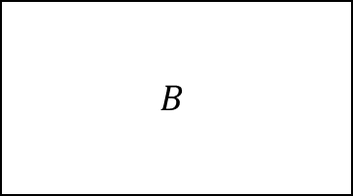

Batch Insertion
mBoxes
$$Box 0_{A}$$
$$Box 1_{B}$$
$$Box 2_{C}$$
$$Box 3_{D}$$
$$Box 4_{E}$$
$$Box 5_{F}$$
mIndices
$$4_{x}$$
$$9_{x}$$
$$…$$
$$5_{x}$$
$${11}_{x}$$
$$…$$
$$1_{x}$$
$$2_{x}$$
$$…$$
$$7_{x}$$
$${10}_{x}$$
$$…$$
$$0_{x}$$
$$3_{x}$$
$$…$$
$$6_{x}$$
$$8_{x}$$
Insert
mAxes[0]
$$\begin{matrix}{24}_{i} \\ {0.1}_{f}\end{matrix}$$
$$\begin{matrix}{12}_{i} \\ {0.2}_{f}\end{matrix}$$
$$\begin{matrix}{13}_{i} \\ {0.5}_{f}\end{matrix}$$
$$\begin{matrix}{25}_{i} \\ {0.7}_{f}\end{matrix}$$
$$\begin{matrix}0_{i} \\ {1.1}_{f}\end{matrix}$$
$$\begin{matrix}6_{i} \\ {1.3}_{f}\end{matrix}$$
$$\begin{matrix}{30}_{i} \\ {1.4}_{f}\end{matrix}$$
$$\begin{matrix}{18}_{i} \\ {2.2}_{f}\end{matrix}$$
$$\begin{matrix}{31}_{i} \\ {2.4}_{f}\end{matrix}$$
$$\begin{matrix}1_{i} \\ {3.0}_{f}\end{matrix}$$
$$\begin{matrix}{19}_{i} \\ {3.1}_{f}\end{matrix}$$
$$\begin{matrix}7_{i} \\ {3.2}_{f}\end{matrix}$$
EndPoint Set
Registered Pairs
$$B$$
Endpoint is max:
Make pairs and add

Slide 66
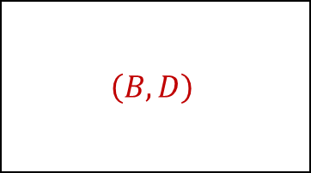
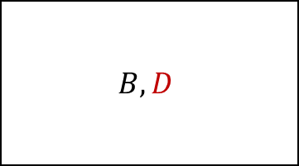
Batch Insertion
mBoxes
$$Box 0_{A}$$
$$Box 1_{B}$$
$$Box 2_{C}$$
$$Box 3_{D}$$
$$Box 4_{E}$$
$$Box 5_{F}$$
mIndices
$$4_{x}$$
$$9_{x}$$
$$…$$
$$5_{x}$$
$${11}_{x}$$
$$…$$
$$1_{x}$$
$$2_{x}$$
$$…$$
$$7_{x}$$
$${10}_{x}$$
$$…$$
$$0_{x}$$
$$3_{x}$$
$$…$$
$$6_{x}$$
$$8_{x}$$
Insert
mAxes[0]
$$\begin{matrix}{24}_{i} \\ {0.1}_{f}\end{matrix}$$
$$\begin{matrix}{12}_{i} \\ {0.2}_{f}\end{matrix}$$
$$\begin{matrix}{13}_{i} \\ {0.5}_{f}\end{matrix}$$
$$\begin{matrix}{25}_{i} \\ {0.7}_{f}\end{matrix}$$
$$\begin{matrix}0_{i} \\ {1.1}_{f}\end{matrix}$$
$$\begin{matrix}6_{i} \\ {1.3}_{f}\end{matrix}$$
$$\begin{matrix}{30}_{i} \\ {1.4}_{f}\end{matrix}$$
$$\begin{matrix}{18}_{i} \\ {2.2}_{f}\end{matrix}$$
$$\begin{matrix}{31}_{i} \\ {2.4}_{f}\end{matrix}$$
$$\begin{matrix}1_{i} \\ {3.0}_{f}\end{matrix}$$
$$\begin{matrix}{19}_{i} \\ {3.1}_{f}\end{matrix}$$
$$\begin{matrix}7_{i} \\ {3.2}_{f}\end{matrix}$$
EndPoint Set
Registered Pairs
$$B,D$$
$$\left(B,D\right)$$
Endpoint is max:
Make pairs and add

Slide 67
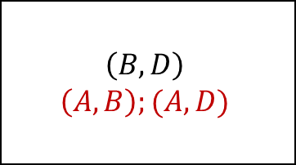
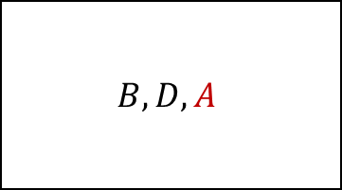
Batch Insertion
mBoxes
$$Box 0_{A}$$
$$Box 1_{B}$$
$$Box 2_{C}$$
$$Box 3_{D}$$
$$Box 4_{E}$$
$$Box 5_{F}$$
mIndices
$$4_{x}$$
$$9_{x}$$
$$…$$
$$5_{x}$$
$${11}_{x}$$
$$…$$
$$1_{x}$$
$$2_{x}$$
$$…$$
$$7_{x}$$
$${10}_{x}$$
$$…$$
$$0_{x}$$
$$3_{x}$$
$$…$$
$$6_{x}$$
$$8_{x}$$
Insert
mAxes[0]
$$\begin{matrix}{24}_{i} \\ {0.1}_{f}\end{matrix}$$
$$\begin{matrix}{12}_{i} \\ {0.2}_{f}\end{matrix}$$
$$\begin{matrix}{13}_{i} \\ {0.5}_{f}\end{matrix}$$
$$\begin{matrix}{25}_{i} \\ {0.7}_{f}\end{matrix}$$
$$\begin{matrix}0_{i} \\ {1.1}_{f}\end{matrix}$$
$$\begin{matrix}6_{i} \\ {1.3}_{f}\end{matrix}$$
$$\begin{matrix}{30}_{i} \\ {1.4}_{f}\end{matrix}$$
$$\begin{matrix}{18}_{i} \\ {2.2}_{f}\end{matrix}$$
$$\begin{matrix}{31}_{i} \\ {2.4}_{f}\end{matrix}$$
$$\begin{matrix}1_{i} \\ {3.0}_{f}\end{matrix}$$
$$\begin{matrix}{19}_{i} \\ {3.1}_{f}\end{matrix}$$
$$\begin{matrix}7_{i} \\ {3.2}_{f}\end{matrix}$$
EndPoint Set
Registered Pairs
$$B,D,A$$
$$\left(B,D\right) \\ \left(A,B\right);(A,D)$$
Endpoint is max:
Make pairs and add

Slide 68
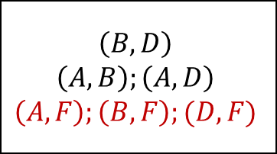
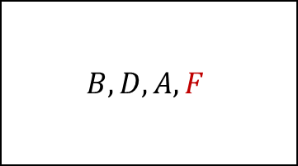
Batch Insertion
mBoxes
$$Box 0_{A}$$
$$Box 1_{B}$$
$$Box 2_{C}$$
$$Box 3_{D}$$
$$Box 4_{E}$$
$$Box 5_{F}$$
mIndices
$$4_{x}$$
$$9_{x}$$
$$…$$
$$5_{x}$$
$${11}_{x}$$
$$…$$
$$1_{x}$$
$$2_{x}$$
$$…$$
$$7_{x}$$
$${10}_{x}$$
$$…$$
$$0_{x}$$
$$3_{x}$$
$$…$$
$$6_{x}$$
$$8_{x}$$
Insert
mAxes[0]
$$\begin{matrix}{24}_{i} \\ {0.1}_{f}\end{matrix}$$
$$\begin{matrix}{12}_{i} \\ {0.2}_{f}\end{matrix}$$
$$\begin{matrix}{13}_{i} \\ {0.5}_{f}\end{matrix}$$
$$\begin{matrix}{25}_{i} \\ {0.7}_{f}\end{matrix}$$
$$\begin{matrix}0_{i} \\ {1.1}_{f}\end{matrix}$$
$$\begin{matrix}6_{i} \\ {1.3}_{f}\end{matrix}$$
$$\begin{matrix}{30}_{i} \\ {1.4}_{f}\end{matrix}$$
$$\begin{matrix}{18}_{i} \\ {2.2}_{f}\end{matrix}$$
$$\begin{matrix}{31}_{i} \\ {2.4}_{f}\end{matrix}$$
$$\begin{matrix}1_{i} \\ {3.0}_{f}\end{matrix}$$
$$\begin{matrix}{19}_{i} \\ {3.1}_{f}\end{matrix}$$
$$\begin{matrix}7_{i} \\ {3.2}_{f}\end{matrix}$$
EndPoint Set
Registered Pairs
$$B,D,A,F$$
$$\left(B,D\right) \\ \left(A,B\right);\left(A,D\right) \\ \left(A,F\right);\left(B,F\right);(D,F)$$
Endpoint is max:
Make pairs and add

Slide 69
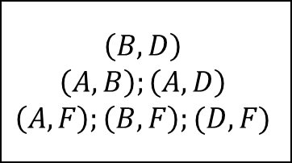
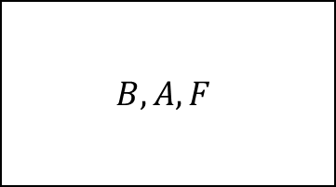
Batch Insertion
mBoxes
$$Box 0_{A}$$
$$Box 1_{B}$$
$$Box 2_{C}$$
$$Box 3_{D}$$
$$Box 4_{E}$$
$$Box 5_{F}$$
mIndices
$$4_{x}$$
$$9_{x}$$
$$…$$
$$5_{x}$$
$${11}_{x}$$
$$…$$
$$1_{x}$$
$$2_{x}$$
$$…$$
$$7_{x}$$
$${10}_{x}$$
$$…$$
$$0_{x}$$
$$3_{x}$$
$$…$$
$$6_{x}$$
$$8_{x}$$
Insert
mAxes[0]
$$\begin{matrix}{24}_{i} \\ {0.1}_{f}\end{matrix}$$
$$\begin{matrix}{12}_{i} \\ {0.2}_{f}\end{matrix}$$
$$\begin{matrix}{13}_{i} \\ {0.5}_{f}\end{matrix}$$
$$\begin{matrix}{25}_{i} \\ {0.7}_{f}\end{matrix}$$
$$\begin{matrix}0_{i} \\ {1.1}_{f}\end{matrix}$$
$$\begin{matrix}6_{i} \\ {1.3}_{f}\end{matrix}$$
$$\begin{matrix}{30}_{i} \\ {1.4}_{f}\end{matrix}$$
$$\begin{matrix}{18}_{i} \\ {2.2}_{f}\end{matrix}$$
$$\begin{matrix}{31}_{i} \\ {2.4}_{f}\end{matrix}$$
$$\begin{matrix}1_{i} \\ {3.0}_{f}\end{matrix}$$
$$\begin{matrix}{19}_{i} \\ {3.1}_{f}\end{matrix}$$
$$\begin{matrix}7_{i} \\ {3.2}_{f}\end{matrix}$$
EndPoint Set
Registered Pairs
$$B,A,F$$
$$\left(B,D\right) \\ \left(A,B\right);\left(A,D\right) \\ \left(A,F\right);\left(B,F\right);(D,F)$$
Endpoint is min:
Remove from set

Slide 70
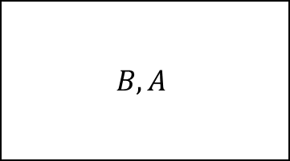
Batch Insertion
mBoxes
$$Box 0_{A}$$
$$Box 1_{B}$$
$$Box 2_{C}$$
$$Box 3_{D}$$
$$Box 4_{E}$$
$$Box 5_{F}$$
mIndices
$$4_{x}$$
$$9_{x}$$
$$…$$
$$5_{x}$$
$${11}_{x}$$
$$…$$
$$1_{x}$$
$$2_{x}$$
$$…$$
$$7_{x}$$
$${10}_{x}$$
$$…$$
$$0_{x}$$
$$3_{x}$$
$$…$$
$$6_{x}$$
$$8_{x}$$
Insert
mAxes[0]
$$\begin{matrix}{24}_{i} \\ {0.1}_{f}\end{matrix}$$
$$\begin{matrix}{12}_{i} \\ {0.2}_{f}\end{matrix}$$
$$\begin{matrix}{13}_{i} \\ {0.5}_{f}\end{matrix}$$
$$\begin{matrix}{25}_{i} \\ {0.7}_{f}\end{matrix}$$
$$\begin{matrix}0_{i} \\ {1.1}_{f}\end{matrix}$$
$$\begin{matrix}6_{i} \\ {1.3}_{f}\end{matrix}$$
$$\begin{matrix}{30}_{i} \\ {1.4}_{f}\end{matrix}$$
$$\begin{matrix}{18}_{i} \\ {2.2}_{f}\end{matrix}$$
$$\begin{matrix}{31}_{i} \\ {2.4}_{f}\end{matrix}$$
$$\begin{matrix}1_{i} \\ {3.0}_{f}\end{matrix}$$
$$\begin{matrix}{19}_{i} \\ {3.1}_{f}\end{matrix}$$
$$\begin{matrix}7_{i} \\ {3.2}_{f}\end{matrix}$$
EndPoint Set
Registered Pairs
$$B,A$$
$$\left(B,D\right) \\ \left(A,B\right);\left(A,D\right) \\ \left(A,F\right);\left(B,F\right);(D,F)$$
Endpoint is min:
Remove from set

Slide 71
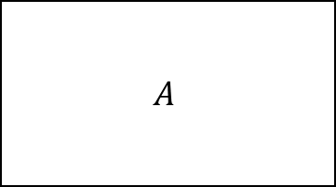
Batch Insertion
mBoxes
$$Box 0_{A}$$
$$Box 1_{B}$$
$$Box 2_{C}$$
$$Box 3_{D}$$
$$Box 4_{E}$$
$$Box 5_{F}$$
mIndices
$$4_{x}$$
$$9_{x}$$
$$…$$
$$5_{x}$$
$${11}_{x}$$
$$…$$
$$1_{x}$$
$$2_{x}$$
$$…$$
$$7_{x}$$
$${10}_{x}$$
$$…$$
$$0_{x}$$
$$3_{x}$$
$$…$$
$$6_{x}$$
$$8_{x}$$
Insert
mAxes[0]
$$\begin{matrix}{24}_{i} \\ {0.1}_{f}\end{matrix}$$
$$\begin{matrix}{12}_{i} \\ {0.2}_{f}\end{matrix}$$
$$\begin{matrix}{13}_{i} \\ {0.5}_{f}\end{matrix}$$
$$\begin{matrix}{25}_{i} \\ {0.7}_{f}\end{matrix}$$
$$\begin{matrix}0_{i} \\ {1.1}_{f}\end{matrix}$$
$$\begin{matrix}6_{i} \\ {1.3}_{f}\end{matrix}$$
$$\begin{matrix}{30}_{i} \\ {1.4}_{f}\end{matrix}$$
$$\begin{matrix}{18}_{i} \\ {2.2}_{f}\end{matrix}$$
$$\begin{matrix}{31}_{i} \\ {2.4}_{f}\end{matrix}$$
$$\begin{matrix}1_{i} \\ {3.0}_{f}\end{matrix}$$
$$\begin{matrix}{19}_{i} \\ {3.1}_{f}\end{matrix}$$
$$\begin{matrix}7_{i} \\ {3.2}_{f}\end{matrix}$$
EndPoint Set
Registered Pairs
$$A$$
$$\left(B,D\right) \\ \left(A,B\right);\left(A,D\right) \\ \left(A,F\right);\left(B,F\right);(D,F)$$
Endpoint is min:
Remove from set

Slide 72
Batch Insertion
mBoxes
$$Box 0_{A}$$
$$Box 1_{B}$$
$$Box 2_{C}$$
$$Box 3_{D}$$
$$Box 4_{E}$$
$$Box 5_{F}$$
mIndices
$$4_{x}$$
$$9_{x}$$
$$…$$
$$5_{x}$$
$${11}_{x}$$
$$…$$
$$1_{x}$$
$$2_{x}$$
$$…$$
$$7_{x}$$
$${10}_{x}$$
$$…$$
$$0_{x}$$
$$3_{x}$$
$$…$$
$$6_{x}$$
$$8_{x}$$
Insert
mAxes[0]
$$\begin{matrix}{24}_{i} \\ {0.1}_{f}\end{matrix}$$
$$\begin{matrix}{12}_{i} \\ {0.2}_{f}\end{matrix}$$
$$\begin{matrix}{13}_{i} \\ {0.5}_{f}\end{matrix}$$
$$\begin{matrix}{25}_{i} \\ {0.7}_{f}\end{matrix}$$
$$\begin{matrix}0_{i} \\ {1.1}_{f}\end{matrix}$$
$$\begin{matrix}6_{i} \\ {1.3}_{f}\end{matrix}$$
$$\begin{matrix}{30}_{i} \\ {1.4}_{f}\end{matrix}$$
$$\begin{matrix}{18}_{i} \\ {2.2}_{f}\end{matrix}$$
$$\begin{matrix}{31}_{i} \\ {2.4}_{f}\end{matrix}$$
$$\begin{matrix}1_{i} \\ {3.0}_{f}\end{matrix}$$
$$\begin{matrix}{19}_{i} \\ {3.1}_{f}\end{matrix}$$
$$\begin{matrix}7_{i} \\ {3.2}_{f}\end{matrix}$$
EndPoint Set
Registered Pairs
$$\left(B,D\right) \\ \left(A,B\right);\left(A,D\right) \\ \left(A,F\right);\left(B,F\right);(D,F)$$
Endpoint is min:
Remove from set

Slide 73
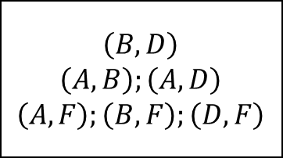
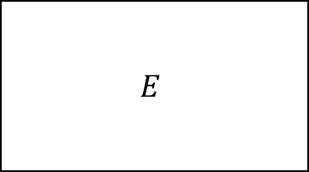
Batch Insertion
mBoxes
$$Box 0_{A}$$
$$Box 1_{B}$$
$$Box 2_{C}$$
$$Box 3_{D}$$
$$Box 4_{E}$$
$$Box 5_{F}$$
mIndices
$$4_{x}$$
$$9_{x}$$
$$…$$
$$5_{x}$$
$${11}_{x}$$
$$…$$
$$1_{x}$$
$$2_{x}$$
$$…$$
$$7_{x}$$
$${10}_{x}$$
$$…$$
$$0_{x}$$
$$3_{x}$$
$$…$$
$$6_{x}$$
$$8_{x}$$
Insert
mAxes[0]
$$\begin{matrix}{24}_{i} \\ {0.1}_{f}\end{matrix}$$
$$\begin{matrix}{12}_{i} \\ {0.2}_{f}\end{matrix}$$
$$\begin{matrix}{13}_{i} \\ {0.5}_{f}\end{matrix}$$
$$\begin{matrix}{25}_{i} \\ {0.7}_{f}\end{matrix}$$
$$\begin{matrix}0_{i} \\ {1.1}_{f}\end{matrix}$$
$$\begin{matrix}6_{i} \\ {1.3}_{f}\end{matrix}$$
$$\begin{matrix}{30}_{i} \\ {1.4}_{f}\end{matrix}$$
$$\begin{matrix}{18}_{i} \\ {2.2}_{f}\end{matrix}$$
$$\begin{matrix}{31}_{i} \\ {2.4}_{f}\end{matrix}$$
$$\begin{matrix}1_{i} \\ {3.0}_{f}\end{matrix}$$
$$\begin{matrix}{19}_{i} \\ {3.1}_{f}\end{matrix}$$
$$\begin{matrix}7_{i} \\ {3.2}_{f}\end{matrix}$$
EndPoint Set
Registered Pairs
$$E$$
$$\left(B,D\right) \\ \left(A,B\right);\left(A,D\right) \\ \left(A,F\right);\left(B,F\right);\left(D,F\right)$$
Endpoint is max:
Make pairs and add

Slide 74
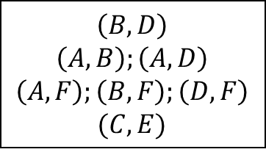
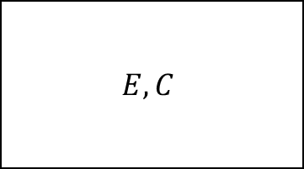
Batch Insertion
mBoxes
$$Box 0_{A}$$
$$Box 1_{B}$$
$$Box 2_{C}$$
$$Box 3_{D}$$
$$Box 4_{E}$$
$$Box 5_{F}$$
mIndices
$$4_{x}$$
$$9_{x}$$
$$…$$
$$5_{x}$$
$${11}_{x}$$
$$…$$
$$1_{x}$$
$$2_{x}$$
$$…$$
$$7_{x}$$
$${10}_{x}$$
$$…$$
$$0_{x}$$
$$3_{x}$$
$$…$$
$$6_{x}$$
$$8_{x}$$
Insert
mAxes[0]
$$\begin{matrix}{24}_{i} \\ {0.1}_{f}\end{matrix}$$
$$\begin{matrix}{12}_{i} \\ {0.2}_{f}\end{matrix}$$
$$\begin{matrix}{13}_{i} \\ {0.5}_{f}\end{matrix}$$
$$\begin{matrix}{25}_{i} \\ {0.7}_{f}\end{matrix}$$
$$\begin{matrix}0_{i} \\ {1.1}_{f}\end{matrix}$$
$$\begin{matrix}6_{i} \\ {1.3}_{f}\end{matrix}$$
$$\begin{matrix}{30}_{i} \\ {1.4}_{f}\end{matrix}$$
$$\begin{matrix}{18}_{i} \\ {2.2}_{f}\end{matrix}$$
$$\begin{matrix}{31}_{i} \\ {2.4}_{f}\end{matrix}$$
$$\begin{matrix}1_{i} \\ {3.0}_{f}\end{matrix}$$
$$\begin{matrix}{19}_{i} \\ {3.1}_{f}\end{matrix}$$
$$\begin{matrix}7_{i} \\ {3.2}_{f}\end{matrix}$$
EndPoint Set
Registered Pairs
$$E,C$$
$$\left(B,D\right) \\ \left(A,B\right);\left(A,D\right) \\ \left(A,F\right);\left(B,F\right);\left(D,F\right) \\ (C,E)$$
Endpoint is max:
Make pairs and add

Slide 75
Batch Insertion
mBoxes
$$Box 0_{A}$$
$$Box 1_{B}$$
$$Box 2_{C}$$
$$Box 3_{D}$$
$$Box 4_{E}$$
$$Box 5_{F}$$
mIndices
$$4_{x}$$
$$9_{x}$$
$$…$$
$$5_{x}$$
$${11}_{x}$$
$$…$$
$$1_{x}$$
$$2_{x}$$
$$…$$
$$7_{x}$$
$${10}_{x}$$
$$…$$
$$0_{x}$$
$$3_{x}$$
$$…$$
$$6_{x}$$
$$8_{x}$$
Insert
mAxes[0]
$$\begin{matrix}{24}_{i} \\ {0.1}_{f}\end{matrix}$$
$$\begin{matrix}{12}_{i} \\ {0.2}_{f}\end{matrix}$$
$$\begin{matrix}{13}_{i} \\ {0.5}_{f}\end{matrix}$$
$$\begin{matrix}{25}_{i} \\ {0.7}_{f}\end{matrix}$$
$$\begin{matrix}0_{i} \\ {1.1}_{f}\end{matrix}$$
$$\begin{matrix}6_{i} \\ {1.3}_{f}\end{matrix}$$
$$\begin{matrix}{30}_{i} \\ {1.4}_{f}\end{matrix}$$
$$\begin{matrix}{18}_{i} \\ {2.2}_{f}\end{matrix}$$
$$\begin{matrix}{31}_{i} \\ {2.4}_{f}\end{matrix}$$
$$\begin{matrix}1_{i} \\ {3.0}_{f}\end{matrix}$$
$$\begin{matrix}{19}_{i} \\ {3.1}_{f}\end{matrix}$$
$$\begin{matrix}7_{i} \\ {3.2}_{f}\end{matrix}$$
EndPoint Set
Registered Pairs
$$E$$
$$\left(B,D\right) \\ \left(A,B\right);\left(A,D\right) \\ \left(A,F\right);\left(B,F\right);\left(D,F\right) \\ (C,E)$$
Endpoint is min:
Remove from set

Slide 76
Batch Insertion
mBoxes
$$Box 0_{A}$$
$$Box 1_{B}$$
$$Box 2_{C}$$
$$Box 3_{D}$$
$$Box 4_{E}$$
$$Box 5_{F}$$
mIndices
$$4_{x}$$
$$9_{x}$$
$$…$$
$$5_{x}$$
$${11}_{x}$$
$$…$$
$$1_{x}$$
$$2_{x}$$
$$…$$
$$7_{x}$$
$${10}_{x}$$
$$…$$
$$0_{x}$$
$$3_{x}$$
$$…$$
$$6_{x}$$
$$8_{x}$$
Insert
mAxes[0]
$$\begin{matrix}{24}_{i} \\ {0.1}_{f}\end{matrix}$$
$$\begin{matrix}{12}_{i} \\ {0.2}_{f}\end{matrix}$$
$$\begin{matrix}{13}_{i} \\ {0.5}_{f}\end{matrix}$$
$$\begin{matrix}{25}_{i} \\ {0.7}_{f}\end{matrix}$$
$$\begin{matrix}0_{i} \\ {1.1}_{f}\end{matrix}$$
$$\begin{matrix}6_{i} \\ {1.3}_{f}\end{matrix}$$
$$\begin{matrix}{30}_{i} \\ {1.4}_{f}\end{matrix}$$
$$\begin{matrix}{18}_{i} \\ {2.2}_{f}\end{matrix}$$
$$\begin{matrix}{31}_{i} \\ {2.4}_{f}\end{matrix}$$
$$\begin{matrix}1_{i} \\ {3.0}_{f}\end{matrix}$$
$$\begin{matrix}{19}_{i} \\ {3.1}_{f}\end{matrix}$$
$$\begin{matrix}7_{i} \\ {3.2}_{f}\end{matrix}$$
EndPoint Set
Registered Pairs
$$\left(B,D\right) \\ \left(A,B\right);\left(A,D\right) \\ \left(A,F\right);\left(B,F\right);\left(D,F\right) \\ (C,E)$$
Endpoint is min:
Remove from set

Slide 77
Batch Deletion
Deletion is more complicated
Can be broken up into 3 large-ish steps:
Mark boxes as invalid
Remove pairs
Remove Endpoints
Notes:
Deletion is a more difficult but can be broken up into 3 main steps. Each of these steps is a fairly complicated.

Slide 78









Batch Deletion
mBoxes
$$Box 0_{A}$$
$$Box 1_{B}$$
$$Box 2_{C}$$
$$Box 3_{D}$$
$$Box 4_{E}$$
$$Box 5_{F}$$
mIndices
$$4_{x}$$
$$9_{x}$$
$$…$$
$$5_{x}$$
$${11}_{x}$$
$$…$$
$$1_{x}$$
$$2_{x}$$
$$…$$
$$7_{x}$$
$${10}_{x}$$
$$…$$
$$0_{x}$$
$$3_{x}$$
$$…$$
$$6_{x}$$
$$8_{x}$$
mAxes[0]
$$\begin{matrix}{24}_{i} \\ {0.1}_{f}\end{matrix}$$
$$\begin{matrix}{12}_{i} \\ {0.2}_{f}\end{matrix}$$
$$\begin{matrix}{13}_{i} \\ {0.5}_{f}\end{matrix}$$
$$\begin{matrix}{25}_{i} \\ {0.7}_{f}\end{matrix}$$
$$\begin{matrix}0_{i} \\ {1.1}_{f}\end{matrix}$$
$$\begin{matrix}6_{i} \\ {1.3}_{f}\end{matrix}$$
$$\begin{matrix}{30}_{i} \\ {1.4}_{f}\end{matrix}$$
$$\begin{matrix}{18}_{i} \\ {2.2}_{f}\end{matrix}$$
$$\begin{matrix}{31}_{i} \\ {2.4}_{f}\end{matrix}$$
$$\begin{matrix}1_{i} \\ {3.0}_{f}\end{matrix}$$
$$\begin{matrix}{19}_{i} \\ {3.1}_{f}\end{matrix}$$
$$\begin{matrix}7_{i} \\ {3.2}_{f}\end{matrix}$$
Registered Pairs
$$\left(B,D\right) \\ \left(A,B\right);\left(A,D\right) \\ \left(A,F\right);\left(B,F\right);\left(D,F\right) \\ (C,E)$$
Notes:
The first step is to mark all boxes that we’re going to stop using as invalid.

Slide 79
Batch Deletion – Pair Removal
Bi-parte box pruning:
Remove overlapping pairs of only objects we’re removing (keep old pairs)
If an endpoint is a Min:
If being deleted:
Remove pairs with both sets and add to removal set
Else
Remove pairs only with removal set, add to old set
Else if max:
Remove from the correct set
Notes:
Removing pairs is a lot more complicated. This is known as a bi-parte box pruning algorithm as we only want to remove some pairs and not others. Any pairs with boxes that are being deleted we want to get rid of, but pairs of objects not being deleted need to stay around. We achieve this by keeping two endpoints sets, one of endpoints being removed and the other of normal endpoints.

Slide 80
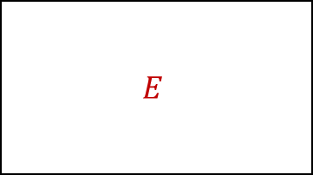
Batch Deletion
mBoxes
$$Box 0_{A}$$
$$Box 1_{B}$$
$$Box 2_{C}$$
$$Box 3_{D}$$
$$Box 4_{E}$$
$$Box 5_{F}$$
mIndices
$$4_{x}$$
$$9_{x}$$
$$…$$
$$5_{x}$$
$${11}_{x}$$
$$…$$
$$1_{x}$$
$$2_{x}$$
$$…$$
$$7_{x}$$
$${10}_{x}$$
$$…$$
$$0_{x}$$
$$3_{x}$$
$$…$$
$$6_{x}$$
$$8_{x}$$
mAxes[0]
$$\begin{matrix}{24}_{i} \\ {0.1}_{f}\end{matrix}$$
$$\begin{matrix}{12}_{i} \\ {0.2}_{f}\end{matrix}$$
$$\begin{matrix}{13}_{i} \\ {0.5}_{f}\end{matrix}$$
$$\begin{matrix}{25}_{i} \\ {0.7}_{f}\end{matrix}$$
$$\begin{matrix}0_{i} \\ {1.1}_{f}\end{matrix}$$
$$\begin{matrix}6_{i} \\ {1.3}_{f}\end{matrix}$$
$$\begin{matrix}{30}_{i} \\ {1.4}_{f}\end{matrix}$$
$$\begin{matrix}{18}_{i} \\ {2.2}_{f}\end{matrix}$$
$$\begin{matrix}{31}_{i} \\ {2.4}_{f}\end{matrix}$$
$$\begin{matrix}1_{i} \\ {3.0}_{f}\end{matrix}$$
$$\begin{matrix}{19}_{i} \\ {3.1}_{f}\end{matrix}$$
$$\begin{matrix}7_{i} \\ {3.2}_{f}\end{matrix}$$
Normal Indices
Removal Indices
Registered Pairs
Removed Pairs
$$E$$
$$\left(B,D\right) \\ \left(A,B\right);\left(A,D\right) \\ \left(A,F\right);\left(B,F\right);\left(D,F\right) \\ (C,E)$$
Notes:
The first endpoint is a min we’re removing, we remove pairs with everything in the normal and removal indices and then add to the removal indices. In this case we just add to removal indices.

Slide 81
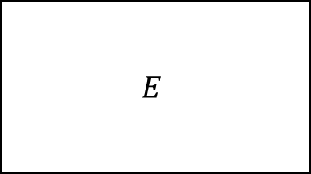
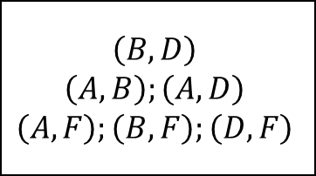
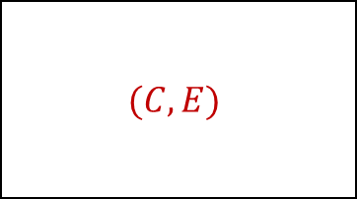
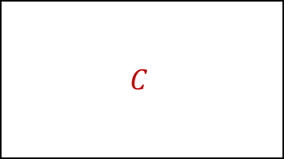
Batch Deletion
mBoxes
$$Box 0_{A}$$
$$Box 1_{B}$$
$$Box 2_{C}$$
$$Box 3_{D}$$
$$Box 4_{E}$$
$$Box 5_{F}$$
mIndices
$$4_{x}$$
$$9_{x}$$
$$…$$
$$5_{x}$$
$${11}_{x}$$
$$…$$
$$1_{x}$$
$$2_{x}$$
$$…$$
$$7_{x}$$
$${10}_{x}$$
$$…$$
$$0_{x}$$
$$3_{x}$$
$$…$$
$$6_{x}$$
$$8_{x}$$
mAxes[0]
$$\begin{matrix}{24}_{i} \\ {0.1}_{f}\end{matrix}$$
$$\begin{matrix}{12}_{i} \\ {0.2}_{f}\end{matrix}$$
$$\begin{matrix}{13}_{i} \\ {0.5}_{f}\end{matrix}$$
$$\begin{matrix}{25}_{i} \\ {0.7}_{f}\end{matrix}$$
$$\begin{matrix}0_{i} \\ {1.1}_{f}\end{matrix}$$
$$\begin{matrix}6_{i} \\ {1.3}_{f}\end{matrix}$$
$$\begin{matrix}{30}_{i} \\ {1.4}_{f}\end{matrix}$$
$$\begin{matrix}{18}_{i} \\ {2.2}_{f}\end{matrix}$$
$$\begin{matrix}{31}_{i} \\ {2.4}_{f}\end{matrix}$$
$$\begin{matrix}1_{i} \\ {3.0}_{f}\end{matrix}$$
$$\begin{matrix}{19}_{i} \\ {3.1}_{f}\end{matrix}$$
$$\begin{matrix}7_{i} \\ {3.2}_{f}\end{matrix}$$
Normal Indices
Removal Indices
Registered Pairs
Removed Pairs
$$C$$
$$E$$
$$\left(B,D\right) \\ \left(A,B\right);\left(A,D\right) \\ \left(A,F\right);\left(B,F\right);\left(D,F\right)$$
$$(C,E)$$
Notes:
We now have a min we aren’t removing. We remove pairs with everything in the removal indices (not the normal ones) and then add to the normal indices.

Slide 82
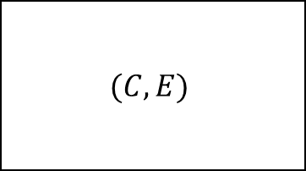
Batch Deletion
mBoxes
$$Box 0_{A}$$
$$Box 1_{B}$$
$$Box 2_{C}$$
$$Box 3_{D}$$
$$Box 4_{E}$$
$$Box 5_{F}$$
mIndices
$$4_{x}$$
$$9_{x}$$
$$…$$
$$5_{x}$$
$${11}_{x}$$
$$…$$
$$1_{x}$$
$$2_{x}$$
$$…$$
$$7_{x}$$
$${10}_{x}$$
$$…$$
$$0_{x}$$
$$3_{x}$$
$$…$$
$$6_{x}$$
$$8_{x}$$
mAxes[0]
$$\begin{matrix}{24}_{i} \\ {0.1}_{f}\end{matrix}$$
$$\begin{matrix}{12}_{i} \\ {0.2}_{f}\end{matrix}$$
$$\begin{matrix}{13}_{i} \\ {0.5}_{f}\end{matrix}$$
$$\begin{matrix}{25}_{i} \\ {0.7}_{f}\end{matrix}$$
$$\begin{matrix}0_{i} \\ {1.1}_{f}\end{matrix}$$
$$\begin{matrix}6_{i} \\ {1.3}_{f}\end{matrix}$$
$$\begin{matrix}{30}_{i} \\ {1.4}_{f}\end{matrix}$$
$$\begin{matrix}{18}_{i} \\ {2.2}_{f}\end{matrix}$$
$$\begin{matrix}{31}_{i} \\ {2.4}_{f}\end{matrix}$$
$$\begin{matrix}1_{i} \\ {3.0}_{f}\end{matrix}$$
$$\begin{matrix}{19}_{i} \\ {3.1}_{f}\end{matrix}$$
$$\begin{matrix}7_{i} \\ {3.2}_{f}\end{matrix}$$
Normal Indices
Removal Indices
Registered Pairs
Removed Pairs
$$E$$
$$\left(B,D\right) \\ \left(A,B\right);\left(A,D\right) \\ \left(A,F\right);\left(B,F\right);\left(D,F\right)$$
$$(C,E)$$
Notes:
We just remove max endpoints from whatever set they were in.

Slide 83
Batch Deletion
mBoxes
$$Box 0_{A}$$
$$Box 1_{B}$$
$$Box 2_{C}$$
$$Box 3_{D}$$
$$Box 4_{E}$$
$$Box 5_{F}$$
mIndices
$$4_{x}$$
$$9_{x}$$
$$…$$
$$5_{x}$$
$${11}_{x}$$
$$…$$
$$1_{x}$$
$$2_{x}$$
$$…$$
$$7_{x}$$
$${10}_{x}$$
$$…$$
$$0_{x}$$
$$3_{x}$$
$$…$$
$$6_{x}$$
$$8_{x}$$
mAxes[0]
$$\begin{matrix}{24}_{i} \\ {0.1}_{f}\end{matrix}$$
$$\begin{matrix}{12}_{i} \\ {0.2}_{f}\end{matrix}$$
$$\begin{matrix}{13}_{i} \\ {0.5}_{f}\end{matrix}$$
$$\begin{matrix}{25}_{i} \\ {0.7}_{f}\end{matrix}$$
$$\begin{matrix}0_{i} \\ {1.1}_{f}\end{matrix}$$
$$\begin{matrix}6_{i} \\ {1.3}_{f}\end{matrix}$$
$$\begin{matrix}{30}_{i} \\ {1.4}_{f}\end{matrix}$$
$$\begin{matrix}{18}_{i} \\ {2.2}_{f}\end{matrix}$$
$$\begin{matrix}{31}_{i} \\ {2.4}_{f}\end{matrix}$$
$$\begin{matrix}1_{i} \\ {3.0}_{f}\end{matrix}$$
$$\begin{matrix}{19}_{i} \\ {3.1}_{f}\end{matrix}$$
$$\begin{matrix}7_{i} \\ {3.2}_{f}\end{matrix}$$
Normal Indices
Removal Indices
Registered Pairs
Removed Pairs
$$\left(B,D\right) \\ \left(A,B\right);\left(A,D\right) \\ \left(A,F\right);\left(B,F\right);\left(D,F\right)$$
$$(C,E)$$
Notes:
We just remove max endpoints from whatever set they were in.

Slide 84
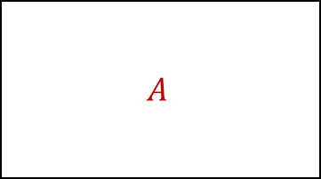
Batch Deletion
mBoxes
$$Box 0_{A}$$
$$Box 1_{B}$$
$$Box 2_{C}$$
$$Box 3_{D}$$
$$Box 4_{E}$$
$$Box 5_{F}$$
mIndices
$$4_{x}$$
$$9_{x}$$
$$…$$
$$5_{x}$$
$${11}_{x}$$
$$…$$
$$1_{x}$$
$$2_{x}$$
$$…$$
$$7_{x}$$
$${10}_{x}$$
$$…$$
$$0_{x}$$
$$3_{x}$$
$$…$$
$$6_{x}$$
$$8_{x}$$
mAxes[0]
$$\begin{matrix}{24}_{i} \\ {0.1}_{f}\end{matrix}$$
$$\begin{matrix}{12}_{i} \\ {0.2}_{f}\end{matrix}$$
$$\begin{matrix}{13}_{i} \\ {0.5}_{f}\end{matrix}$$
$$\begin{matrix}{25}_{i} \\ {0.7}_{f}\end{matrix}$$
$$\begin{matrix}0_{i} \\ {1.1}_{f}\end{matrix}$$
$$\begin{matrix}6_{i} \\ {1.3}_{f}\end{matrix}$$
$$\begin{matrix}{30}_{i} \\ {1.4}_{f}\end{matrix}$$
$$\begin{matrix}{18}_{i} \\ {2.2}_{f}\end{matrix}$$
$$\begin{matrix}{31}_{i} \\ {2.4}_{f}\end{matrix}$$
$$\begin{matrix}1_{i} \\ {3.0}_{f}\end{matrix}$$
$$\begin{matrix}{19}_{i} \\ {3.1}_{f}\end{matrix}$$
$$\begin{matrix}7_{i} \\ {3.2}_{f}\end{matrix}$$
Normal Indices
Removal Indices
Registered Pairs
Removed Pairs
$$A$$
$$\left(B,D\right) \\ \left(A,B\right);\left(A,D\right) \\ \left(A,F\right);\left(B,F\right);\left(D,F\right)$$
$$(C,E)$$
Notes:
Min that isn’t being removed: remove pairs with everything in the removal indices (not the normal ones) and then add to the normal indices.

Slide 85
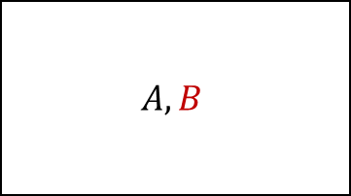
Batch Deletion
mBoxes
$$Box 0_{A}$$
$$Box 1_{B}$$
$$Box 2_{C}$$
$$Box 3_{D}$$
$$Box 4_{E}$$
$$Box 5_{F}$$
mIndices
$$4_{x}$$
$$9_{x}$$
$$…$$
$$5_{x}$$
$${11}_{x}$$
$$…$$
$$1_{x}$$
$$2_{x}$$
$$…$$
$$7_{x}$$
$${10}_{x}$$
$$…$$
$$0_{x}$$
$$3_{x}$$
$$…$$
$$6_{x}$$
$$8_{x}$$
mAxes[0]
$$\begin{matrix}{24}_{i} \\ {0.1}_{f}\end{matrix}$$
$$\begin{matrix}{12}_{i} \\ {0.2}_{f}\end{matrix}$$
$$\begin{matrix}{13}_{i} \\ {0.5}_{f}\end{matrix}$$
$$\begin{matrix}{25}_{i} \\ {0.7}_{f}\end{matrix}$$
$$\begin{matrix}0_{i} \\ {1.1}_{f}\end{matrix}$$
$$\begin{matrix}6_{i} \\ {1.3}_{f}\end{matrix}$$
$$\begin{matrix}{30}_{i} \\ {1.4}_{f}\end{matrix}$$
$$\begin{matrix}{18}_{i} \\ {2.2}_{f}\end{matrix}$$
$$\begin{matrix}{31}_{i} \\ {2.4}_{f}\end{matrix}$$
$$\begin{matrix}1_{i} \\ {3.0}_{f}\end{matrix}$$
$$\begin{matrix}{19}_{i} \\ {3.1}_{f}\end{matrix}$$
$$\begin{matrix}7_{i} \\ {3.2}_{f}\end{matrix}$$
Normal Indices
Removal Indices
Registered Pairs
Removed Pairs
$$A,B$$
$$\left(B,D\right) \\ \left(A,B\right);\left(A,D\right) \\ \left(A,F\right);\left(B,F\right);\left(D,F\right)$$
$$(C,E)$$
Notes:
Min that isn’t being removed: remove pairs with everything in the removal indices (not the normal ones) and then add to the normal indices.

Slide 86
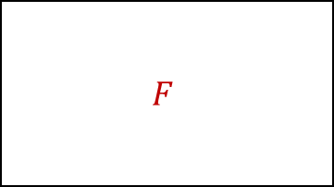
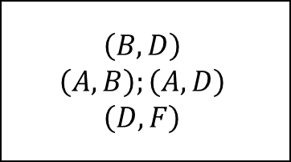
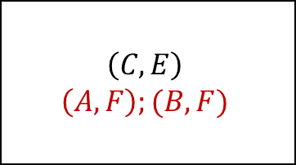
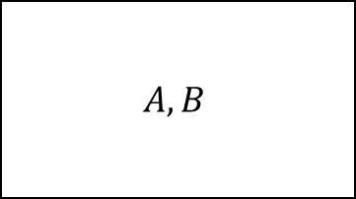
Batch Deletion
mBoxes
$$Box 0_{A}$$
$$Box 1_{B}$$
$$Box 2_{C}$$
$$Box 3_{D}$$
$$Box 4_{E}$$
$$Box 5_{F}$$
mIndices
$$4_{x}$$
$$9_{x}$$
$$…$$
$$5_{x}$$
$${11}_{x}$$
$$…$$
$$1_{x}$$
$$2_{x}$$
$$…$$
$$7_{x}$$
$${10}_{x}$$
$$…$$
$$0_{x}$$
$$3_{x}$$
$$…$$
$$6_{x}$$
$$8_{x}$$
mAxes[0]
$$\begin{matrix}{24}_{i} \\ {0.1}_{f}\end{matrix}$$
$$\begin{matrix}{12}_{i} \\ {0.2}_{f}\end{matrix}$$
$$\begin{matrix}{13}_{i} \\ {0.5}_{f}\end{matrix}$$
$$\begin{matrix}{25}_{i} \\ {0.7}_{f}\end{matrix}$$
$$\begin{matrix}0_{i} \\ {1.1}_{f}\end{matrix}$$
$$\begin{matrix}6_{i} \\ {1.3}_{f}\end{matrix}$$
$$\begin{matrix}{30}_{i} \\ {1.4}_{f}\end{matrix}$$
$$\begin{matrix}{18}_{i} \\ {2.2}_{f}\end{matrix}$$
$$\begin{matrix}{31}_{i} \\ {2.4}_{f}\end{matrix}$$
$$\begin{matrix}1_{i} \\ {3.0}_{f}\end{matrix}$$
$$\begin{matrix}{19}_{i} \\ {3.1}_{f}\end{matrix}$$
$$\begin{matrix}7_{i} \\ {3.2}_{f}\end{matrix}$$
Normal Indices
Removal Indices
Registered Pairs
Removed Pairs
$$A,B$$
$$F$$
$$\left(B,D\right) \\ \left(A,B\right);\left(A,D\right) \\ \left(D,F\right)$$
$$\left(C,E\right) \\ \left(A,F\right);(B,F)$$
Notes:
Min that is being removed: remove pairs with everything in the both sets and then add to the removal indices.

Slide 87
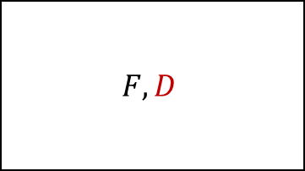
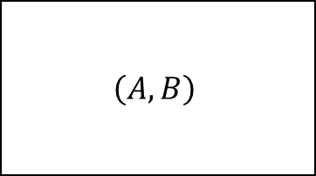

Batch Deletion
mBoxes
$$Box 0_{A}$$
$$Box 1_{B}$$
$$Box 2_{C}$$
$$Box 3_{D}$$
$$Box 4_{E}$$
$$Box 5_{F}$$
mIndices
$$4_{x}$$
$$9_{x}$$
$$…$$
$$5_{x}$$
$${11}_{x}$$
$$…$$
$$1_{x}$$
$$2_{x}$$
$$…$$
$$7_{x}$$
$${10}_{x}$$
$$…$$
$$0_{x}$$
$$3_{x}$$
$$…$$
$$6_{x}$$
$$8_{x}$$
mAxes[0]
$$\begin{matrix}{24}_{i} \\ {0.1}_{f}\end{matrix}$$
$$\begin{matrix}{12}_{i} \\ {0.2}_{f}\end{matrix}$$
$$\begin{matrix}{13}_{i} \\ {0.5}_{f}\end{matrix}$$
$$\begin{matrix}{25}_{i} \\ {0.7}_{f}\end{matrix}$$
$$\begin{matrix}0_{i} \\ {1.1}_{f}\end{matrix}$$
$$\begin{matrix}6_{i} \\ {1.3}_{f}\end{matrix}$$
$$\begin{matrix}{30}_{i} \\ {1.4}_{f}\end{matrix}$$
$$\begin{matrix}{18}_{i} \\ {2.2}_{f}\end{matrix}$$
$$\begin{matrix}{31}_{i} \\ {2.4}_{f}\end{matrix}$$
$$\begin{matrix}1_{i} \\ {3.0}_{f}\end{matrix}$$
$$\begin{matrix}{19}_{i} \\ {3.1}_{f}\end{matrix}$$
$$\begin{matrix}7_{i} \\ {3.2}_{f}\end{matrix}$$
Normal Indices
Removal Indices
Registered Pairs
Removed Pairs
$$A,B$$
$$F,D$$
$$\left(A,B\right)$$
$$\left(C,E\right) \\ \left(A,F\right);\left(B,F\right) \\ \left(A,D\right);\left(B;D\right);(D,F)$$
Notes:
Min that is being removed: remove pairs with everything in the both sets and then add to the removal indices.

Slide 88
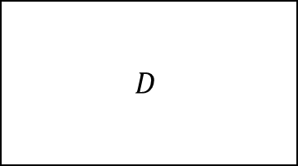
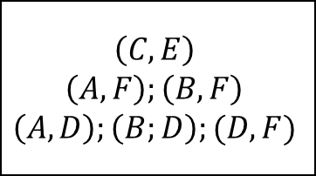
Batch Deletion
mBoxes
$$Box 0_{A}$$
$$Box 1_{B}$$
$$Box 2_{C}$$
$$Box 3_{D}$$
$$Box 4_{E}$$
$$Box 5_{F}$$
mIndices
$$4_{x}$$
$$9_{x}$$
$$…$$
$$5_{x}$$
$${11}_{x}$$
$$…$$
$$1_{x}$$
$$2_{x}$$
$$…$$
$$7_{x}$$
$${10}_{x}$$
$$…$$
$$0_{x}$$
$$3_{x}$$
$$…$$
$$6_{x}$$
$$8_{x}$$
mAxes[0]
$$\begin{matrix}{24}_{i} \\ {0.1}_{f}\end{matrix}$$
$$\begin{matrix}{12}_{i} \\ {0.2}_{f}\end{matrix}$$
$$\begin{matrix}{13}_{i} \\ {0.5}_{f}\end{matrix}$$
$$\begin{matrix}{25}_{i} \\ {0.7}_{f}\end{matrix}$$
$$\begin{matrix}0_{i} \\ {1.1}_{f}\end{matrix}$$
$$\begin{matrix}6_{i} \\ {1.3}_{f}\end{matrix}$$
$$\begin{matrix}{30}_{i} \\ {1.4}_{f}\end{matrix}$$
$$\begin{matrix}{18}_{i} \\ {2.2}_{f}\end{matrix}$$
$$\begin{matrix}{31}_{i} \\ {2.4}_{f}\end{matrix}$$
$$\begin{matrix}1_{i} \\ {3.0}_{f}\end{matrix}$$
$$\begin{matrix}{19}_{i} \\ {3.1}_{f}\end{matrix}$$
$$\begin{matrix}7_{i} \\ {3.2}_{f}\end{matrix}$$
Normal Indices
Removal Indices
Registered Pairs
Removed Pairs
$$A,B$$
$$D$$
$$\left(A,B\right)$$
$$\left(C,E\right) \\ \left(A,F\right);\left(B,F\right) \\ \left(A,D\right);\left(B;D\right);(D,F)$$
Notes:
Max endpoint: remove from whatever set it was in.

Slide 89
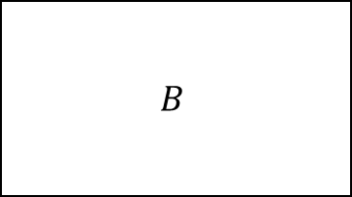
Batch Deletion
mBoxes
$$Box 0_{A}$$
$$Box 1_{B}$$
$$Box 2_{C}$$
$$Box 3_{D}$$
$$Box 4_{E}$$
$$Box 5_{F}$$
mIndices
$$4_{x}$$
$$9_{x}$$
$$…$$
$$5_{x}$$
$${11}_{x}$$
$$…$$
$$1_{x}$$
$$2_{x}$$
$$…$$
$$7_{x}$$
$${10}_{x}$$
$$…$$
$$0_{x}$$
$$3_{x}$$
$$…$$
$$6_{x}$$
$$8_{x}$$
mAxes[0]
$$\begin{matrix}{24}_{i} \\ {0.1}_{f}\end{matrix}$$
$$\begin{matrix}{12}_{i} \\ {0.2}_{f}\end{matrix}$$
$$\begin{matrix}{13}_{i} \\ {0.5}_{f}\end{matrix}$$
$$\begin{matrix}{25}_{i} \\ {0.7}_{f}\end{matrix}$$
$$\begin{matrix}0_{i} \\ {1.1}_{f}\end{matrix}$$
$$\begin{matrix}6_{i} \\ {1.3}_{f}\end{matrix}$$
$$\begin{matrix}{30}_{i} \\ {1.4}_{f}\end{matrix}$$
$$\begin{matrix}{18}_{i} \\ {2.2}_{f}\end{matrix}$$
$$\begin{matrix}{31}_{i} \\ {2.4}_{f}\end{matrix}$$
$$\begin{matrix}1_{i} \\ {3.0}_{f}\end{matrix}$$
$$\begin{matrix}{19}_{i} \\ {3.1}_{f}\end{matrix}$$
$$\begin{matrix}7_{i} \\ {3.2}_{f}\end{matrix}$$
Normal Indices
Removal Indices
Registered Pairs
Removed Pairs
$$B$$
$$D$$
$$\left(A,B\right)$$
$$\left(C,E\right) \\ \left(A,F\right);\left(B,F\right) \\ \left(A,D\right);\left(B;D\right);(D,F)$$
Notes:
Max endpoint: remove from whatever set it was in.

Slide 90
Batch Deletion
mBoxes
$$Box 0_{A}$$
$$Box 1_{B}$$
$$Box 2_{C}$$
$$Box 3_{D}$$
$$Box 4_{E}$$
$$Box 5_{F}$$
mIndices
$$4_{x}$$
$$9_{x}$$
$$…$$
$$5_{x}$$
$${11}_{x}$$
$$…$$
$$1_{x}$$
$$2_{x}$$
$$…$$
$$7_{x}$$
$${10}_{x}$$
$$…$$
$$0_{x}$$
$$3_{x}$$
$$…$$
$$6_{x}$$
$$8_{x}$$
mAxes[0]
$$\begin{matrix}{24}_{i} \\ {0.1}_{f}\end{matrix}$$
$$\begin{matrix}{12}_{i} \\ {0.2}_{f}\end{matrix}$$
$$\begin{matrix}{13}_{i} \\ {0.5}_{f}\end{matrix}$$
$$\begin{matrix}{25}_{i} \\ {0.7}_{f}\end{matrix}$$
$$\begin{matrix}0_{i} \\ {1.1}_{f}\end{matrix}$$
$$\begin{matrix}6_{i} \\ {1.3}_{f}\end{matrix}$$
$$\begin{matrix}{30}_{i} \\ {1.4}_{f}\end{matrix}$$
$$\begin{matrix}{18}_{i} \\ {2.2}_{f}\end{matrix}$$
$$\begin{matrix}{31}_{i} \\ {2.4}_{f}\end{matrix}$$
$$\begin{matrix}1_{i} \\ {3.0}_{f}\end{matrix}$$
$$\begin{matrix}{19}_{i} \\ {3.1}_{f}\end{matrix}$$
$$\begin{matrix}7_{i} \\ {3.2}_{f}\end{matrix}$$
Normal Indices
Removal Indices
Registered Pairs
Removed Pairs
$$B$$
$$\left(A,B\right)$$
$$\left(C,E\right) \\ \left(A,F\right);\left(B,F\right) \\ \left(A,D\right);\left(B;D\right);(D,F)$$
Notes:
Max endpoint: remove from whatever set it was in.

Slide 91
Batch Deletion
mBoxes
$$Box 0_{A}$$
$$Box 1_{B}$$
$$Box 2_{C}$$
$$Box 3_{D}$$
$$Box 4_{E}$$
$$Box 5_{F}$$
mIndices
$$4_{x}$$
$$9_{x}$$
$$…$$
$$5_{x}$$
$${11}_{x}$$
$$…$$
$$1_{x}$$
$$2_{x}$$
$$…$$
$$7_{x}$$
$${10}_{x}$$
$$…$$
$$0_{x}$$
$$3_{x}$$
$$…$$
$$6_{x}$$
$$8_{x}$$
mAxes[0]
$$\begin{matrix}{24}_{i} \\ {0.1}_{f}\end{matrix}$$
$$\begin{matrix}{12}_{i} \\ {0.2}_{f}\end{matrix}$$
$$\begin{matrix}{13}_{i} \\ {0.5}_{f}\end{matrix}$$
$$\begin{matrix}{25}_{i} \\ {0.7}_{f}\end{matrix}$$
$$\begin{matrix}0_{i} \\ {1.1}_{f}\end{matrix}$$
$$\begin{matrix}6_{i} \\ {1.3}_{f}\end{matrix}$$
$$\begin{matrix}{30}_{i} \\ {1.4}_{f}\end{matrix}$$
$$\begin{matrix}{18}_{i} \\ {2.2}_{f}\end{matrix}$$
$$\begin{matrix}{31}_{i} \\ {2.4}_{f}\end{matrix}$$
$$\begin{matrix}1_{i} \\ {3.0}_{f}\end{matrix}$$
$$\begin{matrix}{19}_{i} \\ {3.1}_{f}\end{matrix}$$
$$\begin{matrix}7_{i} \\ {3.2}_{f}\end{matrix}$$
Normal Indices
Removal Indices
Registered Pairs
Removed Pairs
$$\left(A,B\right)$$
$$\left(C,E\right) \\ \left(A,F\right);\left(B,F\right) \\ \left(A,D\right);\left(B;D\right);(D,F)$$
Notes:
Max endpoint: remove from whatever set it was in.

Slide 92
Batch Deletion – EndPoint Removal
Loop from beginning to end of an axis
Keep track of separate insertion and test positions:
If an endpoint is being deleted, skip it
Otherwise copy to the insertion position
Notes:
Now we just have to remove the endpoints that are being deleted in one pass. This is achieved by looping from the beginning to end of the endpoint array and collecting all of the old endpoints at the beginning of the array while ignoring the ones being deleted.

Slide 93
Batch Deletion – EndPoint Removal
mBoxes
$$Box 0_{A}$$
$$Box 1_{B}$$
$$Box 2_{C}$$
$$Box 3_{D}$$
$$Box 4_{E}$$
$$Box 5_{F}$$
mIndices
$$4_{x}$$
$$9_{x}$$
$$…$$
$$5_{x}$$
$${11}_{x}$$
$$…$$
$$1_{x}$$
$$2_{x}$$
$$…$$
$$7_{x}$$
$${10}_{x}$$
$$…$$
$$0_{x}$$
$$3_{x}$$
$$…$$
$$6_{x}$$
$$8_{x}$$
Insert
mAxes[0]
$$\begin{matrix}{24}_{i} \\ {0.1}_{f}\end{matrix}$$
$$\begin{matrix}{12}_{i} \\ {0.2}_{f}\end{matrix}$$
$$\begin{matrix}{13}_{i} \\ {0.5}_{f}\end{matrix}$$
$$\begin{matrix}{25}_{i} \\ {0.7}_{f}\end{matrix}$$
$$\begin{matrix}0_{i} \\ {1.1}_{f}\end{matrix}$$
$$\begin{matrix}6_{i} \\ {1.3}_{f}\end{matrix}$$
$$\begin{matrix}{30}_{i} \\ {1.4}_{f}\end{matrix}$$
$$\begin{matrix}{18}_{i} \\ {2.2}_{f}\end{matrix}$$
$$\begin{matrix}{31}_{i} \\ {2.4}_{f}\end{matrix}$$
$$\begin{matrix}1_{i} \\ {3.0}_{f}\end{matrix}$$
$$\begin{matrix}{19}_{i} \\ {3.1}_{f}\end{matrix}$$
$$\begin{matrix}7_{i} \\ {3.2}_{f}\end{matrix}$$
Endpoint is being deleted:
Ignore
Notes:
The first endpoint is one we are deleting so we want to ignore it. To do this we advance our test position but leave the insertion position alone.

Slide 94
Batch Deletion – EndPoint Removal
mBoxes
$$Box 0_{A}$$
$$Box 1_{B}$$
$$Box 2_{C}$$
$$Box 3_{D}$$
$$Box 4_{E}$$
$$Box 5_{F}$$
mIndices
$$4_{x}$$
$$9_{x}$$
$$…$$
$$5_{x}$$
$${11}_{x}$$
$$…$$
$$1_{x}$$
$$2_{x}$$
$$…$$
$$7_{x}$$
$${10}_{x}$$
$$…$$
$$0_{x}$$
$$3_{x}$$
$$…$$
$$6_{x}$$
$$8_{x}$$
Insert
mAxes[0]
$$\begin{matrix}{24}_{i} \\ {0.1}_{f}\end{matrix}$$
$$\begin{matrix}{12}_{i} \\ {0.2}_{f}\end{matrix}$$
$$\begin{matrix}{13}_{i} \\ {0.5}_{f}\end{matrix}$$
$$\begin{matrix}{25}_{i} \\ {0.7}_{f}\end{matrix}$$
$$\begin{matrix}0_{i} \\ {1.1}_{f}\end{matrix}$$
$$\begin{matrix}6_{i} \\ {1.3}_{f}\end{matrix}$$
$$\begin{matrix}{30}_{i} \\ {1.4}_{f}\end{matrix}$$
$$\begin{matrix}{18}_{i} \\ {2.2}_{f}\end{matrix}$$
$$\begin{matrix}{31}_{i} \\ {2.4}_{f}\end{matrix}$$
$$\begin{matrix}1_{i} \\ {3.0}_{f}\end{matrix}$$
$$\begin{matrix}{19}_{i} \\ {3.1}_{f}\end{matrix}$$
$$\begin{matrix}7_{i} \\ {3.2}_{f}\end{matrix}$$
Endpoint is not being deleted:
Copy to insertion position
Notes:
The next endpoint is not being deleted so we need to copy it to the insertion position. After copying we advance both the insertion and test position

Slide 95


Batch Deletion – EndPoint Removal
mBoxes
$$Box 0_{A}$$
$$Box 1_{B}$$
$$Box 2_{C}$$
$$Box 3_{D}$$
$$Box 4_{E}$$
$$Box 5_{F}$$
mIndices
$$4_{x}$$
$$9_{x}$$
$$…$$
$$5_{x}$$
$${11}_{x}$$
$$…$$
$$0_{x}$$
$$2_{x}$$
$$…$$
$$7_{x}$$
$${10}_{x}$$
$$…$$
$$0_{x}$$
$$3_{x}$$
$$…$$
$$6_{x}$$
$$8_{x}$$
Insert
mAxes[0]
$$\begin{matrix}{12}_{i} \\ {0.2}_{f}\end{matrix}$$
$$\begin{matrix}{12}_{i} \\ {0.2}_{f}\end{matrix}$$
$$\begin{matrix}{13}_{i} \\ {0.5}_{f}\end{matrix}$$
$$\begin{matrix}{25}_{i} \\ {0.7}_{f}\end{matrix}$$
$$\begin{matrix}0_{i} \\ {1.1}_{f}\end{matrix}$$
$$\begin{matrix}6_{i} \\ {1.3}_{f}\end{matrix}$$
$$\begin{matrix}{30}_{i} \\ {1.4}_{f}\end{matrix}$$
$$\begin{matrix}{18}_{i} \\ {2.2}_{f}\end{matrix}$$
$$\begin{matrix}{31}_{i} \\ {2.4}_{f}\end{matrix}$$
$$\begin{matrix}1_{i} \\ {3.0}_{f}\end{matrix}$$
$$\begin{matrix}{19}_{i} \\ {3.1}_{f}\end{matrix}$$
$$\begin{matrix}7_{i} \\ {3.2}_{f}\end{matrix}$$
Endpoint is not being deleted:
Copy to insertion position
Notes:
This continues until the test position reaches the end of the array

Slide 96



Batch Deletion – EndPoint Removal
mBoxes
$$Box 0_{A}$$
$$Box 1_{B}$$
$$Box 2_{C}$$
$$Box 3_{D}$$
$$Box 4_{E}$$
$$Box 5_{F}$$
mIndices
$$4_{x}$$
$$9_{x}$$
$$…$$
$$5_{x}$$
$${11}_{x}$$
$$…$$
$$0_{x}$$
$$1_{x}$$
$$…$$
$$7_{x}$$
$${10}_{x}$$
$$…$$
$$0_{x}$$
$$3_{x}$$
$$…$$
$$6_{x}$$
$$8_{x}$$
Insert
mAxes[0]
$$\begin{matrix}{12}_{i} \\ {0.2}_{f}\end{matrix}$$
$$\begin{matrix}{13}_{i} \\ {0.5}_{f}\end{matrix}$$
$$\begin{matrix}{13}_{i} \\ {0.5}_{f}\end{matrix}$$
$$\begin{matrix}{25}_{i} \\ {0.7}_{f}\end{matrix}$$
$$\begin{matrix}0_{i} \\ {1.1}_{f}\end{matrix}$$
$$\begin{matrix}6_{i} \\ {1.3}_{f}\end{matrix}$$
$$\begin{matrix}{30}_{i} \\ {1.4}_{f}\end{matrix}$$
$$\begin{matrix}{18}_{i} \\ {2.2}_{f}\end{matrix}$$
$$\begin{matrix}{31}_{i} \\ {2.4}_{f}\end{matrix}$$
$$\begin{matrix}1_{i} \\ {3.0}_{f}\end{matrix}$$
$$\begin{matrix}{19}_{i} \\ {3.1}_{f}\end{matrix}$$
$$\begin{matrix}7_{i} \\ {3.2}_{f}\end{matrix}$$
Endpoint is being deleted:
Ignore

Slide 97
Batch Deletion – EndPoint Removal
mBoxes
$$Box 0_{A}$$
$$Box 1_{B}$$
$$Box 2_{C}$$
$$Box 3_{D}$$
$$Box 4_{E}$$
$$Box 5_{F}$$
mIndices
$$4_{x}$$
$$9_{x}$$
$$…$$
$$5_{x}$$
$${11}_{x}$$
$$…$$
$$0_{x}$$
$$1_{x}$$
$$…$$
$$7_{x}$$
$${10}_{x}$$
$$…$$
$$0_{x}$$
$$3_{x}$$
$$…$$
$$6_{x}$$
$$8_{x}$$
Insert
mAxes[0]
$$\begin{matrix}{12}_{i} \\ {0.2}_{f}\end{matrix}$$
$$\begin{matrix}{13}_{i} \\ {0.5}_{f}\end{matrix}$$
$$\begin{matrix}{13}_{i} \\ {0.5}_{f}\end{matrix}$$
$$\begin{matrix}{25}_{i} \\ {0.7}_{f}\end{matrix}$$
$$\begin{matrix}0_{i} \\ {1.1}_{f}\end{matrix}$$
$$\begin{matrix}6_{i} \\ {1.3}_{f}\end{matrix}$$
$$\begin{matrix}{30}_{i} \\ {1.4}_{f}\end{matrix}$$
$$\begin{matrix}{18}_{i} \\ {2.2}_{f}\end{matrix}$$
$$\begin{matrix}{31}_{i} \\ {2.4}_{f}\end{matrix}$$
$$\begin{matrix}1_{i} \\ {3.0}_{f}\end{matrix}$$
$$\begin{matrix}{19}_{i} \\ {3.1}_{f}\end{matrix}$$
$$\begin{matrix}7_{i} \\ {3.2}_{f}\end{matrix}$$
Endpoint is not being deleted:
Copy to insertion position

Slide 98



Batch Deletion – EndPoint Removal
mBoxes
$$Box 0_{A}$$
$$Box 1_{B}$$
$$Box 2_{C}$$
$$Box 3_{D}$$
$$Box 4_{E}$$
$$Box 5_{F}$$
mIndices
$$2_{x}$$
$$9_{x}$$
$$…$$
$$5_{x}$$
$${11}_{x}$$
$$…$$
$$0_{x}$$
$$1_{x}$$
$$…$$
$$7_{x}$$
$${10}_{x}$$
$$…$$
$$0_{x}$$
$$3_{x}$$
$$…$$
$$6_{x}$$
$$8_{x}$$
Insert
mAxes[0]
$$\begin{matrix}{12}_{i} \\ {0.2}_{f}\end{matrix}$$
$$\begin{matrix}{13}_{i} \\ {0.5}_{f}\end{matrix}$$
$$\begin{matrix}0_{i} \\ {1.1}_{f}\end{matrix}$$
$$\begin{matrix}{25}_{i} \\ {0.7}_{f}\end{matrix}$$
$$\begin{matrix}0_{i} \\ {1.1}_{f}\end{matrix}$$
$$\begin{matrix}6_{i} \\ {1.3}_{f}\end{matrix}$$
$$\begin{matrix}{30}_{i} \\ {1.4}_{f}\end{matrix}$$
$$\begin{matrix}{18}_{i} \\ {2.2}_{f}\end{matrix}$$
$$\begin{matrix}{31}_{i} \\ {2.4}_{f}\end{matrix}$$
$$\begin{matrix}1_{i} \\ {3.0}_{f}\end{matrix}$$
$$\begin{matrix}{19}_{i} \\ {3.1}_{f}\end{matrix}$$
$$\begin{matrix}7_{i} \\ {3.2}_{f}\end{matrix}$$
Endpoint is not being deleted:
Copy to insertion position

Slide 99



Batch Deletion – EndPoint Removal
mBoxes
$$Box 0_{A}$$
$$Box 1_{B}$$
$$Box 2_{C}$$
$$Box 3_{D}$$
$$Box 4_{E}$$
$$Box 5_{F}$$
mIndices
$$2_{x}$$
$$9_{x}$$
$$…$$
$$3_{x}$$
$${11}_{x}$$
$$…$$
$$0_{x}$$
$$1_{x}$$
$$…$$
$$7_{x}$$
$${10}_{x}$$
$$…$$
$$0_{x}$$
$$3_{x}$$
$$…$$
$$6_{x}$$
$$8_{x}$$
Insert
mAxes[0]
$$\begin{matrix}{12}_{i} \\ {0.2}_{f}\end{matrix}$$
$$\begin{matrix}{13}_{i} \\ {0.5}_{f}\end{matrix}$$
$$\begin{matrix}0_{i} \\ {1.1}_{f}\end{matrix}$$
$$\begin{matrix}6_{i} \\ {1.3}_{f}\end{matrix}$$
$$\begin{matrix}0_{i} \\ {1.1}_{f}\end{matrix}$$
$$\begin{matrix}6_{i} \\ {1.3}_{f}\end{matrix}$$
$$\begin{matrix}{30}_{i} \\ {1.4}_{f}\end{matrix}$$
$$\begin{matrix}{18}_{i} \\ {2.2}_{f}\end{matrix}$$
$$\begin{matrix}{31}_{i} \\ {2.4}_{f}\end{matrix}$$
$$\begin{matrix}1_{i} \\ {3.0}_{f}\end{matrix}$$
$$\begin{matrix}{19}_{i} \\ {3.1}_{f}\end{matrix}$$
$$\begin{matrix}7_{i} \\ {3.2}_{f}\end{matrix}$$
Endpoint is being deleted:
Ignore

Slide 100

Batch Deletion – EndPoint Removal
mBoxes
$$Box 0_{A}$$
$$Box 1_{B}$$
$$Box 2_{C}$$
$$Box 3_{D}$$
$$Box 4_{E}$$
$$Box 5_{F}$$
mIndices
$$2_{x}$$
$$9_{x}$$
$$…$$
$$3_{x}$$
$${11}_{x}$$
$$…$$
$$0_{x}$$
$$1_{x}$$
$$…$$
$$7_{x}$$
$${10}_{x}$$
$$…$$
$$0_{x}$$
$$3_{x}$$
$$…$$
$$6_{x}$$
$$8_{x}$$
Insert
mAxes[0]
$$\begin{matrix}{12}_{i} \\ {0.2}_{f}\end{matrix}$$
$$\begin{matrix}{13}_{i} \\ {0.5}_{f}\end{matrix}$$
$$\begin{matrix}0_{i} \\ {1.1}_{f}\end{matrix}$$
$$\begin{matrix}6_{i} \\ {1.3}_{f}\end{matrix}$$
$$\begin{matrix}0_{i} \\ {1.1}_{f}\end{matrix}$$
$$\begin{matrix}6_{i} \\ {1.3}_{f}\end{matrix}$$
$$\begin{matrix}{30}_{i} \\ {1.4}_{f}\end{matrix}$$
$$\begin{matrix}{18}_{i} \\ {2.2}_{f}\end{matrix}$$
$$\begin{matrix}{31}_{i} \\ {2.4}_{f}\end{matrix}$$
$$\begin{matrix}1_{i} \\ {3.0}_{f}\end{matrix}$$
$$\begin{matrix}{19}_{i} \\ {3.1}_{f}\end{matrix}$$
$$\begin{matrix}7_{i} \\ {3.2}_{f}\end{matrix}$$
Endpoint is being deleted:
Ignore

Slide 101
Batch Deletion – EndPoint Removal
mBoxes
$$Box 0_{A}$$
$$Box 1_{B}$$
$$Box 2_{C}$$
$$Box 3_{D}$$
$$Box 4_{E}$$
$$Box 5_{F}$$
mIndices
$$2_{x}$$
$$9_{x}$$
$$…$$
$$3_{x}$$
$${11}_{x}$$
$$…$$
$$0_{x}$$
$$1_{x}$$
$$…$$
$$7_{x}$$
$${10}_{x}$$
$$…$$
$$0_{x}$$
$$3_{x}$$
$$…$$
$$6_{x}$$
$$8_{x}$$
Insert
mAxes[0]
$$\begin{matrix}{12}_{i} \\ {0.2}_{f}\end{matrix}$$
$$\begin{matrix}{13}_{i} \\ {0.5}_{f}\end{matrix}$$
$$\begin{matrix}0_{i} \\ {1.1}_{f}\end{matrix}$$
$$\begin{matrix}6_{i} \\ {1.3}_{f}\end{matrix}$$
$$\begin{matrix}0_{i} \\ {1.1}_{f}\end{matrix}$$
$$\begin{matrix}6_{i} \\ {1.3}_{f}\end{matrix}$$
$$\begin{matrix}{30}_{i} \\ {1.4}_{f}\end{matrix}$$
$$\begin{matrix}{18}_{i} \\ {2.2}_{f}\end{matrix}$$
$$\begin{matrix}{31}_{i} \\ {2.4}_{f}\end{matrix}$$
$$\begin{matrix}1_{i} \\ {3.0}_{f}\end{matrix}$$
$$\begin{matrix}{19}_{i} \\ {3.1}_{f}\end{matrix}$$
$$\begin{matrix}7_{i} \\ {3.2}_{f}\end{matrix}$$
Endpoint is being deleted:
Ignore

Slide 102
Batch Deletion – EndPoint Removal
mBoxes
$$Box 0_{A}$$
$$Box 1_{B}$$
$$Box 2_{C}$$
$$Box 3_{D}$$
$$Box 4_{E}$$
$$Box 5_{F}$$
mIndices
$$2_{x}$$
$$9_{x}$$
$$…$$
$$3_{x}$$
$${11}_{x}$$
$$…$$
$$0_{x}$$
$$1_{x}$$
$$…$$
$$7_{x}$$
$${10}_{x}$$
$$…$$
$$0_{x}$$
$$3_{x}$$
$$…$$
$$6_{x}$$
$$8_{x}$$
Insert
mAxes[0]
$$\begin{matrix}{12}_{i} \\ {0.2}_{f}\end{matrix}$$
$$\begin{matrix}{13}_{i} \\ {0.5}_{f}\end{matrix}$$
$$\begin{matrix}0_{i} \\ {1.1}_{f}\end{matrix}$$
$$\begin{matrix}6_{i} \\ {1.3}_{f}\end{matrix}$$
$$\begin{matrix}0_{i} \\ {1.1}_{f}\end{matrix}$$
$$\begin{matrix}6_{i} \\ {1.3}_{f}\end{matrix}$$
$$\begin{matrix}{30}_{i} \\ {1.4}_{f}\end{matrix}$$
$$\begin{matrix}{18}_{i} \\ {2.2}_{f}\end{matrix}$$
$$\begin{matrix}{31}_{i} \\ {2.4}_{f}\end{matrix}$$
$$\begin{matrix}1_{i} \\ {3.0}_{f}\end{matrix}$$
$$\begin{matrix}{19}_{i} \\ {3.1}_{f}\end{matrix}$$
$$\begin{matrix}7_{i} \\ {3.2}_{f}\end{matrix}$$
Endpoint is not being deleted:
Copy to insertion position

Slide 103


Batch Deletion – EndPoint Removal
mBoxes
$$Box 0_{A}$$
$$Box 1_{B}$$
$$Box 2_{C}$$
$$Box 3_{D}$$
$$Box 4_{E}$$
$$Box 5_{F}$$
mIndices
$$2_{x}$$
$$4_{x}$$
$$…$$
$$3_{x}$$
$${11}_{x}$$
$$…$$
$$0_{x}$$
$$1_{x}$$
$$…$$
$$7_{x}$$
$${10}_{x}$$
$$…$$
$$0_{x}$$
$$3_{x}$$
$$…$$
$$6_{x}$$
$$8_{x}$$
Insert
mAxes[0]
$$\begin{matrix}{12}_{i} \\ {0.2}_{f}\end{matrix}$$
$$\begin{matrix}{13}_{i} \\ {0.5}_{f}\end{matrix}$$
$$\begin{matrix}0_{i} \\ {1.1}_{f}\end{matrix}$$
$$\begin{matrix}6_{i} \\ {1.3}_{f}\end{matrix}$$
$$\begin{matrix}1_{i} \\ {3.0}_{f}\end{matrix}$$
$$\begin{matrix}6_{i} \\ {1.3}_{f}\end{matrix}$$
$$\begin{matrix}{30}_{i} \\ {1.4}_{f}\end{matrix}$$
$$\begin{matrix}{18}_{i} \\ {2.2}_{f}\end{matrix}$$
$$\begin{matrix}{31}_{i} \\ {2.4}_{f}\end{matrix}$$
$$\begin{matrix}1_{i} \\ {3.0}_{f}\end{matrix}$$
$$\begin{matrix}{19}_{i} \\ {3.1}_{f}\end{matrix}$$
$$\begin{matrix}7_{i} \\ {3.2}_{f}\end{matrix}$$
Endpoint is being deleted:
ignore

Slide 104
Batch Deletion – EndPoint Removal
mBoxes
$$Box 0_{A}$$
$$Box 1_{B}$$
$$Box 2_{C}$$
$$Box 3_{D}$$
$$Box 4_{E}$$
$$Box 5_{F}$$
mIndices
$$2_{x}$$
$$4_{x}$$
$$…$$
$$3_{x}$$
$${11}_{x}$$
$$…$$
$$0_{x}$$
$$1_{x}$$
$$…$$
$$7_{x}$$
$${10}_{x}$$
$$…$$
$$0_{x}$$
$$3_{x}$$
$$…$$
$$6_{x}$$
$$8_{x}$$
Insert
mAxes[0]
$$\begin{matrix}{12}_{i} \\ {0.2}_{f}\end{matrix}$$
$$\begin{matrix}{13}_{i} \\ {0.5}_{f}\end{matrix}$$
$$\begin{matrix}0_{i} \\ {1.1}_{f}\end{matrix}$$
$$\begin{matrix}6_{i} \\ {1.3}_{f}\end{matrix}$$
$$\begin{matrix}1_{i} \\ {3.0}_{f}\end{matrix}$$
$$\begin{matrix}6_{i} \\ {1.3}_{f}\end{matrix}$$
$$\begin{matrix}{30}_{i} \\ {1.4}_{f}\end{matrix}$$
$$\begin{matrix}{18}_{i} \\ {2.2}_{f}\end{matrix}$$
$$\begin{matrix}{31}_{i} \\ {2.4}_{f}\end{matrix}$$
$$\begin{matrix}1_{i} \\ {3.0}_{f}\end{matrix}$$
$$\begin{matrix}{19}_{i} \\ {3.1}_{f}\end{matrix}$$
$$\begin{matrix}7_{i} \\ {3.2}_{f}\end{matrix}$$
Endpoint is not being deleted:
Copy to insertion position

Slide 105


Batch Deletion – EndPoint Removal
mBoxes
$$Box 0_{A}$$
$$Box 1_{B}$$
$$Box 2_{C}$$
$$Box 3_{D}$$
$$Box 4_{E}$$
$$Box 5_{F}$$
mIndices
$$2_{x}$$
$$4_{x}$$
$$…$$
$$3_{x}$$
$$5_{x}$$
$$…$$
$$0_{x}$$
$$1_{x}$$
$$…$$
$$7_{x}$$
$${10}_{x}$$
$$…$$
$$0_{x}$$
$$3_{x}$$
$$…$$
$$6_{x}$$
$$8_{x}$$
Insert
mAxes[0]
$$\begin{matrix}{12}_{i} \\ {0.2}_{f}\end{matrix}$$
$$\begin{matrix}{13}_{i} \\ {0.5}_{f}\end{matrix}$$
$$\begin{matrix}0_{i} \\ {1.1}_{f}\end{matrix}$$
$$\begin{matrix}6_{i} \\ {1.3}_{f}\end{matrix}$$
$$\begin{matrix}1_{i} \\ {3.0}_{f}\end{matrix}$$
$$\begin{matrix}7_{i} \\ {3.2}_{f}\end{matrix}$$
$$\begin{matrix}{30}_{i} \\ {1.4}_{f}\end{matrix}$$
$$\begin{matrix}{18}_{i} \\ {2.2}_{f}\end{matrix}$$
$$\begin{matrix}{31}_{i} \\ {2.4}_{f}\end{matrix}$$
$$\begin{matrix}1_{i} \\ {3.0}_{f}\end{matrix}$$
$$\begin{matrix}{19}_{i} \\ {3.1}_{f}\end{matrix}$$
$$\begin{matrix}7_{i} \\ {3.2}_{f}\end{matrix}$$
Reached the end of the endpoints
Notes:
We terminate once the test position reaches the end of the endpoint array.

Slide 106
Batch Deletion – EndPoint Removal
mBoxes
$$Box 0_{A}$$
$$Box 1_{B}$$
$$Box 2_{C}$$
mIndices
$$2_{x}$$
$$4_{x}$$
$$…$$
$$3_{x}$$
$$5_{x}$$
$$…$$
$$0_{x}$$
$$1_{x}$$
Insert
mAxes[0]
$$\begin{matrix}{12}_{i} \\ {0.2}_{f}\end{matrix}$$
$$\begin{matrix}{13}_{i} \\ {0.5}_{f}\end{matrix}$$
$$\begin{matrix}0_{i} \\ {1.1}_{f}\end{matrix}$$
$$\begin{matrix}6_{i} \\ {1.3}_{f}\end{matrix}$$
$$\begin{matrix}1_{i} \\ {3.0}_{f}\end{matrix}$$
$$\begin{matrix}7_{i} \\ {3.2}_{f}\end{matrix}$$
Remove everything after the last insertion position
Notes:
To finish off we “remove: the boxes and indices (we might just be ignoring them and marking them in a free list). Finally the endpoints at the insertion position and after are garbage we don’t care about so we simply chop off the end of the array.

Slide 107
Quantization
Integer comparisons are faster than floats
*Ever so slightly (5% last I checked)
SAP can work exclusively with integer comparison (via some tricks)
Notes:
There’s a few extra things I want to cover about SAP. One of them is what’s known as quantization. Technically, integer comparison is a little faster than float comparisons (last I checked it was around 5% slower with floats). We can actually turn all float values in SAP into integers for more efficient comparisons.

Slide 108
Quantization
Method 1:
Choose a world scale and re-normalize to [-int max, int max]
Problems:
Accuracy
Artificial world limitations
Notes:
The simplest way to quantize is to pick some world bounds, say [-m,m] and divide the every coordinate by this bounds. This gives us values in the range of [-1, 1]. Now we can scale up by the max size of an integer to span the entire integer range.
This method isn’t without issues. First of all we lose some accuracy as some values that were explicitly different will snap to artificial integer boundaries. Another issue is that we’ve imposed a max size on our world. This can actually be a much more obnoxious issue to deal with.
Luckily, there’s a much easier way to quantize!

Slide 109
Quantization
Method 2: Convert floats to ints
We just need integers that sort like floats
No math necessary!
Two observations of floating point numbers:
Negative floats are larger than positive (sign bit)
Negative floats sort backwards
Negative’s floats are larger than positive (sign bit)
Negative floats sort backwards
Notes:
The second method to quantize is to just turn a float into an int without any real math. As long as we produce an integer that sorts in the correct order we really don’t care what it becomes. We technically don’t even care if we can reverse engineer the value (although we’ll be able to).
To do this we have to look closely at the floating point format and observe 2 key things:
When treating a float like an integer, negative floats are larger than positive. This is because negative floats have the sign bit (the most significant bit) set.
Negative floats sort backwards, that is -1000 is larger than -1. This is because a float is only negative because of its sign bit, but otherwise is the exact same as its positive counter-part.
If we can fix these two issues without losing accuracy then we have our quantization!

Slide 110
Quantization
Solution:
If positive, set the sign bit
If negative, binary not the value
const unsigned int signBit = 1 << 31;
int FloatEncode(float val)
{
unsigned int encodedVal = *reinterpret_cast<int*>(&val);
// If negative, binary not the entire value
if(encodedVal & signBit)
encodedVal = ~encodedVal;
// If positive just set the sign bit
else
encodedVal |= signBit;
return encodedVal;
}
Notes:
Since positives need to sort greater than negatives we just need to swap their sign bits to get them to sort correctly with respect to each other. After this positive floats will sort correct with themselves and with negative values, however negative values will still sort backwards. Instead of just flipping the sign bit of negative floats, we can actually just binary not the entire value. This will make negative floats also sort correctly against each other.
Note that with this quantization method we didn’t lose any precision of floating point numbers as we just converted a 32-bit float to some special and unique 32-bit integer.

Slide 111
Casting
One of the biggest problems with SAP
No good optimization for any casting methods
Main reason it’s not used anymore
That and clustering
Notes:
Now for the unfortunate news about SAP. Although it has a pretty bad worse-case scenario, the biggest real problem with it is that it’s only good at finding pairs. Doing any kind of cast or query against it is not efficient. There’s something called stabbing numbers that was used in the past, but honestly I can’t find any information about it anymore. The only thing I know about it is that it adds more information to each endpoint to more efficiently jump around. Adding this information increases memory overhead which causes SAP to not perform as fast and is also incredibly complicated.

Slide 112
Raycasting
Raycasting through non-uniform grid is hard
Notes:
I’m not going to go through it here, but ray-casting through a non-uniform grid is a lot trickier than one might think. Given a starting cell and a ray, it’s not that hard to traverse efficiently through the cells that the ray goes through. Unfortunately finding which cell the ray starts in is worst-case $O\left(n\right)$ as you have to search to find what “cell” the ray starts in.

Slide 113
Shape Casting
No good method, just do linear pass
Or use another spatial partition
Notes:
Shape casting works even worse than ray-casting. You effectively have to rasterize a shape to the non-uniform grid and traverse all cells it overlaps. Most people I know who implemented SAP (myself included) simply did a linear pass for shape-casting (or created another spatial partition just for casts).

Slide 114
Questions?

