Slide 1
SAT
jodavis42@gmail.com

Slide 2
Naïve Convex Intersection
How could we detect collision between two convex polyhedral?
Throw out first guess intersection algorithms
Notes:
Before getting into the actual topic I want to briefly brainstorm how to approach convex shape intersection. In particular, I want to come up with the basic naïve intersection method.

Slide 3
Naïve Convex Intersection
Test every vertex for containment in the other
Test every triangle against the shape
Do it for both
Or use a Bsp tree
Or use SAT!
Notes:
If we want to determine if two convex meshes are intersecting the naïve approach would be to test all vertices in mesh A for containment in mesh B. Likewise we’d have to test all of B for containment in A. Even this isn’t enough though as it won’t catch cases of edge intersection, hence we have to check each triangle in A against each triangle in B. One method to make this better would be to use bsp-trees as discussed before, but there are much better ways.
Convex shapes in particular can be optimized quite extensively for collision detection. The simplest and easiest to understand algorithm for this is known as the Separating Axis Theorem or SAT.

Slide 4
Hyperplane Separation Theorem
If you can separate 2 convex shapes with a hyperplane they don’t overlap
Notes:
SAT comes from the Hyperplane Separation Theorem which roughly states that two convex objects are separating if a hyperplane can be drawn between them. Once again, a hyperplane is just a plane of dimensionality d-1, so in 3d it’s just a regular plane and in 2d it’s a line. If we can draw a line between two convex shapes that doesn’t intersect the two objects then we know they don’t collide.
We could perform this test in 3d by classifying all points on each shape and if their classifications overlap then the shapes “overlap” on this axis.

Slide 5
Separating Axis Theorem
Separating plane always has an axis (the normal)
Check for separation of projections on this axis
Notes:
Instead of using the hyperplane we can use an axis. No matter what dimension we’re in, the separating hyperplane defines an axis (or the hyperplane’s normal). SAT then states that if two shape projections onto this axis don’t overlap then there is no overlap between the objects.

Slide 6
Separating Axis Theorem
Why SAT over HST?
Personal best guess:
Many planes have the same axis
*Modern SAT is basically HST (more in another lecture)
Notes:
So this leads to the question of why is SAT the prevalent algorithm and not HST? Well I don’t know the real reason, but I can make a few educated guesses.
In particular, SAT can be faster than HST by realizing that there’s many redundant axes. All planes with the same normal are the same SAT test. This means that some axes can be “combined” for large speed-ups. Additionally we don’t have to worry about where to position a plane for a test as any plane with the same normal is equivalent.
All of that being said, I’ll take back these reasons at a later point in time as modern SAT implementations are basically HST.

Slide 7
SAT - Overview
An axis of separation implies no intersection
Notes:
So the basic idea of SAT is to test if the projections of two objects on an axis are separating. If an axis is separating then the objects don’t intersect!

Slide 8
SAT - Overview
Overlap on an axis doesn’t imply intersection
Notes:
Overlap on an axis doesn’t imply that the objects separate though. It should be obvious from this picture that even though the x-axis is overlapping that the shapes are not.

Slide 9
SAT - Overview
Separation on any axis implies no intersection
Notes:
All that matters is if we can find an axis of separation. No matter how many axes do overlap, if there is even 1 axis of separation then the objects don’t overlap.

Slide 10
SAT - Overview
No separating axis implies intersection
SAT is not a test for intersection!
Notes:
This leads to the important point that SAT is not a test for intersection. It is a test for non-intersection. It is only if no axis of separation exists that we can conclude that the objects overlap.

Slide 11
SAT: Required Axes
How do we know what axes to test?
Naïve Method: Pick a lot of axes
Notes:
So SAT states if we can’t find an axis of separation then the objects overlap, but how do we know what axes have to be tested? We obviously can’t test every axis so how many are enough?
One method would be to spread out axes every 5 degree and test each of them. This starts to get very expensive and is not even guaranteed to find separation if it exists. There has to be some proper method of choosing what axes must be tested.

Slide 12
SAT: Required Axes
What features of convex polyhedral can meet?
Face vs. Face
Face vs. Edge
Face vs. Vertex
Edge vs. Edge
Edge vs. Vertex
Vertex vs. Vertex
*Non-polyhedral shapes are outside our scope
Notes:
To figure out what axes have to be tested we should first look at what kind of features can meet for collision between convex polyhedral. There are 6 different feature sets that can meet.
Note: I’m limiting our discussion to polyhedra. The reason is that it’s much easier to define what axes need to be tested. SAT does work for curved surfaces as well, it’s just more complicated to figure out what axes need to be tested.

Slide 13
SAT: Required Axes
Simplifies to 3 cases:
Face vs. Face
Face vs. Edge
Edge vs. Edge
Notes:
For basic intersection testing, several of these tests are redundant. As vertices are part of edges, all tests that involve edges can replace the ones with vertices. This leaves us with only 3 kinds of feature pairings to consider.

Slide 14
SAT: Required Axes
What is the separating axis of face vs. face?
Always a face normal!
Notes:
When two faces come to meet the obvious separation axis is one of their face normals.

Slide 15
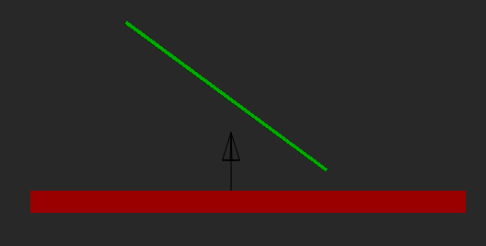
SAT: Required Axes
What is the separating axis of face vs. edge?
Will always be the face’s normal!
Notes:
For the face vs. edge case it is also sufficient to just test the face’s normal. No matter how the features of face vs. edge meet the face’s normal will be separating them. If this is not the case then we’ve moved on to the next case.

Slide 16
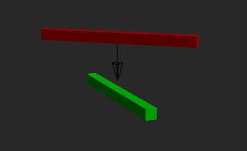
SAT: Required Axes
What is the separating axis of edge vs. edge?
The perpendicular vector between the edges
Notes:
Edge vs. edge is the hardest case to visualize because it only happens in 3d. If we imaging two edges coming towards each other in 3d the axis that would always separate them (if possible) is the perpendicular vector between them. This vector can be computed from the cross product of the two edges.

Slide 17
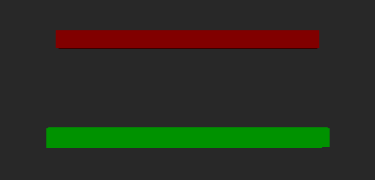
Edge cross robustness
What if the two edge crosses result in the zero vector?
Might still be separating!
Notes:
If the edge’s cross product is zero does this mean there’s no axis to test? We can choose to ignore the axis and hope it’s not the only separating one. This is only likely to cause small overlaps to get reported as intersecting so this is a viable solution, but we do need to make sure to not test a zero axis (or one close enough to zero).
To more correctly deal with this we need to find another way to compute this axis of separation. To do this we will assume that the two lines are contained on a plane. We can compute the plane’s normal by forming a triangle with one of the edges and a vertex from the other edge. The normal of this triangle should be perpendicular to both edges. We can then take the cross with the original edge and the plane’s normal to produce a vector perpendicular to the two edges. That is, given the two edges represented from points AB, and CD:
$${\vec{p}}_{n}=Cross\left(\vec{b}−\vec{a},\vec{c}−\vec{d}\right) \\ \vec{n}=Cross\left(\vec{b}−\vec{a},{\vec{p}}_{n}\right)$$
If this still fails then the edges are on a line and we can safely ignore them for testing as they cannot be the separating feature.

Slide 18
SAT: Required Axes
Required axes:
Face normals of A
Face normals of B
Axes from all edges in A crossed against all edges in B
Don’t test “close enough” axes (remove duplicates)
Don’t test “zero” vector axes
Notes:
So at the end of the day we know what axes have to be tested. To cover the face vs. face and face vs. edge cases we need to test all face normals of each shape. To deal with the edge vs. edge cases we have to test all combinations of Cross(edgeA, edgeB).
This is likely to produce many redundant axes. Any axes that are close enough to each other should be merged together. This can be done with a simple dot product on normalized edges. Likewise we can and should remove vectors that are close enough to zero. This can be tested by just checking the vector’s magnitude.
What epsilons to use is a much harder question and tends to be application specific.

Slide 19
SAT: Required Axes Examples
Aabb vs. Aabb example:
3 unique face normals of A (B is parallel)
Notes:
So the simple formula for how many axes we have to test is: $F_{a}+F_{b}+E_{a}∗E_{b}$; where F and E are the number of faces and edges respectively for each object.
If we look at the simple intersection test of Aabb vs. Aabb from before we can see that we have 3 faces from A and B, but by definition they’re parallel. Likewise every edge cross term will produce another axis that is parallel to the faces of A. Hence only 3 axes need to be tested.

Slide 20
SAT: Required Axes Examples
Obb vs. Obb example:
3 unique face normals of A
3 unique face normals of B
3 unique edges on each Obb
3 + 3 + 3 * 3 = 15
Notes:
A slightly more complicated example is Obb vs. Obb. In this case we have no guarantee that the faces of A and B are parallel. Each obb has 3 unique edges (the local space x, y, and z axes), however Obb A and Obb B are likely to have a different set of 3 unique edges. So in this case we get 15 total axes that have to be tested.

Slide 21
SAT: Required Axes Examples
Aabb vs. Frustum example:
3 unique normals of Aabb
5 unique normals of frustum
3 unique edges of Aabb
6 unique edges of frustum
3 + 5 + 3 * 6 = 26
Notes:
Now for a much more fun example, and one that I glossed over before. If you remember I talked about how our Aabb vs. Frustum test was an approximation typically used for culling. The test we used wasn’t sufficient to actually detect overlap, but it would often detect separation. If we use our new knowledge of required axes we can find out what exactly would have to be tested.
An aabb has 3 unique faced normal and 3 unique edges. A frustum has 5 unique faces (the near and far planes are the same). It also has 6 unique edges (x and y of the near plane and the 4 axes along the z axis connecting the near and far plane). That means we get a whopping total of 24 axes we’d have to test.

Slide 22

SAT: Required Axes Examples
Required Axes: $F_{A}+F_{B}+E_{A}∗E_{B}$
SAT doesn’t scale with large shapes
Quadratic in number of edge tests
Notes:
So if we look at the equation for the required number of intersection tests it becomes clear that SAT scales quadratically with edges. So SAT isn’t the most practical for large meshes in its traditional form.
We’ll look at some other methods of convex shape intersection that perform much better with large shapes later. Additionally, I’ll come back to some more modern implementations of SAT that deal with this problem. It is useful to note though that SAT performs very well with a low number of faces, in particular with boxes and triangles.

Slide 23
SAT: Implementation details
Ask now if you have questions!
Notes:
So now I’m going to go over actual implementation details, but beforehand I need to make sure that the basic concepts make sense.

Slide 24
Axis Separation
Basic axis test:
How do we compute a shape’s projection?
Need a new concept: Support functions
bool TestIfSeparating(const Vector3& axis, Shape& shapeA, Shape& shapeB)
{
float minProjA, maxProjA, minProjB, maxProjB;
ComputeProjection(axis, shapeA, minProjA, maxProjA);
ComputeProjection(axis, shapeB, minProjB, maxProjB);
// Test for separation
if(maxProjB < minProjA || maxProjA < minProjB)
return true;
return false;
}
Notes:
So with this we can look at the core function of SAT that checks if two shapes separate on an axis. This function just computes the projection intervals of each shape and then does a simple 1-dimension overlap check. The big question here is how do we compute the projection interval for a shape?
To do this I’m going to introduce one more concept that we’ll see a lot throughout the remainder of this class: support functions.
Note: support functions normally aren’t explicitly used in traditional SAT literature, but they fit very nicely here and will be important later.

Slide 25
Support Function
class Shape
{
// Finds a point furthest in the given direction
virtual Vector3 Support(const Vector3& direction);
};
How do we actually define a support function?
Notes:
The support function can be though of as a virtual interface on a shape that finds a point on the surface of an object furthest in a direction. This function can then be specialized for any shape that needs it. So the root question is, how do we define this support function?
Note: there isn’t always a unique result from a support function. This doesn’t matter though as long as the result is as far or further than every other point on the surface.

Slide 26


Generic Convex Support Function
Iterate over all points, finding the max projection value point
$$max$$
$$\vec{d}$$
Notes:
So the first support function we’ll look at is the most generic one: an arbitrary convex mesh. A convex mesh is simply defined from all of its vertices, so we can just find the point furthest in the target direction. This is a simple loop over all of the vertices, keeping track of which one has the largest projection value in that direction (dot-product).

Slide 27





Efficient Support Functions
Many shapes can efficiently compute a support function
Sphere:
$$\vec{p}=\vec{c}+r\hat{d}$$
$$\vec{p}$$
$$r$$
$$\hat{d}$$
$$\vec{c}$$
Notes:
There are many shapes that can define a more efficient support function. The simplest to look at is a sphere.
There’s an infinite number of points on a sphere so iterating over all of the points on the surface doesn’t make sense. That being said, it’s trivial to find the furthest point in a direction on a sphere’s surface. Simply use the direction vector to compute a point on the surface and you’re done!

Slide 28
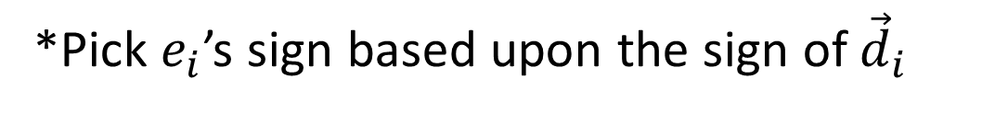




Efficient Support Functions
Aabb: Same as PlaneAabb’s find point furthest in a direction
$$\vec{p}=\vec{c}+Vec3(±e_{x},±e_{y},±e_{z})$$
$$e_{y}$$
$$e_{x}$$
$$\vec{c}$$
*Pick $e_{i}$’s sign based upon the sign of ${\vec{d}}_{i}$
Notes:
An aabb can perform a similar set of operations to more efficiently compute a support as mentioned during the simple intersections slides. Using center and half extents is the easiest aabb representation to implement the support function with. Any point on an aabb can be represented as a sum of positive or negative components of the half extents, so it’s just a matter of choosing the correct signs to add. As we want the point furthest in a direction we want either the positive or negative half extent depending on the sign of the direction vector.

Slide 29














Efficient Support Functions
Obb:
Transform into Aabb
Transform point back to world
$$R{\vec{e}}_{x}$$
$${\vec{e}}_{x}$$
$$R{\vec{e}}_{x}$$
$$\vec{c}$$
$$\vec{d}$$
$${\vec{e}}_{y}$$
$$\vec{c}$$
$$\vec{c}$$
$$\vec{d}$$
$$\vec{p}$$
$${R\vec{e}}_{y}$$
$$\vec{d}$$
$${R\vec{e}}_{y}$$
$$\vec{p}′$$
Search on Aabb
Notes:
Obb’s support function can also be efficiently calculated. The simplest way to think of this function is as a transformed Aabb support. Any Aabb can be turned into an Obb by applying a rotation transformation. This means to get from an Obb to an Aabb we apply the inverse transform. So we can map an Obb’s support function into an Aabb’s by inverse transforming the support direction. Once we do this we can perform the aabb support function to get the best point on the Aabb (pictured as $\vec{p}′$). Once we have this point on the aabb we have to transform it back onto to the Obb. The simplest way to do this is to apply the transform (this time on a point). Note: be careful about properly transforming a vector to get into local space and transforming a point (or turning the point into a vector) to get back into world space.
One other common implementation will perform the local space aabb test but will sum the column bases vectors of the obb. This is because the column vectors or a rotation matrix are the basis vectors in world space.

Slide 30
Shape Projection
Computing a shape’s is easy with support functions
void ComputeProjection(const Vector3& axis, Shape& shape, float& minProj, float& maxProj)
{
Vector3 minPt = shape.Support(-axis);
Vector3 maxPt = shape.Support(axis);
minProj = Math::Dot(minPt, axis);
maxProj = Math::Dot(maxPt, axis);
}
Notes:
With a support function in place we can very easily compute a shape’s projection on an axis. We simply have to find the min and max points in a direction and then compute their projections on the axis. Note: projections are computed easily using the dot product assuming the axis is normalized.

Slide 31
SAT
Now we can write the full SAT algorithm:
Test all face normal of both shapes
Test all edge vs. edge normals
Notes:
Now we can write the full SAT algorithm very easily. We simply need to iterate over all faces on each object and the edge vs. edge terms and test each of these axes for overlap. If any axis is separating then we return false, otherwise we return true.

Slide 32
SAT: Live Demo
Just to show this isn’t hard
Notes:
To prove that this is easy, I’m going to implement a very basic SAT algorithm live.

Slide 33
SAT Part 2: Contact Information
Faster algorithms exist for convex intersection tests
SAT is still used. Why?
Notes:
While we haven’t covered them yet, there are more modern algorithms than SAT that are faster when a shape gets more complex. That being said, SAT is still heavily used in the industry. This begs the question: Why?

Slide 34
SAT Part 2: Contact Information
SAT is the fastest algorithm that also returns useful contact information
What do we want from contact information?
What direction to push
How much to push
Want the direction that requires the “least work” (MTD)
Notes:
The main reason why is that SAT is still the fastest (and most numerically stable) algorithm that returns useful information about how shapes are intersecting. We’ll see later with GJK and MPR that these algorithms return useful information in other ways, but none are as useful as SAT (apart from EPA) when it comes to getting contact information.
So what information do we need? Well the basic idea is that we have objects overlapping that we want to make not overlap so we need to know what direction to push and how much to push them. There’s infinitely many directions that we can push objects apart though, so we typically want the axis that requires the least work, or the minimum translational distance (MTD).

Slide 35




Generating Contact Info
B
More specifically:
$$\vec{n}$$
struct ContactInfo
{
struct ContactPoint
{
Vector3 mPointA;
Vector3 mPointB;
Vector3 mPenetrationDistance;
};
Vector3 mAxis;
Array<ContactPoint> mPoints;
};
$${\vec{p}}_{a}$$
$$d$$
$${\vec{p}}_{b}$$
A
How do we even start?
Notes:
A more fully defined contact manifold is typically defined of 3 core pieces of information: the contact normal, points of contact, and penetration distance. The contact points are typically split up into two points with one point on each shape. The penetration distance is also grouped with the points as each pair of points have their own penetration distance that needs to be fixed.
Knowing that we need to find three different kinds of data, where do we start?
*The exact way this is structured changes quite a bit depending on what you’re trying to do, but here’s the generic version. If you don’t have rotations, you might not even need the points.

Slide 36

Generating Contact Info
First find the contact normal: The axis of “least work”
The axis of least penetration is the contact normal!
$$\vec{n}$$
Notes:
To start we need to find the axis of MTD, that is the axis that requires the “least work” to push the objects apart on. Logically, the axis that requires the least work is the axis with the least penetration. The axis of least penetration is the same as the axis of largest separation (assuming we have no positive separation). This is information we can easily gather during SAT!

Slide 37
Generating Contact Info
Modify SAT to track what features created this normal
Two cases for generating contact points/penetration:
Face vs. something
Edge vs. Edge
Notes:
One we know what the contact normal is, we need to know how that axis was created from SAT. In particular, we need to know if that axis came from a face normal or from an edge vs. edge normal and which specific shape’s feature generated this. This requires a little extra bookkeeping during SAT to track which features produced this axis but nothing too complicated.
Once we have this information we can break solve for the contact points and penetration distance together. This is broken up into two cases:
Face vs. something
Edge vs. Edge

Slide 38
Edge vs. Edge
Compute the closest points between the two edges
This is the easy test!
Notes:
In the case of edge vs. edge we want to find the closest features between the two edges. This amounts to finding the closest point between two line segments. For the fine details of this test see the section on closest features in Real-Time Collision Detection.

Slide 39
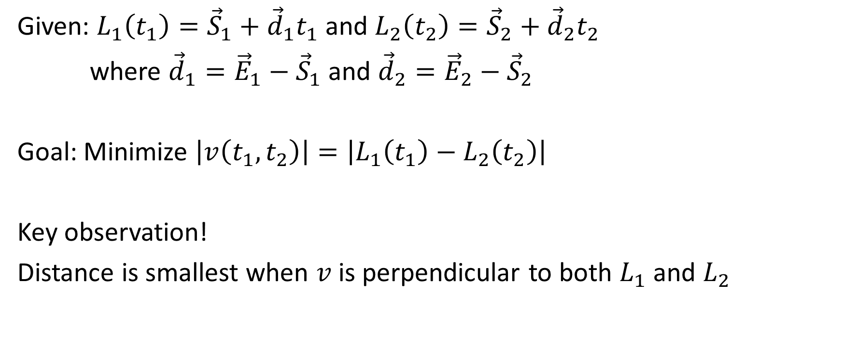
Closest Point of Two Lines
Given: $L_{1}\left(t_{1}\right)={\vec{S}}_{1}+{\vec{d}}_{1}t_{1}$ and $L_{2}\left(t_{2}\right)={\vec{S}}_{2}+{\vec{d}}_{2}t_{2}$
where ${\vec{d}}_{1}={\vec{E}}_{1}−{\vec{S}}_{1}$ and ${\vec{d}}_{2}={\vec{E}}_{2}−{\vec{S}}_{2}$
Goal: Minimize $\left|v\left(t_{1},t_{2}\right)\right|=\left|L_{1}\left(t_{1}\right)−L_{2}\left(t_{2}\right)\right|$
Key observation!
Distance is smallest when $v$ is perpendicular to both $L_{1}$ and $L_{2}$
Notes:
To find the closest point between two edges we first need to look at the closest point between two infinite lines.
The closest point between two lines will be one where we minimize the length of the vector formed by a point on line A and a point on line B.
The key observation here is that the closest points between the two objects will form a line that is perpendicular to both $L_{1}$ and $L_{2}$.
This is easiest to see if we just look at closest point between a point and a line. In this case the closest point will be the orthogonal projection of the test point on the line.

Slide 40
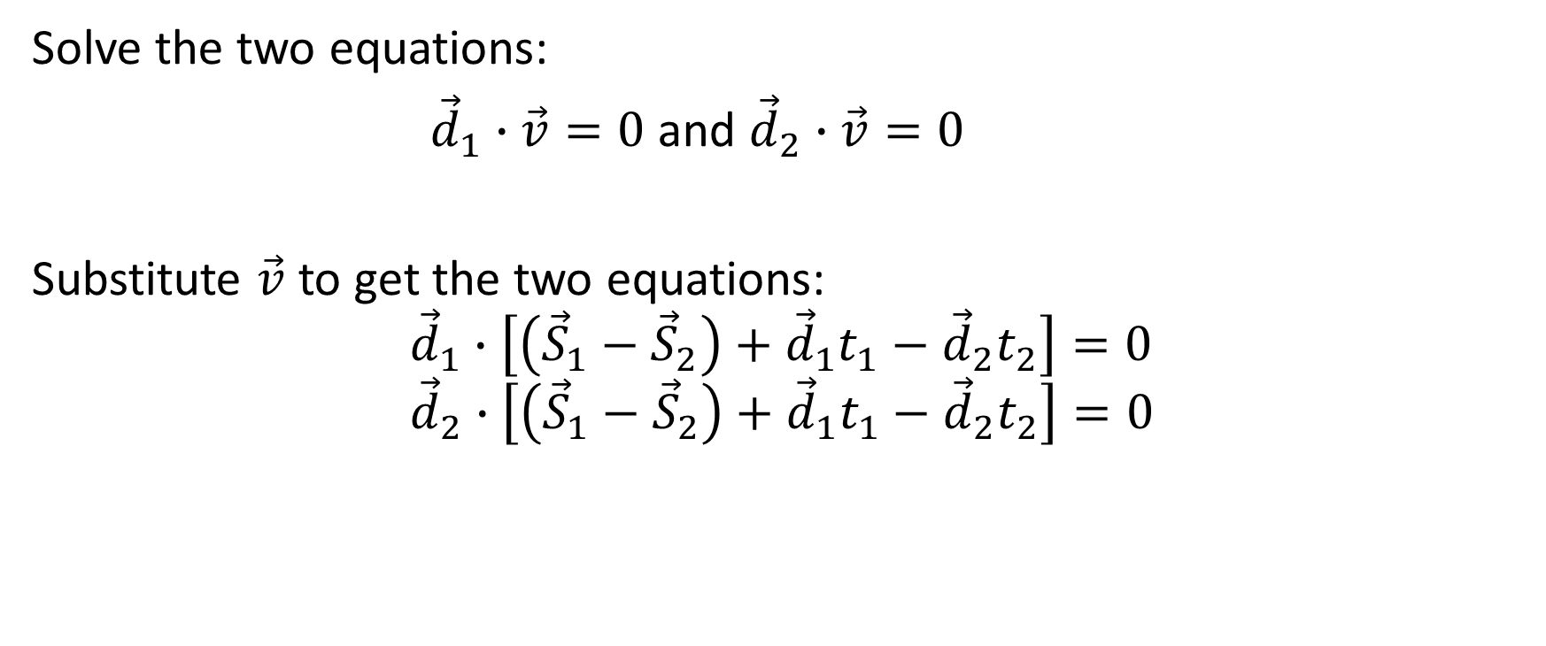
Closest Point of Two Lines
Solve the two equations:
${\vec{d}}_{1}∙\vec{v}=0$ and ${\vec{d}}_{2}∙\vec{v}=0$
Substitute $\vec{v}$ to get the two equations:
$${\vec{d}}_{1}∙\left[\left({\vec{S}}_{1}−{\vec{S}}_{2}\right)+{\vec{d}}_{1}t_{1}−{\vec{d}}_{2}t_{2}\right]=0 \\ {\vec{d}}_{2}∙\left[\left({\vec{S}}_{1}−{\vec{S}}_{2}\right)+{\vec{d}}_{1}t_{1}−{\vec{d}}_{2}t_{2}\right]=0$$
Notes:
To find the 2 t-values we can plug in v and solve.

Slide 41

Closest Point of Two Lines
Solution:
$$\left[\begin{matrix}{\vec{d}}_{1}∙{\vec{d}}_{1} & {−\vec{d}}_{1}∙{\vec{d}}_{2} \\ {\vec{d}}_{1}∙{\vec{d}}_{2} & −{\vec{d}}_{2}∙{\vec{d}}_{2}\end{matrix}\right]\left[\begin{matrix}t_{1} \\ t_{2}\end{matrix}\right]=\left[\begin{matrix}−{\vec{d}}_{1}∙{\vec{S}}_{12} \\ −{\vec{d}}_{2}∙{\vec{S}}_{12}\end{matrix}\right]$$
Where ${\vec{S}}_{12}={\vec{S}}_{1}−{\vec{S}}_{2}$
Solve using Cramer’s rule.
Notes:
If we sit down we can solve to get a 2x2 system of equations.
We can then label this as $\left[\begin{matrix}a & −b \\ b & −e\end{matrix}\right]\left[\begin{matrix}t_{1} \\ t_{2}\end{matrix}\right]=\left[\begin{matrix}−c \\ −f\end{matrix}\right]$
Where $a={\vec{d}}_{1}∙{\vec{d}}_{1}$, $b={\vec{d}}_{1}∙{\vec{d}}_{2}$, $c={\vec{d}}_{1}∙{\vec{S}}_{12}$, $e={\vec{d}}_{2}∙{\vec{d}}_{2}$, and $f=−{\vec{d}}_{2}∙{\vec{S}}_{12}$.
When solving with Cramer’s rule we can then solve for $t_{1}=(fb−ce)/d$ and $t_{2}=(af−cb)/d$
Where $d=ae−b^{2}$. Note: this re-arranged some terms to remove some minus signs.
From a quick look we can see some interesting things about d. First note that we can expand to get $d={\vec{d}}_{1}^{2}{\vec{d}}_{2}^{2}−{\left({\vec{d}}_{1}∙{\vec{d}}_{2}\right)}^{2}$. First remember our dot-product identities. So we can expand to get: $d={\vec{d}}_{1}^{2}{\vec{d}}_{2}^{2}−{\left(\left|{\vec{d}}_{1}\right|\left|{\vec{d}}_{2}\right|cos\left(θ\right)\right)}^{2}$. From here we can do some more manipulation to get: $d={\vec{d}}_{1}^{2}{\vec{d}}_{2}^{2}{\left(1−cos\left(θ\right)\right)}^{2}={\vec{d}}_{1}^{2}{\vec{d}}_{2}^{2}\sin^{2}\left(θ\right)$. Note now that $d≥0$ and if d is zero then the lines are parallel.

Slide 42

Closest Point of Two Line Segments
Just clamp the two t-values between $[0,1]$ right?
Notes:
So now we can move onto closest point of two line segments. This should only be clamping the t-values on each line segment right?

Slide 43
Closest Point of Two Line Segments
Some simple examples where this doesn’t work
Notes:
Unfortunately things are a bit more complicated than that. It’s not too hard to construct an example where clamping one each line segment will not work.

Slide 44
Closest Point of Two Line Segments
Solution:
Clamp t to Line 1 to get P1
Compute closet point on Line 2 to P1
Clamp that point to get P2
If P2 <0 or 1<P2 then compute closet point on Line 1 to P2
Notes:
The solution is to just clamp multiple times using closest point to line segment from point.
Some extra optimizations can be made by computing the solution for $t_{2}$ given $t_{1}$ and vice-versa. This is left as an exercise for the reader (also see the orange book).

Slide 45

Face vs. Something
Identify face on other shape most anti-parallel to the collision normal
B
$$\vec{n}$$
A
A
Notes:
Face vs. something is much harder. The basic idea is to find the overlapping area and what points identify that area. This is a bit difficult and we can do with a little worse information. Instead we want to find the features most offending to the collision.
To make life easier, I will reference to shape A as being the one that the normal is coming from and shape B as the other shape.
To start with we need to find which feature on shape B is most anti-parallel to the contact normal.

Slide 46




Contact Point Generation
First clip the other face to the incident face
$${\vec{p}}_{b1}$$
$${\vec{p}}_{b1}$$
$${\vec{p}}_{b2}$$
$${\vec{p}}_{b2}$$
A
A
Notes:
Once we’ve identified the offending face we need to generate contact points to represent the intersecting region. To do this we need to clip face B against face A.
In 3d clipping a face is a bit tricky. One good method to go about this is to transform into A’s space and then project B’s face onto A’s. Now clipping is a 2d problem, the only trick is how to un-project the clipped points. Barycentric coordinates can be used to do this.
Another thing to consider in 3d is how to reduce the number of contact points down to a manageable level. We might only store 4 contact points but generate 8 during clipping. Ideally we will compute the widest spread of points. One method to do this is to divide up our projection space into as many sections as we will create points for. Then we can find a point most in that area.

Slide 47



Contact Point Generation
Keep all penetrating points (toss the rest)
$${\vec{p}}_{b1}$$
$${\vec{p}}_{b2}$$
A
$${\vec{p}}_{b2}$$
A
Notes:
After clipping we want to only keep points that are actually penetrating into face A. In the simple case like pictured above we’re fine with only 1 point of contact as the object won’t really need to come to rest.

Slide 48



Penetration Depth
Compute the distance between a pair of points
$${\vec{p}}_{a2}$$
$$d_{2}$$
$${\vec{p}}_{b2}$$
A
Notes:
To compute the penetration depth is easy now. For a pair of points the penetration depth is the distance between the point on A and the point on B in the direction of the normal ($d=Dot\left({\vec{p}}_{b}−{\vec{p}}_{a},\vec{n}\right)$).

Slide 49


More complicated example
First identify the two faces
B
$${\vec{p}}_{b1}$$
A
$${\vec{p}}_{b2}$$

Slide 50




More complicated example
Clip face B to face A
$${\vec{p}}_{b1}$$
$${\vec{p}}_{b1}$$
$${\vec{p}}_{b2}$$
$${\vec{p}}_{b2}$$

Slide 51






More complicated example
Project the points onto face A to compute the point pairs
$${\vec{p}}_{a1}$$
$${\vec{p}}_{b1}$$
$${\vec{p}}_{b1}$$
$${\vec{p}}_{a2}$$
$${\vec{p}}_{b2}$$
$${\vec{p}}_{b2}$$

Slide 52
Final Notes
SAT:
Accurately checks for convex shape intersection
Can be very fast when objects separate (1 axis?)
Can be used to find the MTD when overlap occurs
Can be used to find a full contact manifold
Doesn’t scale well with complex shapes
Will talk about more modern stuff later that addresses this
Notes:
Here’s a quick summary of SAT. In particular, note that it is an algorithm for finding if two convex objects are separating. In the case of overlap, it tracks all the information needed to determine contact information.
The biggest drawback about SAT is that it doesn’t scale well with large objects due to the quadratic number of edge tests. There are quite a few modern updates to SAT that can drastically improve its performance, in particular one called Gauss Map optimizations that we’ll look at later.

Slide 53
Questions?

