Slide 1
Survey of Multi-Physics
Joshua Davis – jodavis42@gmail.com

Slide 2
My Thesis – “Multi-Physics”
Interactions between different kinds of physics simulations
Different base assumptions
Efficiency
Stability
Notes:
Thesis about multi-physics
Issue because of assumptions
Mention forces on rigid bodies
Important for shown reason
Talk about different models
Discrete not continuous

Slide 3
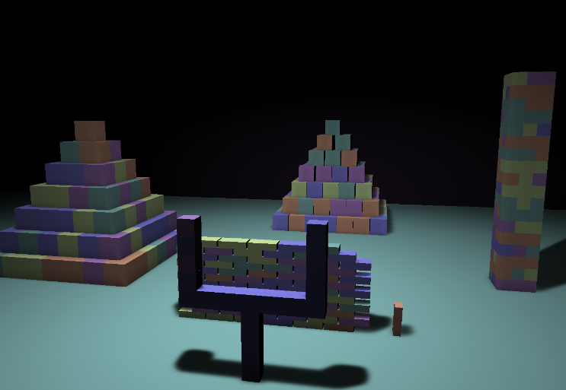
Rigid Bodies
Expected behavior
Efficient
Stable multi-body interactions
Stacking
Notes:
What is a rigid body?
Common metrics

Slide 4
Rigid Bodies
Update Loop
Mirtich [Mirtich94] separates
Kinematic Integration
Collision Detection
Resolve Dynamics
Collisions:
Basic Impulses
Contacts:
Restitution of 1
Problem
Step 1
Step 3

Slide 5
Rigid Bodies with Stacking
Updated integration - [Guendelman 03]
Detect Collision
Resolve Dynamics (Collisions)
Kinematic Velocity Integration
Resolve Dynamics (Contacts)
Shock Step
Kinematic Position Integration
Step 2
Step 3
Step 4
Notes:
Negative restitution to propagate energy in contacts
Iterates multiple times in each step

Slide 6
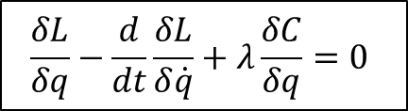
Constraints
Come from Lagrange mechanics
Sequential Impulses [Catto05]
Baumgarte stabilization
Inequality constraints (proper total impulse clamping)
$$\frac{δL}{δq}−\frac{d}{dt}\frac{δL}{δ\dot{q}}+λ\frac{δC}{δq}=0$$

Slide 7
Velocity Constraint
Jacobian
J and V are perpendicular
velocity
Corrective Force
gravity
Corrective force
Direction of force
Magnitude of force
Notes:
What is a Jacobian?
Direction to solve
What is lambda?
Strength to solve

Slide 8
Jakobsen
[Jakobsen03]
Connected with infinite stiffness springs
Collision resolved by snapping points to surface
Distance too large
Correct distance
Distance to short
Notes:
Infinite changes from dynamics to kinematics

Slide 9

2D Cloth
Nodal point masses connect with springs
Hooke’s Law:
Structural, Sheer and Bending springs [Bridson02]
$$\vec{F}=−k\vec{x}$$
Notes:
Move Hooke’s law down a line

Slide 10
2D Cloth
Problems:
Stability issues with stiff systems
Stiffness bound by the timestep
Un-intuitive material properties
Why use spring systems?
Efficiency
Cloth is actually a set of wet fibers, not a continuum [Breen94]

Slide 11
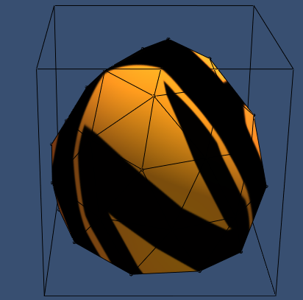
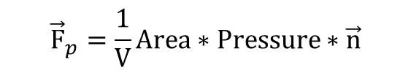
Pressure Model Soft Bodies
Spring system with a pressure force inside – [Matyka04a]
$${\vec{F}}_{p}=\frac{1}{V}Area∗Pressure∗\vec{n}$$
Normal
Volume
Area
Notes:
Pressure force inside
Based on volume
Balloon like objects

Slide 12

FEM
Pioneered by Terzopolous [Terzopoulos88]
Evaluates the continuum of the object
Solves the generalized form of Hooke’s Law:
Breaks the volume of the object up into tetrahedra
$$K\vec{u}={\vec{f}}_{ext}$$
Volume spring instead of position spring
Notes:
Say used to solve generalized hooke’s law, swap that with breaks volume

Slide 13
Brittle Fracture
[O`Brien99]
Fracture objects based upon eigenvalue and eigenvector of strain tensor
eigenvalue determines whether or not to split
eigenvector is the fracture plane
Local remeshing of object during fracture

Slide 14
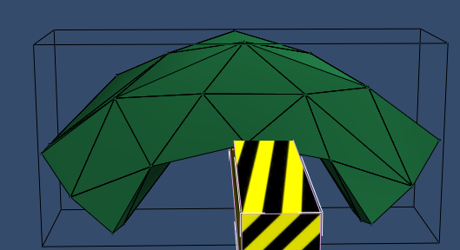


Ductile Fracture and Plasticity
[O`Brien02]
Plastic deformation from plastic strain
$e_{elastic}=e_{total}−e_{plastic}$
Use material properties of yield, creep and max
$$if\left(\left|e_{elastic}\right|>yield\right)$$
$$e_{plastic}+=\min\left(creep,\frac{1}{dt}\right)∗dt∗e_{elastic}$$
$$if\left(\left|e_{plastic}\right|>max\right)$$
$$e_{plastic}=\left(\frac{e_{plastic}}{\left|e_{plastic}\right|}\right)∗max$$
Notes:
Strain: related to deviation from equilibrium position

Slide 15
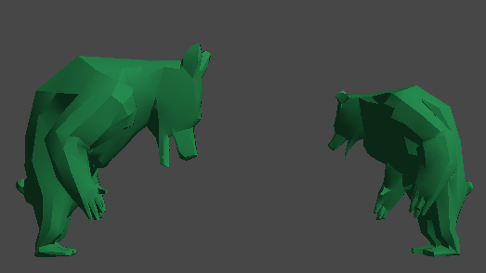
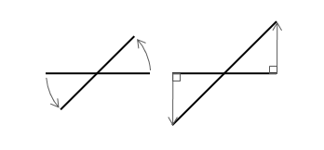
FEM improvements
[Muller04]
Linearized Green-Strain produces rotation artifacts
Stiffness warping fixes this
Compute the forces in an un-rotated frame
Rotate the forces to the world frame
Notes:
Why linearize?
Problems
Stiffness warping

Slide 16
Multi-Physics
Two main categories to focus on:
Coupling – Defining a pair-wise relationship for two systems
Embedding – Proxying a system into the primary system
Coupling
Embedding
A
B
A
B
C
D
C
D
Notes:
Coupling
Embedding
Mention picture

Slide 17





Interleaving
[Baraff92]
Problems:
Needs a repair step
Works best with large mass disparity
System A
Input Forces
$$t_{0}$$
System B
$$t_{1}$$
System A
$$t_{2}$$
System B
$$t_{3}$$
System A
$$t_{4}$$
Notes:
Run simulations sequentially
Use other system’s previous results in the next step

Slide 18
Coupling
One-way vs. Two way coupling [O`Brien00]
One-way coupling
Two-way coupling
Primary System
Forces
Passive System
System A
Forces
System B
Soil simulation [Li93]
Impulses [Sifakis07]
Soft bound particles
Constraints [Shinar08]
Allowed embedding rigid body skeletons
Notes:
Maybe remove title and expand further down with 1-2 way as title

Slide 19
Coupling
A full two-way coupling is more expensive than it seems [O`Brien00]
System A
@ native 60fps
System B
@ native 300fps
Timestep not coupled
Timestep coupled
Notes:
Extra expensive
Not just time(A) + time(B) + time(Coupling)
Rigid body spring example

Slide 20
Embedding
Proxy objects into primary system
[Parker09]
Rigid Body
FEM
Approximated center mass’ velocity to apply back to rigid bodies
Commercial rigid body engine
Solved with penalty forces
A
B
C
D
[Fishman12]
Rigid Body
FEM
Collided as point masses (infinite inertia)
Solved with constraints

Slide 21
My Projects
Rigid
Deformable
Jakobsen
Stick Constraint
Trivial coupling
Jakobsen
Stick Constraint
Newtonian Impulse
Coupling
Spring Mass Aggregate
Constraints
Embedding
FEM
Notes:
I will now talk about these in context of my thesis.

Slide 22
Newtonian Impulses
Same
Integration scheme
Negative restitution
Contact Graph
Shock propagation
Differences
Guendelman
Me
Level set geometry
Offline
Remove contacts when separating
Only convex shapes (mesh based)
Real-time
Ignore separating contacts

Slide 23
Constraints
Same
Sequential Impulses
Baumgarte penetration resolution
Differences
Catto
Me
Friction direction (velocity projection)
Friction Limits are constant
Contact caching from contact ids
Persistent friction direction
Friction limits based upon normal impulse
Contact caching from point proximity

Slide 24
Jakobsen
Same
Verlet Integration
Position-based constraints
Friction
Differences
Jakobsen
Me
Collision with points
Collision with triangles
Barycentric weights for nodal points

Slide 25
Springs
My implementation
Structure, shear and bend springs [Bridson02]
Solve for spring and damping force [Nealen05]
Semi-implicit Euler integrator
Pressure-Model Soft Body: Gauss-Green theorem for volume [Matyka04b]

Slide 26
FEM Deformable Bodies
Implementation details by Erleben [Erleben05]
Linearized Cauchy Strain
Stiffness warping
Rotation computation
Plasticity
Conjugate Gradient [Shewchuk94]
Extras:
Inverted Elements [Nesme05]

Slide 27
Multi-Physics - Coupling
Based on Sifakis’ work [Sifakis07]
Same
Different
Deformables collide as point masses
Impulses for resolution
No persistent soft bound points
Soft bound point comes from collision detection
Rigid bodies not represented as point
masses

Slide 28
Multi-Physics - Embedding
Most similar to Fishman
[Fishman12]
Rigid Body
FEM
Constraints with point masses
Me
Rigid Body
FEM
Fully proxy rigid body:
center of mass, angular velocity, inertia and orientation

Slide 29
Comparison
Coupling
Embedding
Pros:
Efficient
Explicit control of system interactions
More accurate
Cons:
Not scalable
Extra forces must be explicitly added
Requires a way to modify the update loop
Scales to most expensive system
Pros:
Simpler
Transfers extra forces easier
Cons:
Slows down primary system
Requires a way to proxy in primary system
Approximation
Extra memory
Coupling
Embedding
A
B
A
B
C
D
C
D
Notes:
Efficiency:
Embedding slows primary
Coupling slows to most expensive
Accuracy:
Coupling more accurate
Embedding believable
Scalability:
Coupling doesn’t scale
Embedding scales and is simple
Extra forces
Embedding inherits PGS mass ratio issues
Modifications:
Both required

Slide 30
Benchmarks
Impulse: 300 cubes
Constraints: 300 cubes at 60 fps
100 Jakobsen cubes (800 particles and 2000 constraints + more for contacts)
Springs: 30x30 cloth
PMSB: 1500 vertices
FEM: around 2000 tetrahedron at 60 fps
Coupling: hundreds each
Embedding: 60 each fem cubes and rigid body cubes
Notes:
Maybe rigid body vs fem cube graph
Maybe total rigid body count (element count stuff)

Slide 31
References
[Baraff92] Baraff D., Witkin A. " Dynamic Simulation of Non-penetrating Flexible Bodies." Computer Graphics, Vol. 26, No. 2. (1992), pp. 303-308.
[Breen94] Breen D., House D., Wozny M. "Predicting the Drape of Woven Cloth Using Interacting Particles." SIGGRAPH `94 (1994), pp. 365-372.
[Bridson02] Bridson R., Fedkiw R., Anderson J. “Robust Treatment of Collisions, Contact and Friction for Cloth Animation”. ACM Transactions on Graphics, vol. 21, no. 3, Proc. ACM SIGGRAPH 2002, pp. 594-603.
[Cat05] Catto, E. "Iterative Dynamics with Temporal Coherence". Game Developers Conference 2005.
[Erleben05] Erleben K., Sprorring J., Henriksen K., Dohlman H. "Physics Based Animation." Charles River Media, 2005.
[Fishman12] Fishman T. Real-Time Deformation with the Finite Element Method and Embedding Using Rigid Body Proxies. Master Thesis. DigiPen Institution of Technology, Summer 2012.
[Gue03] Guendelman E., Bridson R. and Fedkiw R. "Nonconvex Rigid Bodies with Stacking." SIGGRAPH 2003. ACM TOG 22, 871-878 (2003).
[Jak03] Jakobsen T. "Advanced Character Physics." Web. 21 January 2003. http://www.gamasutra.com/view/feature/131313/advanced_character_physics.php
[Li93] Li X. and Moshell J. M. Modeling Soil: Realtime Dynamic Models for Soil Slippage and Manipulation. Proc. Siggraph 93, ACM, New York, Aug. 1993, pp.361-368.
[Matyka04b] Matyka M., Ollila M. "Pressure Model Soft Body Simulation." SIGGRAPH (November 2003), pp. 20-21.
[Matyka04b] Matyka M. "How To Implement a Pressure Soft Body Model." Web. 30 March 2004. http://www.matyka.pl/.
[Mirtich94] Mirtich B., Canny J. "Impulse-based Dynamic Simulation.'' In Proc. Workshop on Algorithmic Foundations of Robotics (WAFR-94), February 1994.
[Muller04] Muller M., Gross M. "Interactive Virtual Materials." In GI ’04: Proceedings of Graphics Interface 2004 (2004), pp. 239–246.
[Nealan05] Nealan A., Muller M., Keiser R., Boxerman E., Carlson M. "Physically Based Deformable Models in Computer Graphics." EUROGRAPHICS 2005.
[Nesme05] Nesme M., Payan Y., Faure F. "Efficient, physically plausible finite elements." EUROGRAPHICS 2005.
[O`Brien99] O`Brien J., Hodgins J. "Graphical Modeling and Animation of Brittle Fracture." In Proceedings of SIGGRAPH 1999 (1999), pp. 287–296.
[O`Brien00] O`Brien J., Zordan V., Hodgins J. "Combining Active and Passive Simulations for Secondary Motion." IEEE Computer Graphics and Applications. 20. (2000).
[O`Brien02] O`Brien J., Bargteil A., Hodgins J. "Graphical Modeling and Animation of Ductile Fracture." In Proceedings of SIGGRAPH 2002 (2002), pp. 291–294.
[Parker09] Parker E., O’Brien F. "Real Time Deformation and Fracture in a Game EnvironMent." Eurographics/ACM SIGGRAPH Symposium on Computer Animation (2009).
[Shinar08] Shinar T., Schroeder C., Fedkiw R. Two-way Coupling of Rigid and Deformable Bodies. In SCA `08: Proceedings of the 2008 ACM SIGGRAPH/Eurographics symposium on Computer animation. pages 95-103, 2008.
[Sifakis07] Sifakis E., Shinar T., Irving G., Fedkiw R. Hybrid Simulation f Deformable Solids. In Proc. OF ACM SIGGRAPH/Eurographics Symp. on Computer Animation. (2007), pp.81-90.
[Shewchuk94] Shewchuk J. "An Introduction to the Conjugate Gradient Method Without the Agonizing Pain." August 1994. http://www.cs.cmu.edu/~jrs/jrspapers.html
[Terzopoulos88] Terzopoulos D. and Witkin A. "Physically Based Models with Rigid and Deformable Components." IEEE Computer Graphics and Applications 8, 6 (1988), 41–51.

Slide 32
End of new slides

Slide 33
My Thesis – “Multi-Physics”
Interactions between different kinds of physics simulations
Different base assumptions
Efficiency
Stability
Notes:
Thesis about multi-physics
Issue because of assumptions
Mention forces on rigid bodies
Important for shown reason
Talk about different models
Discrete not continuous

Slide 34
Rigid Bodies
Expected behavior
Efficient
Stable multi-body interactions
Stacking
Notes:
What is a rigid body?
Common metrics

Slide 35
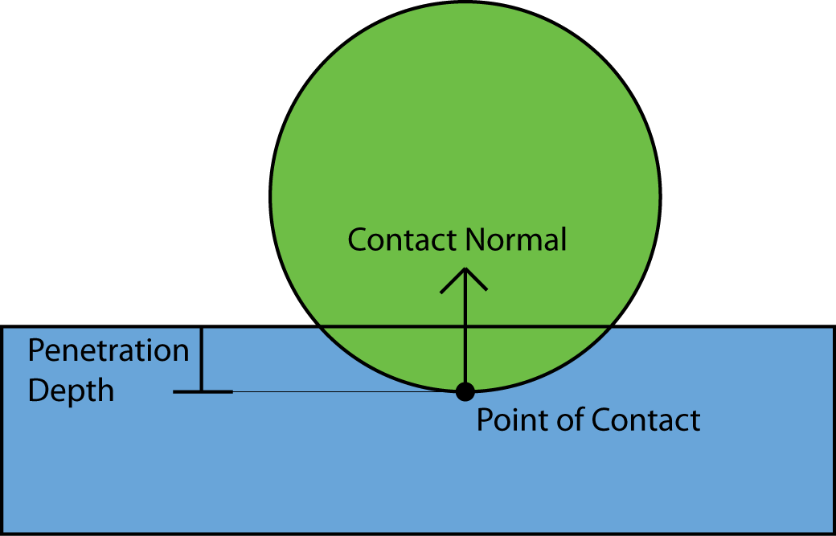
Rigid Body Manifold
Normal
Point(s) of contact
Penetration depth(s)
Notes:
Explain each paramter

Slide 36
Penalty method
Apply a force based upon penetration distance
a spring oscillates
Side effects:
Non-physical response
Not stable
Extra restitution depending
on penetration distance
Notes:
What is a penalty method?
Problems
Extra speed
Not physical
Extra restitution
Different time steps

Slide 37
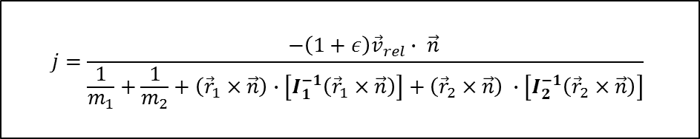
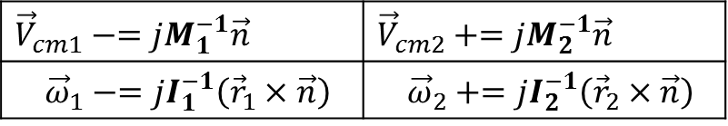
Newtonian Impulses
Idea: Find the impulse to separate the velocities at the point of contact
Solve for impulse scalar:
Apply the impulse to each object:
$$j=\frac{−\left(1+ε\right){\vec{v}}_{rel}∙ \vec{n} }{\frac{1}{m_{1}}+\frac{1}{m_{2}}+\left({\vec{r}}_{1}×\vec{n}\right)∙\left[I_{1}^{−1}\left({\vec{r}}_{1}×\vec{n}\right)\right]+\left({\vec{r}}_{2}×\vec{n}\right) ∙\left[I_{2}^{−1}\left({\vec{r}}_{2}×\vec{n}\right)\right]}$$
$${\vec{V}}_{cm1}−=jM_{1}^{−1}\vec{n}$$ | $${\vec{V}}_{cm2}+=jM_{2}^{−1}\vec{n}$$
$${\vec{ω}}_{1}−=jI_{1}^{−1}\left({\vec{r}}_{1}×\vec{n}\right)$$ | $${\vec{ω}}_{2}+=jI_{2}^{−1}\left({\vec{r}}_{2}×\vec{n}\right)$$
Notes:
instantaneous force
Compute j to apply to each object
Updated shown below

Slide 38
Newtonian Impulse - Stacking
“Usual” integration
Updated integration - [Gue 03]
Detect Collision
Integrate Velocity
Resolve Collisions
Integrate Positions
Detect Collision
Resolve Collisions
Integrate Velocity
Resolve Contacts
Shock Step
Integrate Positions
Step 1
Step 2
Step 3
Step 2
Step 3
Step 4
Notes:
Usual integration
Objects at rest bounce
Concept of collision vs. contact
Velocity threshold
Fedkiw approach
Objects at rest don’t bounce
Shock step for extra stability

Slide 39
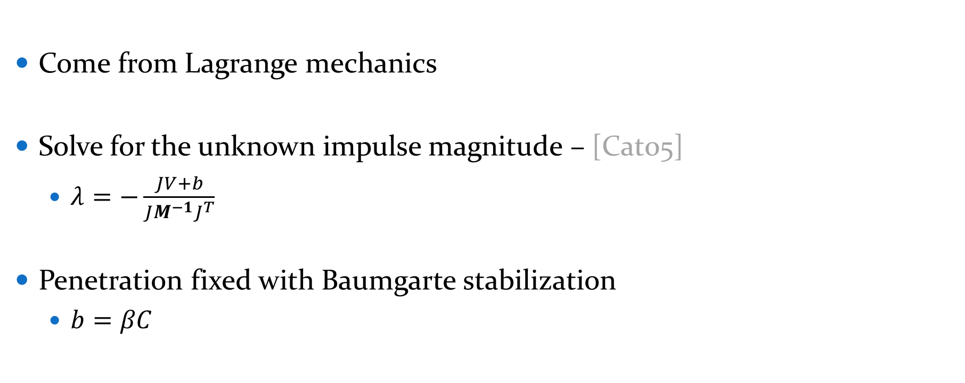
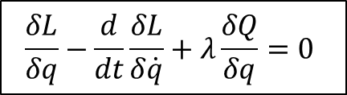
Constraints
Come from Lagrange mechanics
Solve for the unknown impulse magnitude – [Cat05]
$λ=−\frac{JV+b}{JM^{−1}J^{T}}$
Penetration fixed with Baumgarte stabilization
$b=βC$
$$\frac{δL}{δq}−\frac{d}{dt}\frac{δL}{δ\dot{q}}+λ\frac{δQ}{δq}=0$$
Notes:
Lagrange mechanics
Solve for Q
Sequential impulses (Catto)
Penetration (Baumgarte)
“Penalty force”
Constraints can apply negative impulses that don’t reverse

Slide 40
Velocity Constraint
Jacobian
J and V are perpendicular
velocity
Corrective Force
gravity
Corrective force
Direction of force
Magnitude of force
Notes:
What is a Jacobian?
Direction to solve
What is lambda?
Strength to solve

Slide 41
Constraints
Also allow modeling of:
Limits
Motors
Springs
Notes:
Allow lots of different joints
Allow in same system
Limits
Motors
Springs
More expensive but more robust than a normal spring

Slide 42
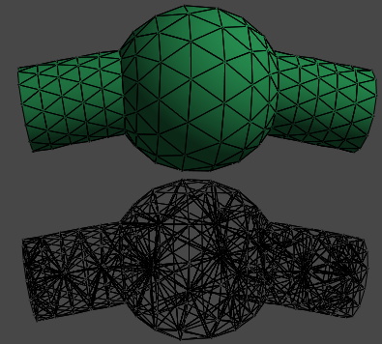
Deformables
Mass Aggregate Model
Continuum Model
Notes:
Mass aggregates
Lump mass on nodes
Connected by springs
Nothing preserves area/volume
Continuum
Solve for forces within volume

Slide 43
Jakobsen Constraint
[Jak03]
Model everything as point masses
Connected with infinite stiffness springs
Verlet integration
Distance too large
Correct distance
Distance to short
Notes:
Not physically based
Mass aggregate
Infinite stiffness springs
Why this is good
Rigid bodies
Verlet (implicit velocity)

Slide 44
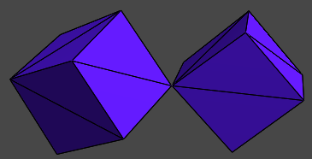
Jakobsen Constraint
Collision resolved by snapping points to surface
Velocity implicitly fixed from Verlet
Can also be used to model articulate bodies
Notes:
Collisions
Restitution
Articulated bodies
Pin
Hinge
Ragdolls

Slide 45
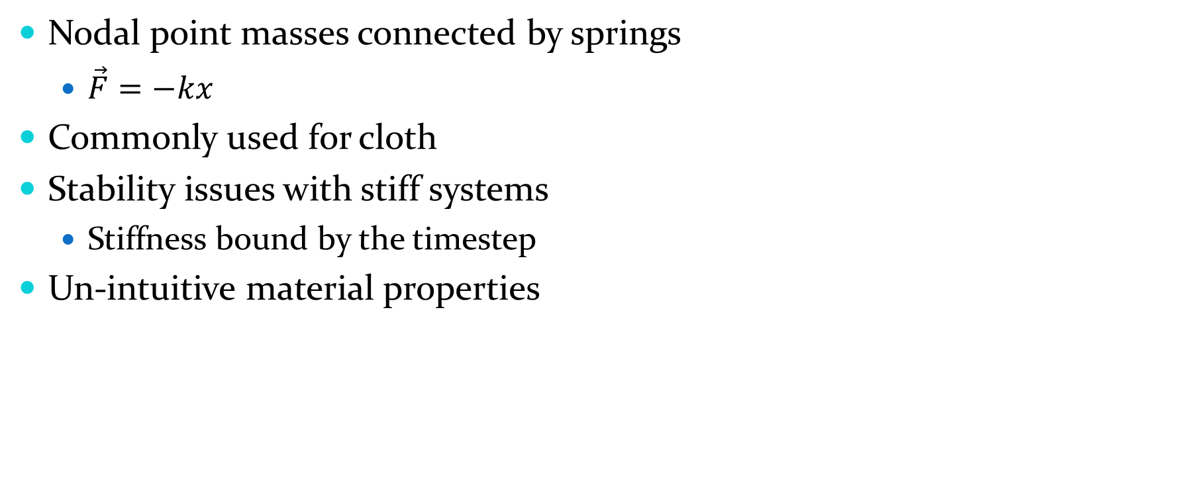

Spring Mass Aggregate
Nodal point masses connected by springs
$\vec{F}=−kx$
Commonly used for cloth
Stability issues with stiff systems
Stiffness bound by the timestep
Un-intuitive material properties
$$\vec{F}=k_{s}∗\left(\left|{\vec{x}}_{ij}\right|−l\right)∗\frac{{\vec{x}}_{ij}}{\left|{\vec{x}}_{ij}\right|}$$
$${\vec{F}}_{d}=k_{d}∗\frac{{\vec{v}}_{ij}∙{\vec{x}}_{ij}}{\left|{\vec{x}}_{ij}\right|}∗{\vec{x}}_{ij}$$
Notes:
Cloth
Problems
Overly stiff/damp
What controls upper limit
Overly restrictive timestep
Unintuitive params

Slide 46
Pressure Model Soft Bodies
Spring system with a pressure force inside – [Mat04]
$${\vec{F}}_{p}=\frac{1}{V}Area∗Pressure∗\vec{n}$$
Normal
Volume
Area
Notes:
Pressure force inside
Based on volume
Balloon like objects

Slide 47
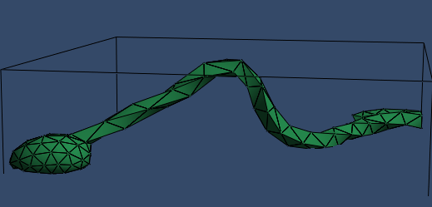
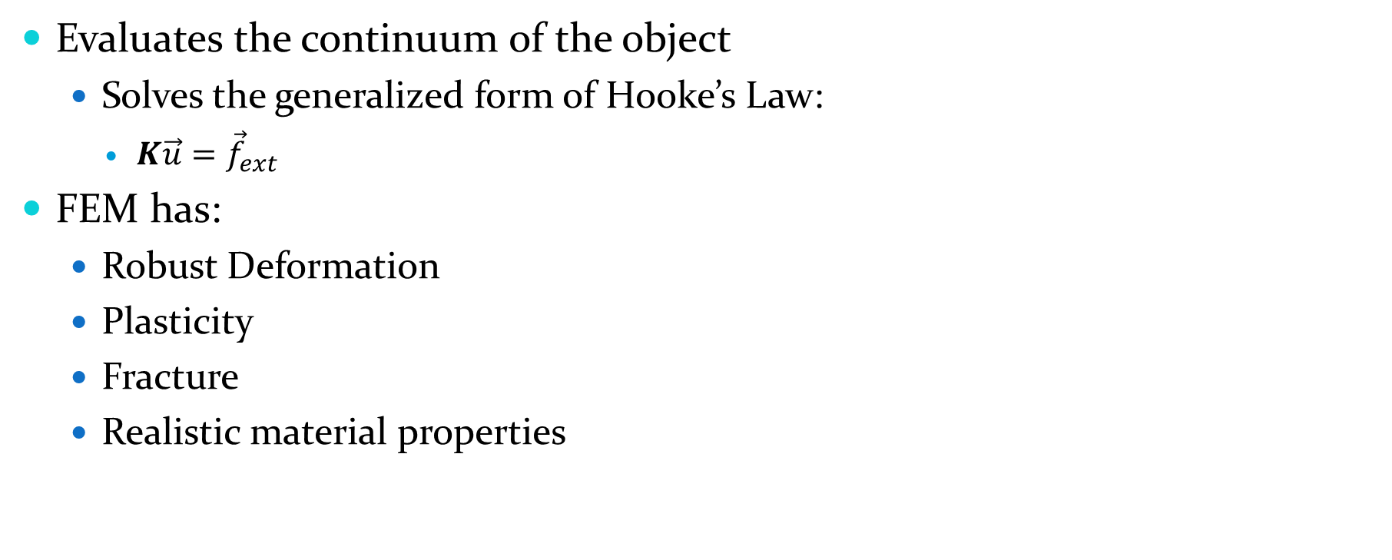
Finite Element Method
Evaluates the continuum of the object
Solves the generalized form of Hooke’s Law:
$K\vec{u}={\vec{f}}_{ext}$
FEM has:
Robust Deformation
Plasticity
Fracture
Realistic material properties
Notes:
Continuum (only fem talked about)
Series of elements
Explain each parameter
Static equilibrium
Dynamics not shown
Benefits

Slide 48
FEM improvements
[Mul04]
Linearized Green-Strain produces rotation artifacts
Stiffness warping fixes this
Compute the forces in an un-rotated frame
Rotate the forces to the world frame
Notes:
Why linearize?
Problems
Stiffness warping

Slide 49
Multi-Physics
Many different ways to try to combine physics engines
Two main categories to focus on:
Coupling – Defining a pair-wise relationship for two systems
Embedding – Proxying a system into the primary system
Coupling
Embedding
A
B
A
B
C
D
C
D
Notes:
Coupling
Embedding
Mention picture

Slide 50
One-way Coupling
One system does not affect the other
Useful for several kinds of simulations:
Large mass differences
When one system is not important for the simulation
Soil simulation [Li93]
Notes:
One way forces
Useful in:
Large mass differences
Primary drives passive
Li’s sim

Slide 51
Two-way coupling
The forces are applied equally to each system
Generally uses a very accurate method of response
Hybrid approaches can be used as well
Less accurate but reasonable approximations
Notes:
Accurate
Full force transfer
Hybrid
Less accurate but fast approx.
i.e. force fields

Slide 52
Coupling
Before Coupling
With Coupling
System A:
Integrate Velocity
Detect Collision
Resolve Collision
Integrate Position
Publish Results
System A:
Integrate Velocity
Detect Collision
Resolve Collision
System B:
Integrate Velocity
Detect Collision
Resolve Collision
Coupling:
Detect Collision
Resolve Collision
System B:
Integrate Velocity
Detect Collision
Resolve Collision
Integrate Position
Publish Results
System A:
Integrate Position
Publish Results
System B:
Integrate Position
Publish Results
Notes:
Coupling will be too late
Coupling
Resolve loop
Full coupling iterate between systems

Slide 53
Coupling
A full two-way coupling is more expensive than it seems
System A
@ native 60fps
System B
@ native 300fps
Timestep not coupled
Timestep coupled
Notes:
Extra expensive
Not just time(A) + time(B) + time(Coupling)
Rigid body spring example

Slide 54
Embedding
Define a primary system
Proxy all other systems into the primary
Proxies pretend to be native object types
Inherently less accurate than two-way coupling
Believable though
Notes:
Embedding
Everyone proxies into primary system
Less accurate
Believable

Slide 55
My Projects
Rigid
Deformable
Jakobsen
Stick Constraint
Trivial coupling
Jakobsen
Stick Constraint
Newtonian Impulse
Coupling
Spring Mass Aggregate
Constraints
Embedding
FEM
Notes:
I will now talk about these in context of my thesis.

Slide 56
Jakobsen system
Allows modeling of rigid and deformable objects together
Simple interactions
No stacking
Lacks robust and stable collision
Only simple “constraints”
Notes:
Trivial coupling
Mal-adapted at rigid bodies
Friction
No complex interactions
Stacking
No prismatics or motors

Slide 57
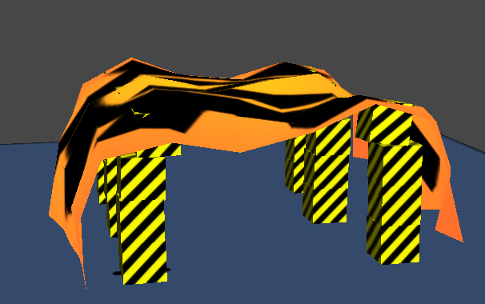
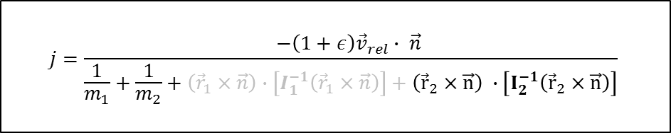
Coupling
Spring-mass aggregate and Newtonian impulse
Collide springs as a point mass
$$j=\frac{−\left(1+ε\right){\vec{v}}_{rel}∙ \vec{n} }{\frac{1}{m_{1}}+\frac{1}{m_{2}}+\left({\vec{r}}_{1}×\vec{n}\right)∙\left[I_{1}^{−1}\left({\vec{r}}_{1}×\vec{n}\right)\right]+\left({\vec{r}}_{2}×\vec{n}\right) ∙\left[I_{2}^{−1}\left({\vec{r}}_{2}×\vec{n}\right)\right]}$$
Notes:
Spring system as point mass
Infinite inertia
Impulse to resolve

Slide 58
Embedding
Constraints and FEM
FEM proxies each tetrahedron as a rigid body
FEM computes mass, inertia and velocities for rigid body system
Constraints solved as normal, not knowing the difference
Notes:
Rigid body primary
Fem pretends to be rigid body
Mass, inertia, velocity approximated
All joints work
Issues due to approximations
Full FEM coupling (every constraint iteration)
Full mass of FEM for every tetrahedron for better behavior

Slide 59
Comparison
Coupling
Embedding
Pros:
Efficient
Explicit control of system interactions
More accurate
Cons:
Not scalable
Extra forces must be explicitly added
Requires a way to modify the update loop
Scales to most expensive system
Pros:
Simpler
Transfers extra forces easier
Cons:
Slows down primary system
Requires a way to proxy in primary system
Approximation
Extra memory
Coupling
Embedding
A
B
A
B
C
D
C
D
Notes:
Efficiency:
Embedding slows primary
Coupling slows to most expensive
Accuracy:
Coupling more accurate
Embedding believable
Scalability:
Coupling doesn’t scale
Embedding scales and is simple
Extra forces
Embedding inherits PGS mass ratio issues
Modifications:
Both required

Slide 60
Demo

Slide 61
Questions?

Slide 62
References
[Bridson02] Bridson R., Fedkiw R., Anderson J. “Robust Treatment of Collisions, Contact and Friction for Cloth Animation”. ACM Transactions on Graphics, vol. 21, no. 3, Proc. ACM SIGGRAPH 2002, pp. 594-603.
[Cat05] Catto, E. "Iterative Dynamics with Temporal Coherence". Game Developers Conference 2005.
[Gue03] Guendelman E., Bridson R. and Fedkiw R. "Nonconvex Rigid Bodies with Stacking." SIGGRAPH 2003. ACM TOG 22, 871-878 (2003).
[Jak03] Jakobsen T. "Advanced Character Physics." Web. 21 January 2003. http://www.gamasutra.com/view/feature/131313/advanced_character_physics.php
[Li93] Li X. and Moshell J. M. Modeling Soil: Realtime Dynamic Models for Soil Slippage and Manipulation. Proc. Siggraph 93, ACM, New York, Aug. 1993, pp.361-368.
[Mat04] Matyka M., Ollila M. "Pressure Model Soft Body Simulation." SIGGRAPH (November 2003), pp. 20-21.
[Muller04] Muller M., Gross M. "Interactive Virtual Materials." In GI ’04: Proceedings of Graphics Interface 2004 (2004), pp. 239–246.

Slide 63
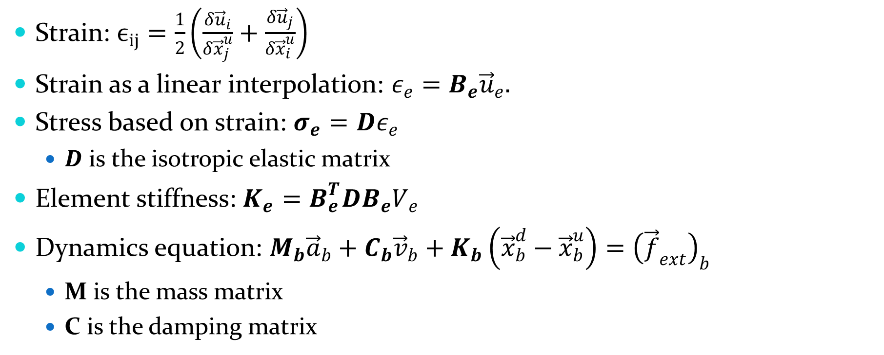
FEM - Dynamics
Strain: $ϵ_{ij}=\frac{1}{2}\left(\frac{δ{\vec{u}}_{i}}{δ{\vec{x}}_{j}^{u}}+\frac{δ{\vec{u}}_{j}}{δ{\vec{x}}_{i}^{u}}\right)$
Strain as a linear interpolation: $ε_{e}=B_{e}{\vec{u}}_{e}.$
Stress based on strain: $σ_{e}=Dε_{e}$
$D$ is the isotropic elastic matrix
Element stiffness: $K_{e}=B_{e}^{T}DB_{e}V_{e}$
Dynamics equation: $M_{b}{\vec{a}}_{b}+C_{b}{\vec{v}}_{b}+K_{b}\left({\vec{x}}_{b}^{d}−{\vec{x}}_{b}^{u}\right)={\left({\vec{f}}_{ext}\right)}_{b}$
M is the mass matrix
C is the damping matrix

Slide 64
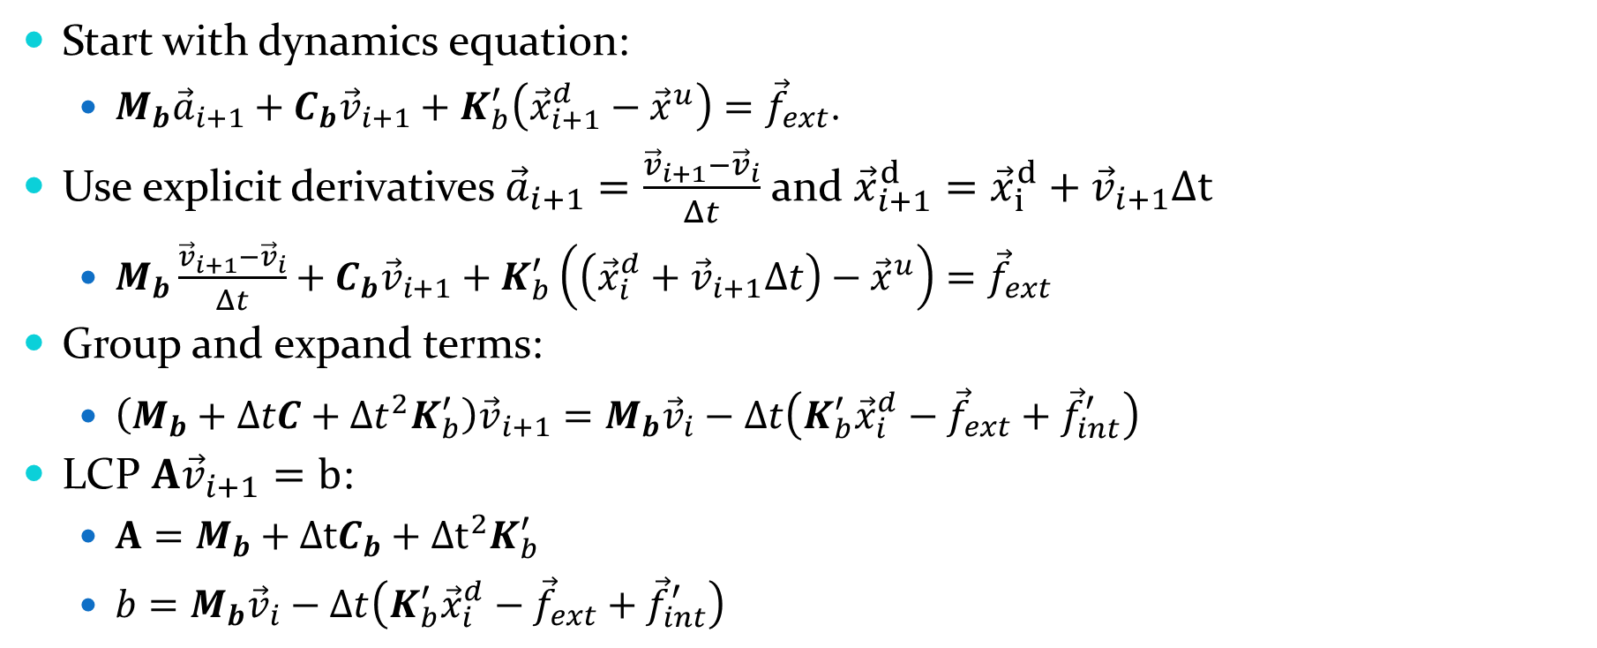
FEM - Integration
Start with dynamics equation:
$M_{b}{\vec{a}}_{i+1}+C_{b}{\vec{v}}_{i+1}+K_{b}^{′}\left({\vec{x}}_{i+1}^{d}−{\vec{x}}^{u}\right)={\vec{f}}_{ext}$.
Use explicit derivatives ${\vec{a}}_{i+1}=\frac{{\vec{v}}_{i+1}−{\vec{v}}_{i}}{Δt}$ and ${\vec{x}}_{i+1}^{d}={\vec{x}}_{i}^{d}+{\vec{v}}_{i+1}Δt$
$M_{b}\frac{{\vec{v}}_{i+1}−{\vec{v}}_{i}}{Δt}+C_{b}{\vec{v}}_{i+1}+K_{b}^{′}\left(\left({\vec{x}}_{i}^{d}+{\vec{v}}_{i+1}Δt\right)−{\vec{x}}^{u}\right)={\vec{f}}_{ext}$
Group and expand terms:
$\left(M_{b}+ΔtC+Δt^{2}K_{b}^{′}\right){\vec{v}}_{i+1}=M_{b}{\vec{v}}_{i}−Δt\left({K_{b}^{′}{\vec{x}}_{i}^{d}−\vec{f}}_{ext}+{\vec{f}}_{int}^{′}\right)$
LCP $A{\vec{v}}_{i+1}=b$:
$A=M_{b}+ΔtC_{b}+Δt^{2}K_{b}^{′}$
$b=M_{b}{\vec{v}}_{i}−Δt\left(K_{b}^{′}{\vec{x}}_{i}^{d}−{\vec{f}}_{ext}+{\vec{f}}_{int}^{′}\right)$

Slide 65
Constraints
Stem from Lagrange mechanics
Able to model many different interactions
Can be implemented as a series of sequential impulses
This is very similar to Newtonian impulses
Total impulse is clamped
Penetration fixed with Baumgarte
A sort of penalty method
Total impulse clamping fixes most issues

Slide 66
Coupling
Spring-mass aggregate and Newtonian Impulse
Update:
Update springs through resolution
Update impulses through resolution
Detect and resolve collision between impulse and springs
Integrate springs position
Integrate impulse position
Notes:
As for coupling, I couple the Newtonian impulse and spring mass aggregate systems together. The way

Slide 67




Coupling
Barycentric coordinates to get point values. (mass and velocity)
Point is treated as a point mass and resolved with the Newtonian impulse
Impulse applied back to each point
$$P_{0}$$
$$p$$
$$P_{1}$$
$$P_{2}$$
Notes:
Coupling is resolved with Newtonian impulses as a rigid body vs point mass. A point mass is just a point with a velocity and mass. The relevant angular terms from the impulse equation drop to zero then. The values of the point of contact are computed with by barycentrically averaging the nodal point values. These values compute the impulse to apply to this point, which in turn applies it back to the nodal points using the barycentric weights

Slide 68
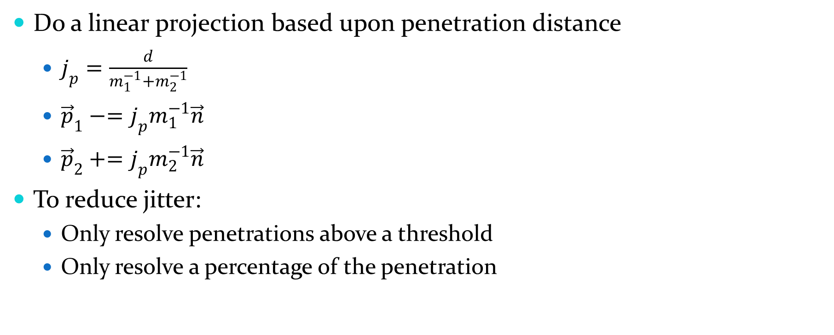
Newtonian Impulse - Penetration
Do a linear projection based upon penetration distance
$j_{p}=\frac{d}{m_{1}^{−1}+m_{2}^{−1}}$
${\vec{p}}_{1}−=j_{p}m_{1}^{−1}\vec{n}$
${\vec{p}}_{2}+=j_{p}m_{2}^{−1}\vec{n}$
To reduce jitter:
Only resolve penetrations above a threshold
Only resolve a percentage of the penetration
Notes:
Being a discrete engine, we have to remove the penetration both for visual aesthetics and to keep position error from accumulating over time, causing objects to sink slowly into the ground. We could add an extra bias to the impulse calculation to push the objects out based upon penetration distance, but then we’d be back at a penalty method. Instead, we can just move the positions.
We can once again compute an “impulse” of sorts as a mass weighted average of the penetration distance. We can then use this to push each object in the direction of the normal. This is only a linear projection, but it will work well enough to remove all penetration.
Shooting for zero penetration can cause some instabilities. To mitigate this we can both allow a slop factor where we only resolve penetrations above a certain amount. We can also choose to only resolve a portion of the penetrations each frame, thus causing the full amount to be pushed out in a sort of exponential fashon.

Slide 69
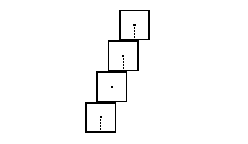
Newtonian Impulse
Simple
Good basic dynamics
Hard to get stacking
Shock step produces staircase effect
Notes:
Newtonian impulses are conceptually simple and easy to implement. They give a good first stab at rigid body collision resolution. They are however hard to get stable stacks with, especially in 3d. I’ll demonstrate this in my demo, but especially when you have multiple points of contacts, getting good enough collision info from detection can be very difficult. Without “perfect” collision info, stacks will not be resolve to zero velocity. On top of that, the shock step will cause stacks to be overly stable, allowing this sort of staircase effect pictured here.
One other downside to a Newtonian impulse engine is that it only models collisions. To get other neat effects such as joints and motors, separate systems must be implemented.

Slide 70
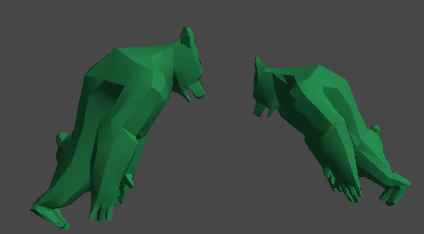
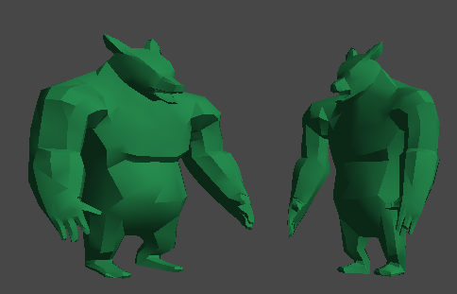

Slide 71

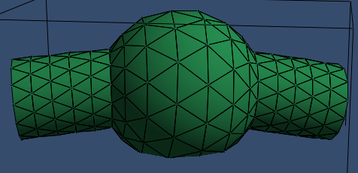
Deformables
Mass Aggregate Model
Continuum Model
Notes:
There are two main categories of modeling deformable objects I want to talk about. These two methods are mass aggregate models and continuum models. Mass aggregate models lump all of the mass of an object into point masses that are then usually connected by a form of spring. Continuum models on the other hand represent the entire volume of the object and solve for the forces within the object.

Slide 72

Springs
Springs
Structure, Shear and Bend springs [Bridson02]
Solve for spring and damping force [Nealen05]
Semi-implicit Euler integrator
PM Soft bodies
Solve volume with Gauss-Green theorem [Matyka04b]
$${\vec{F}}_{s}=k_{s}∗\left(\left|{\vec{x}}_{ij}\right|−l\right)∗\frac{{\vec{x}}_{ij}}{\left|{\vec{x}}_{ij}\right|}$$
$${\vec{F}}_{d}=k_{d}∗\frac{{\vec{v}}_{ij}∙{\vec{x}}_{ij}}{\left|{\vec{x}}_{ij}\right|}∗{\vec{x}}_{ij}$$

Slide 73
System A:
Integrate Velocity
Detect Collision
Resolve Collision
System B:
Integrate Velocity
Detect Collision
Resolve Collision
Coupling:
Detect Collision
Resolve Collision
System A:
Integrate Position
Publish Results
System B:
Integrate Position
Publish Results

