Slide 1
Collision Resolution Impulses
Joshua Davis
jodavis@digipen.edu

Slide 2
Collision Resolution
We found out objects hit and how they hit
Now we have to resolve them
To re-iterate, we need these 3 pieces of data
Normal
Point of contact
Penetration distance
A
B

Slide 3
Collision Resolution Techniques
Two main methods of collision resolution
Pros
Impulses: easy to understand and get things working quickly
Constraints: Give really cool effects with not much extra effort
Cons
Impulses: hard to get realistic stacking, somewhat of a hack
Constraints: hard to get working at all, complicated math

Slide 4
Why Impulses?
Constraints seem better apart from being harder, so why talk about impulses?
Easier to implement and debug
Easier to understand
Good first start (I recommend doing impulses at least once)
Will not talk about stacking this lecture

Slide 5
What’s the difference
To be honest, not much
Mostly math and derivations are different
Constraints solve “simultaneously”
Friction
Clamping instead of separating velocity check
More details on these later and in the constraints lecture
*Constraints are still cooler

Slide 6
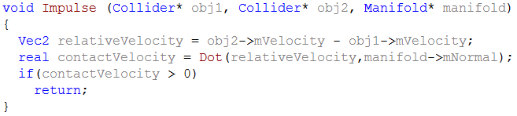
Note
We must always check to see if the velocities are separating before applying an impulse
If they are separating do nothing
*The normal is always assumed to be from object 1 to object 2 in my derivations
*all calculations done in world space

Slide 7
Concept
We have two bodies hitting at a certain speed
Newton’s 3rd law states there must be an equal and opposite reaction
Same force should be applied to both objects
Their different masses make it so the end velocity is different

Slide 8
J?
We know everything here except for j
J is the scalar coefficient of the impulse
Have to find a value that will apply a realistic looking result and conserve energy
Same concept will apply in constraints, we know the direction but not the magnitude of the force

Slide 9
Impulses 2D (no rotation)
ɛ is the elasticity of the collision which ranges from 0 to 1 (coefficient of restitution)
0 corresponds to in-elastic (clay)
1 corresponds to completely elastic (super ball)
Vrel is the relative velocity of the objects which in 2D with no rotation is

Slide 10
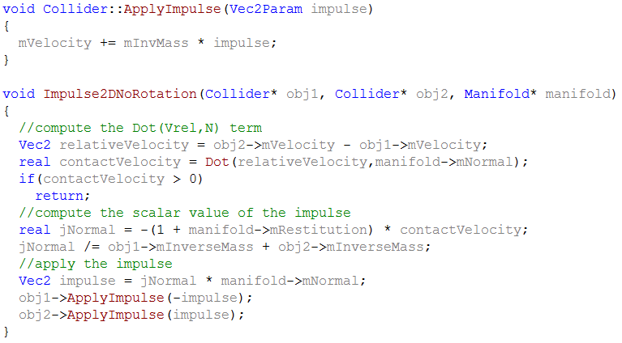
Impulses code (2D no rotation)

Slide 11
Impulses Details (2D no rotation)

Slide 12
Rotation
Well that was simple, but we want objects to rotate (friction discussed later)
The concept is the same, but we also have a rotational term
*I is the inertia (tensor)

Slide 13
Impulses 2D (with rotation)
r is the vector from the center of mass to the point of contact for that body
Vrel_{p} is now the separating velocity of the points of contact
Where the velocity of a point is given by

Slide 14
2D cross product?
Cross product is 3D only, however there is a 2D analog
What does this even mean?
Might recall the equation:
Still holds true
*the result is a scalar, not a Vector2

Slide 15
2D cross product…again?
You may have noticed the equation
Cross product between a vector and scalar?
Use this notation to keep the 3D analog
The result of this equation can be thought of as

Slide 16
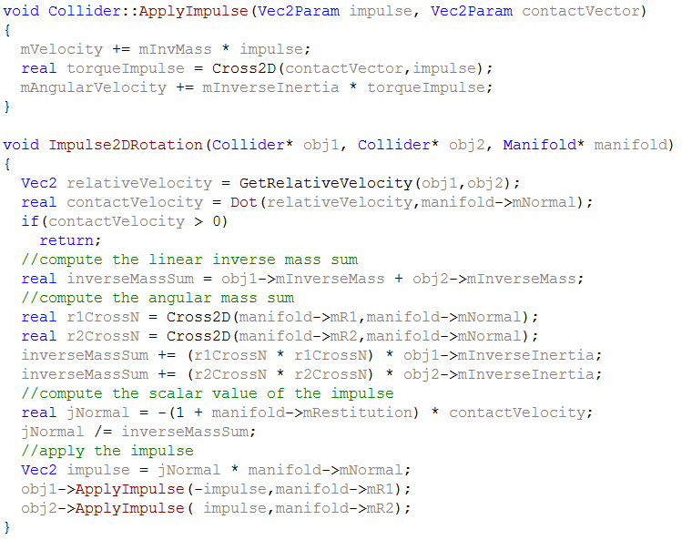
Impulses code (2D rotation)

Slide 17
Impulses 3D
The equation is almost the same as 2D
I is now a matrix so the terms cannot be simplified to a squared value
Cross product is the normal 3D one

Slide 18
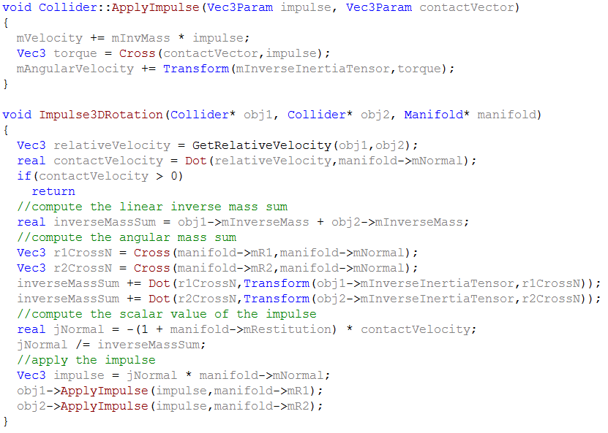
Impulses code (3D)

Slide 19
Well what about friction?
We’ve taken care of the normal impulse but still have no friction
Get normal working first
Friction is simple
Take previous equation and replace normal terms with tangent terms

Slide 20
Normal Impulse
Tangent Impulse
*Set ɛ to 0 for friction (already accounted for with the normal force)

Slide 21
What is the Tangent vector?
Normal
Velocity

Slide 22
Applying the impulse
Normal Impulse
Tangent Impulse

Slide 23
Friction Limit
Unlike the normal force, friction has a limit bound by the normal force
Comes from the Coulumb friction law which states
If the friction force is less than the normal force times static friction, use the tangent force
Otherwise, use the normal force times the kinetic friction coefficient

Slide 24
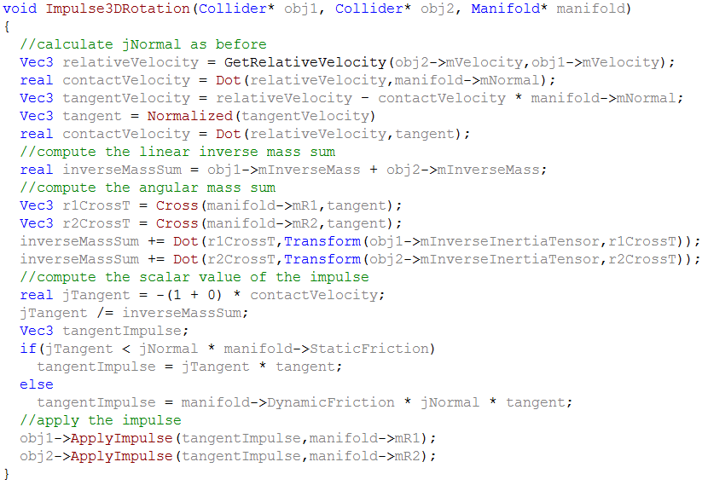
Friction Code

Slide 25
Penetration Resolution
Velocities have now been fixed
Still have left over penetration to fix
We have to manually move the objects apart
Several methods to resolve penetration
Added velocity bias term
Linear projection
Linear and angular projection
Will only talk about linear projection (velocity bias is used in constraints)

Slide 26
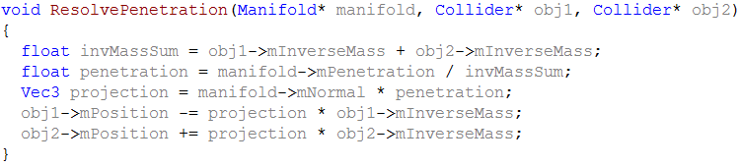
Penetration
Don’t want to blindly move both objects
Do a weighted average so heavier objects are moved less

Slide 27
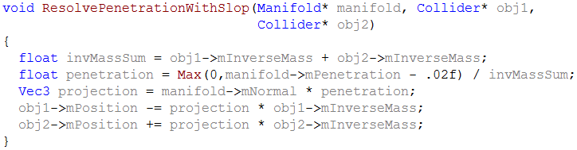
Jitter from penetration resolution
If we just blindly resolve penetration, objects will jitter
Common strategy even havok uses is to allow a slop factor
Take some value (say .02) and count that as 0 penetration

Slide 28
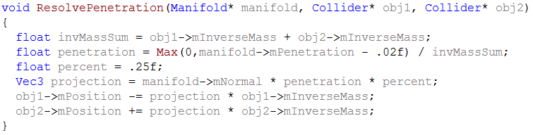
Penetration resolution - cont.
Another common tactic is to only resolve a percentage of penetration
Commonly 25% - 75%

Slide 29
Iteration
A small tweak to get better results is to iterate over the collisions a couple of times
Apply the impulse normally each time, making sure to return if the velocities are separating
Only iterate over the normals and tangents, don’t iterate over penetration resolution
This will propagate energy through the system quicker
Think billiard balls lined up in a row

Slide 30
Final Advice
Get just the normal force working first with no rotations
Add rotations and then friction afterwards
Make sure integration is right
Can make friction look wrong when it isn’t
Make sure everything is in the same space
R vectors
Inertia tensors: likely bug if objects spin out of control
To bring inertia tensor to world space:

Slide 31
Questions?

