Slide 1
Composites
Joshua Davis
jodavis42@gmail.com

Slide 2
Outline
Composites
Structure
Mass Properties
Integration
Optimizations

Slide 3
Compositing
What is compositing?
Use of hierarchical transforms
Defined relative to our parent
Scale
Rotation
Translation
We do this normally, but our parent is the world

Slide 4
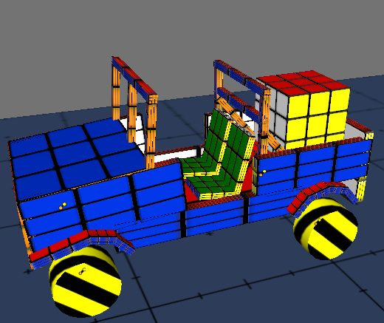
Why?
Non-convex objects
Tables
Chairs
Boxes
Cars
Efficient representation and update
Quicker and more stable than constraints
Garry’s mod weld constraint?

Slide 5
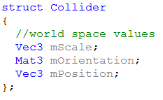
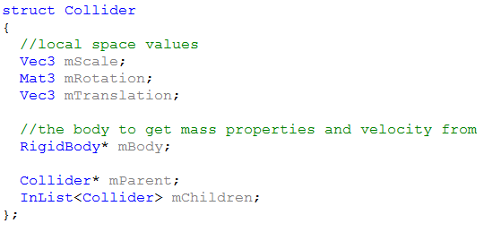
Collider Structure
Old Structure
New Structure

Slide 6
Structure
Engine has two main components: RigidBody and Collider
Several different meanings to having these objects on a composition
Collider only: static object
RigidBody only: dynamic point cloud (can’t collide)
Both: normal dynamic object
Likewise we can use these representations to mean different things for compositing

Slide 7
Composition
We have two main types of trees
Composition
C
R
C
C
C
C
C
C
C
C
C
Static
Dynamic

Slide 8
Engine Support
Here’s where it is good to determine if this is an engine feature or physics feature
Many systems can benefit from composites
Graphics naturally works this way
Messy for physics if it is not engine supported
Physics needs to update the Transform after iteration
Local values? Only update the root
World Values? Have to update each piece
From here on, I will assume this is an engine supported feature (Transform stores local transformation)

Slide 9
Static Composites
Objects are static, relative transform doesn’t really matter
Mostly a grouping feature
Useful for an editor
Still an important first step
Makes sure physics can communicate with everyone

Slide 10
Dynamic Composites
Here’s the main reason we do composites
We want to represent a non-convex object as if it were one object
Build the object out of convex pieces
How?
We have an object with a lot of collision pieces that moves as one object
This is a tree of Colliders where the root collider has a rigid body

Slide 11
Mass Properties
We can now represent non-convex objects with convex pieces
Now we just have to move the objects
Problem
All objects dealt with so far shared their center with the center of mass
In order to have objects move realistically, we need to compute new mass properties
The following formulas are generalized, so they can be used for 2D and 3D

Slide 12
Important point before continuing
We have to make sure all of our values when computing mass properties are in the same space
Easiest space to use is the world
Define 2 Helper functions for each collider
GetWorldCenterMass()
GetWorldInvInertiaTensor()
*Be explicit by using naming the function World

Slide 13
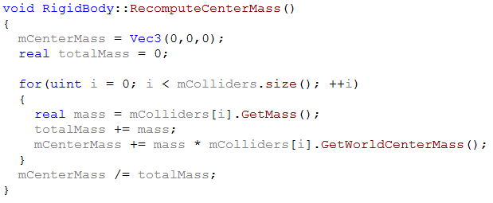
Center of mass
First we have to get the center of mass of our composite
Mathematically, the center of mass of a point cloud is defined as:
m = object mass
r = object position
R = new center of mass
Code would look like this

Slide 14
Inertia Tensor
Now we know where the center of mass is
This tells us where the object is
Also tells us what point is naturally rotated around
We don’t know how easy it is to rotate about different axes
The inertia tensor will tell us that

Slide 15
Inertia Tensor
To compute the inertia tensor, we have to look at the parallel axis theorem
What do these terms mean?
J – the new tensor
I – the old tensor
m – the mass of the object
r – the vector from the new center of mass to the old one
- the Kronecker Delta, if i == j then it is 1, else it is 0
B
A
cm_{b}
cm
cm_{a}
r_{b}
r_{a}
Unfortunately this calculation uses inertia tensors, not inverse. So we have to invert our tensor, do the calculation then invert the result…

Slide 16
Inertia Tensor – 2D
In 2D it is just the inertia, not a tensor
Can compute the inertia from previous formula
We rotate about the z axis, so we can take
And expand along the z axis (element 2,2) to get

Slide 17
Inertia Tensor
In 3D, the result doesn’t seem as obvious
This is due to summation notation
For programmers, this is what all of those subscripts mean
*This is the world space inertia tensor, we have to bring it back to the parent’s body space with R⁻¹ * J * R

Slide 18
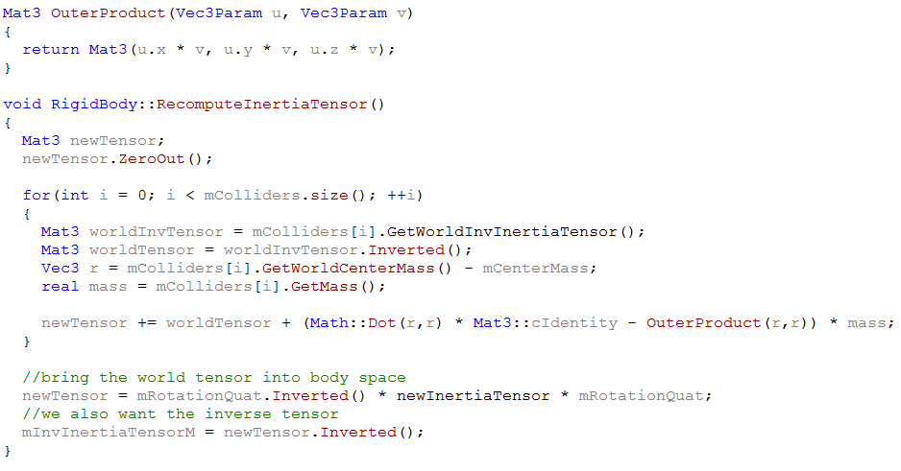
Inertia Tensor - Code

Slide 19
Update – Linear Movement
We now know the mass properties to move an object, we just have to move it during integration
Position movement is simple, we just move the center of mass
We also have to move the parent’s position by the same amount
Since everything is defined relative to the parent, they implicitly move

Slide 20
Update – Angular Movement
For angular movement we obviously just update the parent with our new rotation…right?
Obviously not what we wanted…
Objects rotate about their center of mass, not the root’s position
We have to rotate the root about the center of mass as well as rotate the root
???

Slide 21
Update – Angular Movement
Two options
Incrementally - Rotate around the center of mass by the delta rotation
Direct - Keep a locally defined offset from the center of mass to the position
First option is easier, but likely to produce numerical issues
Second takes a little more memory, but is more stable

Slide 22
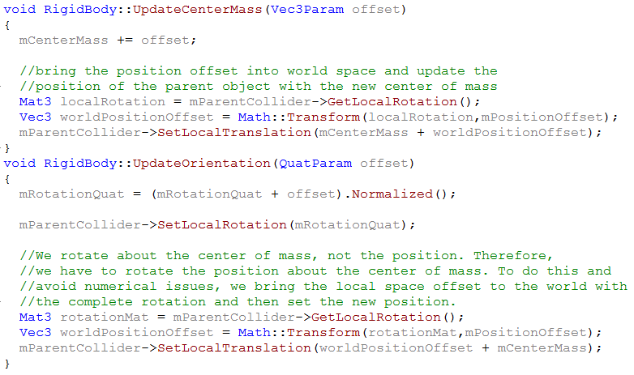
Update - Final

Slide 23
Update - Note
We have two representations of rotations: Quaternions and Matrices
Need a Quaternion for integration
Need a Matrix for everything else
We only integrate RigidBodies, so keep the Quaternion there and give each Collider a Matrix
Just have to make sure they are in sync

Slide 24
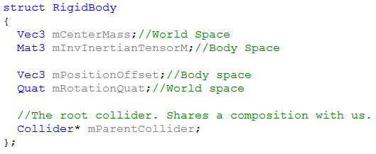
Rigid Body Structure

Slide 25
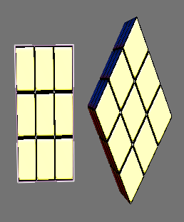
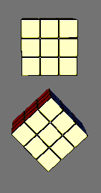
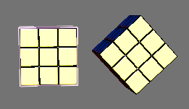
Scale it…wait…
Now we can take our composite
Rotate it
If we allow non-uniform scaling, we allow shears to happen
We can either:
Not allow non-uniform scaling
Remove the shear (more later)
I will not talk about having non-uniform objects with uniform scale
Ask me later if you are curious

Slide 26
World Transformation
While this representation is quick, collision and resolution will suffer in speed
Have to recompute the world position, orientation and scale many times
Constraints and contacts do many body to world transformations
Even though we are locally defined, we still need the world transformation

Slide 27
World Transformation
Keep around the Matrix4 that is your bodyToWorld Transform
This works, but might have shears
Decompose the Matrix4 into the world scale, rotation, and translation
The shear is now gone
Keep around the original Matrix4 if you want to minimize error accumulation

Slide 28
3rd Composite type
There is one other main composite type I haven’t mentioned yet
I call it multi-dynamic
Composition
R
C
Composition
R
C
C
C
C

Slide 29
Multi-Dynamic?
Each rigid body chain can be thought of as completely separate objects
One’s movement does not affect the other
They are just defined relative to each other
Why?
Think of something that graphics and logic need relative but physics needs independent
Skinned Ragdoll
Car wheels
Worry about this only if you need it.
Bigger pain than one might think…
shears can be ridiculous

Slide 30
Iteration
So how does compositing affect the physics loop?
Most of what changes is grabbing world values instead of local
I will still cover each main step in detail
We already talked about integration and result publishing though

Slide 31
Broadphase
Several options
Use the entire composite
Break the composite into its pieces
MidPhase
1 will cause Broadphase to run quicker but NarrowPhase slower
2 will cause Broadphase to run slower but NarrowPhase quicker, also will return pairs of an object with itself
3 is a combination of 1 and 2
Insert the entire composite into Broadphase
Have each composite in a small AABB tree or something
Run an object against this before determining what goes to NarrowPhase
3 probably won’t be practical for simple composites
Very useful for complex composites
Also for deformable objects

Slide 32
NarrowPhase
NarrowPhase mostly changes in having to bring local values to world values
Afterwards, just run NarrowPhase on each piece in the composite
Small caveat, we don’t want to collide objects in the same composite
If they have the same RigidBody pointer then ignore them

Slide 33
Islanding
Islanding is the process of figuring out what groups of objects have to be resolved together
Composites do not contain connections among itself
An Island will naturally break here if we are not careful
Have to extend an Island across all objects on a composite
Not doing this will result in jitter

Slide 34
Resolution
In the resolution equations, we have an r vector
This was the vector from the center of the object to the point of contact/constraint
This needs to be from the center of mass, not the center of the object
cm
r

Slide 35
Final Tips
Don’t grab an object’s transformation directly
Make functions to get world scale, rotation, translation
Will minimize the pain when changing how you represent compositing
Make sure everything is in the correct space
I found errors making these slides…

Slide 36
Questions?

Slide 37
References
Erik Mohrmann
Bullet Forums
Chris Peters

