Slide 1
Constraints Introduction
Joshua Davis
jodavis@digipen.edu

Slide 2
Outline
Constraints
Velocity Constraints
Jacobians
Constraint Solver
Solver Tweaks
Solver Structure
Tips

Slide 3
What will not be covered
Constraints are a large topic, so this will be a two part lecture (next semester)
The second part will cover
More advanced constraints
Motors
Limits
Generic solving
Other position correction techniques
Understanding this lecture is a must for the next one

Slide 4
Collision Resolution
To reiterate, two main forms of collision resolution
Impulses - poke with stick
Constraints - force field
Already gave intro to impulses
Now intro to constraints

Slide 5
Why constraints?
Constraints are hard, so why do them?
More realistic results
Better stacking
Any sort of effect you can think of
More resilient
Cool effects are still feasible other ways
Constraints unify the form
Mathematically backed
Constraints do tend to be slower though

Slide 6
What is a constraint?
A scalar function that is equal to zero
Yes, that is it
Example: distance between two points is a Length
Generally involves an object’s position or velocity
May also include time
Also generally it is between two objects
Occasionally only one object

Slide 7
Velocity Constraint
Like impulses, we don’t update an object’s position directly.
Update its velocity
Differentiate with respect to time to get a velocity constraint
This is done by hand for each kind of constraint
A velocity constraint defines the allowed motion of objects relative to each other

Slide 8
Velocity Constraint
The allowed motion is perpendicular to the pendulum

Slide 9
Velocity Constraint
If it is some form of a position constraint
The derivative will always be of the form
This is due to the chain rule
J is the Jacobian
V is the velocity vector
B is the “work term” commonly called a bias
I will go through these terms in just a moment
First, some equations

Slide 10
Velocity Constraint
implies that J and V are perpendicular
Jacobian
velocity
We can see that the corrective force will be in the direction of J
gravity
Corrective force
Lambda is the magnitude of the force that we don’t know

Slide 11
Velocity “vector”
Stores the linear and angular velocity of the pair of objects
Not a vector in the standard sense
Technically a 12x1 vector in 3D
In 2D it’s a 6x1 vector
I prefer to think of it as such
Four element column vector
Each element is a Vec3
All math will refer to this notation

Slide 12
Jacobian
The Jacobian is a coordinate transform
Brings velocity from Cartesian space to constraint space
Cartesian Velocity
Constraint Velocity

Slide 13
Jacobian
The transpose of the Jacobian is the inverse transform
Brings force from constraint space to Cartesian space
Constraint
Force
Cartesian Force

Slide 14
Jacobian “matrix”
What is the Jacobian?
Technically, it is a matrix
A 1x12 matrix in 3D
A 1x6 matrix in 2D
Equivalent to a four element row vector
Each element being a transposed Vec3
L and A are my own terms
Stand for linear and angular
You’ll see why when you apply the force

Slide 15
Jacobian “matrix”
The Jacobian is a strange matrix
Which is why I choose to not treat it as one
Can treat the Jacobian like the velocity “vector”
Just have to change what the multiplication is

Slide 16
Jacobian Multiplication
For some reason, mathematicians never use
dot products
This matrix multiplication is equivalent to a dot product

Slide 17
Why do we care?
The Jacobian is a transformation
In constraint space the best axis to solve on is known
This axis is the Jacobian
A Jacobian always points in the direction where the least amount of work needs to be done
We have half of the force we need to apply now
Have direction
Don’t have magnitude
The magnitude is known as (lambda)

Slide 18
Bias
The bias term is the b in
Will be zero in most constraint
The bias is a term that does work (adds energy)
Constraints generally do no work

Slide 19
Bias
If constraints do no work, why have a bias?
Some constraints do work (motors)
Also any time you need to add energy
Position Drift (later)
Restitution (elasticity)

Slide 20
is what is known as the Lagrange multiplier
Comes from Lagrange mechanics
Slight detour here on Lagrangians
Doesn’t matter, it is the magnitude of the force
How do we find this?
A constraint solver (more later)

Slide 21
Solving for a Jacobian
Solving for a Jacobian comes easier with time
The standard steps are
Start with the position constraint
Differentiate with respect to time
Isolate V
Determine J and b by inspection
Some constraints you might start with the velocity constraint
Here, just start with the 3rd step above

Slide 22
And all this means?
For the force we now have
Direction
Magnitude
Since we’ve computed the Jacobian offline, if we can solve for lambda we have our force
Also as a note
Contacts = Contact Constraints
Joints = Everything else

Slide 23
JACOBIAN EXAMPLE
2D line constraint
Constrain the point P to be on the line defined by the normal N and the point D
P
N
D
r
Cm

Slide 24
Line Constraint 2D Answer
Point Velocity
Identity still holds in 2D

Slide 25
Distance Joint 3D
Object2
Cm2
r2
p1
d
r1
p2
Object1
Cm1
*L is the desired Length

Slide 26
Details

Slide 27
Contact Constraint
Object2
N
Cm2
r2
p1
p2
r1
Object1
Cm1
*d is the penetration distance

Slide 28
Gory Details

Slide 29
Homework
Try to solve these constraints on your own
3D plane constraint
Forced rotation about a given axis
Locking two objects points together on the y axis
A parabola constraint
Cubic spline
Just for the hell of it
All of these consist of only one constraint!

Slide 30
Half way there. Questions?
Everyone who didn’t raise their hand just now is a liar.
Please ask questions now
It only gets more confusing…

Slide 31
Constraint Solver
We have the Jacobian
Need lambda from a constraint solver
Two types of solvers
Global
Iterative
We will do an iterative solver
Easier to understand and implement
More scalable
They work well enough
If you want to try a global solver
Look up “conjugate gradient without the agonizing pain”

Slide 32
Sequential Impulses (SI)
SI is an iterative solver that applies impulses to converge to a correct answer.
Might be thinking, “Impulses? I thought we were doing constraints to be better than that.”
An Impulse is just an instantaneous force
Also, the “impulse” we apply is not the exact same as before

Slide 33
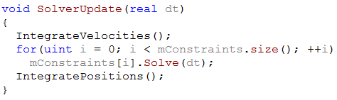
SI steps
We’ve already talked about integration so I won’t cover that here

Slide 34
What is an Impulse?
An impulse is defined as the force times the timestep
So now we need to solve for this impulse

Slide 35
Using these equations, we can solve for lambda

Slide 36
Impulse Solved
Mass matrix
Individual object mass matrix
Mc is the “mass” of the constraint
*I is the inertia tensor

Slide 37
Details

Slide 38
Note
Please do not actually create a 12x12 mass matrix
Almost all of it is zeros
At the bare minimum mc can be simplified to
This holds true for a lot of constraint math
Be smart about wasted calculations

Slide 39
Now we can calculate the impulse and update our velocity
And in case you’ve forgotten how

Slide 40
Simple right? Maybe not…
That was how to solve one constraint in isolation
We may have thousands
The following slides are additions to get better stability and more advanced features
Get the previous stuff working first
However, all of these slides are essential to a robust solver and good stacking
However you can do the first step easily
Iterate multiple times

Slide 41
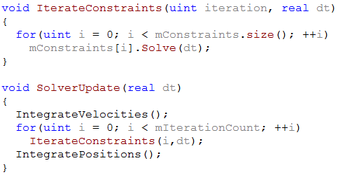
Solve loop (updated)

Slide 42
Position Drift
Currently, constraints will not fix position error

Slide 43
Baumgarte Stabilization
Most common method to fix position error
Feed the position error back into the velocity constraint
What’s a good value for B?
It’s simulation dependant
Try starting at 0, increasing until unstable, then use half that

Slide 44
Restitution
Separating velocity -
Add bounce as a bias -
You should probably only do this above some threshold
ie. Only if > 1
Tweak the number for your simulation
Otherwise stacks will become less stable

Slide 45
Slop
Trying to achieve zero penetration results in jitter
To reduce jitter, allow a slop factor of penetration
C in this case is the penetration distance

Slide 46
Inequality constraints
Most constraints are of the form
However we need inequality constraint to deal with contacts and limits
With code, this is simply
If
Enforce
Else
Skip constraint

Slide 47
Clamping
We still have to properly clamp our impulse for inequality constraints
Used to be
Now
Things are a little more complicated than this though

Slide 48
Clamping (force limits)
Some constraints have limits on the amount of work they can do (friction)
Convert force limits to impulse limits
Then just do this, right?
Wrong.
We have to clamp the total impulse, not the corrective impulse

Slide 49
Why clamp total? 2D Inelastic collision
A Falling box
v
Global solution

Slide 50
Iterative Solution
Constraint 1
Constraint 2
What if the corrections are too strong?

Slide 51
Second Iteration
To keep the box from bouncing, we need a negative impulse!

Slide 52
Correct clamping
Not doing this is a way to introduce jitter
*Clamp before applying the impulse

Slide 53
Friction
Same constraint as the normal
Replace the normal with a tangent
And another tangent for the other friction
*Don’t apply a baumgarte for friction

Slide 54
Tangent directions
How do you compute tangent directions?
Any two vectors perpendicular to the normal and each other should work
“Should” have improved stability if one is aligned with the direction of the separating velocity

Slide 55
Friction clamping
If we used Columb’s friction law
This works for 2D but not 3D
If you don’t know yet, friction in 3D sucks
2D has a solution
3D is NP hard
The above clamping makes the normal coupled with friction
The guy who first experimented with coupled equations came up with chaos theory

Slide 56
Tangent clamping
So what do we do?
Where
is the friction coefficient
is gravity
is the constraint mass
Dividing the upper and lower bounds by the number of contacts might help stability

Slide 57
Caching Impulses
SI is an iterative solver that performs better with an initial guess
What should we use as a guess?
How about last frame?
Store the lambda from the previous frame
Apply that lambda before all iterations
Helps to converge quicker
Better stacking at less iterations

Slide 58
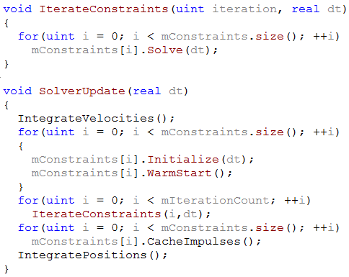
Solve loop (updated)

Slide 59
Caching Contacts
Just storing the old impulse isn’t good enough for contacts
Points move around a lot on a body
Caching relies on frame coherency
Inconsistent points means instability
We have to see if the old point is close enough to the new point
Only then do we cache

Slide 60
Contact Caching
But wait, if we get a different corner each frame, we’ll never cache our impulse
Solution 1: multiple points
Get multiple points from collision detection
Solution 2: multiple points
However here, we only ever get 1 point from detection
Add points and keep them around unless they separate enough
Then match up new points to old points
I’ll leave Solution 2 for HW
I’ll also talk about it next constraints lecture

Slide 61
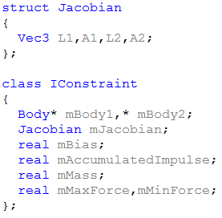
Constraint Object
Each constraint should look roughly like this now
You may have more or less data
You may have specialized classes
You will obviously have helper functions

Slide 62
Solver structure
Now I will talk about some different approaches to store constraints
For future reference
Contacts = contact constraints
Joints = every other type of constraint
IConstraint = base constraint class

Slide 63
Solver Structure (1st attempt)
Have an array of IConstraints
But wait, contacts are added and removed a lot
Removal in an array is O(n)
Mapping a new contact to a pre-existing one is also O(n)

Slide 64
Solver Structure (2nd attempt)
A map of IConstraints
Lexicographic sort to map new contacts to old ones, O(1)
Seems good right?
Slower to iterate O(log(n))
Lexicographic sort only works for one pair
May have a joint between a pair that also has a contact
May have more than one joint between a pair
Could always store a map of an array, but lets not go there

Slide 65
Solver Structure (3rd attempt)
A map for contacts and an array for joints
Use lexicographic index to find contacts
Joints aren’t inserted/removed often, so an array works just fine
Have to iterate through 2 different structures
Have to duplicate some code
Apart from insertion and removal patterns, contacts and joints are the same, but we’ve separated them now
This method is a feasible first start
It’s what I had at first

Slide 66
InList
Quick refresher for what an InList is
We all know a linked list
Stores a previous and next pointer as well as the object data
InList stands for intrusive linked list
The object actually contains the previous and next pointer
InList is crucial to the next method I will mention
See the Physics Engine Architecture slides for more details

Slide 67
Solver Structure (4th attempt)
pointer
Constraint
containment
next
Constraint
Edge1
Edge2
Edge
Edge
next
Constraint
prev
Constraint
next
Edge
Constraint
Edge
prev
other
other
prev
Edge
Edge
edgeList
edgeList
Body
Body

Slide 68


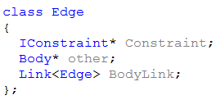
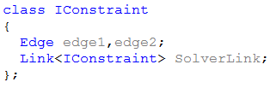
Class Definitions

Slide 69
Wait…what?
Confusing, I know…
What does this gain us?
Bodies can find all of their constraints
Bodies can find the other body on any constraint
Islands are already formed
Constraints can find both bodies
Constraints have O(1) removal
Joints have O(1) insertion
Contacts have O(n) insertion (n is much smaller now though)
And all this manipulation requires zero memory overhead

Slide 70
Tips
#1 tip: Do the math!!!
Trust me, even though I gave you the final results
Not doing it is just asking for things to explode and you not know why
Take your time. Small mistakes can cause explosions
Know your coordinate system (everything in the world space)
Make sure your normal is consistent with your derivation
Draw your constraints
Ask for help
Come to Einstein and ask me anything about constraints
If you don’t attempt #1, I might make you do it on the spot…

Slide 71
Questions?

Slide 72
References
Erin Catto
Box2D
GDC Slides
Iterative Dynamics with Temporal Coherence (paper)
Erik Mohrmann
Bullet forums
Kenny Erleben’s thesis
Stable, Robust, and Versatile Multibody Dynamics Animation
Physics Club

