Slide 1
Deformables Jakobsen Constraints
Joshua Davis – jodavis42@gmail.com

Slide 2
Deformable Objects
What will be covered
What won’t be covered
Math of deformables
Jakobsen Constraints
Spring-Mass Aggregates
Finite Element Method (FEM)
Collision Detection
Collision Resolution
Multi-Physics (rigid vs. deformable)
Notes:
This will be a 3 part mini-series on how to model deformable objects. The point of this series will be to explain the math behind different kinds of deformable modeling systems. The focus will be on how to calculate the internal forces due to the internal “springs” that give the object its shape. What won’t be covered is how to detect and resolve collision between these shapes. The one exception to this is the Jakobsen system, where modeling the internal forces is closely related to modeling collisions. The other topic that won’t be covered is multi-physics. This is a much more in depth field that I feel currently has no right answer. If you want further details on this you should check out my thesis paper. Feel free to email if you can’t find it.

Slide 3
Deformable Objects
Why is it hard to model deformables?
More complicated equations
More than 6 DOF (more data too)
Force takes time to propagate
Stability
Efficiency
Notes:
So why is it hard to model deformable objects? The primary reason is just that the underlying equations of motion tend to be more complicated. This is partially due to objects no longer having 6 DOF (degrees of freedom). Because of this there ends up being a lot more data to keep track of per object. Also, since the object is not rigid, it takes time for force to propagate and reverse the direction of the object. This can make resolving collisions tricky as you only push a small portion of the object but need the entire thing to reverse.
Combined with all of this, the simulation needs to be efficient and stable. One common problem in deformable systems is objects self destructing. This usually happens due to trying to make too stiff of a system. More about this will be covered next presentation. Due to the extra data and need of stability, efficiency can also be tricky, especially when it comes to collision detection and resolution.

Slide 4
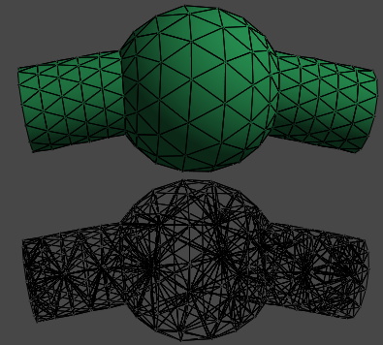
Deformables – Two Main Types
Mass Aggregate Model
Continuum Model
Notes:
There are two main types of deformable objects that I will be talking about.
Mass aggregates
Mass aggregate systems lump all of the mass into nodal points. These points are generally connected with some kind of spring. These springs are used to preserve the distance between the nodes and help the object keep its shapes. However, there’s nothing that directly preserves area or volume. This type of simulation is most commonly used for cloth systems (and works quite well for it).
Continuum
A continuum model solves for the forces within the entire volume of the object. Most commonly, the object is discretized into smaller shapes that are easier to compute the forces for. These forces are then assembled together and solved as one continuous body.
Mass aggregate models tend to be a lot faster, but more of an approximation. Continuum models have the benefit of not only being more accurate, but commonly being able to model stiffer objects. Also, mass aggregate models change behavior based upon the tessellation and where the nodal points are. Continuum models however are only affected by this in the detail level of where deformations can take place.

Slide 5
Jakobsen Constraints
Mass-Aggregate Model
Not physically based
“Springs” connecting particles
Position solved and modified each frame
Used successfully in commercial game:
Hitman: Codename 47
Notes:
The deformable model of this lecture is the Jakobsen Constraints system. This was made by Thomas Jakobsen for the game Hitman: Codename 47 and is very simple to implement and understand. This system is able to model both rigid and deformable objects in the same framework. As a mass-aggregate model, there are nodal points that are connected by “springs”. These are more of logical springs than physical springs as there are no forces or velocity involved. This system works entirely by modifying particle positions.
And do make sure to note, this system is not physically based. In fact it doesn’t really have any dynamics in it. This makes certain features such as stacking and friction painful.

Slide 6
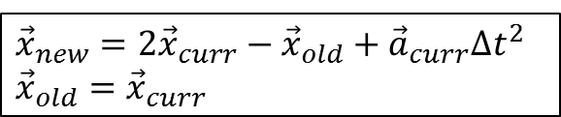
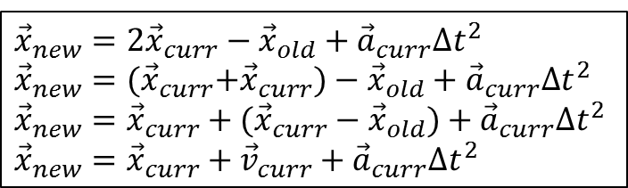
Detour – Verlet Integration
Verlet only uses
current acceleration
current position
old position
No velocity
Velocity can be approximated
$${\vec{x}}_{new}=2{\vec{x}}_{curr}−{\vec{x}}_{old}+{\vec{a}}_{curr}Δt^{2}$$
$${\vec{x}}_{old}={\vec{x}}_{curr}$$
$${\vec{x}}_{new}=2{\vec{x}}_{curr}−{\vec{x}}_{old}+{\vec{a}}_{curr}Δt^{2}$$
$${\vec{x}}_{new}={(\vec{x}}_{curr}+{\vec{x}}_{curr})−{\vec{x}}_{old}+{\vec{a}}_{curr}Δt^{2}$$
$${\vec{x}}_{new}={\vec{x}}_{curr}+({\vec{x}}_{curr}−{\vec{x}}_{old})+{\vec{a}}_{curr}Δt^{2}$$
$${\vec{x}}_{new}={\vec{x}}_{curr}+{\vec{v}}_{curr}+{\vec{a}}_{curr}Δt^{2}$$
Notes:
The Jakobsen system uses Verlet as its integrator. Verlet is a bit weird as it doesn’t use velocity at all, instead it uses the old position along with the current position and acceleration. This makes it tricky for gameplay, as people understand velocity very well and find it hard to work without. Velocity can be approximated as a difference of the positions. There is an alternative to Verlet known as Velocity Verlet which does have velocity in it, however for the purposes of this system normal Verlet works best.
There are 2 important things to understand in how we’ll use Verlet in this system.
Moving the current position will implicitly calculate the velocity from where we were to where we’re going
Moving the old position will affect the velocity without changing our current position

Slide 7
Jakobsen Constraints
Infinite stiffness springs
Distance too large
Correct distance
Distance to short
Notes:
This may be jumping the gun a little, but bear with me. In a normal spring system it’s hard to model stiff springs as they tend to explode (more next lecture). Instead of trying to have springs we can make stiff, this system takes the opposite approach: infinite stiffness springs (we’ll make them soft later).
If a spring has infinite stiffness we know the end result, the two nodes will be the length of the spring apart. This makes it very easy to solve, especially with the Verlet system. As Verlet works directly with position we can just snap our nodes to wherever we want and the dynamics will be implicitly calculated from that.

Slide 8
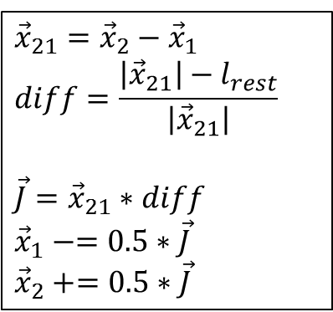

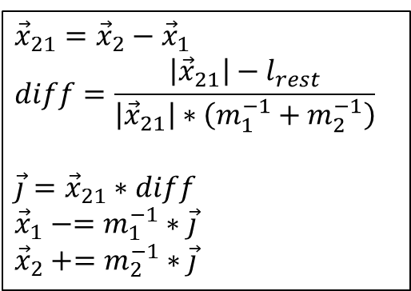
Distance Constraint Solving
No mass
With mass
Snap points equally
Weight movement by mass
$${\vec{x}}_{21}={\vec{x}}_{2}−{\vec{x}}_{1}$$
$$diff=\frac{\left|{\vec{x}}_{21}\right|−l_{rest}}{\left|{\vec{x}}_{21}\right|}$$
$$\vec{J}={\vec{x}}_{21}∗diff$$
$${\vec{x}}_{1}−=0.5∗\vec{J}$$
$${\vec{x}}_{2}+=0.5∗\vec{J}$$
$${\vec{x}}_{21}={\vec{x}}_{2}−{\vec{x}}_{1}$$
$$diff=\frac{\left|{\vec{x}}_{21}\right|−l_{rest}}{\left|{\vec{x}}_{21}\right|∗\left(m_{1}^{−1}+m_{2}^{−1}\right)}$$
$$\vec{j}={\vec{x}}_{21}∗diff$$
$${\vec{x}}_{1}−=m_{1}^{−1}∗\vec{j}$$
$${\vec{x}}_{2}+=m_{2}^{−1}∗\vec{j}$$
*$l_{rest}$ is the rest length of the spring
Notes:
To solve a simple distance constraint the points are just snapped based upon the error. Naively done, both points will be equally moved. With a small modification mass can be taken into account so lighter nodes are moved more than heavier nodes.

Slide 9

Soft constraints
Simple to turn infinite stiffness spring to soft spring
Solve a percent
Can also solve fewer iterations
$$\vec{j}={\vec{x}}_{21}∗diff∗fraction$$
Notes:
Everything covered so far is an infinite stiffness spring, so that means we won’t have deformable objects. We can get soft and springy constraints by not solving the full percentage every frame. By doing this it will take time for the object to come to rest. This will also allow waves to propagate through a body. Fewer iterations can also be used which will make the system take longer to converge to the rest position

Slide 10
Collision Resolution
Snap points to surface
Notes:
As with everything else in this system, collision is handled by directly moving points to where we want them. By snapping particles in a collision to be at the surface of the object we effectively reduce the velocity. This is because our velocity is based upon the difference in old and current position. So by directly moving the new position to where we want we’ve changed the velocity.

Slide 11
Restitution
Reflect old position across the surface
Integrate
Resolve Collision
Reflect old position
Bounce with restitution
Notes:
Restitution is easy to add. Simply reflect the old position across the surface where the particle collides. By doing this we’re altering the velocity by pretending that the particle just came from the other side of the shape. This particle will then continue out as if it was bouncing.

Slide 12


Friction
$$\vec{v}$$
Corrected $\vec{v}$
Integration
By moving old position the “velocity” is reduced
Notes:
Friction can be approximated as well by moving the old position. You can reduce the distance between the old position and current position on the surface of the collision (perpendicular to the collision normal). By doing this the velocity is reduced. This however is not a very robust solution, even Jakobsen admitted this. You need to take care to not cause the old position to cross over for one. This also doesn’t scale well when in contact with multiple objects. I don’t have a better solution to this unfortunately, it does work decently well enough for a simple engine (and for Hitman apparently)

Slide 13
Surface Collision
Compute barycentric ratio of values
Mass
Old Position
Compute new “impulse”
Apply weighted impulse back to particles
Notes:
Things can get a little more complicated when you want to collide with surfaces. If you have a point colliding with a triangle, how do you push the triangle away? The simplest way is to use barycentric coordinates. These allow you to interpolate any value across the surface of a triangle. Therefore you can find the mass and old position of the point on the surface of the triangle. These values can be used in collision resolution to get an “impulse”. This impulse is simply how much to push the contact point by. This value can then be applied back to each node of the triangle using their barycentric weights.

Slide 14
Rigid Bodies
Make sure there’s only 6 DOF
1 particle = 3 DOF
1 constraint = -1 DOF
N particles + M constraints = 6 DOF
Notes:
To make a rigid body in this system is very simple as well. Knowing that a rigid body has 6 DOF and each particle has 3 DOF you need to make sure there are enough constraints to get down to 6 DOF, of course making sure to not have duplicate constraints. More constraints can be added to make an over constrained system that is more rigid, however if it’s over constrained there is the possibility of it exploding if it can’t be solved.

Slide 15
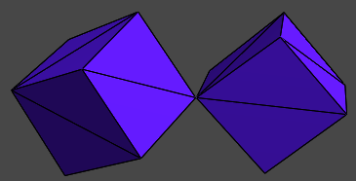
Articulated Bodies
Make a body with fewer DOF
Simple Joints
Distance Joint
Position Joint
Hinge Joint
Rag-dolls
Notes:
Articulated bodies can also easily be added into the system. By simply removing enough distance constraints so that there is the correct DOF in the object any sort of simple joint can be modeled. Obviously a distance joint can be made as that’s the basis of the system, however some other joints can be made. A position joint is made by just fixing two points with a distance constraint of length 0. Likewise a hinge can be made by connecting an edge together. Limits can be approximated by connecting other parts of a body together with limited constraints, for example a distance joint between the knees on a ragdoll can be added that doesn’t allow them to get too close. Modeling actual angle limits is also possible if you can come up with a way to resolve the points.

Slide 16
System Update
void SolveContraints()
{
//Make sure to solve each constraint once before moving on to the next iteration.
//Check an individual constraint's max iterations here as well.
for(uint i = 0; i < mConstraints.size(); ++i)
SolveConstraint(mConstraints[i]);
}
void Update(real dt)
{
//Integrate all particles (using verlet)
for(uint i = 0; i < mParticles.size(); ++i)
Integrate(mParticles[i], dt);
DetectCollisions();
for(uint i = 0; i < mIterations; ++i)
SolveConstraints();
//Now update all of our bodies once we've obtained their final positions
//(I only show aabb's and graphics, but this can be whatever)
for(uint i = 0; i < mBodies.size(); ++i)
{
UpdateAabb(mBodies[i]);
UpdateGraphics(mBodies[i]);
}
}
Notes:
This is just showing the basic update loop of this system. Do take note that you iterate on all constraints a set number of times, making sure to solve all constraints for iteration 1 before moving on to iteration 2. An added check can be added for softer constraints by limiting individual constraints to fewer iterations. For instance, Jakobsen modeled plant leaves by only allowing those constraints 2 or so iterations while everything else had 5.
There are a few different times that integration can happen, I chose after constraint solving but it could just as easily be before collision detection.

Slide 17
Jakobsen System
Pros
Cons
Models rigid and deformables together
Simple contacts
Articulated bodies
Not physically based
No stacking
Lacks robust and stable collision
Only simple “constraints”
Notes:
The main benefits of the Jakobsen system is how simple it is and that you get rigid and deformable bodies together. It also works decently well for simple ragdolls. The biggest issue is that it’s not physically based. This means more complex physical interactions, such as stacking, tend to not work well. Also, in 3d especially, collision detection can be very difficult to get working robustly. Thin shell collision is not the simplest of things to solve robustly. Since position is modified directly any errors in collision detection are much more noticeable as a particle can teleport very far away instantly. The bulk of my time was spent working on triangle intersection, eventually I abandoned 2-sided collision and stuck with 1-sided so resolution would be robust.

Slide 18
Structures
class Particle
{
Vec3 mPos;
Vec3 mOldPos;
Vec3 mAcceleration;
real mInvMass;
}
class DistanceJoint
{
Particle* mParticles[2];
real mLength;
uint mMaxIterations;
//Controls the softness of the constraint
real mResolvePercent;
}
class Body
{
InList<Particle> mParticles;
Aabb mAabb;
//More needed here for detection (the triangle faces, etc...)
}
class Contact
{
Particle* mParticles[2];
Vec3 mPoints[2];
Vec3 mNormal;
real mDistance;
}
Notes:
Just showing the basic structure I used to model my objects.

Slide 19
Questions?

Slide 20
References
Original post: www.gamasutra.com/view/feature/131313/advanced_character_physics.php
http://en.wikipedia.org/wiki/Verlet_integration

