Slide 1
Deformables Springs
Joshua Davis – jodavis42@gmail.com

Slide 2
Idea
Points connected by physical springs
Primary Use:
Cloth
Soft Bodies
Notes:
The basic idea in a spring mass-aggregate model is to have a collection of nodal points connected by springs. The mass of the entire object is lumped into these nodal points and the springs are used to enforce the shape of the object. Generally speaking, a triangle mesh is made at the surface for collision, rendering etc…
The most common use of this is with cloth simulation. Spring mass-aggregates are still the dominant model of this despite more sophisticated methods due mainly to speed and believability. Soft bodies are an easy extension to the core spring-mass aggregate model.

Slide 3



Springs
$$\vec{F}=−kx$$
Fully expanded for 3d we get:
Problems
Stability issues with stiff systems
Un-intuitive material properties
$${\vec{F}}_{s}=k_{s}∗\left(\left|{\vec{x}}_{ij}\right|−l\right)∗\frac{{\vec{x}}_{ij}}{\left|{\vec{x}}_{ij}\right|}$$
$${\vec{F}}_{d}=k_{d}∗\frac{{\vec{v}}_{ij}∙{\vec{x}}_{ij}}{\left|{\vec{x}}_{ij}\right|}∗{\vec{x}}_{ij}$$
*${\vec{x}}_{ij}={\vec{x}}_{i}−{\vec{x}}_{j}$
Notes:
$\vec{F}=−kx$, You’ve probably all seen it before. Simply stated, the force of the spring is proportional to the deviation from its rest length.
In 3d things get a bit more complicated, but not by much. Basically we need a vector for our force. Damping is also a bit more complicated than the simple $\vec{F}=−c\vec{v}$ as we only want the to calculate the velocity in the direction of the spring (hence the projection step). Also note that $k_{s}$ and $k_{d}$ are just the spring and drag coefficients that are just constants for your system.
That’s all that there is to a spring system, just calculating these forces. There are a few considerations to keep in mind.
Springs have the stiff problem. If you try to make your springs too stiff they will explode violently. In fact, generally you’ll see bad behavior for a few frames and then you’ll see nothing. Why nothing? The spring’s exploded so much that it flies completely off the screen.
The spring coefficients do not have intuitive units. This means it’s really hard to come up with good values. They also require constant tweaking as the same shape’s behavior will change if the underlying topology of the mesh changes even though the spring coefficient is the same.
Unfortunately these two tend to be tied together. You try to pick good coefficients to make your springs work like you want (which is generally too stiff) and they explode. Then you slowly lower the spring coefficients to get the best you can get. There’s 2 primary ways to have stiff springs and no explosions: a better integrator and a smaller time step.

Slide 4



Integration – Know your Euler
Explicit Euler
Fully-Implicit Euler
Semi-implicit Euler
$$x_{i+1}=x_{i}+v_{i}Δt$$
$$v_{i+1}=v_{i}+\frac{1}{m}f\left(x_{i}\right)Δt$$
$$x_{i+1}=x_{i}+v_{i+1}Δt$$
$$v_{i+1}=v_{i}+\frac{1}{m}f\left(x_{i+1}\right)Δt$$
$$x_{i+1}=x_{i}+v_{i+1}Δt$$
$$v_{i+1}=v_{i}+\frac{1}{m}f\left(x_{i}\right)Δt$$
Notes:
Before going into more details on how to implement a spring system it is important to understand your integration techniques. There are 3 main forms of Euler integration.
Explicit Euler uses the old position to calculate the forces for the new velocity and then uses the old velocity to calculate the new position.
Fully implicit Euler uses the new position to calculate the forces for the new velocity and then uses the new velocity to calculate the new position. Note: This one is not really possible to do…
Semi-implicit Euler uses the old position to calculate the forces for the new velocity and then uses the new velocity to calculate the new position.
Each of these equations have their pros and cons (like not being able to solve fully-implicit Euler…), but where do these equations even come from? I’m going to take a quick detour here to try to make sure you understand the fundamentals.

Slide 5
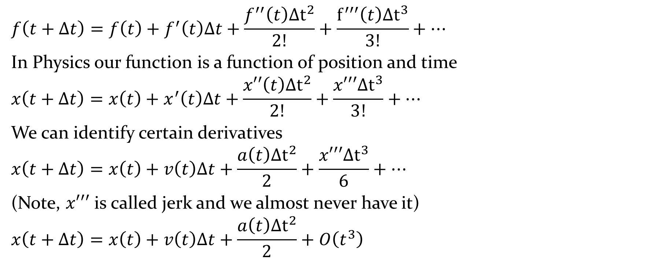
Taylor Series
$$f\left(t+Δt\right)=f\left(t\right)+f^{′}\left(t\right)Δt+\frac{f^{′′}\left(t\right)Δt^{2}}{2!}+\frac{f^{′′′}\left(t\right)Δt^{3}}{3!}+…$$
In Physics our function is a function of position and time
$$x\left(t+Δt\right)=x\left(t\right)+x^{′}\left(t\right)Δt+\frac{x′′\left(t\right)Δt^{2}}{2!}+\frac{x′′′Δt^{3}}{3!}+…$$
We can identify certain derivatives
$$x\left(t+Δt\right)=x\left(t\right)+v\left(t\right)Δt+\frac{a\left(t\right)Δt^{2}}{2}+\frac{x′′′Δt^{3}}{6}+…$$
(Note, $x′′′$ is called jerk and we almost never have it)
$$x\left(t+Δt\right)=x\left(t\right)+v\left(t\right)Δt+\frac{a\left(t\right)Δt^{2}}{2}+O\left(t^{3}\right)$$
Notes:
The Taylor series allows us to approximate a function at a later time. One key benefit is that it allows us to know how much error we are accumulating by knowing what order terms we are ignoring.

Slide 6
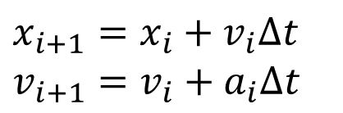
Explicit Euler
We can take the 1st order term
We can use the Taylor series for velocity as well
Explicit Euler!
$$x\left(t+Δt\right)=x\left(t\right)+v\left(t\right)Δt+O\left(t^{2}\right)$$
$$v\left(t+Δt\right)=v\left(t\right)+a\left(t\right)Δt+O\left(t^{2}\right)$$
$$x_{i+1}=x_{i}+v_{i}Δt$$
$$v_{i+1}=v_{i}+a_{i}Δt$$
Notes:
We can take the simplest approximation to the Taylor series by stopping at the 1st derivative. We can do the same thing for the velocity equation (Taylor series can approximate any function). Combining these two we get the ever familiar explicit Euler equation. Note: explicit Euler has second order error.

Slide 7


Fully-Implicit Euler
Evaluate at $−Δt$:
Rearrange to solve for position
Can do the same for velocity
Fully-Implicit Euler!
$$x\left(t−Δt\right)=x\left(t\right)−v\left(t\right)Δt+O\left(t^{2}\right)$$
$$x\left(t\right)=x\left(t−Δt\right)+v\left(t\right)Δt+O\left(t^{2}\right)$$
$$v\left(t\right)=v\left(t−Δt\right)+a\left(t\right)Δt+O\left(t^{2}\right)$$
$$x_{i+1}=x_{i}+v_{i+1}Δt$$
$$v_{i+1}=v_{i}+a_{i+1}Δt$$
Notes:
We can evaluate the Taylor series at any point in time, even the past. Why would we do this? It allows us to manipulate the terms in a different way and causes us to get the equation for fully-implicit Euler!

Slide 8

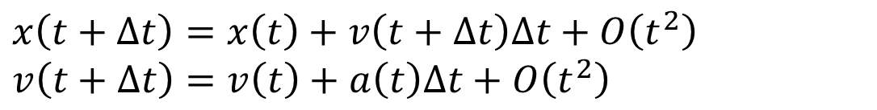

Semi-Implicit Euler
No reason we can’t mix and match
Often behaves better and free!
$$x\left(t+Δt\right)=x\left(t\right)+v\left(t+Δt\right)Δt+O\left(t^{2}\right)$$
$$v\left(t+Δt\right)=v\left(t\right)+a\left(t\right)Δt+O\left(t^{2}\right)$$
$$x+=vΔt$$
$$v+=aΔt$$
$$v+=aΔt$$
$$x+=vΔt$$
vs
Notes:
With a small modification we can get my favorite, semi-implicit Euler. This is done by just mixing and matching the previous two. We can use an explicit step to get our new velocity and then use an implicit step (using the new velocity) to get our new position. Doing this takes no extra effort (it’s literally swapping two lines of code), but is it any better? This has the same 2nd order error as before so it doesn’t seem any better. In some scenarios this will actually give the perfect answer as the two different error terms will cancel, but this is only in extreme cases (such as a spherical orbit).
Here’s my two cents on this: If you have constant acceleration (just gravity), this won’t matter as all the error terms fall to 0. If you do have a non-constant acceleration, this will tend to dampen the result energy (during integration) a bit while explicit will add energy. Having a small amount of damping is always a good thing! Also, I can’t think of any scenario where this will cause worse behavior.

Slide 9
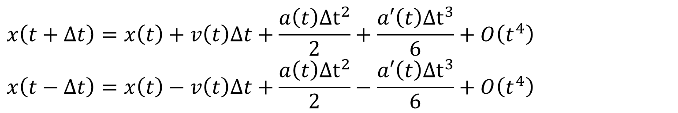
Can we do better?
There’s no way to evaluate more terms (we don’t have jerk)
What if we combine equations?
Add them to get:
$$x\left(t+Δt\right)=x\left(t\right)+v\left(t\right)Δt+\frac{a\left(t\right)Δt^{2}}{2}+\frac{a′\left(t\right)Δt^{3}}{6}+O\left(t^{4}\right)$$
$$x\left(t−Δt\right)=x\left(t\right)−v\left(t\right)Δt+\frac{a\left(t\right)Δt^{2}}{2}−\frac{a′\left(t\right)Δt^{3}}{6}+O\left(t^{4}\right)$$
$$x\left(t+Δt\right)+x\left(t−Δt\right)=2x\left(t\right)+a\left(t\right)Δt^{2}+O\left(t^{4}\right)$$
Notes:
All of the previous equations had 2nd order error terms, can we get any better? Well we don’t have jerk so we can’t just expand more terms of the Taylor series. We can do some trickery by combining the explicit and implicit equations.

Slide 10
Verlet Integration
We added, so what?
The 3rd order term disappeared and we’re left with 4th order!
This is known as Verlet integration:
$$x\left(t+Δt\right)=2x\left(t\right)−x\left(t−Δt\right)+a\left(t\right)Δt^{2}+O\left(t^{4}\right)$$
$$x_{i+1}=2x_{i}−x_{i−1}+a_{i}Δt^{2}$$
Notes:
Combining these two equations drops the 3rd order error term and we’re left with an equation that has 4th order error. Note: Verlet doesn’t have velocity in it. This can work to our advantage (see the previous lecture on the Jakobsen system), but can also be detrimental. We can easily recover a velocity using velocity Verlet by noting that $v≅x_{i}−x_{i−1}$.
$$x_{i+1}=2x_{i}−x_{i−1}+a_{i}Δt^{2}$$
$$x_{i+1}=x_{i}+\left(x_{i}−x_{i−1}\right)+a_{i}Δt^{2}$$
$$x_{i+1}=x_{i}+v_{i}+a_{i}Δt^{2}$$
But how do we update velocity? Well we can always use an explicit Euler step.
Do note though, this is not actual velocity Verlet, look on Wikipedia for that. However this is a simple alternative that works quite well.

Slide 11
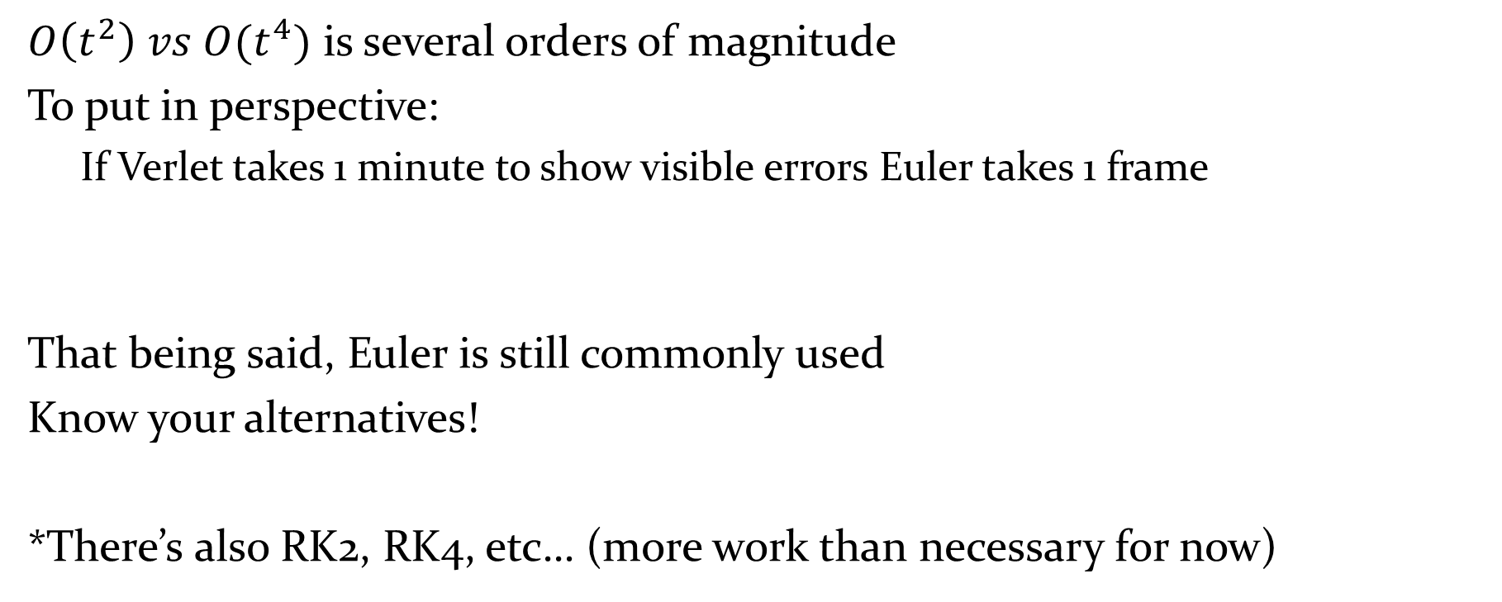
Why do we care?
$O\left(t^{2}\right) vs O(t^{4})$ is several orders of magnitude
To put in perspective:
If Verlet takes 1 minute to show visible errors Euler takes 1 frame
That being said, Euler is still commonly used
Know your alternatives!
*There’s also RK2, RK4, etc… (more work than necessary for now)
Notes:
So having these different error terms is all fine and dandy, but what does that mean to us. Well first note, this is a difference of 2 orders of magnitude. That’s a huge difference in error! Just think real quick, ${\left(\frac{1}{60}\right)}^{2}=\frac{1}{3600}$. This means if error shows up in 1 minute in Verlet (3600 seconds) then it’ll show up in only 1 frame in Euler. If you add a small amount of damping into the system Verlet won’t explode. Euler can explode instantly without being overly damped.
Despite all this, semi-implicit Euler is probably the most commonly used integration technique in the industry right now. Just keep this all in mind when making a game. You might have a game that needs to accurately model non-constant acceleration (such as a planet simulation) and Verlet will be the best option.
There are other techniques for integration I won’t go into such as the Runge-Kutta methods. Don’t worry about them now, just know later that RK4 is $O\left(t^{5}\right)$, but it’s a lot more work.

Slide 12


Wind
Wind force can be approximated by a triangle’s visible area
$strength=Abs\left(\vec{n}∙\vec{w}\right)∗windSpeed$
$\vec{F}=A∗strength∗\vec{w}$
This force is applied to each node of the triangle
*$\vec{w}$ is the direction of the wind
Notes:
Now back to modeling cloth. One simple effect that is commonly used with cloth is wind. Wind can easily be approximated by applying a force based upon how much surface of a triangle the wind sees. We can approximate how close to parallel the wind and normal of the triangle is using the dot product (make sure to take care of your sign). This allows us to apply a percentage of the wind based upon the triangle’s current area.

Slide 13
Cloth Update Loop
Accumulate external forces (gravity)
Solve internal forces
Solve spring forces
Integrate velocity
Integrate position
Notes:
The update loop is quite simple for springs (especially since collision detection/resolution is ignored here). Basically accumulate global forces then solve for the internal forces (springs). Finally integrate (I depicted semi-implicit Euler here).

Slide 14
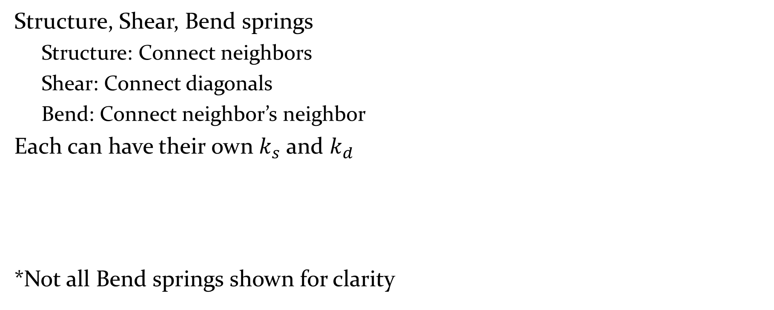
Cloth Meshes
Shear Spring
Structure, Shear, Bend springs
Structure: Connect neighbors
Shear: Connect diagonals
Bend: Connect neighbor’s neighbor
Each can have their own $k_{s}$ and $k_{d}$
*Not all Bend springs shown for clarity
Bend Spring
Structure Spring
Notes:
So that’s basically all you need to know to make a spring system: integration and forces. But how should you structure your mesh to make a cloth. There is a standard structure used for cloths that gets the best response with the fewest number of springs. First you have structural springs that are in-between adjacent nodes. Then there are shear springs that are the diagonals. Finally there are bend springs, these connect a node 2 spaces (or 2 jumps via structure springs) away.

Slide 15
Generic meshes
Connect nodes of n-distance steps
 | A | B | C | D | E | F | G | H
A | 0 | 1 | 1 | 2 | 2 | 3 | 3 | 4
B | 1 | 0 | 1 | 1 | 2 | 2 | 2 | 3
C | 1 | 1 | 0 | 1 | 1 | 2 | 2 | 3
D | 2 | 1 | 1 | 0 | 1 | 1 | 1 | 2
E | 2 | 2 | 1 | 1 | 0 | 1 | 2 | 2
F | 3 | 2 | 2 | 1 | 1 | 0 | 1 | 1
G | 3 | 2 | 2 | 1 | 2 | 1 | 0 | 1
H | 4 | 3 | 3 | 2 | 2 | 1 | 1 | 0
Notes:
So that’s creating a cloth, how can we extend this to more generic shapes. Cloth has a very specific structure (structure, shear, bend), but what if we want a triangle mesh for a character? One simple way to connect a mesh is by building a graph that determines how many edges are required to get from one node to another. Two nodes are connected with springs if they are within a certain number of jumps. Above shows only 1 jump (the mesh itself).

Slide 16
Generic meshes - continued
Adding level 2
This is the same as a cloth mesh
 | A | B | C | D | E | F | G | H
A | 0 | 1 | 1 | 2 | 2 | 3 | 3 | 4
B | 1 | 0 | 1 | 1 | 2 | 2 | 2 | 3
C | 1 | 1 | 0 | 1 | 1 | 2 | 2 | 3
D | 2 | 1 | 1 | 0 | 1 | 1 | 1 | 2
E | 2 | 2 | 1 | 1 | 0 | 1 | 2 | 2
F | 3 | 2 | 2 | 1 | 1 | 0 | 1 | 1
G | 3 | 2 | 2 | 1 | 2 | 1 | 0 | 1
H | 4 | 3 | 3 | 2 | 2 | 1 | 1 | 0
Notes:
This of course can be extended many levels to get stiffer spring systems. However, note that at 2 jumps the resulting mesh is close to equivalent to the spring’s structure, shear and bend springs (bend springs will connect things 2 diagonals away). You can keep extending this to get stiffer systems, however remember that too stiff (and unsolvable) of a system will explode.

Slide 17
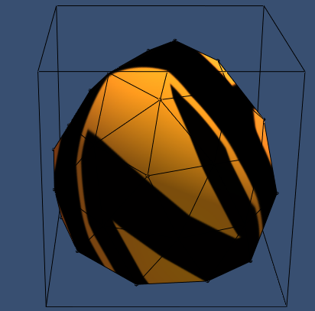
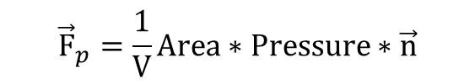
Pressure Model Soft Body
$${\vec{F}}_{p}=\frac{1}{V}Area∗Pressure∗\vec{n}$$
Normal
Volume
Area
Notes:
Just connecting more and more springs together to get a more rigid structure doesn’t always work. In particular, nothing is actually enforcing the volume of the shape (inversions can happen, etc…). One small addition that does preserve volume is pressure model soft bodies. An extra force is added to every node that keeps the object inflated. This force is based upon the area of the triangle, the volume encased by the body and the triangle normal. There is also a tweakable constant to change the pressure of the body.

Slide 18
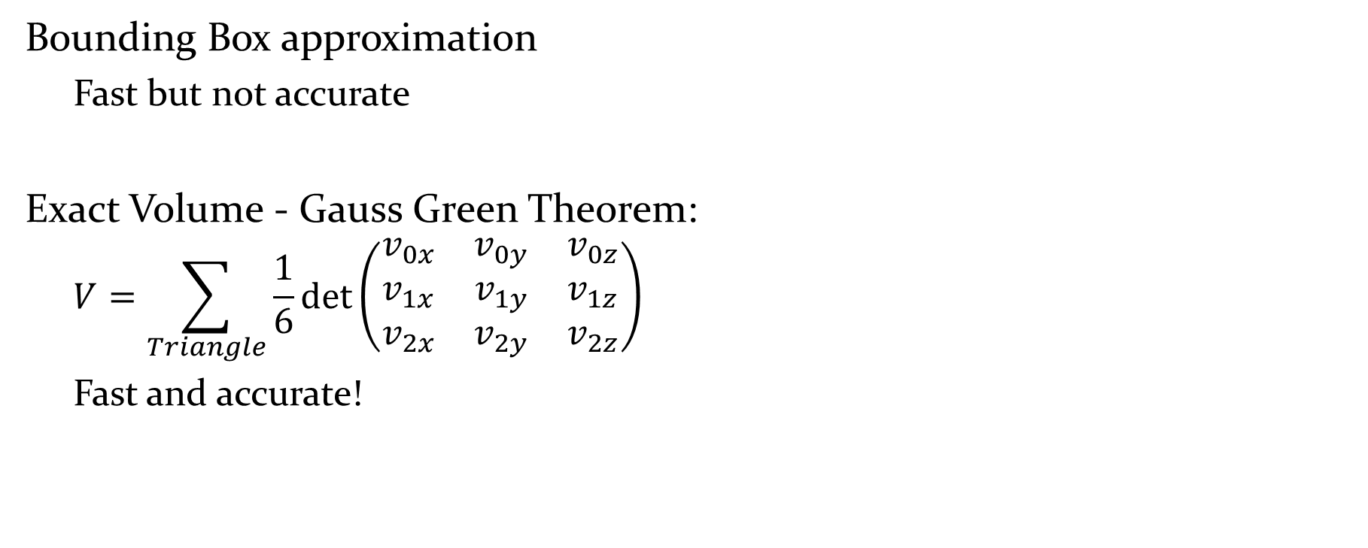
Mesh Volume Calculation
Bounding Box approximation
Fast but not accurate
Exact Volume - Gauss Green Theorem:
$$V=\sum_{Triangle}{\frac{1}{6}det\left(\begin{matrix}v_{0x} & v_{0y} & v_{0z} \\ v_{1x} & v_{1y} & v_{1z} \\ v_{2x} & v_{2y} & v_{2z}\end{matrix}\right)}$$
Fast and accurate!
Notes:
One simple way to calculate the volume within the soft body is to just approximate it with a bounding box (or a bounding box hierarchy). This however won’t be very accurate.
It’s actually quite simple to calculate the exact volume of any (concave included) mesh using the Gauss-Green Theorem.
This works due to the accumulate of positive and negative volume that’ll cancel out to give the exact volume (ask me for more details if you want to understand better).

Slide 19
Soft Bodies – Update Loop
Accumulate external forces (gravity)
Solve internal forces
Solve spring forces
Solve pressure forces
Integrate velocity
Integrate position
Notes:
The update loop for a soft body is just a simple addition. When computing our internal forces (previously just springs) we now add the pressure forces. That’s it!

Slide 20
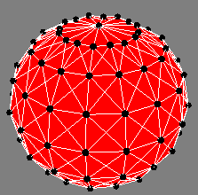
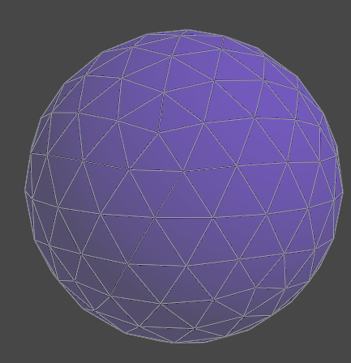
PMSB meshes
Stack/Slice vs. Geodesic sphere
Geodesic behaves better (especially at the top)
Use spherical coordinates
Start with icosahedron and subdivide
Notes:
There’s a few different ways to make soft body meshes. The same approach can always be used for generic meshes, but some specific shapes should be made carefully. In particular, a sphere has 2 main ways of being constructed. One is the standard stack and slice approach. This approach tends to not work too well, especially at the top since a lot of vertices are connected to the same top vertex.
The best way to construct a sphere is with a geodesic sphere. That’s a sphere where all faces are equilateral triangles. The simplest way to construct this is to start with an icosahedron and subdivide each face into equilateral triangles. This can be done recursively for finer meshes.

Slide 21
Questions?

Slide 22
References
Springs: too many to count, ask if you want some white-papers
Matyka:
“Pressure Model Soft Body Simulation.“
"How To Implement a Pressure Soft Body Model.“
www.matyka.pl/
Geodesic Sphere:
http://donhavey.com/blog/tutorials/tutorial-3-the-icosahedron-sphere/
http://stackoverflow.com/questions/7687148/drawing-sphere-in-opengl-without-using-glusphere/7687312#7687312

