Slide 1
Modern SAT
jodavis42@gmail.com

Slide 2
Modern SAT
Previously talked about “Traditional SAT”
Modern SAT is more complicated but faster
Notes:
My previous presentation on SAT mostly talked about “Traditional SAT”. There have been a few small improvements over the last decade or two to make SAT a bit faster. As of the last few years though, there have been some large changes to SAT that make it a major competitor. In this presentation I want to cover most of those modern updates!

Slide 3
Modern SAT
How modern is this stuff?
When were SAT/GJK invented in comparison to this stuff?
HST is credited to Hermann Minkowski (1864 -1909)
SAT probably used in computers around 1980
GJK published in 1988
Modern SAT: 2013
Notes:
Saying an algorithm is modern is always a bit odd, especially with content that is as of 2018 about 5 years old, however this is what is currently used in the industry. That being said, I want to give some basic numbers about when these updates came about.
So a few random details, some of this I had to approximate after asking various sources. As near as I can tell, HST was credited to Hermann Minkowski who lived from 1864 to 1909. That being said, this algorithm probably wasn’t used in computational geometry until around 1980. GJK was first published in 1988. The first GDC talk of modern SAT was 2013, more than 20 years later!

Slide 4
Quick Detour
Look at SAT/GJK/MPR as algorithms not solutions
They solve the same problem
Viewing SAT through GJK can be useful
Many updates to algorithms come from merging two different ideas!
Notes:
One quick detour I want to make is to emphasize that many advancements in fields come about from taking two seemingly unrelated pieces of info and realizing that they’re related. Sometimes this is literally taking two different things and merging them but is often more subtle.
In our case the main idea is to look at things from different viewpoints. In particular, I want you to look at the collision detection algorithms we’ve covered as just that, algorithms (or tools) used to solve a problem, not the solutions themselves. All of these algorithms attempt to solve the same problem, so sometimes viewing SAT material through the lens of GJK can lead to new understanding. That is in my opinion how the majority of this came about

Slide 5
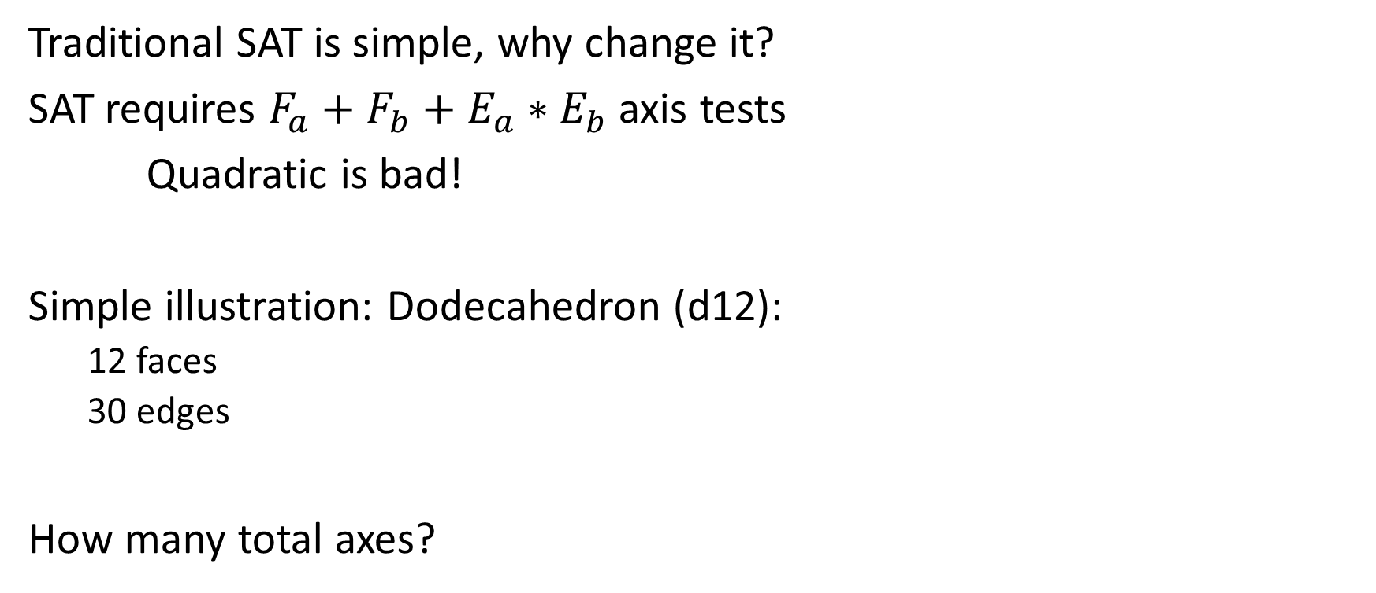
SAT – Why Update it?
Traditional SAT is simple, why change it?
SAT requires $F_{a}+F_{b}+E_{a}∗E_{b}$ axis tests
Quadratic is bad!
Simple illustration: Dodecahedron (d12):
12 faces
30 edges
How many total axes?
Notes:
With that out of the way, let’s do a quick refresher on why we even need to update SAT. Make no mistake, what I’m about to cover is more complicated, and the original SAT was very simple, so why update it?
Well the root reason is how expensive SAT can be with more complicated shapes. In particular, remember that SAT has to test $F_{a}+F_{b}+E_{a}∗E_{b}$ axes, which means this is quadratic in the number of edges. This is actually closer to $N^{3}$ in terms of the polygons as each axis requires iterating through the features of each shape. So how expensive is this really?
Let’s look at a simple shape, a dodecahedron (d12). According to Wikipedia, a d12 has 12 faces and 30 edges. This means that SAT needs to test a total of 924 axes! It shouldn’t be hard to see that GJK would be significantly faster than this!

Slide 6
SAT – Why use it?
GJK is faster, why use SAT?
Still best algorithm for finding contact info
Very fast on separation
Modern updates make SAT comparable
This is currently used in real production AAA games!
Notes:
So why use SAT when we have more modern algorithms like GJK that are significantly faster? Well part of the reason is that SAT is still the “best” algorithm for determine contact information when objects overlap. EPA exists, but is complicated to write, not fast, and has lots of numerical stability issues.
With these updates I’ll cover you’ll hopefully see that SAT can be made very fast. Also to be clear, this is still the current industry standard and is used in several AAA games, in particular I know that Valve and Blizzard use this!

Slide 7
Optimizations
Few simple ones to keep in mind before more complicated ones
Notes:
Now I’m going to cover a bunch of optimizations that can be added to SAT to make it fast. The first few are not really new but I haven’t explicitly talked about them in the context of SAT before.

Slide 8
Optimization 1: Broadphase
Don’t call SAT if not necessary!
Simple bounding Sphere/Aabbs save a lot
No optimization is better than not doing anything!
Notes:
The most obvious optimization is to not call SAT if it’s not required. This is what we’ve spent the majority of this semester on, broadphases. Even a simple Aabb N-Squared spatial partition is a huge speed up on calling SAT or even GJK on a more complicated shape. Remember no optimization is better than not doing something.!

Slide 9
Optimization 2: Temporal Coherence
SAT can terminate on the first axis of separation
Temporal Coherence: Objects don’t move much each frame
Cache the last axis of separation and use that to start!
We did this in frustum tests
Notes:
The second optimization I’ve talked about before, but not in the context of generic SAT. If you recall, SAT is an algorithm that tests for separation. If any axis of separation is found then you can immediately return false. So this means we can get lucky and terminate after only one axis test.
If you think back, you’ll recall that we talked about temporal coherence with Frustum tests. Temporal coherence is the idea that objects don’t move much from frame-to-frame, so if an axis was separating last frame, then there’s a good chance it’s separating again this frame. This leads to a very easy optimization of caching the last axis of separation and simply starting with that axis again. With any luck, this means even when broadphase fails that it’ll take only one axis check to return false.

Slide 10
Optimization 3: Temporal Coherence
Temporal coherence for intersection:
There’s a good chance that contact normals didn’t change
Basic idea:
If relative orientation is the same, re-run clipping
Only fall back on SAT if axis separates or clipping fails
Notes:
The third and last of the simple optimizations is also temporal coherence, although in this case it’s temporal coherence for intersection instead of separation. This is the optimization I’m least familiar with but the idea is fairly simple:
If two objects were in contact last frame on an axis, it’s very likely that axis is still the best axis.
This of course isn’t 100% true so the question is how do we detect failure. This is achieved by storing the relative orientation between the two objects. If the relative orientation isn’t substantially different from last frame then the same features should be in in contact unless one of two things happen:
The features separated. In this case we’d detect that this axis now has separation and SAT can return false.
The orientations stayed the same but the objects slid apart. In this case when we re-run clipping we should get an empty contact manifold. This would signify that the axis is no longer valid and we have to re-run the full SAT test.
Note that this optimization is not unique to SAT.

Slide 11

Optimization 4: Hyperplane Separation Theorem
First real change that is modern: SAT -> HST
Remember:
SAT tests axes
HST tests planes
#axes $≤$ #planes
Why would this be better?
Notes:
Now we can talk about some bigger optimizations. The first big one is to undo everything I talked about previously and convert SAT back into HST.
Remember the core difference between SAT and HST is that SAT tests axes and HST tests planes. However if we take a second to think we’ll realize that there’s guaranteed to be the same or less axes than there are planes (think aabb where $±\vec{x}$ produce the same axis). So how would this ever be an optimization?

Slide 12
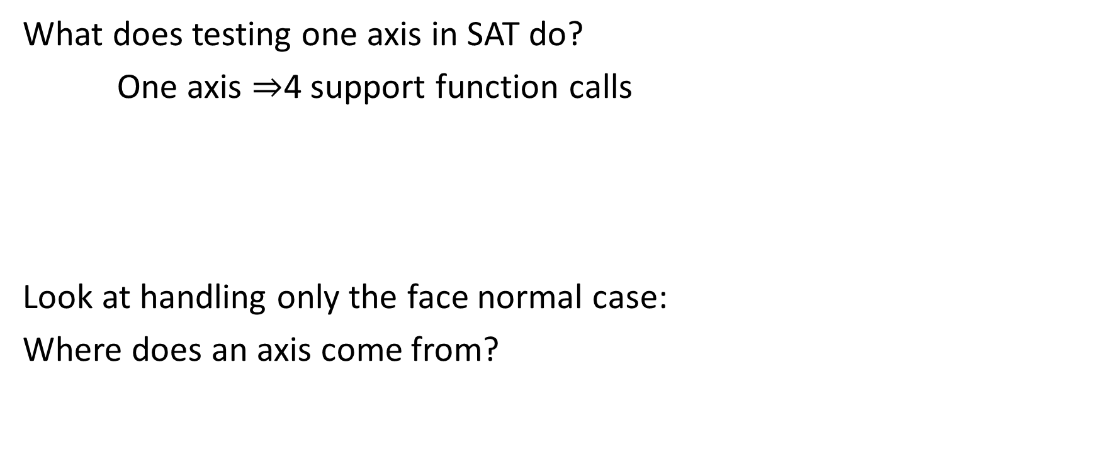
Optimization 4: HST
What does testing one axis in SAT do?
One axis $⇒$4 support function calls
Look at handling only the face normal case:
Where does an axis come from?
Notes:
To do this we have to go back and look at the basics again. In particular, look at what work testing one axis in SAT does.
If you recall, to test one axis we needed the projection of each shape. Each shape’s projection was computed from two calls to its support function; one in the axis direction, the other in the negative axis direction. This means a total of 4 support function calls are needed to test one axis in SAT. For more general convex shapes, a support function is will walk all vertices so this will be very expensive!
To optimize this we’re only going to consider the face normals (not edge vs. edge). If we take a step in and look at the problem a little less abstractly we can get some useful insight, in particular let’s look at where this face normal comes from.

Slide 13



Optimization 4: HST
The plane comes from one shape’s face
Why test the vertices on that shape?
$$\vec{p}$$
$$S(−\vec{n})$$
$$\vec{n}$$
*Requires only 1 support call
Notes:
The key observation is that all face normals come from a face on an object. Since the shape is convex, by definition all of the vertices are on or behind this face, so we know the maximum projection value for this face normal. Now to test for overlap on this axis we need to find the point furthest in the opposite direction of the normal and test it against the plane defined by the axis and any point on the face. We can determine non-intersection if the point is on the positive side of the plane, otherwise we have to defer to later axes.
This means we drop the total number of support function calls from 4 down to 1. This does come at the cost of having to test redundant axes, but this typically is a saving.

Slide 14
Optimization: HST
Face tests are optimized!
Can’t use this to optimize edge tests…
There’s even more of these too!
Notes:
This optimization can greatly speed up face normal axes, but doesn’t help speed up edge vs. edge tests. To make matters worse, the edge axes were the big problem anyways since they’re quadratic. There’s also no clear way to optimize these to not take four support calls like we did with the face normals.
Note: after finishing this presentation it might seem like you could run this optimization on edges as long as you get a correct normal direction but it doesn’t work if you don’t use the gauss maps to skip axis.

Slide 15
Questions?
Things are going to get more complicated
Notes:
Now’s when the real modern stuff comes in. As a warning, this is a bit tricky to understand as it requires understanding and piecing together several different things. Luckily it isn’t hard to implement.

Slide 16
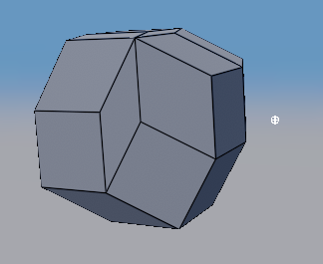
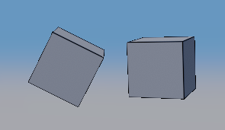
Minkowski Difference + SAT
Remember the Minkowski difference:
Shape vs. Shape
Shape vs. Point
* The Minkowski difference is convex
Notes:
Before starting the next major optimization I need to lay some ground work. In particular I need to discuss Minkowski differences and how they relate to SAT. These might seem like unrelated things, but remember that they’re used to solve the same problem!
To start, remember how the Minkowski difference works for collision detection. Shape vs. Shape is transformed into Shape vs. Point. It’s also important to remember that the result of the Minkowski difference of two convex shapes is also a convex shape.

Slide 17
Minkowski Difference + SAT
What’s the easiest way to write point vs. convex mesh?
Notes:
Since the Minkowski difference is convex, we could write a simple point in convex shape algorithm.

Slide 18
Minkowski Difference + SAT
What’s the easiest way to write point vs. convex mesh?
Sound familiar? This is an SAT test!
bool PointVsConvexMesh(const Vector3& point, ConvexMesh& mesh)
{
foreach(var face in mesh.Faces)
{
// If outside the mesh (positive side of plane is outside)
if(PointPlane(point, face.mPlane) == IntersectionType::Inside)
return false;
}
return true;
}
Notes:
The easiest (but not fastest) point vs. convex mesh algorithm you could write is to simply test the point against all faces in the mesh. If the point is outside any face then it’s outside the mesh. It’s only if the point is inside all faces that the point is inside the mesh. (Remember, faces normals point outwards by convention so this tests for being on the positive side of a plane, not the negative).
This test should sound a bit familiar.

Slide 19
Minkowski Difference + SAT
Minkowski difference is related to SAT!
Different view of the same problem
Notes:
This leads us to believe that running SAT on the Minkowski difference is equivalent to running SAT on the two individual shapes! This should logically make sense as the Minkowski difference a transformation on the shapes that preserves several useful properties including the collision result. The important thing about this space is that it’s solving a simpler problem which makes it easier to see what is actually required. In particular, in the Minkowski difference space it’s easy to see exactly what axes have to be tested for separation.

Slide 20
Minkowski Difference + SAT
Where do the Minkowski difference faces come from?
Notes:
Now we can try to relate this problem back to our original one. In particular, let’s look at where each face (and hence each SAT axis) on the Minkowski difference comes from.

Slide 21
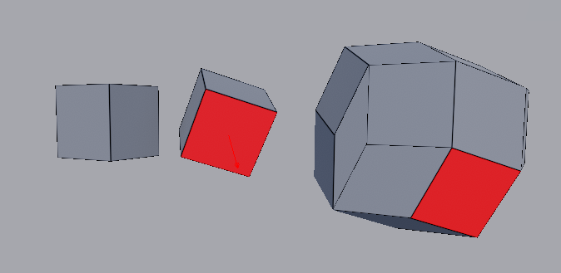
Minkowski Difference + SAT
Some faces come from the object faces
Notes:
It shouldn’t be hard to see that several of the faces come from a face on one of the original shapes.

Slide 22
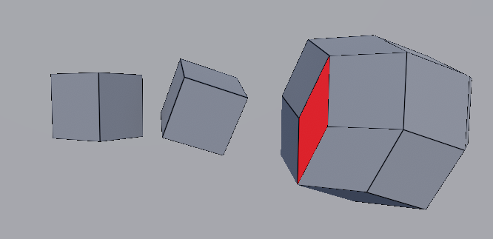
Minkowski Difference + SAT
Some faces clearly don’t come from either object
Where do these extra faces come from?
Notes:
While it’s easy to guess where most of these square-ish faces come from, there are some faces that have no obvious relation back to a feature of the original shapes.

Slide 23
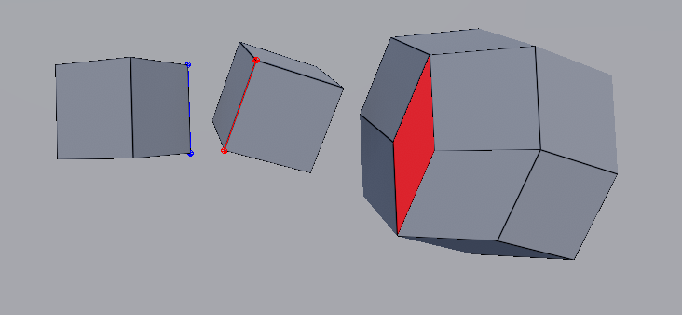
Minkowski Difference + SAT
The other faces come from an edge vs. edge pair
Face normal is the cross product of the two edges!
Notes:
Knowing what we know about SAT it should be hard to guess that these extra faces come from an edge vs. edge pair. Sure enough, all of the extra faces on the Minkowski difference come from sweeping one edge across another.
Now we see that these problems are completely related. The Minkowski difference is simply composed of all of the faces on each object and the edge vs. edge pairs.

Slide 24
Minkowski Difference + SAT
How does this help us? Look at how many axes each test needs
30 axes
156 axes
What happened to the other 126 edge faces?
Notes:
If we left the problem here then we’d simply have a nifty view of the original SAT problem with no real benefits. Luckily we make a very simple observation to realize something is off. In particular simply count the number of axes required for SAT on each test.
The Minkowski difference has 30 faces and hence 30 axes to test in SAT.
In the traditional method of SAT, each box has 6 face normals (using the HST approach) and 12 edges bringing it to a grand total of 6 + 6 + 12 * 12 or 156 axes.
This leads us to a simple question, where did the other 126 edge vs. edge terms go?

Slide 25
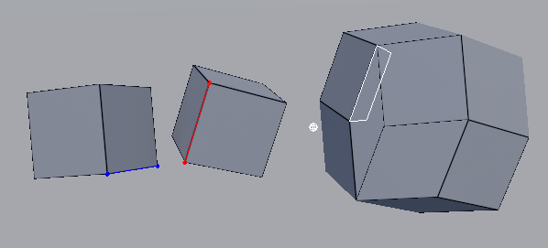
Minkowski Difference + SAT
Some edges aren’t on the surface of the Minkowski difference
Do these edge normals need to be tested?
Notes:
From here we can try to observe where the rest of the edges end up in the Minkowski difference. In particular we find that many of the edge pairs create a face that only contain a point or edge on the surface of the Minkowski difference, but are otherwise inside the hull. These faces clearly don’t need to be tested for separation on the Minkowski difference and hence they don’t need to be tested at all.

Slide 26
Minkowski Difference + SAT
Only edges that produce a face on the Minkowski difference’s surface need to be tested!
Can we efficiently determine which edges to test?
Notes:
This leads us to the key observation: we only need to test edge pairs that create a face on the surface of the Minkowski difference, all other faces can be skipped. As demonstrated earlier, this allows us to cull out a huge number of axes, even on simple shapes.
So while this tells us what axes we need to test, the question is can we figure out how to prune these extra edges quickly enough that it’s worth while?

Slide 27
Edge Pruning (Bad)
Why not build the Minkowski difference directly?
Simply test each face normal from the result!
Don’t do this!!!
Notes:
One way to avoid this whole problem is to just build the Minkowski difference directly. From the Minkowski difference we know exactly what face normals we need to test and we can pass these back into SAT.
It should be obvious that this is a bad idea though. Not only is this slow, but we could just run EPA on this instead of instead of calling SAT.

Slide 28
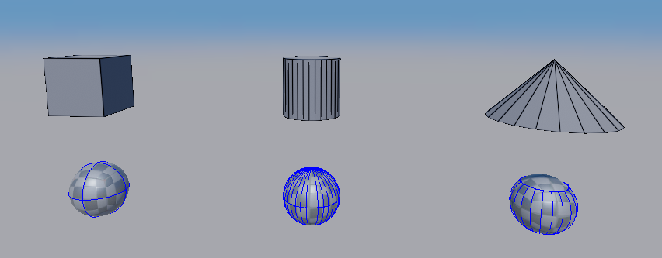

Gauss Maps
Wikipedia: In differential geometry, the Gauss map (named after Carl F. Gauss) maps a surface in Euclidean space $R^{3}$ to the unit sphere $S^{2}$
Notes:
Instead we’re going to introduce a new concept called a Gauss Map. A gauss map is basically a different way to view the same data that can provide some useful insights (I’m no expert).

Slide 29
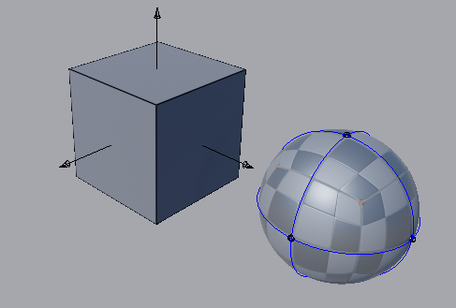
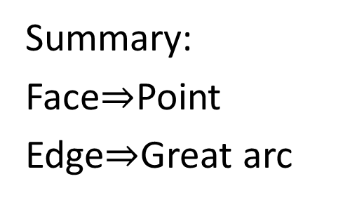
Gauss Maps
Summary:
Face$⇒$Point
Edge$⇒$Great arc
Why does this matter?
Notes:
To build a gauss map, every face normal maps to a point on the unit sphere. For an edge, a great arc is created between the normals of the two faces it’s adjacent to.
While this is a neat way to view the data, the question is how does this help us solve the SAT edge axis problem?

Slide 30
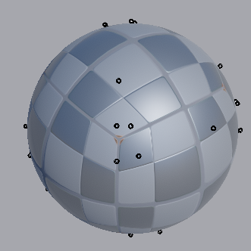
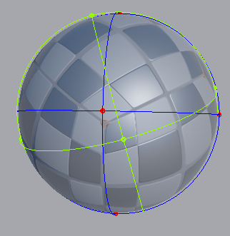

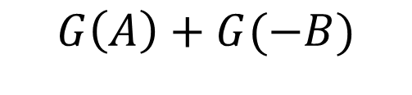
Gauss Maps
$$G(A−B)$$
$$G\left(A\right)+G(−B)$$
What can we notice?
Notes:
To help understand let’s look at the difference between the gauss map of the Minkowski difference ($G\left(A−B\right)$) and the gauss map of the two shapes ($G\left(A\right)+G(−B)$). Remember these are the same problem being solved, just in two difference spaces. On the left picture we’re only drawing the face normals as these are the only relevant axes for SAT. On the right we’re drawing the full gauss map of each shape (A is blue and B is green).
Remember we need to test every point on the gauss map of the Minkowski difference.

Slide 31
Gauss Maps
$$G(A−B)$$
$$G\left(A\right)+G(−B)$$
Face normals show up in both
Notes:
First lets look at normals we know about. In particular look at the vertices on $G\left(A\right)+G\left(−B\right)$. It shouldn’t be a surprise that each of these map to vertices $G(A−B)$. This shows that the face normals of each shape directly map to face normals on the minkowski difference.
The question is where do all of the other vertices in $G\left(A−B\right)$ come from?

Slide 32
Gauss Maps
$$G(A−B)$$
$$G\left(A\right)+G(−B)$$
Other points only exist when great arcs intersect!
Notes:
It shouldn’t be too hard to see that the other vertices on the Minkowski difference match everywhere that the great arcs intersect.

Slide 33
Gauss Maps
Two edges only form a surface on the Minkowski difference if their great arcs intersect!
*Real proof is outside this class’ scope
Notes:
This leads to a very important observation: Two edges only form a surface on the Minkowski difference (and hence actually need to be tested) if their corresponding great arcs intersect!
The basic idea is that we only want to test edges that face towards each other. On the gauss map, an edge represents all of the normals between the two adjacent faces. So if the edges intersect (remember it’s –B) then the edges mostly point towards each other.
I’ve shown this with a fair amount of empirical evidence and a reasonable explanation, but there is a real proof out there. That being said, it’s way beyond the scope of this class so you’ll just have to trust me or research it yourself.

Slide 34
Gauss Maps
If the great arcs don’t intersect we can skip an edge pair!
Cool…can we even do this efficiently?
Story time!
Notes:
The problem is can we test this efficiently enough that this information is even worthwhile?
Now the intersecting thing for me is that I was around during the development of this so I have a bit of a story related to this.
Short version:
Sergiy Migdalsky (Valve) gave a talk at DigiPen where he explained gauss maps but didn’t have an efficient way to test this.
Around the same time Game Physics Pearls was published and it had a very complicated solution to this.
Later Erin Catto (Blizzard) came across an unrelated article that talked about gauss maps and a new collision detection algorithm.
Erin realized a small paragraph from this article could solve SAT’s problem.
This once again goes to show that seemingly unrelated things can sometimes be useful (similar story for matrices being used in physics).

Slide 35
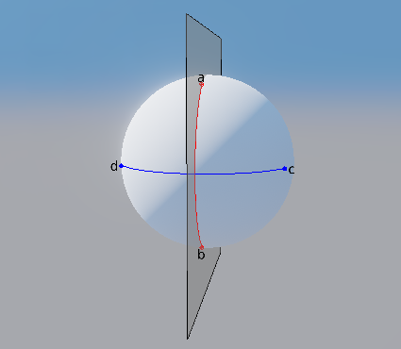
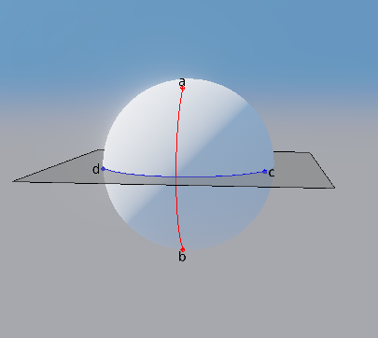


Gauss map optimizations
Test planes defined by each edge!
$$\left[c∙\left(b×a\right)\right]∙\left[d∙\left(b×a\right)\right]<0$$
$$\left[a∙\left(d×c\right)\right]∙\left[b∙\left(d×c\right)\right]<0$$
Is this test sufficient?
Notes:
So how do we efficiently test if the great arcs intersect? Well this is funnily enough actually SAT itself.
Let a and b be points on edge 0’s great arc and c and d be points on edge 1’s great arc. The two edges intersect if:
d and c are on opposite sides of the plane defined by a and b
a and b are on opposite sides of the plane defined by c and d.
The above test simplifies this check by realizing that if two points are on opposite sides one of them point tests will produce a positive value and the other will be negative, so the product of both will be negative.
This test isn’t sufficient for verifying the great arcs intersect though.

Slide 36
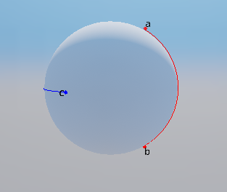
Gauss map optimizations
What if the arcs are on opposite hemispheres?
Notes:
The case where the previous two checks fail are if the great arcs intersect but lie on opposite sides of the sphere. Luckily this is an easy enough case to remedy.

Slide 37
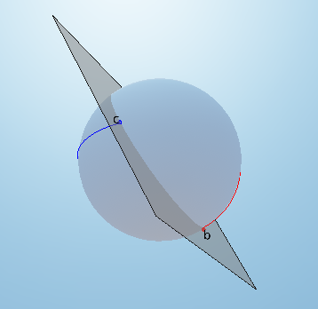
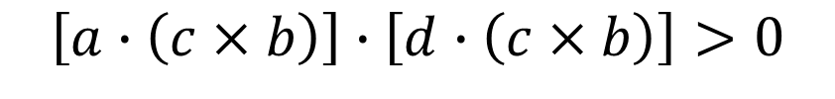
Gauss map optimizations
Test for the arcs being on the same hemisphere
$$\left[a∙\left(c×b\right)\right]∙\left[d∙\left(c×b\right)\right]>0$$
Notes:
The final check is to see if the arcs are in the same hemisphere. If they aren’t in the same hemisphere then the arcs cannot intersect! To do this we just build one more plane to test, the plane through vertex b and c and then test the other two points (a and b).
Note: in the above picture the first two tests would return true but this test catches that the arcs do not actually intersect.

Slide 38











Gauss Maps - Great Arc Intersections
Total test is four scalar triple products:
$$\left[c∙\left(b×a\right)\right]∙\left[d∙\left(b×a\right)\right]<0$$
$$\&\&$$
$$\left[a∙\left(d×c\right)\right]∙\left[b∙\left(d×c\right)\right]<0$$
$$\&\&$$
$$\left[a∙\left(c×b\right)\right]∙\left[d∙\left(c×b\right)\right]>0$$
Using the identity:
$$a∙\left(b×c\right)=b∙\left(c×a\right)=c∙(a×b)$$
$$\left[c∙\left(b×a\right)\right]∙\left[d∙\left(b×a\right)\right]<0$$
$$\&\&$$
Optimize to:
$$\left[a∙\left(d×c\right)\right]∙\left[b∙\left(d×c\right)\right]<0$$
$$\&\&$$
$$\left[c∙\left(b×a\right)\right]∙\left[b∙\left(d×c\right)\right]>0$$
Notes:
With this we can write the final edge test as 6 scalar triple products. Some small optimizations can be made by knowing the scalar triple product identity so we can re-arrange the hemisphere test. This makes the final result 4 unique scalar triple products that only need 2 cross products.

Slide 39


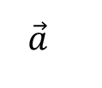

Gauss Maps – Removing Cross Products
Small optimization: What are the cross product terms?
$$\vec{b}$$
$$\vec{e}$$
$$\vec{a}$$
Cross product terms are edge directions
$$\vec{e}=\vec{a}×\vec{b}$$
*Makes test also work with double sided triangles
Notes:
One more optimization for gauss maps. In particular if we look at the cross product terms in the previous equations we’ll see that they’re always between two triangle normals on adjacent faces. If we look the result of these cross product terms we’ll realize they’re always the edge direction between the two shapes. This allows us to save a cross product by simply using the edge direction (no normalization required).
More importantly, this allows us to deal with double sided triangles. Our previous test would produce a zero vector for the cross product terms on a double sided triangle which would break the test.

Slide 40
Gauss Maps – Edge Distance
Can now skip most edges with 3 comparisons
When arcs intersect we still have to run 4 support calls
Can we improve this?
Notes:
We can now skip a majority of the edge tests with 3 simple checks. This typically prunes the tests run by an order of magnitude so it’s a very large savings! That being said, when we do have to test an edge we still need to test for overlap which is 4 support functions still. Luckily there’s one more major optimization!

Slide 41
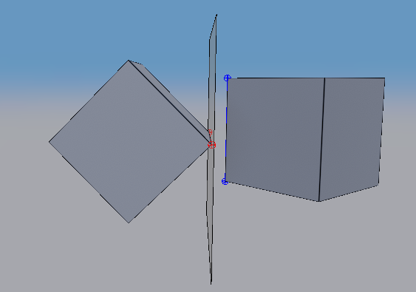
Gauss Maps – Edge Distance
Observation: When features overlap on a gauss map in a direction, those features are the closest supporting features.
Only need to check edge distance. O(1)!
Notes:
When features overlap on a gauss map in a direction, those features are the closest supporting features.
What this means is that when two edges intersect on the gauss map, the closest features are the edges themselves. Because of this, we only need to test the individual edges and no support functions are needed.
To check if the edges overlap we build the plane with the edge cross product as the normal going through one of the edge vertices. We then test any point on the other edge against the plane to see if there is separation. This test is now requires no support function calls at all and is $O(1)$.

Slide 42



Gauss Maps – Edge Distance
Need a consistent normal direction:
$$\vec{p}$$
$$\vec{c}$$
$$\vec{n}$$
Make sure: $\vec{n}∙\left(\vec{p}−\vec{c}\right)>0$
Notes:
There is one small caveat. To test edge distance we need a valid normal direction so we know which side is positive and which side is negative.
This is easy to do by making sure the normal always points away from the center of one shape (object 0 for instance). This can be checked with a simple dot product check between the normal and the vector from the center of the mesh to one of the vertices on the edge. If these don’t point in the same direction then simply negate the normal.

Slide 43
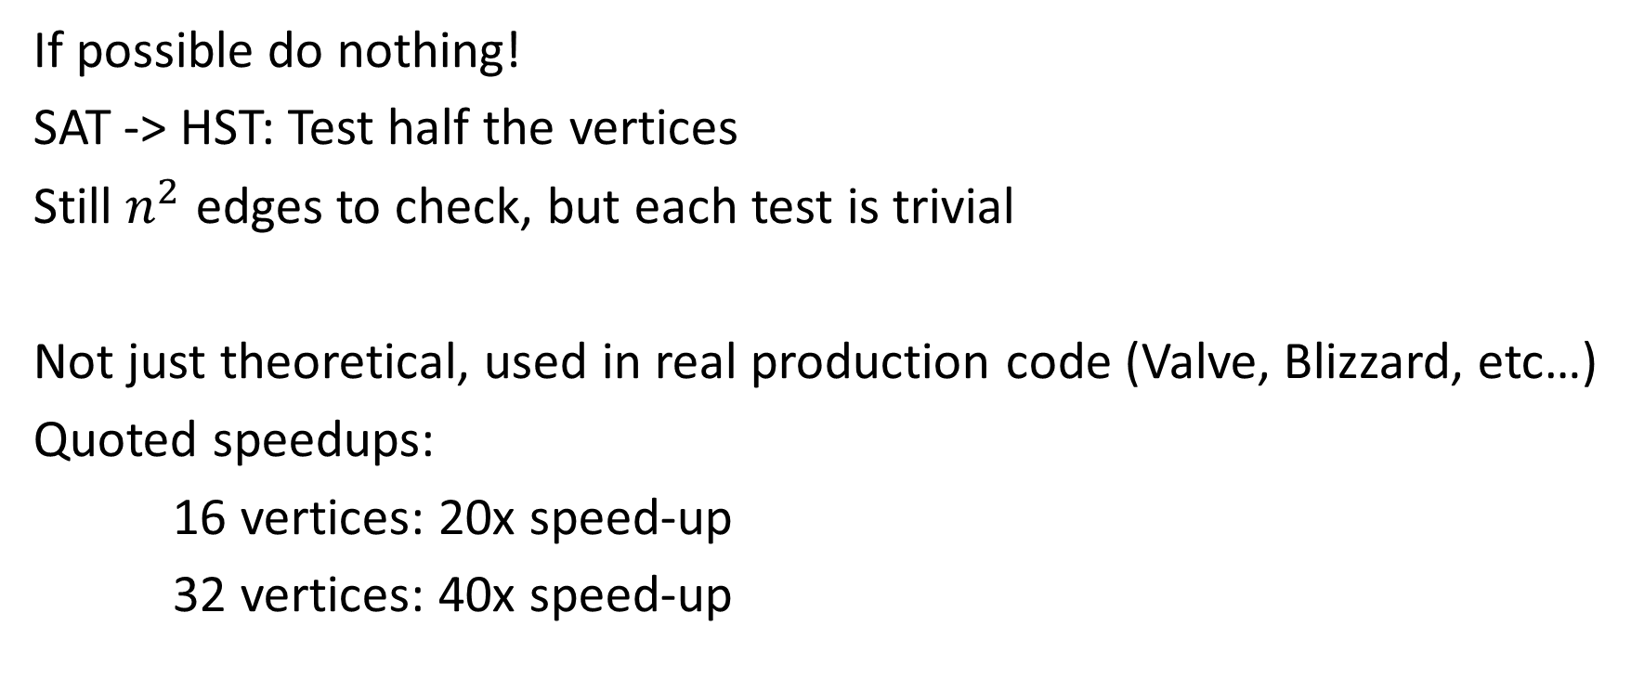
Summary
If possible do nothing!
SAT -> HST: Test half the vertices
Still $n^{2}$ edges to check, but each test is trivial
Not just theoretical, used in real production code (Valve, Blizzard, etc…)
Quoted speedups:
16 vertices: 20x speed-up
32 vertices: 40x speed-up
Notes:
To summarize, the main observation is as always to do nothing if possible.
After those optimizations we were able to remove half the work on each face direction by converting SAT to HST. This allowed us to call the support function around half as many times since we already knew the furthest vertex on one shape.
The biggest bottleneck was always the edge tests though as we had to test $n^{2}$ edges. This doesn’t change, but we’re able to prune most of the edges with 3 simple comparisons. For the edges we still had to test we also removed all support function calls making the total edge test $O\left(1\right)$. So the complexity of SAT as a whole didn’t change but the cost of each operation becomes miniscule.
To finish up I want to emphasize that these optimizations are not theoretical, they’re used in real production code. While I’m sure more companies use this, I know for a fact that Blizzard and Valve use these optimizations. Here are some of the speed-up numbers given by Dirk at Valve.

Slide 44
Questions?

Slide 45
References
Dirk Gregorios: “The Separating Axis Test”, (GDC 2013)
S. Migdalsky: “SAT in Narrow Phase and Contact Manifold Construction” (in Game Physics Pearls)
Y. Choi: “Collision Detection of Convex Polyhedra Based on Duality Transformation” (Minkowski Sum and Gauss Map)

