Slide 1
Packet Capture and Analysis

Slide 2
Packet Capture
To identify and investigate events on a network, network packets can be captured from an endpoint
Network traffic is collected and stored in either pcap or libcap format
A few commonly used sniffers/network analyzers:
tcpdump
Wireshark
Windump

Slide 3
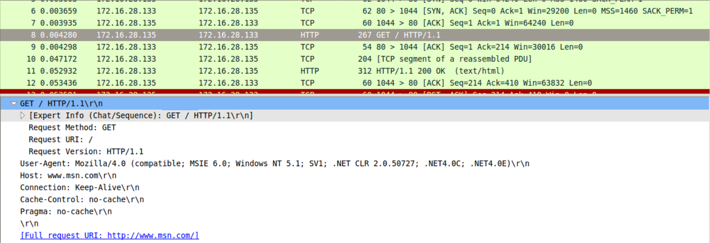
Wireshark
Can sort and filter by protocol, source IP, destination IP, or other desired fields
More information on how to use Wireshark and tcpdump can be found in the Cyber Operation and Penetration Testing course, “Network traffic monitoring and analysis using Wireshark” lecture

Slide 4
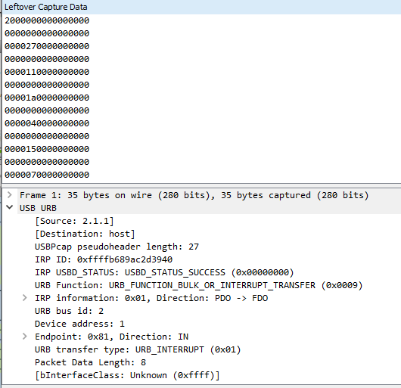
Wireshark
Can be used to
monitor and analyze
device traffic, such as
a USB device

Slide 5
Scapy
A python tool to parse packet data and decode network activity, without automatic interpretation of results to avoid erroneous conclusions
https://scapy.net/
https://www.holidayhackchallenge.com/2015/winners/ctfhacker/holidayhack2015-writeup/counterhack-holidayhack.html shows the usage of scapy to solve a CTF challenge

Slide 6
Packet Analysis in CTFs
Many CTFs include a packet analysis challenge under the Forensics category
Often, a pcap showing a custom communication protocol is used
Most likely involves reverse engineering the communication protocol to find the flag
May use a known communication protocol but require the recovery of an obscured piece of data the identification of a certain host

