Slide 1
More Javascript
Both Review and New-view

Slide 2
Code Standards
Programming is very similar to learning a new language
In fact javascript, C++, C#, java are all called programming “languages” for a reason
Code syntax is very similar to sentence structure
Coding standards can be considered the grammar of programming languages

Slide 3
Make code pretty!
Search for a set of coding standards and read it and try to follow it. (e.g. simple - https://www.w3schools.com/js/js_conventions.asp or more involved - https://google.github.io/styleguide/jsguide.html)
Indentation, indentation, indentation. (Indentation.)
Declare your variables at the top of the file or inside a function at the top. This prevents any unforeseen issues from hoisting. If you want to read more google “hoisting in javascript”, and “es6 let vs var” and check out hoisting.js.
Use comments to section off code to easily find certain parts of your code.
Take a look at example.js

Slide 4
Questions?

Slide 5
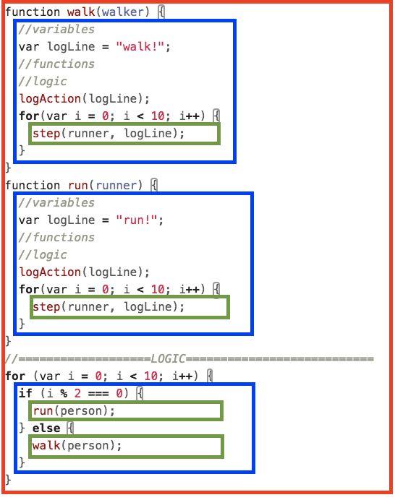
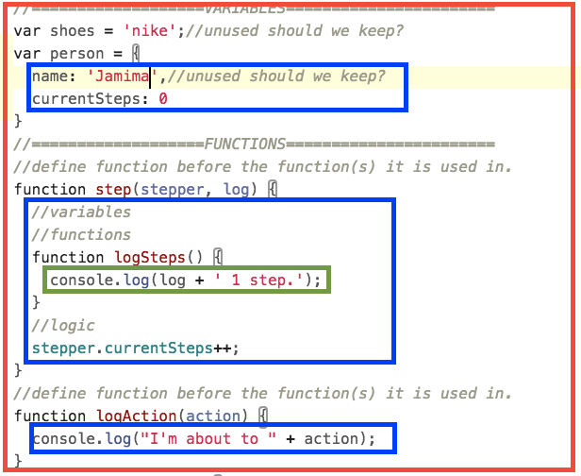
Indentation helps us read

Slide 6
Repeating objects
Remember how we said the solution to any repeating code is functions?
Answer for repeating objects: constructor! Look at no-constructor.js
Why is no constructor hard to debug?

Slide 7
Object constructors!
Vocabulary: the object definition we have gone over already as “Object literals”
Object literals create only one object
Object constructors are another way of creating objects using a function
Code standards: we name constructors starting with a capital (e.g. function SomeConstructor () {})
We also call these functions using the “new” keyword (e.g. var myObject = new SomeConstructor())
Take a look at constructor.js
How is this helpful in maintaining code?

Slide 8
Review of this!
Remember that horrible thing: this
It becomes really helpful with object constructors.
You can create properties/methods in a constructor by using this.<property or method name>

Slide 9
Thinking in objects
A practice in objects:
When you are sitting at home bored, and also right now try to think of things in your daily life as objects
Think about what properties they have
Think about what methods they have

