Slide 1
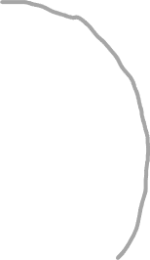

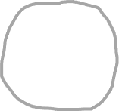






Chronosystem
Macrosystem
Exosystem
Mesosystem
Microsystem
Gov’t
Politics
Peers
School
Child
Family
Church
Culture
Media
Neighbors
Ideology

Slide 2














Latent (unobserved) constructs
Hypothesized causal relationship
Construct
Construct
Construct
Operationalization through measurement
Behavior
Behavior
Behavior
Behavior
Operationalized (observable) variables

Slide 3



Framework
Theory
Computational model
Statistical model

Slide 4






































*

