Slide 1






Our tea experiment
All tea drinkers
Milk first
Sample of tea drinkers
Tea quality rating
Tea first

Slide 2


milk ordering
tea quality

Slide 3
7
Rating
1
Tea-first (T)
Milk-first (M)

Slide 4


Estimation
“best” normal distribution
7
Probability
Rating
θ_{M}
1
θ_{M} is the mean of the best-fitting normal distribution

Slide 5


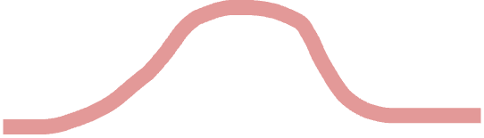
The maximum likelihood curve is the one that maximizes the likelihood of all the points
Probability
Substantially worse curve
Likelihood of an individual point
1
7
Rating

Slide 6
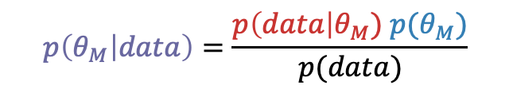
likelihood
prior
posterior
$$p\left(θ_{M} | data\right)=\frac{p\left(data\right|θ_{M}) p(θ_{M})}{p(data)}$$

Slide 7
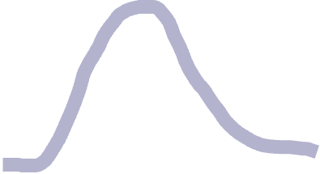

Prior expectation that ratings will be low
Posterior reflects combination of prior and likelihood
Probability
Likelihood
1
7
Rating

Slide 8

With a weak prior, posterior is closer to likelihood
Weak prior expectations about ratings
Probability
1
7
Rating

Slide 9
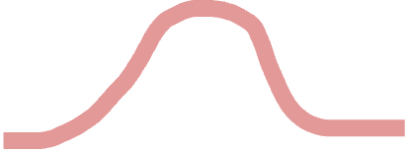
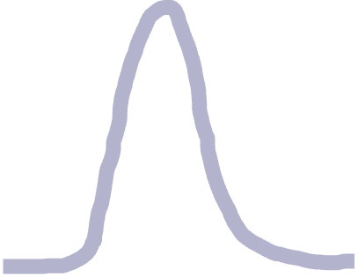
With more data, posterior mean is closer to maximum likelihood mean
Low prior
Probability
1
7
Rating

Slide 10
Estimating the average treatment effect:
β = θ_{M} - θ_{T}
7
θ_{M}
Rating
θ_{T}
β
1
Tea-first (T)
Milk-first (M)

Slide 11
From effect to effect size
Summarize effect with units given by the original rating scale (points of difference in rating
7
Rating
θ_{M}
θ_{T}
2
1
Tea-first (T)
Milk-first (M)
Rating difference
0
-2

Slide 12

Summarize effect with units given by the original rating scale (points of difference in rating)
Divide by standard deviation to get effect size (comparable to other studies with different measures)
7
2
1
Rating
θ_{M}
θ_{T}
Rating difference
Effect size (d)
0
0
1
-2
-1
Tea-first (T)
Milk-first (M)

Slide 13
7
Rating
1
Age (years)

Slide 14

Distance from mean age
θ_{A}
Distance from mean rating
7
Rating
θ_{M}
1
Age (years)

Slide 15
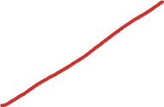


Age distribution
θ_{A}
σ_{A}
7
Rating
θ_{M}
Rating distribution
σ_{M}
1
Age (years)

Slide 17
Run the experiment many times
no effect
ATE from the experiment we just ran
-1
0
1
average treatment effect
β

Slide 18
Run the experiment many times
no effect
-1
0
1
average treatment effect
β

Slide 19

Run the experiment many times
no effect
Distribution of treatment effects
-1
0
1
average treatment effect
β

Slide 20
Run the experiment many times
no effect
Distribution of treatment effects (N=9)
-1
0
1
average treatment effect
β

Slide 21

Run the experiment many times
no effect
Distribution of treatment effects (N=9/group)
Small
experiment
-1
1
Distribution of treatment effects (N=24/group)
Medium experiment
-1
0
1
average treatment effect β

Slide 22

Run the experiment many times
no effect
Distribution of treatment effects (N=9/group)
Small
experiment
-1
1
Distribution of treatment effects (N=200/group)
Big experiment
-1
0
1
average treatment effect β

Slide 23
Run the experiment many times
no effect
Small
experiment
On average, treatment effect is the same for small experiments and big experiments. But small experiments are much noisier in any individual instance…
-1
1
Big experiment
-1
0
1
average treatment effect β

