Slide 1

no effect
Distribution of treatment effects (N=9)
-1
0
1
average treatment effect
β

Slide 2

On average, treatment effect is the same for small experiments and big experiments. But small experiments are much noisier in any individual instance.
no effect
Small sample size
-1
1
Big sample size
-1
0
1
average treatment effect β

Slide 3
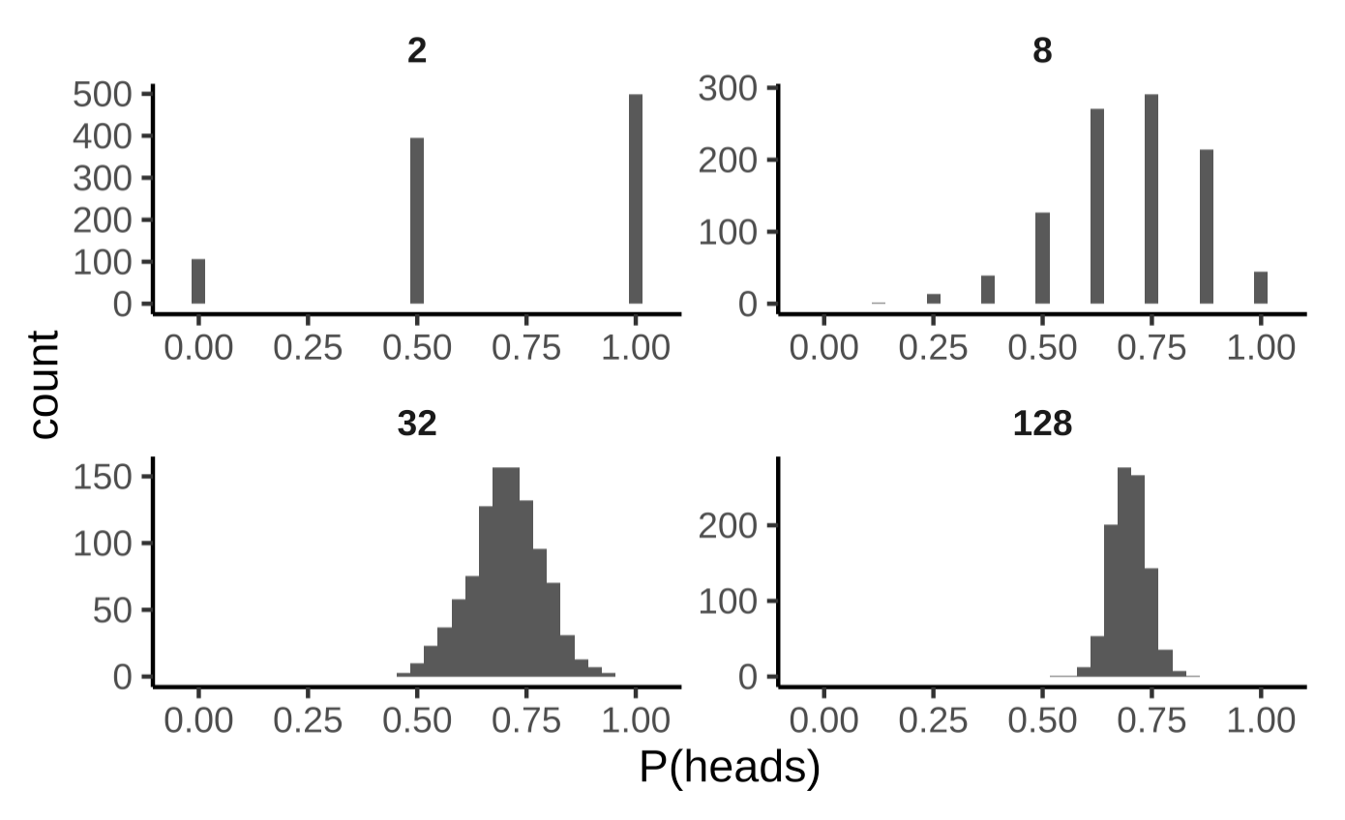



Proportion
0 .5 1

Slide 4



N=2
N=8
Proportion
0 .5 1
0 .5 1
N=32
N=128
0 .5 1
0 .5 1

Slide 5
Treatment has no effect
no effect
-1
0
1
average treatment effect

Slide 6
Treatment has no effect
no effect
-1
0
1
average treatment effect

Slide 7

Treatment has no effect
no effect
Null distribution (N=9/group)
-1
0
1
average treatment effect

Slide 8
Treatment has no effect
no effect
Likelihood of particular treatment effect under the null distribution
-1
0
1
average treatment effect

Slide 9




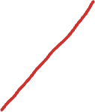

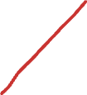
Treatment has no effect
2.5%
97.5%
no effect
-1
0
1
average treatment effect
Likelihood of all observations in these two regions is 5%

Slide 10




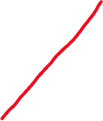
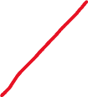
Treatment has no effect
2.5%
97.5%
no effect
-1
0
1
average treatment effect
Likelihood of all observations in this region is 5%

Slide 11

Treatment has no effect
2.5%
97.5%
no effect
-1
0
1
average treatment effect
Likelihood of all observations in this region is 95%

Slide 12
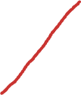
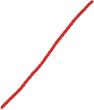
Treatment has no effect
2.5%
97.5%
no effect
-1
0
1
average treatment effect
p value: likelihood of observed data (or any more extreme) under the null distribution

Slide 13
Treatment has no effect
2.5%
97.5%
no effect
p < .05 in this region
p < .05 in this region
-1
0
1
average treatment effect
p value: likelihood of observed data (or any more extreme) under the null distribution

Slide 14
Likelihood under the null
2.5%
97.5%
no effect
-1
0
1
average treatment effect

Slide 15
Likelihood under the null
2.5%
97.5%
no effect
ATE from the experiment we just ran
-1
0
1
average treatment effect

Slide 16


Likelihood under the null
2.5%
97.5%
no effect
ATE from the experiment we just ran
-1
0
1
average treatment effect
P-value: likelihood of this ATE or any more extreme under the null
… In this case, p > .05

Slide 17
Likelihood under the null
2.5%
97.5%
no effect
Alternative ATE, p < .05
-1
0
1
average treatment effect
Notice how extreme the effect has to be to get to p < .05… that’s because the sample is small!

Slide 18

Likelihood under the null
2.5%
97.5%
no effect
Bigger sample size leads to a tighter null distribution!
-1
0
1
average treatment effect

Slide 19
Likelihood under the null
2.5%
97.5%
no effect
ATE from our experiment again
-1
0
1
average treatment effect

Slide 20
Likelihood under the null
2.5%
97.5%
no effect
ATE from our experiment again
-1
0
1
average treatment effect
P-value: likelihood of this ATE or any more extreme under the null
… in this case, very small, so p < .05

Slide 21
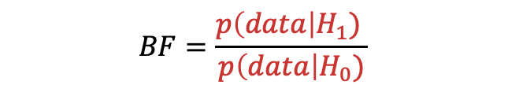
Likelihood of data under hypothesis of non-zero difference in ability
$$BF=\frac{p\left(data\right|H_{1}) }{p\left(data\right|H_{0})}$$
Likelihood of data under null hypothesis of zero difference

Slide 22
2
1
Rating difference
Effect size (d)
0
0
-2
-1
Alternative framework for inference: compute an interval around the estimate – 95% of the time will contain population parameter
95% CI not crossing zero is the same as p < .05, but the emphasis is on the estimate and your uncertainty!

Slide 23

7
2
Rating
Rating difference
0
1
-2
Tea-first (T)
Milk-first (M)

Slide 24
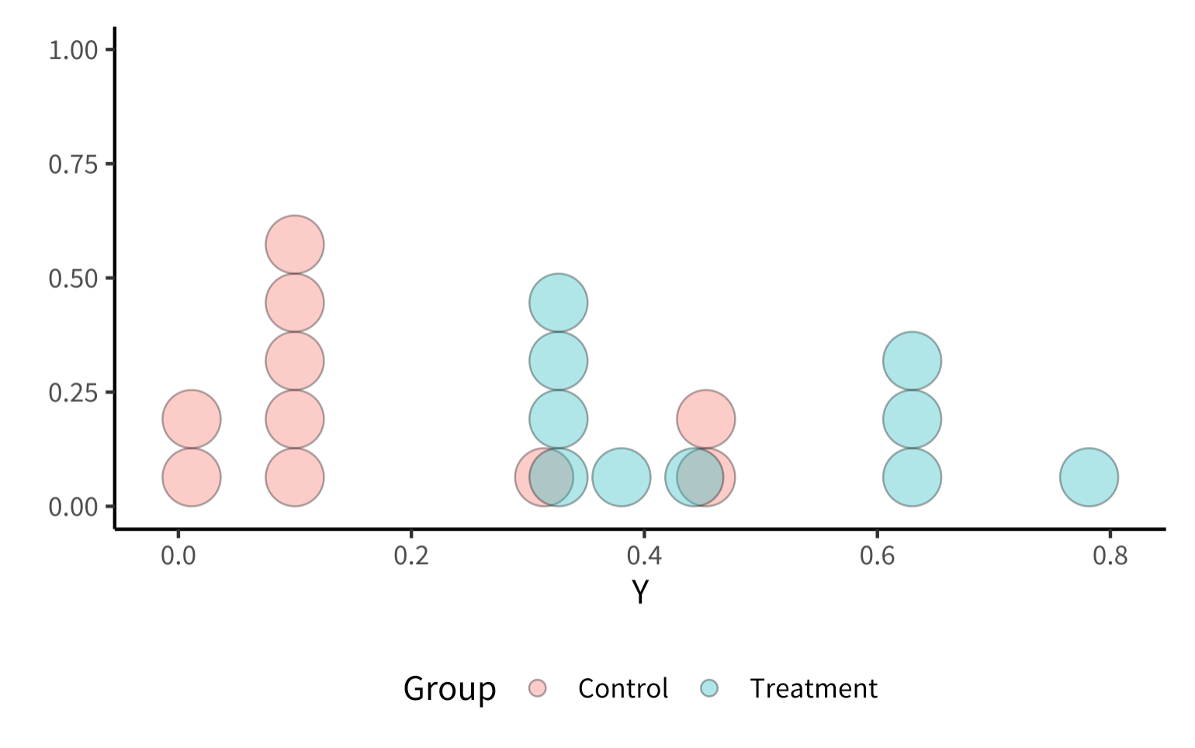
7
Rating
1
Tea-first (T)
Milk-first (M)

