Slide 1



Discrete, two-level design
Discrete, three-level design
Continuous design
Outcome
0 1
Control
Treatment
Control T1 T2
0 1 2 3 4
Condition
Condition
Treatment dosage

Slide 2
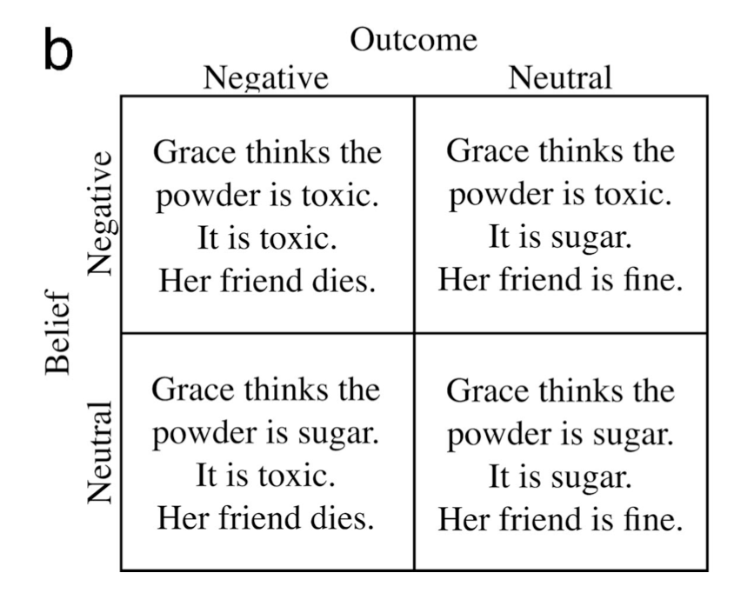

Outcome
Negative
Neutral
Grace thinks the powder is toxic. It is toxic. Her friend dies.
Grace thinks the powder is toxic. It is sugar. Her friend is fine.
Negative
Belief
Grace thinks the powder is sugar. It is toxic. Her friend dies.
Grace thinks the powder is sugar. It is sugar. Her friend is fine.
Neutral

Slide 3
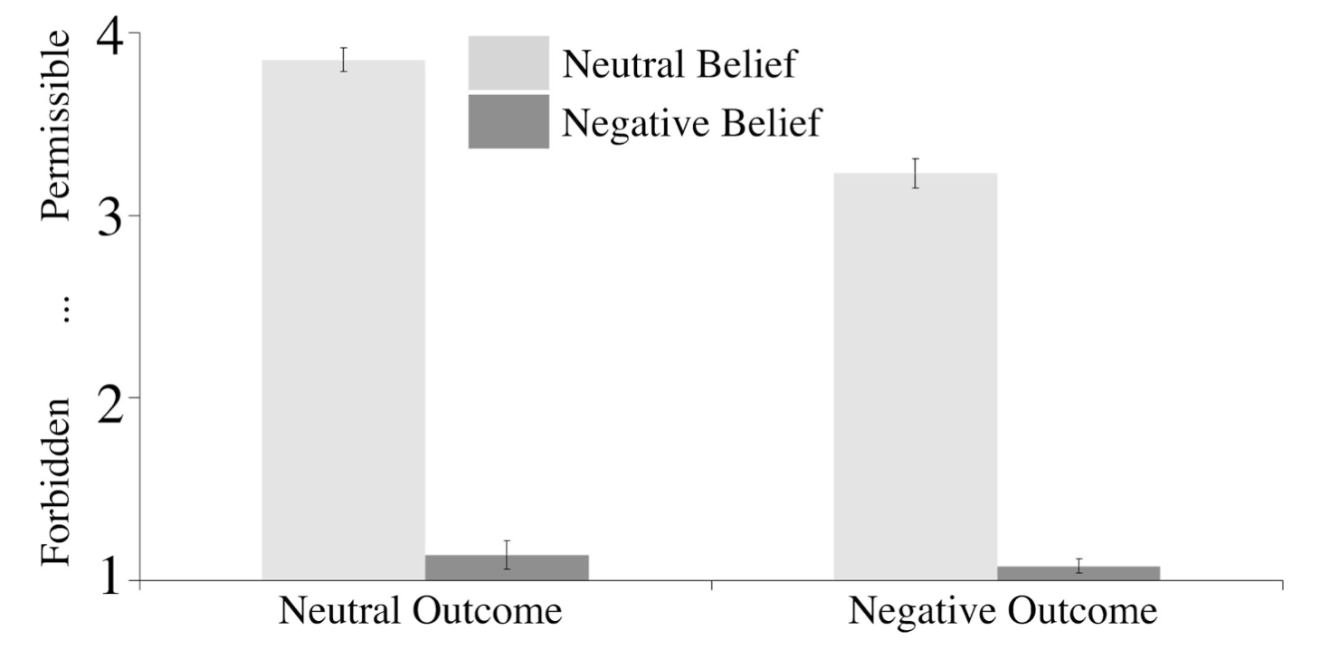







Simple effects
interaction effect
$$β_{B,−O}$$
$$β_{−B,O}$$
$${β_{−B,O}+β_{B,−O}+β}_{−B,−O}$$

Slide 4
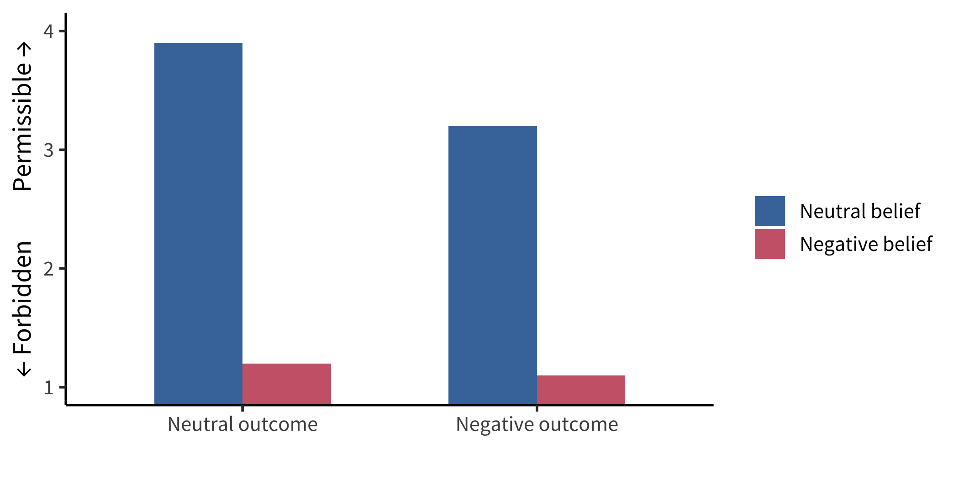






Simple effects
$$β_{B,−O}$$
interaction effect
$$β_{−B,O}$$
$${β_{−B,O}+β_{B,−O}+β}_{−B,−O}$$

