Slide 1
Between
Within
Main advantage
No contamination by other exposure to experimental materials
Disadvantages
Requires many participants
Individual differences create a lot of variability in groups
Potential for assignment bias: need to control for differences between groups
Other environmental group differences
Main advantage
Eliminates subject variability
Relatively few participants needed, because of this lack of variability
Disadvantages
Carryover effects mean that ordering of conditions can be problematic
Not always possible
General contention: preferable when possible

Slide 2
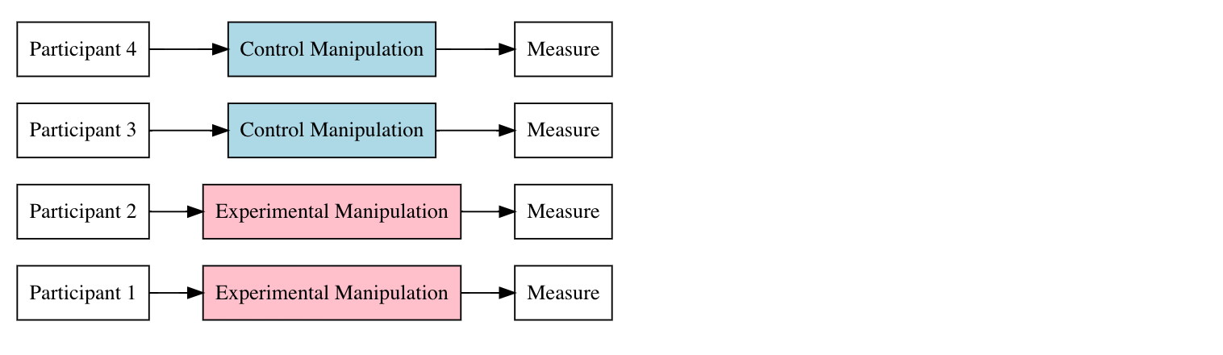




Control
Measure
Control
Measure
Treatment
Measure
Treatment
Measure

Slide 3
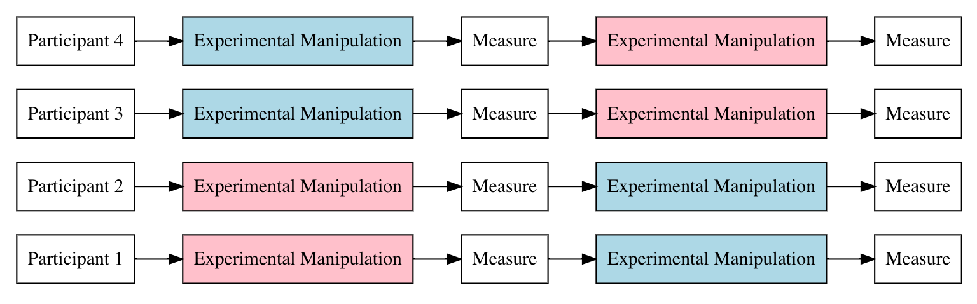

Control
Measure
Treatment
Measure
Control
Measure
Treatment
Measure
Treatment
Measure
Control
Measure
Treatment
Measure
Control
Measure

Slide 4
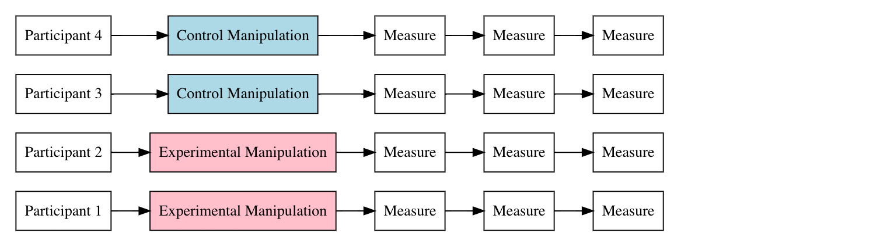
Control
Measure
Measure
Measure
Control
Measure
Measure
Measure
Treatment
Measure
Measure
Measure
Treatment
Measure
Measure
Measure

Slide 5
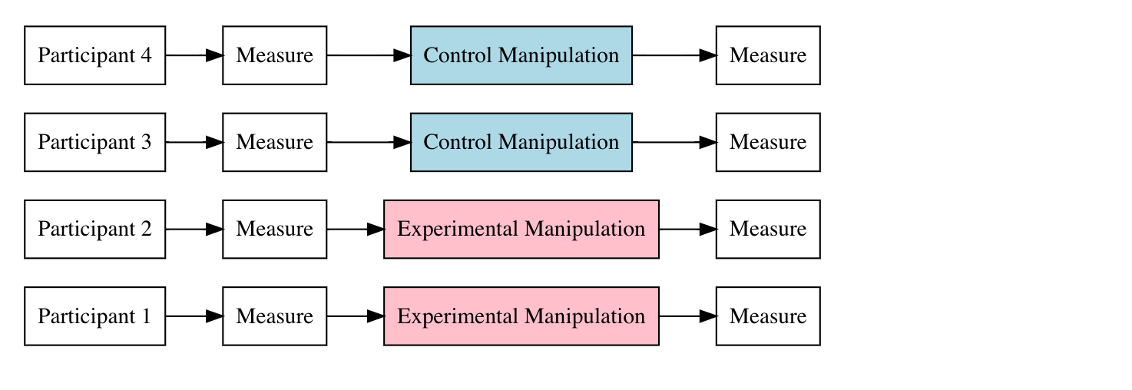
Measure
Control
Measure
Measure
Control
Measure
Measure
Treatment
Measure
Measure
Treatment
Measure

