Slide 1
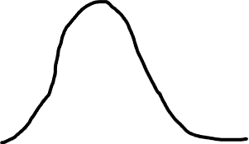


Small sample size
Larger sample size
Distribution under null (H₀)
Distribution under null (H₀)
Larger sample yields a tighter null distribution and lower significance threshold
Significance threshold (values unlikely under null)
Significant effects under the null
Probability
Distribution under alternative (H₁)
Distribution under alternative (H₁)
Larger sample yields a greater proportion of significant effects, even with the same effect size
Power is the proportion of significant effects given a true known effect
Effect size

