Slide 1
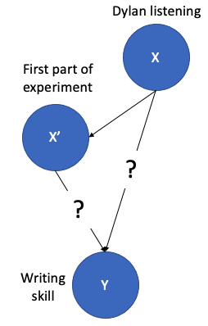



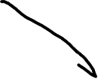

Condition assignment
More money
Later time
Happiness
Money
Happiness

Slide 2



Condition assignment
More money
Later time
Happiness
Money
Happiness

Slide 3







Education
Randomization removes all unknown confounds
Friends
Money
Happiness
Money
Happiness

