Slide 1
Raw data
Unaltered analog data
(e.g., paper surveys)
Digitization
Raw digital data
Data in their most basic digital form (e.g., videos or experiment software output)
Processing
Processed data
Data after initial cleaning and preprocessing (e.g., spreadsheets)
Analysis
Quantitative results
Figures, tables, and numeric values
Dissemination
Research reports
Papers, posters, slides

Slide 2




Your work
Merging the branch back in to main
Starting a new branch
Main branch
Someone else’s work
A single commit on the main branch

Slide 3
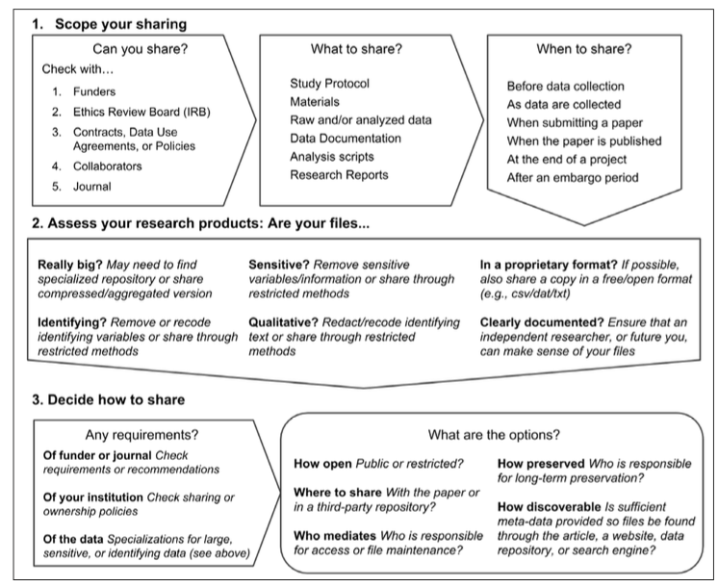
Can you share / must you share?
Check with…
Collaborators
Ethics Review Board
Contracts or data use agreements
Journal
Funders
What can you share?
Study protocol
Materials
Raw data
Documentation
Analysis scripts
Research reports
When to share?
As data are being collected
When submitting a paper
When the paper is published
After an embargo period
How to share?
Select a FAIR repository
Check for…
Access controls for sensitive data
Size restrictions

