Slide 1





 |  | Dataset
 |  | Same | Different
Analysis | Same | Reproducible | Replicable
 | Different | Robust
Dataset
Same
Different
Same
Reproducible
Replicable
Analysis
Different
Robust

Slide 2
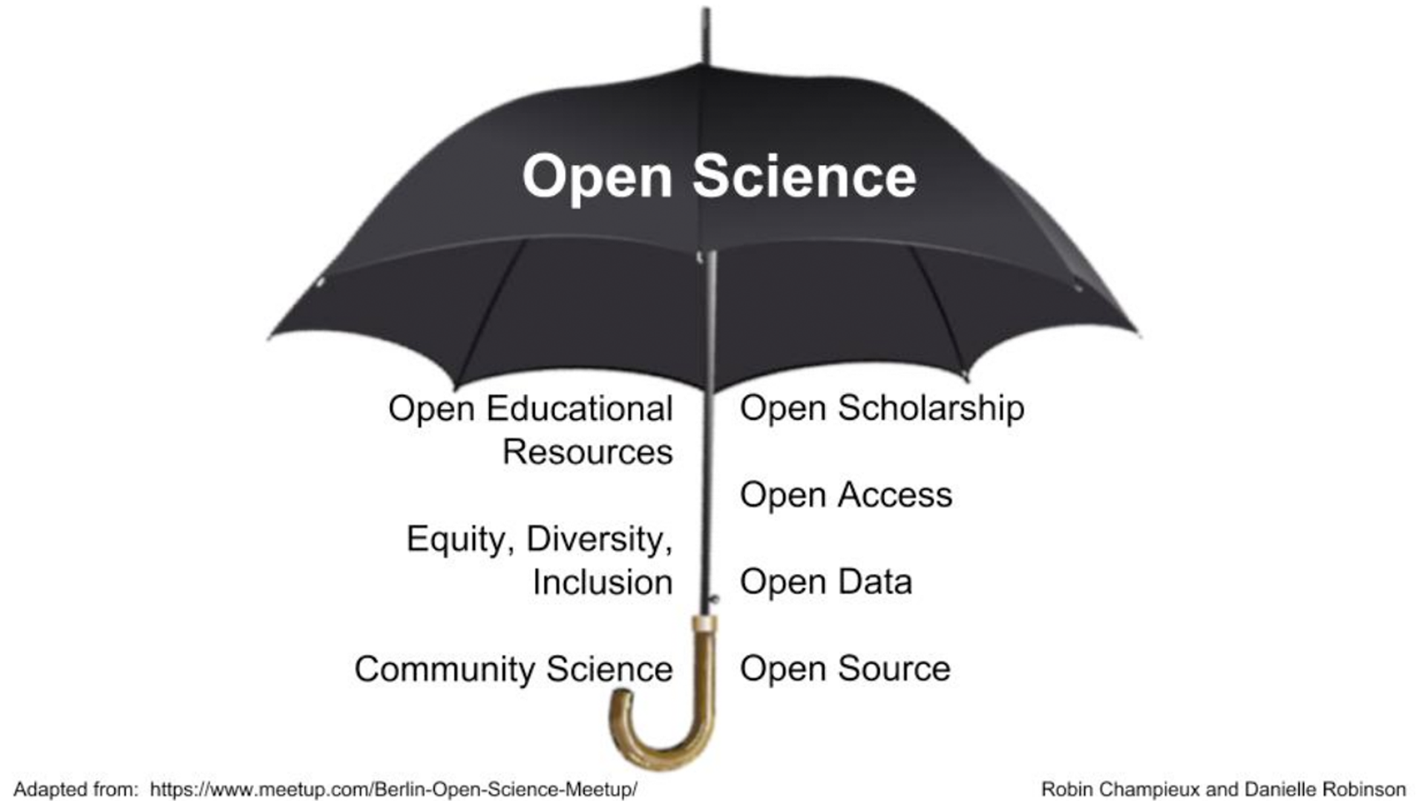











Open Science
Open Educational Resources
Equity, Diversity, and Inclusion
Citizen Science
Open Scholarship
Open Access
Open Source
Open Data

