Slide 1




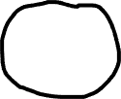

Similarity
Generalization
Pairwise similarity
judgments
Generalization measure

