Slide 1

ETHER
BLOCK
SMART
AETHER
Notes:
https://jmchoppergunnernl.deviantart.com/art/Assassin-s-Creed-III-Abstergo-Sans-Lite-Font-386322384

Slide 2
ETHER

Slide 3
ETHER
BLOCKCHAIN . SMART CONTRACT

Slide 4
ETHER
BLOCKCHAIN . SMART CONTRACT

Slide 5

TIMELINE
20th Jun *Proposal Submission*
16th to 21th Aug *Acceptance*
1 11th Jun
2 25th Jun
3 9th Jul
4 23rd Jul
5 6th Aug
6 20th Aug
NON-TECHNICAL
Proposal Draft
Wiki Page
GitHub Repo
Software Installation
Resource Learning
W3 JavaScript development
Metamask Integration
W3 JavaScript development
Metamask Integration
Custom RPC environment
Peer 2 Peer testing over school network
Database setup and establish connection to store Ethereum transactions
Custom RPC environment
Peer 2 Peer testing over school network
Database setup and establish connection to store Ethereum transactions
Proposal Draft
Wiki Page
GitHub Repo
Software Installation
Resource Learning
29th Oct *Poster*
12 5th Nov
10 15th Oct
9 1st Oct
8 17th Sep
11 29th Oct
Continue work on react native applications
Educational aspects of application
Standardize UI
Testing/Buffer
7 3rd Sep
Continue work on react native applications
Educational aspects of application
Ethereum backend for KYC verification
Continue on react native applications
Ethereum backend for KYC verification
Continue on react native applications
Implementation of biometrics APIs (Facial Recognition)
Start on react native applications
Implementation of biometrics APIs (facial recognition)
Start on react native applications
Poster Submission
Testing/Buffer
Preparation for submission
Trial Demo
27th Nov
*Finals Presentation*
Final adjustment
Preparation for live demo
13 12th Nov
14 19th Nov

Slide 6
TIMELINE
20th Jun *Proposal Submission*
16th to 21th Aug *Acceptance*
1 11th Jun
2 25th Jun
3 9th Jul
4 23rd Jul
5 6th Aug
6 20th Aug
NON-TECHNICAL
NON-TECHNICAL
NON-TECHNICAL
NON-TECHNICAL
ACCOUNT MANAGEMENT MODULE
NON-TECHNICAL
UAT #1
Reviews for UAT
Integration & Deployment of Application
Peer 2 Peer testing over school network
Prepare for acceptance
Proposal Draft
Wiki Page Prototype 1
Resource Learning
Finalise Wiki Page Design
Set-up GitHub Repo
Software Installation
Mid-fi Prototype
Technical Research
W3 JavaScript development
Metamask Integration
Admin:
>Login
>Agent Management
>Access Control
>Logout
Database Setup
Prepare for UAT #1
Post Acceptance Review
Establish connection to store Ethereum transactions
ACCOUNT MANAGEMENT MODULE
Agent:
>Login
>Consumer Account Creation
SECURITY MODULE
KYC Authentication
CAS Persistent to Blockchain
Start on Facial Recognition API
SECURITY MODULE
Central Authentication System
KYC Authentication
CAS Persistent to Blockchain
SECURITY MODULE
Central Authentication System
KYC Authentication

Slide 7
TIMELINE
20th Jun *Proposal Submission*
16th to 21th Aug *Acceptance*
1 11th Jun
2 25th Jun
3 9th Jul
4 23rd Jul
5 6th Aug
6 20th Aug
7 3rd Sep
8 17th Sep
NON-TECHNICAL
NON-TECHNICAL
NON-TECHNICAL
NON-TECHNICAL
NON-TECHNICAL
NON-TECHNICAL
ACCOUNT MANAGEMENT MODULE
NON-TECHNICAL
UAT #1
Reviews for UAT
Integration & Deployment of Application
Peer 2 Peer testing over school network
Prepare for acceptance
Proposal Draft
Wiki Page Prototype 1
Resource Learning
Finalise Wiki Page Design
Set-up GitHub Repo
Software Installation
Mid-fi Prototype
Technical Research
W3 JavaScript development
Metamask Integration
Admin:
>Login
>Agent Management
>Access Control
>Logout
Database Setup
Prepare for UAT #1
Post Acceptance Review
Establish connection to store Ethereum transactions
Start on React Native Application
Prepare for UAT #2
Test in class
Continue on react native applications
ACCOUNT MANAGEMENT MODULE
SECURITY MODULE
Implement Facial Recognition
Integrating Existing APIs:
>Verify KYC ID with CAS
>Customer Account Creation
Wallet/Hash Transaction
Agent:
>Login
>Consumer Account Creation
SECURITY MODULE
KYC Authentication
CAS Persistent to Blockchain
Start on Facial Recognition API
SECURITY MODULE
Integrating Existing APIs:
>Customer Account Creation
>Deposit Account Creation
Wallet/Hash Transaction
SECURITY MODULE
Central Authentication System
KYC Authentication
CAS Persistent to Blockchain
SECURITY MODULE
Central Authentication System
KYC Authentication

Slide 8
8th – 15th Oct *Midterm Milestone*
29th Oct: Poster
9 1st Oct
10 15th Oct
11 29th Oct
12 5th Nov
13 12th Nov
14 19th Nov
NON-TECHNICAL
NON-TECHNICAL
NON-TECHNICAL
NON-TECHNICAL
NON-TECHNICAL
Prepare for Midterm
UAT #2
Reviews for UAT
Integration & Deployment of Application
Prepare for Poster
Integration & Deployment of Application
Start on Learning Aspect of Project
NON-TECHNICAL
Prepare for Final
Project Review and Clean up
Final Integration & Deployment
Integration & Deployment of Application
Start on Learning Aspect of Project
Prepare UAT #3
Start on Lab/Admin Guide
Integration & Deployment of Application
UAT #3
Reviews for UAT
Poster Submission
Integration & Deployment of Application
Final Test on All Modules
27th Nov
*Finals Presentation*
SECURITY MODULE
Review and make adjustment to Security Module
Integrating Existing APIs:
>Customer Account Creation
>Deposit Account Creation
Wallet/Hash Transaction
SECURITY MODULE
ACCOUNT MANAGEMENT MODULE
ACCOUNT MANAGEMENT MODULE
Integrating Existing APIs:
>TOKEN/PIN
Storing/Hash Meta-data and image
SECURITY MODULE
Review and make adjustment to Account Management Module
Storing/Hash Meta-data and image
Traceability & Accounting of Previous Blockchain Transaction
DYNAMIC REQUIREMENTS MODULE
DYNAMIC REQUIREMENTS MODULE
LEARNING MODULE
SECURITY MODULE
Integrating Existing APIs:
>Customer Account Creation
>Deposit Account Creation
Wallet/Hash Transaction
Multiple Language Support for Account Management Module
Smart Contract View: String/Hash on Blockchain
Multiple Language Support for Account Management Module
Smart Contract View: String/Hash on Blockchain
DYNAMIC REQURIEMENTS MODULE
GAMIFICATION
Multiple Language Support for Account Management Module
LEARNING MODULE
LEARNING MODULE
LEARNING MODULE
GAMIFICATION
GAMIFICATION
GAMIFICATION

Slide 9
13 12th Nov
14 19th Nov
NON-TECHNICAL
NON-TECHNICAL
Poster Submission
Integration & Deployment of Application
Final Test on All Modules
Prepare for Final
Project Review and Clean up
Final Integration & Deployment
27th Nov
*Finals Presentation*
ACCOUNT MANAGEMENT MODULE
Traceability & Accounting of Previous Blockchain Transaction
LEARNING MODULE
GAMIFICATION

Slide 10
TIMELINE
20th Jun *Proposal Submission*
16th to 21th Aug *Acceptance*
1 11th Jun
2 25th Jun
3 9th Jul
4 23rd Jul
5 6th Aug
6 20th Aug
NON-TECHNICAL
NON-TECHNICAL
ACCOUNT MANAGEMENT MODULE
NON-TECHNICAL
NON-TECHNICAL
NON-TECHNICAL
Proposal Draft
Wiki Page Prototype 1
Resource Learning
Finalise Wiki Page Design
Set-up GitHub Repo
Software Installation
Mid-fi Prototype
Technical Research
Prepare for UAT #1
UAT #1
Reviews for UAT
Integration & Deployment of Application
Peer 2 Peer testing over school network
Prepare for acceptance
Post Acceptance Review
Establish connection to store Ethereum transactions
W3 JavaScript development
Metamask Integration
Admin:
>Login
>Agent Management
>Access Control
>Logout
Database Setup
ACCOUNT MANAGEMENT MODULE
Agent:
>Login
>Consumer Account Creation
SECURITY MODULE
KYC Authentication
CAS Persistent to BlockChain
Start on Facial Recognition API
SECURITY MODULE
SECURITY MODULE
Central Authentication System
KYC Authentication
Central Authentication System
KYC Authentication
CAS Persistent to BlockChain
1 11th Jun
2 25th Jun
3 9th Jul
4 23rd Jul
5 6th Aug
6 20th Aug
NON-TECHNICAL
NON-TECHNICAL
NON-TECHNICAL
NON-TECHNICAL
NON-TECHNICAL
29th Oct *Poster*
12 5th Nov
10 15th Oct
9 1st Oct
8 17th Sep
11 29th Oct
Continue work on react native applications
Educational aspects of application
Standardize UI
Testing/Buffer
7 3rd Sep
Continue work on react native applications
Educational aspects of application
Ethereum backend for KYC verification
Continue on react native applications
Ethereum backend for KYC verification
Continue on react native applications
Implementation of biometrics APIs (Facial Recognition)
Start on react native applications
Implementation of biometrics APIs (facial recognition)
Start on react native applications
Poster Submission
Testing/Buffer
Preparation for submission
Trial Demo
27th Nov
*Finals Presentation*
Final adjustment
Preparation for live demo
13 12th Nov
14 19th Nov

Slide 11

ETHER
SCOPE
ACCOUNT MANAGEMENT MODULE:
Admin
Login
Agent Management
Access Control
Agent
Login
Consumer Account Creation
Logout
CENTRAL AUTHENTICATION SYSTEM
KYC AUTHENTICATION
CAS PERSISTENT TO BLOCKCHAIN
FACIAL RECOGNITION AS 2FA
INVOKE EXISTING TBANK FUNCTIONS:
VERIFY KYC ID WITH CAS (REST API VIA BW)
CUSTOMER ACCOUNT CREATION
DEPOSIT ACCOUNT CREATION
TOKEN/PIN
CORE
SECONDARY
WALLET/HASH TRANSACTION
STORING/HASH META-DATA AND IMAGE
LEARNING MODULE(GAMIFICATION)
TRACEABILITY AND ACCOUNTING OF PREVIOUS BLOCKCHAIN TRANSACTION
MULTIPLE LANGUAGE SUPPORT
SMART CONTRACT VIEW – STRING/ACTUAL HASH ON THE BLOCKCHAIN
TERTIARY
GOOD TO HAVE

Slide 12
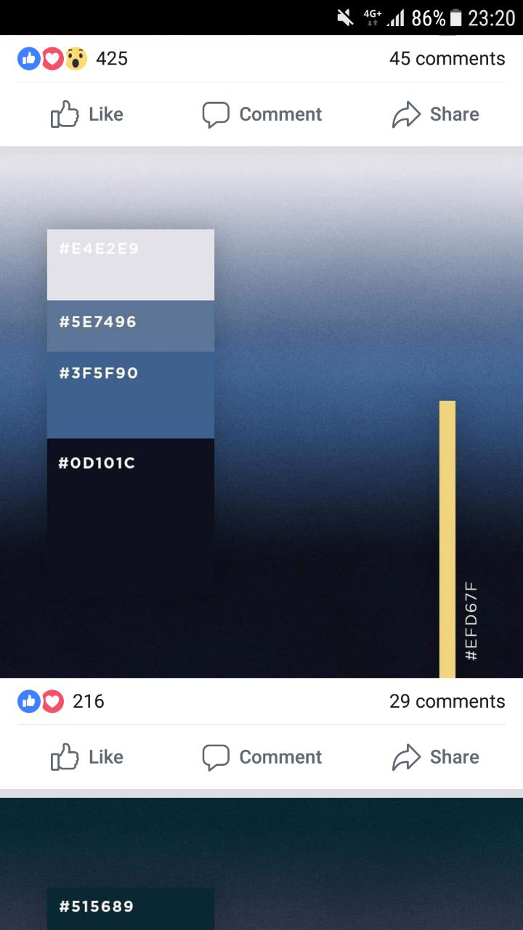
Home
CURRENT ITERATION
UPCOMING MEETINGS
MILESTONES
1
INTERNAL
-
PROPOSAL
ACCEPTANCE
EXTERNAL
-
MIDTERM
OF 14
11th June – 25th June
POSTER
SUPERVISOR
-
FINAL

Slide 13
Description
OUR PROJECT
Project Aether is a web application designed to ease the process for potential SMU tBank customers on-boarding and account creation by leveraging on Blockchain/Ethereum technologies rather than the traditional method. Aether is a solution that can potentially improve the accuracy and efficiency of the Banking Account creation process yet improving the current security measures.

Slide 14
Description
Description
Project Aether is a web application designed to ease the process for potential SMU tBank customers on-boarding and account creation by leveraging on Blockchain/Ethereum technologies rather than the traditional method. Aether is a solution that can potentially improve the accuracy and efficiency of the Banking Account creation process yet improving the current security measures.
Motivation
Blockchain distributed ledger technology has become more prevalent in the market than before. It is going to play an integral role in the future of Banking Industry. As SMU tBank is an academics platform for students to simulate real world banking operations and technology scenarios, it is an advantage to leverage on SMU tBank to integrate blockchain features to gain exposure and grasp the depth of latest technology.

Slide 15
WIKI - FORMAT
HOME
MAIN
MIDTERM
FINAL
ABOUT
ROLES AND RESPONSIBILITIES
PROJECT OVERVIEW
DESCRIPTION AND MOTIVATION
SCOPE
X-FACTOR
STAKEHOLDERS
PROJECT MANAGEMENT
SCHEDULE
METRIC
TASK METRICS
RISK ASSESSMENT METRICS
DOCUMENTATION

Slide 16
CORE
SECONDARY
ACCOUNT MANAGEMENT MODULE:
ADMIN
LOGIN
AGENT MANAGEMENT
ACCESS CONTROL
AGENT
LOGIN
CONSUMER ACCOUNT CREATION
LOGOUT
SECURITY MODULE:
CENTRAL AUTHENTICATION SYSTEM
KYC AUTHENTICATION
CAS PERSISTENT TO BLOCKCHAIN
FACIAL RECOGNITION AS 2FA
INTEGRATING EXISITNG APIs:
VERIFY KYC ID WITH CAS (REST API VIA BW)
CUSTOMER ACCOUNT CREATION
DEPOSIT ACCOUNT CREATION
TOKEN/PIN
DYNAMIC REQUIREMENTS MODULE
MULTIPLE LANGUAGE SUPPORT
SMART CONTRACT VIEW – STRING/ACTUAL HASH ON THE BLOCKCHAIN
TERTIARY
SECURITY MODULE
WALLET/HASH TRANSACTION
STORING/HASH META-DATA AND IMAGE
LEARNING MODULE
(GAMIFICATION)
GOOD TO HAVE
ACCOUNT MANAGEMENT
TRACEABILITY AND ACCOUNTING OF PREVIOUS BLOCKCHAIN TRANSACTION

Slide 17

STAKEHOLDERS
SPONSOR
USERS
New SMU tBank Customer(s)
Students taking financial technology related courses
Prof Alan Megargel,
Senior Lecturer of Information Systems
Project Head, T-bank and Special Projects

Slide 18
RISK
Risk Type | Risk Event | Likelihood | Potential Impact | Mitigation Plan
Technical | Unfamiliarity with the Blockchain technology and e-Wallet system | High | High | All team members will undergo a Udemy blockchain course to gain familiarity on how the technology works and the grasp the technical concepts of using an Ethereum blockchain to improve existing applications.
Human | Team Members unavailable due to internships (overseas or local) and work commitments | High | Low | Regular group discussion will take place weekly after members’ working hours. Overseas members will be kept up to date on the progress and allocated respective tasks by the Project Manager. The project codes are segmented into front and back end. Each segment will be handled by minimally two members, to make it clear who will take over in case of unavailability.

