Slide 1
Telecom Churn Prediction
Prepared by:
Judah Odida | Date: JULY 2025

Slide 2
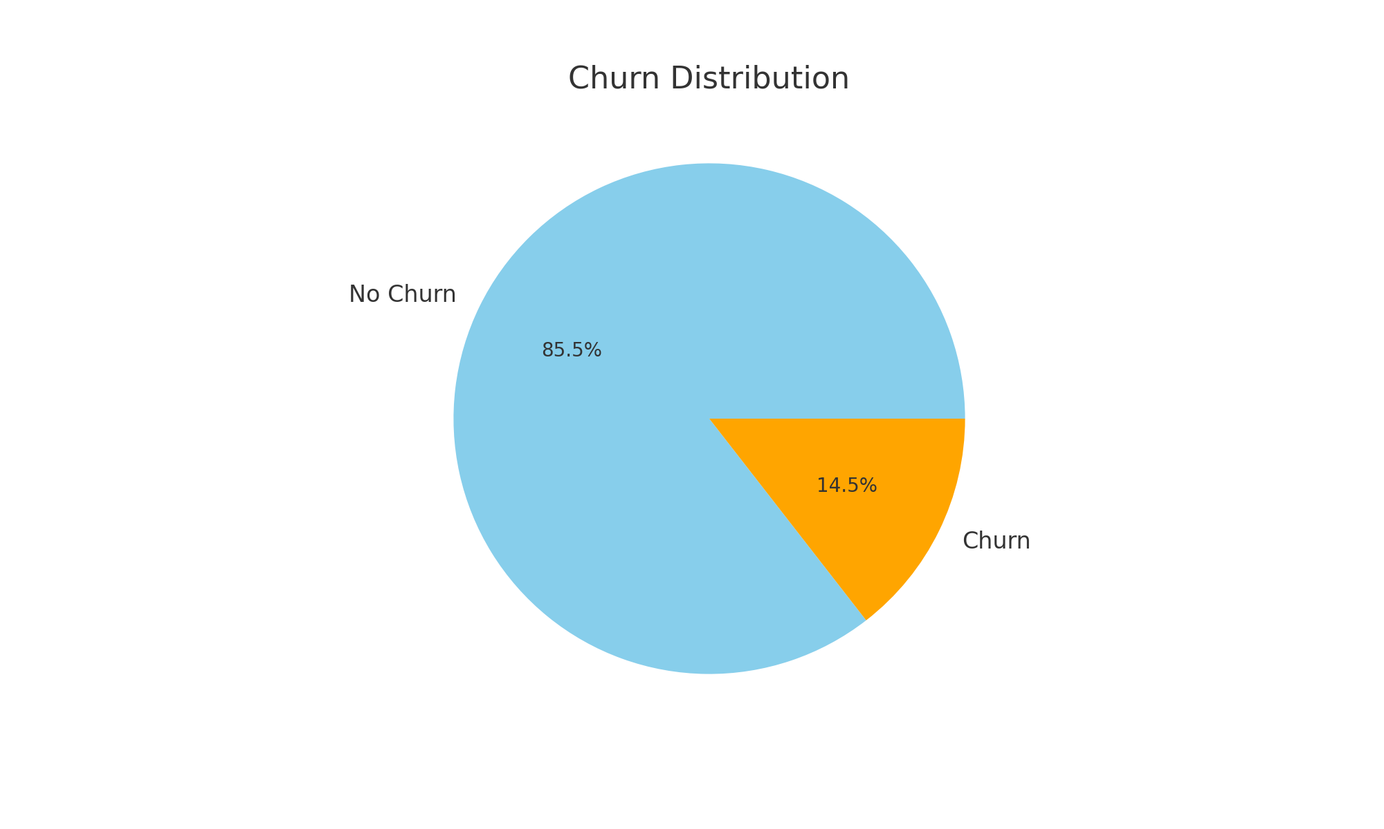
Business Problem
Customer churn impacts revenue & profitability.
Acquiring new customers costs 5x more than retaining existing ones.
Current challenge: High churn without clear drivers.

Slide 3
Project Goal
• Predict customers likely to churn
• Identify top factors influencing churn
• Enable proactive retention strategies

Slide 4
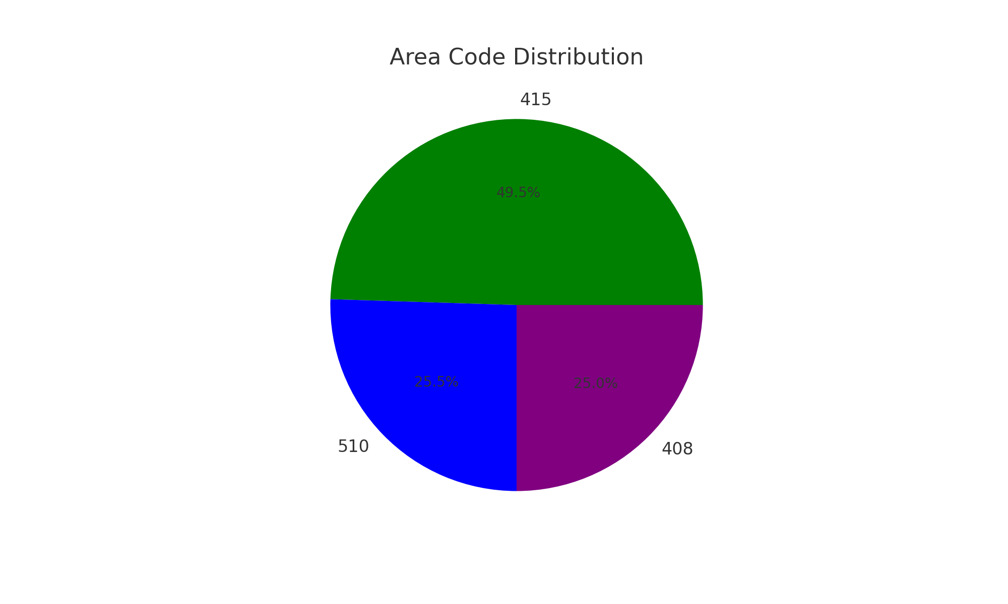
Data Overview
• Dataset: SyriaTel (3,333 customers)
• Features:
- Numeric: Call durations, charges, service calls
- Categorical: State, Area code, Plans
• Target: Churn (Yes/No)

Slide 5
Key Insights from EDA
• Churn Rate: 14.5% (imbalanced data)
• Customers with International Plan churn more
• More service calls = higher churn risk
• Heavy imbalance in area code distribution (415 dominates)

Slide 6
Modeling Approach
3 Models Tested: Logistic Regression, Decision Tree, Random Forest
Addressed imbalance using SMOTE
Evaluated on Accuracy, Recall, AUC

Slide 7
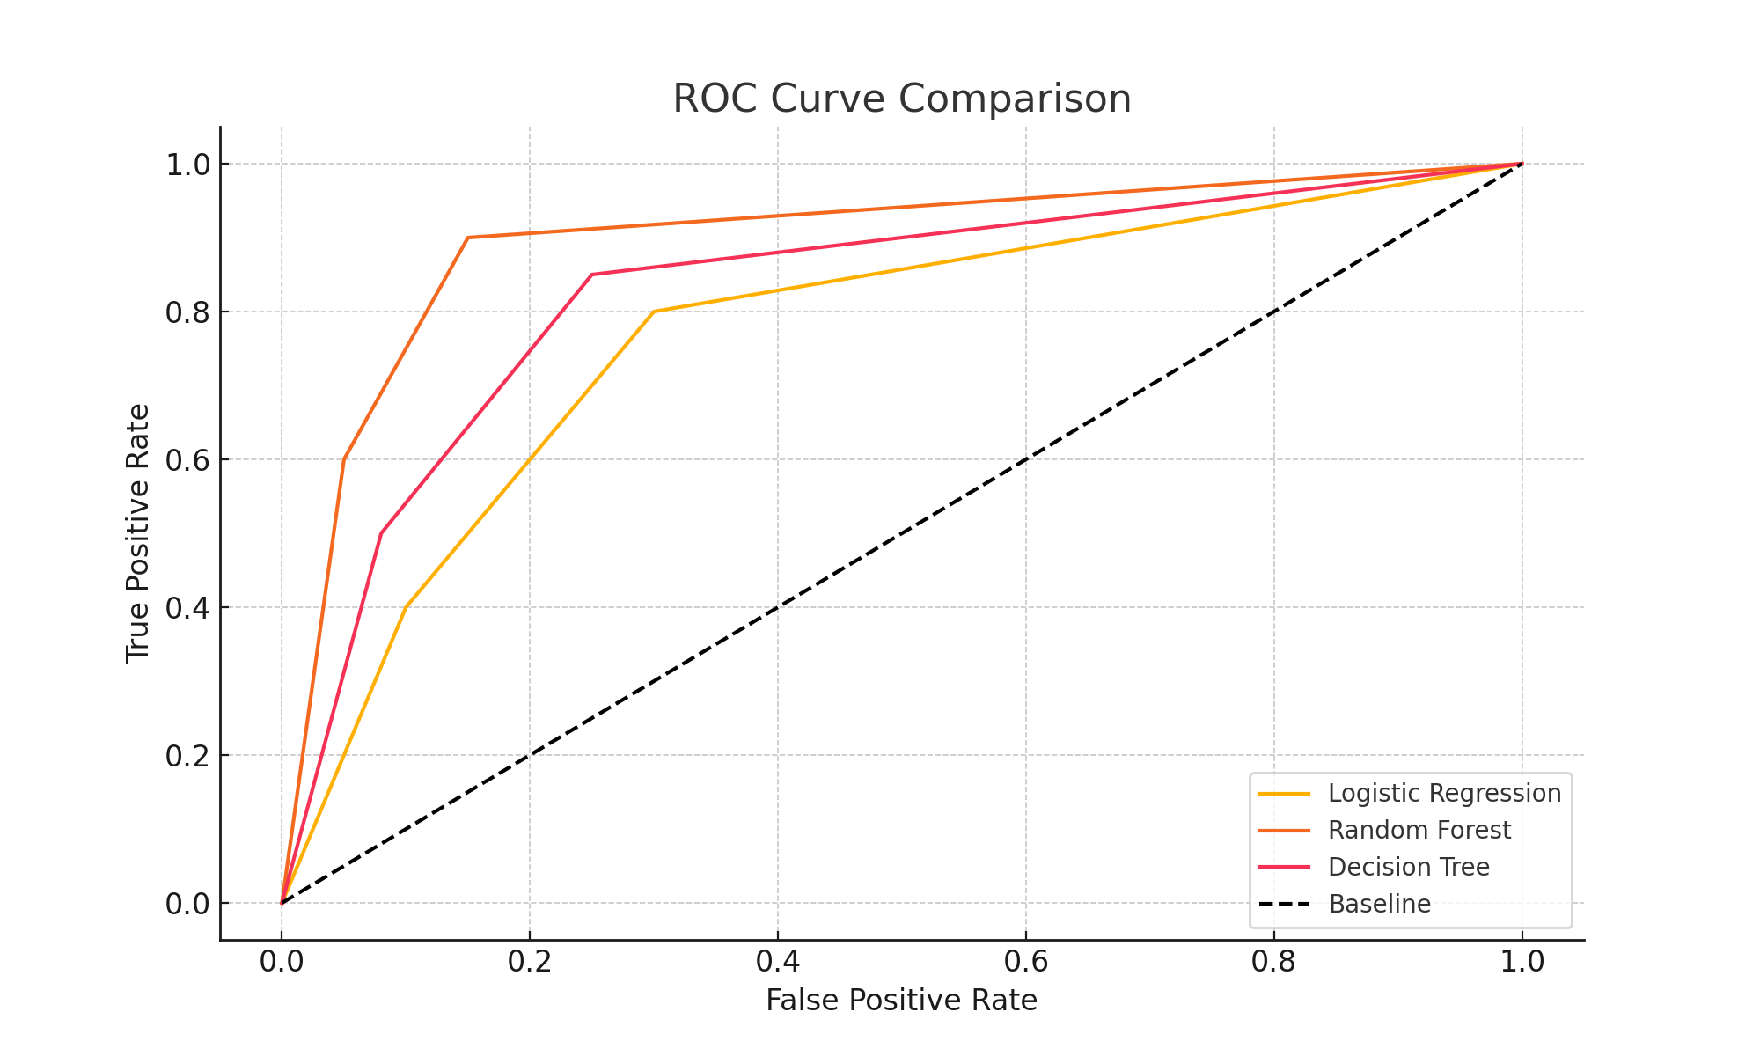
Model Comparison
Logistic Regression: Accuracy=0.88, Recall=0.32, ROC-AUC=0.79
Decision Tree: Accuracy=0.90, Recall=0.64, ROC-AUC=0.82
Random Forest: Accuracy=0.93, Recall=0.64, ROC-AUC=0.88
Winner: Random Forest

Slide 8
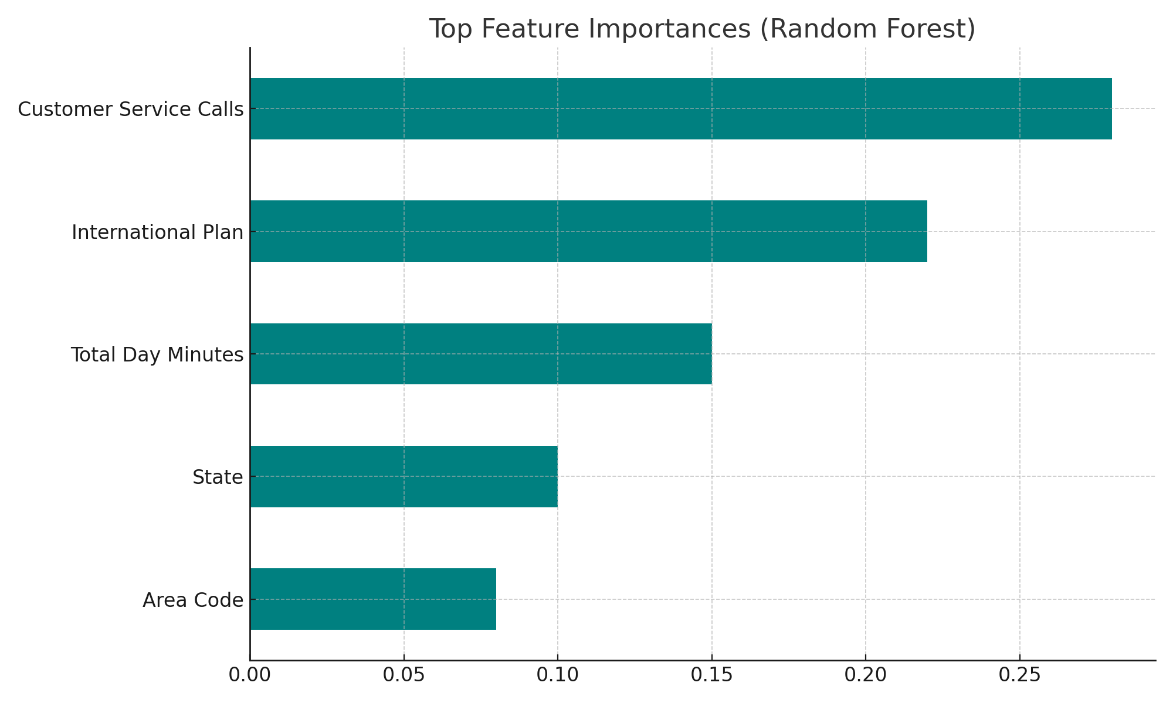
Top Churn Drivers
Customer Service Calls (High dissatisfaction)
International Plan
Daytime Minutes
State & Area Code

Slide 9
Business Recommendations
Proactively reach out to customers with frequent service calls
Review International Plan pricing & support
Implement loyalty offers for high-usage customers
Regional strategies for area code 415

Slide 10
Conclusion & Next Steps
Random Forest deployed as the best model
Enables data-driven retention campaigns
Future Enhancements:
- Deploy prediction dashboard
- Continuous model monitoring

Slide 11
Business Actions & KPIs
Recommended Business Actions:
Proactively monitor high-risk customers (high service calls).
Offer loyalty incentives to customers with international plans.
Review international plan pricing and customer experience.
Create retention campaigns for customers with high usage patterns.
Train customer support teams to resolve issues effectively.
Key KPIs to Track:
Monthly Churn Rate
Retention Rate after Intervention
Customer Satisfaction Score (CSAT)
Average Resolution Time for Complaints
Cost of Retention per Customer

