Slide 1

MANTHAN X FOUNDERS
FLOWRA Insights
Organize. Automate. Accelerate.
· An AI-first operating system for Indian SMEs running Tally / Busy
· Made by Jodidar India, Raipur, Chhattisgarh, India
· Founder: Ankit Sarawgi · Team: Punit · Kritika
· Pitched at: Manthan X Founders
Jodidar India · FLOWRA Insights · Organize. Automate. Accelerate.

Slide 2
Detailed · Slide 2 / 16
The Problem
10 million Indian SMEs run their books on Tally / Busy — and are stuck there.
Tally / Busy were built in the 1990s — desktop-only, single-machine, no analytics layer
Owners can't see live sales, stock, dispatch or salesman performance unless they sit at the office machine
Field salesmen capture orders on paper / WhatsApp → 2–4 day data lag
Dispatch & receivables are manual — papers move from desk to desk
Hindi-English bilingual + low-bandwidth realities are ignored by most SaaS
Indian MSMEs contribute ~30% of GDP. Almost every one of them uses Tally ERP 9 / Tally Prime or Busy as their book of record — but those systems were never designed for the smartphone era. The result is a structural blind-spot: the owner knows what was in his books last Saturday, not what his salesman or godown did this morning.
Jodidar India · FLOWRA Insights · Organize. Automate. Accelerate.

Slide 3
Detailed · Slide 3 / 16
The Opportunity
₹15,000 Cr SME-software TAM in India by 2027.
TAM — 10 M+ active SMEs on Tally / Busy across India
SAM — 1.5 M SMEs with ≥3 employees and a smartphone-using owner
SOM — 50 K early-adopter SMEs in Tier-2 & Tier-3 cities (Year 1 wedge)
Tailwind — Digital India, ONDC, GST 3.0, Account Aggregator → SME digitization is now policy
We are NOT competing with Tally — we sit ON TOP of it. The Tally Sync Agent reads vouchers, stock, masters, ledgers via Tally's own ODBC / TDL XML protocol. Zero workflow change for the accountant. Owner gets the cloud + AI + mobile layer.
Jodidar India · FLOWRA Insights · Organize. Automate. Accelerate.

Slide 4
Detailed · Slide 4 / 16
The Solution — FLOWRA Insights
One cloud layer that sees everything Tally / Busy sees — plus AI on top.
Lightweight Windows agent reads Tally / Busy in real time (no manual export)
Multi-company, multi-branch, multi-FY ready out of the box
Mobile-first dashboards for the owner, salesman, dispatch & CA
AI Insights powered by Gemini & GPT-5 — explains numbers in plain Hindi/English
100% Indian data residency — Mumbai region MongoDB Atlas
Plug-and-play: install agent → log in → 30-second sync of last 3 years of data. The agent auto-updates from our manifest. Every API endpoint enforces tenant isolation; no two customer's data can ever cross.
Jodidar India · FLOWRA Insights · Organize. Automate. Accelerate.

Slide 5
Detailed · Slide 5 / 16
The Suite — 8 Integrated Modules
Each module ships value on day 1; together they replace 6–8 disjoint tools.
1. Sales & Receivables — live aging, top customers, collection nudges
2. Inventory & Stock — ABC, reorder, multi-group filters, PO generation
3. Salesman App — beat plans, daily check-ins, order & payment capture
4. Dispatch Terminal — Kanban board, LR / Bilty upload, porter assignment
5. CA Corner — TDS, GST, balance-sheet reconciliation, journal nudges
6. AI Insights — natural-language Q&A on your own books
Modules share a unified data model — a sales voucher captured by the salesman flows instantly into Sales reports, Dispatch board, CA reconciliation and the Loyalty points ledger. One source of truth, eight surfaces.
7. FLOWRA Tasks — task & workflow assignment across roles
8. FLOWRA Loyalty — built-in customer-rewards engine for SMEs
Jodidar India · FLOWRA Insights · Organize. Automate. Accelerate.

Slide 6
Detailed · Slide 6 / 16
Differentiators
Why not just build it in Tally / Excel / Zoho?
Tally-native — no double-entry, no CSV imports, no workflow change
Bilingual UI — English + Hindi, Tier-2/Tier-3 ready
Multi-tenant SaaS — full data isolation, GST-compliant audit trail
AI layer — GPT-5 + Gemini, explains receivables / inventory in plain language
FLOWRA Tasks & Loyalty — value-adds Tally / Zoho simply don't have
Made-in-India price points — fraction of Salesforce / Zoho One
Competitors fall into 3 camps: (a) Tally add-ons that still need a desktop; (b) global SaaS like Zoho / Salesforce that ignore Tally; (c) standalone ERPs that demand migration. FLOWRA sits in the white-space — Tally-native, cloud-mobile, AI-aware, and priced for India.
Jodidar India · FLOWRA Insights · Organize. Automate. Accelerate.

Slide 7
Detailed · Slide 7 / 16
FLOWRA Tasks — Roles, Reminders, Accountability
A built-in operations layer for the owner and the team.
Assign tasks to salesman, dispatch, CA, or any employee — by name or by role
Recurring tasks (weekly stock count, monthly GSTR, daily bank reco)
Tally-data-aware triggers — auto-create a task when receivables cross a threshold
Mobile push + WhatsApp reminders (roadmap)
Full audit trail — who did what, when, with proof attachment
Tasks isn't a generic to-do list. Every task can be linked to a Tally voucher, customer, or item — so closing a task automatically updates the relevant FLOWRA report. Think Asana, but it actually knows your books.
Jodidar India · FLOWRA Insights · Organize. Automate. Accelerate.

Slide 8
Detailed · Slide 8 / 16
FLOWRA Loyalty — Reward Programs, Built-In
Turn one-time buyers into repeat customers without a separate tool.
Points engine — auto-credit on every Tally sales voucher
Tiers — Silver / Gold / Platinum with tenant-defined rules
Redemption — discount coupon or cash-back against next invoice
Customer-facing WhatsApp / SMS / email card (roadmap)
Owner dashboard — top loyal customers, churn-risk customers, lifetime value
Indian SMEs lose ~25-30% of their customer base every year because they have no structured retention play. FLOWRA Loyalty fixes that — without forcing the owner to subscribe to a separate platform like LoyaltyXpert, Capillary or Easyrewardz.
Jodidar India · FLOWRA Insights · Organize. Automate. Accelerate.

Slide 9
Detailed · Slide 9 / 16
How It Works
5 steps from sign-up to first AI insight — under 10 minutes.
1. Owner signs up at flowralive.in (free 7-day trial)
2. Downloads the FLOWRA Tally Sync Agent (10 MB Windows .exe)
3. Agent reads Tally vouchers + masters in real time via official TDL
4. Data lands in encrypted Mumbai-region MongoDB Atlas (multi-tenant)
5. Dashboards + AI Insights + mobile apps light up instantly
The Sync Agent is the moat. It auto-discovers companies, handles Tally Prime 7.0's new AlterID protocol, supports multi-FY, and auto-updates itself from a signed manifest. Customers don't touch their accountant's setup.
Jodidar India · FLOWRA Insights · Organize. Automate. Accelerate.

Slide 10
Detailed · Slide 10 / 16
Where We Are
Live with pilot customers — feedback-driven product.
Pilot customers across automobile, electrical, textile & lubricant verticals
100K+ Tally vouchers processed in pilots
v9.8.28 desktop agent — Tally Prime 7.0 compatible, hot-update channel live
111 product iterations shipped; 101/101 automated tests green
Bilingual marketing posters + landing page ready (flowralive.in)
We deliberately picked pilot customers across 4 verticals to harden multi-tenant, multi-company and bilingual edge cases before scale-up. Their daily feedback drives the public roadmap on the website.
Jodidar India · FLOWRA Insights · Organize. Automate. Accelerate.

Slide 11
Detailed · Slide 11 / 16
Business Model
Subscription SaaS · per company · per user · annual upfront.
Tiered subscription: Starter / Growth / Enterprise
Per-additional-user pricing for salesman & dispatch logins
Add-on revenue: WhatsApp credits, AI Calling minutes, GST filing assistance
Pricing — currently pilot test going on; commercial rollout post-pilot
Sticky integration → low expected churn once a tenant onboards
Once a tenant maps its Tally companies, customers, salesmen and loyalty rules into FLOWRA, the cost of switching to another tool is high. We expect <5% annual churn based on comparable Indian SaaS benchmarks (Vyapar, RazorpayX Payroll).
Jodidar India · FLOWRA Insights · Organize. Automate. Accelerate.

Slide 12
Detailed · Slide 12 / 16
Go-to-Market
Three concentric circles — CA → Tally Partner → SME owner.
1. Partner-led — Chartered Accountants + Tally Partners channel (revenue share)
2. Self-serve — Hindi/English landing page, 7-day free trial, no credit card
3. Community-led — Tier-2/3 owner communities, WhatsApp groups, local conclaves
4. Content — bilingual demo videos, GST/TDS explainers, AI-insight walkthroughs
5. Referral engine — built-in referral codes for existing users (live in product)
Indian SMEs trust their CA more than any marketer. We turn the CA into FLOWRA's first champion — they get a Corner of their own (CA Corner module), and a revenue share when their clients subscribe.
Jodidar India · FLOWRA Insights · Organize. Automate. Accelerate.

Slide 13
Detailed · Slide 13 / 16
Tech Stack
Modern, multi-tenant, India-first.
Frontend — React 19 + Tailwind, mobile-first, bilingual
Backend — Python FastAPI, async, hot-reload, modular routes
DB — MongoDB Atlas (Mumbai region) with full tenant isolation
Desktop Agent — Windows Python + PyInstaller, signed .exe, auto-update
AI — Gemini 3 + GPT-5 + nano-banana via Emergent integrations
Hosting — DigitalOcean droplet, Nginx + Supervisor, encrypted at rest
We chose Python + React + MongoDB so a small founding team can ship daily. Multi-tenant isolation is enforced at every query; no application code can ever leak data across tenants. All secrets are in environment variables, not in code.
Jodidar India · FLOWRA Insights · Organize. Automate. Accelerate.

Slide 14
Detailed · Slide 14 / 16
The Team
Small, founder-led, ship-every-day culture.
Ankit Sarawgi — Founder, Product & Strategy
Punit — Engineering & Tally protocol
Kritika — UX, Brand & Customer Success
Headquartered in Raipur, Chhattisgarh, India
AI-augmented engineering — daily build, daily test, daily ship
Our biggest moat is operational velocity — we ship and verify against live customer Tally data every week. A larger competitor would take a quarter to do what we ship in a sprint.
Jodidar India · FLOWRA Insights · Organize. Automate. Accelerate.

Slide 15
Detailed · Slide 15 / 16
12-Month Roadmap
From pilot to 500+ paying SMEs.
Q1 — WhatsApp automation (AiSensy / Meta Cloud) + AI Calling bot for recovery
Q2 — GST Portal integration + FLOWRA Loyalty v1 GA + Google Drive document store
Q3 — Hindi UI complete + ONDC connector + Open Account-Aggregator pull
Q4 — Iframe / API for ERP partners + India-first AI co-pilot
Always-on — daily product polish driven by pilot customer feedback
Every roadmap item is already specced and prioritised in our PRD.md (versioned in repo). We do not run on guesswork — every quarter's deliverables are visible to pilot customers.
Jodidar India · FLOWRA Insights · Organize. Automate. Accelerate.

Slide 16
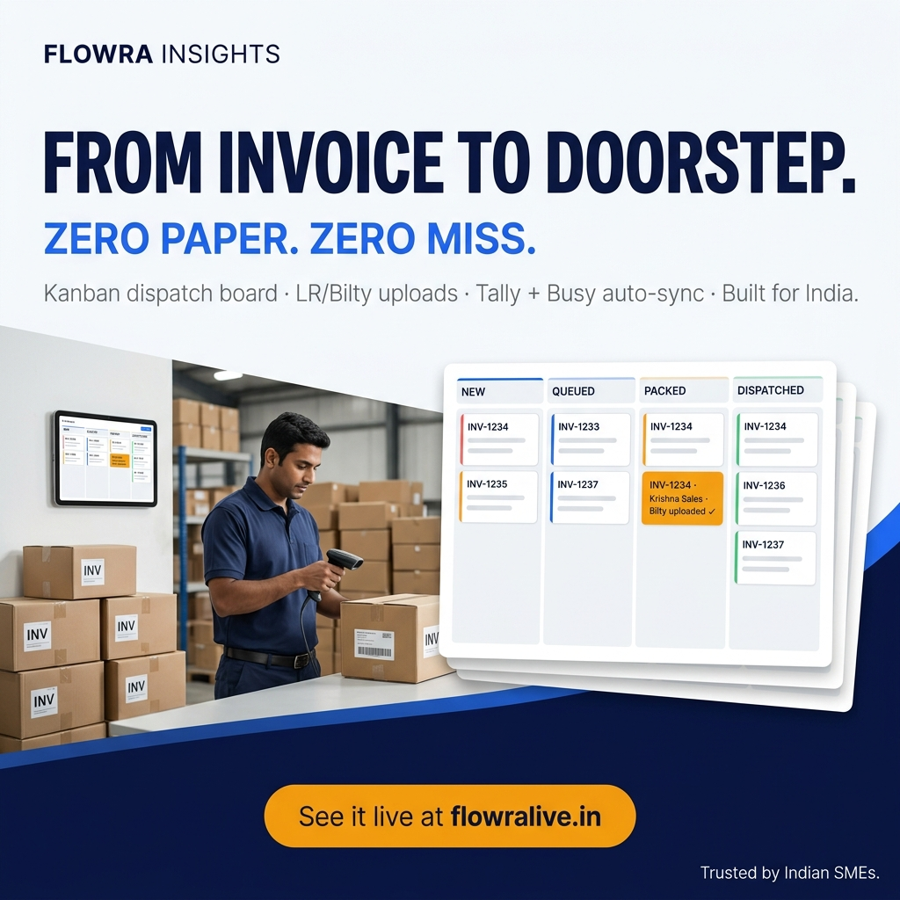
Thank You
Let's build the operating system for Indian SMEs together.
· Product — flowralive.in
· Founder — Ankit Sarawgi · ankit@jodidarindia.in
· Company — Jodidar India, Raipur, Chhattisgarh, India
· Pitched at — Manthan X Founders
· Questions welcome — and demo available on request.
Jodidar India · FLOWRA Insights · Organize. Automate. Accelerate.

