Slide 1

MANTHAN X FOUNDERS
FLOWRA Insights
Organize. Automate. Accelerate.
· An AI-first operating system for Indian SMEs running Tally / Busy
· Made by Jodidar India, Raipur, Chhattisgarh, India
· Founder: Ankit Sarawgi · Team: Punit · Kritika
· Pitched at: Manthan X Founders
Jodidar India · FLOWRA Insights · Organize. Automate. Accelerate.

Slide 2
Pointers · Slide 2 / 10
The Problem
10 million Indian SMEs run their books on Tally / Busy — and are stuck there.
Tally / Busy were built in the 1990s — desktop-only, single-machine, no analytics layer
Owners can't see live sales, stock, dispatch or salesman performance unless they sit at the office machine
Field salesmen capture orders on paper / WhatsApp → 2–4 day data lag
Dispatch & receivables are manual — papers move from desk to desk
Hindi-English bilingual + low-bandwidth realities are ignored by most SaaS
Jodidar India · FLOWRA Insights · Organize. Automate. Accelerate.

Slide 3
Pointers · Slide 3 / 10
The Opportunity
₹15,000 Cr SME-software TAM in India by 2027.
TAM — 10 M+ active SMEs on Tally / Busy across India
SAM — 1.5 M SMEs with ≥3 employees and a smartphone-using owner
SOM — 50 K early-adopter SMEs in Tier-2 & Tier-3 cities (Year 1 wedge)
Tailwind — Digital India, ONDC, GST 3.0, Account Aggregator → SME digitization is now policy
Jodidar India · FLOWRA Insights · Organize. Automate. Accelerate.

Slide 4
Pointers · Slide 4 / 10
The Solution — FLOWRA Insights
One cloud layer that sees everything Tally / Busy sees — plus AI on top.
Lightweight Windows agent reads Tally / Busy in real time (no manual export)
Multi-company, multi-branch, multi-FY ready out of the box
Mobile-first dashboards for the owner, salesman, dispatch & CA
AI Insights powered by Gemini & GPT-5 — explains numbers in plain Hindi/English
100% Indian data residency — Mumbai region MongoDB Atlas
Jodidar India · FLOWRA Insights · Organize. Automate. Accelerate.

Slide 5
Pointers · Slide 5 / 10
The Suite — 8 Integrated Modules
Each module ships value on day 1; together they replace 6–8 disjoint tools.
1. Sales & Receivables — live aging, top customers, collection nudges
2. Inventory & Stock — ABC, reorder, multi-group filters, PO generation
3. Salesman App — beat plans, daily check-ins, order & payment capture
4. Dispatch Terminal — Kanban board, LR / Bilty upload, porter assignment
5. CA Corner — TDS, GST, balance-sheet reconciliation, journal nudges
6. AI Insights — natural-language Q&A on your own books
7. FLOWRA Tasks — task & workflow assignment across roles
8. FLOWRA Loyalty — built-in customer-rewards engine for SMEs
Jodidar India · FLOWRA Insights · Organize. Automate. Accelerate.

Slide 6
Pointers · Slide 6 / 10
Differentiators
Why not just build it in Tally / Excel / Zoho?
Tally-native — no double-entry, no CSV imports, no workflow change
Bilingual UI — English + Hindi, Tier-2/Tier-3 ready
Multi-tenant SaaS — full data isolation, GST-compliant audit trail
AI layer — GPT-5 + Gemini, explains receivables / inventory in plain language
FLOWRA Tasks & Loyalty — value-adds Tally / Zoho simply don't have
Made-in-India price points — fraction of Salesforce / Zoho One
Jodidar India · FLOWRA Insights · Organize. Automate. Accelerate.

Slide 7
Pointers · Slide 7 / 10
How It Works
5 steps from sign-up to first AI insight — under 10 minutes.
1. Owner signs up at flowralive.in (free 7-day trial)
2. Downloads the FLOWRA Tally Sync Agent (10 MB Windows .exe)
3. Agent reads Tally vouchers + masters in real time via official TDL
4. Data lands in encrypted Mumbai-region MongoDB Atlas (multi-tenant)
5. Dashboards + AI Insights + mobile apps light up instantly
Jodidar India · FLOWRA Insights · Organize. Automate. Accelerate.

Slide 8
Pointers · Slide 8 / 10
Where We Are
Live with pilot customers — feedback-driven product.
Pilot customers across automobile, electrical, textile & lubricant verticals
100K+ Tally vouchers processed in pilots
v9.8.28 desktop agent — Tally Prime 7.0 compatible, hot-update channel live
111 product iterations shipped; 101/101 automated tests green
Bilingual marketing posters + landing page ready (flowralive.in)
Jodidar India · FLOWRA Insights · Organize. Automate. Accelerate.

Slide 9
Pointers · Slide 9 / 10
Business Model
Subscription SaaS · per company · per user · annual upfront.
Tiered subscription: Starter / Growth / Enterprise
Per-additional-user pricing for salesman & dispatch logins
Add-on revenue: WhatsApp credits, AI Calling minutes, GST filing assistance
Pricing — currently pilot test going on; commercial rollout post-pilot
Sticky integration → low expected churn once a tenant onboards
Jodidar India · FLOWRA Insights · Organize. Automate. Accelerate.

Slide 10
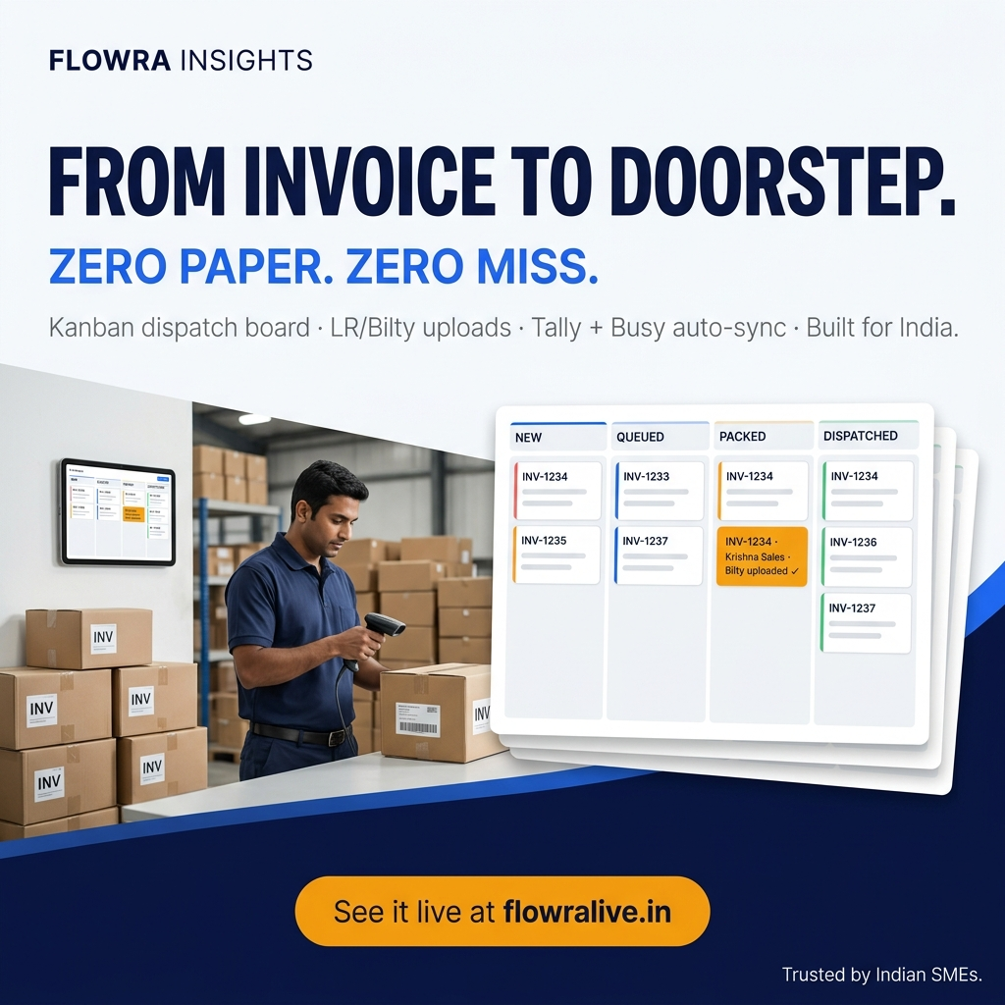
Thank You
Let's build the operating system for Indian SMEs together.
· Product — flowralive.in
· Founder — Ankit Sarawgi · ankit@jodidarindia.in
· Company — Jodidar India, Raipur, Chhattisgarh, India
· Pitched at — Manthan X Founders
· Questions welcome — and demo available on request.
Jodidar India · FLOWRA Insights · Organize. Automate. Accelerate.

