Slide 1
FLOWRA · INSIGHTS
CONFIDENTIAL
The Tally-native business intelligence platform.
Two-year plan to ₹7.5 Cr ARR · ₹4 Cr seed · Feb 2026
For investor & partner review · Not for redistribution

Slide 2
The Problem
5-second questions taking 30 minutes inside Tally.
Owner question | Today (Tally only)
How much is overdue from my top 10 customers? | 4-step report → Excel → manual sort
Where is my salesman? What did he sell yesterday? | Phone call. WhatsApp screenshot.
Which 20 SKUs are dead inventory? | Custom report from CA, billed ₹2,000
Did the dispatch boy actually deliver invoice 5421? | Phone call to the godown
How does this month compare to same month last year? | Two reports, side by side, on paper
FLOWRA reduces each of these to a tap.
FLOWRA Insights · Business Proposal · v1.0 · Feb 2026
2 / 19

Slide 3
The Product
18 modules already in production. Read-only Tally agent.
Visibility
Operations
Compliance
• Owner Dashboard
• Sales Analytics
• Inventory Pareto
• AI Insights (GPT-5.2)
• CRM with FIFO ageing
• Salesman Beat Plans
• Dispatch Kanban Terminal
• Sync History
• CA Corner: P&L, BS, Cash Flow
• GST-ready exports
• Audit logs
• Daily backups
The Tally Sync Agent is our moat — 6+ months of XML edge cases competitors must repeat.
FLOWRA Insights · Business Proposal · v1.0 · Feb 2026
3 / 19

Slide 4
Market Size
11.5 lakh addressable Indian SMEs · ₹3,450 Cr TAM
Segment | Tally + Busy seats | Fit % | Addressable
Manufacturing SMEs (₹5–500 Cr) | 4.5 L | 70% | 3.2 L
Distribution / FMCG | 6.5 L | 80% | 5.2 L
Retail chains | 5.0 L | 40% | 2.0 L
Pharma / Chemicals | 1.5 L | 75% | 1.1 L
TOTAL | 17.5 L | — | 11.5 L
0.05% capture
0.5% capture
2% capture
575 tenants
5,750 tenants
23,000 tenants
₹1.7 Cr ARR
₹17 Cr ARR
₹68 Cr ARR
FLOWRA Insights · Business Proposal · v1.0 · Feb 2026
4 / 19

Slide 5
Competitive Landscape
Nobody else reads from Tally without asking customer to migrate.
Player | Approach | Where they win | Where we win
Zoho Books | Cloud accounting | All-in-one | Customer must migrate off Tally
Vyapar / Marg | Tally alternative | Mobile billing | Replaces Tally — non-starter for 95%
Khatabook | Khata only | Free tier | No analytics, inventory, dispatch
Tally on Cloud | Lift-and-shift | Same UI as Tally | Still no dashboards or mobile
Power BI / Tableau | BI tools | Powerful | Needs IT team; ₹50k+ to set up
Our wedge: zero-migration. Owner gets dashboards in 20 min. CA stays on Tally.
FLOWRA Insights · Business Proposal · v1.0 · Feb 2026
5 / 19

Slide 6
Pricing & Unit Economics
Blended ARPU ₹2,499/mo · LTV/CAC 13×
Plan | ₹/month | Companies | Employees | Modules
Starter | 999 | 1 | 2 | Dashboard + Sales + Inventory + Sync
Professional | 2,499 | 3 | 5 | + CRM + Analytics
Enterprise | 3,799 | 10 | 20 | + Salesman + Dispatch + AI + CA
ARPU
Gross margin
CAC
₹2,499
78%
₹3,200
/mo blended
post all infra costs
blended Y1
Payback
LTV
LTV/CAC
3.5 mo
₹85,000
13×
industry: 12 mo
5-yr, 2% churn
industry: 3-5×
FLOWRA Insights · Business Proposal · v1.0 · Feb 2026
6 / 19

Slide 7
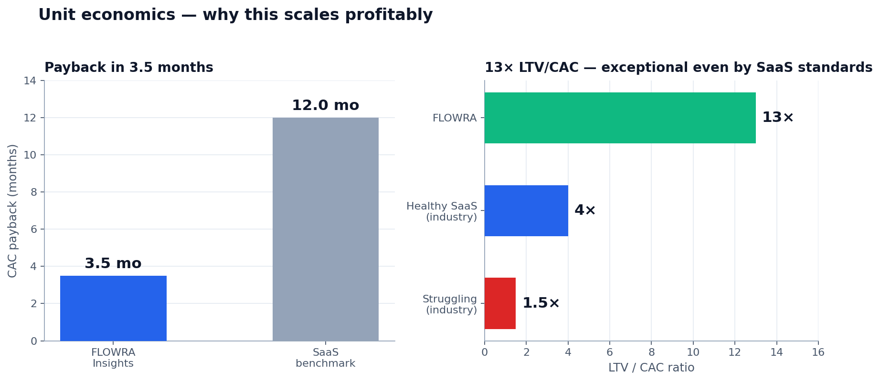
Unit Economics
Why this scales profitably.
LTV ₹85,000 · CAC ₹6,500 · Payback 3.5 mo · 78% gross margin.
FLOWRA Insights · Business Proposal · v1.0 · Feb 2026
7 / 19

Slide 8
Go-to-Market
Beachhead: distribution sector in MH/GJ/KA.
Channel | % new tenants | CAC (₹) | Notes
Meta Ads (FB + IG lead forms) | 40% | 4,000 | Geo: MH/GJ/KA
WhatsApp organic + referral | 25% | 500 | Founder net + early-customer ref
YouTube content (Tally tutorials) | 15% | 1,200 | SEO long-tail
CA partner programme | 10% | 3,500 | Year 2 trigger
Trade shows + Tally events | 5% | 8,000 | High-trust
Outbound (cold WA) | 5% | 6,000 | Closing inbound demos
BLENDED | 100% | 3,200 | Drops to ₹2,400 by M18
Funnel: 10,000 impressions → 22 paying tenants → ₹54,978 new MRR / ₹50k spend.
FLOWRA Insights · Business Proposal · v1.0 · Feb 2026
8 / 19

Slide 9
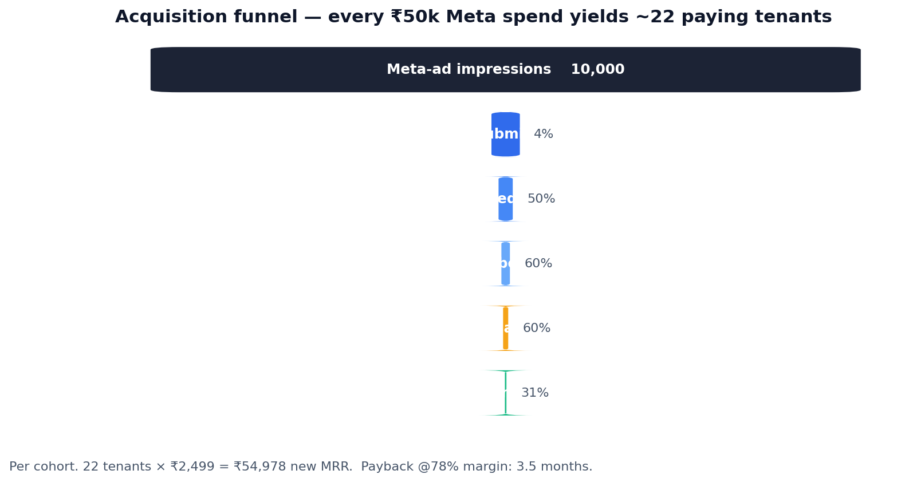
Acquisition Funnel
Per ₹50k Meta-ad spend cohort.
3.5-month CAC payback at 78% gross margin.
FLOWRA Insights · Business Proposal · v1.0 · Feb 2026
9 / 19

Slide 10
Traction & Roadmap
Already shipped. What's next.
Already shipped (Feb 2026)
Next 12 months
• 18 production modules + 120+ regression tests
• Tally Sync Agent v9.8.9 with Day-Book LVD fallback
• Multi-tenant + 6 roles (admin, dispatch, salesman, employee, super_admin, flowra_staff)
• Windows GUI + system-tray + auto-start build kit
• AI Insights (GPT-5.2 expense narratives)
• Production Operations Playbook (18 pages)
• Q1: Atlas + DO + CI/CD + Sentry (production hardening)
• Q2: GST Portal + WhatsApp BSP + Audit log CSV
• Q3: Mobile app (React Native), advanced beat optimiser
• Q4: CA partner programme + white-label (alpha)
• Code-signed installer + auto-update channel
FLOWRA Insights · Business Proposal · v1.0 · Feb 2026
10 / 19

Slide 11
Team & Hiring Plan
From 1 founder today → 16 FTE by Year 2.
Function | Today | Month 6 | Month 12 | Month 24
Engineering | 1 | 3 | 5 | 10
Sales & demos | 0 | 2 | 5 | 12
Customer Success | 0 | 1 | 3 | 6
Marketing / Content | 0 | 1 | 2 | 4
Operations / Finance / HR | 0 | 1 | 1 | 3
TOTAL FTE | 1 | 8 | 16 | 35
Monthly burn (₹ L) | — | 6.3 | 14.5 | 31.5
Engineering hires the first quarter; sales scales fastest in months 6-18.
FLOWRA Insights · Business Proposal · v1.0 · Feb 2026
11 / 19

Slide 12
Technical Scalability
Cost-per-tenant asymptotes near ₹45/mo. Margin improves with scale.
Tenants | Architecture | Cost ₹/tenant/mo
100 | Single droplet + Atlas M10 | ₹130
500 | + Redis cache, CDN | ₹70
2,000 | Atlas M20 + read replica | ₹47
5,000 | Horizontal API, queue-based ingest, sharding | ₹45
10,000 | Per-region clusters, multi-master | ₹45
Reliability targets
Year 1: 99.5% uptime · Year 2: 99.9% · RPO 1 hr · RTO 30 min
FLOWRA Insights · Business Proposal · v1.0 · Feb 2026
12 / 19

Slide 13
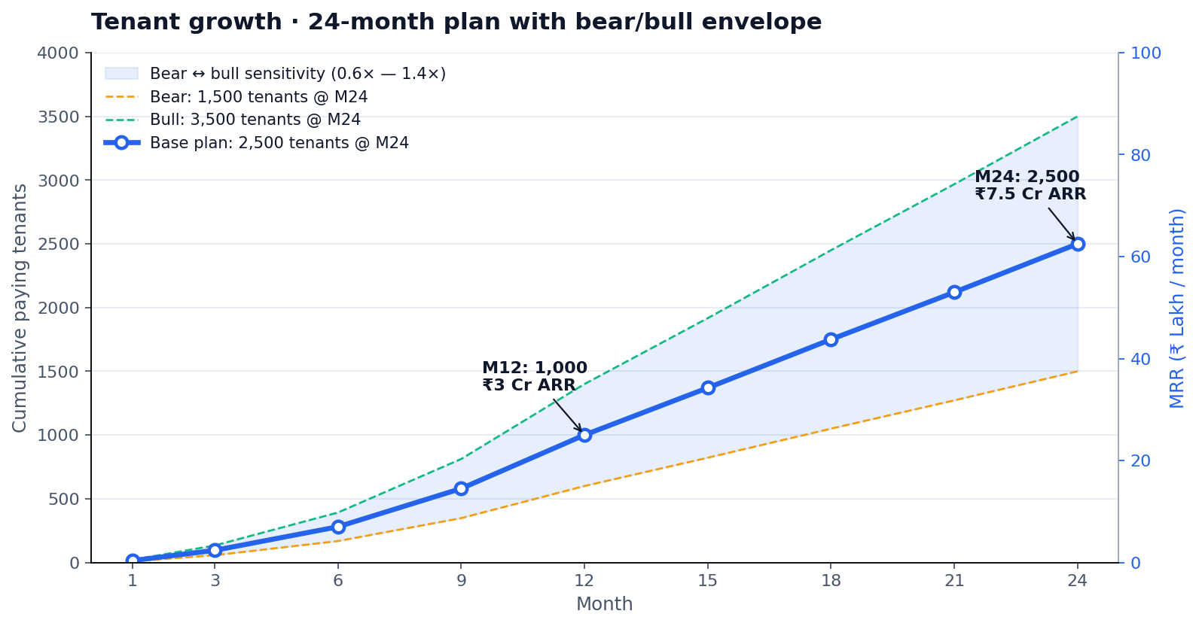
Tenant Growth Curve
24-month plan with bear / base / bull sensitivity.
Default-alive at M30. Series A target: M24 at ₹7.5 Cr ARR.
FLOWRA Insights · Business Proposal · v1.0 · Feb 2026
13 / 19

Slide 14
24-Month Projections
1,000 tenants by M12 → 2,500 by M24 → ₹7.5 Cr ARR.
Month | Cum. paying | MRR (₹L) | ARR (₹Cr)
3 | 95 | 2.4 | 0.3
6 | 280 | 7.0 | 0.8
12 | 1,000 | 25.0 | 3.0
18 | 1,750 | 43.7 | 5.2
24 | 2,500 | 62.5 | 7.5
Sensitivity at M24
Bear · 0.6× exec
₹4.5 Cr ARR · 1,500 tenants
Base · plan
₹7.5 Cr ARR · 2,500 tenants
Bull · CA partner unlock
₹10.5 Cr ARR · 3,500 tenants
EBITDA-positive: Month 30. Default-alive: Month 30 with current trajectory.
FLOWRA Insights · Business Proposal · v1.0 · Feb 2026
14 / 19

Slide 15
Two-Year Roadmap
Quarter-by-quarter execution.
Period | Theme | Key milestones | Tenants
Y1 Q1 (Mar–May) | Foundation | Atlas + DO + CI/CD + Sentry | 50
Y1 Q2 (Jun–Aug) | GTM ignition | GST Portal, WhatsApp digest | 250
Y1 Q3 (Sep–Nov) | Salesman wedge | Mobile-responsive, beat optimiser | 550
Y1 Q4 (Dec–Feb) | Year-1 close | Mobile alpha, audit-log CSV | 1,000
Y2 Q1 (Mar–May) | Mobile + partner | Mobile GA, CA programme open | 1,400
Y2 Q2 (Jun–Aug) | Geo expand | Push to N. India + TN | 1,800
Y2 Q3 (Sep–Nov) | Enterprise tier | SSO, API, white-label | 2,200
Y2 Q4 (Dec–Feb) | Series A | ₹15-20 Cr round closes | 2,500
FLOWRA Insights · Business Proposal · v1.0 · Feb 2026
15 / 19

Slide 16
Risks & Mitigations
What could go wrong, and what we're doing about it.
Risk | Severity | Likelihood | Mitigation
Tally Solutions launches competing dashboard | High | Medium | We own dispatch + salesman they don't focus on
Customer Tally version too old | Med | Med | Already supports ERP 9 + Prime; agent degrades gracefully
Meta WhatsApp policy tightens | Med | Med | Diversify to SMS + email; user-initiated WA only
Founder bus factor | High | Low | Hire technical co-lead by M6; documented Production Playbook
CAC inflation (Meta) | Med | High | Diversify to YouTube + organic + CA partner
GST policy change breaks sync | Med | Med | Read-only consumer; we follow Tally's adaptation
Customer data breach | Catastrophic | Low | Atlas encryption, TLS, pen-test M4, cyber insurance
FLOWRA Insights · Business Proposal · v1.0 · Feb 2026
16 / 19

Slide 17
Why Now
Five tailwinds aligning in the same 24-month window.
GST + e-invoicing mandate
Forces every ₹5 Cr+ business to keep accurate Tally books — quality of source data is rising fast.
DPDP Act (Indian data privacy)
Lift-and-shift cloud SaaS lose trust. We are data-residency-friendly: customer's books stay in India.
WhatsApp Business API maturing
Zero-friction notifications now reliable. Was clunky 18 months ago.
Mobile-first owners in tier-2/3 cities
~70% prefer phone over desktop for daily insights — perfect fit for our digest model.
Tally Solutions moving slowly
Their 'Tally on AWS' has zero analytics. The wedge is wide open for 24-36 months.
FLOWRA Insights · Business Proposal · v1.0 · Feb 2026
17 / 19

Slide 18
The Ask
₹4 Cr Seed at ₹16-20 Cr post-money.
Use of funds | ₹ Cr | %
Engineering hires (5 FTE × 24m) | 1.6 | 40%
Sales + CS hires (8 FTE × 24m) | 1.0 | 25%
Marketing / acquisition | 0.8 | 20%
Infra + tooling + compliance | 0.2 | 5%
Working capital buffer | 0.4 | 10%
TOTAL | 4.0 | 100%
RAISING
₹4 Cr
at ₹16-20 Cr post-money
24 months runway
Series A target: M24 at ₹7.5 Cr ARR
Funded milestones: M12 → 1,000 tenants · M24 → 2,500 tenants · ₹7.5 Cr ARR
FLOWRA Insights · Business Proposal · v1.0 · Feb 2026
18 / 19

Slide 19
We don't ask the customer to change anything.
We just turn on the lights.
Thank you.
FLOWRA Insights · founders@flowra.in · Feb 2026

