Slide 1
Deadlocks

Slide 2
The Deadlock Problem
A set of blocked processes each holding a resource and waiting to acquire a resource held by another process in the set
Example1
➔System has 2 tape drives
➔P₁ and P₂ each hold one tape drive and each needs another one
Example2
➔Semaphores A and B, initialized to 1
P₀ P₁
Wait (A); Wait(B)
Wait (B); Wait(A)

Slide 3
Bridge Crossing Example
Traffic only in one direction.
Each section of a bridge can be viewed as a resource.
If a deadlock occurs, it can be resolved if one car backs up (preempt resources and rollback).
Several cars may have to be backed up if a deadlock occurs.
Starvation is possible.

Slide 4
System Model
Resource types R₁, R₂, . . ., R_{m}
CPU cycles, memory space, I/O devices
Each resource type R_{i} has W_{i} instances
Each process utilizes a resource
1.Request
2.Use
3.Release
Request and release of resources is done through system calls

Slide 5
Deadlock Characterization
Deadlock can arise if four conditions hold simultaneously.
Mutual exclusion: only one process at a time can use a resource(i.e. resource is non-sharable).
Hold and wait: a process holding at least one resource is waiting to acquire additional resources held by other processes.
No preemption: a resource can be released only voluntarily by the process holding it, after that process has completed its task.
Circular wait: there exists a set {P₀, P₁, …, P_{n}} of waiting processes such that
P₀ is waiting for a resource that is held by P₁
P₁ is waiting for a resource that is held by P₂
…, P_{n–1} is waiting for a resource that is held byP_{n}
and P_{n} is waiting for a resource that is held by P₀.

Slide 6
Resource-allocation Graph
A set of vertices V and a set of edges E.
V is partitioned into two types:
➔P = {P₁, P₂, …, P_{n}}, the set consisting of all the processes in the system.
➔R = {R₁, R₂, …, R_{m}}, the set consisting of all resource types in the system
Request edge – directed edge P_{i} → R_{j}
Assignment edge – directed edge R_{j} → P_{i}

Slide 7
Resource-Allocation Graph (Cont.)
Process
Resource Type with 4 instances
P_{i} requests instance of R_{j}
P_{i} is holding an instance of R_{j}
P_{i}
R_{j}
P_{i}
R_{j}

Slide 8
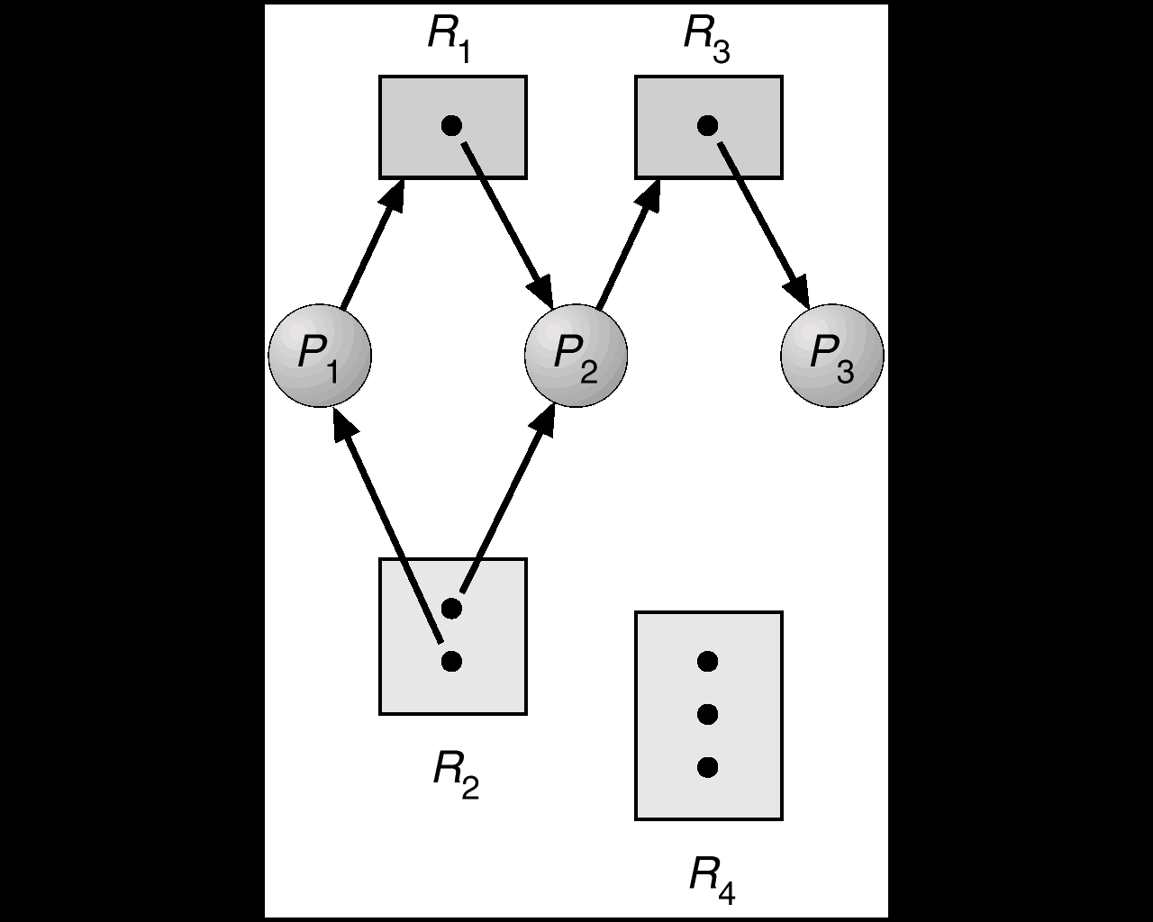
Example of a Resource Allocation Graph

Slide 9
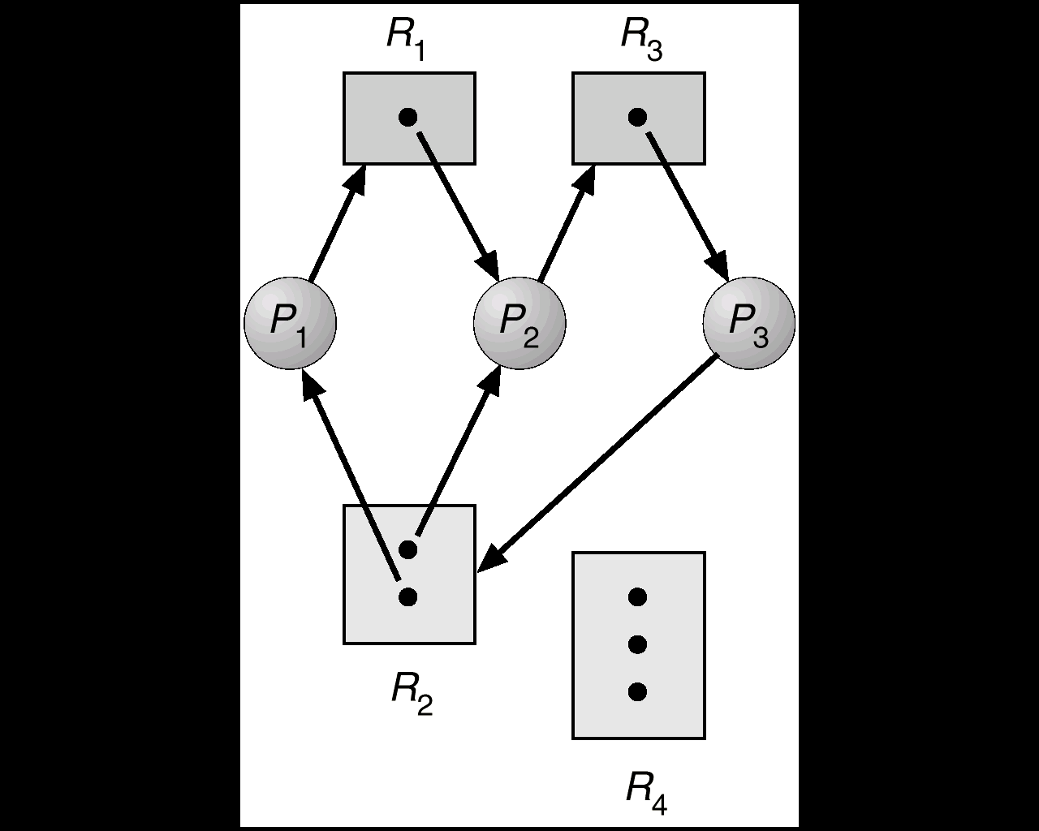
Resource Allocation Graph With A Deadlock

Slide 10
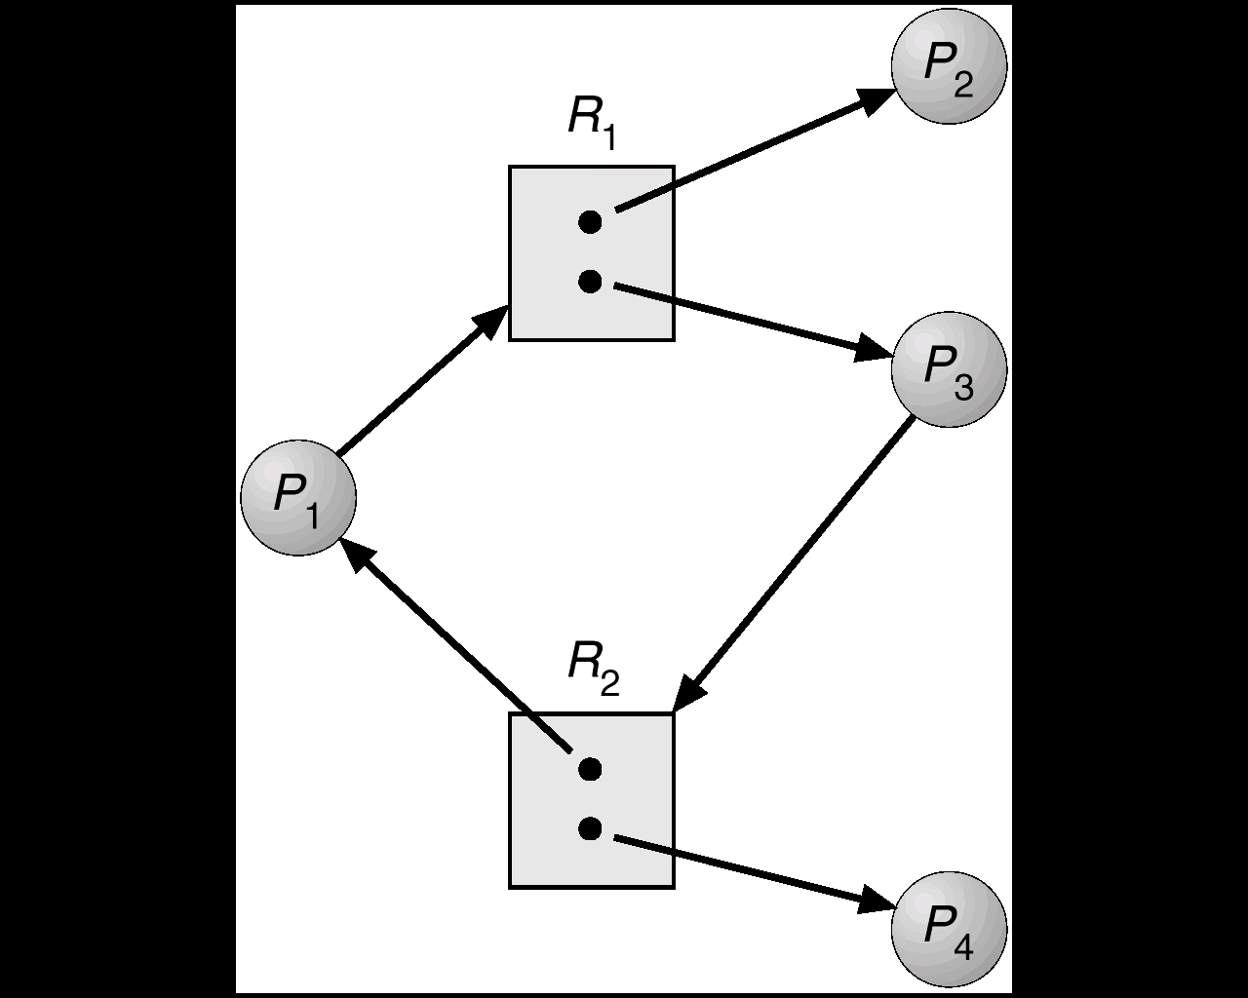
Resource Allocation Graph With A Cycle But No Deadlock

Slide 11
Basic Facts
If graph contains no cycles ⇒ no deadlock.
If graph contains a cycle ⇒
➔If only one instance per resource type, then deadlock
➔If several instances per resource type, possibility of deadlock

Slide 12
Methods for Handling Deadlocks
Ensure that the system will never enter a deadlock state.
(Prevention or Avoidance)
Allow the system to enter a deadlock state and then recover.

Slide 13
Deadlock Characterization
Deadlock can arise if four conditions hold simultaneously.
Mutual exclusion
Hold and wait
No preemption
Circular wait

Slide 14
Deadlock Prevention
Ensure that one of the 4 necessary conditions for deadlock does not hold.
Constraints the way requests can be made for resources
Mutual exclusion
not required for sharable resources;
Must hold for non-sharable resources.
➔Make non-sharable resources as sharable
➔some resources are intrinsically non sharable

Slide 15
Deadlock Prevention
Hold and wait – must guarantee that whenever a process requests a resource, it does not hold any other resources
➔Require process to request and be allocated all its resources before it begins execution,
Need to know all the requirement in the beginning itself
Allow process to request resources only when the process has none.
If a process has resource and requires additional resources, it must release all resources it is holding and then make request
➔Low resource utilization; Starvation possible

Slide 16
Deadlock Prevention (Cont.)
No preemption – Approach -1
➔If a process that is holding some resources requests another resource that cannot be immediately allocated to it, then all resources currently being held are released
➔Preempted resources are added to the list of resources for which the process is waiting
➔Process will be restarted only when it can regain its old resources, as well as the new ones that it is requesting.
➔Cannot be generally applied to resources like printers, tape drives etc.

Slide 17
No preemption (cont-)
If resource is
available
Yes
Allocate
resource
NO
Resource allocated to
Waiting process
Yes
Preempt the resource
from waiting process
No
Make the requesting
process wait
Notes:
Whenever a process requests a resource, check if resource is available then allocate it to requesting process. If resource is not available then check if it is allocated to waiting process, if so preempt the desired resources from waiting process. If the resources are neither available nor held by waiting process then the requesting process must be made to wait.

Slide 18
Deadlock Prevention (Cont.)
Circular wait – impose a total ordering of all resource types, and require that each process requests resources in an increasing order of enumeration

Slide 19
Deadlock Avoidance
Requires that the system has some additional a priori information available.
Simplest and most useful model requires that each process declare the maximum number of resources of each type that it may need.
The deadlock-avoidance algorithm
Dynamically finds the resource-allocation state in order to ensure that a circular-wait condition does not occur.
Resource-allocation state is defined by
the number of available resources
the number of allocated resources,
the maximum requirement of the processes

Slide 20
Safe State
When a process requests an available resource, the system needs to decide if immediate allocation leaves the system in a safe state.
A state is safe if system can allocate resources to each process (Max requirement ) in some order and still avoid deadlock
System is in safe state if there exists a safe sequence of all processes.

Slide 21
Sequence <P₁, P₂, …, P_{n}> is safe if for each P_{i}, the resources that P_{i} can still request can be satisfied by currently available resources + resources held by all the P_{j}, with j< i
➔If P_{i} resource needs are not immediately available, then P_{i} can wait until all P_{j} have finished
➔When P_{j} is finished, P_{i} can obtain needed resources, execute, return allocated resources, and terminate
➔When P_{i} terminates, P_{i+1} can obtain its needed resources, and so on

Slide 22
Basic Facts
If a system is in safe state ⇒ no deadlocks.
If a system is in unsafe state ⇒ possibility of deadlock.
Avoidance ⇒ ensure that a system will never enter an unsafe state

Slide 23
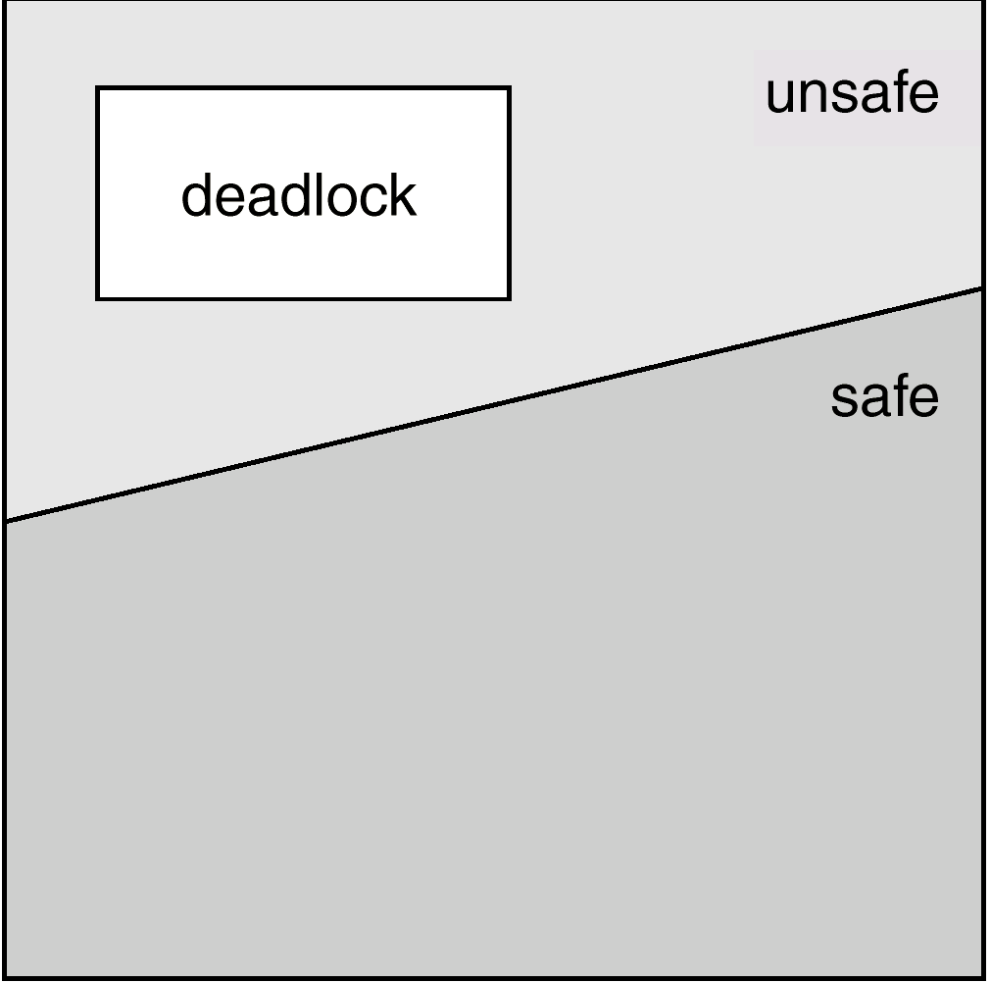
Safe, Unsafe , Deadlock State

Slide 24
Example
 | Maximum need | Allocation
P0 | 10 | 5
P1 | 4 | 2
P2 | 9 | 2
Total no of resources =12
safe sequence < P1,P0,P2>

Slide 25
Resource-Allocation Graph Algorithm
Claim edge P_{i} → R_{j} indicates that process P_{i} may request resource R_{j}; represented by a dashed line.
Claim edge converts to request edge when a process requests a resource.
When a resource is released by a process, assignment edge reconverts to a claim edge.
Resources must be claimed a priori in the system.

Slide 26
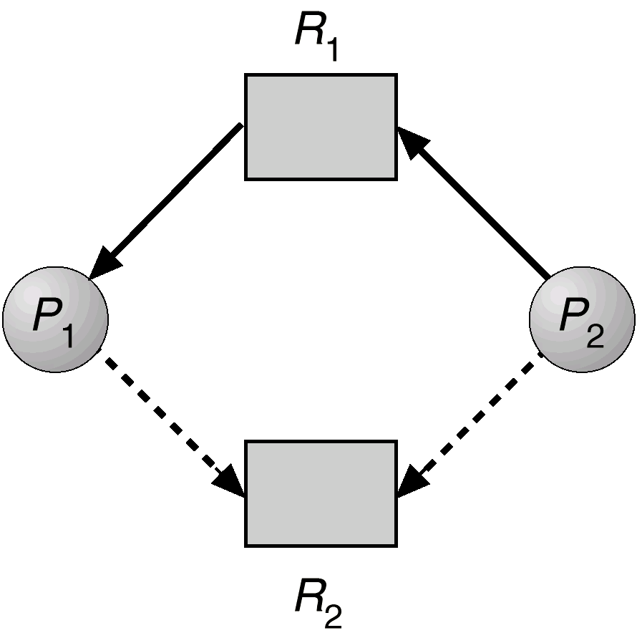
Resource-Allocation Graph For Deadlock Avoidance

Slide 27
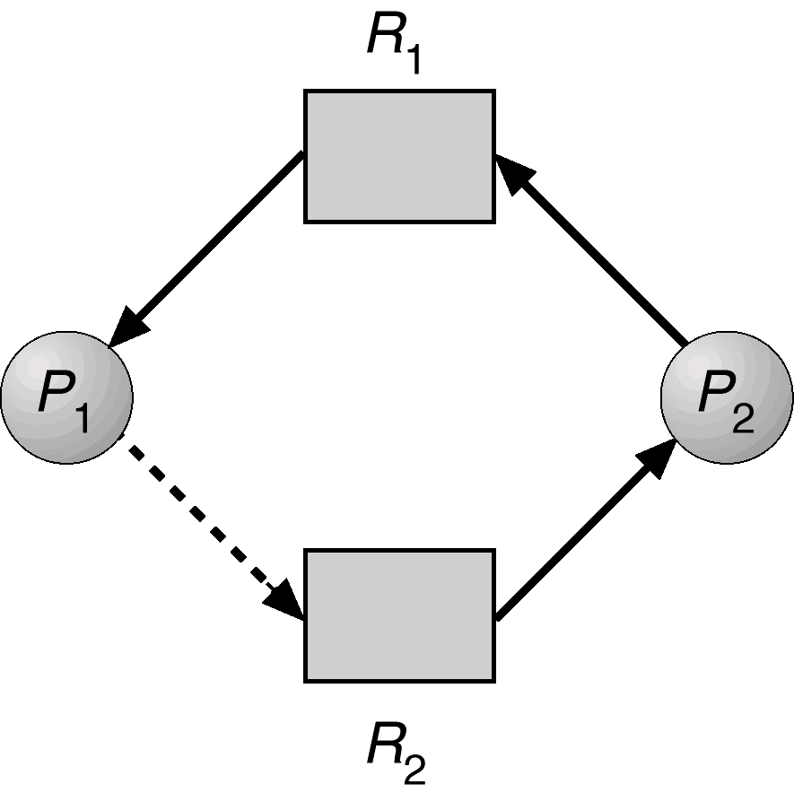
Unsafe State In Resource-Allocation Graph

Slide 28
Banker’s Algorithm
Multiple instances.
Each process must a priori claim maximum use.
When a process requests a resource it may have to wait.
When a process gets all its resources it must return them in a finite amount of time.

Slide 29
Data Structures for the Banker’s Algorithm
Let n = number of processes, and m = number of resources types.
Available: Vector of length m. If Available [ j] = k, there are k instances of resource type R_{j} available.
Max: n x m matrix. If Max [I , j] = k, then process P_{i} may request at most k instances of resource type R_{j}.
Allocation: n x m matrix. If Allocation[I , j] = k then P_{i} is currently allocated k instances of R_{j.}
Need: n x m matrix. If Need[I , j] = k, then P_{i} may need k more instances of R_{j} to complete its task.
Need [I , j] = Max[I , j] – Allocation [I , j]

Slide 30
Safety Algorithm
1. Let Work and Finish be vectors of length m and n, respectively. Initialize:
Work = Available
Finish [i] = false for i =0,1, …, n-1.
2. Find an index i such that both:
(a) Finish [i] == false
(b) Need_{i} ≤ Work
If no such i exists, go to step 4.
3. Work = Work + Allocation_{i} Finish[ i ] = true go to step 2.
4. If Finish [i ] == true for all i, then the system is in a safe state.

Slide 31
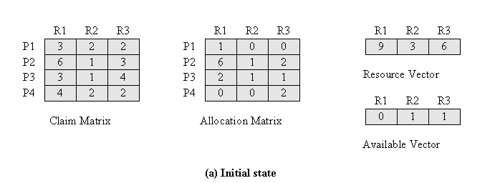
Safe state example
 | R1 | R2 | R3
P1 | 2 | 2 | 2
P2 | 0 | 0 | 1
P3 | 1 | 0 | 3
P4 | 4 | 2 | 0

Slide 32
Resource-Request Algorithm for Process P_{i}
Request _{i} = request vector for process P_{i}.
If Request _{i} [j] = k then process P_{i} wants k instances of resource type R_{j.}
If Request _{i} ≤ Need _{i} then go to step 2.
Otherwise, raise error condition, since process has exceeded its maximum claim.
If Request _{i} ≤ Available, go to step 3.
Otherwise P_{i} must wait, since resources are not available.
3. Pretend to allocate requested resources to P_{i} by modifying the state as follows:
Available = Available –Request_{i} ;
Allocation_{i} = Allocation_{i} + Request_{i} ;
Need_{i} = Need_{i} – Request_{i}
If safe ⇒ the resources are allocated to P_{i}.
If unsafe ⇒ P_{i} must wait, and the old resource-allocation state is restored

Slide 33
Example of Banker’s Algorithm
5 processes P₀ through P₄; 3 resource types A (10 instances), B (5instances) and C (7 instances).
Snapshot at time T₀:
Allocation Max Available
A B C A B C A B C
P₀ 0 1 0 7 5 3 3 3 2
P₁ 2 0 0 3 2 2
P₂ 3 0 2 9 0 2
P₃ 2 1 1 2 2 2
P₄ 0 0 2 4 3 3

Slide 34
Example (Cont.)
The content of the matrix Need is equal to Max – Allocation.
Need
A B C
P₀ 7 4 3
P₁ 1 2 2
P₂ 6 0 0
P₃ 0 1 1
P₄ 4 3 1
The system is in a safe state since the sequence < P₁, P₃, P₄, P₂, P₀> satisfies safety criteria.

Slide 35
Example P₁ Request (1,0,2) (Cont.)
Check that Request ≤ Available that is, (1,0,2) ≤ (3,3,2) ⇒ true.
Allocation Need Available
A B C A B C A B C
P₀ 0 1 0 7 4 3 2 3 0
P₁ 3 0 2 0 2 0
P₂ 3 0 2 6 0 0
P₃ 2 1 1 0 1 1
P₄ 0 0 2 4 3 1
Executing safety algorithm shows that sequence <P₁, P₃, P₄, P₀, P₂> satisfies safety requirement.
Can request for (3,3,0) by P₄ be granted?
Can request for (0,2,0) by P₀ be granted?

Slide 36
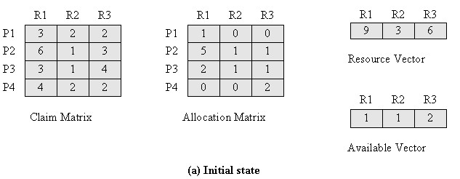
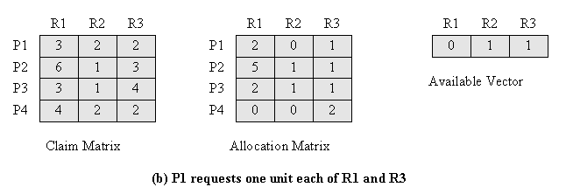
Another example of Unsafe state

Slide 37
Deadlock Detection
Allow system to enter deadlock state
Detection algorithm
Recovery scheme

Slide 38
Single Instance of Each Resource Type
Maintain wait-for graph
➔Nodes are processes
➔P_{i} → P_{j} if P_{i} is waiting for P_{j}
Periodically invoke an algorithm that searches for a cycle in the graph.

Slide 39
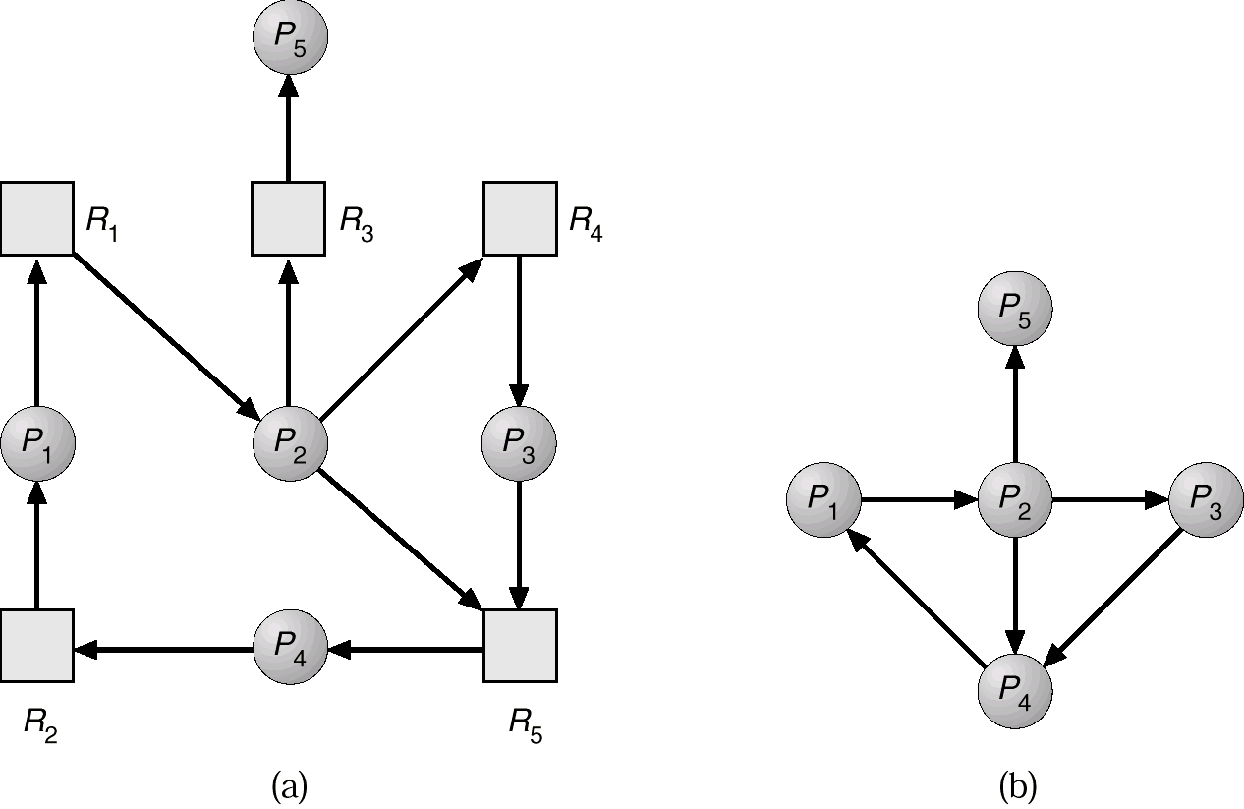
Resource-Allocation Graph and Wait-for Graph
Resource-Allocation Graph
Corresponding wait-for graph

Slide 40
Several Instances of a Resource Type
Available: A vector of length m indicates the number of available resources of each type.
Allocation: An n x m matrix defines the number of resources of each type currently allocated to each process.
Request: An n x m matrix indicates the current request of each process. If Request [i,j] = k, then process P_{i} is requesting k more instances of resource type R_{j}.

Slide 41
Detection Algorithm
1. Let Work and Finish be vectors of length m and n,respectively. Initialize:
(a) Work = Available
(b) For i = 1,2, …, n, if Allocation_{i} ≠ 0, then Finish[i] = false;otherwise, Finish[i] = true.
Find an index i such that both:
(a) Finish[i] == false
Request_{i} ≤ Work If no such i exists, go to step 4.
Work = Work + Allocation_{i} Finish[i] = true go to step 2.
4. If Finish[i] == false, for some i, 1 ≤ i ≤ n, then the system is in deadlock state. Moreover, if Finish[i] == false, then P_{i} is deadlocked.

Slide 42
Example of Detection Algorithm
Five processes P₀ through P₄; three resource types A (7 instances), B (2 instances), and C (6 instances).
Snapshot at time T₀:
Allocation Request Available
A B C A B C A B C
P₀ 0 1 0 0 0 0 0 0 0
P₁ 2 0 0 2 0 2
P₂ 3 0 3 0 0 0
P₃ 2 1 1 1 0 0
P₄ 0 0 2 0 0 2
Sequence <P₀, P₂, P₃, P₄, P₁> will result in Finish[i] = true for all i.

Slide 43
Example (Cont.)
P₂ requests an additional instance of type C.
Request
A B C
P₀ 0 0 0
P₁ 2 0 1
P₂ 0 0 1
P₃ 1 0 0
P₄ 0 0 2
State of system?
➔Can reclaim resources held by process P₀, but insufficient resources to fulfill other processes requests.
➔Deadlock exists, consisting of processes P₁, P₂, P₃, and P₄.

Slide 44
Detection-Algorithm Usage
When, and how often, to invoke depends on:
➔How often a deadlock is likely to occur?
➔How many processes will need to be rolled back?
Frequency of execution
Invoke the algorithm every time request for resource cannot be granted immediately.
Once per hour
When CPU utilization drops below 40%

Slide 45
Recovery from Deadlock: Process Termination
Abort all deadlocked processes➔May be expensive
Abort one process at a time until the deadlock cycle is eliminated ➔Invoke deadlock detection algorithm after every abort.
In which order should we choose to abort?
➔Priority of the process.
➔How long process has computed, and how much longer to completion.
➔Resources the process has used.
➔Resources process needs to complete.
➔Is process interactive or batch?

Slide 46
Recovery from Deadlock: Resource Preemption
Selecting a victim – minimize cost.
Rollback – return to some safe state, restart process for that state.
Starvation – same process may always be picked as victim, include number of rollback in cost factor.

