Slide 1
Computer-System Structures

Slide 2
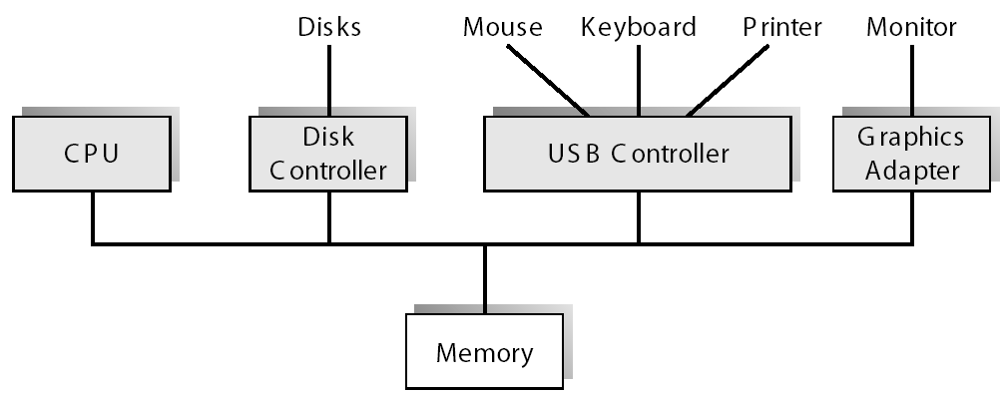
A Modern Computer System

Slide 3
Computer-System Operation
I/O devices and the CPU can execute concurrently
Each device controller is in-charge of a particular device type
Each device controller has a local buffer
CPU moves data from/to main memory to/from local buffers
I/O is from the device to local buffer of controller
Device controller informs CPU that it has finished its operation by causing an interrupt

Slide 4
Common Functions of Interrupts
Interrupt transfers control to the interrupt service routine , through the interrupt vector, which contains the addresses of all the interrupt service routines
Interrupt architecture must save the address of the interrupted instruction
An operating system is interrupt driven

Slide 5
Interrupt Handling
The operating system preserves the state of the CPU by storing registers and the program counter
Determines which type of interrupt has occurred:
Vectored
Non vectored
Separate kernel routines determine what action should be taken for each type of interrupt

Slide 6
I/O Structure
Synchronous I/O - After I/O starts, control returns to user program only upon I/O completion
Asynchronous I/O - After I/O starts, control returns to user program without waiting for I/O completion
Device-status table contains entry for each I/O device indicating its type, address, and state
Operating system access I/O device table to determine device status and to modify table entry

Slide 7
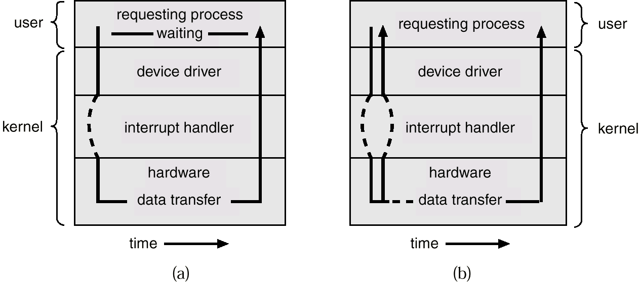
Two I/O Methods
Synchronous
Asynchronous

Slide 8
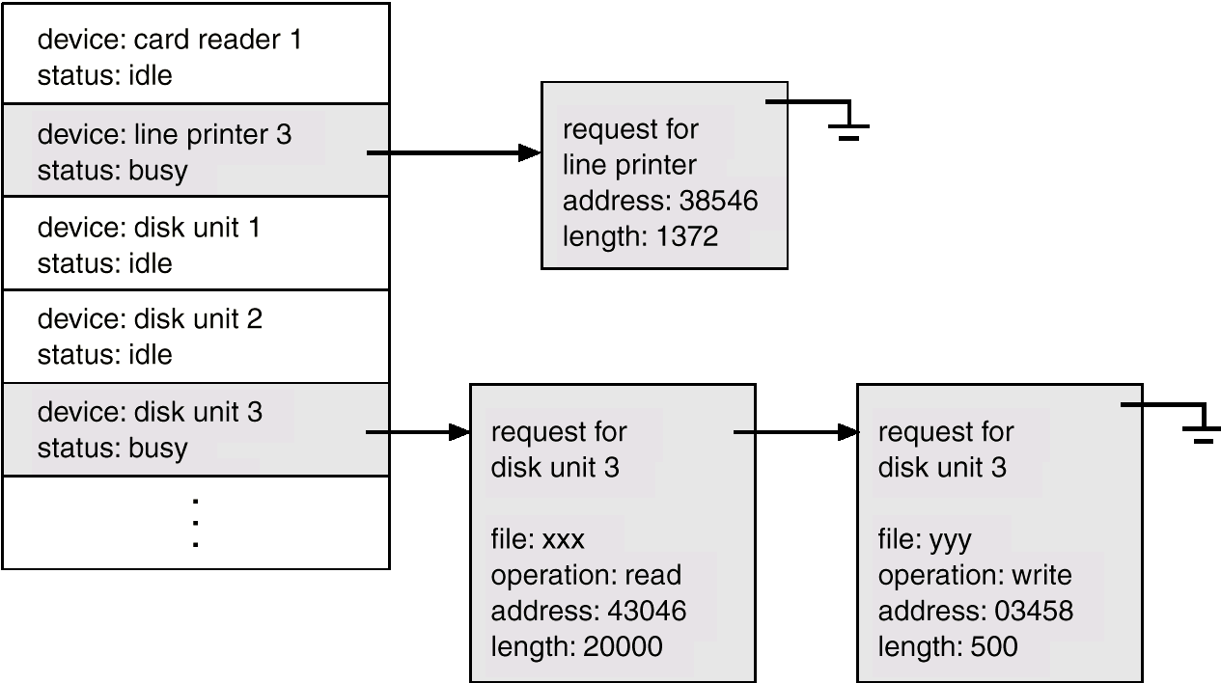
Device-Status Table

Slide 9
Direct Memory Access Structure
Device controller transfers blocks of data from buffer storage directly to main memory without CPU intervention
Only one interrupt is generated per block, rather than the one interrupt per byte

Slide 10
Storage Structure
Main memory – only storage media that the CPU can access directly
Secondary storage – extension of main memory that provides large nonvolatile storage capacity
Magnetic disks – rigid metal or glass platters covered with magnetic recording material
Disk surface is logically divided into tracks, which are subdivided into sectors
The disk controller determines the logical interaction between the device and the computer

Slide 11
Storage Hierarchy
Storage systems organized in hierarchy
Speed
Cost
Volatility
Size
Caching – copying information into faster storage system; main memory can be viewed as a last cache for secondary storage

Slide 12
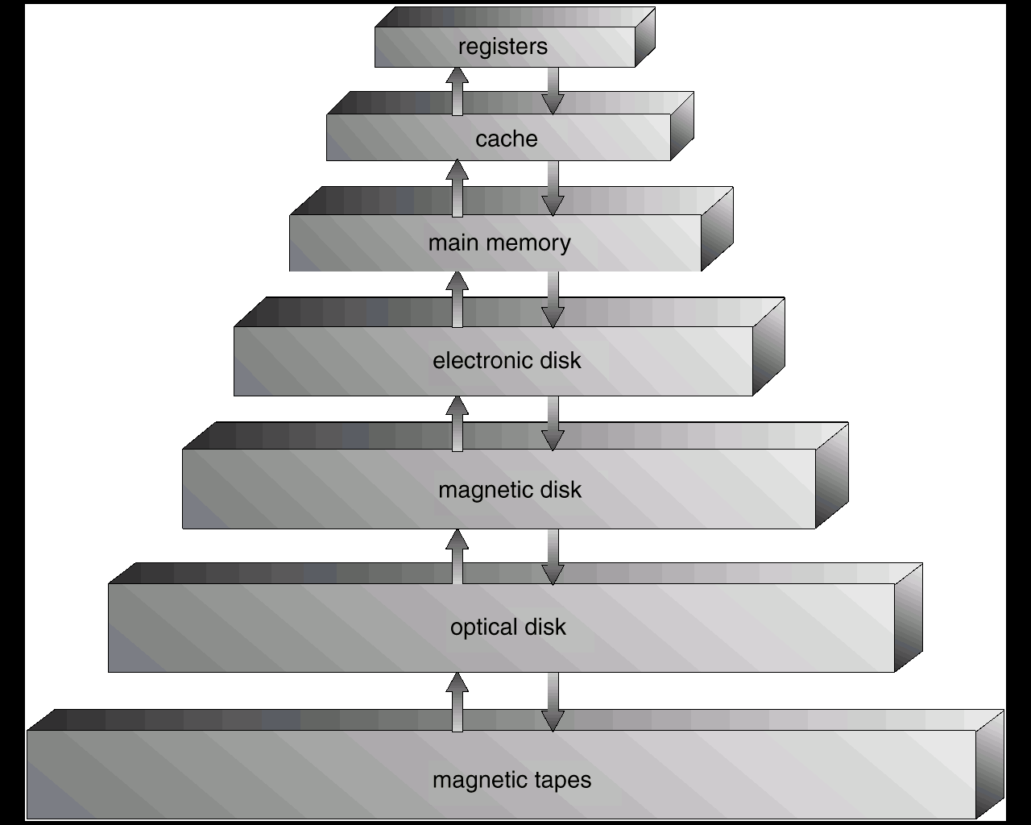
Storage-Device Hierarchy

Slide 13
Caching
Use of high-speed memory to hold recently-accessed data
Requires a cache management policy
Caching introduces another level of complexity in storage hierarchy.
This requires data that is simultaneously stored in more than one level to be consistent

Slide 14
Hardware Protection
Dual-Mode Operation
I/O Protection
Memory Protection
CPU Protection

Slide 15
Dual-Mode Operation
Sharing system resources , requires operating system to ensure that an incorrect program or miss behaving user, cannot cause other programs to execute incorrectly
OS must provide hardware support to differentiate between at least two modes of operations
1. User mode – execution done on behalf of a user
2. Monitor mode (also kernel mode or system mode) – execution done on behalf of operating system

Slide 16
Dual-Mode Operation (Cont.)
Mode bit added to computer hardware to indicate the current mode: monitor (0) or user (1)
When an interrupt or fault occurs hardware switches to monitor mode
Interrupt/fault
monitor
user
set user mode
Privileged instructions can be issued only in monitor mode

Slide 17
I/O Protection
All I/O instructions are privileged instructions
Must ensure that a user program could never gain control of the computer in monitor mode (i.e., a user program that, as part of its execution, stores a new address in the interrupt vector)

Slide 18
Read data from hard disk
Read data from
cyl= 5 , sec =10 head = 2
Application 1
Cyl= 5;
Sec=10;
Head=2
Get data
Read data from
cyl= 20 , sec =5 head = 1
Application 2
Cyl=20;
Sec=5;
head;=1
Get data

Slide 19
Memory Protection
Must provide memory protection at least for the interrupt vector and the interrupt service routines
In order to have memory protection, at a minimum add two registers that determine the range of legal addresses a program may access:
Base register – holds the smallest legal physical memory address
Limit register – contains the size of the range
Memory outside the defined range is protected

Slide 20
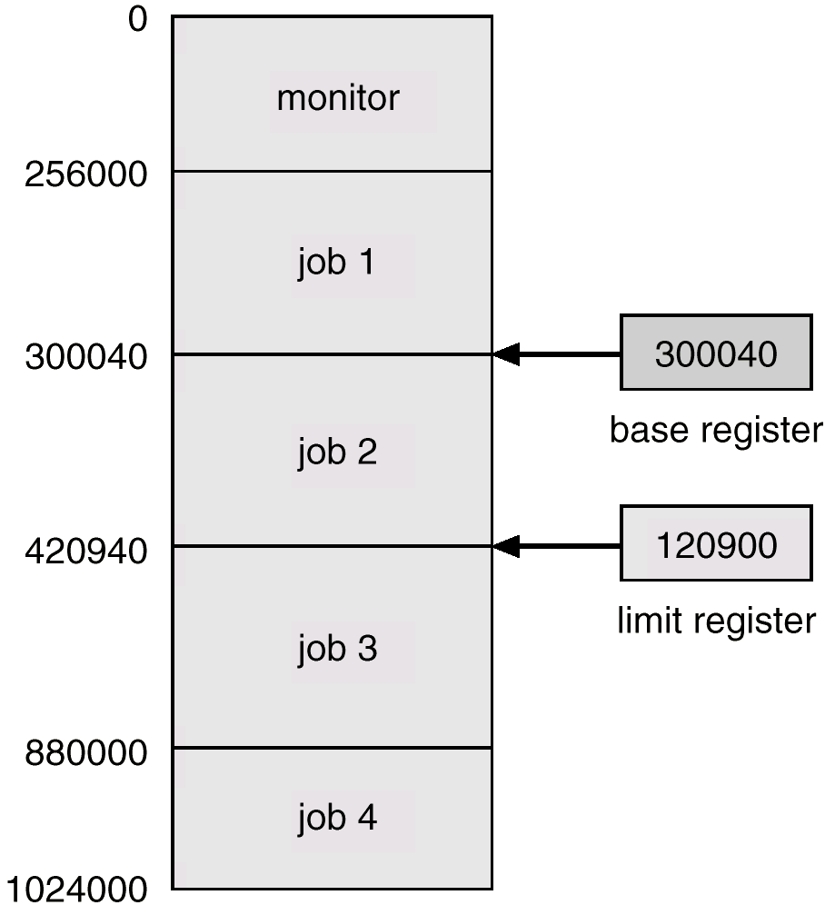
Use of A Base and Limit Register

Slide 21
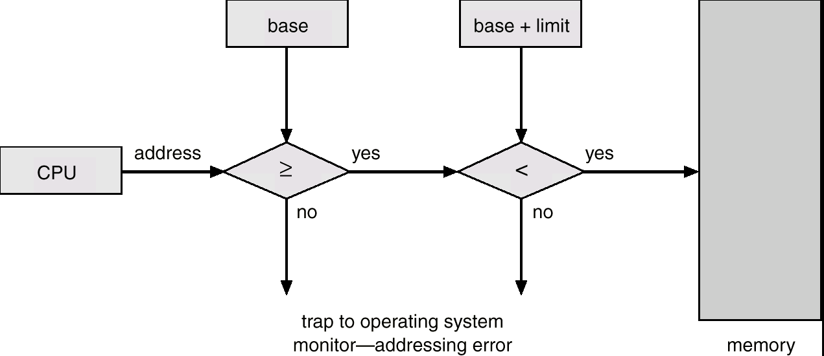
Hardware Address Protection

Slide 22
Hardware Protection
When executing in monitor mode, the operating system has unrestricted access to both monitor and user’s memory
The load instructions for the base and limit registers are privileged instructions

Slide 23
Timer
Timer – interrupts computer after specified period to ensure operating system maintains control
Timer is decremented every clock tick
When timer reaches the value 0, an interrupt occurs
Timer commonly used to implement time sharing
Time also used to compute the current time
Load-timer is a privileged instruction

Slide 24
General-System Architecture
Given the I/O instructions are privileged, how does the user program perform I/O?
System call – the method used by a process to request action by the operating system
Usually takes the form of a trap to a specific location in the interrupt vector
Control passes through the interrupt vector to a service routine in the OS, and the mode bit is set to monitor mode
The monitor verifies that the parameters are correct and legal, executes the request, and returns control to the instruction following the system call

