Slide 1
PROCESS SCHEDULING

Slide 2
Scheduling
Processes in different state maintain Queues.
The different queues are maintained for different purpose eg.
  Ready Queue : Processes waiting for CPU
  Blocked : processes waiting for I/O to complete
Transition from a state where queue is maintained to next state involves decision making such as
  When to move process from one state to another
  Which process to move
When transitions occur, OS may be required to carry out some house keeping activity such as context switch, Mode switch etc. These activities are considered as overhead and must be carried out in efficient manner

Slide 3
Scheduling is matter of managing queues to minimize queuing delay and to optimize performance in queuing environment
Scheduling affects the performance of the system because it determines which process will wait and which will progress

Slide 4
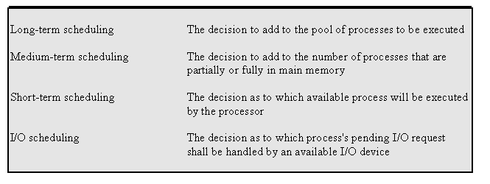
Types of Scheduling

Slide 5
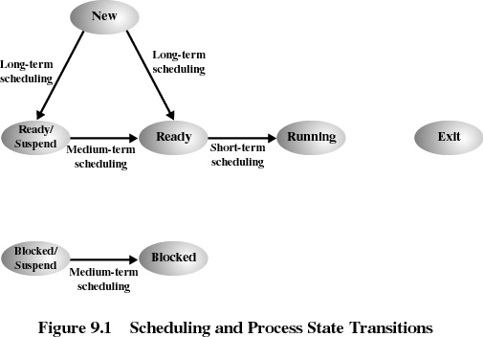

Slide 6
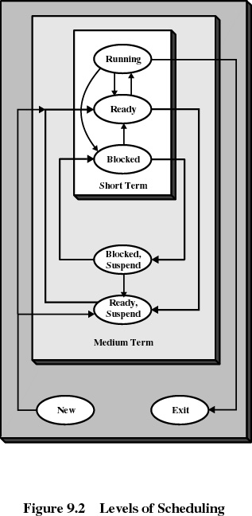

Slide 7
Long-term Scheduling
Long-term scheduler is invoked very infrequently (seconds, minutes) ⇒ (may be slow). Invoked to move a new process to ready or ready suspend queue
Determines which programs are admitted to the system for processing
Controls the degree of multiprogramming

Slide 8
Long-term Scheduling
More processes=> smaller percentage of time each process is executed
Processes can be described as either:
  I/O-bound process – spends more time doing I/O than computations; very short CPU bursts.
  CPU-bound process – spends more time doing computations; very long CPU bursts.
  The long term scheduler must select a good process mix of I/O bound and CPU bound processes

Slide 9
Medium-term Scheduling
Part of the swapping function
Based on the need to manage the degree of multiprogramming and provide a good process mix
Done to free up some memory when required
Invoked to move a process from ready suspend to ready or block to block suspend and vice-versa

Slide 10
CPU(short Term) Scheduler
Selects from among the processes in memory that are ready to execute, and allocates the CPU to one of them.
CPU scheduling decisions may take place when a process:
  1. Switches from running to waiting state.
  2. Switches from running to ready state.
  3. Switches from waiting to ready.
  4. Terminates.
Scheduling under 1 and 4 is nonpreemptive.
All other scheduling is preemptive.

Slide 11
Decision Mode
Nonpreemptive
  Once a process is in the running state, it will continue until it terminates or blocks itself for I/O.
Preemptive
  Currently running process may be interrupted and moved to the Ready state by the operating system
  Allows for better service since any one process cannot monopolize the processor for very long.Unix uses this strategy but the Kernel is nonpreemptive.

Slide 12
Short-term Scheduling
Short-term scheduler is invoked very frequently (once in every 100 milliseconds or so)
⇒ must be fast.
Includes the dispatcher module
Executes most frequently
Invoked when an event occurs
  Clock interrupts
  I/O interrupts
  Operating system calls
  Signals

Slide 13
Dispatcher
Dispatcher module gives control of the CPU to the process selected by the short-term scheduler; this involves:
  switching context
  switching to user mode
  jumping to the proper location in the user program to restart that program
Dispatch latency – time it takes for the dispatcher to stop one process and start another running.

Slide 14
Short-term Scheduling Criteria
User-oriented
  Response Time
    Elapsed time between the submission of a request until there is output(or the CPU is allocated).
  Predictability
System-oriented
  Effective and efficient utilization of the processor
    throughput

Slide 15
Basic Concepts
Uniprocessor Scheduling
Maximum CPU Utilization Obtained With Multiprogramming
Process Execution Consists of a Cycle of CPU Execution and I/O Wait. => CPU–I/O Burst Cycle
CPU Burst Distribution – Processes Mostly Have Short CPU Bursts (~5ms)

Slide 16

Alternating Sequence of CPU And I/O Bursts

Slide 17

Histogram of CPU-burst Times

Slide 18
Scheduling Criteria
CPU utilization – keep the CPU as busy as possible
Throughput – # of processes that complete their execution per time unit
Turnaround time – amount of time taken to complete a particular process from its submission to its termination. Also known as residence time T_{r}.
  The actual CPU time taken by a process is called Service time, T_{s}. The Normalized turnaround time is then defined as T_{r}/T_{s}. Minimum possible value is 1, which means immediate service.
Priorities- can be fixed in many ways

Slide 19
Scheduling Criteria
Waiting time – amount of time a process has been waiting in the ready queue
Response time – amount of time it takes from when a request was submitted until the first response is produced, not output (for time-sharing environment)
Predictability – keep the variance of response time low under different load conditions
Balance- resource utilization
Fairness- Provide equal share of CPU time to all workgroups

Slide 20
Optimization Criteria
In short:
Max CPU utilization
Max throughput
Max predictability
Min turnaround time
Min waiting time
Min response time

Slide 21
First-come, First-served (FCFS) Scheduling
Example: Process Burst Time
P₁ 24
P₂ 3
P₃ 3
Suppose that the processes arrive in the order: P₁ , P₂ , P₃
The Gantt Chart for the schedule is:
Waiting time for P₁ = 0; P₂ = 24; P₃ = 27
Average waiting time: (0 + 24 + 27)/3 = 17
P₁
P₂
P₃
0
24
27
30

Slide 22
FCFS Scheduling (Cont.)
Suppose that the processes arrive in the order: P₂ , P₃ , P₁ .
The Gantt chart for the schedule is:
Waiting time for P₁ = 6; P₂ = 0; P₃ = 3
Average waiting time: (6 + 0 + 3)/3 = 3
Much better than previous case.
Convoy effect short process behind long process => FCFS penalizes short processes
P₂
P₃
P₁
0
3
6
30

Slide 23
First-come-first-served (FCFS)
A short process may have to wait a very long time before it can execute
Favors CPU-bound processes
  I/O processes have to wait until CPU-bound process completes(FCFS is non preemptive)

Slide 24
Shortest-job-first (SJF) Scheduling
Associated with each process is the length of its next CPU burst. Use these lengths to schedule the process with the shortest time.
Two schemes:
  Nonpreemptive – once CPU given to the process it cannot be preempted until completes its CPU burst.
  Also known as Shortest Process Next (SPN)
  Preemptive – if a new process arrives with CPU burst length less than remaining time of current executing process, then preempt. This scheme is known as the
  Shortest-Remaining-Time-First (SRTF).
SJF is optimal – gives minimum average waiting time for a given set of processes.

Slide 25
Example of Non-preemptive SJF
Process Arrival Time Burst Time
P₁ 0.0 7
P₂ 2.0 4
P₃ 4.0 1
P₄ 5.0 4
SJF (non-preemptive)
Average waiting time = (0 + 6 + 3 + 7)/4 = 4
P₁
P₃
P₂
P₄
0
3
7
8
12
16

Slide 26
Shortest Process Next (SJF/SPN)
SJF is commonly used for long term scheduling
Disadvantages:
Predictability of longer processes is reduced
If estimated time for process not correct, the operating system may abort it (in case where the estimate is required to be given by the user)
Possibility of starvation for longer processes

Slide 27
Example of Preemptive SJF/SRTF
Process Arrival Time Burst Time
P₁ 0.0 7
P₂ 2.0 4
P₃ 4.0 1
P₄ 5.0 4
SJF (preemptive)
Average waiting time = (9 + 1 + 0 +2)/4 =3
P₁
P₂
P₃
P₂
P₄
P₁
0
2
4
5
7
11
16

Slide 28
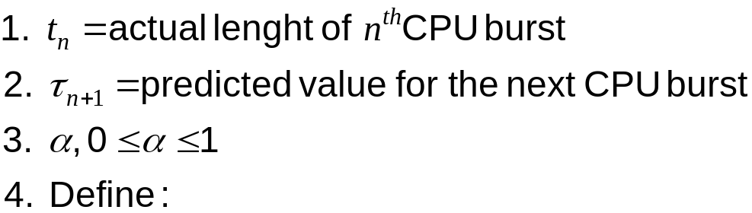

Determining Length of Next CPU Burst
Can only estimate the length.
Overhead of storing the last burst info
Can be done by using the length of previous CPU bursts, using exponential averaging:

Slide 29
Examples of Exponential Averaging
α =0
  τ_{n+1} = τ_{n}
  Recent history does not count.
α =1
  τ_{n+1} = t_{n}
  Only the actual last CPU burst counts.
If we expand the formula, we get:
    τ_{n+1} = α t_{n}+(1 - α) α t_{n} ₋₁+…+(1 - α )^{j}α t_{n-j} + …+(1 - α )^{n}τ₁
Since both α and (1 - α) are less than or equal to 1, each successive term has less weight than its predecessor.

Slide 30
Priority Scheduling
A priority number (integer) is associated with each process
The CPU is allocated to the process with the highest priority (smallest integer ≡ highest priority).
  Preemptive
  Nonpreemptive
SJF is a priority scheduling where priority is the predicted next CPU burst time.
Problem ≡ Starvation – low priority processes may never execute.
Solution ≡ Aging – as time progresses increase the priority of the process.

Slide 31
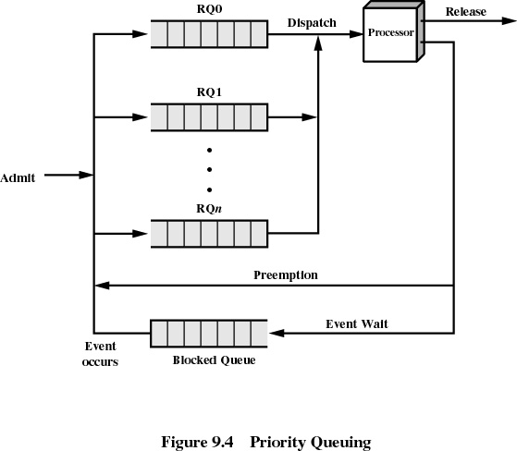

Slide 32
Round Robin (RR)
Each process gets a small unit of CPU time (time quantum), usually 10-100 milliseconds. After this time has elapsed, the process is preempted and added to the end of the ready queue.
If there are n processes in the ready queue and the time quantum is q, then each process gets 1/n of the CPU time in chunks of at most q time units at once. No process waits more than (n-1)q time units.
Performance
  q large ⇒ FIFO
  q small ⇒ q must be large with respect to context switch, otherwise overhead is too high.

Slide 33
Example: RR With Time Quantum = 20
Process Burst Time
P₁ 53
P₂ 17
P₃ 68
P₄ 24
The Gantt chart is:
Typically, higher average turnaround than SJF, but better response.
P₁
P₂
P₃
P₄
P₁
P₃
P₄
P₁
P₃
P₃
0
20
37
57
77
97
117
121
134
154
162

Slide 34

Smaller Time Quantum Increases Context Switches
Rule of thumb: time quantum should be slightly larger than the time required for a typical interaction. also the time quantum should be about 10 times larger than the context switch time
RR is unfair to I/O bound processes=> Use Virtual RR(VRR) with an auxiliary queue

Slide 35
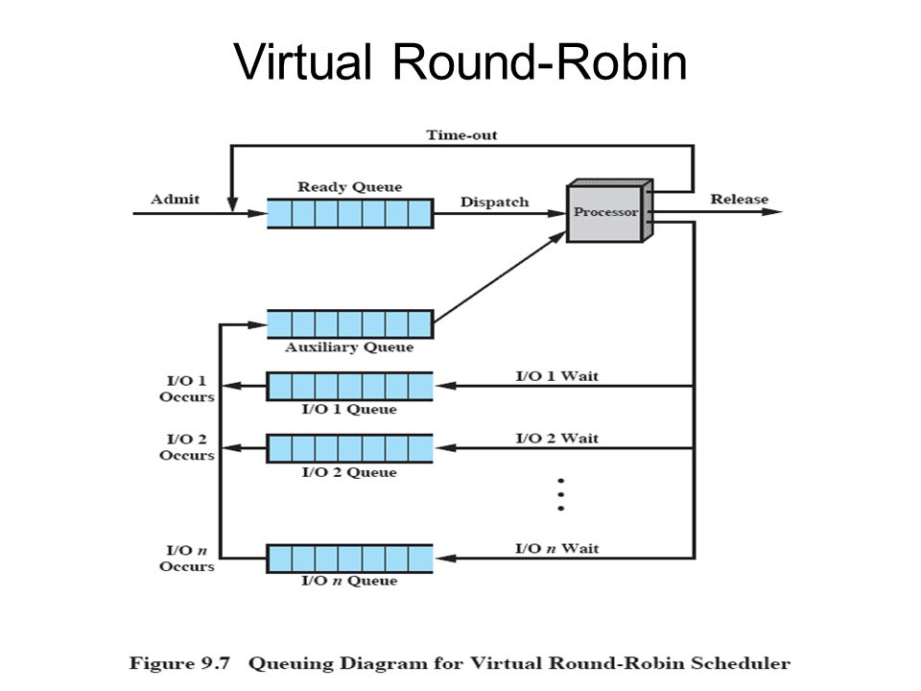
Operating System Concepts

Slide 36

Turnaround Time Varies With The Time Quantum

Slide 37
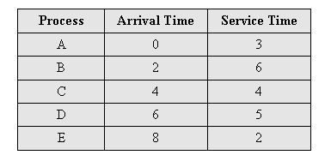
Highest Response Ratio Next (HRRN)
0
5
10
15
20
1
2
3
4
5
Choose next process with the highest ratio (normalized turnaround time)
time spent waiting + expected service time
expected service time
This is a Nonpreemptive strategy

Slide 38
Multilevel Queue
Ready queue is partitioned into separate queues: example:
foreground (interactive)
background (batch)
Each queue has its own scheduling algorithm,
foreground – RR
background – FCFS
Scheduling must be done between the queues.
  Fixed priority scheduling; i.e., serve all from foreground then from background. Possibility of starvation.
  Time slice – each queue gets a certain amount of CPU time which it can schedule amongst its processes; i.e.,
  80% to foreground in RR and 20% to background in FCFS

Slide 39

Multilevel Queue Scheduling

Slide 40
Multilevel Feedback Queue
Separate different processes according to their CPU burst characteristics. Preemption employed
A process can move between the various queues; aging can be implemented this way.
Multilevel-feedback-queue scheduler is defined by the following parameters:
  number of queues
  scheduling algorithms for each queue
  method used to determine when to upgrade a process
  method used to determine when to demote a process
  method used to determine which queue a process will enter when that process needs service

Slide 41

Multilevel Feedback Queues

Slide 42
Example of Multilevel Feedback Queue
Three queues:
  Q₀ – time quantum 8 milliseconds
  Q₁ – time quantum 16 milliseconds
  Q₂ – FCFS
Scheduling
  A new job enters queue Q₀ which is served FCFS. When it gains CPU, job receives 8 milliseconds. If it does not finish in 8 milliseconds, job is moved to queue Q₁.
  At Q₁ job is again served FCFS and receives 16 additional milliseconds. If it still does not complete, it is preempted and moved to queue Q₂.

Slide 43
Fair-share Scheduling
User’s application runs as a collection of processes (sets)
User is concerned about the performance of the application made up of a set of processes
Need to make scheduling decisions based on process sets(groups)
Think of processes as part of a group
Each group has a specified share of the machine time it is allowed to use
Priority is based on the time this processes is active, and the time the other processes in the group have been active

Slide 44
Fair Share Scheduling
Values defined
  P_{j}(i) =Priority of process j at beginning of ith interval
  U_{j} (i) =Processor use by process j during ith interval
  GU_{k}(i) =Processor use by group k during ith interval
  CPU_{j}(i) =Exponentially weighted average for process j from
  beginning to the start of ith interval
  GCPU_{k}(i) =Exponentially weighted average for group k from
  beginning to the start of ith interval
  W_{k} =Weight assigned to group k, 0≤ W_{k} ≤1, Σ_{k}W_{k}=1
  => CPU_{j}(1)=0, GCPU_{k}(1)=0, i=1,2,3,….

Slide 45
Fair Share Scheduling
Calculations (done each second):
  P_{j}(i) = Base_{j} + CPU_{j}(i)/2 + GCPU_{k}(i)/(4*W_{k})
  CPU_{j}(i) = U_{j}(i-1)/2 +CPU_{j}(i-1)/2
  GCPU_{k}(i) = GU_{k}(i-1)/2 + GCPU_{k}(i-1)/2

Slide 46
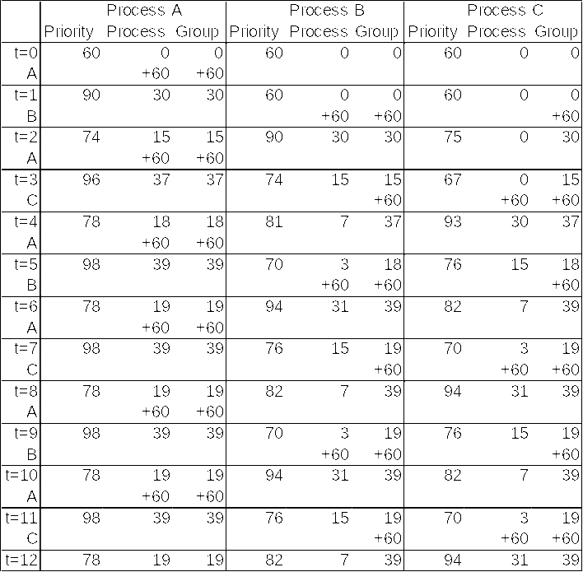
Fair Share Example
Three processes A, B, C; B,C are in one group; A is by itself
Both groups get 50% weighting

Slide 47
Traditional UNIX Scheduling
Multilevel queue using round robin within each of the priority queues
Priorities are recomputed once per second
Base priority divides all processes into fixed bands of priority levels
Adjustment factor used to keep process in its assigned band (called nice)

Slide 48
Bands
Decreasing order of priority
  Swapper
  Block I/O device control
  File manipulation
  Character I/O device control
  User processes
Values
    P_{j}(i) =Priority of process j at start of ith interval
    U_{j}(i) =Processor use by j during the ith interval
  Calculations (done each second):
    CPU_{j} = U_{j}(i-1)/2 +CPU_{j}(i-1)/2
    P_{j} = Base_{j} + CPU_{j}/2 + nice_{j}

Slide 49
Multiprocessor Scheduling Issues
Processors are functionally identical ?
  Homogeneous
  Heterogeneous
System in which i/o is attached to private bus of a processor.
Keep all processor equally busy .
  Load balancing

Slide 50
Approach to MP scheduling
Asymmetric Multiprocessing
  All scheduling , I/O handling, System activity is handled by one processor
  Other processors are used for executing user code
  Simple as only one processor accesses the system data structure ( reduced need for data sharing)
Symmetric Multiprocessing
  Each processor is self scheduling
    Can have single common queue for all processor
    alternatively individual queue for each processor
  Processor affinity
    Soft affinity
    Hard affinity
  Load balancing

Slide 51
Load Balancing
In SMP load balancing is necessary only when each processor has independent (private)ready queue
Push/pull migration
  A specific task checks periodically the load of each processor .
    In case of imbalance , moves process from overloaded to idle processor.
    Pull occurs when Idle processor pulls a process from a busy processor
Load balancing counteracts the benefits of processor affinity

