Slide 1
Mass-Storage Systems
Notes:
<number>

Slide 2
Disk Structure
Disk drives are addressed as large 1-dimensional arrays of logical blocks, where the logical block is the smallest unit of transfer.
The 1-dimensional array of logical blocks is mapped into the sectors of the disk sequentially.
Sector 0 is the first sector of the first track on the outermost cylinder.
Mapping proceeds in order through that track, then the rest of the tracks in that cylinder, and then through the rest of the cylinders from outermost to innermost.
Notes:
<number>

Slide 3
Disk Scheduling
The operating system is responsible for using hardware efficiently — for the disk drives, this means having a fast access time and disk bandwidth.
Access time has two major components
Seek time is the time for the disk arm to move the heads to the cylinder containing the desired sector.
Rotational latency is the additional time waiting for the disk to rotate the desired sector to the disk head.
Minimize seek time
Seek time ≈ seek distance
Disk bandwidth is the total number of bytes transferred, divided by the total time between the first request for service and the completion of the last transfer.
Notes:
<number>

Slide 4
Disk Scheduling (Cont.)
Several algorithms exist to schedule the servicing of disk I/O requests.
Example: request queue (0-199).
98, 183, 37, 122, 14, 124, 65, 67
Head pointer 53
Notes:
<number>

Slide 5
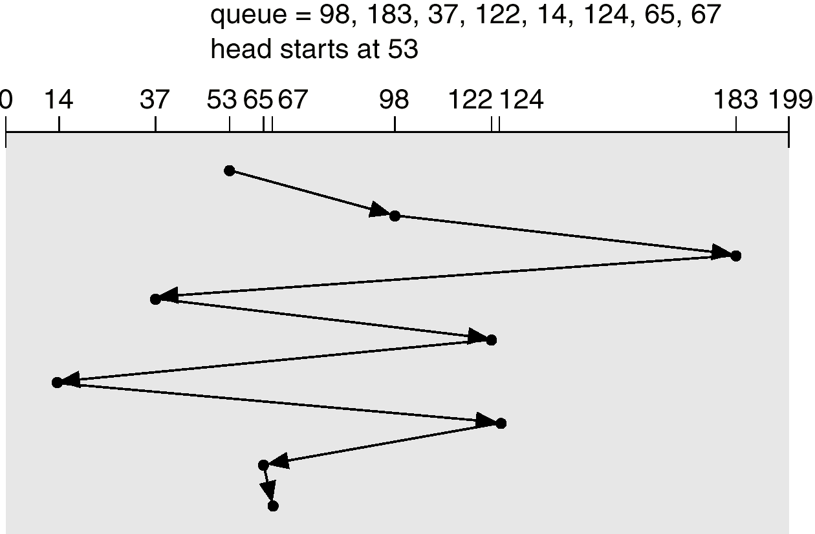
FCFS
Illustration shows total head movement of 640 cylinders.
Notes:
<number>

Slide 6
FCFS is fair
Does not provide fast service
Notes:
<number>

Slide 7
SSTF
Selects the request with the minimum seek time from the current head position.
SSTF scheduling is a form of SJF scheduling; may cause starvation of some requests.
Illustration shows total head movement of 236 cylinders.
Notes:
<number>

Slide 8
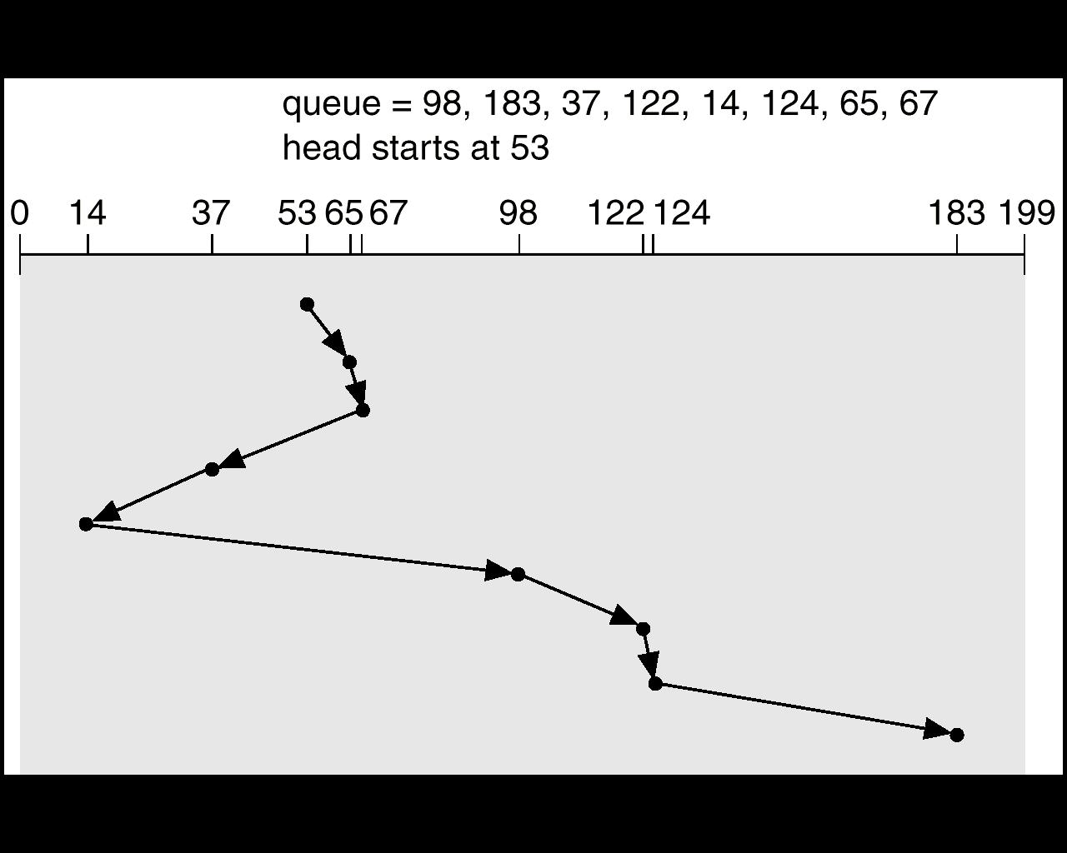
SSTF (Cont.)
Notes:
<number>

Slide 9
SCAN
The disk arm starts at one end of the disk, and moves toward the other end, servicing requests until it gets to the other end of the disk, where the head movement is reversed and servicing continues.
Sometimes called the elevator algorithm.
Illustration shows total head movement of 208 cylinders.
Notes:
<number>

Slide 10
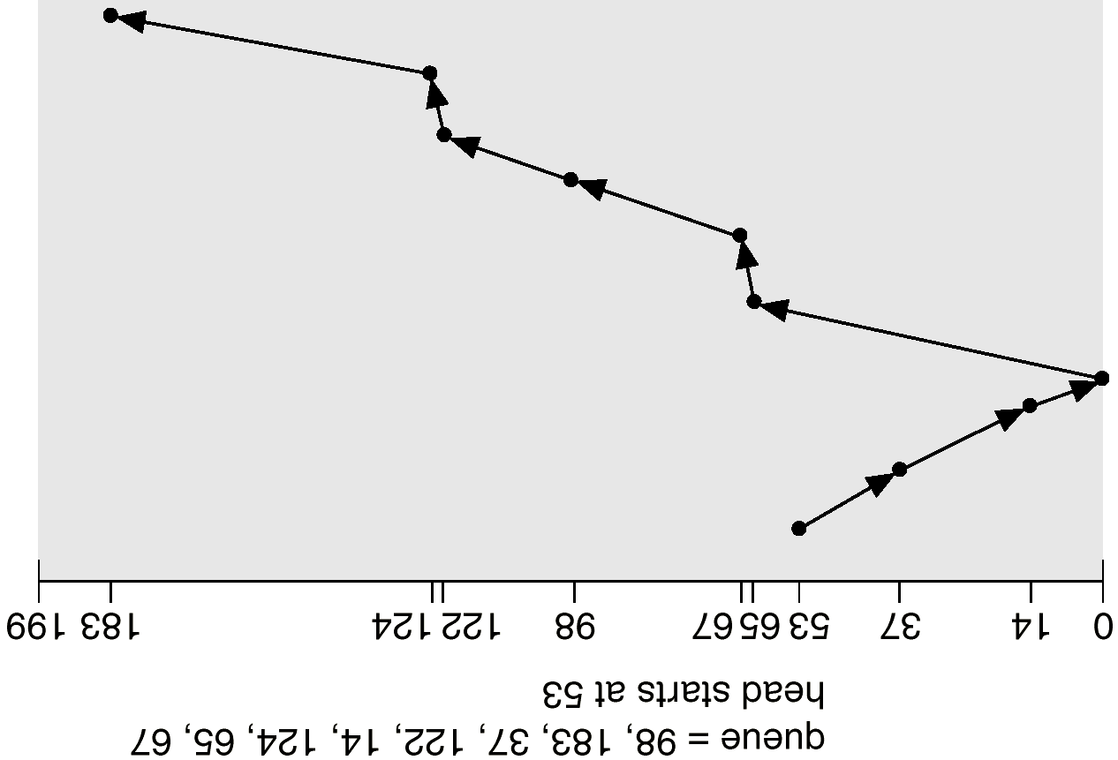
SCAN (Cont.)
Notes:
<number>

Slide 11
C-SCAN
Provides a more uniform wait time than SCAN.
The head moves from one end of the disk to the other servicing requests as it goes. When it reaches the other end, however, it immediately returns to the beginning of the disk, without servicing any requests on the return trip.
Treats the cylinders as a circular list that wraps around from the last cylinder to the first one.
Notes:
<number>

Slide 12
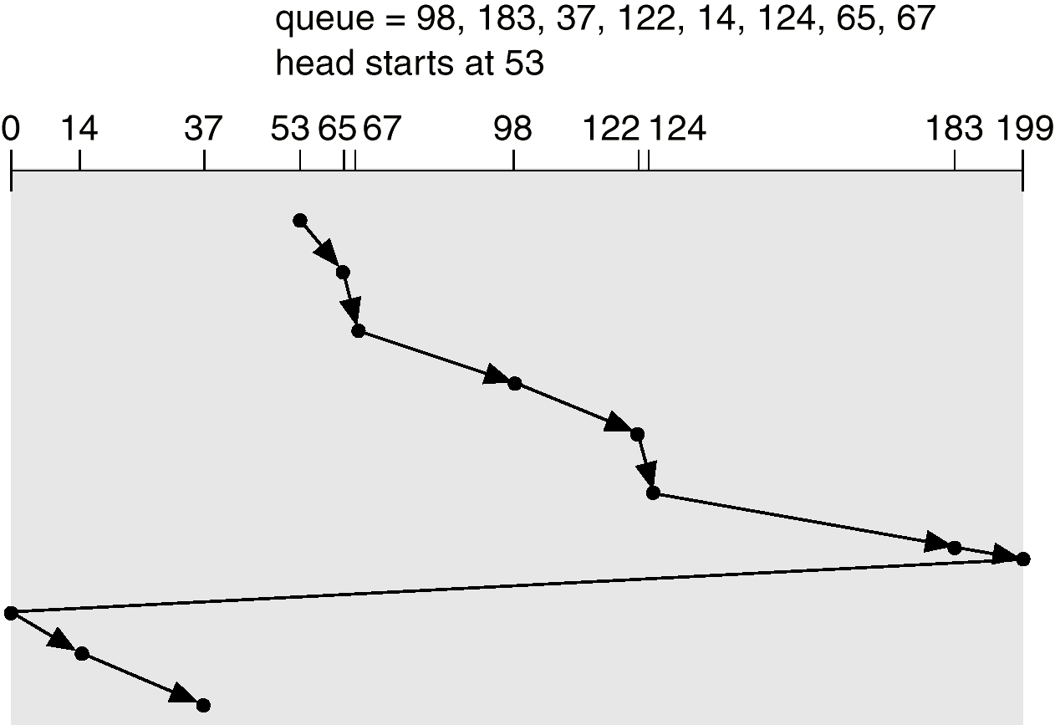
C-SCAN (Cont.)
Notes:
<number>

Slide 13
C-LOOK
Version of C-SCAN
Arm only goes as far as the last request in each direction, then reverses direction immediately, without first going all the way to the end of the disk.
Notes:
<number>

Slide 14
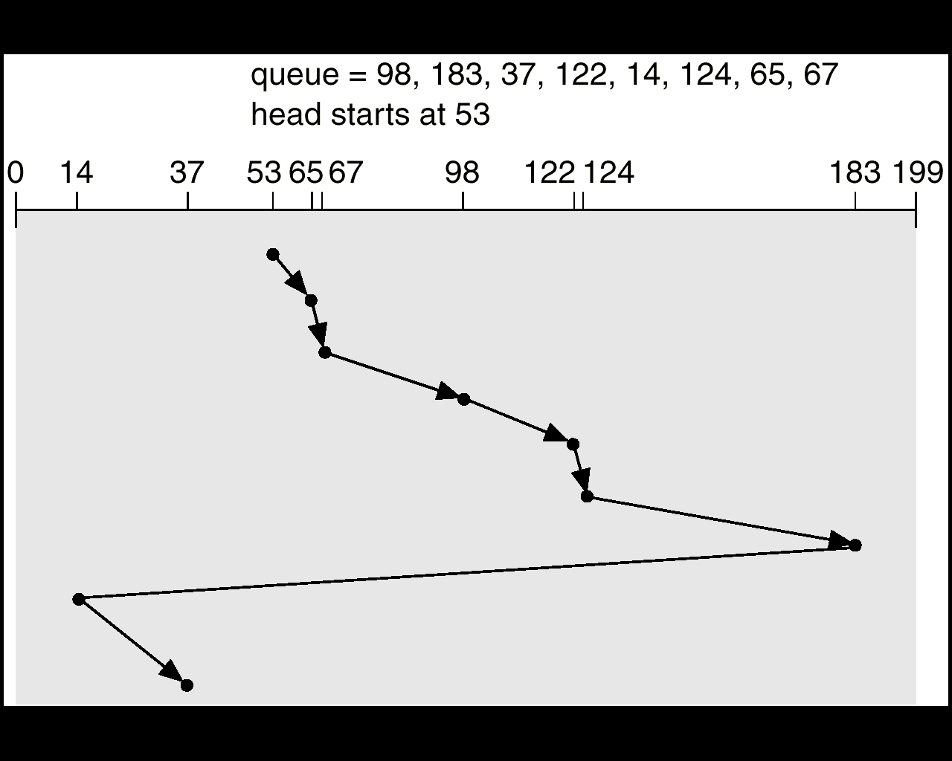
C-LOOK (Cont.)
Notes:
<number>

Slide 15
Selecting a Disk-Scheduling Algorithm
SSTF is common and has a natural appeal
SCAN and C-SCAN perform better for systems that place a heavy load on the disk.
Performance depends on the number and types of requests.
Requests for disk service can be influenced by the file-allocation method.
The disk-scheduling algorithm should be written as a separate module of the operating system, allowing it to be replaced with a different algorithm if necessary.
Either SSTF or LOOK is a reasonable choice for the default algorithm.
Notes:
<number>

Slide 16
RAID Structure
RAID – multiple disk drives provides reliability via redundancy
RAID is arranged into seven different levels.
Notes:
<number>

Slide 17
RAID (cont)
Several improvements in disk-use techniques involve the use of multiple disks working cooperatively.
Disk striping uses a group of disks as one storage unit.
RAID schemes improve performance and improve the reliability of the storage system by storing redundant data.
Mirroring or shadowing keeps duplicate of each disk.
Block interleaved parity uses much less redundancy.
Notes:
<number>

Slide 18
RAID is a set of physical drives viewed by OS as a single Logical drive
Data is distributed across the physical drives of a array
Redundant disk capacity is used for parity for data recovery
RAID 0 and 1 do not have the third characteristics
Should increase I/O handling capacity
Should increase data handling capacity
Notes:
<number>

Slide 19
RAID 0
Does not include any redundancy
Two different I/O requests can be issued in parallel
The logical disk is divided into strips
These strips may be physical blocks, sectors or some other unit
Increases I/O handling capacity
Increases data handling capacity
Notes:
<number>

Slide 20
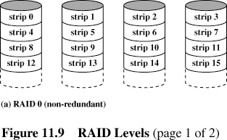
Notes:
<number>

Slide 21
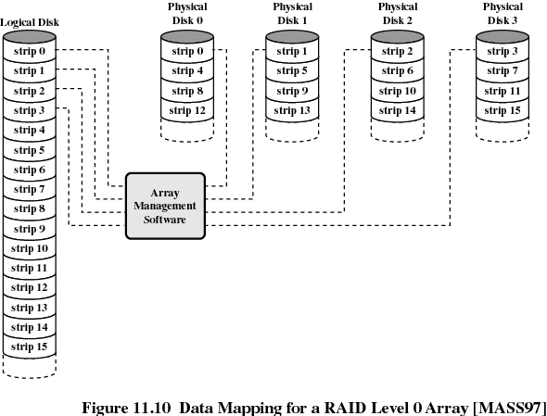
Notes:
<number>

Slide 22
RAID 1
Uses Mirroring
A read request can be serviced by either of two disks whichever has lesser service time
A write request requires that both corresponding strips be updated. This can be done in parallel. There is no write penalty as no parity is calculated.
Recovery from failure is simple.
High data transfer and I/O handling rate.
Notes:
<number>

Slide 23
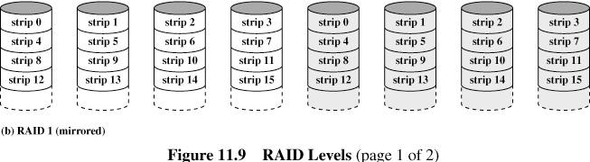
Notes:
<number>

Slide 24
RAID 2
RAID 2 and 3 make use of parallel accessing technique.
All member disks participate in every I/O request
The disk heads are synchronized
In RAID 2 and 3 the strips are very small (byte or word)
Multibit parity is calculated using Hamming code
Number of disks used is less than RAID 1 but still costly
All disks are simultaneously accessed
RAID 2 is not used
Notes:
<number>

Slide 25
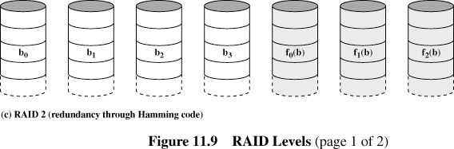
Notes:
<number>

Slide 26
RAID 3
Require only 1 redundant disk
Simple parity bit is used
High data transfer rate
Only 1 I/O request can be handled at a time
Notes:
<number>

Slide 27
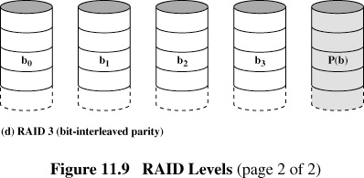
Notes:
<number>

Slide 28
X4(i) = X3(i)⊕ X2(i) ⊕ X1(i) ⊕ X0(i)
Suppose Disk X1 fails
By adding X4(i)⊕ X1(i) on both sides we get
X1(i) = X4(i)⊕ X3(i) ⊕ X2(i) ⊕ X0(i)
Notes:
<number>

Slide 29
RAID 4
Each member disk operates independently
Can handle high I/O request rates
Each WRITE requires two READS and 2 WRITES, which is a bottleneck
Notes:
<number>

Slide 30
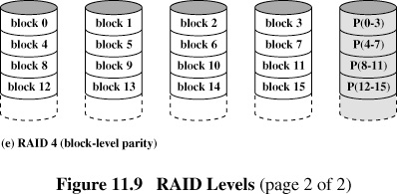
Notes:
<number>

Slide 31
X4(i) = X3(i)⊕ X2(i) ⊕ X1(i) ⊕ X0(i)
Suppose a write is performed which only involves
a strip on disk X1.
Thus
X4’(i) = X3(i)⊕ X2(i) ⊕ X1’(i) ⊕ X0(i)
= X3(i)⊕ X2(i) ⊕ X1’(i) ⊕ X0(i) ⊕ X1(i) ⊕ X1(i)
= X4(i) ⊕ X1(i) ⊕ X1’(i)
Notes:
<number>

Slide 32
RAID 5
Data distribution similar to RAID 4
Parity is rotated
I/O bottleneck of single parity disk is avoided
Notes:
<number>

Slide 33
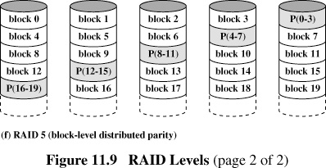
Notes:
<number>

Slide 34
RAID 6
Two different parity calculations are carried out and stored in separate blocks on different disks
N+2 disks are required
Can take care of two disk failures
Provides extremely high data availability
Incurs a substantial write penalty
Notes:
<number>

Slide 35
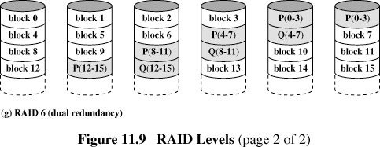
Notes:
<number>

Slide 36
Hamming Code
Notes:
<number>

Slide 37
Data and redundancy bits
Number of data bits m | Number of redundancy bits r | Total bits m + r
1 | 2 | 3
2 | 3 | 5
3 | 3 | 6
4 | 3 | 7
5 | 4 | 9
6 | 4 | 10
7 | 4 | 11
Notes:
<number>

Slide 38
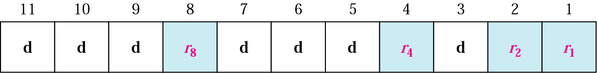
Positions of redundancy bits in Hamming code
Notes:
<number>

Slide 39
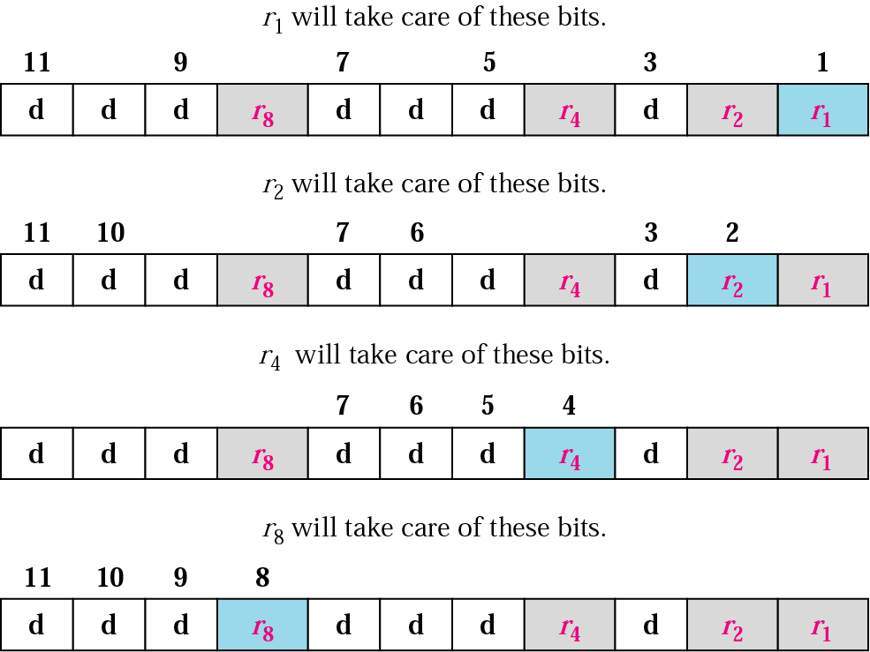
Redundancy bits calculation
Notes:
<number>

Slide 40
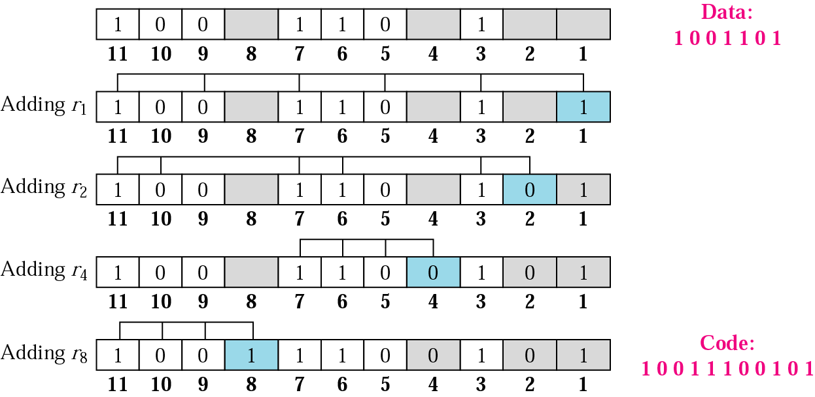
Example of redundancy bit calculation
Notes:
<number>

Slide 41
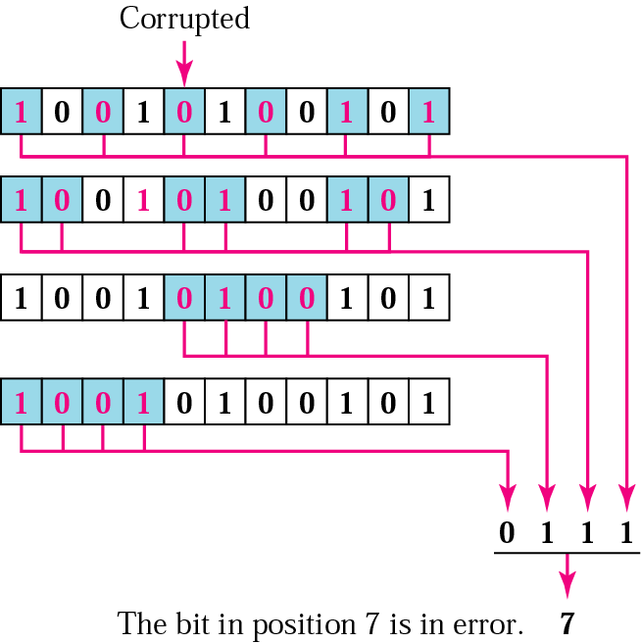
Error detection using Hamming code
Notes:
<number>

