Slide 1
I/O Systems

Slide 2
I/O Hardware
Incredible variety of I/O devices
Common concepts
  Port
  Bus (daisy chain or shared direct access)
  Controller (host adapter)
I/O instructions control devices
Devices have addresses, used by
  Direct I/O instructions
  Memory-mapped I/O

Slide 3
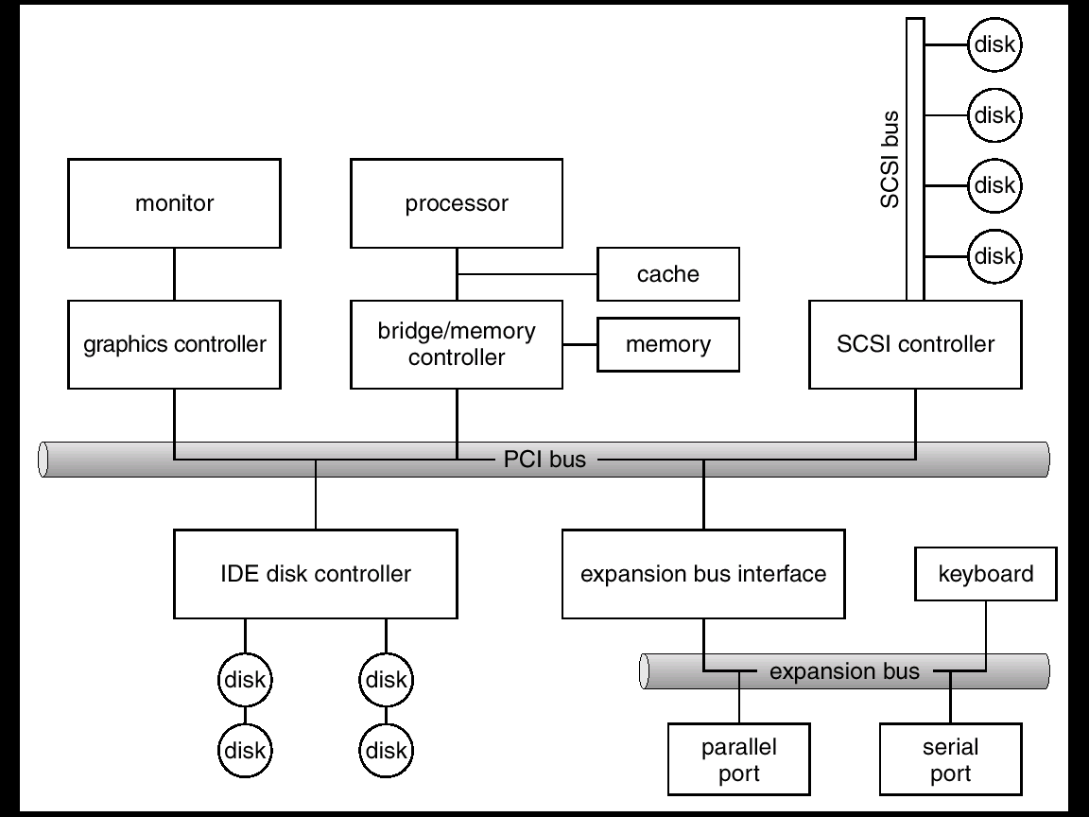
A Typical PC Bus Structure

Slide 4
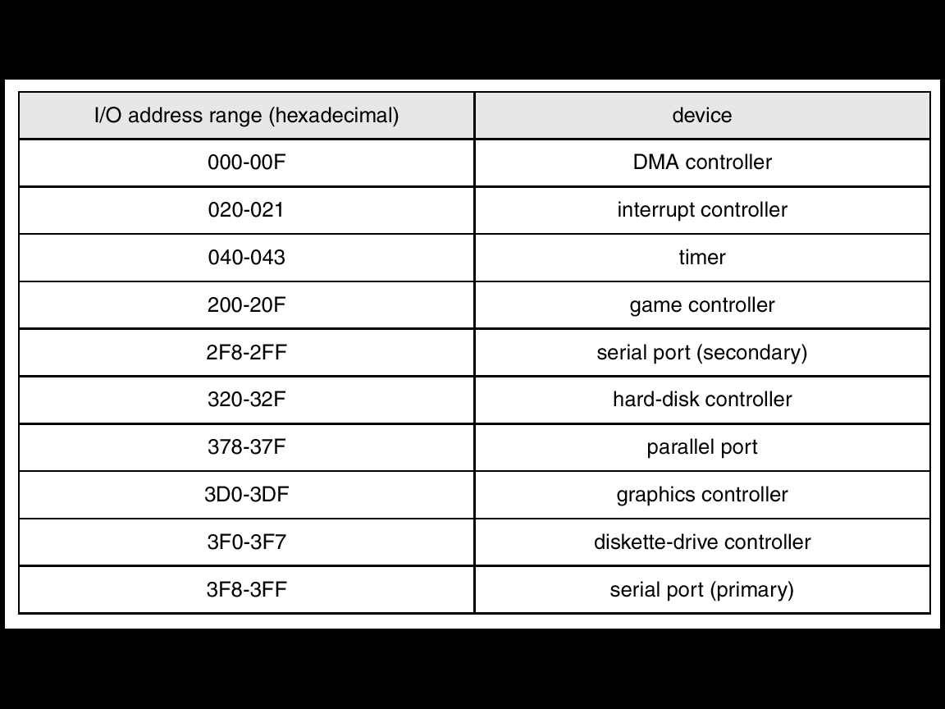
Device I/O Port Locations on PCs (partial)

Slide 5
I/O port typically consists of 4 registers
Status
Control
Data-In
Data-Out

Slide 6
Polling
Processor determines state of device by repeatedly checking it
Busy-wait cycle to wait for I/O from device
Is reasonable only if the device and controller are fast

Slide 7
Interrupts
CPU Interrupt request line triggered by I/O device
Interrupt handler receives interrupts
Maskable to ignore or delay some interrupts
Interrupt vector to dispatch interrupt to correct handler
  Based on priority
  Some unmaskable
Interrupt mechanism also used for exceptions (divide by 0…)
System call are implemented via s/w interrupts

Slide 8
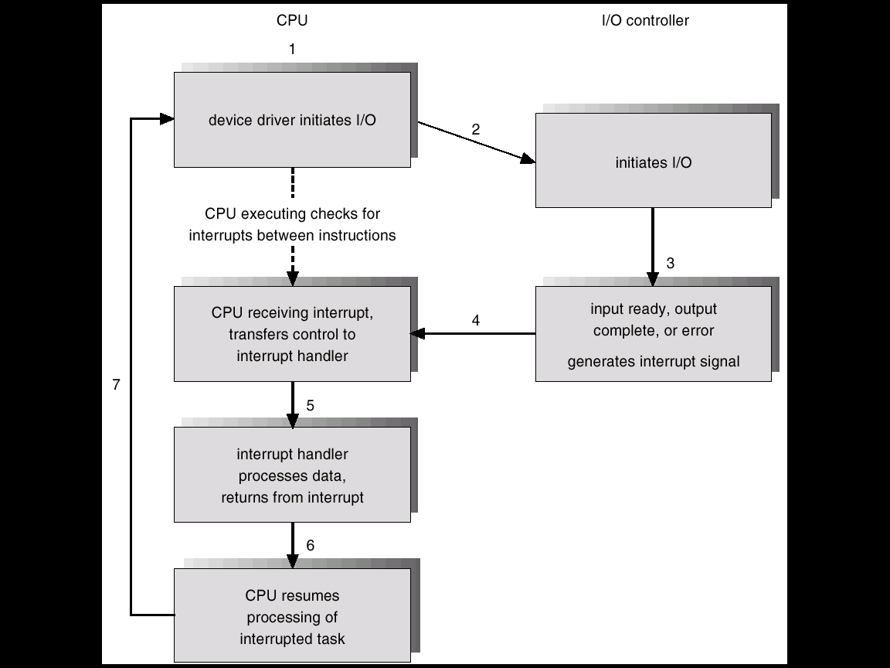
Interrupt-Driven I/O Cycle

Slide 9
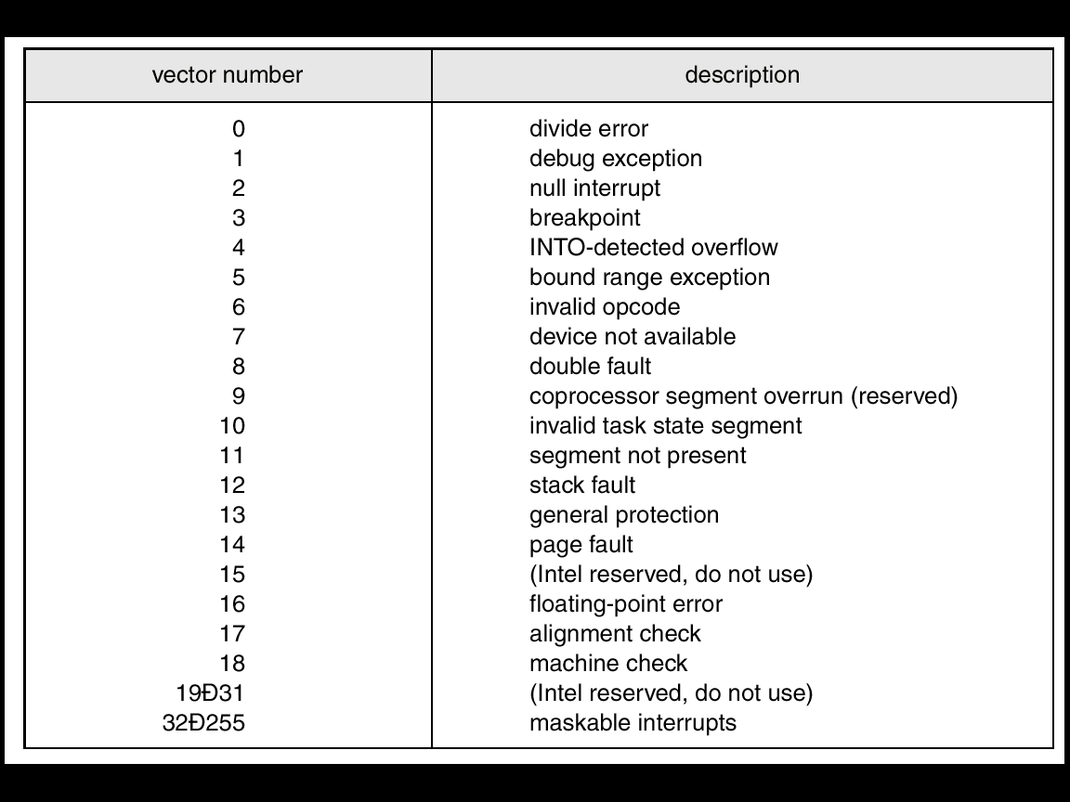
Intel Pentium Processor Event-Vector Table

Slide 10
Direct Memory Access
Used to avoid programmed I/O for large data movement
Requires DMA controller
Bypasses CPU to transfer data directly between I/O device and memory

Slide 11

Six Step Process to Perform DMA Transfer

Slide 12
How can the OS be designed such that new devices can be attached to the computer without the OS being rewritten?

Slide 13
Application I/O Interface
I/O system calls encapsulate device behaviors in generic classes
Device-driver layer hides differences among I/O controllers from kernel
Devices vary in many dimensions
  Character-stream or block
  Sequential or random-access
  Sharable or dedicated
  Speed of operation
  read-write, read only, or write only

Slide 14
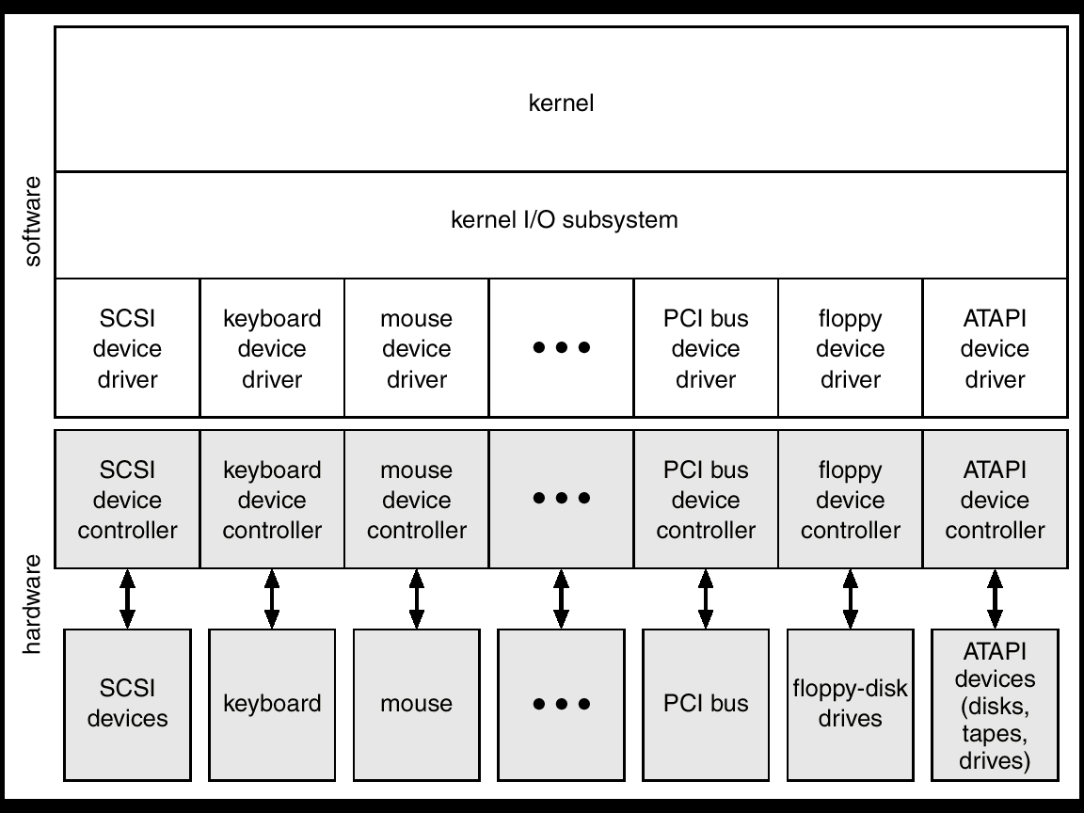
A Kernel I/O Structure

Slide 15
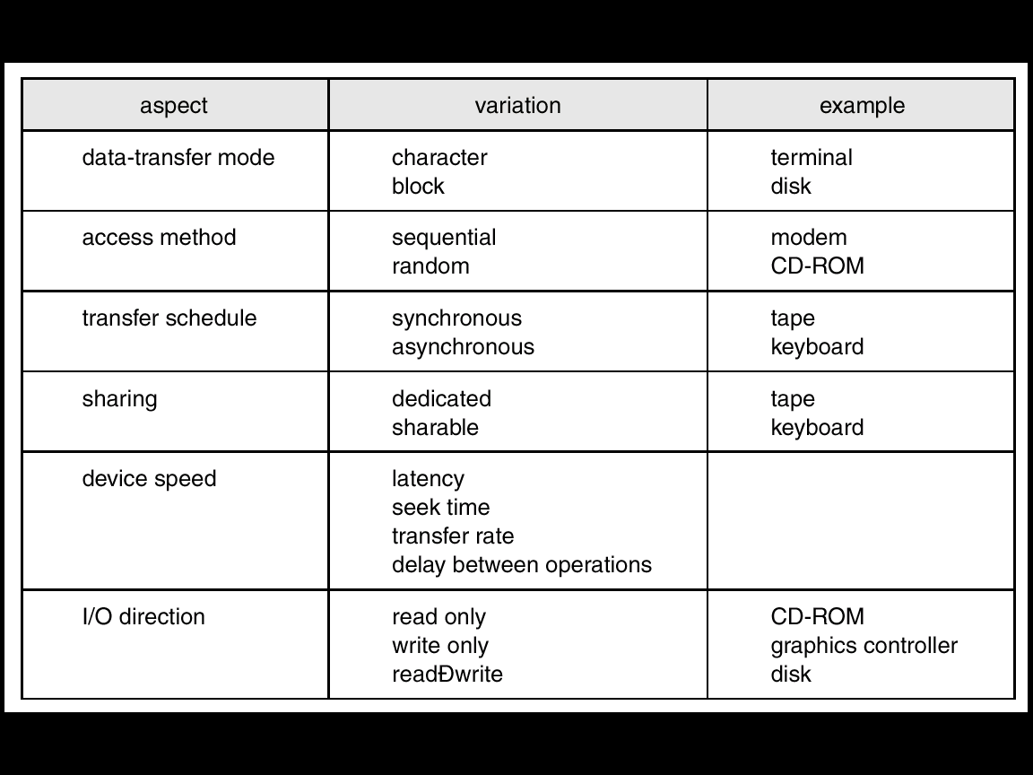
Characteristics of I/O Devices

Slide 16
Block and Character Devices
Block devices include disk drives
  Commands include read, write, seek
  Raw I/O or file-system access
Character devices include keyboards, mice, serial ports
  Commands include get, put

Slide 17
Network Devices
Different from block and character devices to have own interface
Unix and Windows include socket interface
  Separates network protocol from network operation
  Includes select functionality
  (returns information about which socket has room for data or has data available to be read)

Slide 18
Clocks and Timers
Provide current time, elapsed time, timer
Programmable interval timer used for timings, periodic interrupts
ioctl (on UNIX) covers odd aspects of I/O such as clocks and timers

Slide 19
Blocking and Nonblocking I/O
Blocking - process suspended until I/O completed
  Easy to use and understand
Nonblocking - I/O call returns as much as available
  User interface, data copy (buffered I/O)
  Returns quickly with count of bytes read or written

Slide 20
Kernel I/O Subsystem
Scheduling
  Some I/O request ordering via per-device queue
  Some OSs try fairness
Buffering - store data in memory while transferring between devices
  To cope with device speed mismatch
  To cope with device transfer size mismatch (segmentation/reassembly)

Slide 21
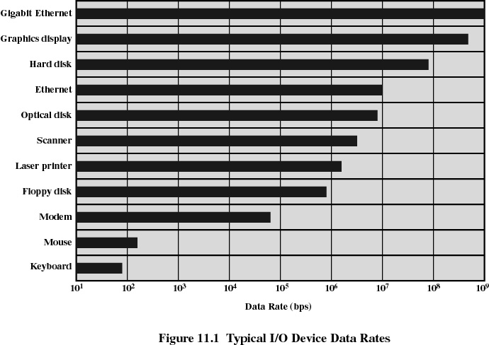
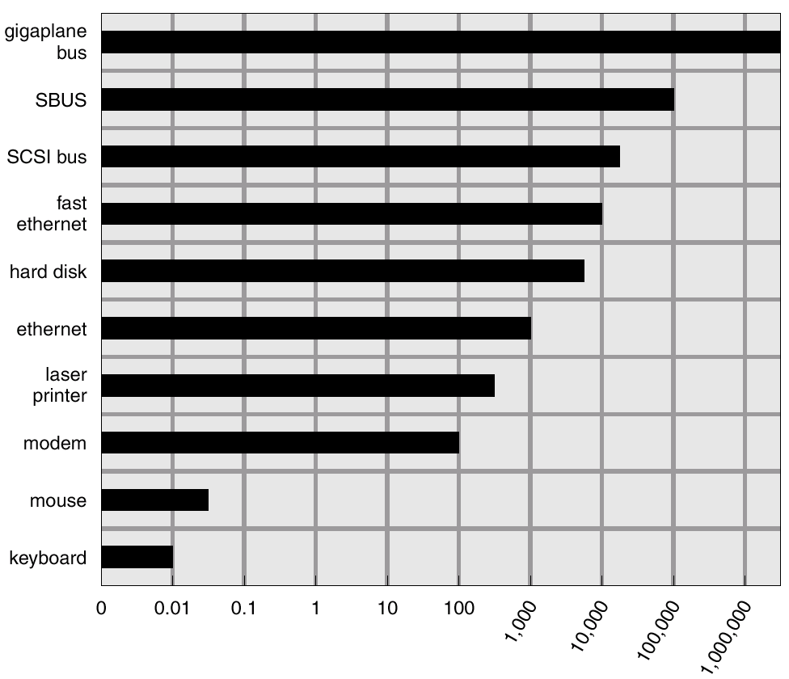
Sun Enterprise 6000 Device-Transfer Rates

Slide 22
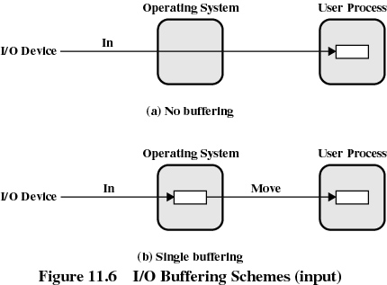

Slide 23
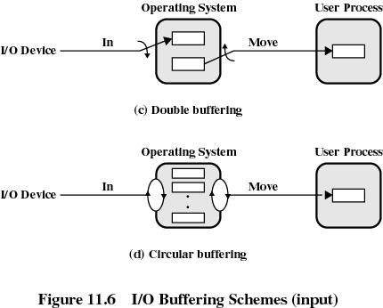

Slide 24
Kernel I/O Subsystem
Caching - fast memory holding copy of data
  Always just a copy
  Key to performance
Spooling - hold output for a device
  If device can serve only one request at a time
  i.e., Printing
Device reservation - provides exclusive access to a device
  System calls for allocation and deallocation
  Watch out for deadlock

Slide 25
Error Handling
OS can recover from disk read, device unavailable, transient write failures
Most return an error number or code when I/O request fails
System error logs hold problem reports

Slide 26
I/O Requests to Hardware Operations
Consider reading a file from disk for a process:
  Determine device holding file
  Translate name to device representation
  Physically read data from disk into buffer
  Make data available to requesting process
  Return control to process

Slide 27
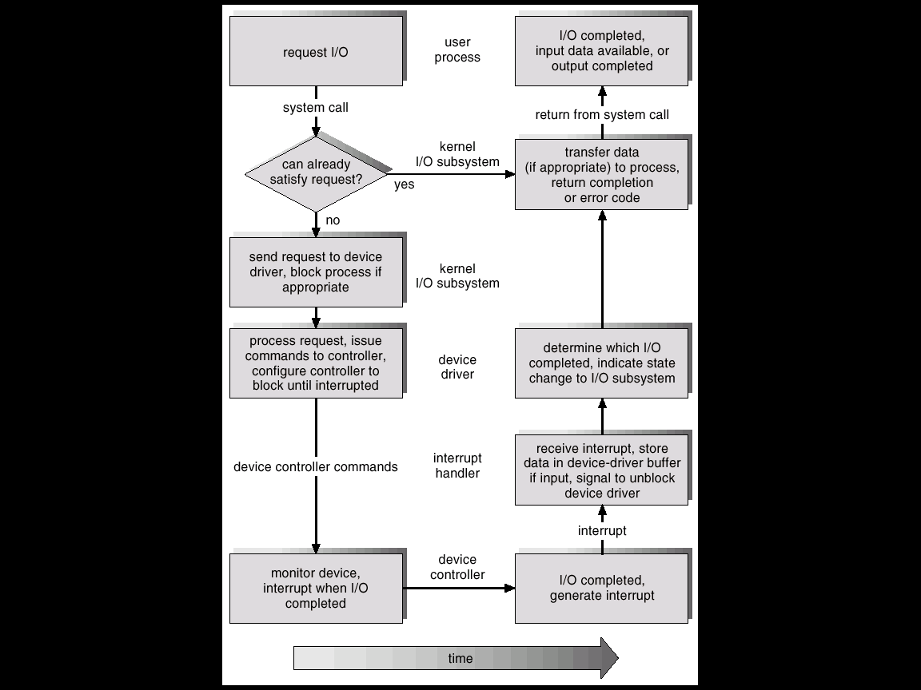
Life Cycle of An I/O Request

Slide 28
Improving Performance
Reduce number of context switches
Reduce data copying
Reduce interrupts by using large transfers, smart controllers, polling
Use DMA
Balance CPU, memory, bus, and I/O performance for highest throughput

Slide 29
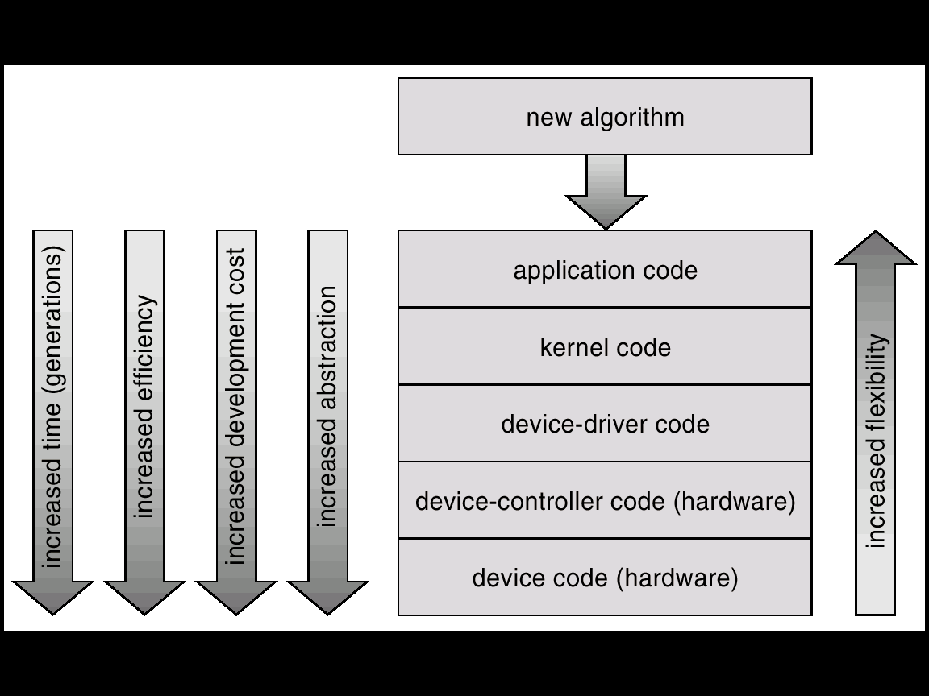
Device-Functionality Progression

Slide 30
Mass-Storage Systems

Slide 31
Disk Structure
Disk drives are addressed as large 1-dimensional arrays of logical blocks, where the logical block is the smallest unit of transfer.
The 1-dimensional array of logical blocks is mapped into the sectors of the disk sequentially.
  Sector 0 is the first sector of the first track on the outermost cylinder.
  Mapping proceeds in order through that track, then the rest of the tracks in that cylinder, and then through the rest of the cylinders from outermost to innermost.

Slide 32
Disk Scheduling
The operating system is responsible for using hardware efficiently — for the disk drives, this means having a fast access time and disk bandwidth.
Access time has two major components
  Seek time is the time for the disk arm to move the heads to the cylinder containing the desired sector.
  Rotational latency is the additional time waiting for the disk to rotate the desired sector to the disk head.
Minimize seek time
Seek time ≈ seek distance
Disk bandwidth is the total number of bytes transferred, divided by the total time between the first request for service and the completion of the last transfer.

Slide 33
Disk Scheduling (Cont.)
Several algorithms exist to schedule the servicing of disk I/O requests.
Example: request queue (0-199).
98, 183, 37, 122, 14, 124, 65, 67
Head pointer 53

Slide 34

FCFS
Illustration shows total head movement of 640 cylinders.

Slide 35
FCFS is fair
Does not provide fast service

Slide 36
SSTF
Selects the request with the minimum seek time from the current head position.
SSTF scheduling is a form of SJF scheduling; may cause starvation of some requests.
Illustration shows total head movement of 236 cylinders.

Slide 37

SSTF (Cont.)

Slide 38
SCAN
The disk arm starts at one end of the disk, and moves toward the other end, servicing requests until it gets to the other end of the disk, where the head movement is reversed and servicing continues.
Sometimes called the elevator algorithm.
Illustration shows total head movement of 208 cylinders.

Slide 39
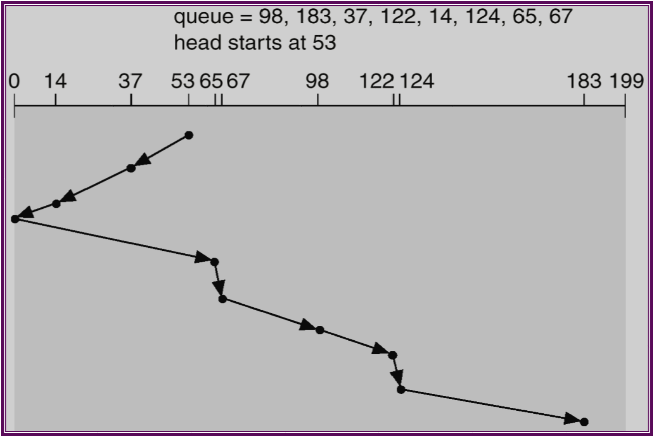
SCAN (Cont.)

Slide 40
C-SCAN
Provides a more uniform wait time than SCAN.
The head moves from one end of the disk to the other servicing requests as it goes. When it reaches the other end, however, it immediately returns to the beginning of the disk, without servicing any requests on the return trip.
Treats the cylinders as a circular list that wraps around from the last cylinder to the first one.

Slide 41

C-SCAN (Cont.)

Slide 42
C-LOOK
Version of C-SCAN
Arm only goes as far as the last request in each direction, then reverses direction immediately, without first going all the way to the end of the disk.

Slide 43

C-LOOK (Cont.)

Slide 44
Priority
  Goal is not to optimize disk use but to meet other objectives
  Short batch jobs may have higher priority
  Provide good interactive response time
Last-in, first-out
  Good for transaction processing systems
    The device is given to the most recent user so there should be little arm movement
  Possibility of starvation since a job may never regain the head of the line

Slide 45
Selecting a Disk-Scheduling Algorithm
SSTF is common and has a natural appeal
SCAN and C-SCAN perform better for systems that place a heavy load on the disk.
Performance depends on the number and types of requests.
Requests for disk service can be influenced by the file-allocation method.
The disk-scheduling algorithm should be written as a separate module of the operating system, allowing it to be replaced with a different algorithm if necessary.
Either SSTF or LOOK is a reasonable choice for the default algorithm.

Slide 46
RAID Structure
RAID – multiple disk drives provides reliability via redundancy (opposed to SLED).
RAID is arranged into seven different levels.

Slide 47
RAID (cont)
Several improvements in disk-use techniques involve the use of multiple disks working cooperatively.
Disk striping uses a group of disks as one storage unit.
RAID schemes improve performance and improve the reliability of the storage system by storing redundant data.
  Mirroring or shadowing keeps duplicate of each disk.
  Block interleaved parity uses much less redundancy.

Slide 48
RAID is a set of physical drives viewed by OS as a single Logical drive
Data is distributed across the physical drives of a array
Redundant disk capacity is used for parity for data recovery
RAID 0 and 1 do not have the third characteristics
Should increase I/O handling capacity
Should increase data handling capacity

Slide 49
RAID 0
Does not include any redundancy
Two different I/O requests can be issued in parallel
The logical disk is divided into strips
These strips may be physical blocks, sectors or some other unit
Strips map to Stripe
Increases I/O handling capacity
Increases data handling capacity

Slide 50
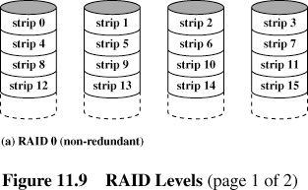

Slide 51
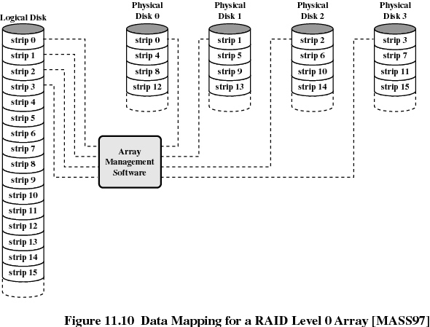

Slide 52
RAID 1
Uses Mirroring
A read request can be serviced by either of two disks whichever has lesser service time
A write request requires that both corresponding strips be updated. This can be done in parallel. There is no write penalty as no parity is calculated.
Recovery from failure is simple.
High data transfer and I/O handling rate.

Slide 53
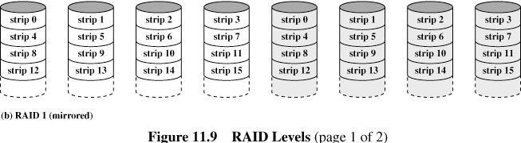

Slide 54
RAID 2
RAID 2 and 3 make use of parallel accessing technique.
All member disks participate in every I/O request
The disk heads are synchronized
In RAID 2 and 3 the strips are very small (byte or word)
Multibit parity is calculated using Hamming code
Number of disks used is less than RAID 1 but still costly
All disks are simultaneously accessed
RAID 2 is not used

Slide 55
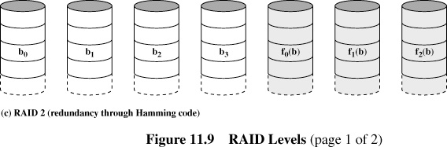

Slide 56
RAID 3
Require only 1 redundant disk
Simple parity bit is used
High data transfer rate
Only 1 I/O request can be handled at a time

Slide 57
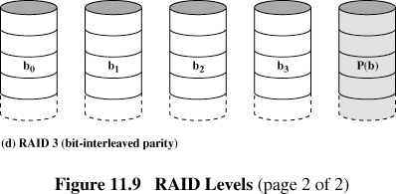

Slide 58
X4(i) = X3(i)⊕ X2(i) ⊕ X1(i) ⊕ X0(i)
Suppose Disk X1 fails
By adding X4(i)⊕ X1(i) on both sides we get
X1(i) = X4(i)⊕ X3(i) ⊕ X2(i) ⊕ X0(i)

Slide 59
RAID 4
Each member disk operates independently
Can handle high I/O request rates
Each WRITE requires two READS and 2 WRITES, which is a bottleneck

Slide 60
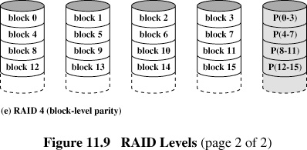

Slide 61
X4(i) = X3(i)⊕ X2(i) ⊕ X1(i) ⊕ X0(i)
Suppose a write is performed which only involves
a strip on disk X1.
Thus
X4’(i) = X3(i)⊕ X2(i) ⊕ X1’(i) ⊕ X0(i)
= X3(i)⊕ X2(i) ⊕ X1’(i) ⊕ X0(i) ⊕ X1(i) ⊕ X1(i)
= X4(i) ⊕ X1(i) ⊕ X1’(i)

Slide 62
RAID 5
Data distribution similar to RAID 4
Parity is rotated
I/O bottleneck of single parity disk is avoided

Slide 63
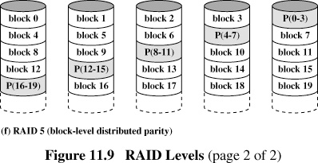

Slide 64
RAID 6
Two different parity calculations are carried out and stored in separate blocks on different disks
N+2 disks are required
Can take care of two disk failures
Provides extremely high data availability
Incurs a substantial write penalty

Slide 65
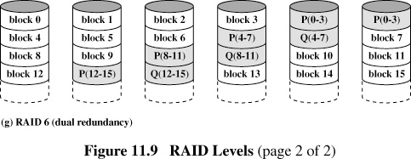

Slide 66



Slide 67
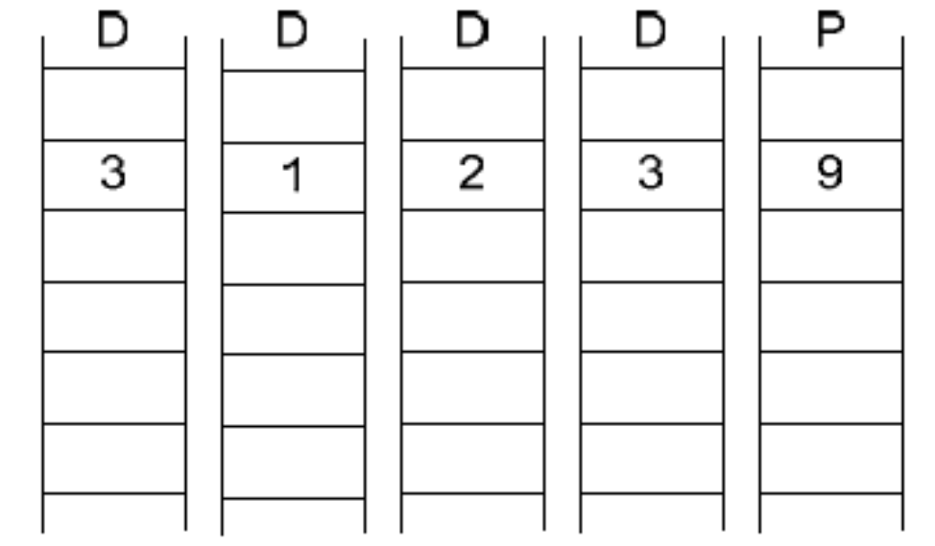
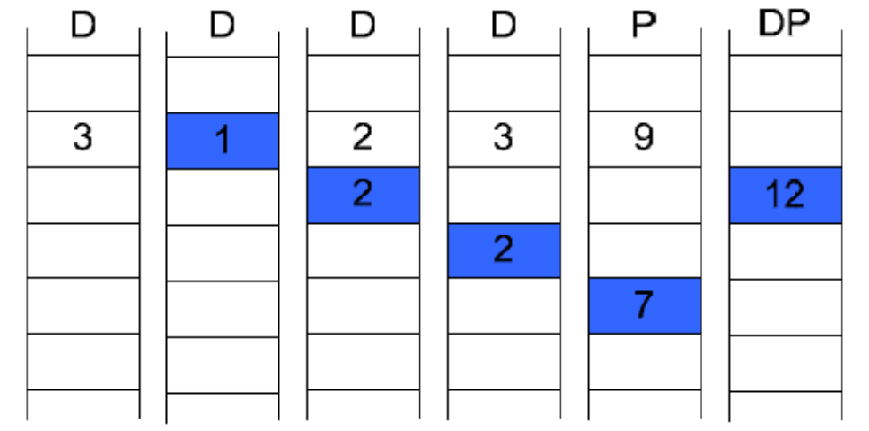
RAID DP

Slide 68
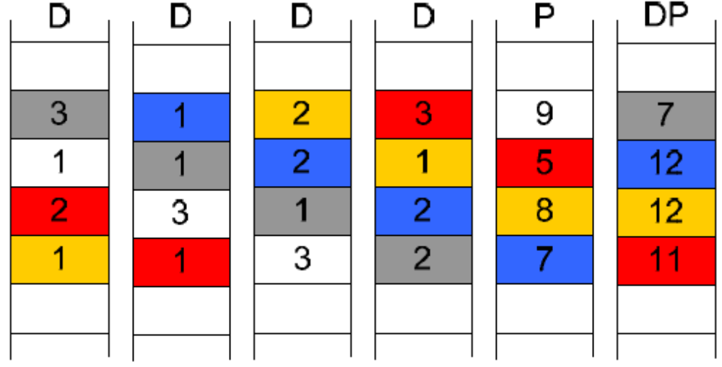
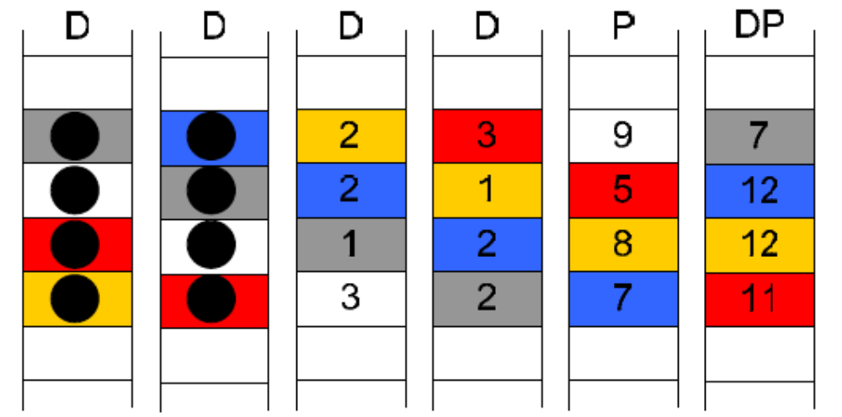
RAID DP

Slide 69
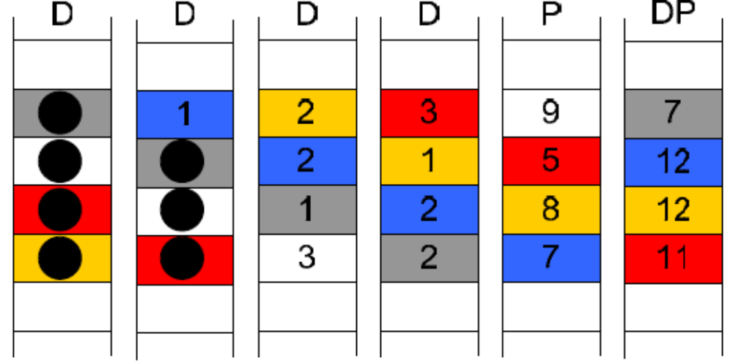
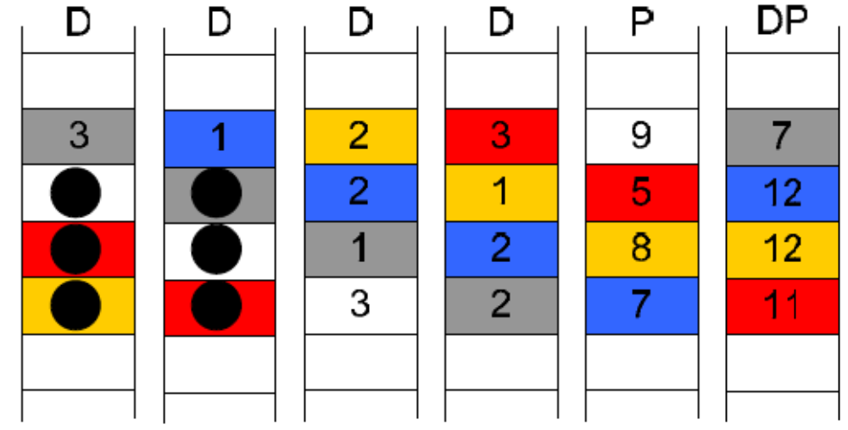
RAID DP

Slide 70
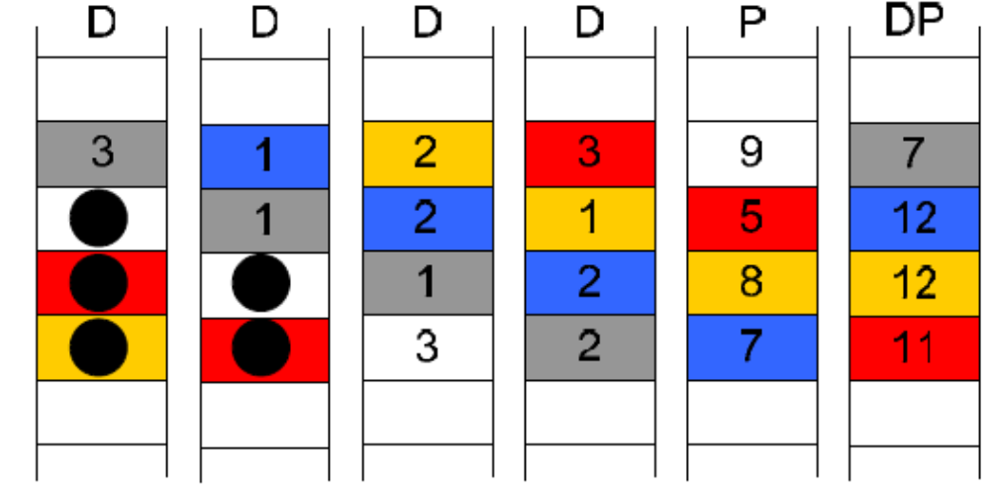
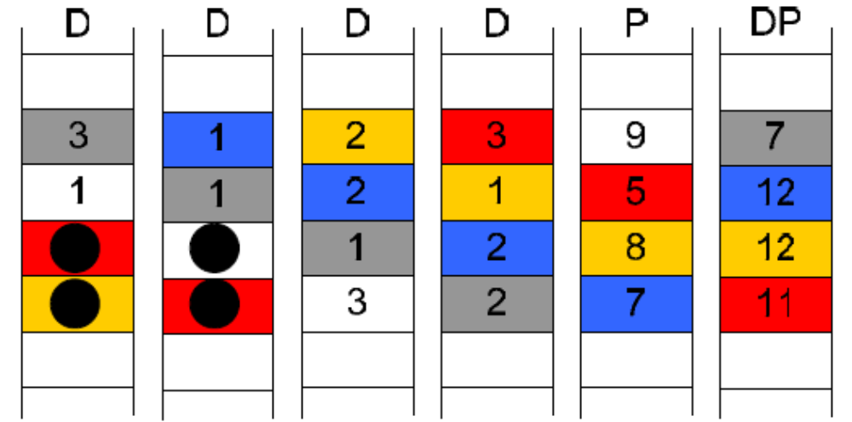
RAID DP

Slide 71
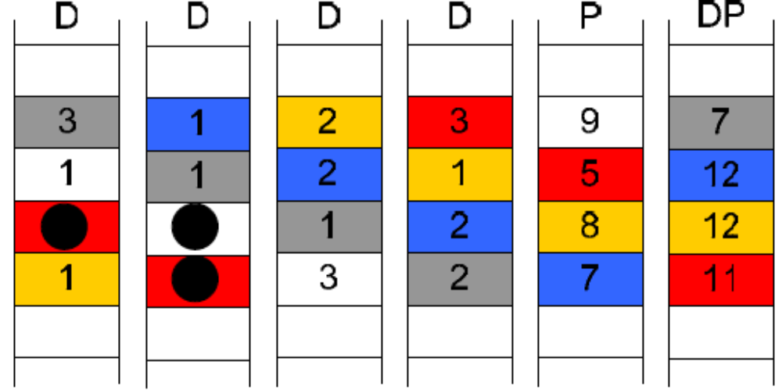
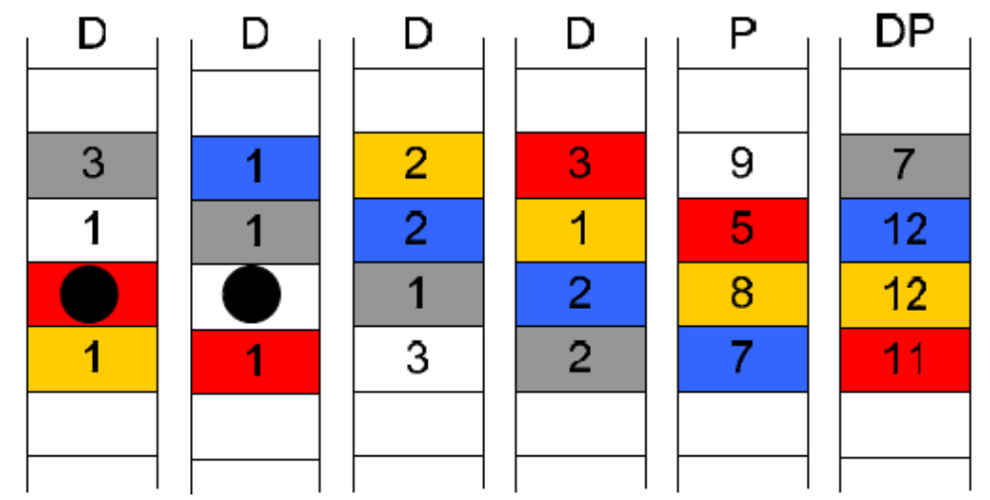
RAID DP

Slide 72
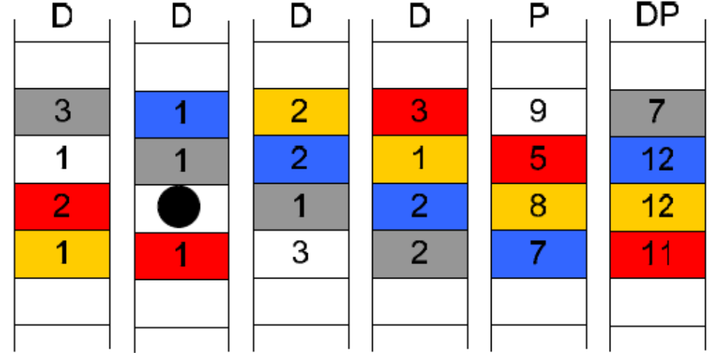
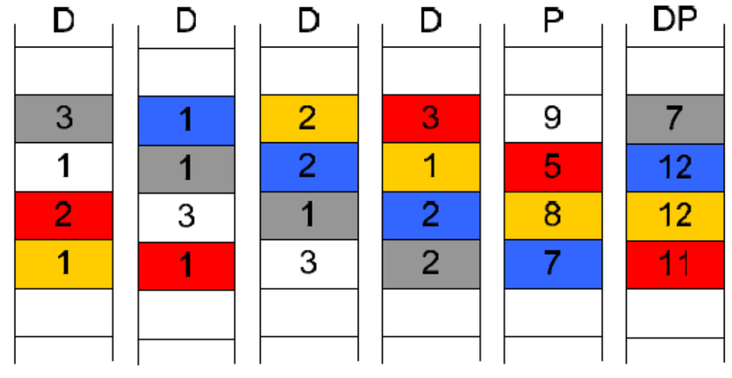
RAID DP

Slide 73
NESTED RAID

Slide 74
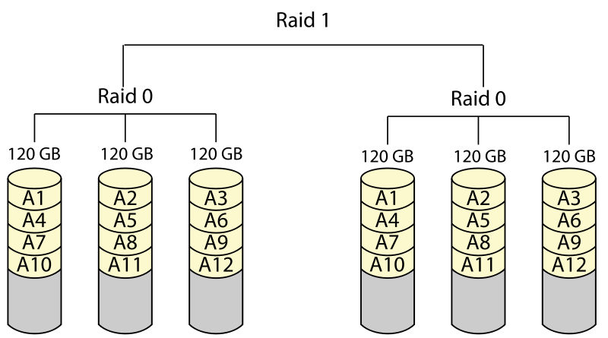
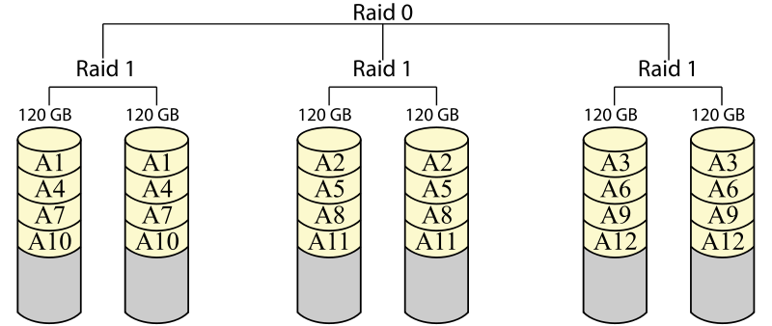
RAID 01
RAID 10
FASTER REBUILD

Slide 75
Implementations
Software based RAID:
Software implementations are provided by many Operating Systems.
A software layer sits above the disk device drivers and provides an abstraction layer between the logical drives(RAIDs) and physical drives.
Server's processor is used to run the RAID software.
Used for simpler configurations like RAID0 and RAID1.

Slide 76
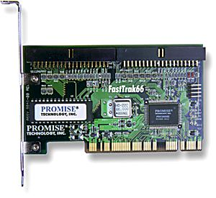
Hardware based RAID:
A hardware implementation of RAID requires at least a special-purpose RAID controller.
On a desktop system this may be built into the motherboard.
Processor is not used for RAID calculations as a separate controller present.
A PCI-bus-based, IDE/ATA hard disk RAID
controller, supporting levels 0, 1, and 01.

Slide 77
Hamming Code

Slide 78
How much code redundancy?
How many check bits needed, i.e., given m data bits, how many more bits (r) are needed to allow all single-bit errors to be corrected?
  Resulting frame is m + r.
  (m+r+1) <= 2^{r}.
  Given m, then find r.
  Example: If m = 7 (ASCII 7 code), minimum r is 4.

Slide 79
Data and redundancy bits
Number of data bits m | Number of redundancy bits r | Total bits m + r
1 | 2 | 3
2 | 3 | 5
3 | 3 | 6
4 | 3 | 7
5 | 4 | 9
6 | 4 | 10
7 | 4 | 11

Slide 80
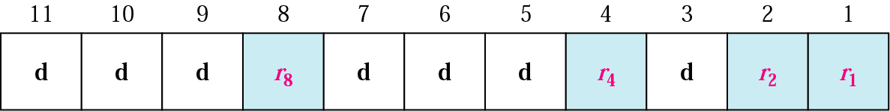
Positions of redundancy bits in Hamming code

Slide 81
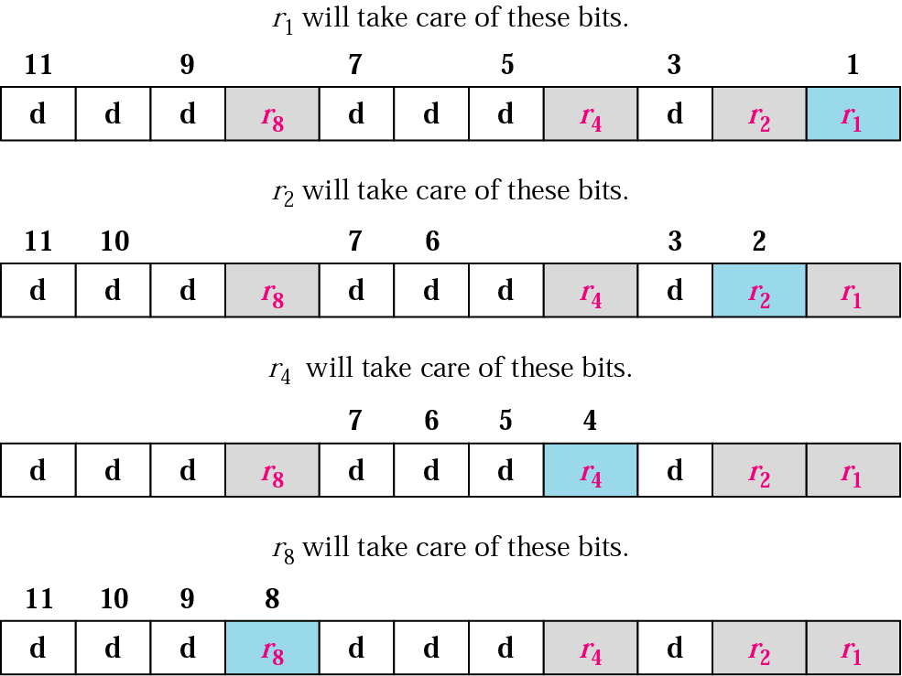
Redundancy bits calculation

Slide 82
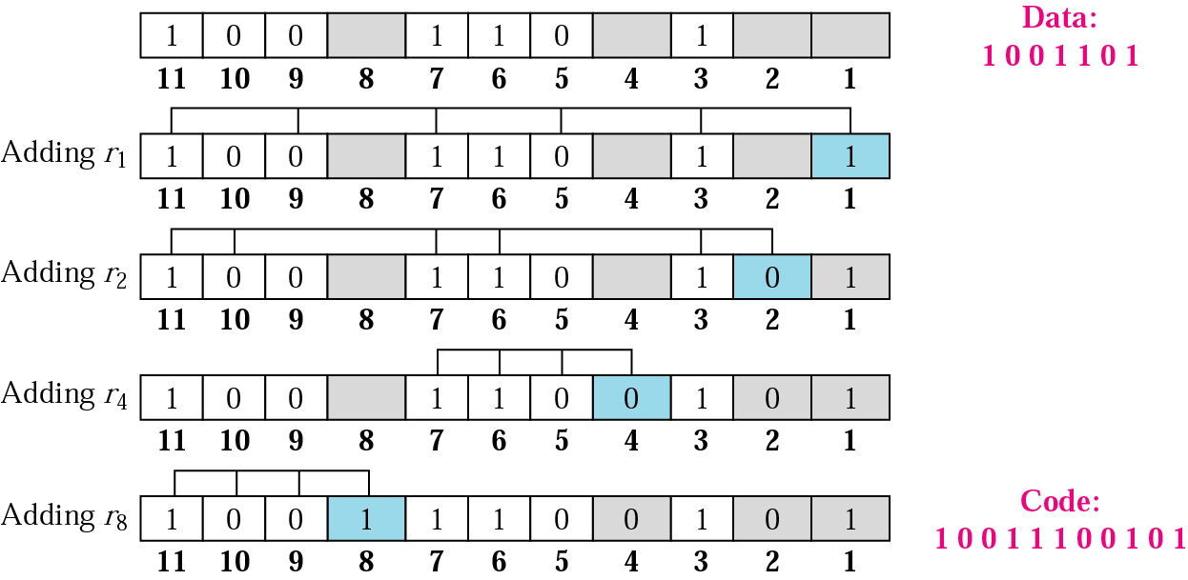
Example of redundancy bit calculation

Slide 83
Q. Find Hamming Code for: 1001101

Slide 84
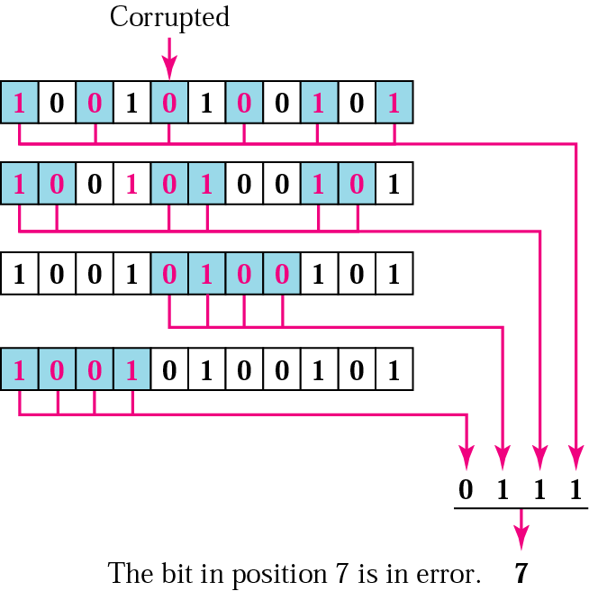
Error detection using Hamming code

