Slide 1
File Operations

Slide 2
File Concept
Collection of related information.
Contiguous logical address space
File is the smallest allotment of logical secondary storage
Types:
Data
numeric
character
binary
Program
Source
Object
Executables

Slide 3
How the files are maintained
Files are maintained with the help of file systems supported by different operating systems
File system is an abstraction of persistent storage

Slide 4
File Structure
None - sequence of words, bytes
Simple record structure
Lines
Fixed length
Variable length
Complex Structures
Formatted document
Relocatable load file
Can simulate last two with first method by inserting appropriate control characters.

Slide 5
File Attributes
Name – only information kept in human-readable form
Identifier – unique tag usually number identifies files with in the file system ( in non human readable form).
Type – needed for systems that support different types.
Location – pointer to file location on device.
Size – current file size.
Protection – controls who can do reading, writing, executing.
Time, date, and user identification – data for protection, security, and usage monitoring.

Slide 6
Directory
Information about files are kept in the directory structure, which is maintained on the disk
Directory entries contain name of file and identifier
The unique identifier in terms may point at rest of the attributes of the file
Directories may occupy several megabytes and are required to be brought into the memory

Slide 7
File Operations
Create
Space in the file system must be found
An entry for the new file must be made in the directory.
Directory entry consist of file name, location & other information about the file.
Write
Make a system call specifying both name of the file and the information to be written.
Search for the location of the file
System must keep a write pointer to keep the location of the file where the next write is to take place.

Slide 8
File Operations
Read
Make a system call specifying the name of the file and where the next block of the file should be put.
Maintain a read pointer to where the next read is to take place.
Reposition within file – file seek
Current file position is set to a given value.
Reposition with in a file does not need to invoke any actual I/O
Delete
Search the directory for the file name
Release all the file space and erase the directory entry.

Slide 9
File Operations
Truncate
Erase the content of a file but keep its attributes.
Only the file length attribute will change.
Other common operations
Append and rename
Open(F_{i}) – search the directory structure on disk for entry F_{i}, and move the content of entry to memory.
Close (F_{i}) – move the content of entry F_{i} in memory to directory structure on disk.

Slide 10
Implementation in Unix
Uses 2 levels of internal tables
A per process table
Tracks all files that a process has open
Stores the information regarding the use of the file by the process ( file pointer indicating the location in the file that the next read or write will affect)
System wide table
Contains process independent information (location of the file, access dates and file size)
It has an open count associated with each file, indicating the number of processes that have the file open.

Slide 11
Information associated with open file table
File pointer
This pointer is unique to each process operating on file.
So it must be kept separate from the on disk file attributes
File open count
If file open count is 0 then only close the file
Disk location of the file
Access rights

Slide 12
Access Methods
Sequential Access
read next
write next
reset
no read after last write (rewrite)
Direct Access
read n
write n
position to n
read next
write next
rewrite n
n = relative block number

Slide 13
Direct access
File is made up of fixed length logical record
Disk is considered as an array of blocks which can be randomly accessed
Logical records are mapped onto disk blocks

Slide 14
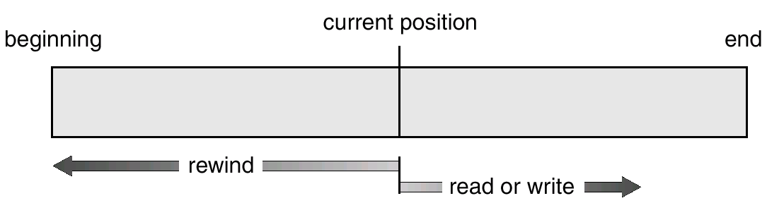
Sequential-access File

Slide 15
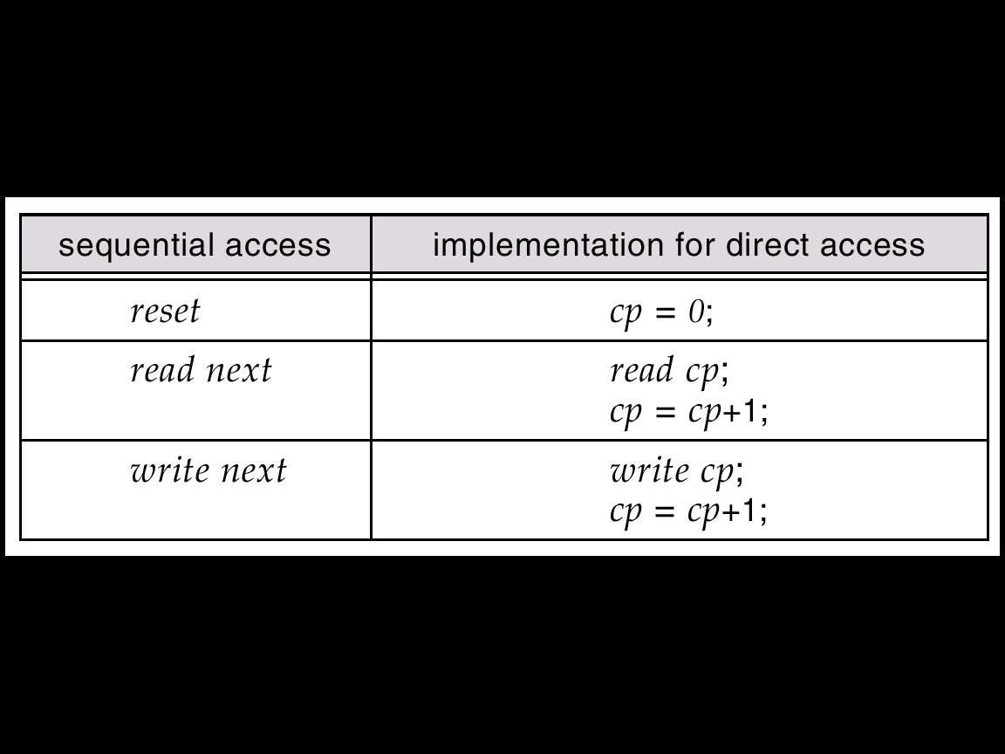
Simulation of Sequential Access on a Direct-access File

Slide 16
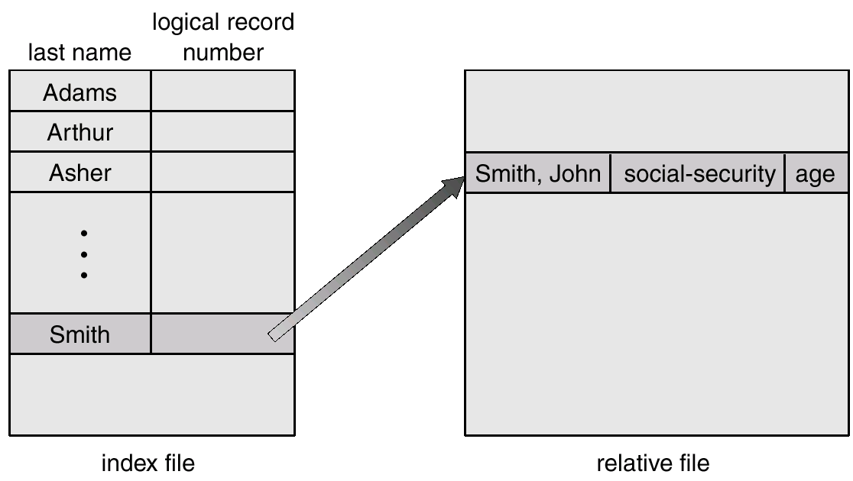
Example of Index and Relative Files

Slide 17
Directory Structure
A collection of nodes containing information about all files.
Directory
Files
F 1
F 2
F 3
F 4
F n
Both the directory structure and the files reside on disk.

Slide 18
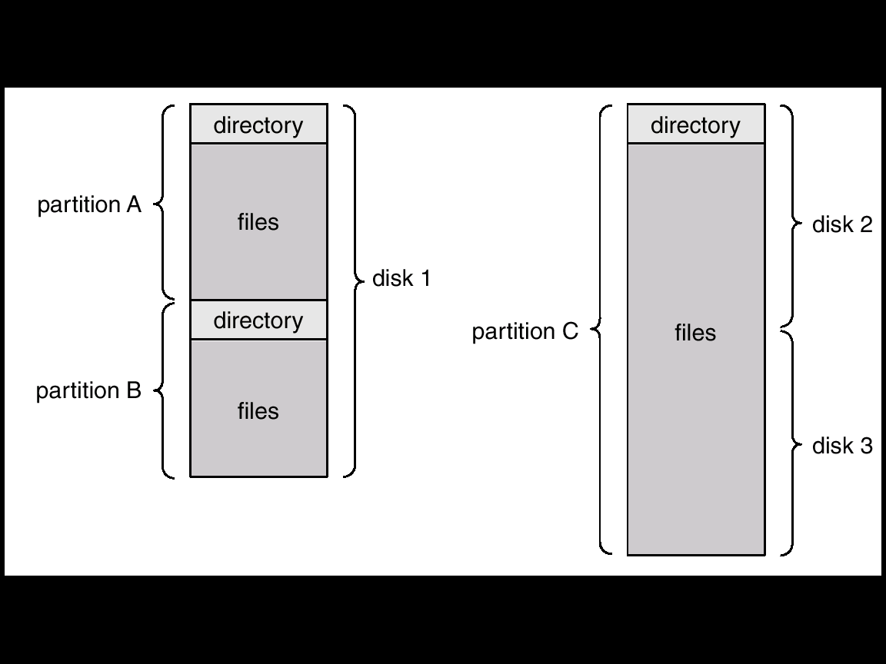
A Typical File-system Organization

Slide 19
Information in a Device Directory
Name
Type
Address
Current length
Maximum length
Date last accessed (for archival)
Date last updated (for dump)
Owner ID
Protection information

Slide 20
Operations Performed on Directory
Search for a file
Search a file in the directory
Create a file
Delete a file
List a directory
List the files in the directory
Rename a file
Rename may also allow its position with in the directory structure to be changed
Traverse the file system

Slide 21
Organize the Directory (Logically) to Obtain
Efficiency – locating a file quickly.
Naming – convenient to users.
Two users can have same name for different files.
The same file can have several different names.
Grouping – logical grouping of files by properties, (e.g., all Java programs, all games, …)

Slide 22
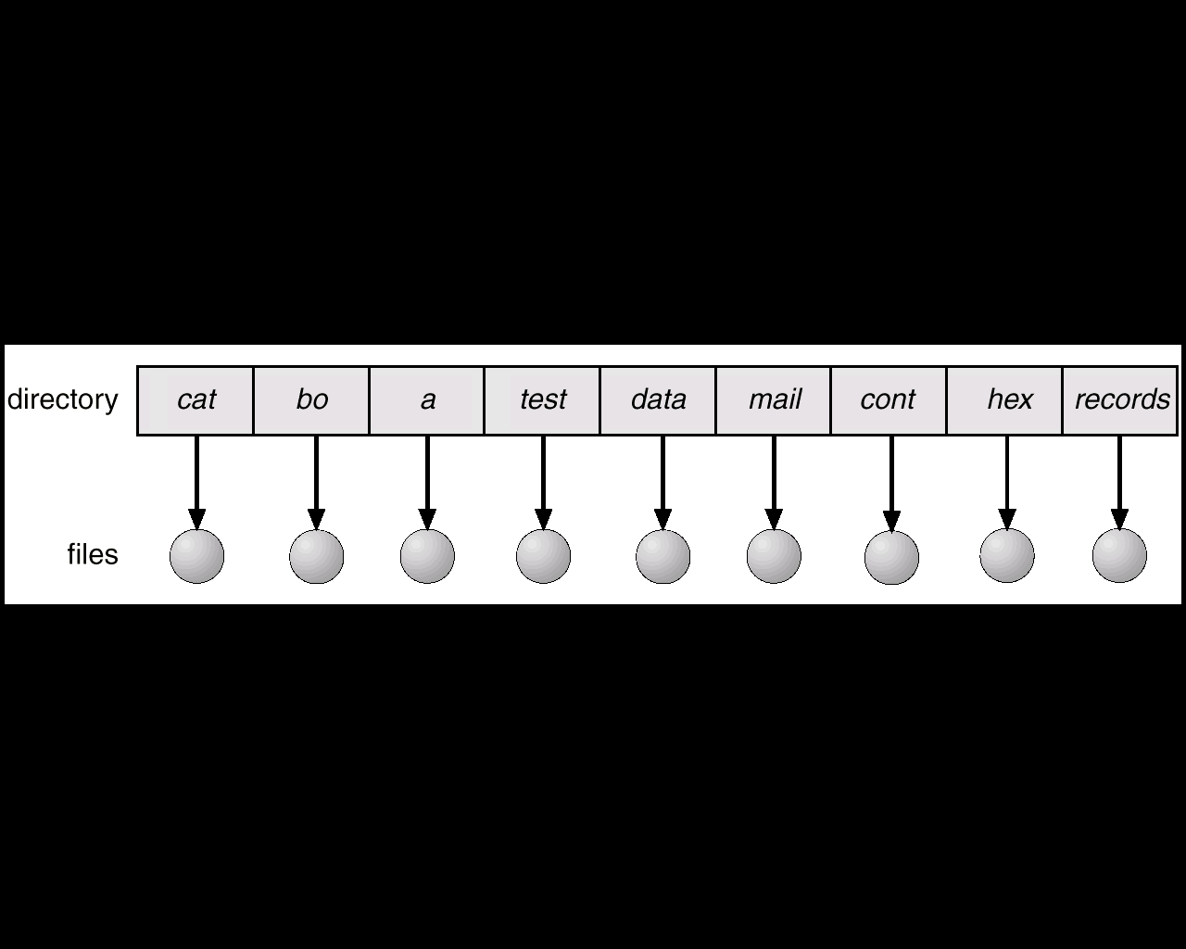
Single-Level Directory
A single directory for all users.
Naming problem : requires unique name
Grouping problem

Slide 23
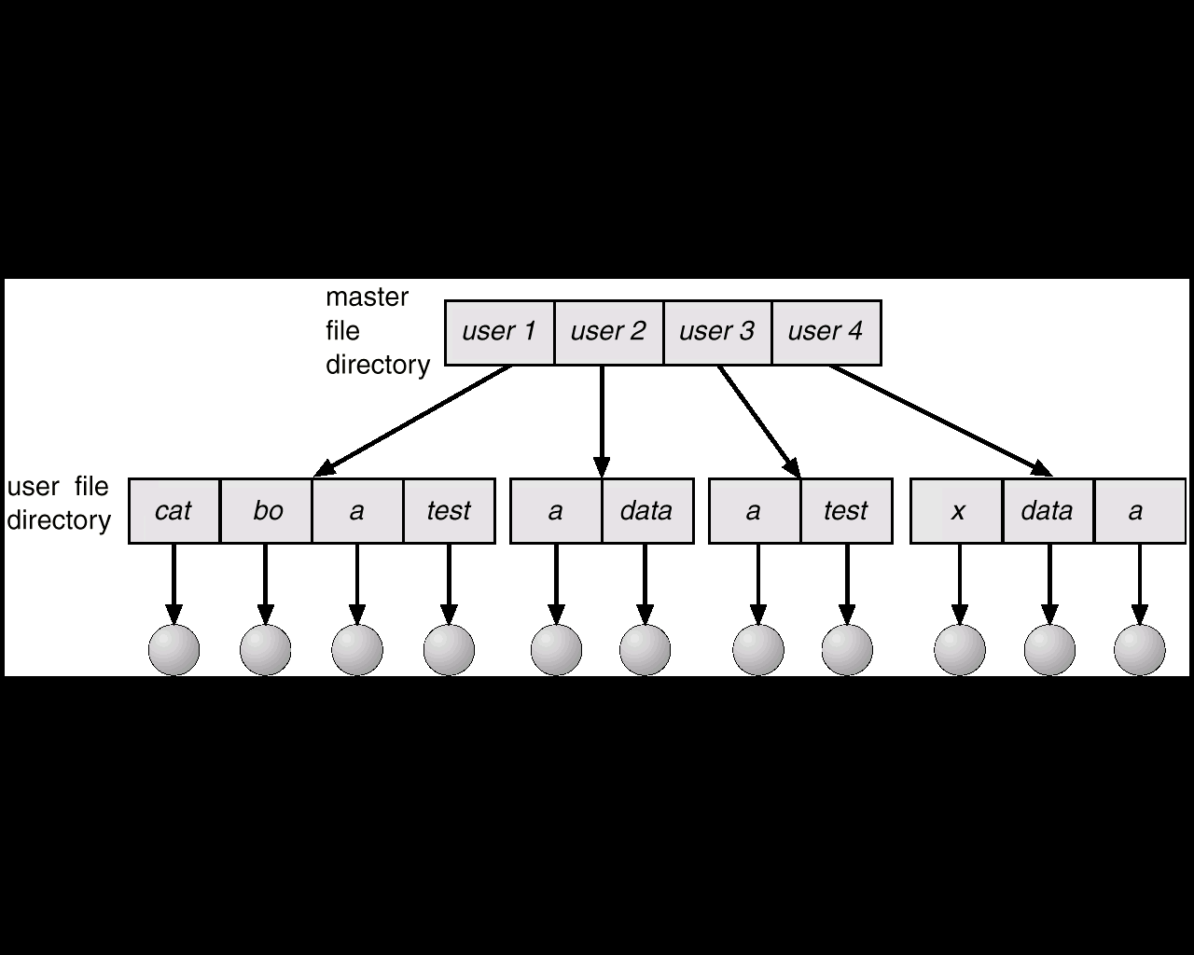
Two-Level Directory
Separate directory for each user.

Slide 24
Two-Level Directory
Each user has his own user file directory (UFD)
When user logs in system master file directory ( MFD ) is searched
MFD Is indexed by user name or account no
Each entry in MFD points to UFD
Path name
Can have the same file name for different user
Efficient searching
No grouping capability
No sharing
How to use system files

Slide 25
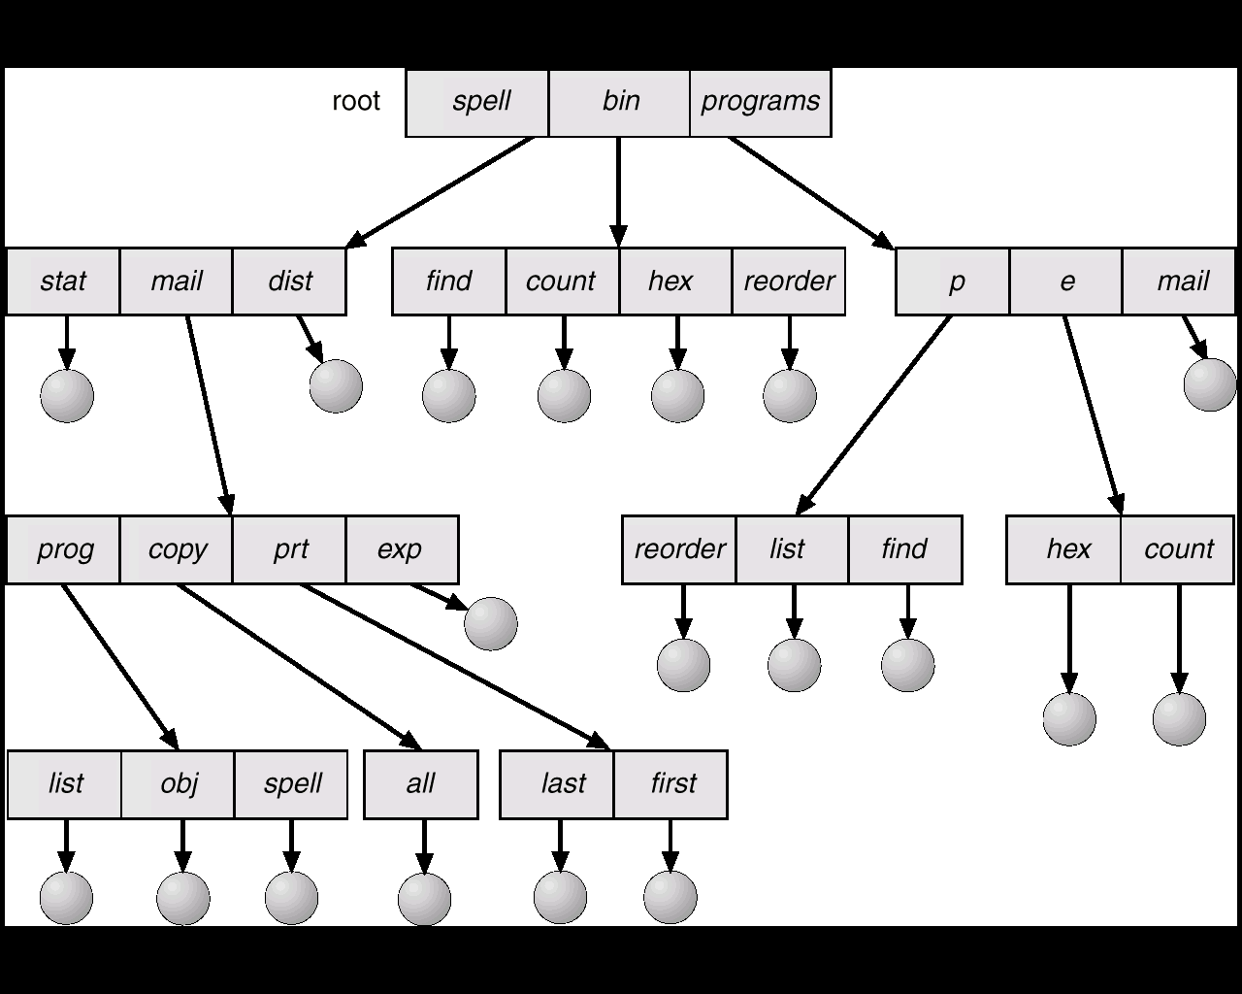
Tree-Structured Directories

Slide 26
Tree-Structured Directories (Cont.)
Efficient searching
Grouping Capability
Current directory (working directory)
cd /spell/mail/prog
type list

Slide 27
Tree-Structured Directories (Cont.)
Absolute or relative path name
Creating a new file is done in current directory.
Delete a file
rm <file-name>
Creating a new subdirectory is done in current directory.
mkdir <dir-name>
Example: if in current directory /mail
mkdir count
mail
prog
copy
prt
exp
count
Deleting “mail” ⇒ deleting the entire subtree rooted by “mail”.

Slide 28
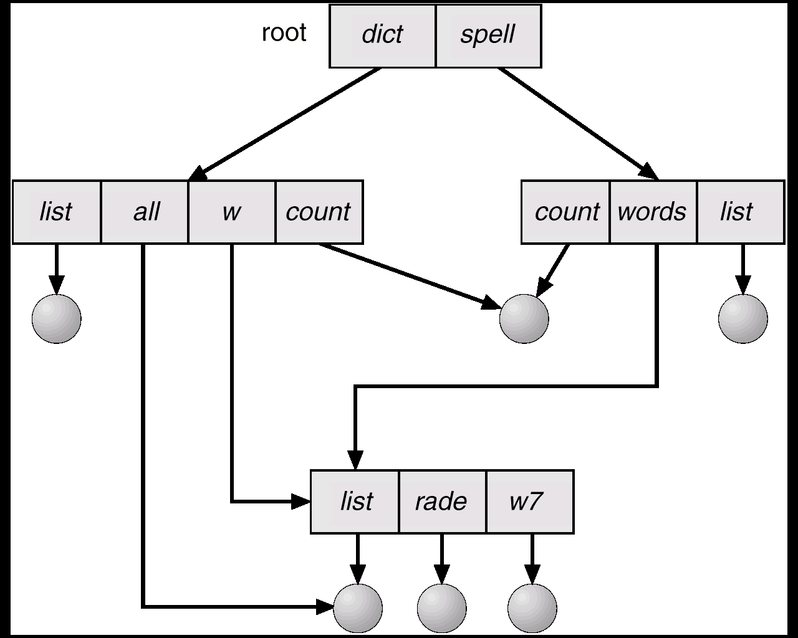
Acyclic-Graph Directories
Have shared subdirectories and files.

Slide 29
Acyclic-Graph Directories (Cont.)
Two different names (aliasing)
Can implement shared files and subdirectories by using link.
OS ignores this link when traversing directory trees to preserve the a cyclic structure of the system.
Can duplicate all information in both shared directory
Inconsistency if the file is modified
Careful during deletion ( dangling pointers)

Slide 30
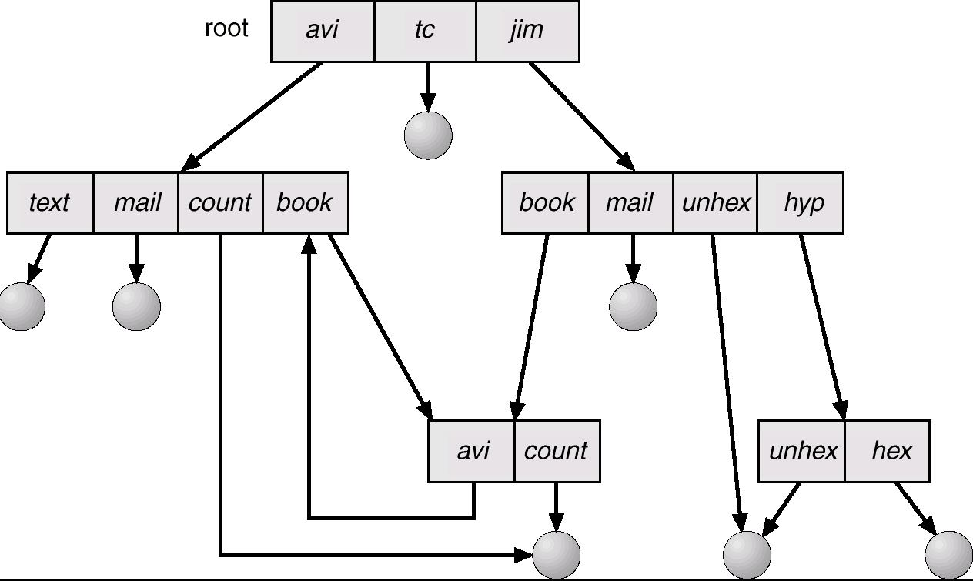
General Graph Directory

Slide 31
General Graph Directory (Cont.)
How do we guarantee no cycles?
Allow only links to file not subdirectories.
Every time a new link is added use a cycle detection algorithm to determine whether it is OK.

Slide 32
File Sharing
Sharing of files on multi-user systems is desirable.
Most OS implement sharing using owner and group
System implement user attributes by managing a list of user names and associated user identifiers
Sharing may be done through a protection scheme.
On distributed systems, files may be shared across a network.
Network File System (NFS) is a common distributed file-sharing method.

Slide 33
Protection
File owner/creator should be able to control:
what can be done
by whom
Types of access
Read read from the file
Write write / rewrite the file
Execute Load the file into memory and execute
Append write new information at the end of the file
Delete delete the file and free the memory for reuse
List List the name and attributes of the file
Rename, copy, editing

Slide 34
Access Lists and Groups
Mode of access: read, write, execute
Three classes of users
RWX
a) owner access 7 ⇒ 1 1 1 RWX
b) group access 6 ⇒ 1 1 0
RWX
c) public access 1 ⇒ 0 0 1
Ask manager to create a group (unique name), say G, and add some users to the group.
For a particular file (say game) or subdirectory, define an appropriate access.
owner
group
public
chmod
761
game
Attach a group to a file chgrp G game

